Slide 1
Express Shopping
Prepared By:
Abd Al-Rahman Badran
Mohammed Mara’bi
Supervisors:
Dr. Mona Dmaidi
Dr. Hanal Abu Zant

Slide 2
Outline
Shopping in Palestine
Development Process and Scenarios
Tools and Technologies
Future Work

Slide 3
Shopping in Palestine
Shopping online inside Palestine is still at an early stage. Stores, restaurants and companies in Palestine ignore the importance of technology in keeping them in contact with customers. On the other hand, customers nowadays are looking for efficient ways of buying their stuff online as this could save them time and effort.
Users tend to use Facebook for selling their products, where hundreds of pages selling similar products, which is confusing for users.

Slide 4
So What ?!
So, in this project a generic platform for selling, buying and delivering goods will be presented. The platform will provide an intermediate service between customers and stores, restaurants and companies.

Slide 5
Development Process and Scenarios
Registering

Slide 6
Development Process and Scenarios
Home pages
Visitor

Slide 7
Development Process and Scenarios
Home pages
Company

Slide 8
Development Process and Scenarios
Home pages
Customer

Slide 9
Development Process and Scenarios
Companies activities

Slide 10
Development Process and Scenarios
Companies activities

Slide 11
Development Process and Scenarios
Companies activities

Slide 12
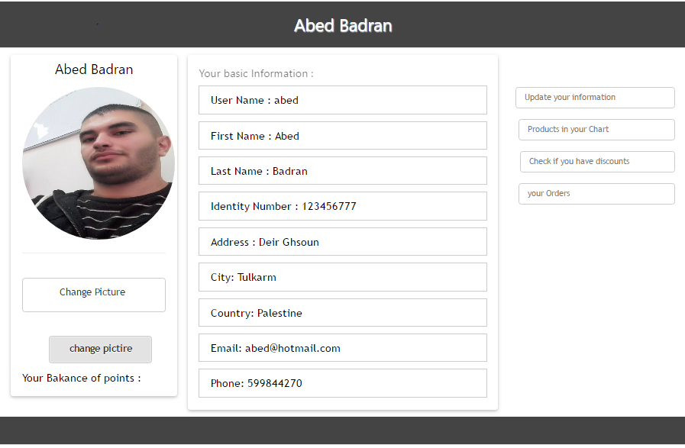
Development Process and Scenarios
Customer activities

Slide 13
Development Process and Scenarios
Customer activities

Slide 14
Development Process and Scenarios
Customer activities

Slide 15
Development Process and Scenarios
Customer activities

Slide 16
Development Process and Scenarios
Customer activities

Slide 17
Development Process and Scenarios
Customer activities

Slide 18
Development Process and Scenarios
Customer activities

Slide 19
Development Process and Scenarios
Admin activities

Slide 20
Development Process and Scenarios
Admin activities

Slide 21
Development Process and Scenarios
Admin activities

Slide 22
Development Process and Scenarios
Admin activities
Delivery

Slide 23
Development Process and Scenarios
Admin activities

Slide 24
Development Process and Scenarios
Admin activities

Slide 25

Tools and Technologies
Web Development
For The Backend We used the Codeigniter PHP Framework
A lightweight open source web application framework that utilizes the MVC architecture

Slide 26

Tools and Technologies
For The Frontend We used the bootstrap
A powerful front-end framework for styling

Slide 27
Future Work
There are a lot of thing we aim to achieve in future to improve our website and to make it available online, and with everyone hands. We can’t achieve everything because of the limitation of the time of the semester, we hope to add new features to our website:
To build a mobile application to allow using it any time and easily.
To build a notification center to notify the user about the status of his order.
To activate online payment using any of tools of payments like PayPal and PalPay.
To add more than one language to our website.

Slide 28
Thanks

