Slide 1

Design a Water and Wastewater Network for Qabatiya Town
Prepared By :
Mustafa Ali Mohammad Alawneh
Supervisor :
Dr. Anan Jayousi

Slide 2
Content: -
Objectives.
Overview of Qabatiya.
The Questionnaire.
Modeling & Analyzing the Existing Network.
Design a Future Water Network.
Design a Wastewater Network.

Slide 3
Objectives: -
Analyze the Existing Water Distribution Network to find out the problems and suggest a solutions to solve these problems.
Design a Future Water Network to overcome the problems in the old network and to be able to meet the future water demand for the next 20 years.
Design a Wastewater Network for the town to serve the town for the next 20 years.

Slide 4
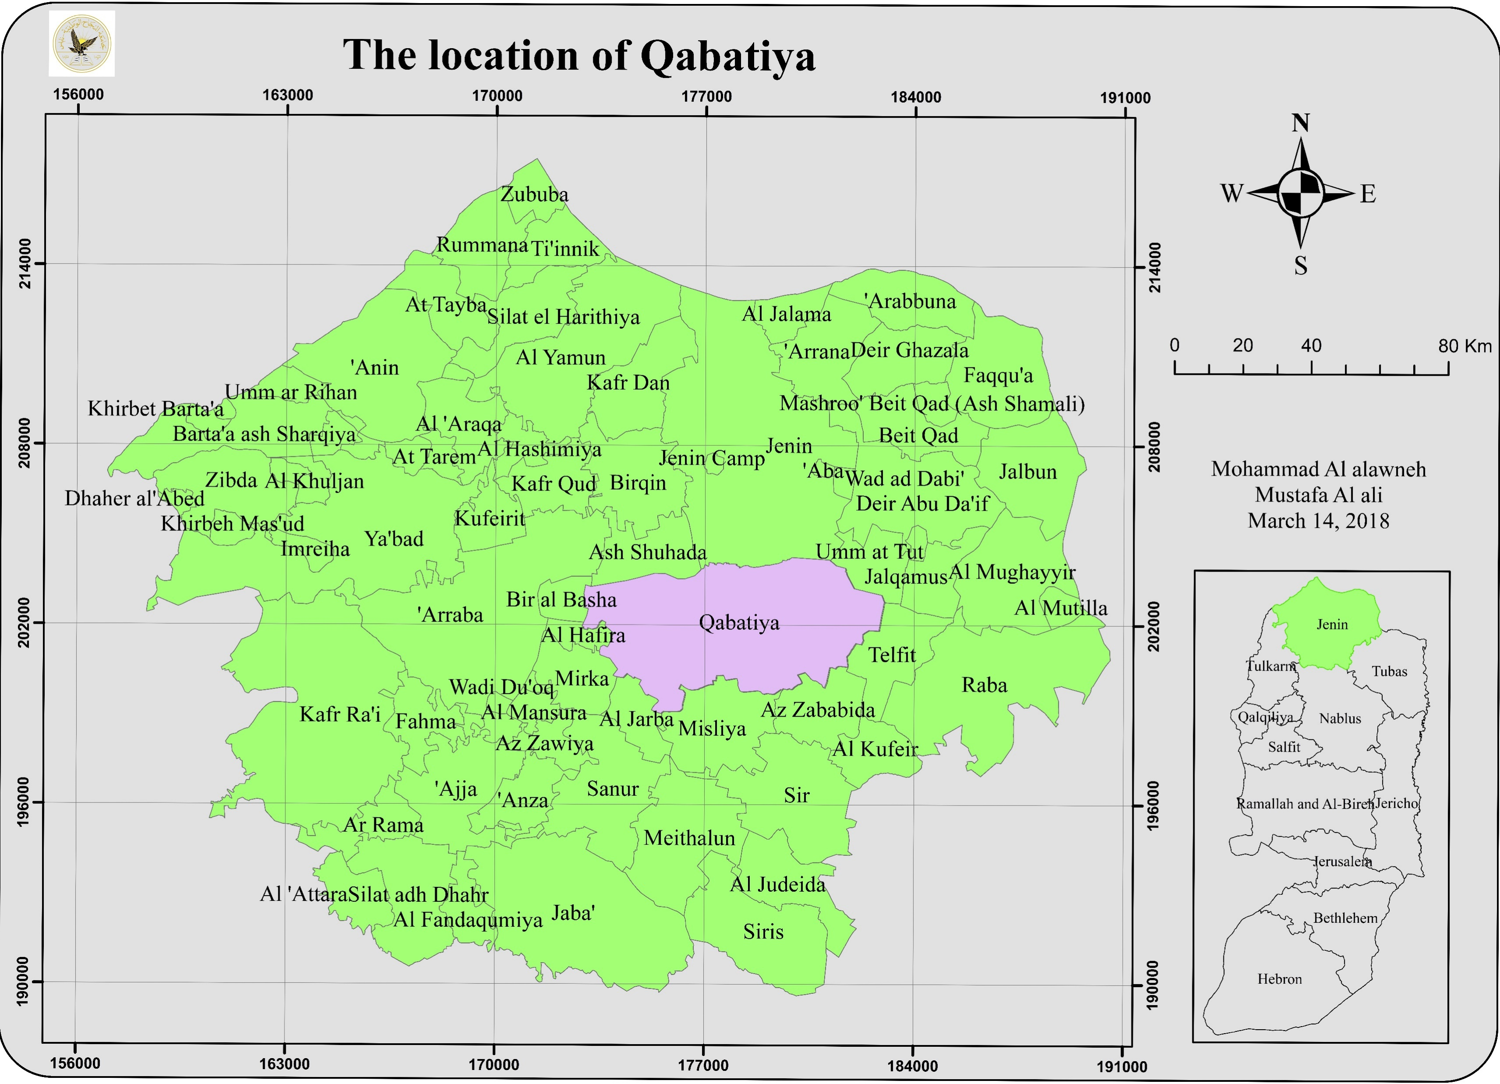
Overview of Qabatiya: -
Location:
Located in the middle of the
Jenin governorate, with total
area 50.747 Km².
Population:
The total population of the
town was 24,439 capita in
2017.

Slide 5
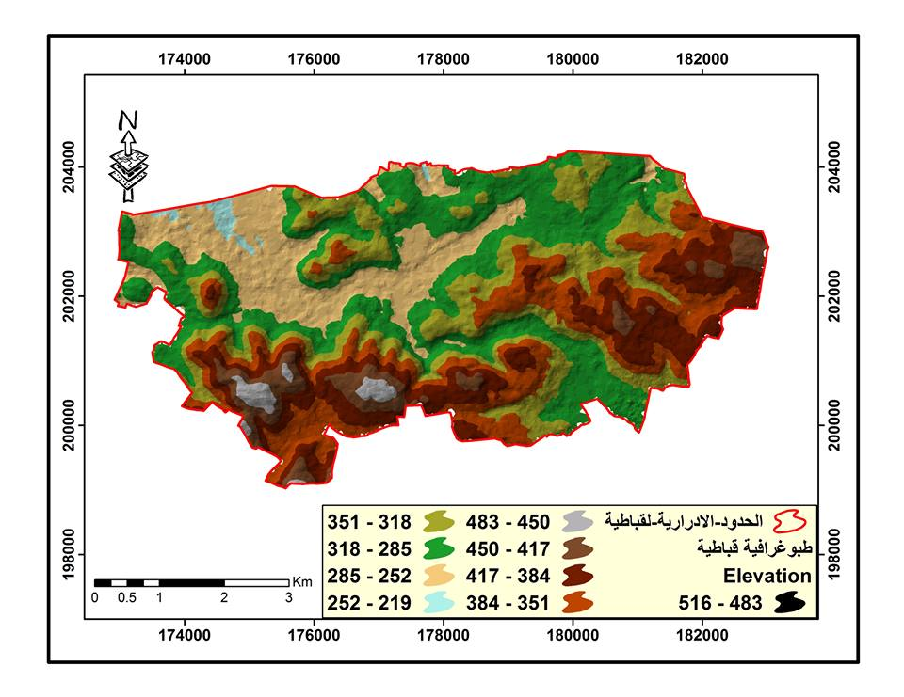
Overview of Qabatiya: -
Topography:
The town elevation vary from 250 m
to 450 m above the mean sea level.
Land Use:
The town famous with agriculture
and quarries.

Slide 6

The Questionnaire

Slide 7
The Questionnaire: -

Slide 8
The Questionnaire: -

Slide 9
The Questionnaire: -

Slide 10
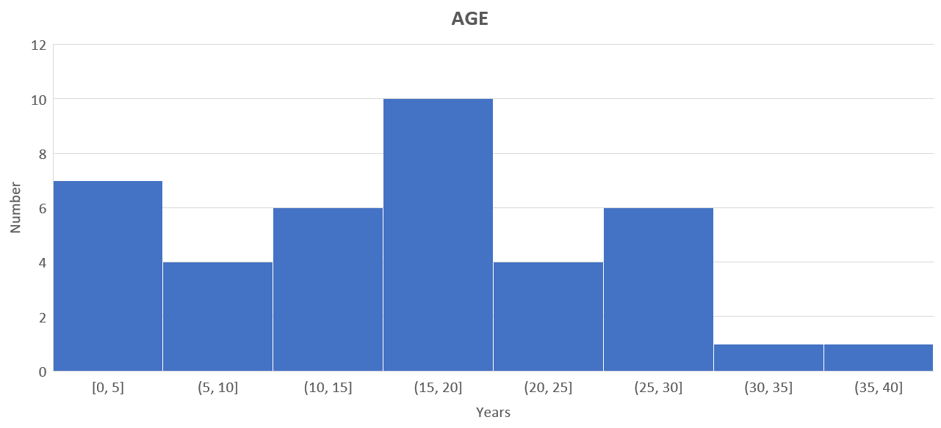
The Questionnaire: -

Slide 11
The Questionnaire: -

Slide 12

The Existing Water Network

Slide 13
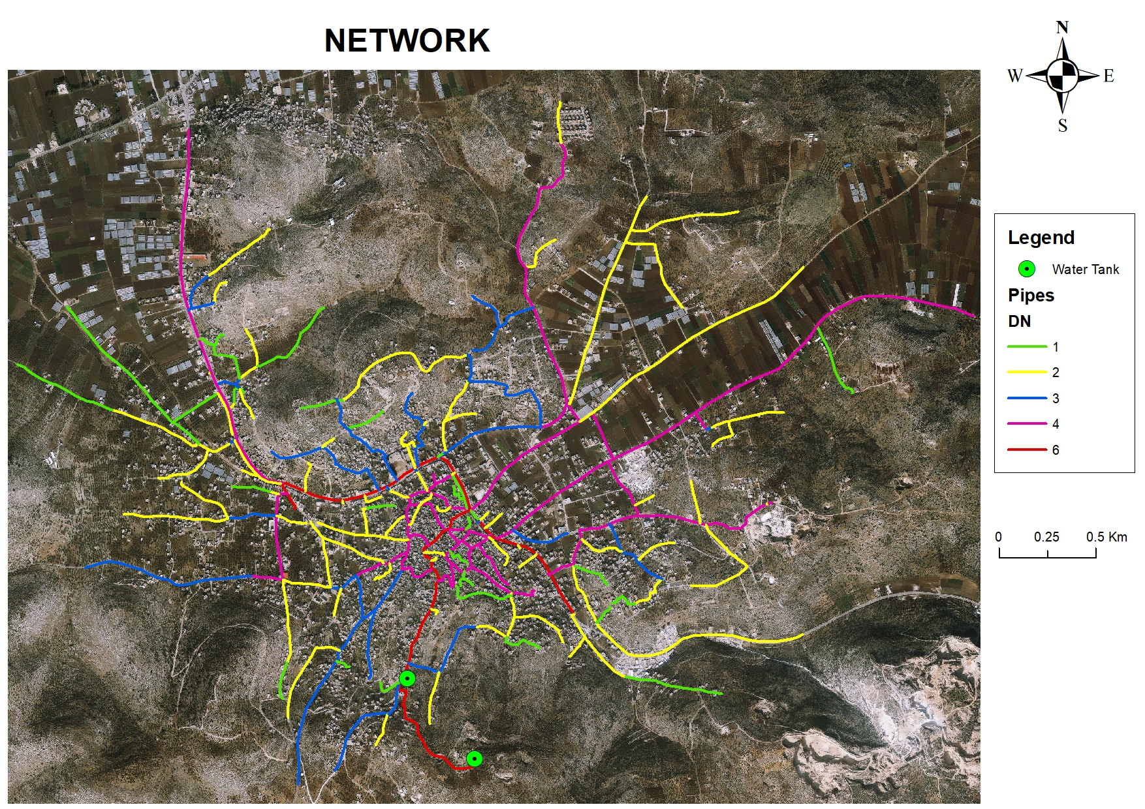
The Network: -
2 Tanks. (1500m³ & 500m³).
285 Nodes.
301 Pipes. (1,2,3,4,6) inch.
70 Km total length.

Slide 14
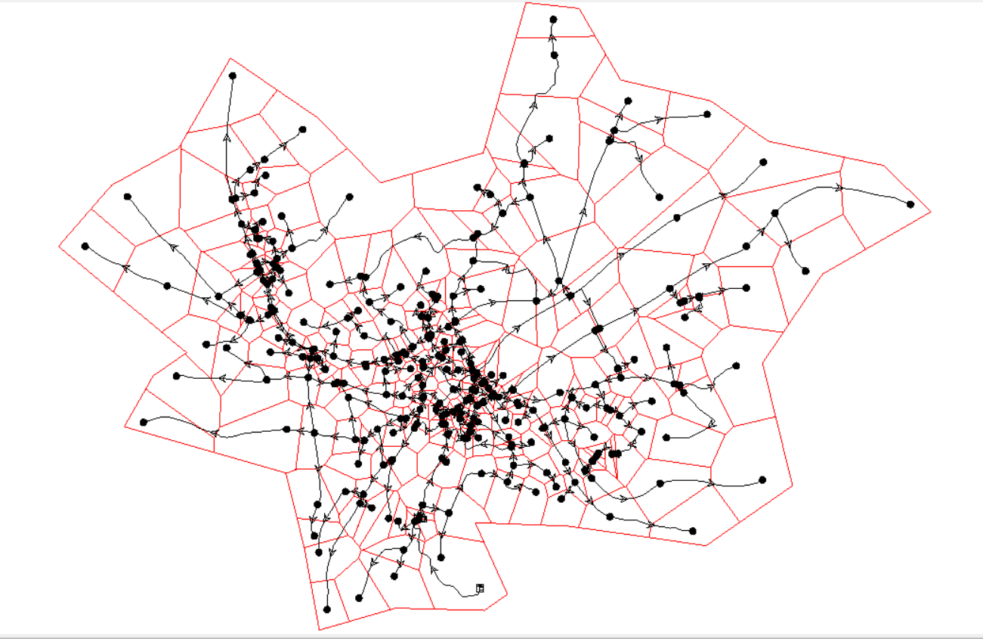
The Network: -
Obtained the network by using the ModelBuilder.
Using Thiessen Polygon Creator to divide the entire served area.

Slide 15
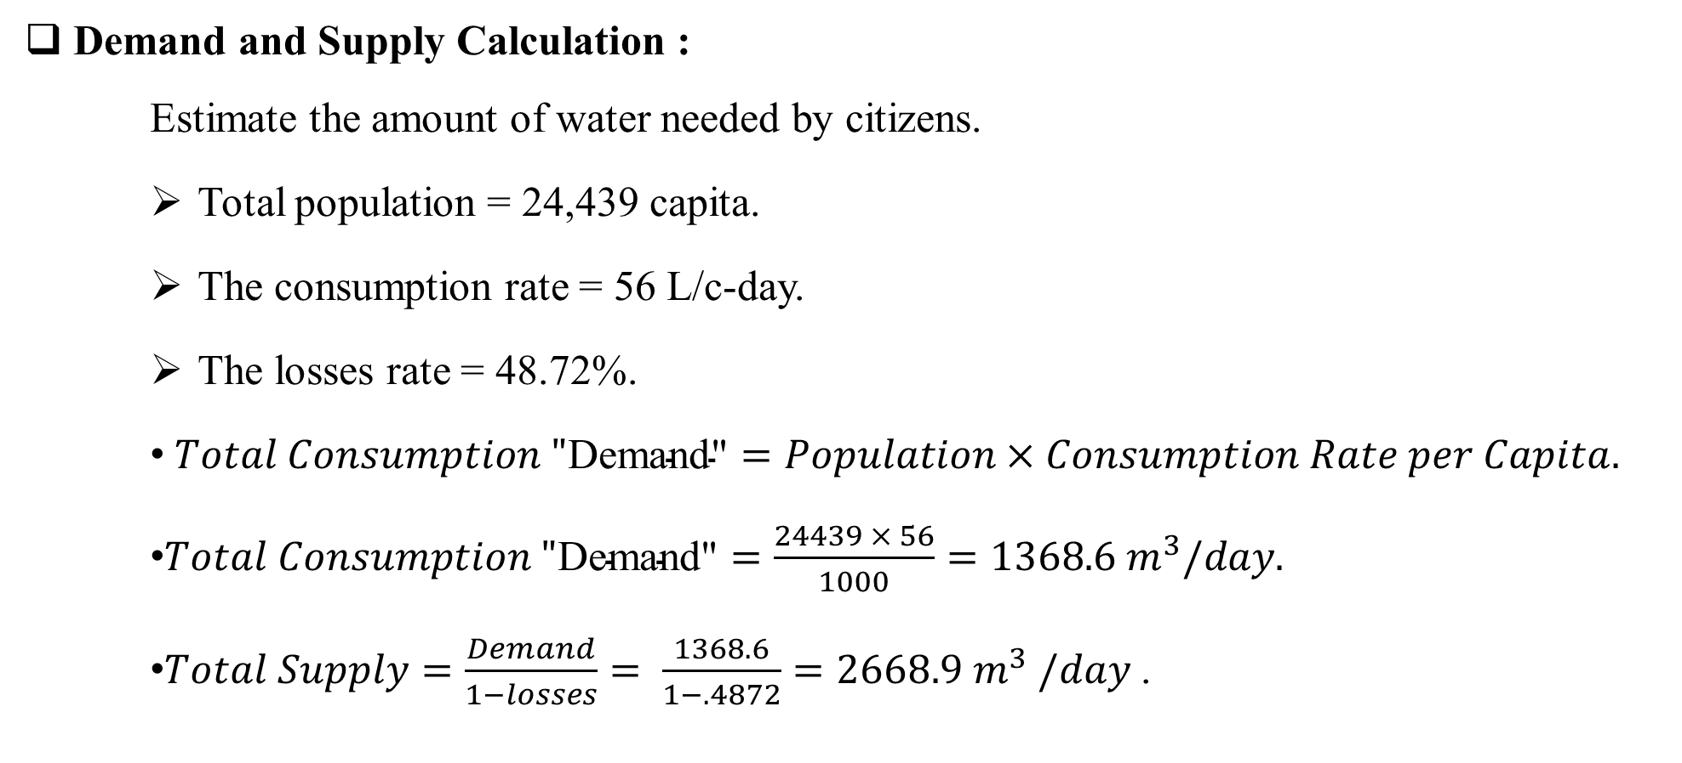
The Network: -
Demand and Supply Calculation :
Estimate the amount of water needed by citizens.
Total population = 24,439 capita.
The consumption rate = 56 L/c-day.
The losses rate = 48.72%.
$Total Consumption "\text{Demand}\text{"}=Population×Consumption Rate per Capita.$
$Total Consumption "\text{Demand}\text{"}=\frac{24439 × 56}{1000}=1368.6 m^{3}/day.$
$Total Supply=\frac{Demand}{1−losses}= \frac{1368.6}{1−.4872}=2668.9 m^{3} /day$ .

Slide 16
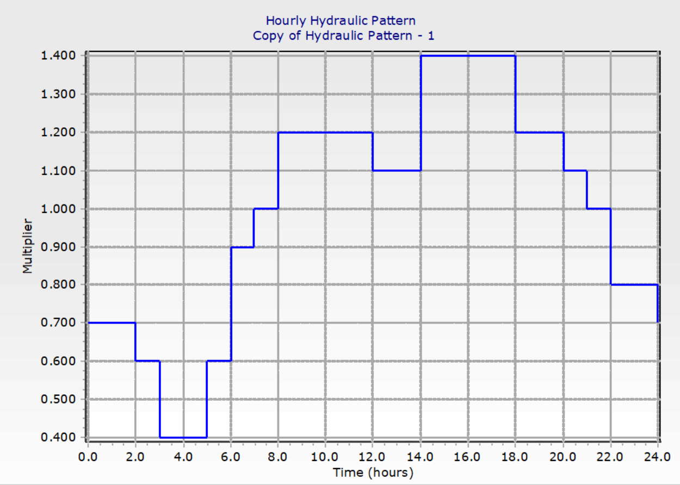
The Network: -
Used Demand Pattern.

Slide 17
Results: -
When Tank-1 Works :
Pressure at 2:00 pm.
Pressure at 4:00 am.

Slide 18
Results: -
Velocity at 2:00 pm.
Velocity at 4:00 am.

Slide 19
Results: -
When Tank-2 take a place.
Pressure at 10:00 pm.

Slide 20
The Designed Water Network

Slide 21
The Designed Network: -
General Conditions:
24 hrs. Supply.
Separate the Network.
Design period 20 years.
Modify the old & the small pipes.
Used the same Demand Pattern.

Slide 22

The Designed Network: -
Calculations:
Population projection:
P_{t}= P₀ ×$e^{Kt1}$.
P₀ )2007) = 18,968 capita.
P_{t} (2017) = 24,439 capita.
t₁ = 10 years.
K = 2.53%.
t₂ = 20 years.
So, P_{t}(2037) = 24,439 × $e^{(0.0253×20)}$ = 40,571 capita.

Slide 23
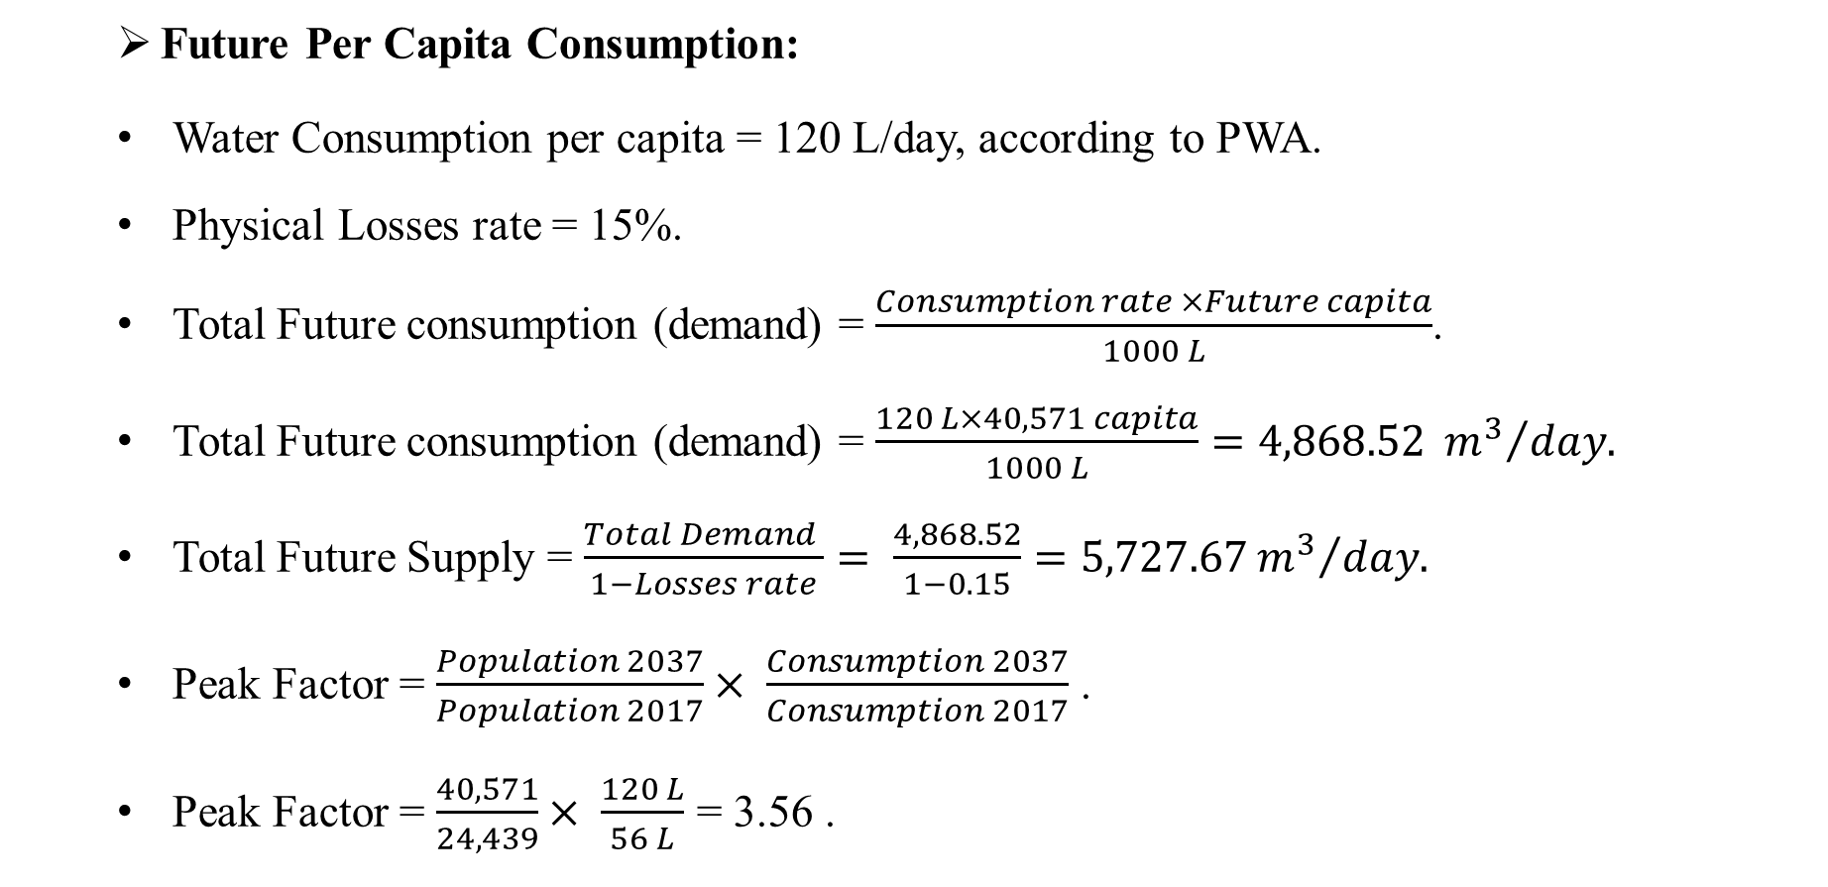
The Designed Network: -
Future Per Capita Consumption:
Water Consumption per capita = 120 L/day, according to PWA.
Physical Losses rate = 15%.
Total Future consumption (demand) = $\frac{Consumption rate ×Future capita}{1000 L}$.
Total Future consumption (demand) = $\frac{120 L×40,571 capita}{1000 L}=4,868.52 {m^{3}}/{day.}$
Total Future Supply = $\frac{Total Demand }{1−Losses rate}= \frac{4,868.52}{1−0.15}=5,727.67{m^{3}}/{day.}$
Peak Factor = $\frac{Population 2037}{Population 2017}× \frac{Consumption 2037}{Consumption 2017}$ .
Peak Factor = $\frac{40,571}{24,439}× \frac{120 L}{56 L}$ = 3.56 .

Slide 24
The Designed Network: -
Results:
Pressure at 2:00 pm.
Pressure at 4:00 am.

Slide 25
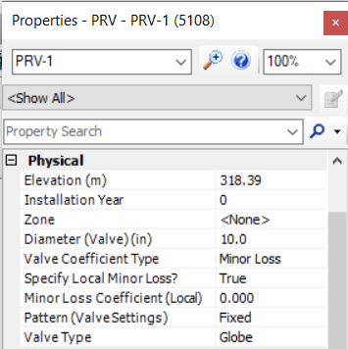
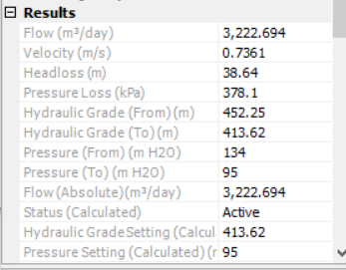
The Designed Network: -
Used a PRV:
PRV Properties

Slide 26
The Designed Network: -
Results after used a PRV:
Pressure at 2:00 pm.
Pressure at 4:00 am.

Slide 27
The Designed Network: -
Results:
Velocity at 2:00 pm.
Velocity at 4:00 am.

Slide 28
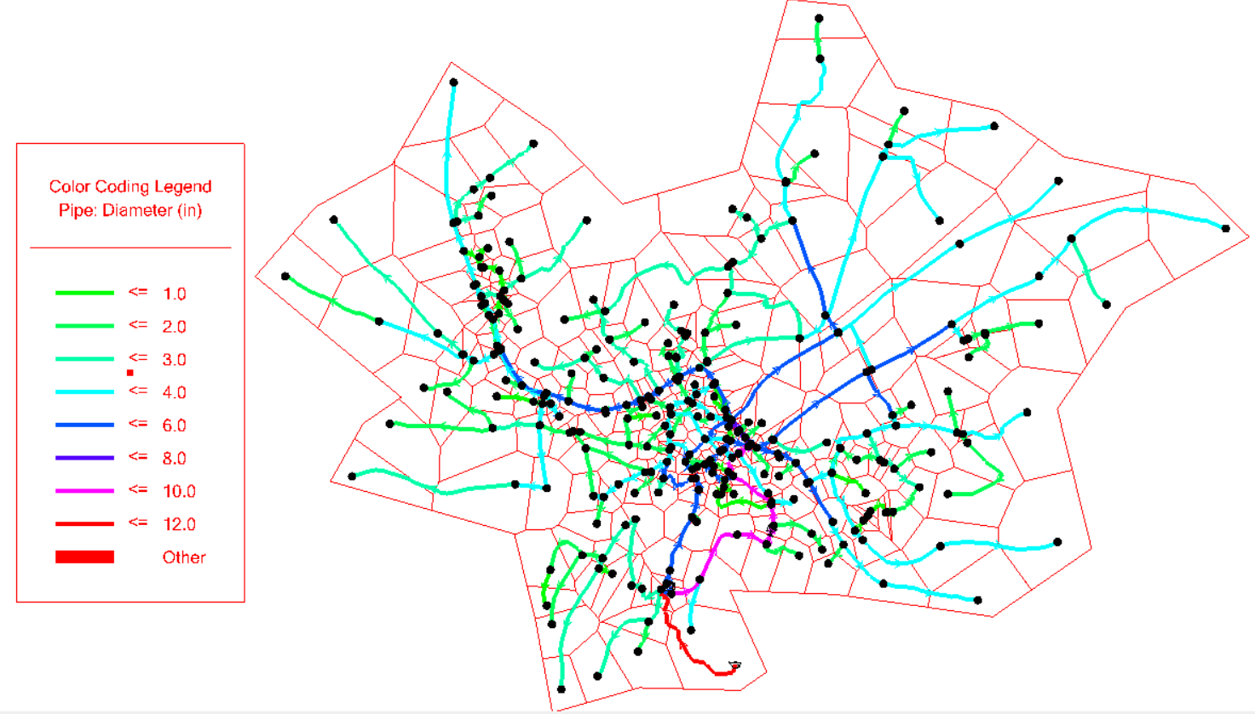
The Designed Network: -
Final Modified Network.

Slide 29
The Designed Network: -
Results:
Length of Modified Pipes:
Diameter (in) | Length (m)
1 | 1789
2 | 7565
3 | 4902
4 | 13028
6 | 6879
8 | 163
10 | 1404
12 | 775

Slide 30
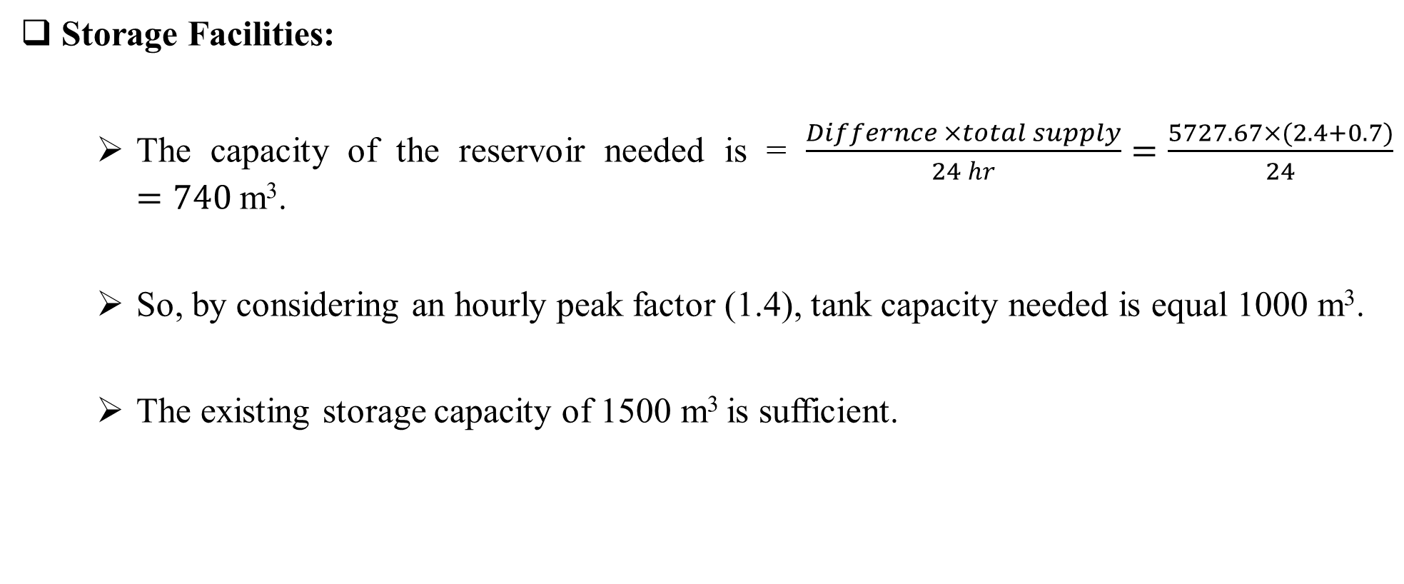
The Designed Network: -
Storage Facilities:
The capacity of the reservoir needed is = $\frac{Differnce ×total supply}{24 hr}=\frac{5727.67×(2.4+0.7)}{24}=740$m³.
So, by considering an hourly peak factor (1.4), tank capacity needed is equal 1000 m³.
The existing storage capacity of 1500 m³ is sufficient.

Slide 31
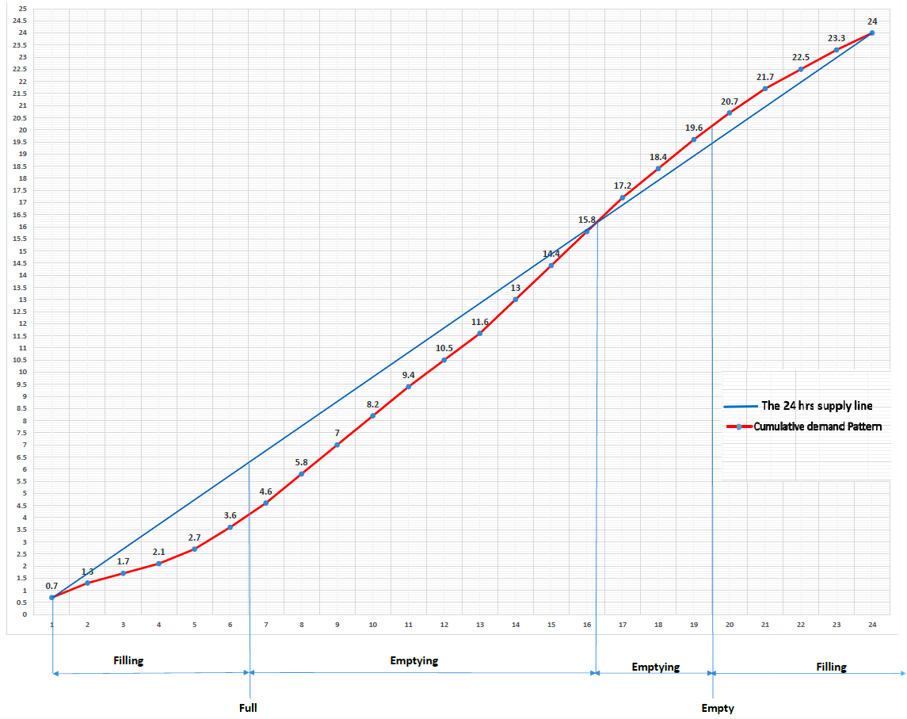
24 Hours/Day | Demand pattern | Cumulative demand pattern | Difference between 24hours and cumulative
1 | 0.7 | 0.7 | -0.3
2 | 0.6 | 1.3 | -0.7
3 | 0.4 | 1.7 | -1.3
4 | 0.4 | 2.1 | -1.9
5 | 0.6 | 2.7 | -2.3
6 | 0.9 | 3.6 | -2.4
7 | 1 | 4.6 | -2.4
8 | 1.2 | 5.8 | -2.2
9 | 1.2 | 7 | -2
10 | 1.2 | 8.2 | -1.8
11 | 1.2 | 9.4 | -1.6
12 | 1.1 | 10.5 | -1.5
13 | 1.1 | 11.6 | -1.4
14 | 1.4 | 13 | -1
15 | 1.4 | 14.4 | -0.6
16 | 1.4 | 15.8 | -0.2
17 | 1.4 | 17.2 | 0.2
18 | 1.2 | 18.4 | 0.4
19 | 1.2 | 19.6 | 0.6
20 | 1.1 | 20.7 | 0.7
21 | 1 | 21.7 | 0.7
22 | 0.8 | 22.5 | 0.5
23 | 0.8 | 23.3 | 0.3
24 | 0.7 | 24 | 0

Slide 32
The Designed Network: -
Cost Estimate:
Diameter (in) | Length (m) | Tax | Transmission | Trench Excavation | Trench Excavation | Trench backfilling | Trench backfilling | Installation and fittings | Unit price /m |  | Total price (NIS)
1 | 1789 | 1 | 28 | 22 | 22 | 30 | 30 | 15 | 95 |  | 169,955
2 | 7565 | 1 | 30 | 25 | 25 | 40 | 40 | 20 | 115 |  | 869,975
3 | 4902 | 1 | 35 | 28 | 28 | 42 | 42 | 25 | 130 |  | 637,260
4 | 13028 | 1 | 67 | 50 | 50 | 64 | 64 | 30 | 211 |  | 2,748,908
6 | 6879 | 1 | 105 | 60 | 60 | 74 | 74 | 35 | 274 |  | 1,884,846
8 | 163 | 1 | 145 | 70 | 70 | 75 | 75 | 40 | 330 |  | 53,790
10 | 1404 | 1 | 200 | 80 | 80 | 80 | 80 | 45 | 405 |  | 56,8620
12 | 775 | 1 | 300 | 150 | 150 | 160 | 160 | 90 | 700 |  | 542,500
Item |  |  | Unit |  | Quantity |  | Unit price |  |  | Total price
The Pressure Reduce Valve |  |  | Item |  | 1 |  | 50,000 |  |  | 50,000
Total Price |  |  |  |  |  |  |  |  |  | 7,525,854

Slide 33
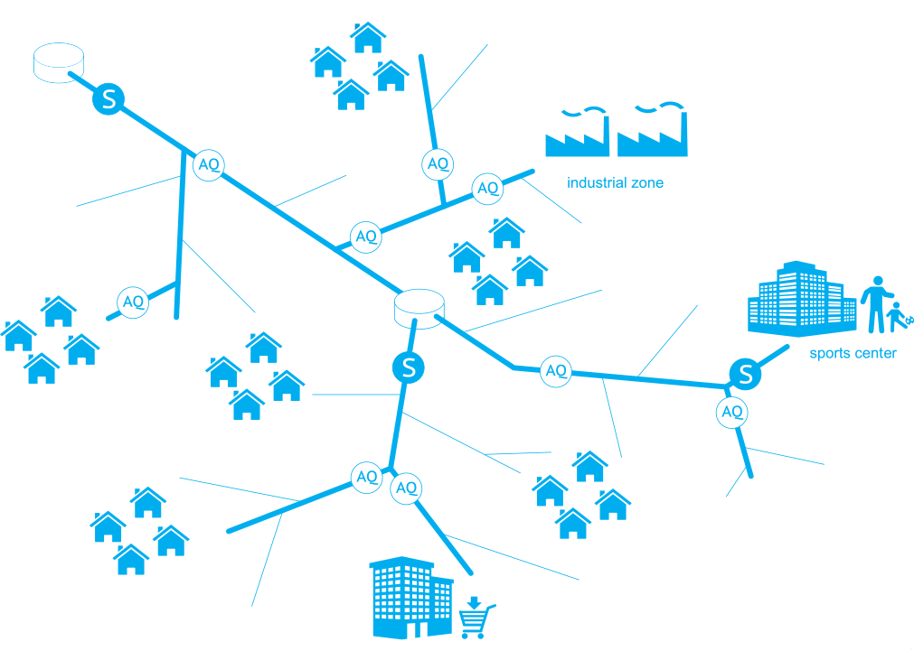
The Designed Wastewater Network

Slide 34
Wastewater Network: -
The town doesn’t have a Wastewater Network.
People depend on the suction to dispose the wastes.
The terrain of the town allows to use gravity flow concept.
Part of a sewage network designed, to represent the concept of gravity flow.

Slide 35
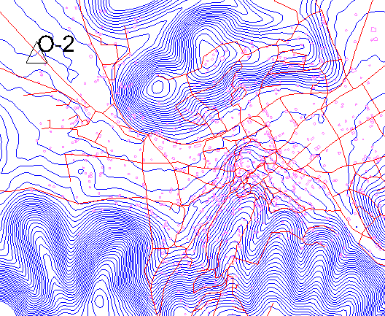
Wastewater Network: -
Location of the Outfall, and the recommended Treatment Plant.
Location of the Outfall, and the recommended Treatment Plant.

Slide 36
Wastewater Network: -
Assumption and Constrains for the Design:
Design period 20 years.
Future Population = 40,571 capita.
120 L/C-D. water demand.
80% of produced waste water from consumed water.
20% infiltration.
Peak factor calculated by (PF =14P^{-1/6}).
The maximum distance between manholes is 30m.
PVC circular pipes.
Velocity constrains between (0.6 – 3) m/s.
Cover constrains between (1 – 3.5) m.
Slope constrains between (1 – 12) %.

Slide 37
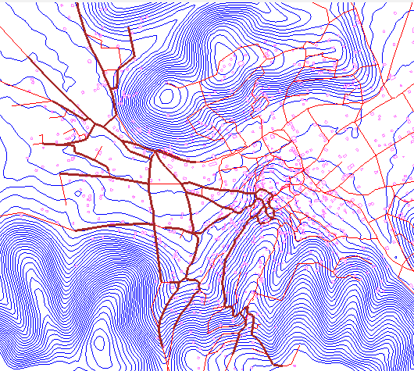
Wastewater Network: -
The designed part of the sewage network.

Slide 38
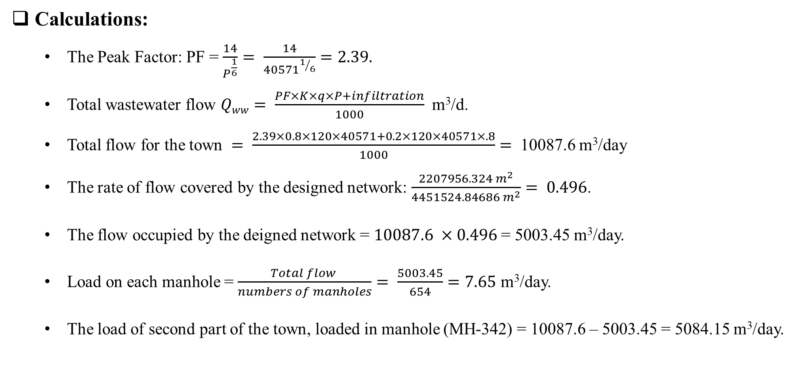
Wastewater Network: -
Calculations:
The Peak Factor: PF = $\frac{14}{P^{\frac{1}{6}}}= \frac{14}{{40571}^{1/6}}=2.39.$
Total wastewater flow $Qww= \frac{PF×K×q×P+infiltration}{1000}$ m³/d.
Total flow for the town $= \frac{2.39×0.8×120×40571+0.2×120×40571×.8}{1000}=$ 10087.6 m³/day
The rate of flow covered by the designed network: $\frac{2207956.324 m^{2}}{4451524.84686 m^{2}}= 0.496$.
The flow occupied by the deigned network = $10087.6 ×0.496$= 5003.45 m³/day.
Load on each manhole = $\frac{Total flow }{numbers of manholes}= \frac{5003.45}{654}=7.65$ m³/day.
The load of second part of the town, loaded in manhole (MH-342) = 10087.6 – 5003.45 = 5084.15 m³/day.

Slide 39
Wastewater Network: -
Results:
Slope.

Slide 40
Wastewater Network: -
Results:
Velocity.

Slide 41
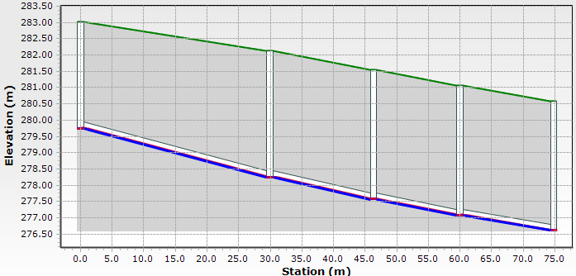
Wastewater Network: -
Results:
Covers:
Maximum cover.

Slide 42
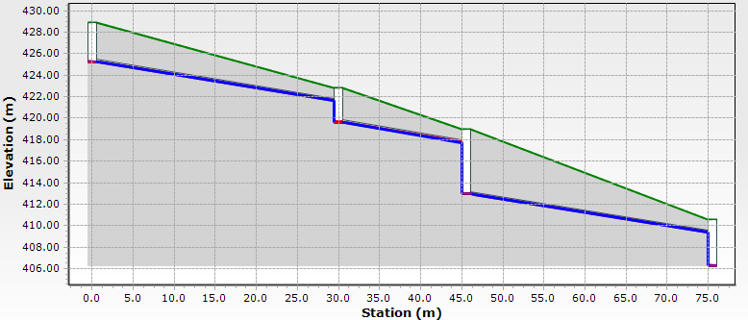
Wastewater Network: -
Results:
Covers:
Drop Manholes.

Slide 43
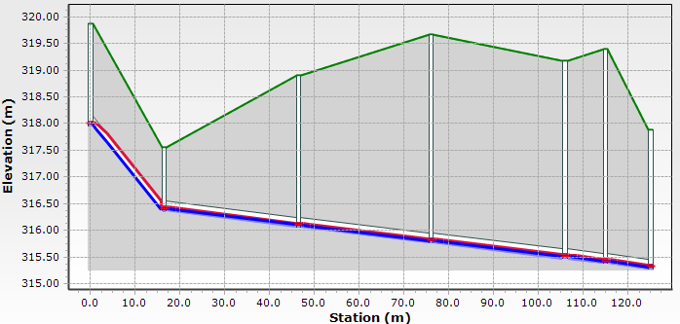
Wastewater Network: -
Results:
Covers:
Difficult Terrain.

Slide 44
Wastewater Network: -
Results:
Diameters.

Slide 45


