Slide 1

Maze Solving Robot
SUPERVISOR : Dr.Saed Tarapiah.
PARTICIPANTS : Majdy Sabra , Naser Tayeh.

Slide 2
TABLE OF CONTENTS
Introduction
Components
Constraints
Working
Principle
Results
Summary

Slide 3
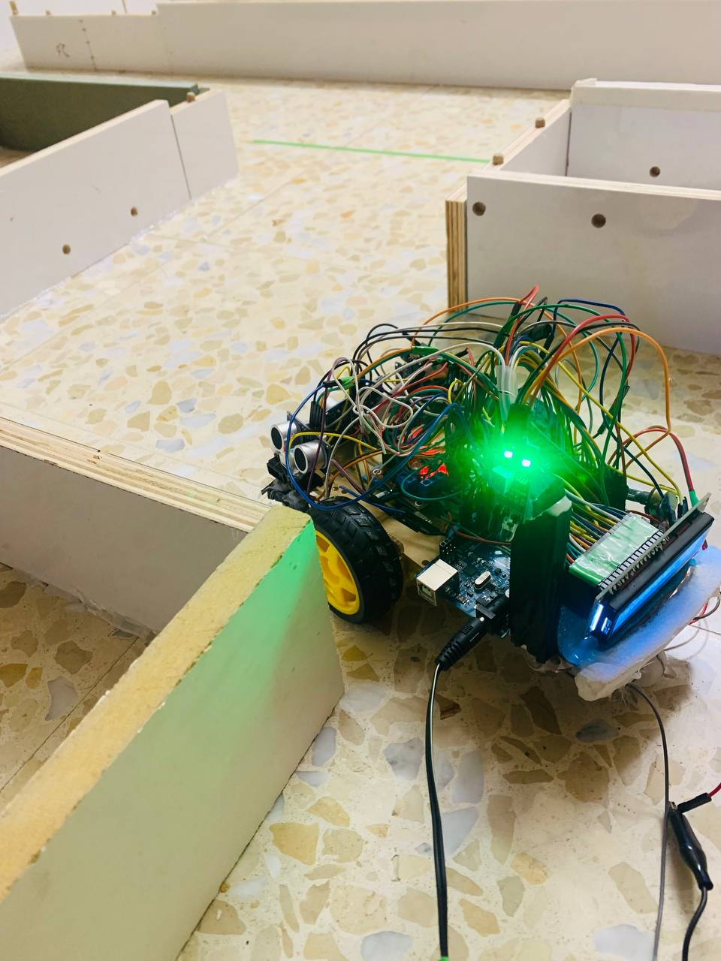
INTRODUCTION
Our project is a Maze solving robot Building a moving robot is a difficult proposition because it demands dealing with many selections before beginning the construction process, like its position, wheels, and torque, the type of motor drive circuit, the ability of the motor to hold all the components and move, in addition to take correct value from the sensors and other matters.
Features:
  Autonomous maze Navigation.
  Self-correctness.
  Efficiency and speed.
  Real time status.

Slide 4
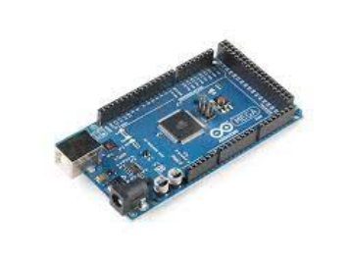
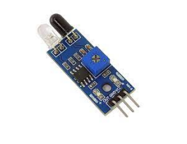
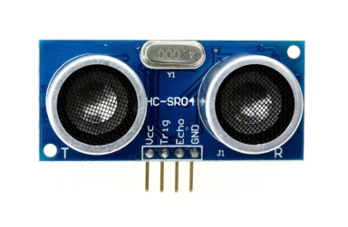
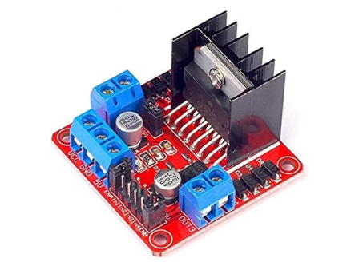
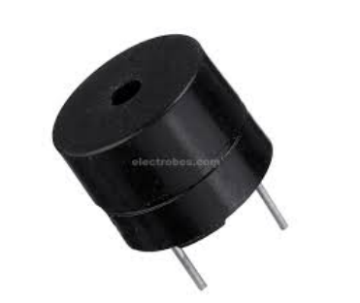
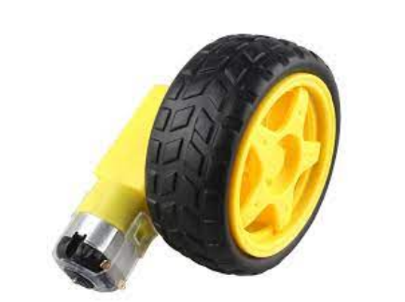
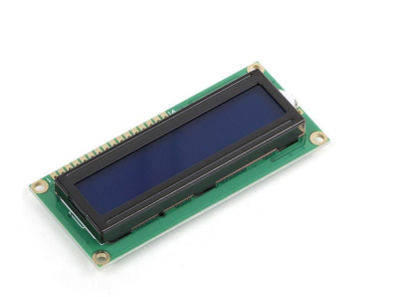
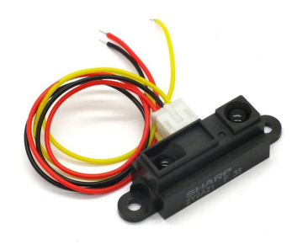
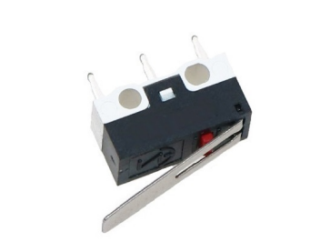
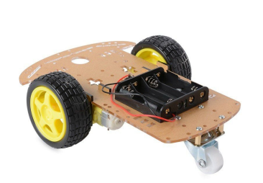
COMPONENTS

Slide 5

CONSTRAINTS
• Distance accuracy :
  • Duo to the lack of efficient hardware distance sensor we had to use more than one
  type of sensors.
  • Sharp-IR is more efficient in short distance.
  • Ultra-sonic is more efficient in large distance.
  • Combining both sensor’s gives us a Satisfying measurements.
• Dealing with a new algorithm.
• The big size of the robot requires a big maze.
• Lack of the ability to provide a stepper motor(small size).
• Lack of the ability to provide a Ladar.
• inability to provide a Ladar lead to not having a path saving feature.

Slide 6
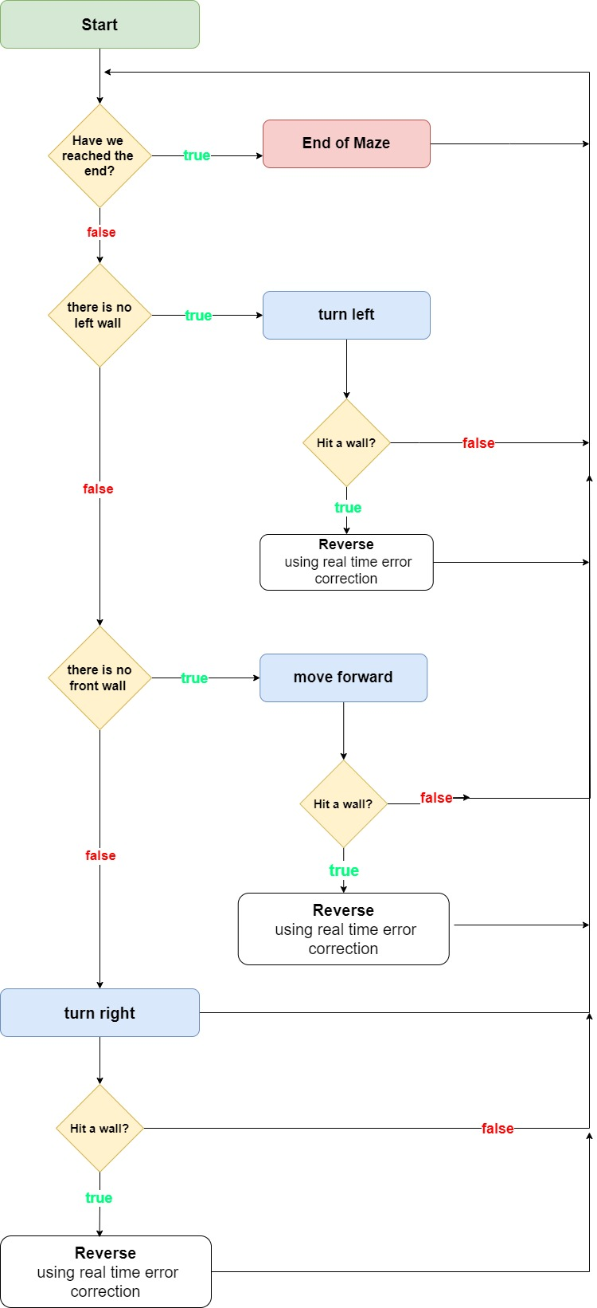
WORKING PRINCIPLE
Select a Starting Point: Begin at a specific point in the maze.
Choose a Wall to Follow: Decide whether to follow the left or right wall (in our case we choses left wall)
Move Forward: Move forward while keeping the chosen wall adjacent to you.
Wall Following Rules: If there is an opening on the side with the chosen wall, turn in that direction. If there is a wall on both sides, turn 180 degrees. If there is a wall on the side opposite to the chosen wall, continue moving forward.
Repeat Until Exit is Found: Continue these steps until you reach the exit or the desired destination.

Slide 7
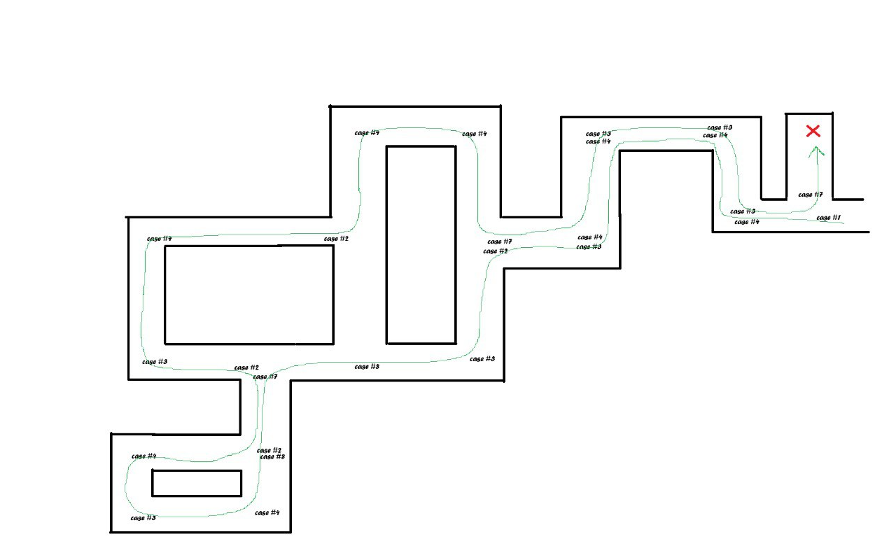
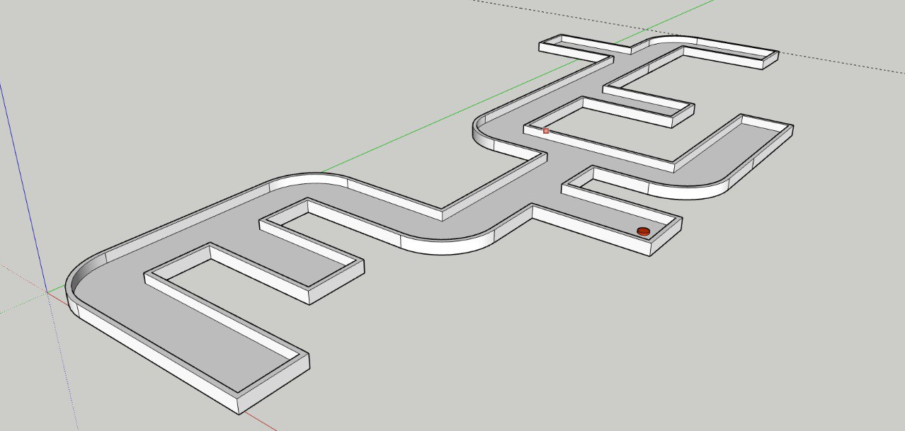
CONT.

Slide 8
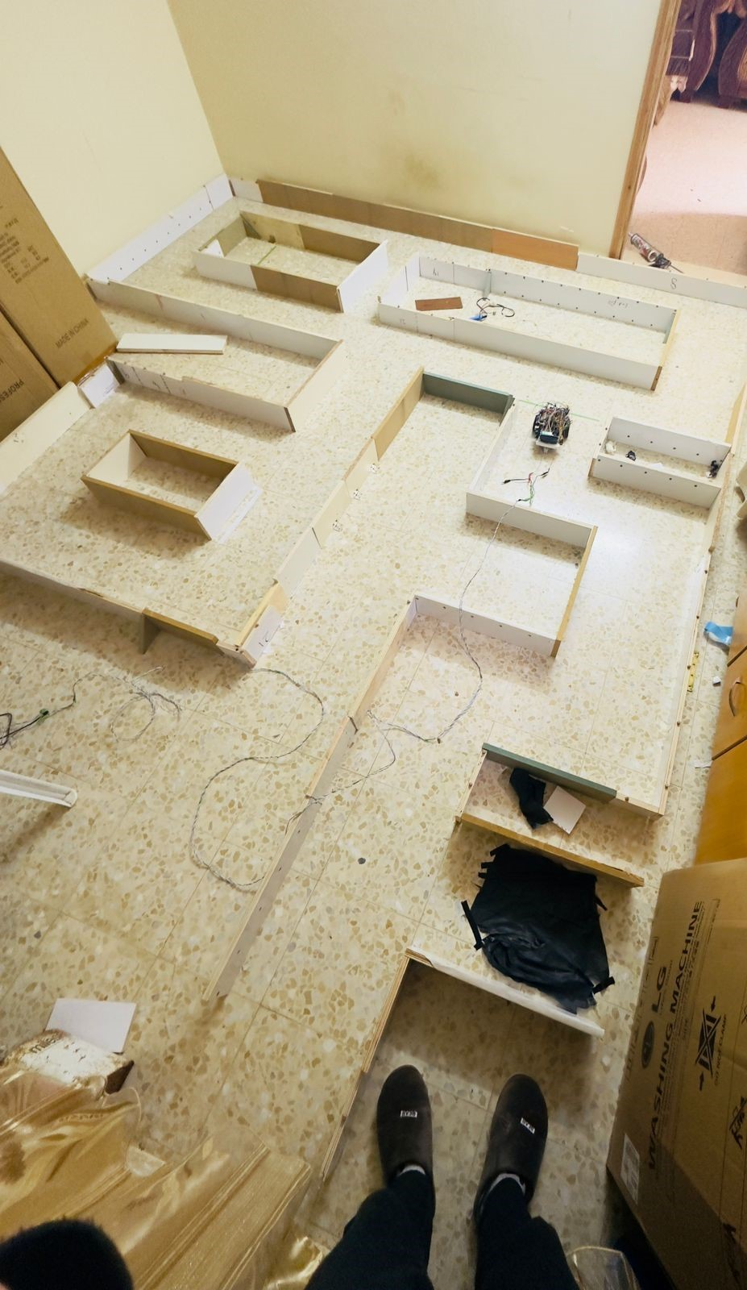
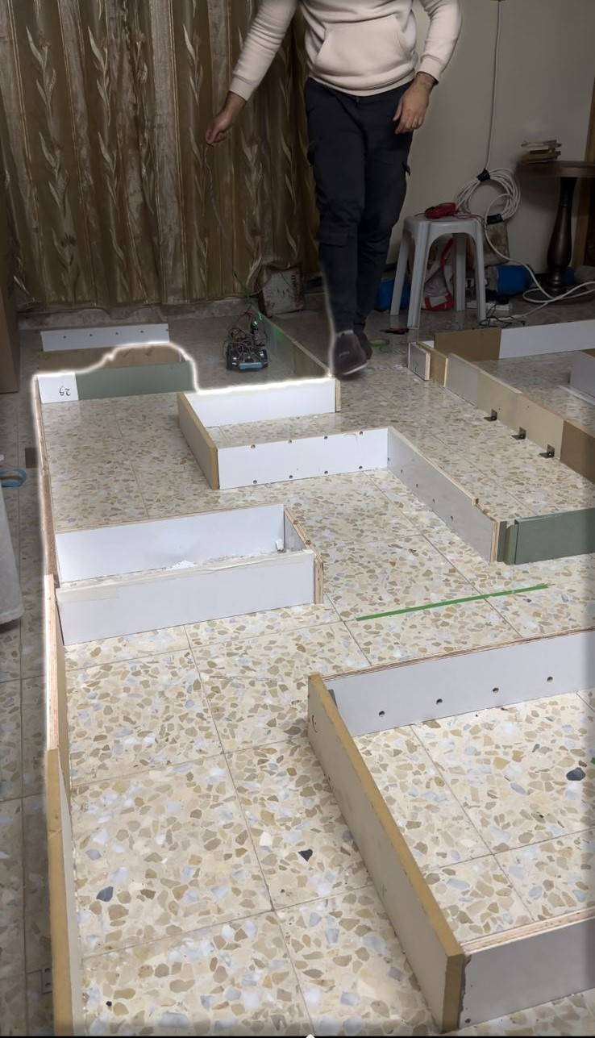
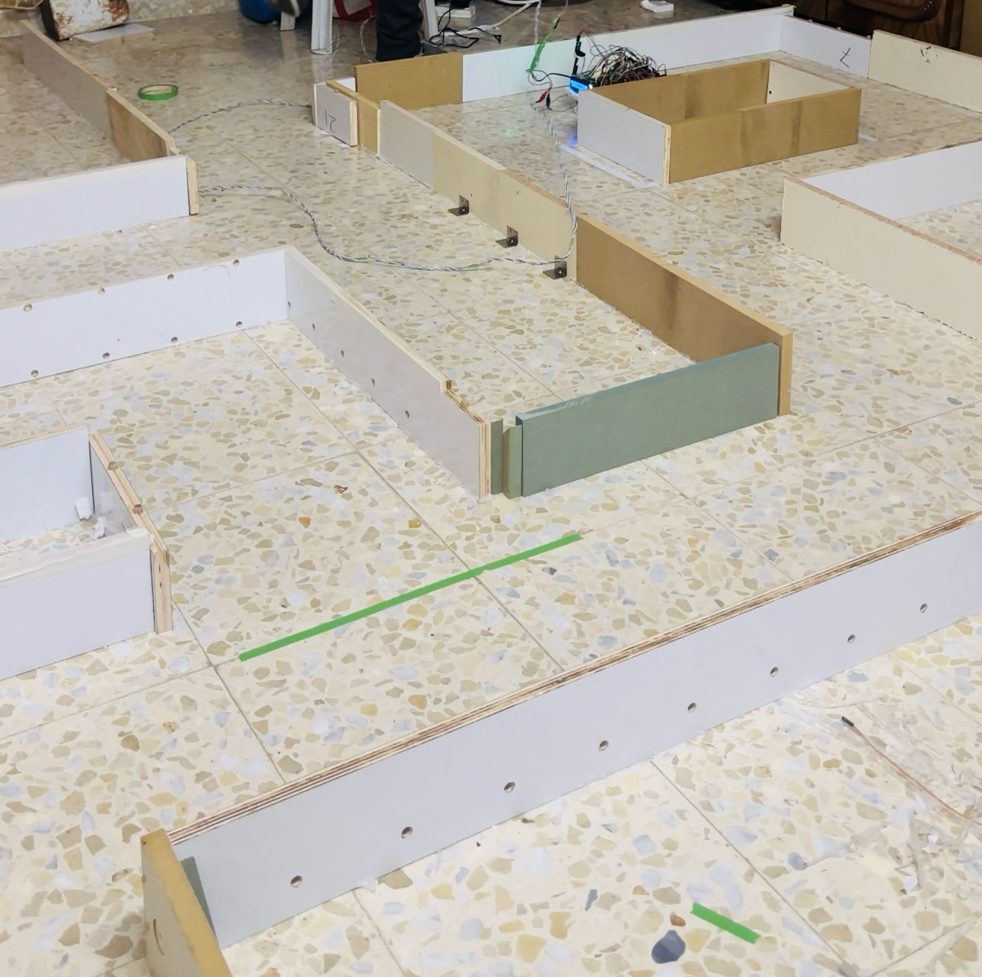
RESULTS

Slide 9
SUMMARY
The wall follower algorithm is a popular technique used to navigate and solve mazes. It’s a simple yet effective approach that involves following a wall (either the left or right wall) throughout the maze until the destination is reached. The algorithm is based on the idea that as long as you keep a hand on the wall and continue walking, you will eventually find the exit. Here are the general steps of the wall follower

Slide 10

THANK YOU

