Slide 1
Smart School Management System
Prepared by:Sondus Abu Ghdaib
Aroub Naeem
Supervisor:Dr.Asmaa’ Afeefy

Slide 2



Slide 3
Outline
Introduction
Language and Programs
Project Features
Constraints and Problems
Future Work
Conclusion

Slide 4
Introduction

Slide 5
Languages
Laravel Framework.
Vue Framework.
Ajax, Javascript, Bootstrap and Jquery
.MySql Database.
Wamp Server.

Slide 6
Members

Slide 7

Home Page

Slide 8
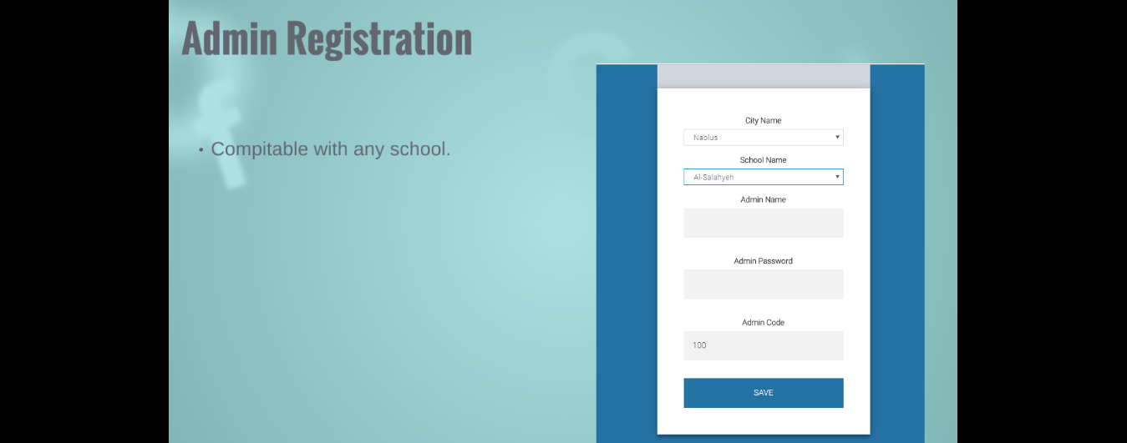
Admin Registration

Slide 9
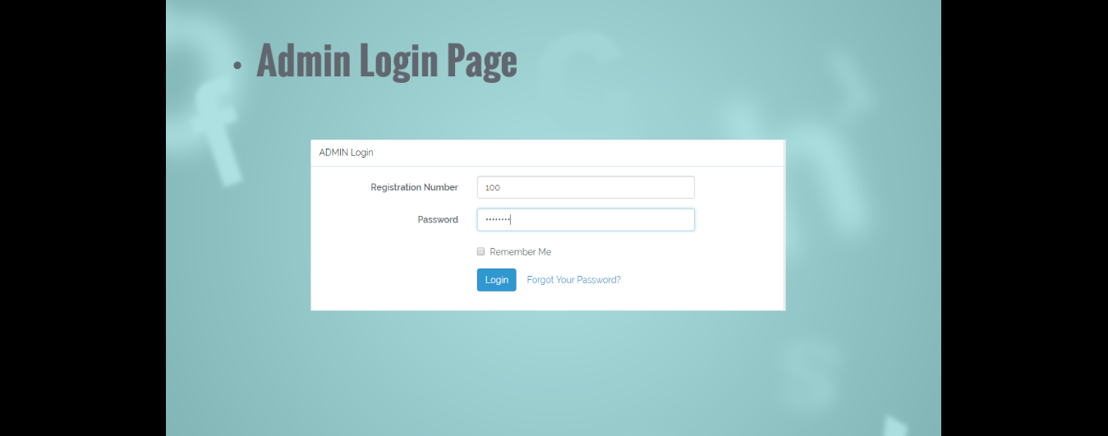
Admin Login Page

Slide 10
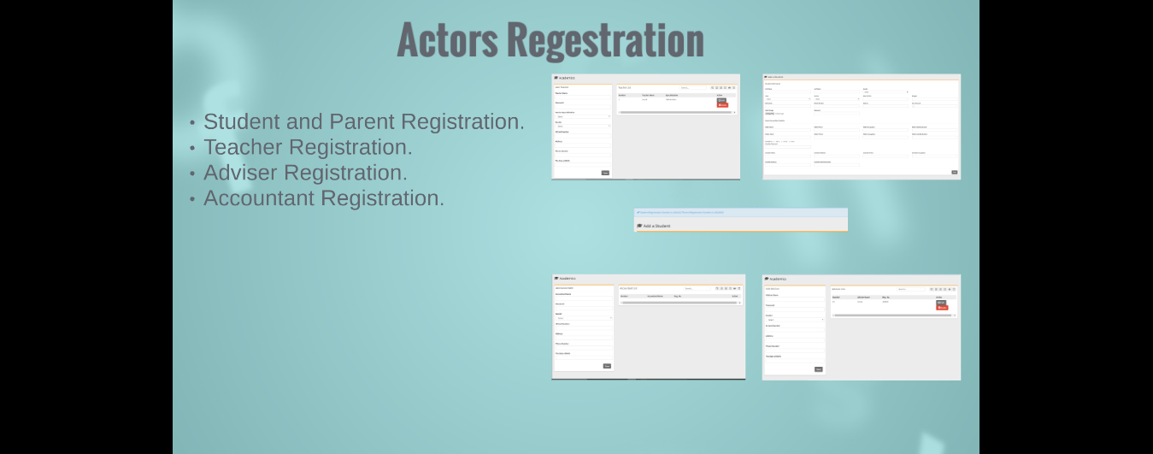
Actors Registration

Slide 11
Administrator
Admin Activities .

Slide 12

Add Classes and Sections

Slide 13
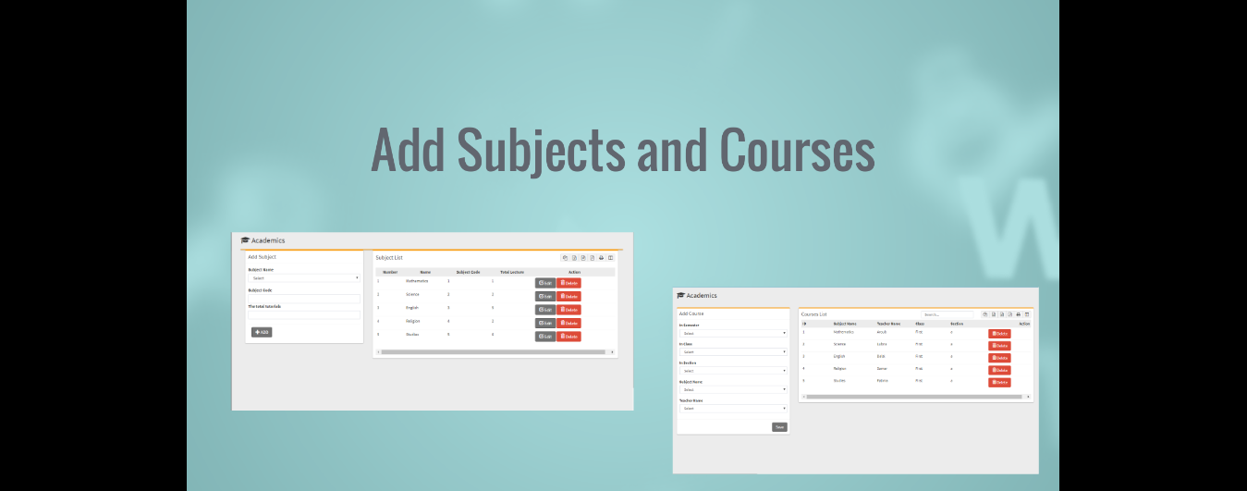
Add Subjects and Courses

Slide 14
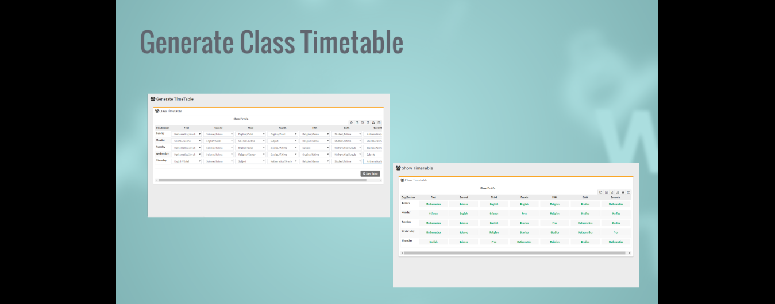
Generate Class Timetable

Slide 15
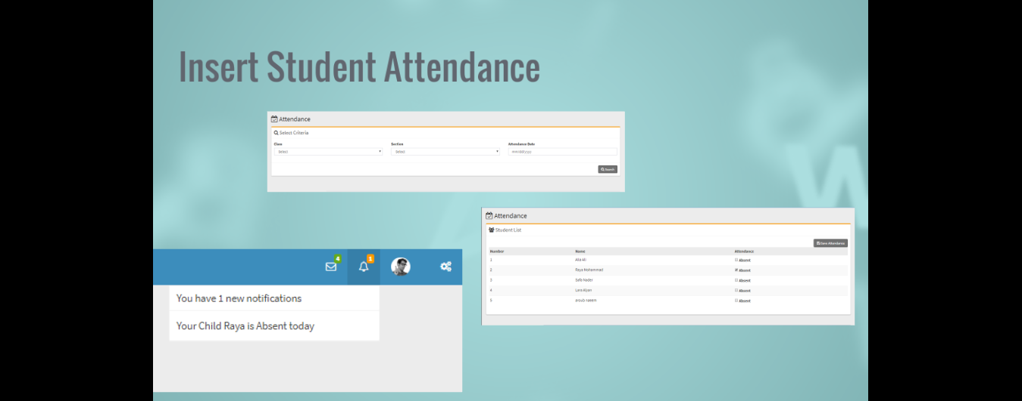
Insert Student Attendance

Slide 16
Teacher
Teacher Activities

Slide 17
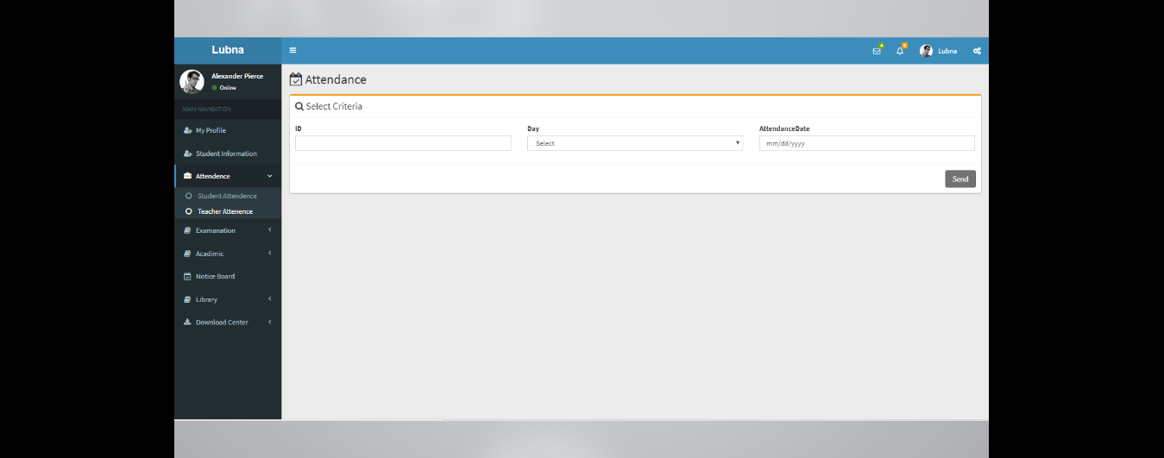
Save Attendance

Slide 18
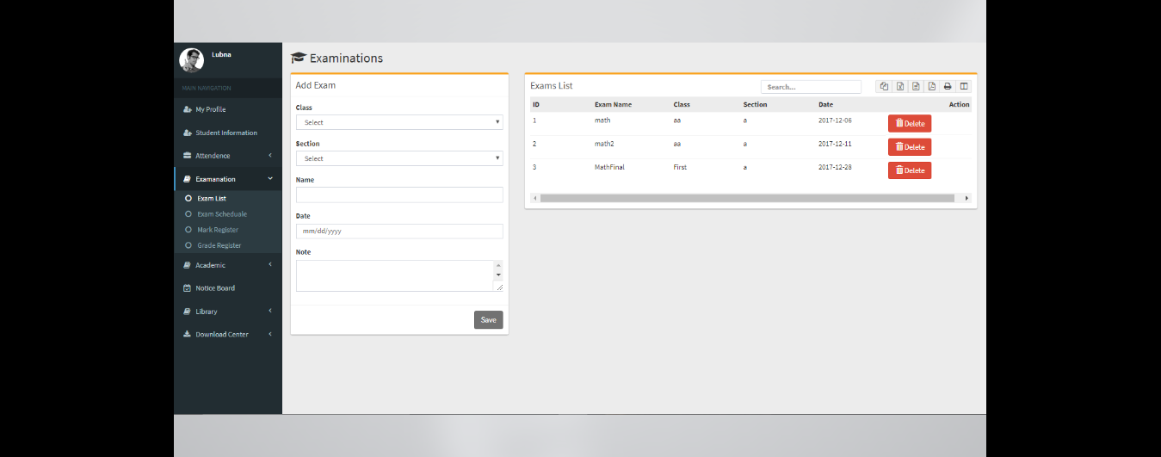
Add Exams and Marks

Slide 19
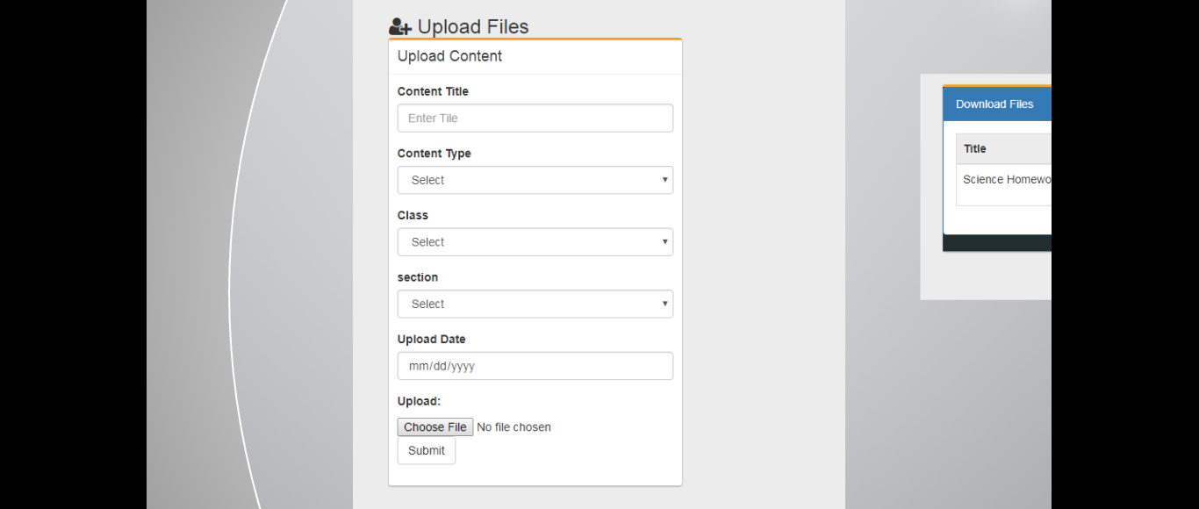
Download Center

Slide 20
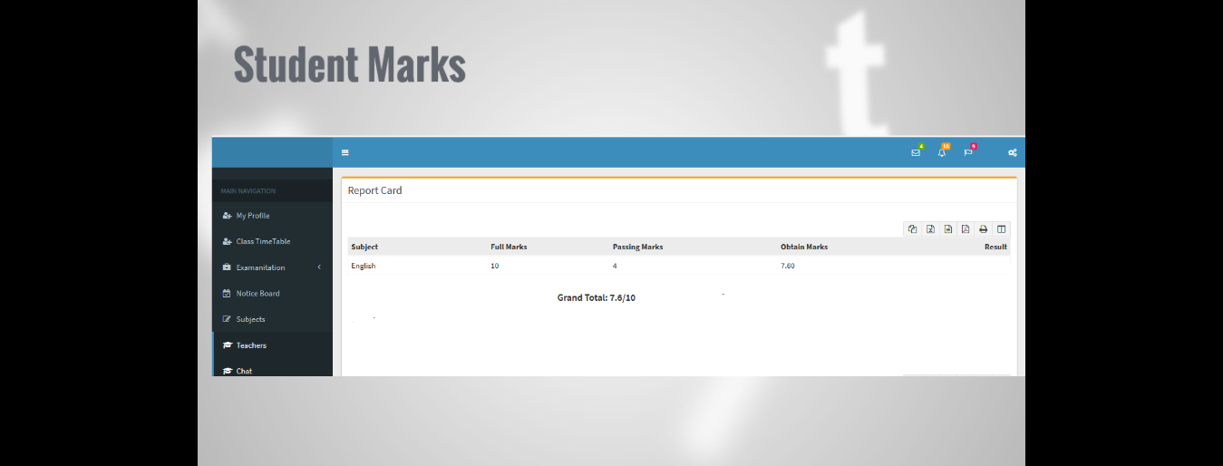
Students Marks

Slide 21
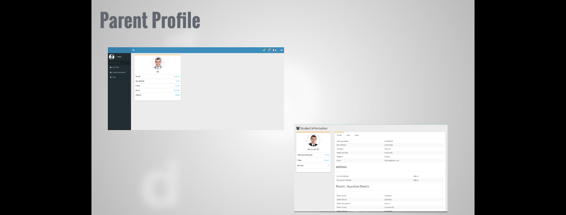
Parent Profile

Slide 22
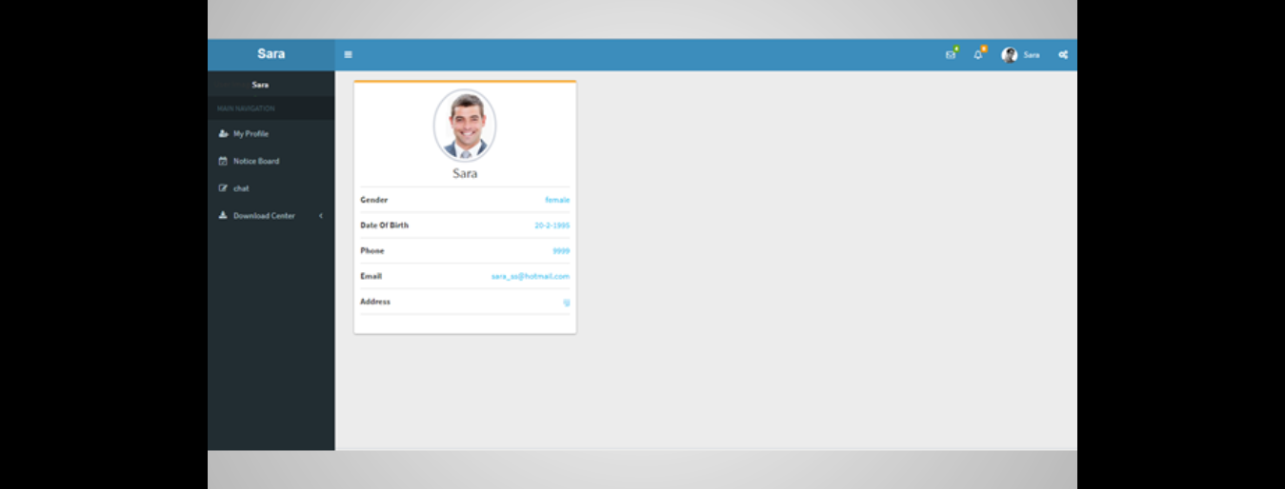
Advisor Profile

Slide 23
Problems and Constraints
Learning New Framework.
No knowledge in school management
Time
Genetic Algorithm

Slide 24

Future Work

Slide 25
Conclusion

