Slide 1

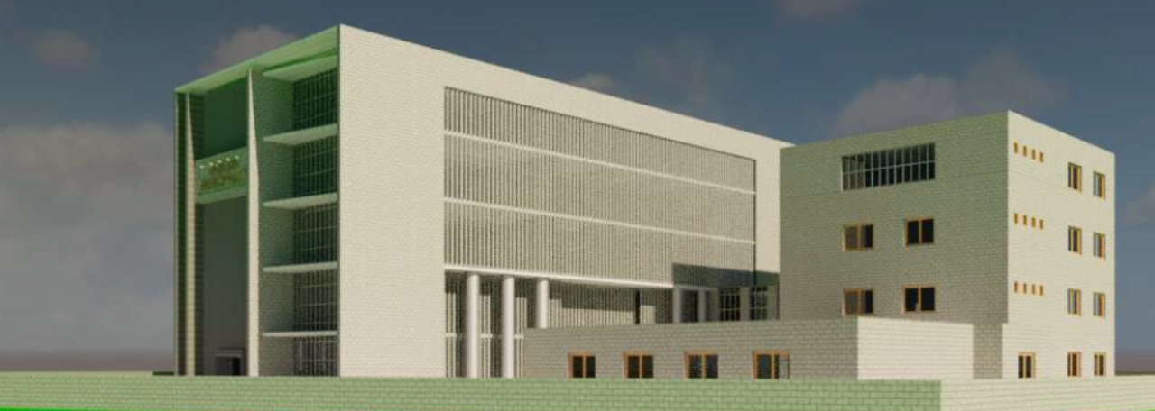
Redesign of Nablus Municipality Building
An-Najah National University
Faculty of Engineering & Information Technology
Building Engineering Department
Graduation Project - II (10611591)
Prepared by group members:
Maram Ghannam
Shahd Hasan Ali
Shahd Qashoo’
Under the supervision of:
Dr. Mutasim Baba’
Presented in partial fulfillment of the requirements for Bachelor degree in Building Engineering
2021

Slide 2
Introduction
01
Architectural Design
02
Environmental Design
03
Structural Design
Outlines
04
Electro-Mechanical Design
05
Quantity surveying & Cost Estimate
06

Slide 3
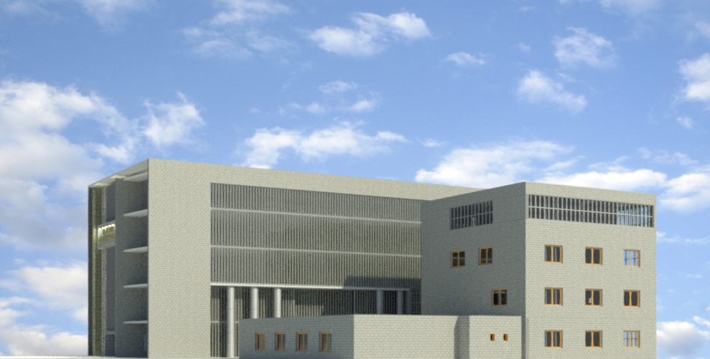
01: Introduction
The building has been analyzed and designed from all architectural, structural, environmental, electrical and mechanical aspects, as will be explained in the following sections.

Slide 4

02
Architectural Design

Slide 5
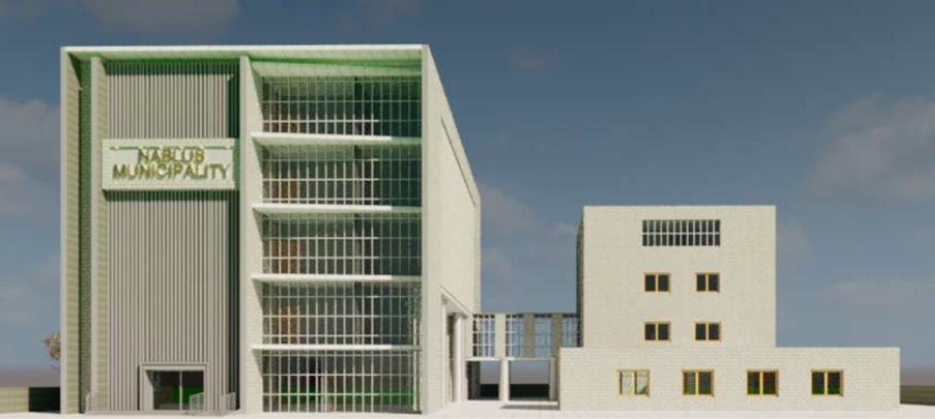
3D-Southern view

Slide 6
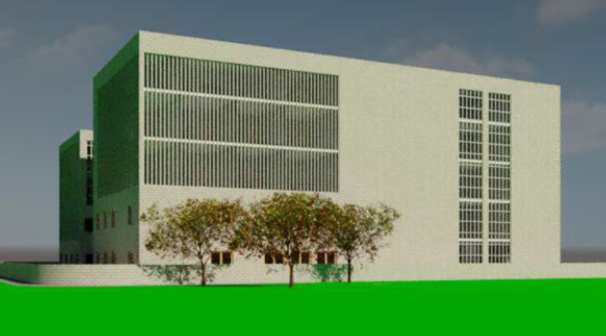
3D-Westren view

Slide 7
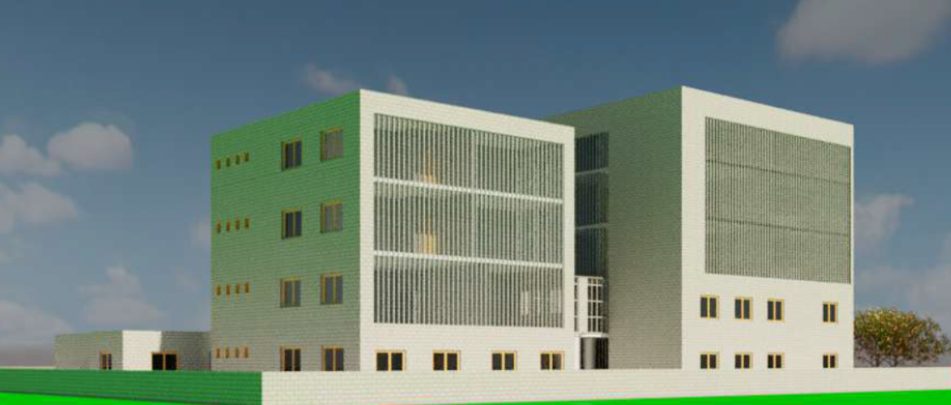
3D-North-East view

Slide 8
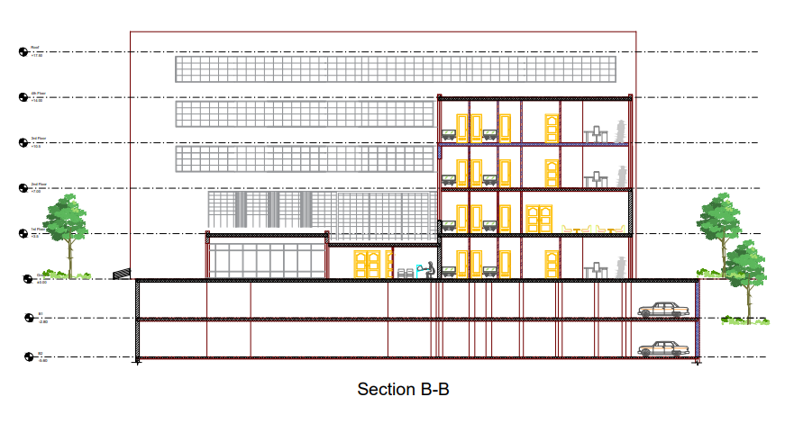
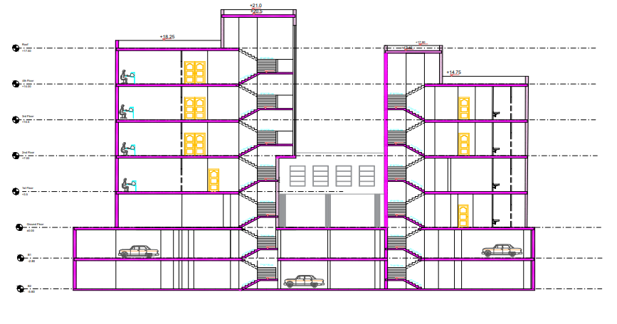
Sections
Section B-B
Section A-A

Slide 9
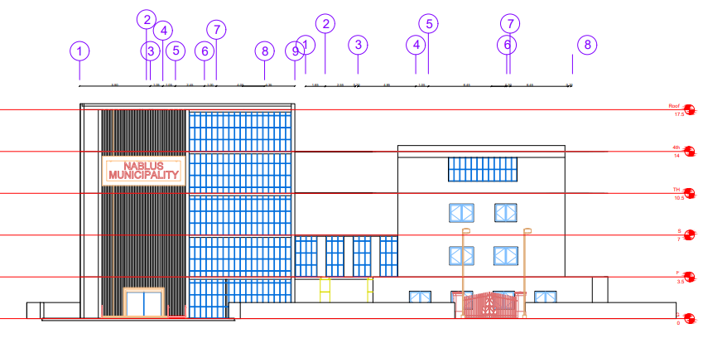
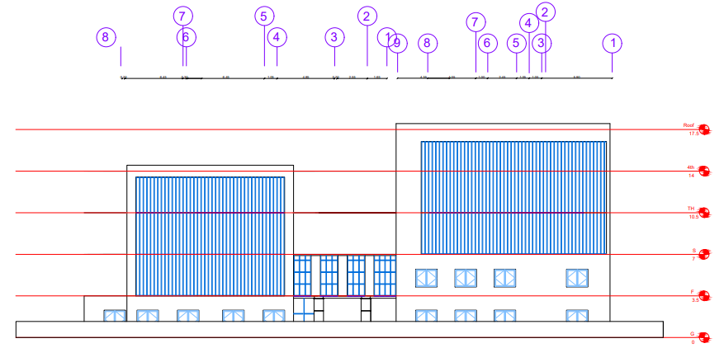
Elevations
South elevation
North elevation

Slide 10
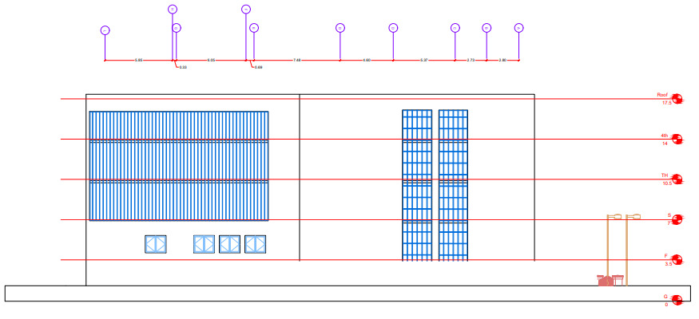
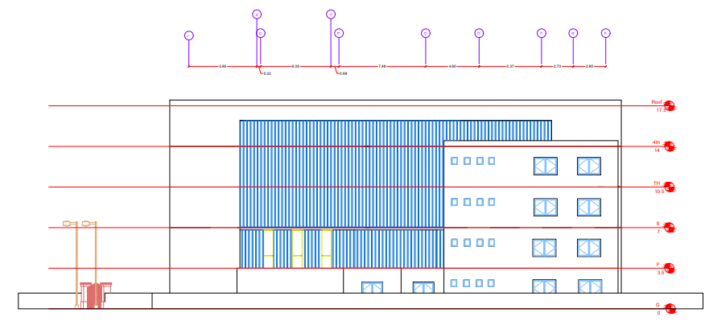
Elevations
West elevation
East elevation

Slide 11
03: Environmental Design
Thermal analysis
Energy efficiency
Shading analysis
Cooling & Heating analysis

Slide 12
Energy Efficiency Strategies
Effective shading
Thermal insulation
Thermal mass

Slide 13
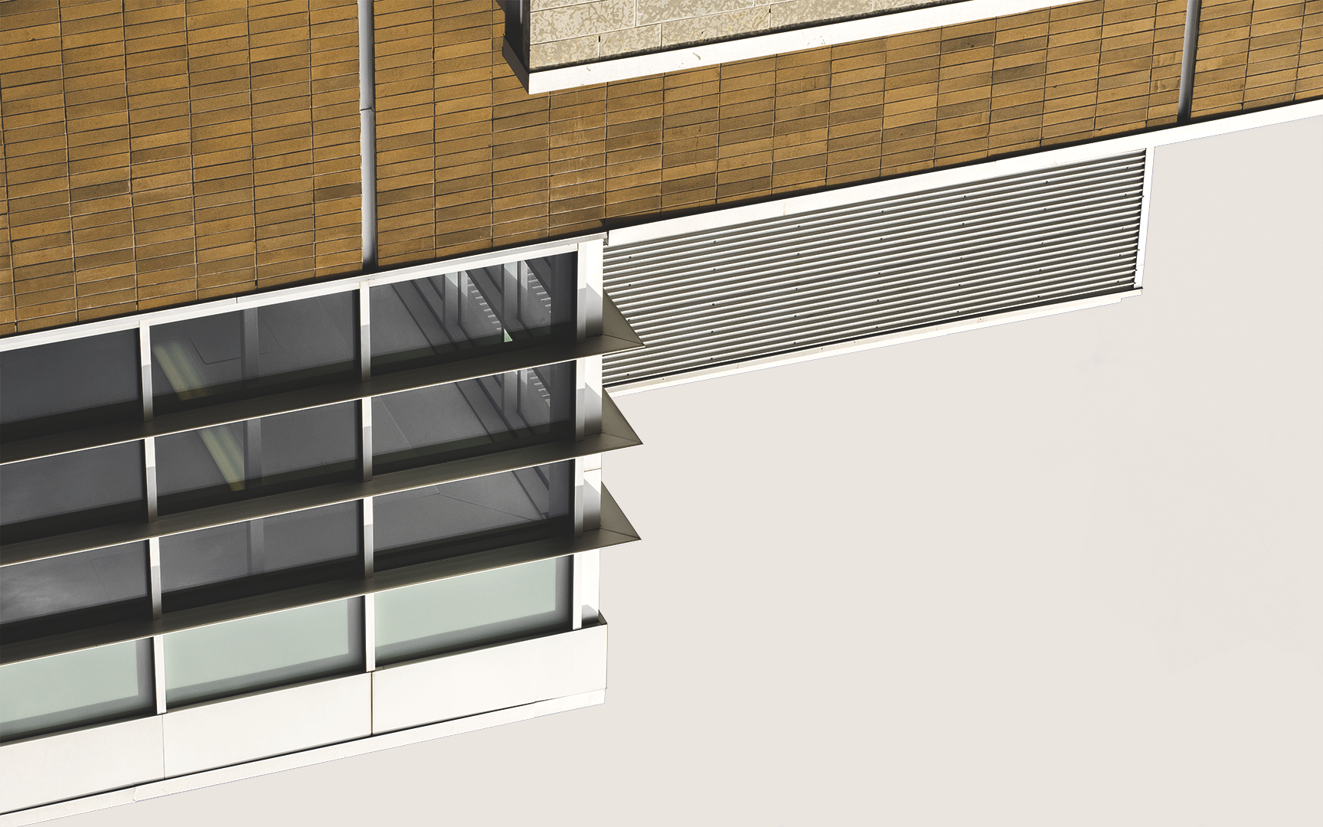
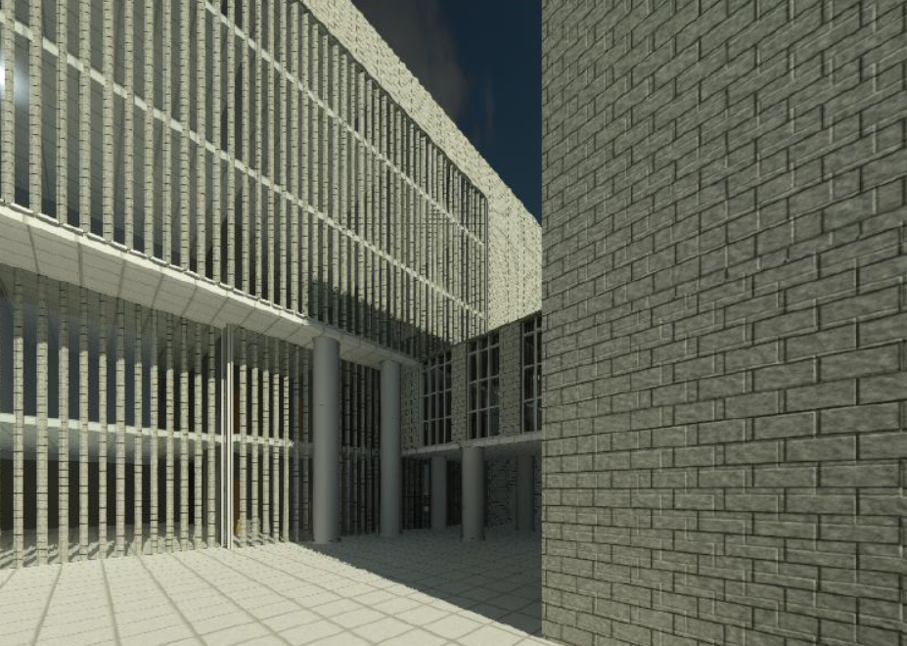
Solutions Used in the Building
South
West & East
Horizontal shutters
Vertical louvers

Slide 14
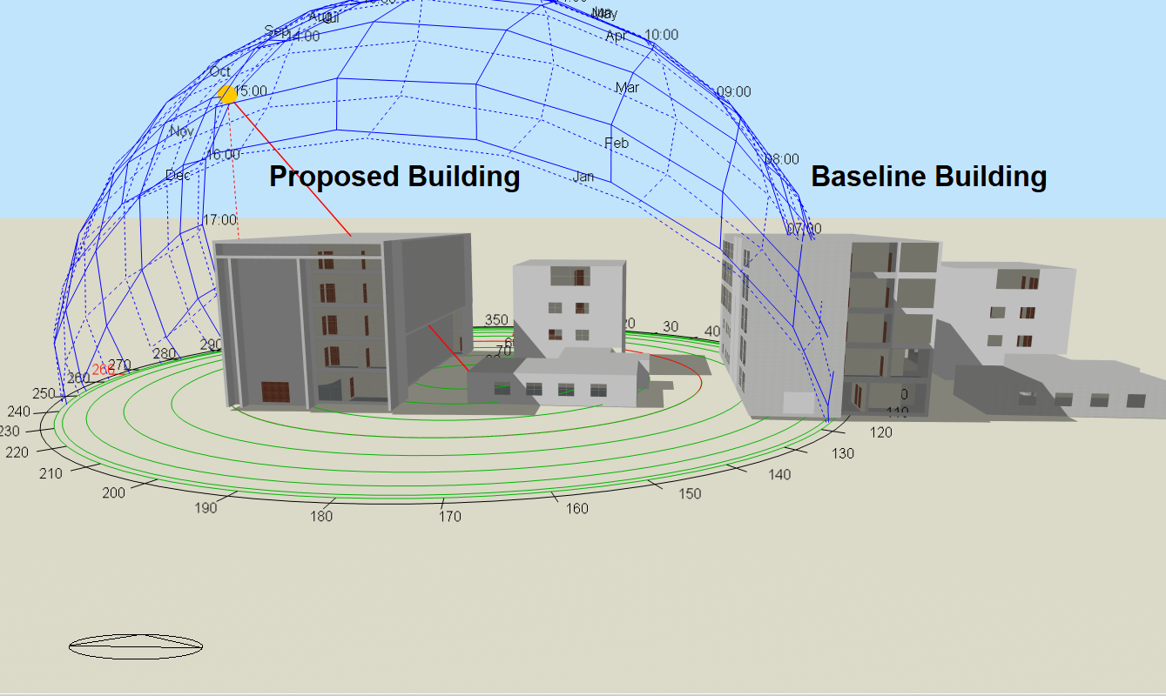
Shading System

Slide 15
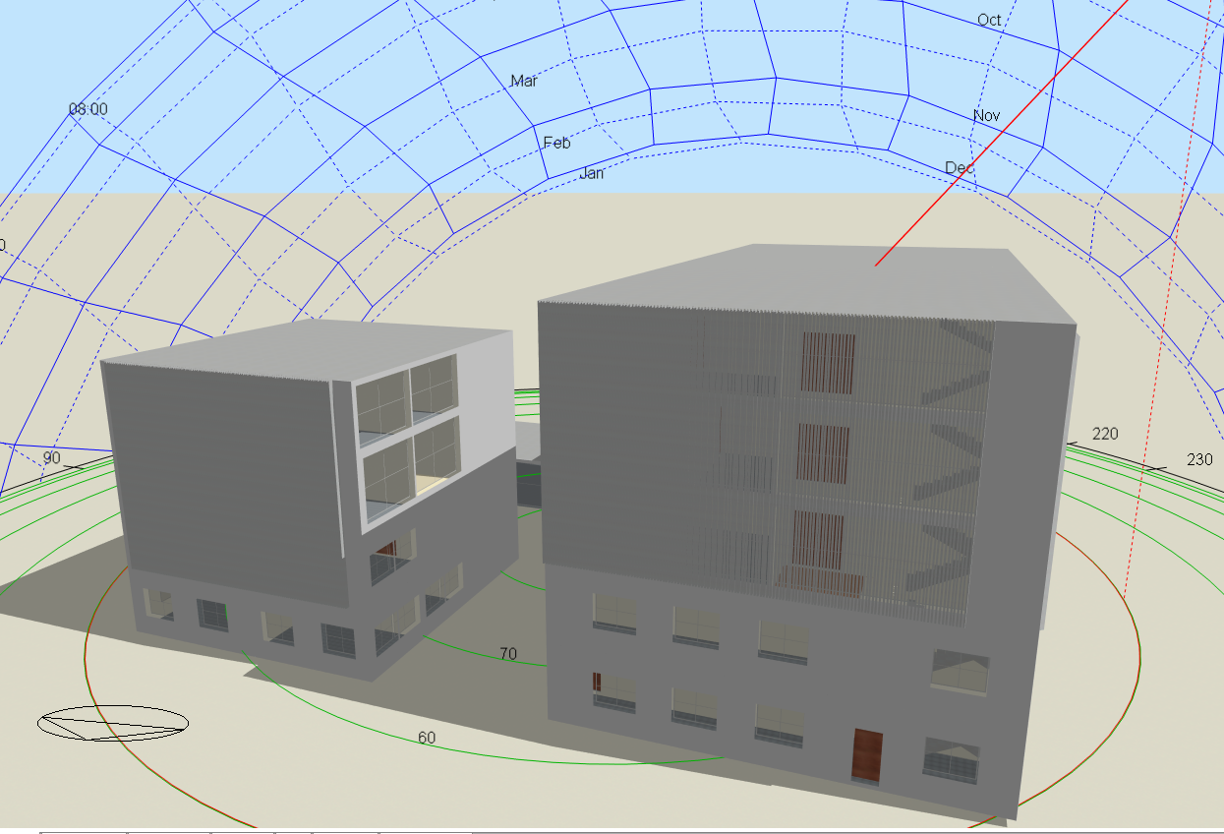
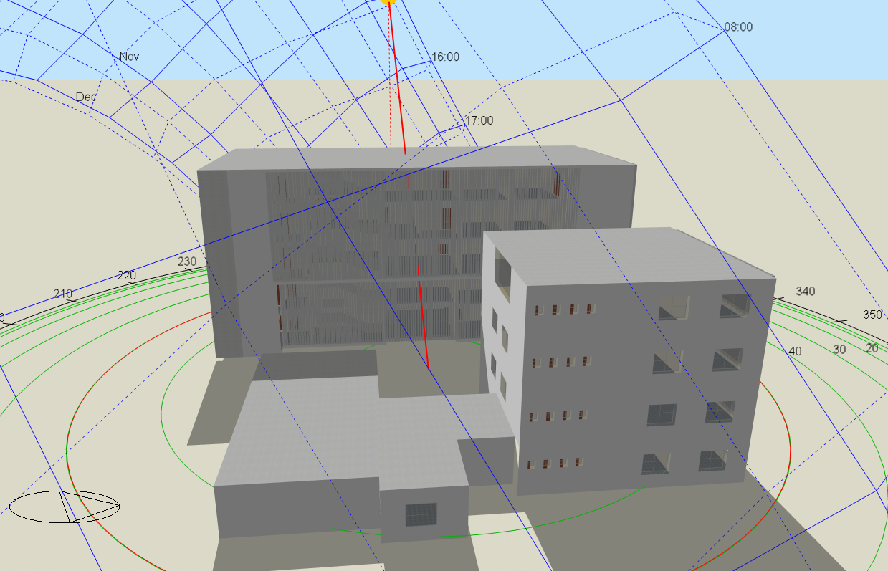
Shading System

Slide 16
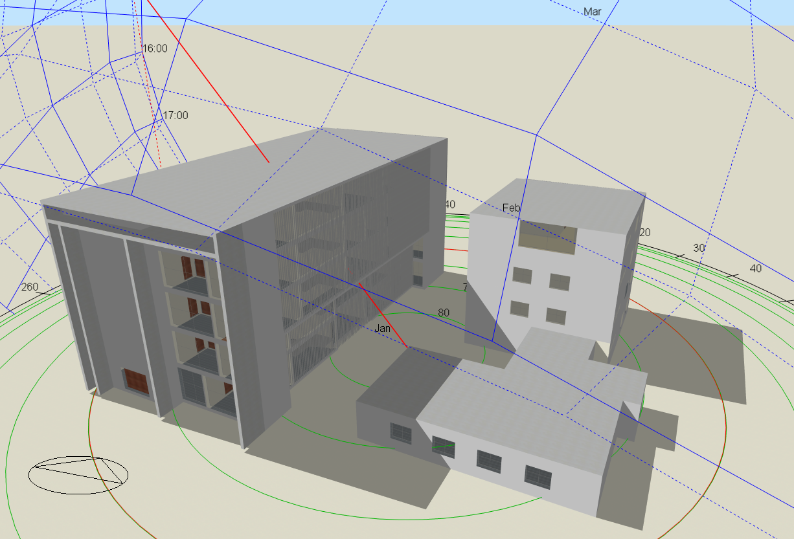
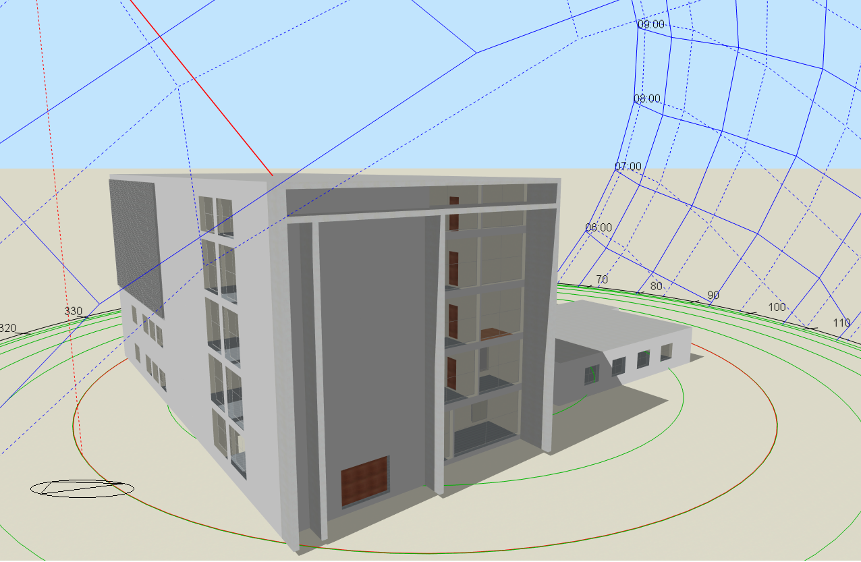
Shading System

Slide 17
Thermal insulation
U-value for Building Envelope
Component | U-Value (w/m2.K)
External walls | 0.384
Internal walls | 2.585
External floor | 0.453
Internal floor | 1.471
Roof | 0.389
Windows properties | 1.689

Slide 18
Thermal Design
Energy density
 | Total energy [kW/h] | Energy per total building area [kWh/m2] | Energy per conditioned building area [kWh/m2]
Total site energy | 417022.53 | 126.13 | 126.13
Net site energy | 417022.53 | 126.13 | 126.13
Total source energy | 1320710.35 | 399.45 | 399.45
Net source energy | 1320710.35 | 399.45 | 399.45

Slide 19
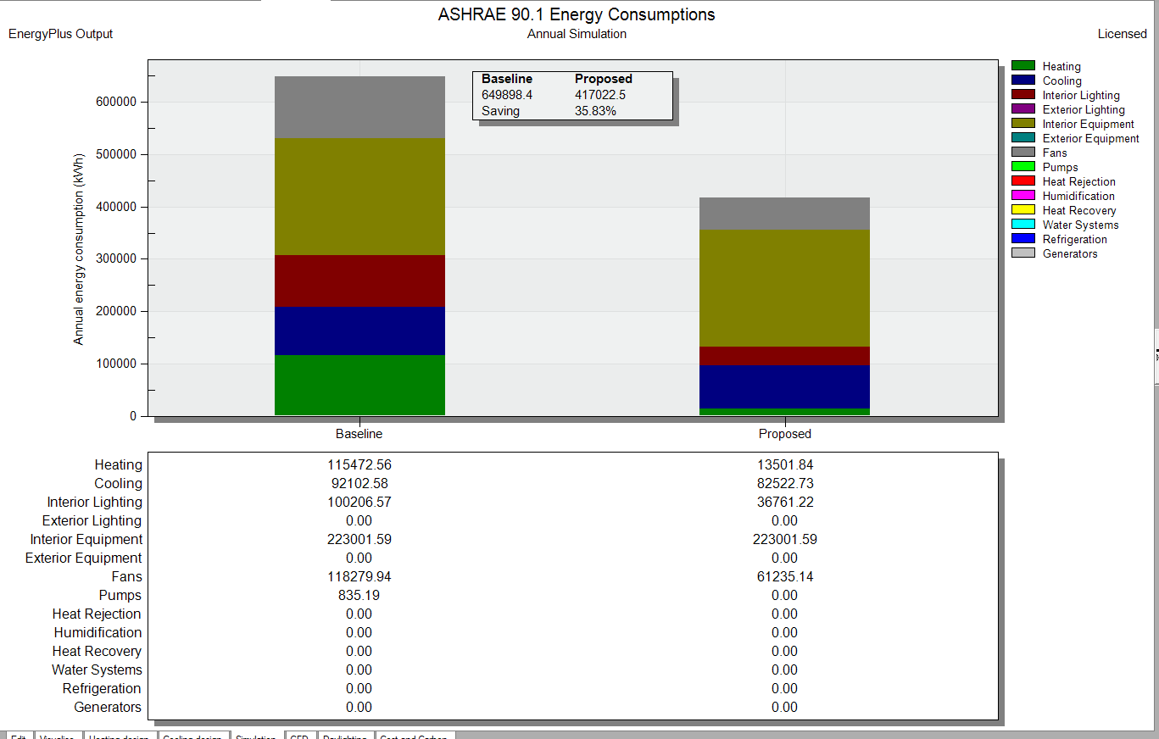
Cooling & Heating Analysis

Slide 20
Thermal Design
Comfort set point not met Summery
`` | Facility [Hours]
Time set point not met during occupied heating | 1.83
Time set point not met during occupied cooling | 30.83
Time not comfortable based on simple ASHRAE 55-2004 | 354.83

Slide 21
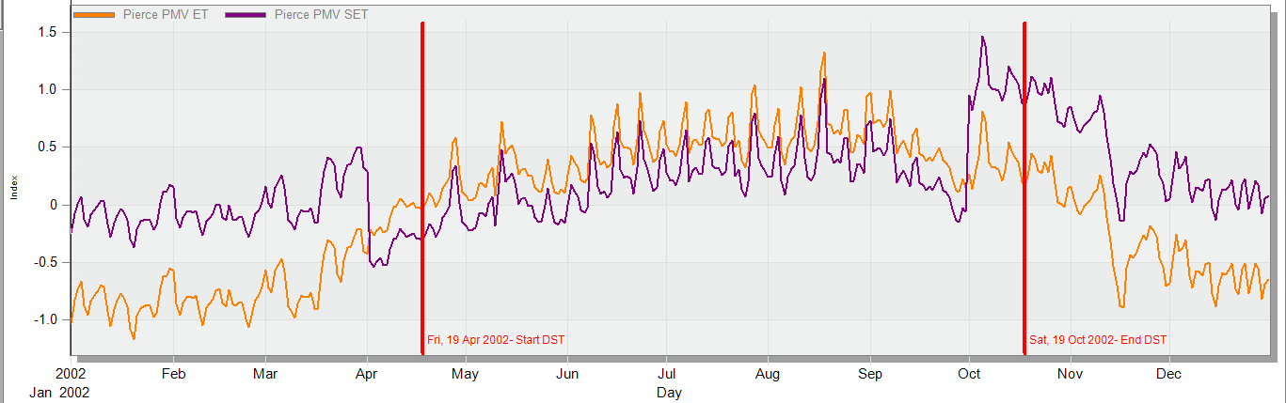
Thermal Design
Comfort PMV index figure

Slide 22
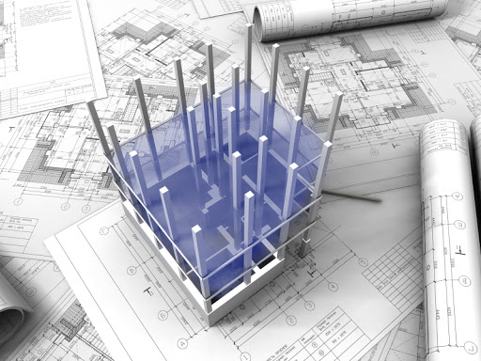
04: Structural Design

Slide 23
Code
Design and analysis of the building is done according to ACI 318-14 Code.
Materials
- Concrete f´c = 28 Mpa for shear walls and columns specific weight of Reinforced concrete (Ɣ) = 25 KN/m³
- Steel
The modulus of elasticity, Es = 200 GPa
Yield strength fy = 420 Mpa.
- Blocks
Unit weight of blocks is considered as 12 kN/m3
General Structural Information

Slide 24
General Structural Information
Loads
Superimposed dead load = 4 KN/m²
Weight of Masonry wall = 21 KN/m
Live Load= 4.8 KN/m²

Slide 25
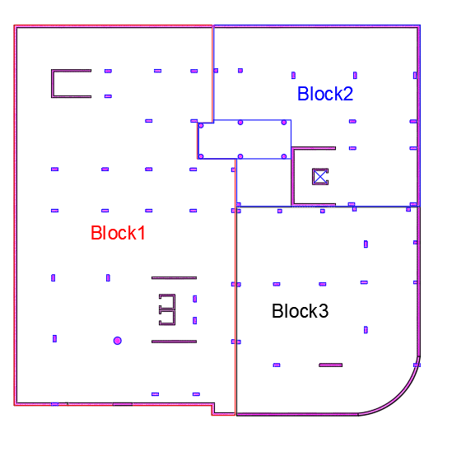
Structural analysis
Structural layout

Slide 26
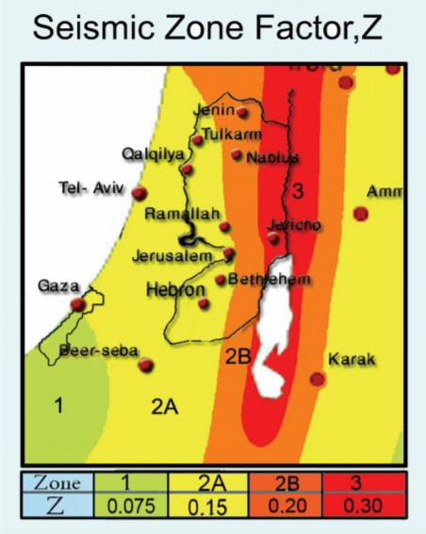
Seismic Load Analysis
Seismic code: UBC-97
Assumptions:
Seismic zone 0.20 (Nablus city)
Seismic importance factor I = 1.
Soil profile type : SB (rock)
Force reduction factor = 5.5.
Velocity dependent seismic coefficient Ca = 0.2 5)
Acceleration dependent seismic coefficient Cv = 0.2
Response spectrum scale factor = 1783.6

Slide 27
Structural & Seismic Checks
Equilibrium check
Compatibility check
Deflection check
Stress strain check
All checks were OK
Drift check
Mass participation ratio check
Base shear check

Slide 28
Design Elements

Slide 29
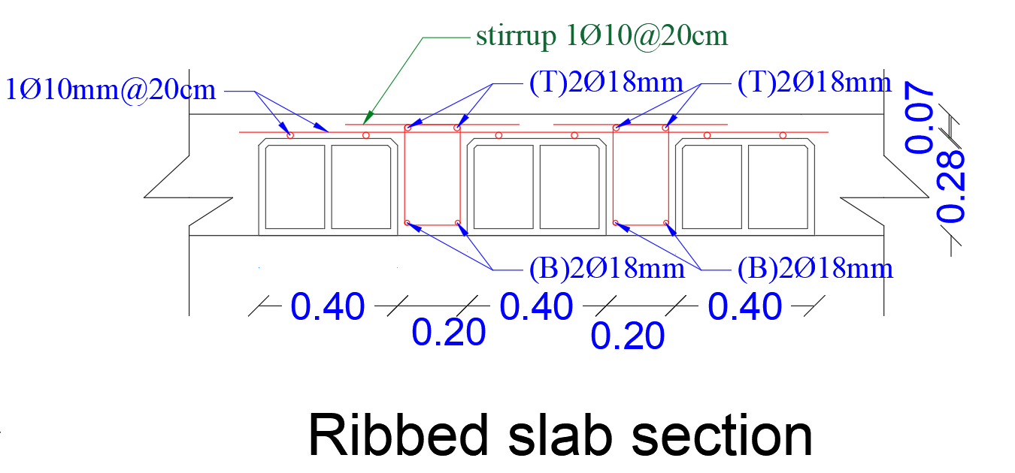
Slab Design

Slide 30
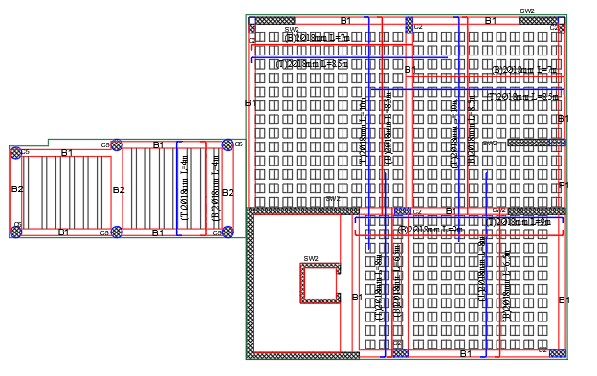
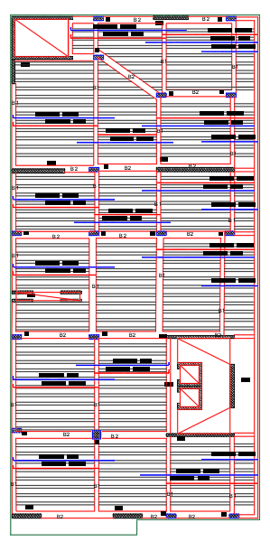
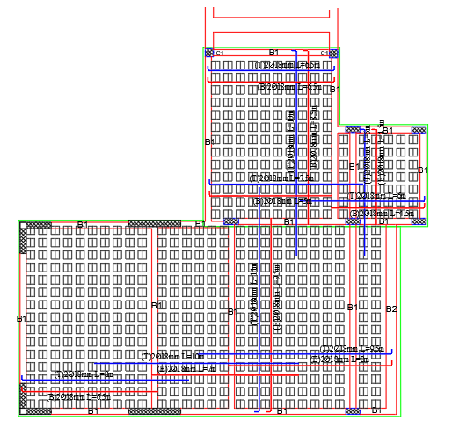
Slab Design

Slide 31
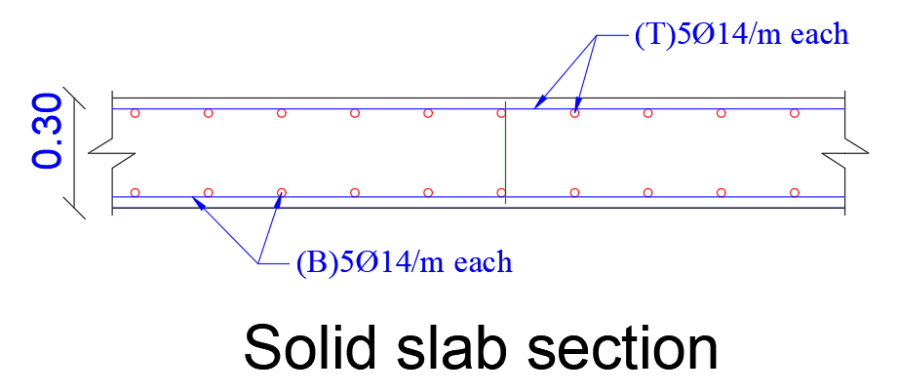
Slab Design

Slide 32
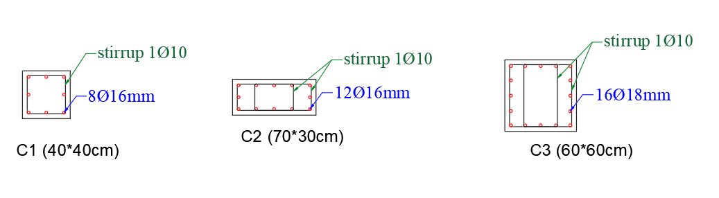
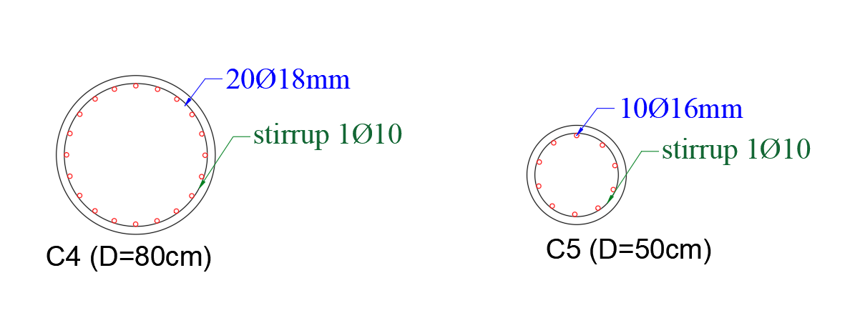
Columns Design

Slide 33
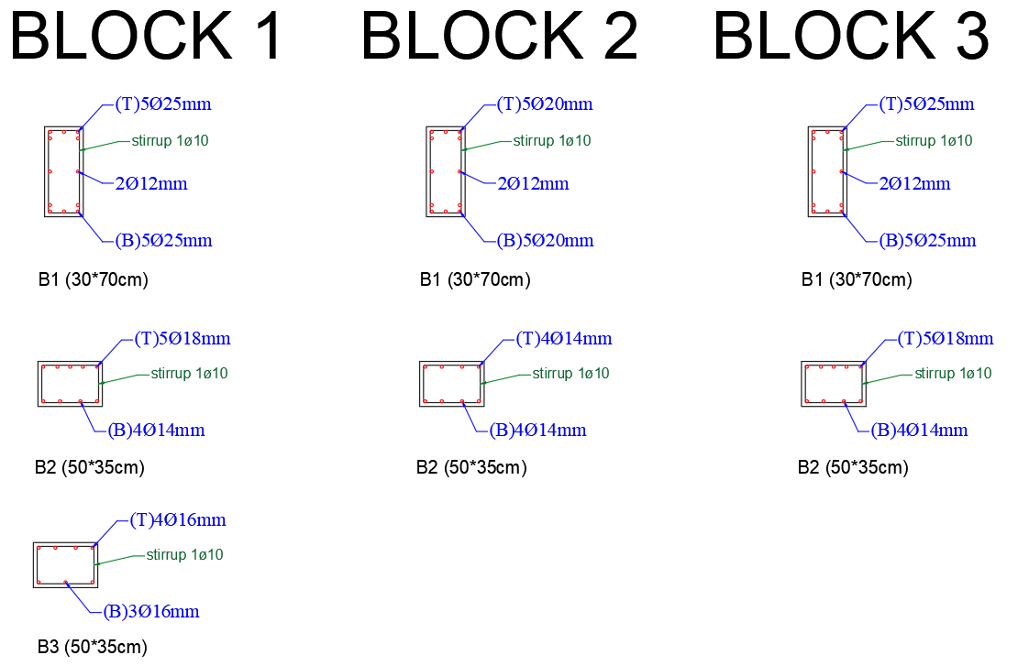
Beams Design

Slide 34
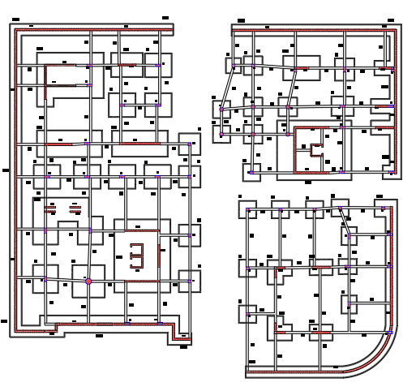
Footing Design
Footing Distribution

Slide 35
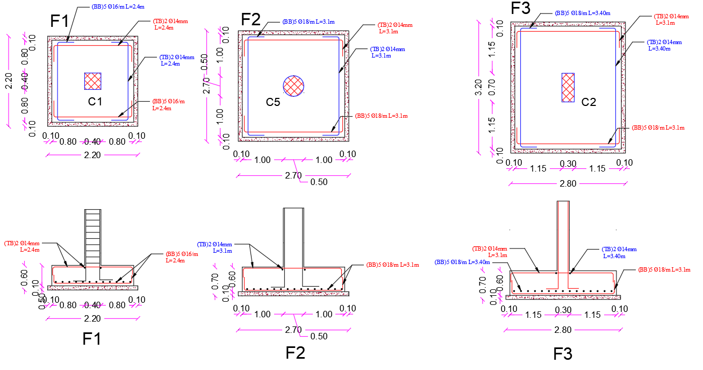
Footing Design

Slide 36
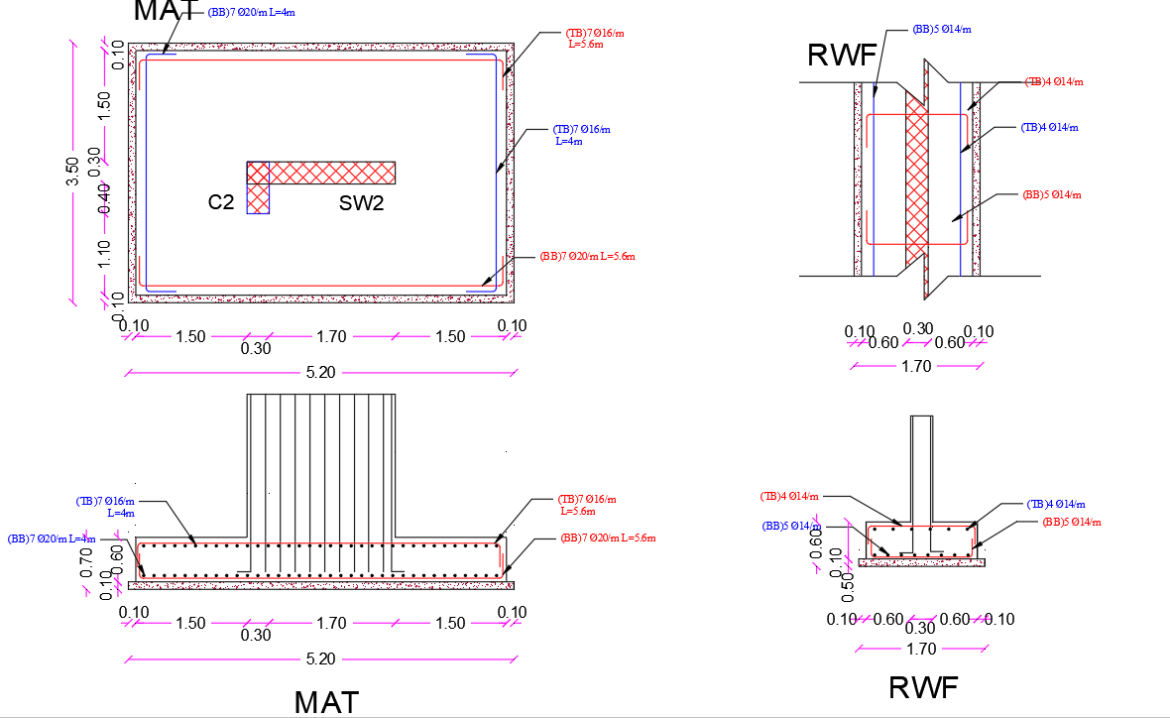
Footing Design

Slide 37
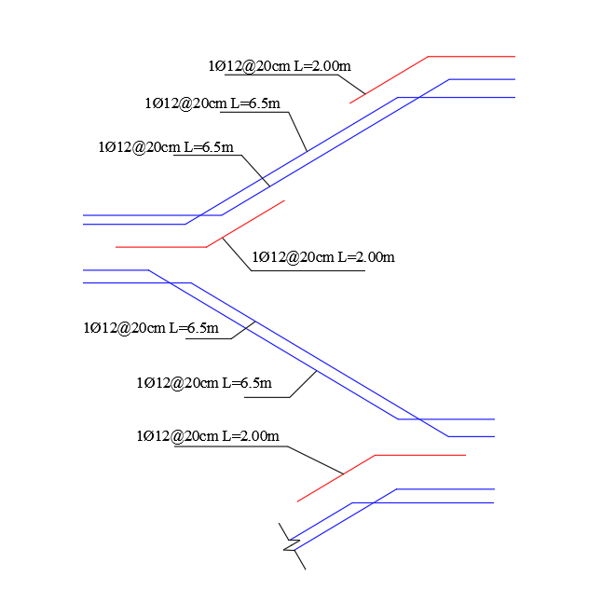
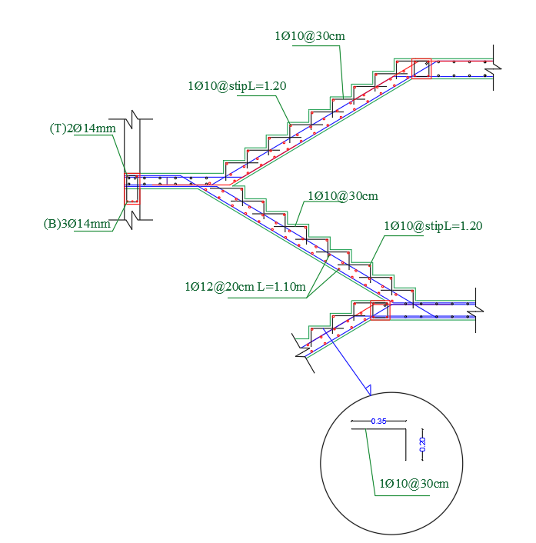
Stair
Design

Slide 38
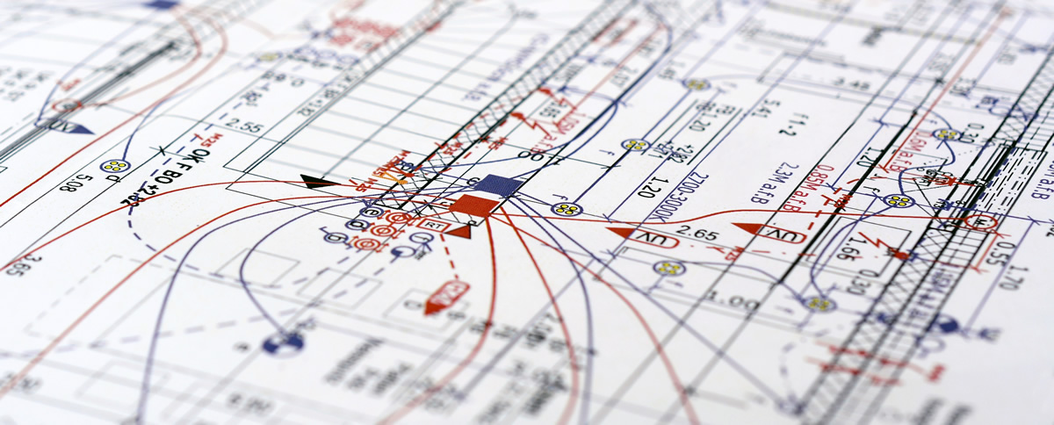
05: Electro-Mechanical Design

Slide 39
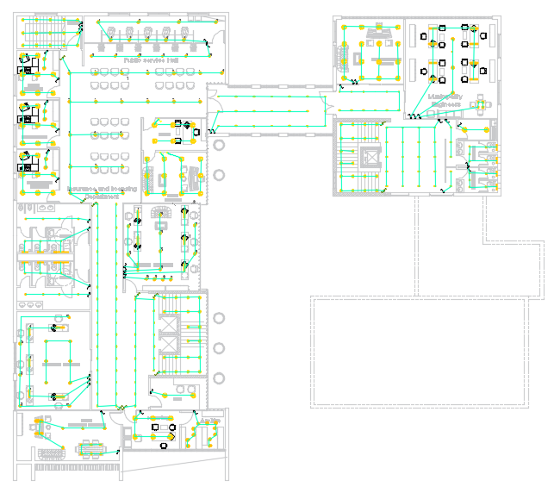
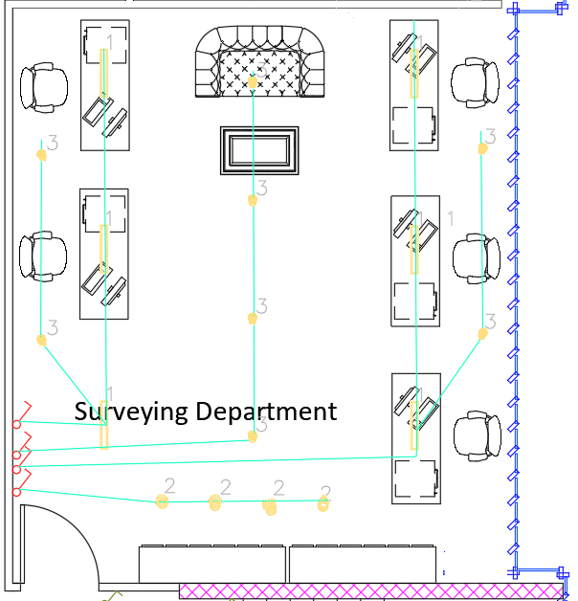
Lighting Design
Lighting for first floor plan

Slide 40
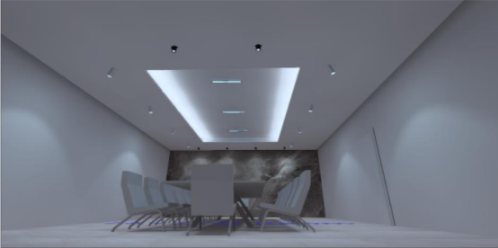
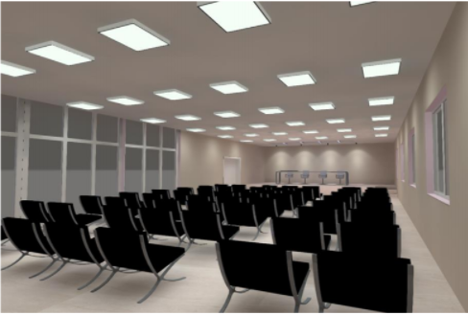
Lighting Design
Meeting Room & Auditoria

Slide 41
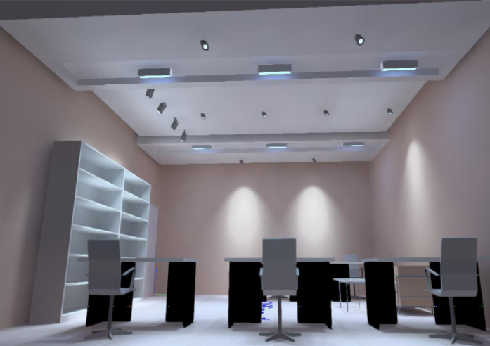
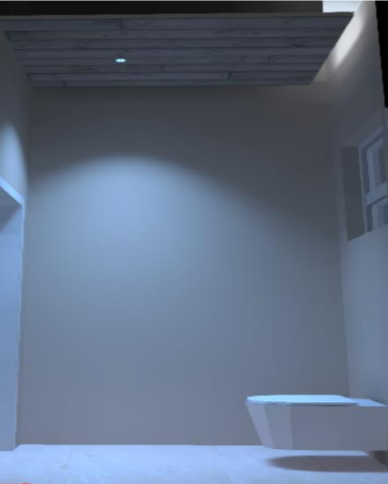
Lighting Design
Office & Bathroom

Slide 42
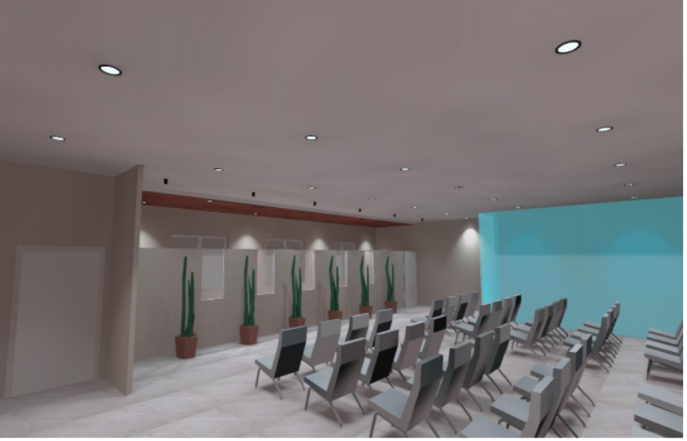
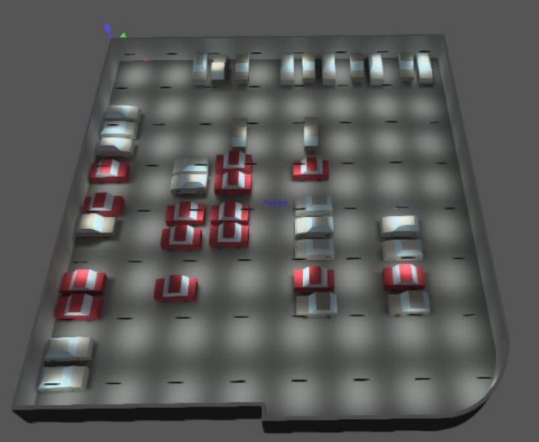
Lighting Design
Service Hall & Parking

Slide 43
Area | Recommended illuminance (Lux) | Design illuminance (lux)
Auditoria | 500 | 511
Meeting Room | 500 | 514
Office | 500 | 520
Bathroom | 200 | 217
Parking | 75 | 75.1
Area | Standard | Simulation Result
Auditoria | ≤19 | 18.2
Meeting Room | ≤19 | 18.1
Office | ≤19 | 13.2
Bathroom | ≤10 | 10
Area | Standard | Simulation Result
Auditoria | 0.33 | 0.2
Meeting Room | 0.6 | 0.4
Bathroom | 0.4 | 0.4
Service Hall Lighting | 0.3 | 0.1
Lighting Design
Illuminance, Glare & Uniformity

Slide 44
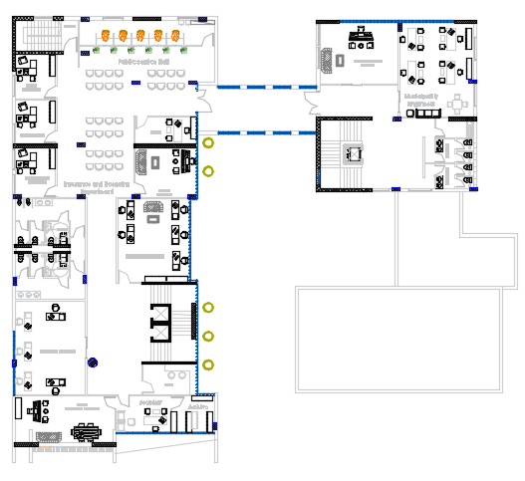
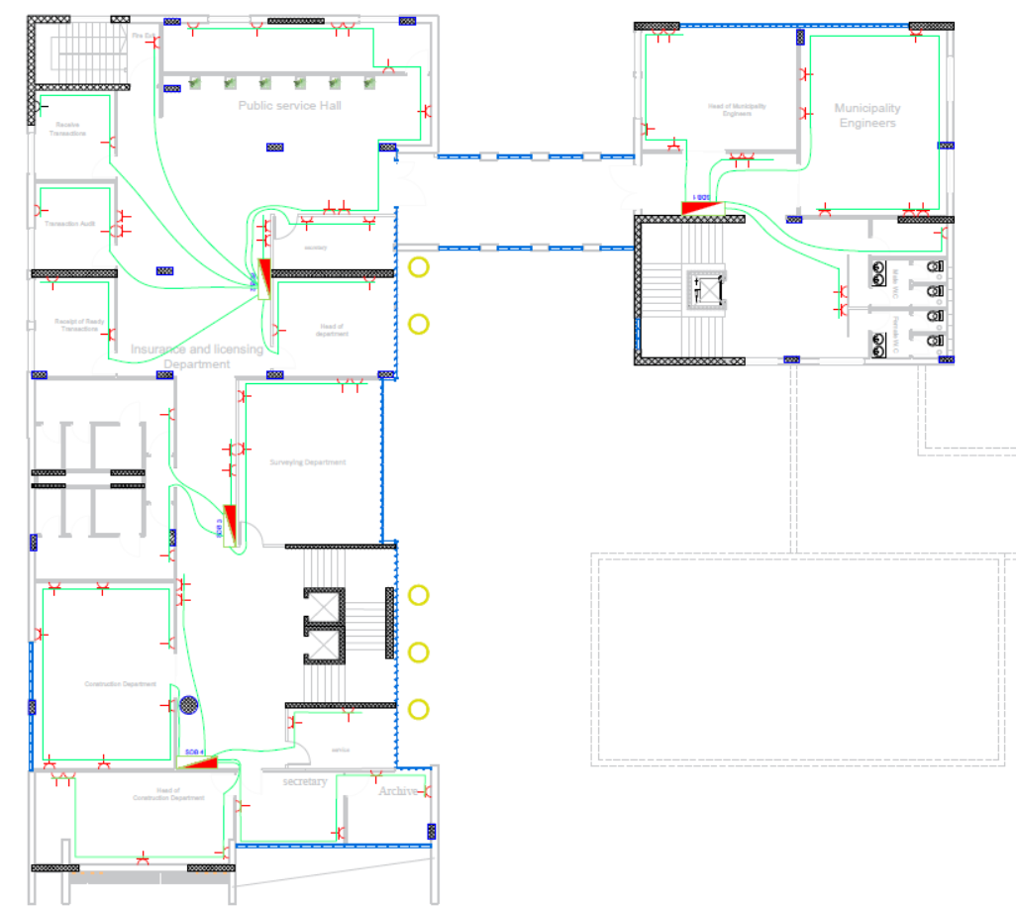
Power for first floor plan

Slide 45
Water supply system
Total water consumption for building is: 8.208 m3.
Fixture unit
Fourth floor | Third floor | Second floor | First floor | Ground floor | floor
53 | 53 | 53 | 53 | 53 | Zone 1
- | 28 | 28 | 28 | 28 | Zone 2
53 | 81 | 81 | 81 | 81
Total Fu in building = 377

Slide 46
Water supply system
Total losses zone 1
 | G.F |  | 1st.F |  | 2nd.F |  | 3rd.F |  | 4th.F
Pipe | Dim (inch) | Pressure loss (psi) | Dim (inch) | Pressure loss (psi) | Dim (inch) | Pressure loss (psi) | Dim (inch) | Pressure loss (psi) | Dim (inch) | Pressure loss (psi)
Vertical | 1.5 | 6.27 | 1.5 | 6.27 | 1.5 | 6.27 | 1.5 | 6.27 | 1.5 | 6.27
Horizontal | 1 | 1.02 | 1 | 1.02 | 1 | 1.02 | 1 | 1.02 | 1 | 1.02
Branch | 0.75 | 3.2 | 0.75 | 3.2 | 0.75 | 3.2 | 0.75 | 3.2 | 0.75 | 3.2
Total losses (psi) | 10.49 |  | 10.49 |  | 10.49 |  | 10.49 |  | 10.49

Slide 47
Water supply system
Total losses zone 2
 | G.F |  | 1st.F |  | 2nd.F |  | 3rd.F |  | 4th.F
Pipe | Dim (inch) | Pressure loss (psi) | Dim (inch) | Pressure loss (psi) | Dim (inch) | Pressure loss (psi) | Dim (inch) | Pressure loss (psi) | Dim (inch) | Pressure loss (psi)
Vertical | 1.5 | 2.74 | 1.5 | 2.74 | 1.5 | 2.74 | 1.5 | 2.74 | 1.5 | 2.74
Horizontal | 1 | 2.91 | 1 | 2.91 | 1 | 2.91 | 1 | 2.91 | 1 | 2.91
Branch | 0.75 | 1.34 | 0.75 | 1.34 | 0.75 | 1.34 | 0.75 | 1.34 | 0.75 | 1.34
Total losses (psi) | 6.99 |  | 6.99 |  | 6.99 |  | 6.99 |  | 6.99

Slide 48
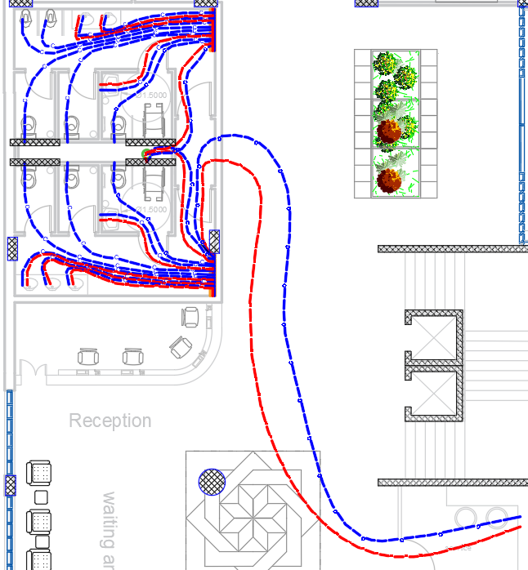
Water supply system For Zone1

Slide 49
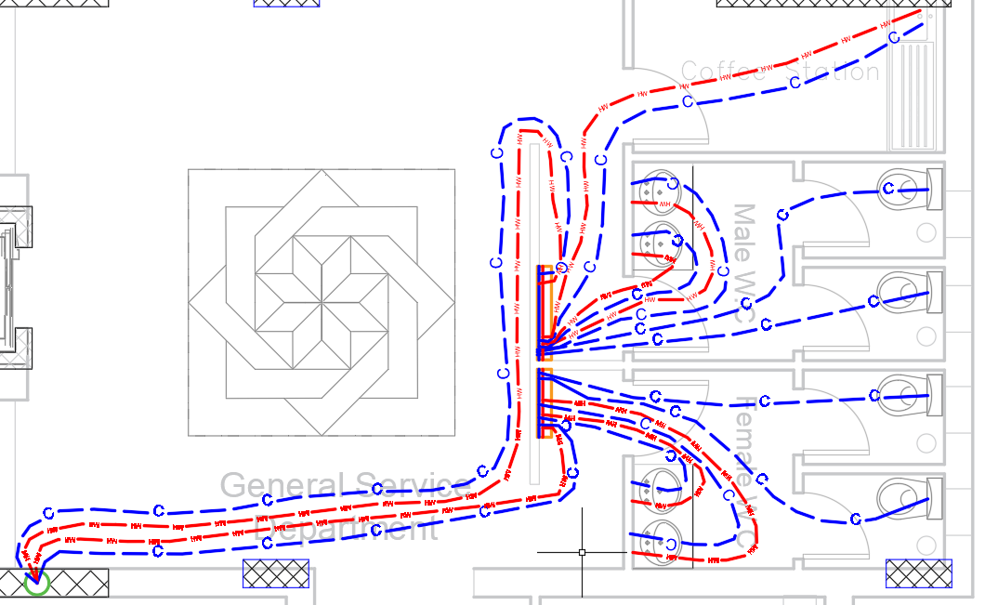
Water supply system For Zone2

Slide 50
Drainage system
Drainage system diameters
Type of Pipe | Slope | Diameter | Pipe
PVC | Vertical | 4” | Vent
PVC | 1 % | 4” | Drainage
PVC | Vertical | 4” | Stack
PVC | 2 % | 2” | Sewer
PVC | 1 % | 6” | Drainage between manholes

Slide 51
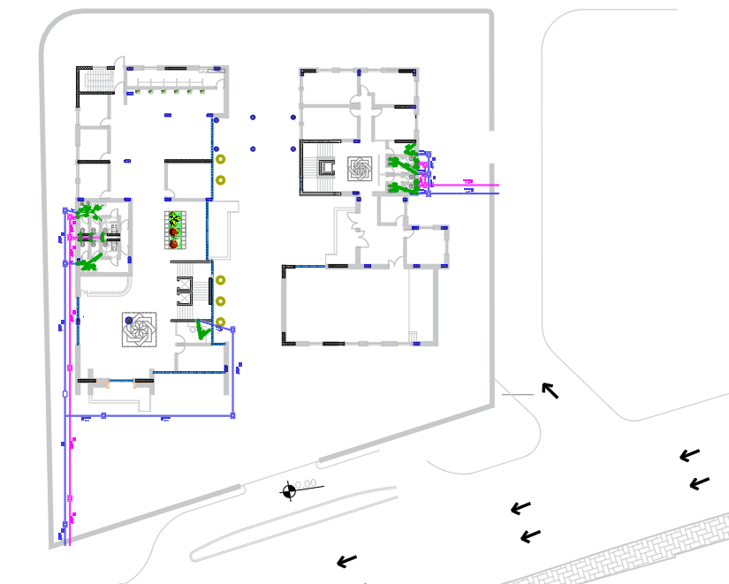
Manholes plan

Slide 52

Manholes plan

Slide 53


Rain water plan

Slide 54



The firefighting systems that we used
sprinkler suppression system
fire extinguisher(CO2)
Hose station (auxiliary system)

Slide 55


Firefighting systems

Slide 56
HVAC Design
Total cooling capacity is 259 kW
Total Heating capacity is 135 kW
System used is VRF(variable refrigerant flow)

Slide 57





HVAC Design
Units Used
Diffuser
Outdoor Unit
Fan coil Unit
Exhausting Unit
Split unit

Slide 58

HVAC Design (VRF)
3rd floor plan

Slide 59
Elevators System Design
Required number of elevators = 4 elevators
Car capacity = 3500 lb. (19 person)
Car speed = 400 fpm (2m/min)

Slide 60
06: Quantity Surveying
Group | Total cost (NIS) | Unit cost (NIS/m2)
Structure | 14857198 | 1600
Finishing | 1125397 | 125
Mechanical | 632775 | 70
Electrical | 715867 | 80
Total | 17331237 | 1875

Slide 61

Thank You for Listening

