Slide 1

.
Smart Glass Window
An-Najah National University
Telecommunications Engineering Department
Submitted by:
Eng. Amr Ishtyeh
Eng. Rafah Nairat
Eng. Yousef Shmlawi
Supervisor:
Dr. Haneen Al-Autt

Slide 2
Outlines:
Abstract
Block Diagram
Goal
Procedures
Simulation and application
Hardware components and devices
Conclusion
Future research

Slide 3
Abstract
This project aims to develop a Smart Glass Window system, a first for the university. The system will use Arduino IDE software to create a window that can adjust its transparency automatically based on weather conditions, with minimal human intervention.

Slide 4
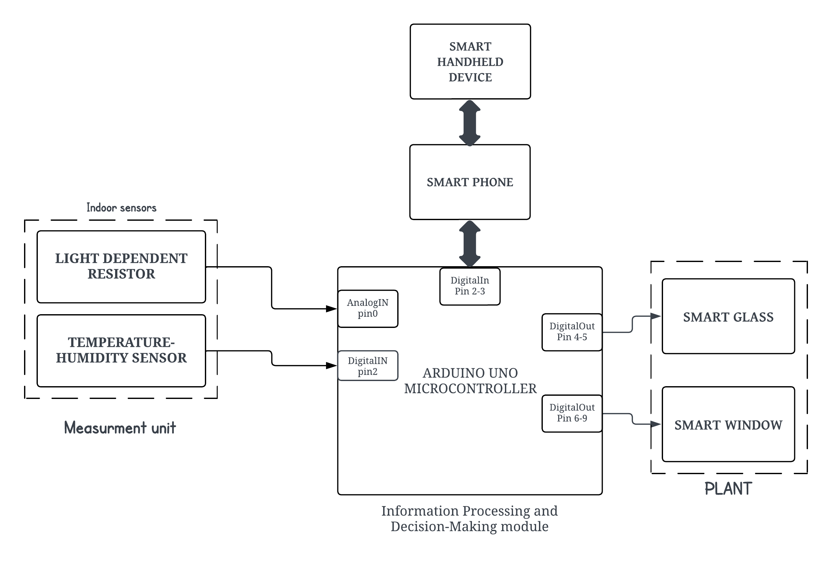
Block Diagram

Slide 5
Goal
Our aim is to implement the system of Smart Glass in real life, and to accomplish the wanted goals
To use Arduino IDE software to build an intelligent Smart Glass Window capable of choosing different transparency degrees.

Slide 6
Procedures
Install ambient light and temperature sensors.
Connect sensors to an Arduino Uno microcontroller.
Integrate the microcontroller with the PDLC module.

Slide 7
Simulation and application.
Simulation was used to predict the behavior of smart glass in the face of environmental factors such as Light and Heat to Analyze how the transparency of glass changes in response to changes in light intensity and temperature.

Slide 8
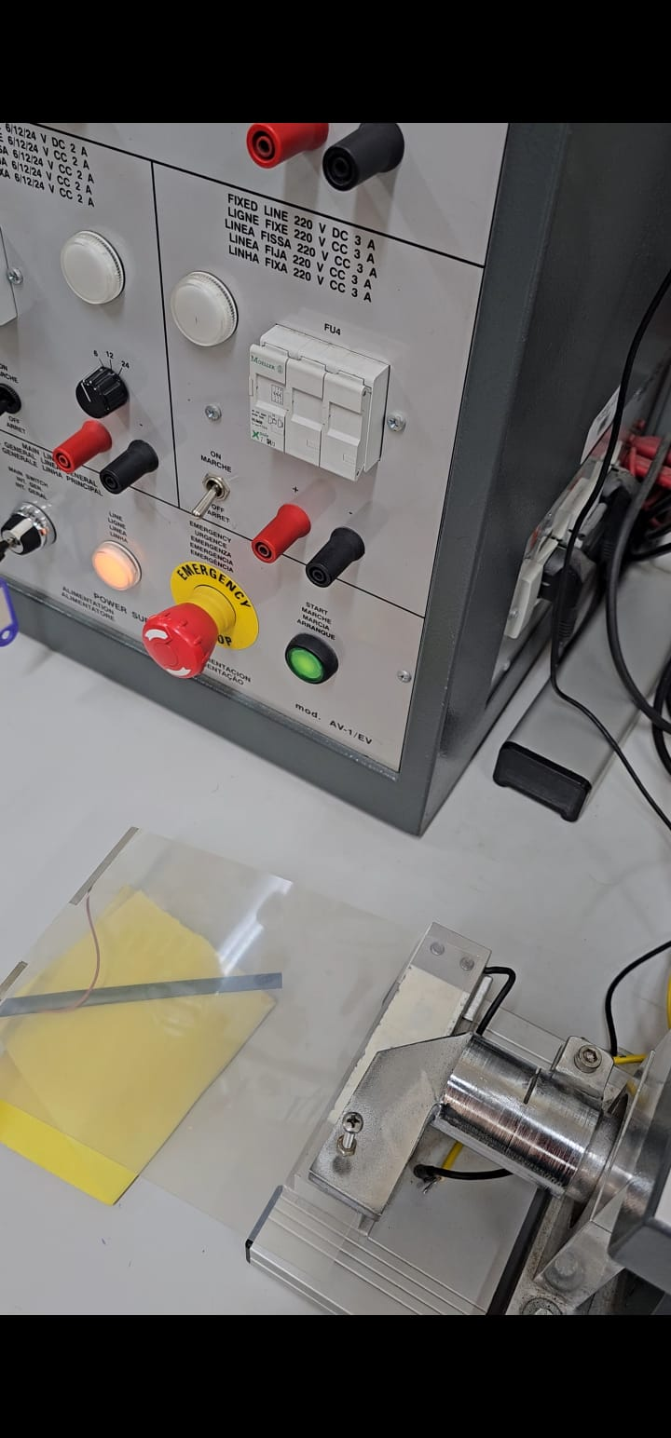
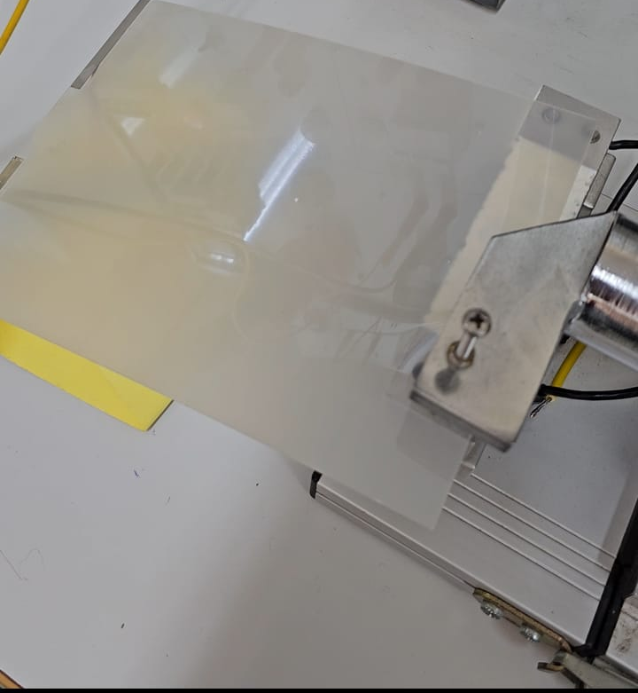
Based on these results, it proved that the PDLC can indeed change transparency based on input sensor data.

Slide 9
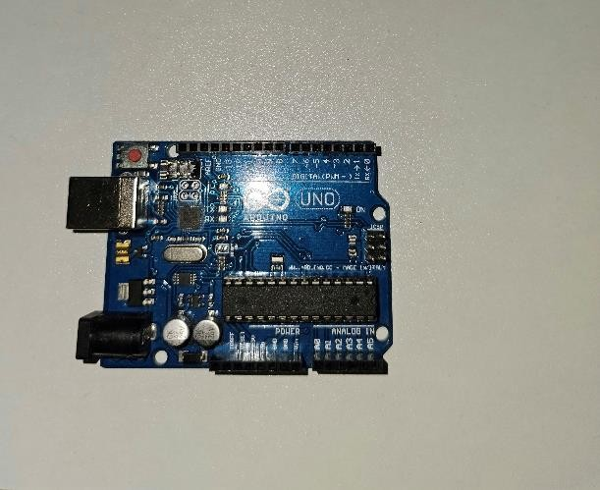
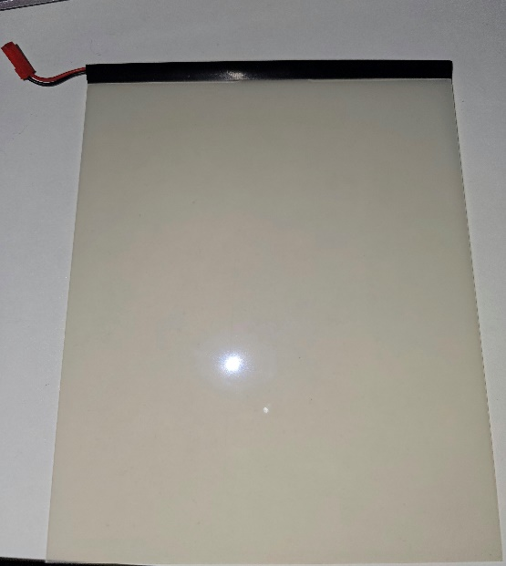
Hardware components and devices
Arduino UNO R3 Microcontroller
      PDLC module

Slide 10
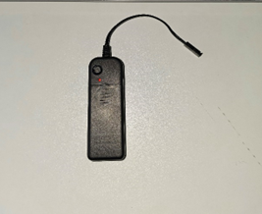
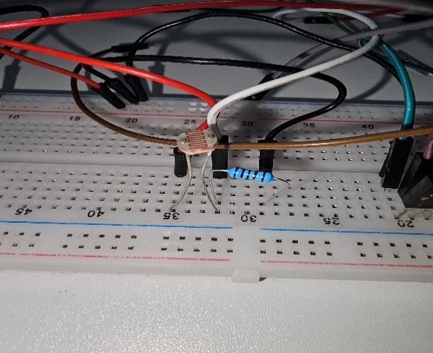
Hardware components Cont.
PDLC Driver
Light Dependent Resistor (LDR)

Slide 11
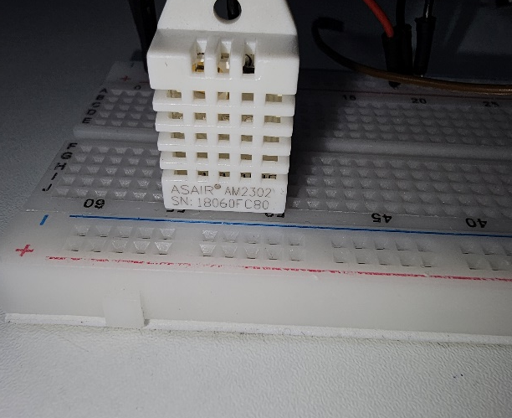
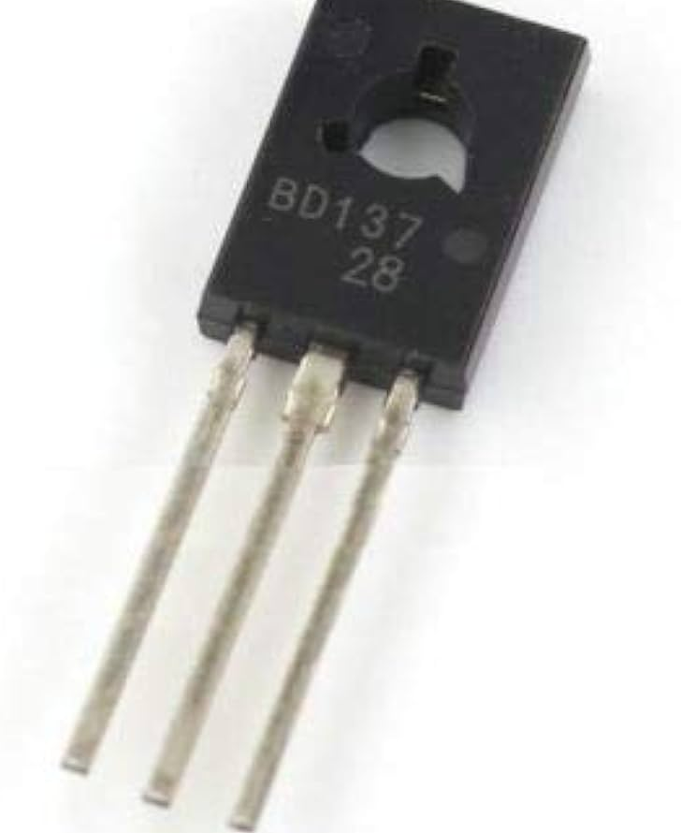
Hardware components Cont.
DHT Sensor
Transistor BD137

Slide 12
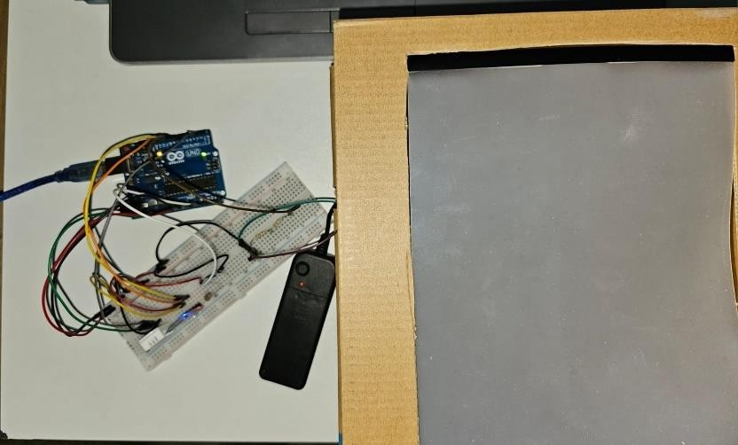
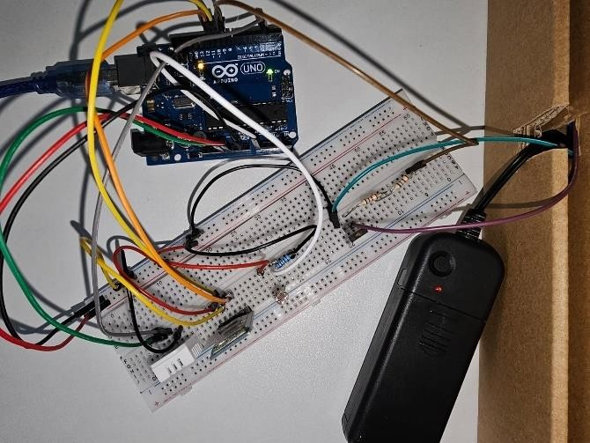
Hardware device

Slide 13
Hardware implementation result
Economical feasibility
Components | Quantity | Cost
Arduino Uno R3 | 1 | 45
PDLC Module | 1 | 180
LDR | 1 | 10
DHT | 1 | 25
Wires | 10 | 10
Total |  | 270

Slide 14
Conclusion.
The project successfully demonstrated adjustable transparency based on environmental conditions.
Advantages and disadvantages
advantage | disadvantage
Adaptable and energy efficiencent | Not very accurate
It is not very difficult to implement such project on a microcontroller | The need of AC voltage and high frequency.
Versatile applications in modern architecture | Cost
Capable of converting different glass types into switchable glass

Slide 15
Future research.
We can increase accuracy and add more sensors to the application.
Artificial Intelligence: Using artificial intelligence to improve smart glass performance by learning from every day patterns
Electronics integration: Integration between smart glass and energy systems to provide more sustainable solutions.
Wireless control of the circuit through WI-FI or Bluetooth.

Slide 16


