Slide 1

Numerical Investigation of Innovative Mechanisms for Heat Transfer Enhancement in Gas Turbines
An-Najah National University
Faculty of Engineering & Information Technology
Students:
Abdalsalam Jabali
Yosef Shanti
Supervised by:
Eng. Luqman Herzallah

Slide 2
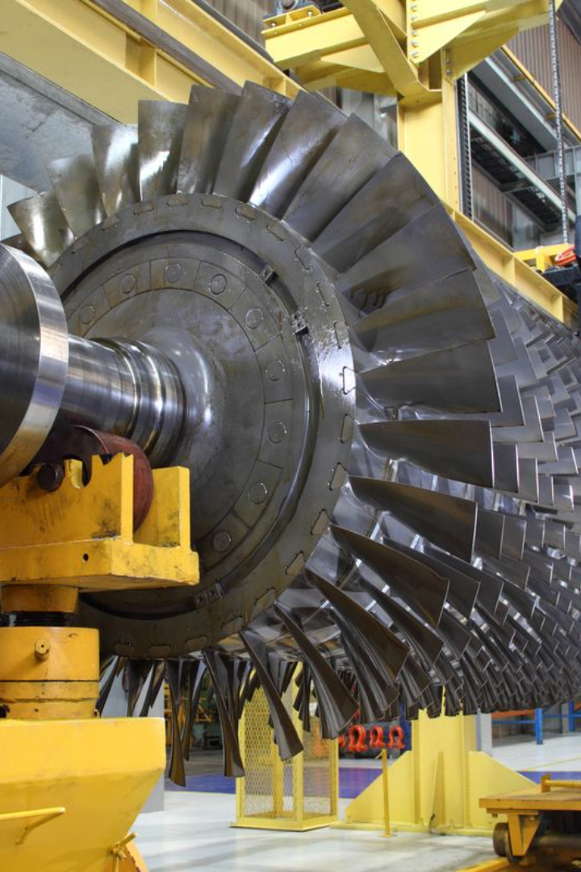
Numerical Investigation of Innovative Mechanisms for Heat Transfer Enhancement in Gas Turbines

Slide 3

Outline
1
Introduction
5
Results
2
Objectives
6
Conclusion and future work
3
Literature review
4
Methodology

Slide 4
Introduction
1
2
Heat Transfer Enhancement
Gas Turbines
Power generation, aviation.
Operate under extreme conditions.
Overheating is a serious problem.
Solution → Efficient cooling.
Objective → Explore innovative mechanisms for heat transfer improvement.
Challenges in traditional cooling mechanisms.
Motivation → Improved efficiency, reduced emissions, and increased turbine lifespan.

Slide 5
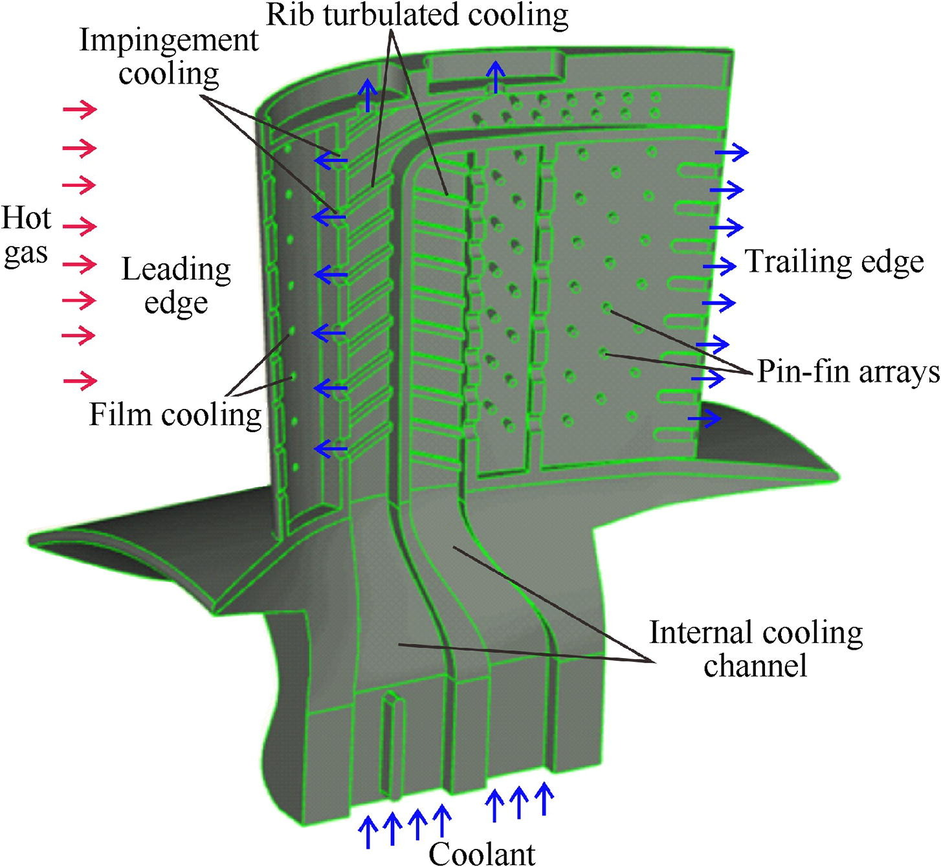

Slide 6
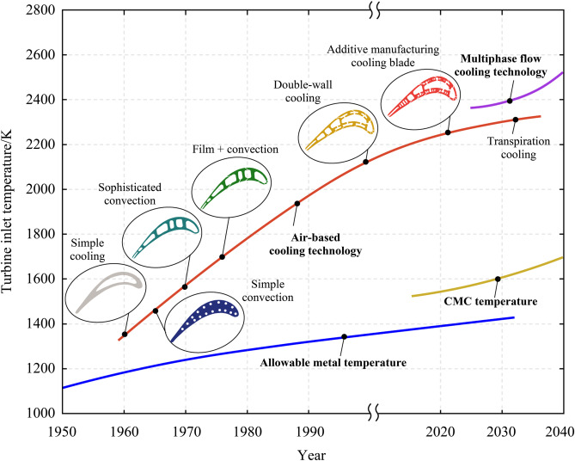

Slide 7

Objectives
1
Project Objectives
Explore innovative cooling techniques for gas turbine blades.
Numerical simulations for cooling mechanisms→ ANSYS and SolidWorks.
Address issues related to turbine blade overheating and degradation.

Slide 8
Literature review
Overview
Managing heat leads to ensuring smooth functionality in gas turbine systems.
innovative approaches, including film cooling, impingement cooling.
exploring cooling mechanisms and optimal cooling strategies for gas turbine blades.
Highlighting recent advancements in cooling techniques.
balance between cooling efficiency and aerodynamic performance.

Slide 9
Methodology
Computational Model and Geometry
Mesh Generation
Boundary Conditions
Turbulence Model

Slide 10
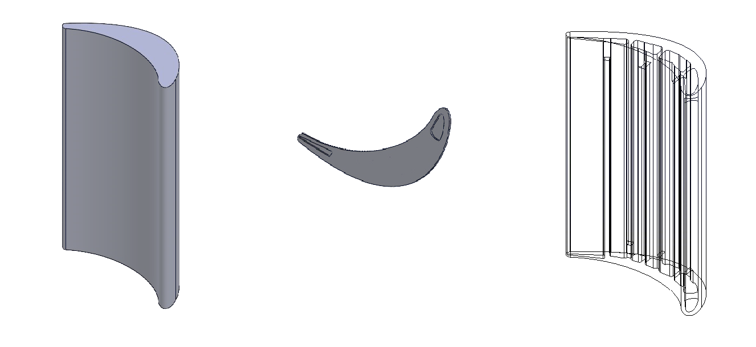
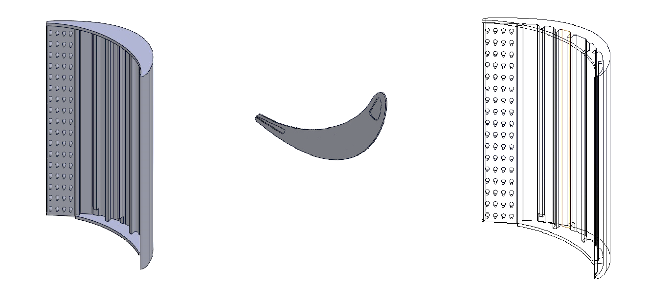

Slide 11
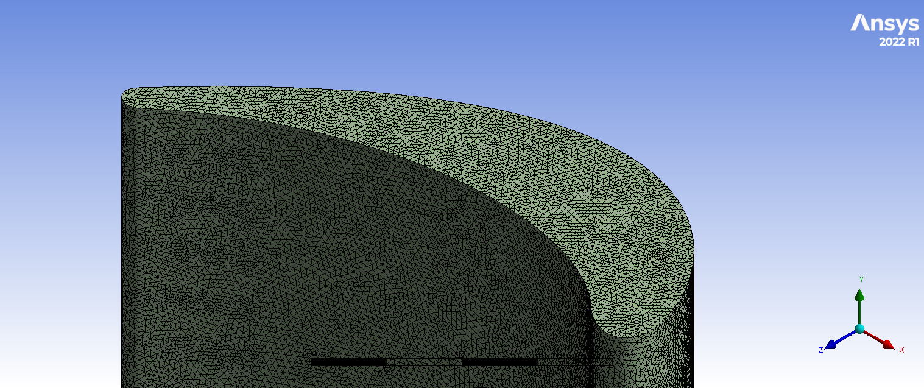
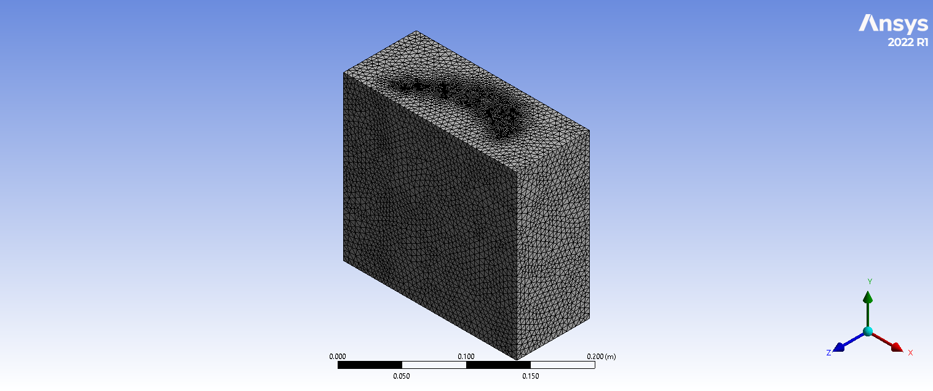
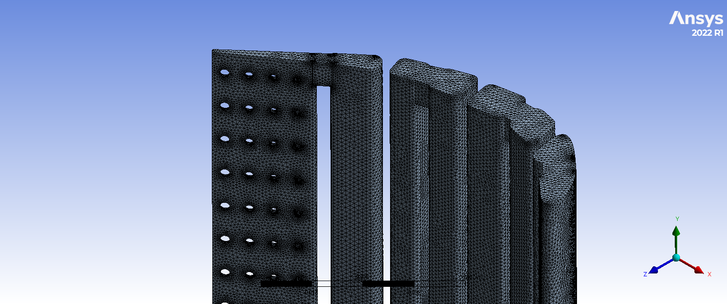

Slide 12
Domain | Boundary | Parameter | Value
Gas Domain | Inlet | Velocity | 260 m/s
 |  | Temperature | 1600°K
 | Outlet | Pressure | 179264 Pa
Coolant Domain | Inlet | Velocity | 110 m/s
 |  | Temperature | 400°K
 | Outlet | Pressure | 101325 Pa

Slide 13
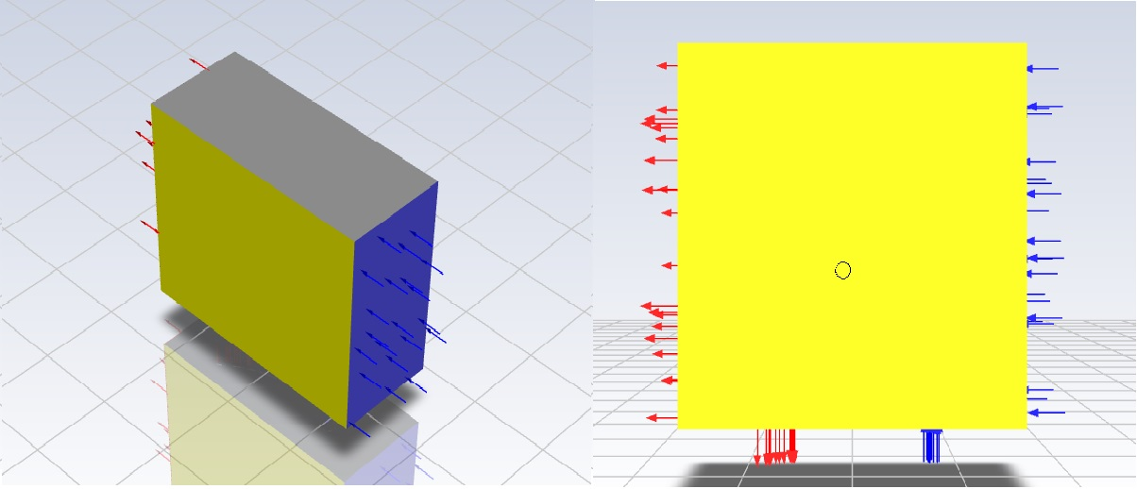

Slide 14
Turbulence Model
k-ω Shear-Stress Transport (SST) model
Importance of modeling near-wall and free-stream turbulence

Slide 15
Results and conclusions
Flow characteristics around conical pins
Velocity distribution
Temperature distribution

Slide 16
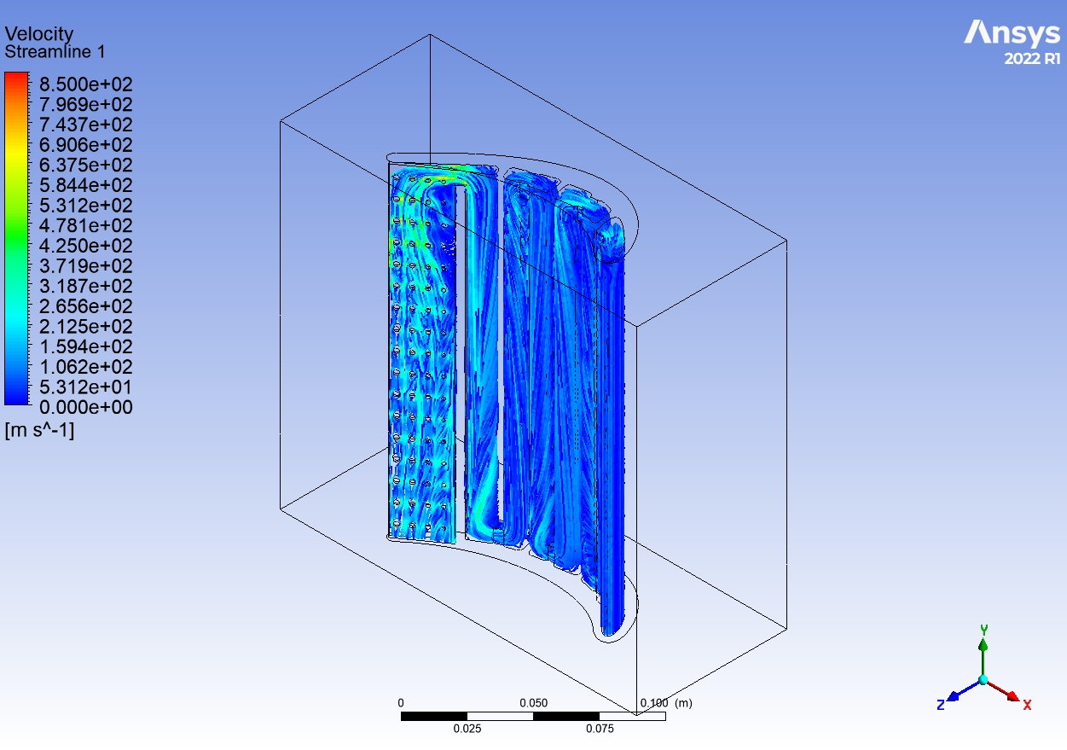

Slide 17
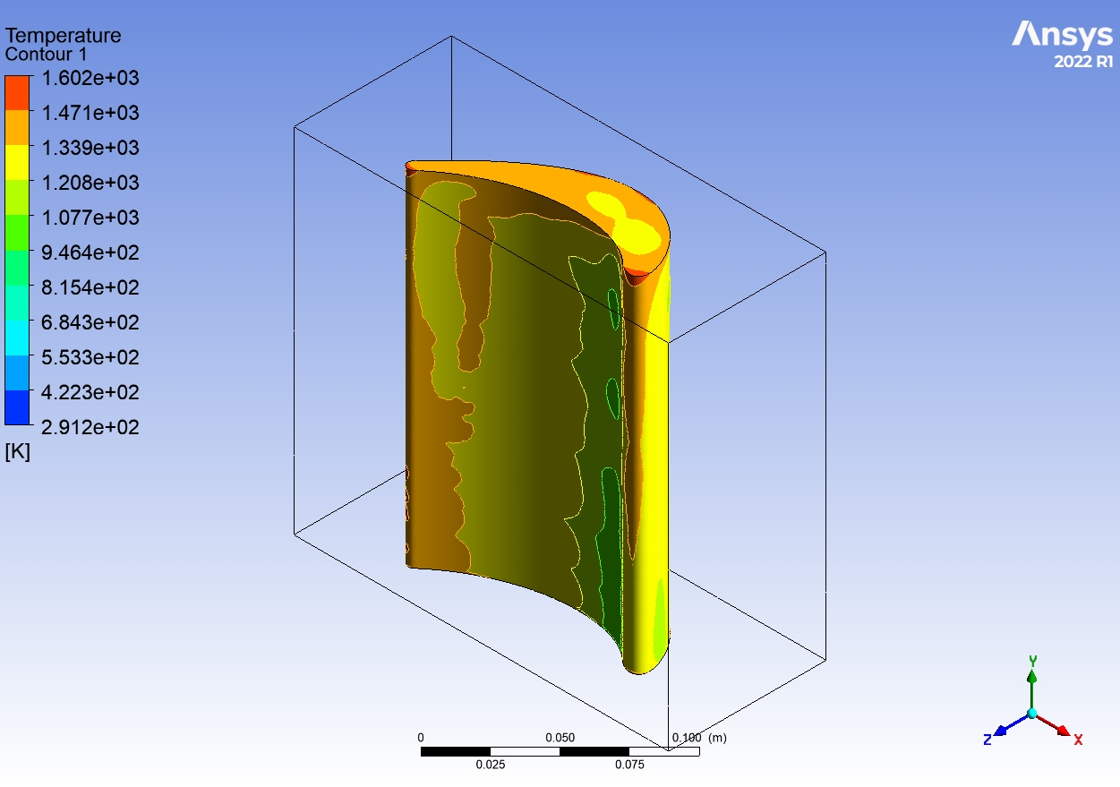

Slide 18
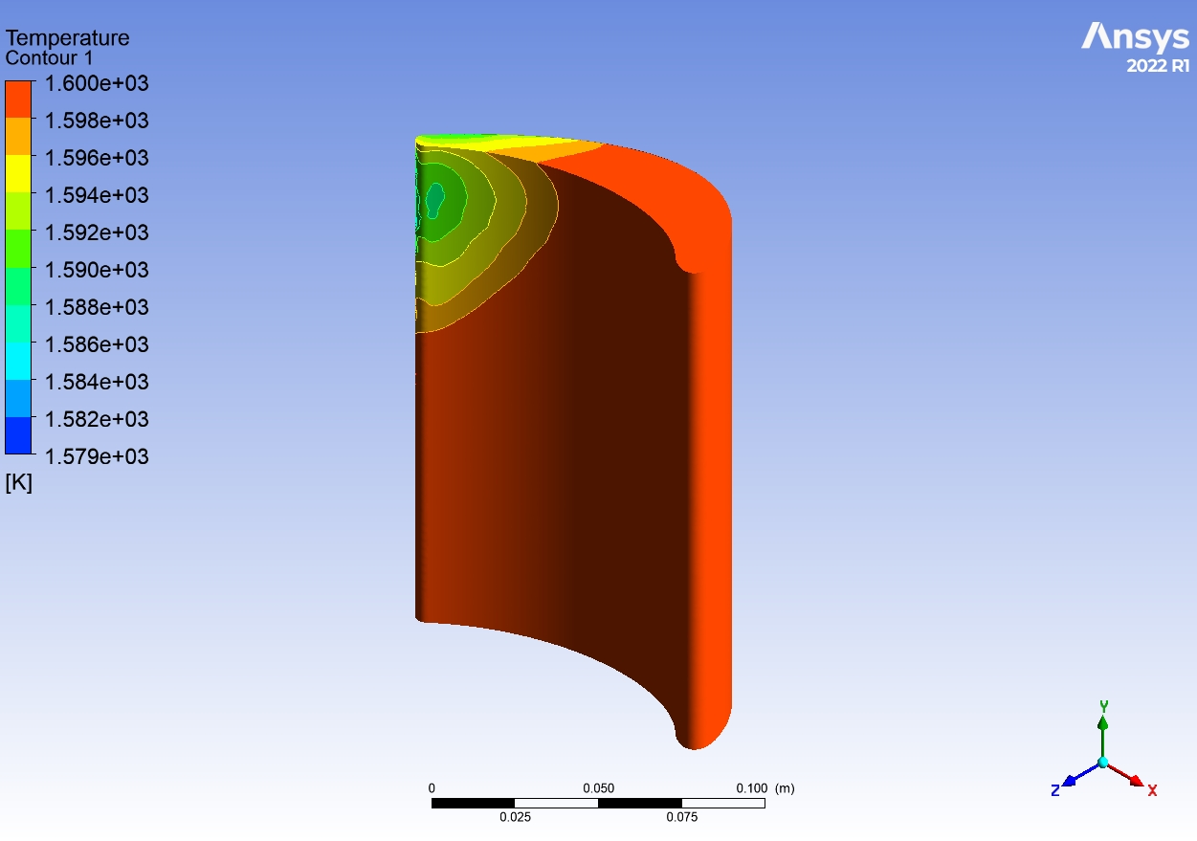

Slide 19
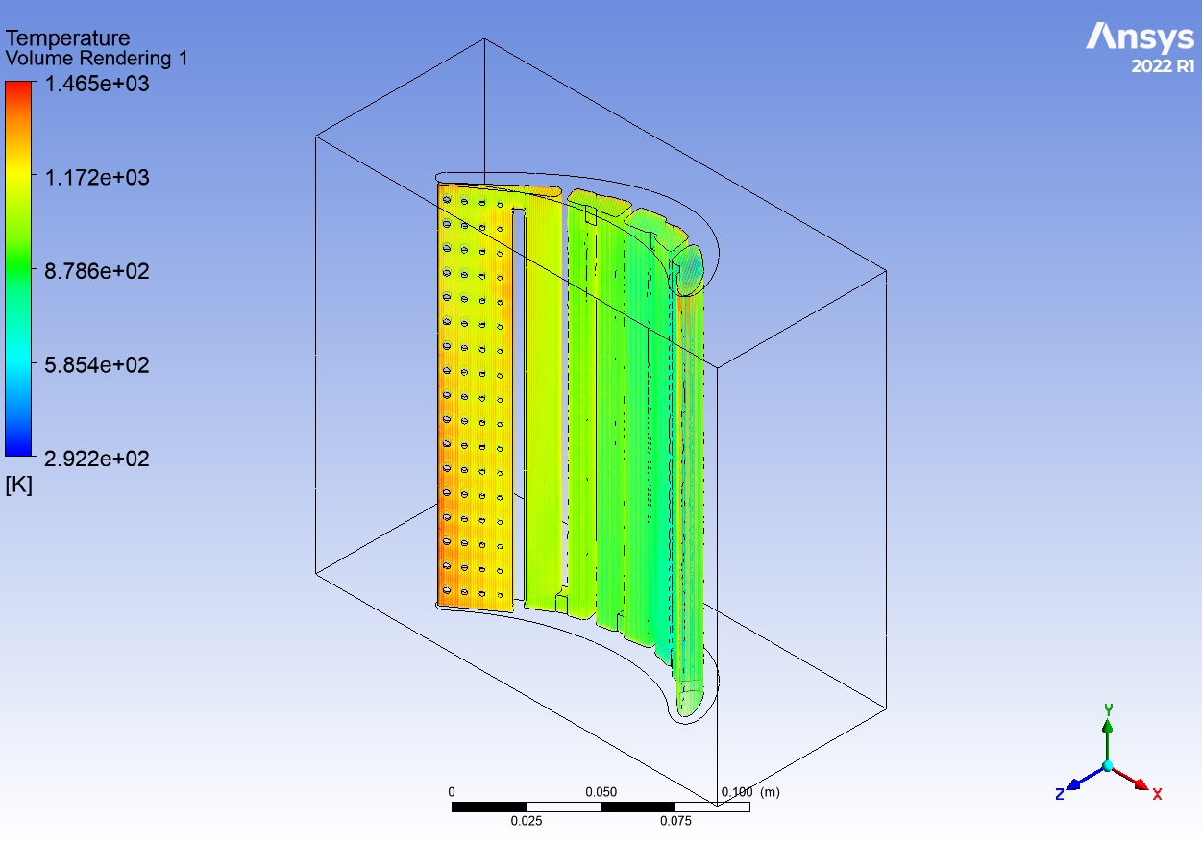

Slide 20
Conclusion and Future Work
Effectiveness of conical pin arrangement
Foundation for future research and more investigations
limitations and gaps: Oversight of practical implementation challenges.
Future research goals: Address limitations. Additional studies on blade without cooling techniques, integration of localized turbulence promoters and enhanced computational setups.

