Slide 1

Biodiesel production from
used cooking oil
Faculty of Engineering
Mechanical Engineering Department
GRADUATION PROJECT II
2018/2019
Presented by: Fihme S.Hantoli
Ahmad H.Ashqar
Maher K.Abdelkareem
Thesis Advisor:
Dr. Ihab H.Alsurakje
Committee members:
Dr. Ossaid Abdelfattah
Eng. Luqman herzallah

Slide 2
Outline
introduction and Background
Research Objectives
Methodology
Results
Literature Review
visibility study
Conclosion
1
2
3
4
5
6
7

Slide 3

Research Objectives

Slide 4


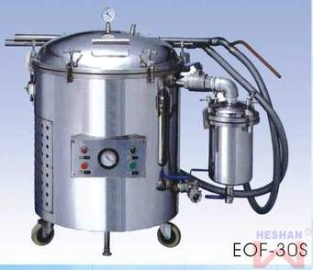
Research Objectives
Literature Review
Methodology
Result
Introduction
Visibility study
Conclusions
This project aims to
Reduce fossil fuel consumption
Recycling of used cooking oil
Manufacture of local machine
1/1

Slide 5

Introduction

Slide 6
Research Objectives
Literature Review
Methodology
Result
Introduction
Visibility study
Conclusions
What is biodiesel
Alternative fuel
Renewable resources
Reduce pollution
1/5
Biodiesel production from used cooking oil

Slide 7
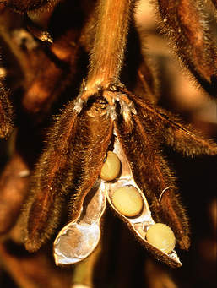
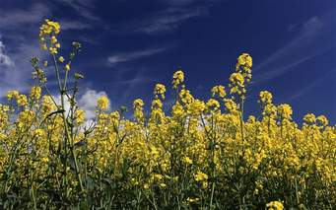




Source of biodiesel
Soybeans
rapeseed
palm
Animal fats
Sunflower
Used cooking oil
Research Objectives
Literature Review
Methodology
Result
Introduction
Visibility study
Conclusions
2/5
7
Biodiesel production from used cooking oil

Slide 8
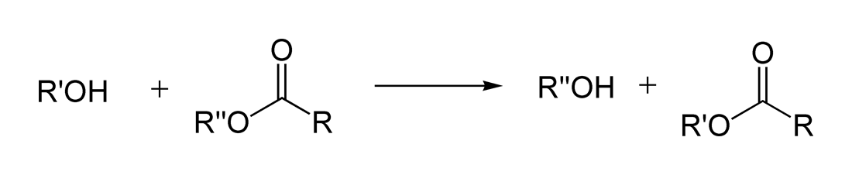
Research Objectives
Literature Review
Methodology
Result
Introduction
Visibility study
Conclusions
Transesterification
3/5
alcohol
organic group
catalyst
ester mixture
another alcohol (glycerol)
8
Biodiesel production from used cooking oil

Slide 9
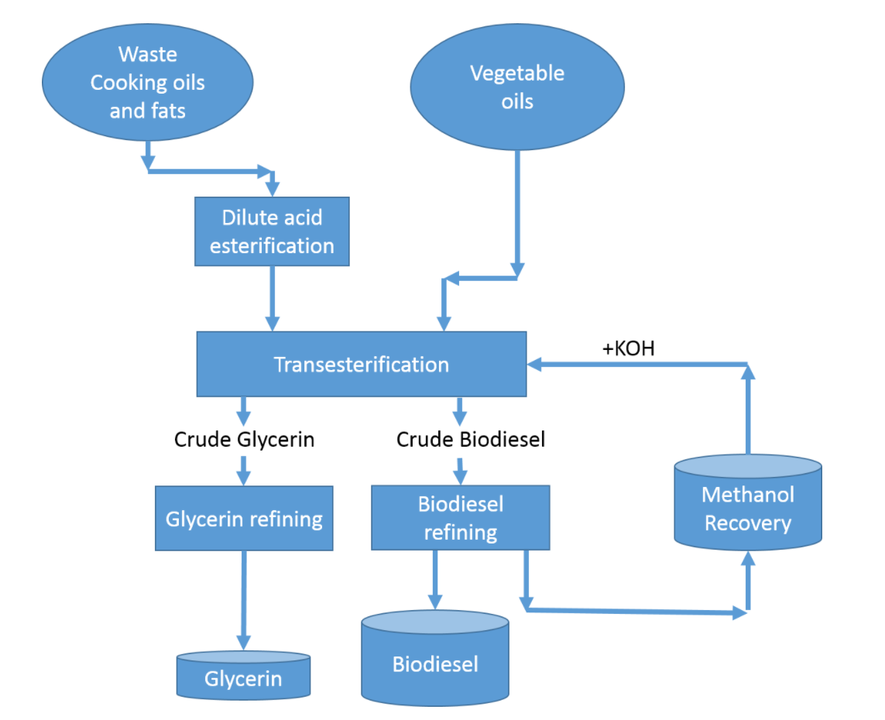
Research Objectives
Literature Review
Methodology
Result
Introduction
Visibility study
Conclusions
process of biodiesel production
8
Biodiesel production from used cooking oil

Slide 10
Research Objectives
Literature Review
Methodology
Result
Introduction
Visibility study
Conclusions
Biodiesel around the world
Biodiesel production
Biodiesel consumption
4/5
9
Biodiesel production from used cooking oil

Slide 11
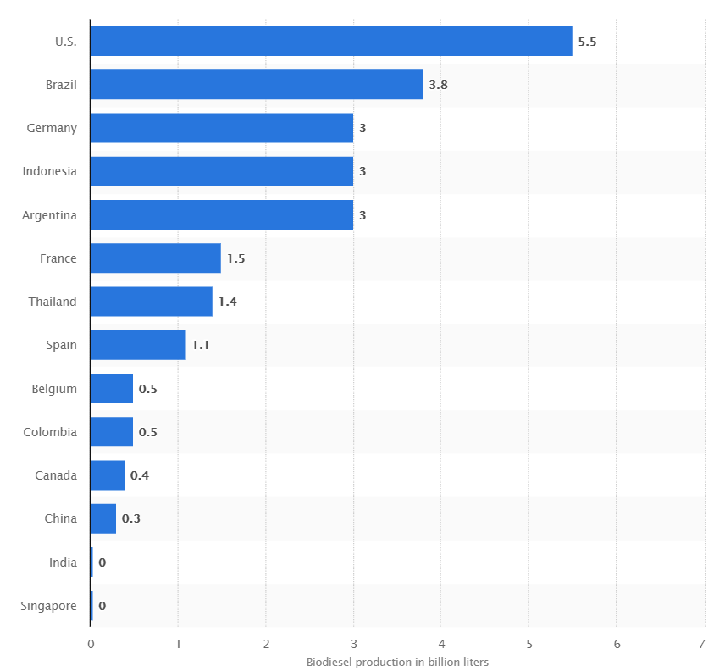

Slide 12
Research Objectives
Literature Review
Methodology
Result
Introduction
Visibility study
Conclusions
Biodiesel around the world
Biodiesel production
Biodiesel consumption
4/5
9
Biodiesel production from used cooking oil

Slide 13
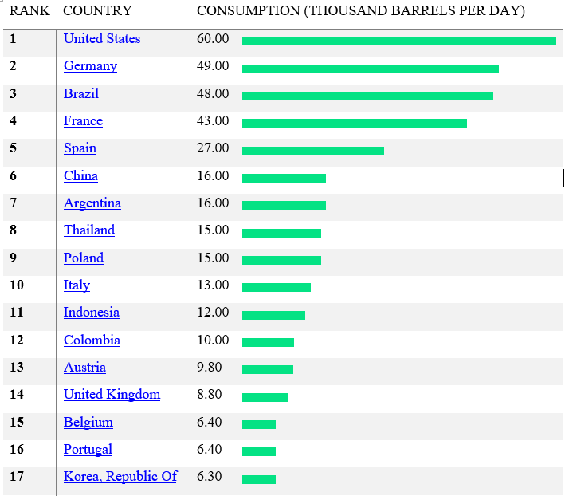

Slide 14
Research Objectives
Literature Review
Methodology
Result
Introduction
Visibility study
Conclusions
Why we need biodiesel ?
5/5
Performance and Economy
Emission
Easy of use
11
Biodiesel production from used cooking oil

Slide 15

Literature Review

Slide 16
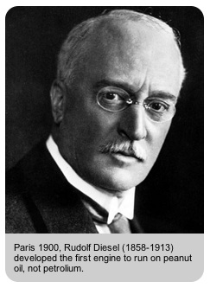
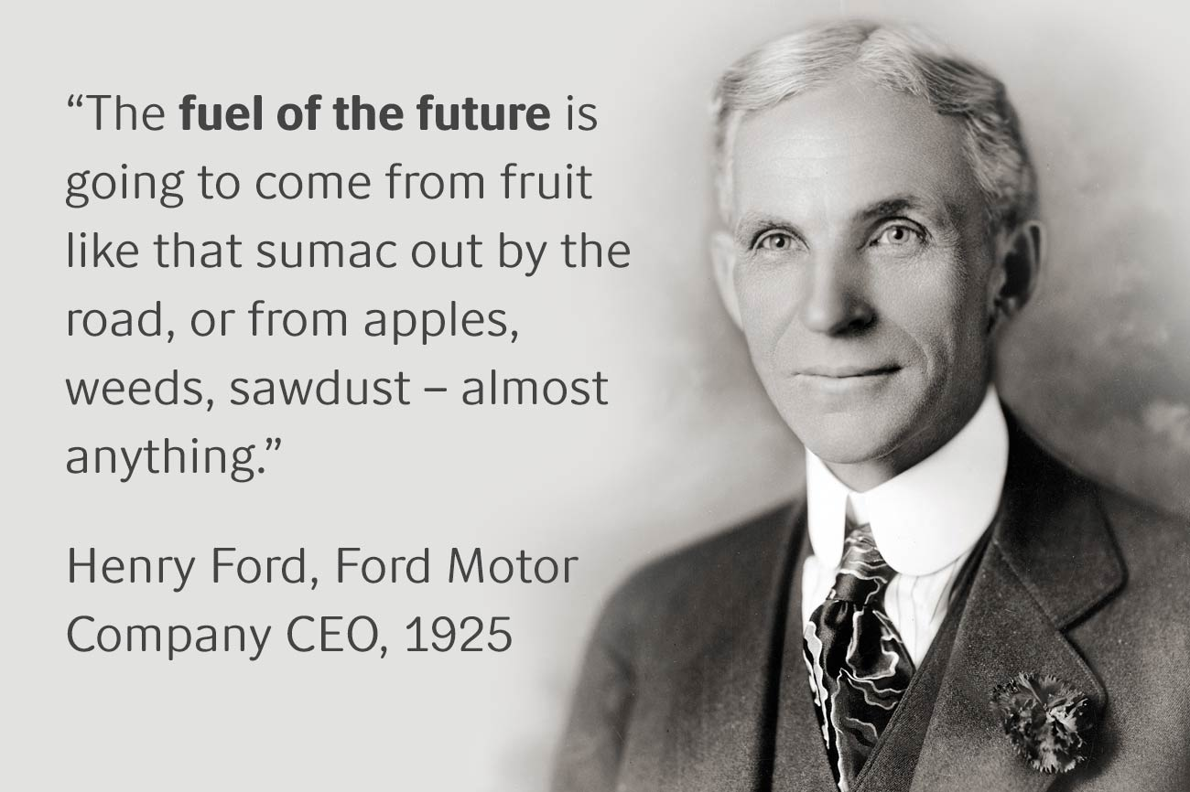
Research Objectives
Literature Review
Methodology
Result
Introduction
Visibility study
Conclusions
history
1/7

Slide 17
Research Objectives
Literature Review
Methodology
Result
Introduction
Visibility study
Conclusions
Blending
2/7
High level
Low level
B100
B5
17

Slide 18
Research Objectives
Literature Review
Methodology
Result
Introduction
Visibility study
Conclusions
Catalyst
Sulfuric acid ($H_{2}SO_{4})$
Sulfuric acid (𝐻_2 𝑆𝑂_4)
Potasium hydroxide ($KOH)$
Potasium hydroxide (𝐾𝑂𝐻)
5/7
18

Slide 19
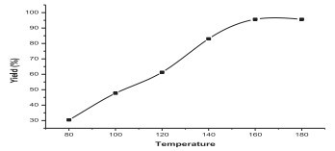
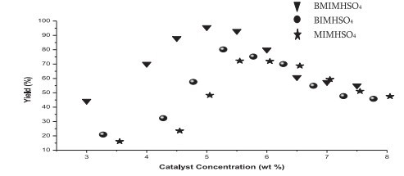
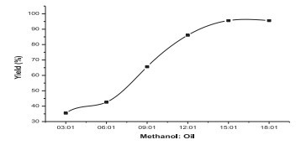
Research Objectives
Literature Review
Methodology
Result
Introduction
Visibility study
Conclusions
Parameters effect on ($H_{2}SO_{4})$
Parameters effect on (𝑯_𝟐 𝑺𝑶_𝟒)
Temperature
Catalyst concentration
Molar ratio
5/7
19

Slide 21
Research Objectives
Literature Review
Methodology
Result
Introduction
Visibility study
Conclusions
Parameters effect on ($H_{2}SO_{4})$
Parameters effect on (𝑯_𝟐 𝑺𝑶_𝟒)
Temperature
Catalyst concentration
Molar ratio
5/7
21

Slide 23
Research Objectives
Literature Review
Methodology
Result
Introduction
Visibility study
Conclusions
Parameters effect on ($H_{2}SO_{4})$
Parameters effect on (𝑯_𝟐 𝑺𝑶_𝟒)
Temperature
Catalyst concentration
Molar ratio
5/7
23

Slide 25
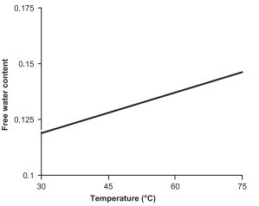
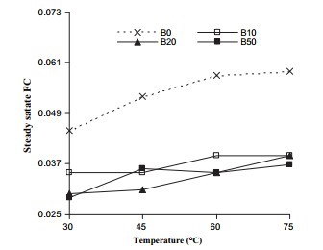
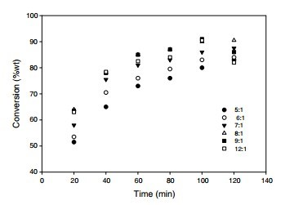
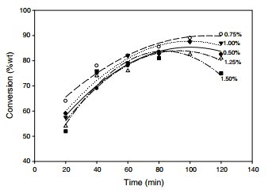
Research Objectives
Literature Review
Methodology
Result
Introduction
Visibility study
Conclusions
Parameters effect on ($KOH)$
Parameters effect on (𝑲𝑶𝑯)
Temperature
Catalyst concentration and time
Molar ratio
6/7
25

Slide 27
Research Objectives
Literature Review
Methodology
Result
Introduction
Visibility study
Conclusions
Parameters effect on ($KOH)$
Parameters effect on (𝑲𝑶𝑯)
Temperature
Catalyst concentration and time
Molar ratio
6/7
27

Slide 29
Research Objectives
Literature Review
Methodology
Result
Introduction
Visibility study
Conclusions
Parameters effect on ($KOH)$
Parameters effect on (𝑲𝑶𝑯)
Temperature
Catalyst concentration and time
Molar ratio
6/7
29

Slide 31
Research Objectives
Literature Review
Methodology
Result
Introduction
Visibility study
Conclusions
Parameters effect on ($KOH)$
Parameters effect on (𝑲𝑶𝑯)
Temperature
Catalyst concentration and time
Molar ratio
6/7
31

Slide 33
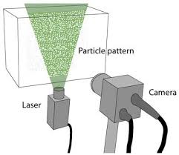
Methodology
Notes:
Visual observations showed that the polymer affected the flow within a few pipe diameters from the injection point. Thus, it was assumed that the polymer is well mixed with the water phase at the location where the recordings were taken

Slide 34
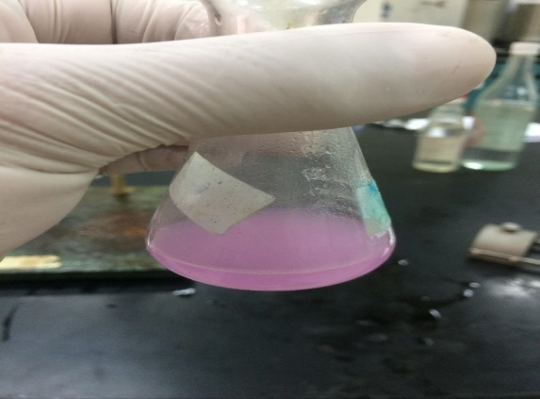
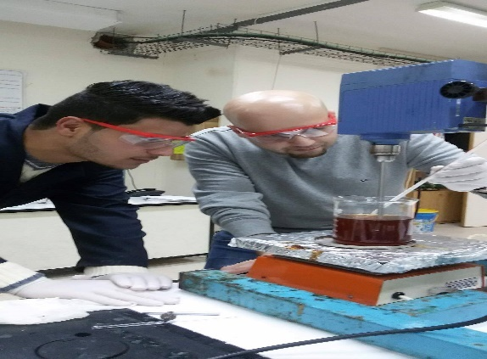
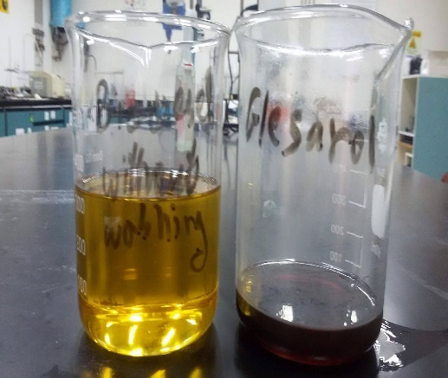
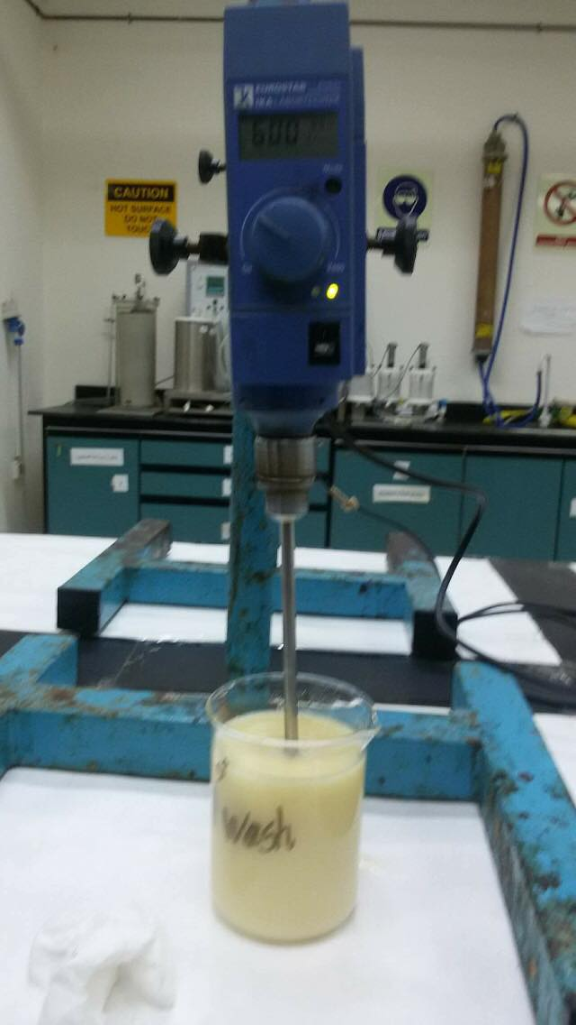
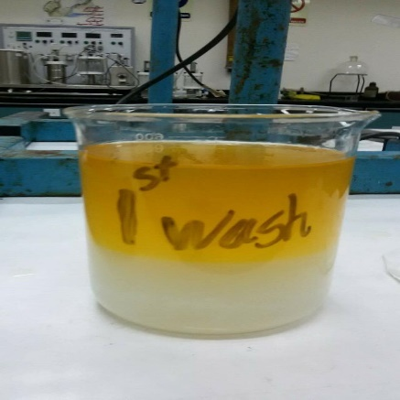

Research Objectives
Literature Review
Methodology
Result
Introduction
Visibility study
Conclusions
Biodiesel sample using $KOH$ as catalyst
1/2
Titration
Measuring the temperature of the reaction
Separation
washing
After washing

Slide 35
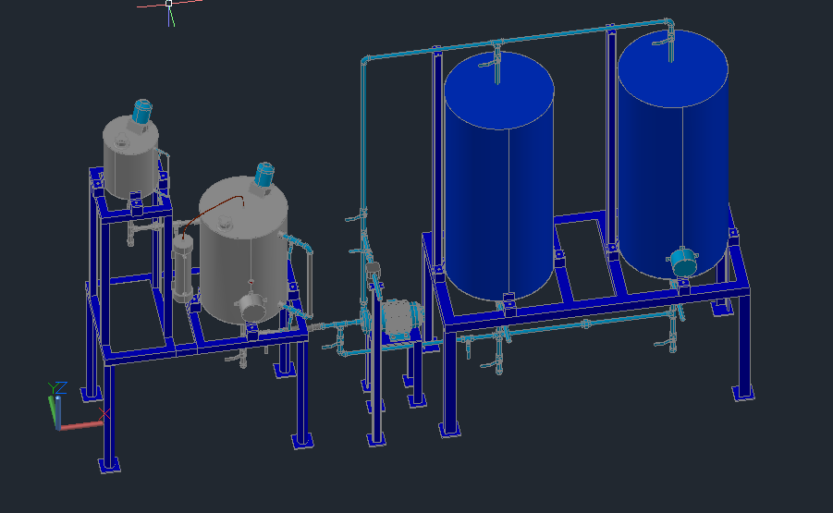
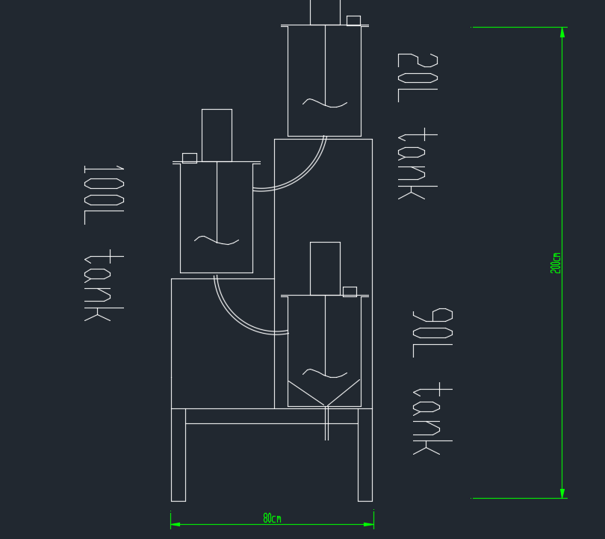
Research Objectives
Literature Review
Methodology
Result
Introduction
Visibility study
Conclusions
Manufacturing Process
2/2
First design of machine
Final design of machine
35

Slide 36
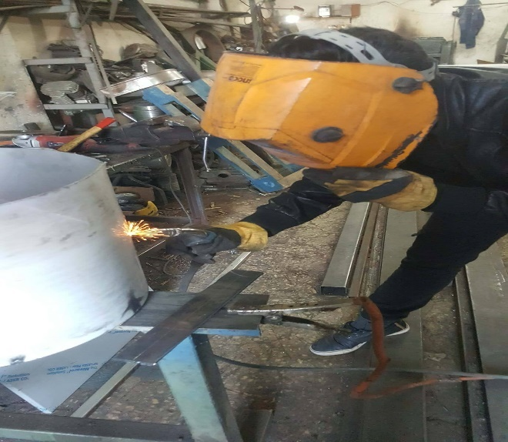
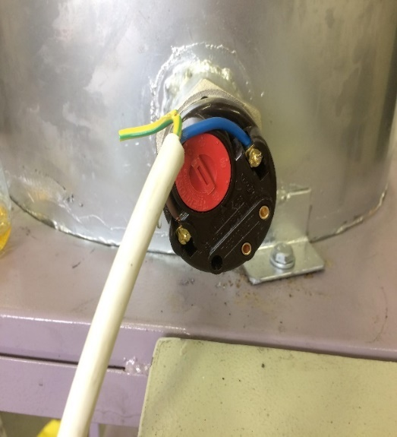
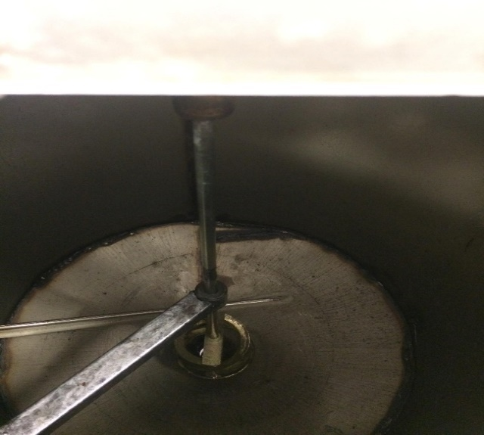
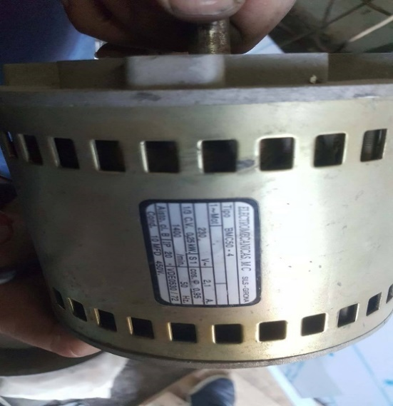
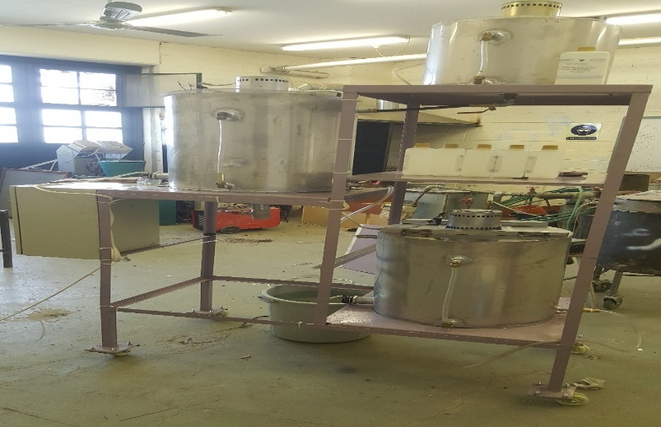
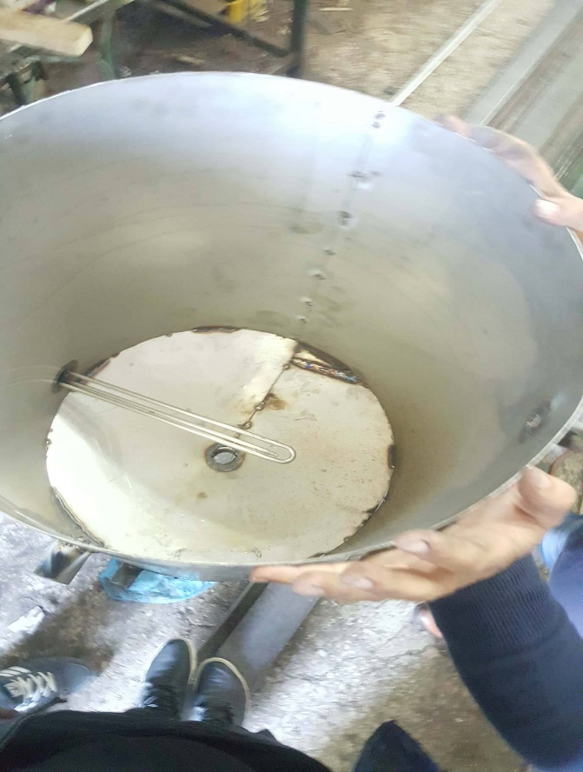
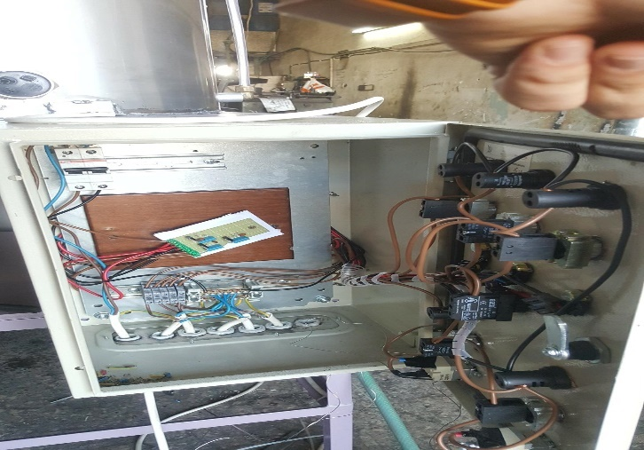
Research Objectives
Literature Review
Methodology
Result
Introduction
Visibility study
Conclusions
manufacturing process
36

Slide 37
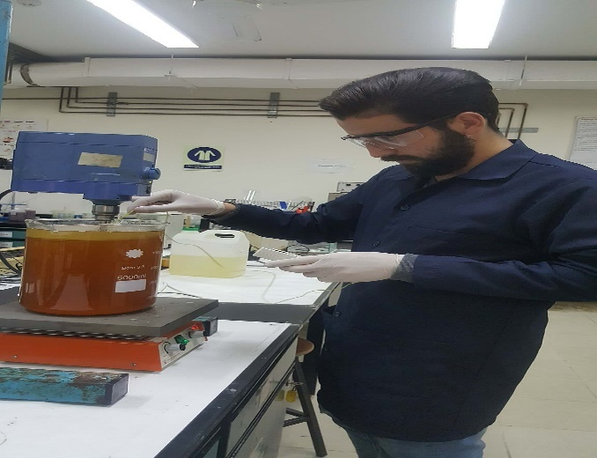
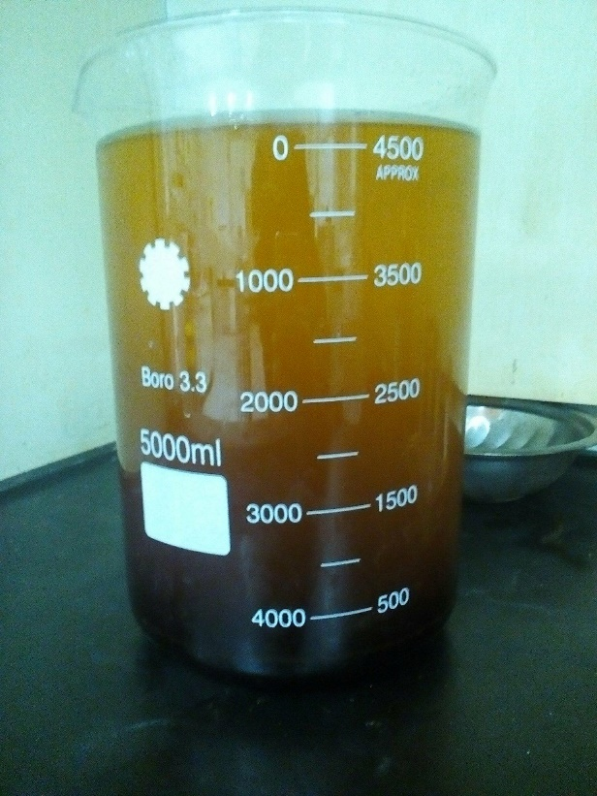
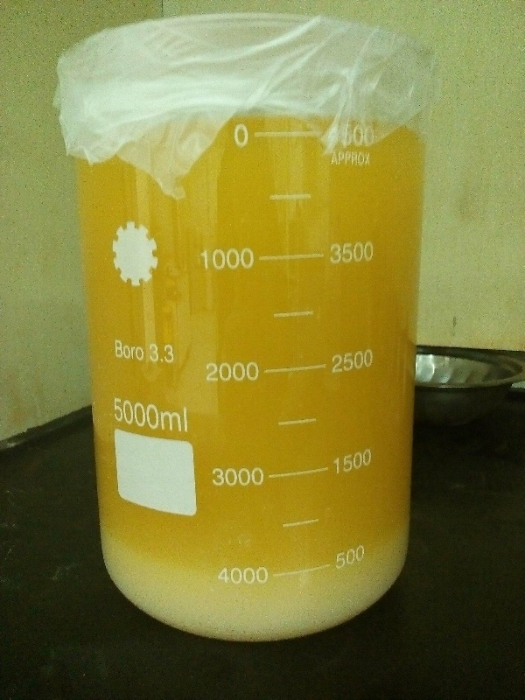
Research Objectives
Literature Review
Methodology
Result
Introduction
Visibility study
Conclusions
Preparing two samples for test
Laboratory sample
37

Slide 38
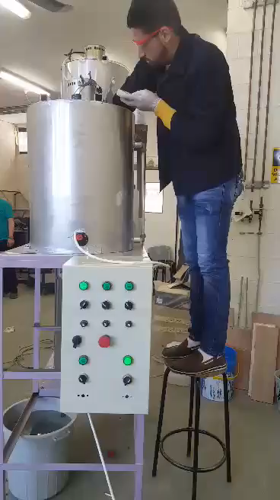
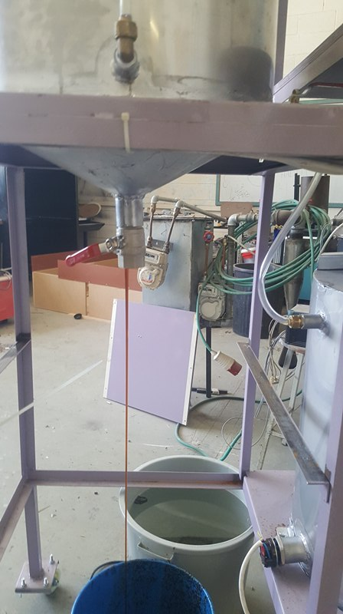
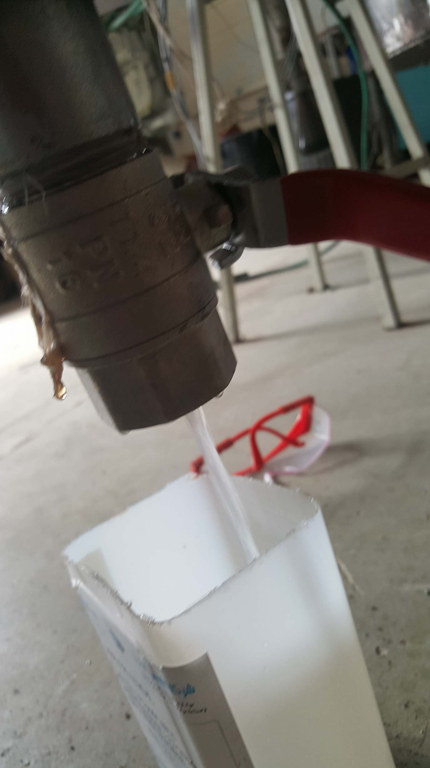
Research Objectives
Literature Review
Methodology
Result
Introduction
Visibility study
Conclusions
Machine sample
38

Slide 39
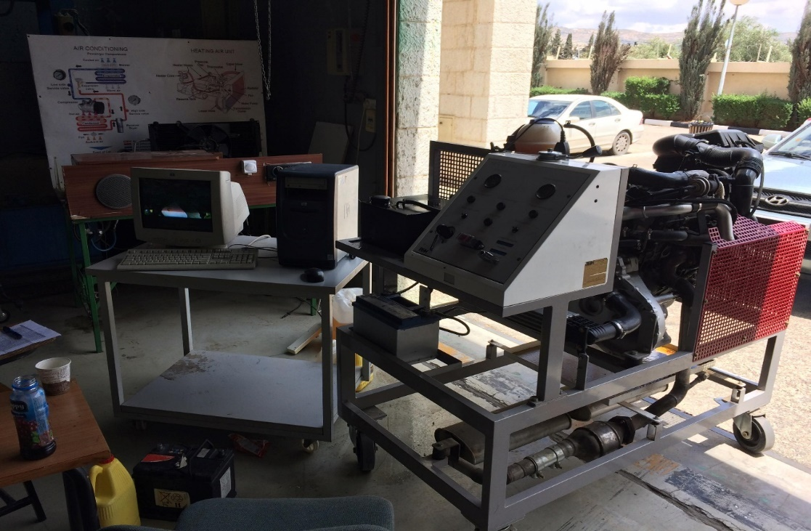

Research Objectives
Literature Review
Methodology
Result
Introduction
Visibility study
Conclusions
The test in Hijjawi College
39

Slide 40


40

Slide 41
Research Objectives
Literature Review
Methodology
Result
Introduction
Visibility study
Conclusions
The effect of % NaOH on (Viscosity, Density, pH, Yield%) of biodiesel
Sample | % NaOH | Viscosity (mPa.s) | Viscosity (cSt) | Density(kg/m³) | pH | %Yield | Glycerol(gm)
1 | 0.1 | 54.6 | 59.477 | 918.0 | 9.5 | 66.5 | 390.0
2 | 1 | 54.0 | 58.779 | 918.7 | 6.3 | 92.2 | 284.5
3 | 1.25 | 56.9 | 61.915 | 919.6 | 9.5 | 78.9 | 196.5
4 | 1.75 | 52.0 | 56.338 | 923.0 | 9.5 | 87.5 | 316.2
41

Slide 42
Research Objectives
Literature Review
Methodology
Result
Introduction
Visibility study
Conclusions
The effect of molar ratio of methanol to oil on (Viscosity, Density, pH ,flash point , %Yield)
Sample | Molar ratio (oil/methanol) | Viscosity (mPa.s) | Viscosity (cSt) | Density(kg/m³) | pH | Flash point ºC | %Yield
1 | 4:1 | 14.3 (4.6%) | 15.606 | 916.3 | 9.6 | 120 | 70.8
2 | 5:1 | 10.5 (3.4%) | 11.862 | 885.2 | 7.6 | 150 | 91.839
3 | 6:1 | 9.3 (3%) | 10.511 | 884.8 | 7.2 | 145 | 87.403
4 | 8:1 | 8.5 (4.7%) | 9.585 | 886.8 | 8.5 | 150 | 78.722
42

Slide 43
Research Objectives
Literature Review
Methodology
Result
Introduction
Visibility study
Conclusions
VCDS program results in engine testing at Hisham Hejawi workshop
43

Slide 44
Research Objectives
Literature Review
Methodology
Result
Introduction
Visibility study
Conclusions
Diesel VS biodiesel
Biodiesel | Petroleum Diesel
The combustion of this fuel is 75% cleaner than petroleum diesel. | This fuel is one of the major air pollutants in the world, thus, is associated with medical ailments of the heart and lungs.
Carbon dioxide emission is appreciably lower (about 78% less) thus, is a major contributing factor in the management of global warming. And whatever amount of this gas gets released does not add to the level of the same in the atmosphere. | Needless to say, petroleum diesel is a fossil fuel thus, burning it release a significant amount of carbon dioxide into the atmosphere thus, contributing to the increase in global warming.
This fuel has a certain solvent that helps in cleaning off deposits of petroleum diesel from the tank walls and pipes thus, serving as a super-lubrication agent. Also, its combustion leaves fewer particulate deposits behind. This may extend the lifetime of engines. | Petro-diesel does not possess such properties
44

Slide 45
Research Objectives
Literature Review
Methodology
Result
Introduction
Visibility study
Conclusions
Diesel VS biodiesel
Biodiesel | Petroleum Diesel
Engines that run on this fuel not only start easily, but run better with cleaner emissions. This is because of the fuel's higher cetane number, which means more oxygen. | This one has a lower cetane number thus is less efficient.
It produces lesser soot (particulate matter), carbon monoxide, unburned hydrocarbons, and sulfur dioxide. | Diesel is known for its high-sulfur emissions, which are extremely harmful for the environment.
The Environmental Protection Agency regards this fuel as non-toxic, and biodegradable. | This fossil fuel is not. So when it mixes with water or soil, it causes pollution.
45

Slide 46
Research Objectives
Literature Review
Methodology
Result
Introduction
Visibility study
Conclusions
Diesel VS biodiesel
Biodiesel | Petroleum Diesel
This less polluting-fuel is also helpful in removing crude oil from water, such as in the case of shorelines that get soiled with crude oil | With petro-diesel, there is no such scope.
Older diesel vehicles, especially those made before 1992, may encounter some problems with higher concentrations of biodiesel. The fuel can jam the fuel filter, and damage rubber components. | It does not give rise to any such problems
The distribution of this fuel is not widespread. If we speak of the United States, then there are 19 National Biodiesel Board, which supply this fuel. | Diesel is available in all fuel stations.
Biodiesel is not only environment friendly, but is highly economical as well. This is because, it does not incur any import costs. | Diesel is an imported product thus, is one of the major reasons of inflation in the country.
46

Slide 47

47

Slide 48
Research Objectives
Literature Review
Methodology
Result
Introduction
Visibility study
Conclusions
Plant cost
Production cost
Pay back period
Visibility study
Costs
48

Slide 49
Research Objectives
Literature Review
Methodology
Result
Introduction
Visibility study
Conclusions
Costs
Plant cost
production cost
49

Slide 50
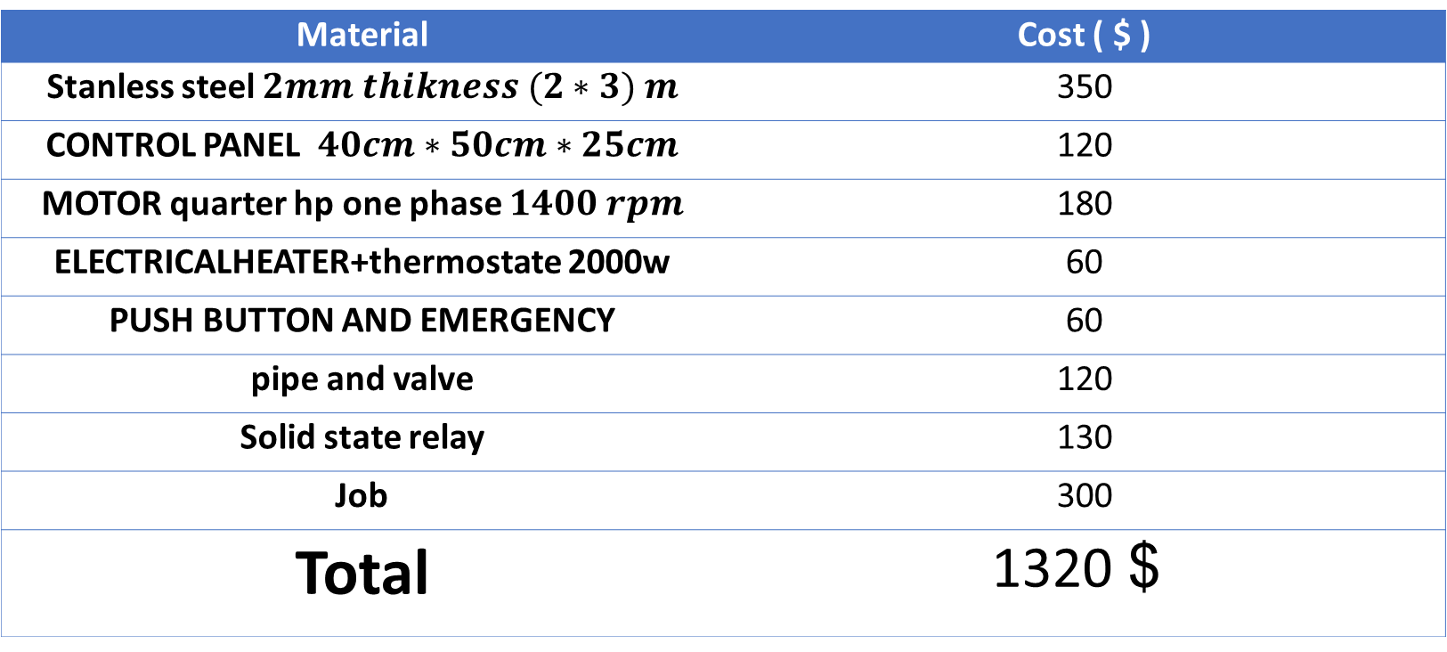
Research Objectives
Literature Review
Methodology
Result
Introduction
Visibility study
Conclusions
Plant cost
Material | Cost ( $ )
Stanless steel $2mm thikness (2∗3) m$ | 350
CONTROL PANEL $40cm∗50cm∗25cm$ | 120
MOTOR quarter hp one phase $1400 rpm$ | 180
ELECTRICALHEATER+thermostate 2000w | 60
PUSH BUTTON AND EMERGENCY | 60
pipe and valve | 120
Solid state relay | 130
Job | 300
Total | 1320 $
50

Slide 51
Research Objectives
Literature Review
Methodology
Result
Introduction
Visibility study
Conclusions
Costs
Plant cost
production cost
51

Slide 52
Research Objectives
Literature Review
Methodology
Result
Introduction
Visibility study
Conclusions
production cost
Material | Amount | Cost ($)
Used cooking oil | 1 Liter | 0.8
Methanol | 1 Liter | 0.33
NaOH | 1 Kg | 5
Distilled water | 1 Liter | 0.006
52

Slide 53
Research Objectives
Literature Review
Methodology
Result
Introduction
Visibility study
Conclusions
Pay back period
If we convert 1 liter of used cooking oil we will produce 0.9 biodiesel
The cost of convert 1 liter used cooking oil is 0.9155 $ ( 3 NIS )
Production rate (180L/24h)
If the price of litter of biodiesel is (4 NIS ) the pay pack period is 25 days
53

Slide 54

Conclusions
Notes:
Visual observations showed that the polymer affected the flow within a few pipe diameters from the injection point. Thus, it was assumed that the polymer is well mixed with the water phase at the location where the recordings were taken

Slide 55


