Slide 1
Enhancing Deaf and Dumb collaboration by Video Annotation
Supervisor:
Amjad Hawash,PHD
__________________________
By:
Zaina Taha ,Roaa Arabasi

Slide 2
Introduction:
Digital annotation has become an excellent tool to exchange people’s ideas globally. With the existence of Internet services and tools

Slide 3
Problem
People who are deaf and dumb have few to no opportunities for comments and communication.

Slide 4
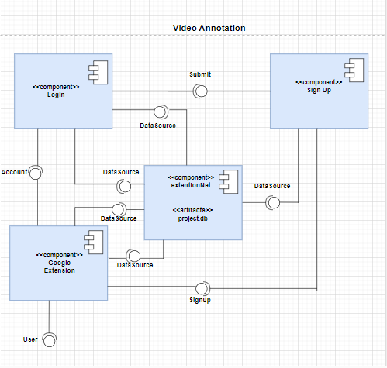
System Component

Slide 5
Client Side
Google Chrome extensions are programs that can be installed into Chrome in order to change the browser's functionality. This includes adding new features to Chrome or modifying the existing behavior of the program itself to make it more convenient for the user.
The tool is a client/server architecture one and the google extension is used to implement the interaction part with the user

Slide 6
Server Side
PHP is the language that used for backend development

Slide 7
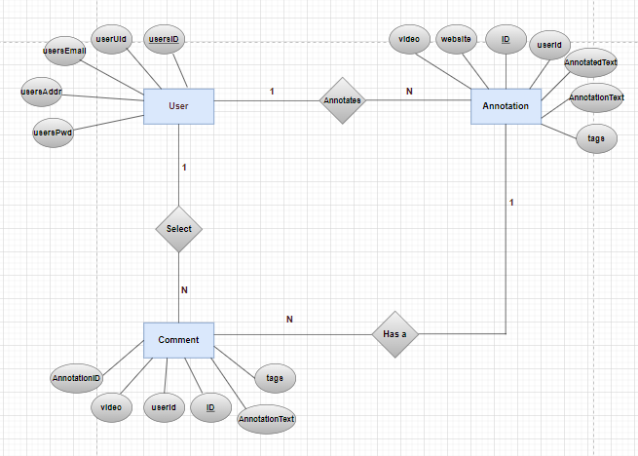
ER-Diagram

Slide 8
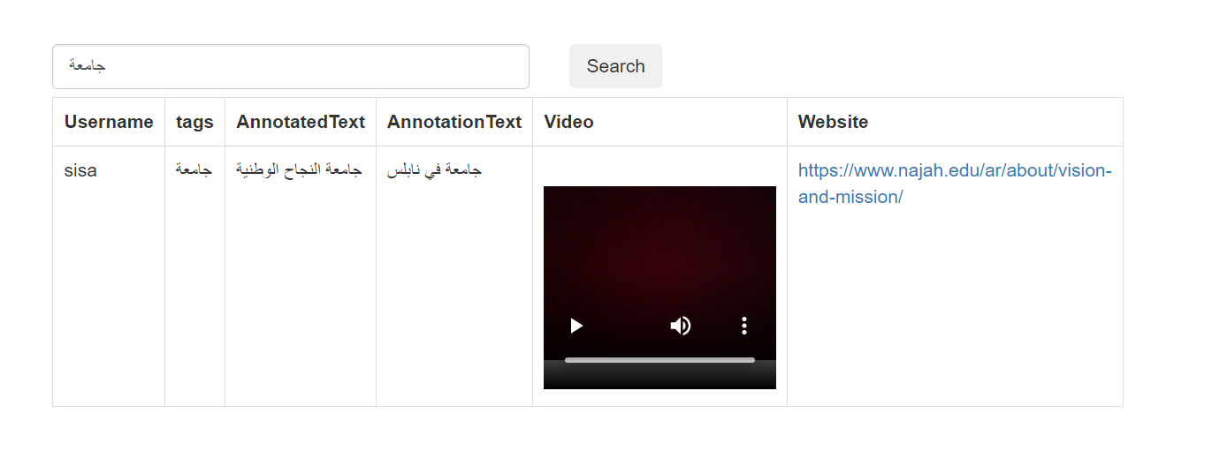
HOW IT WORKS

Slide 9
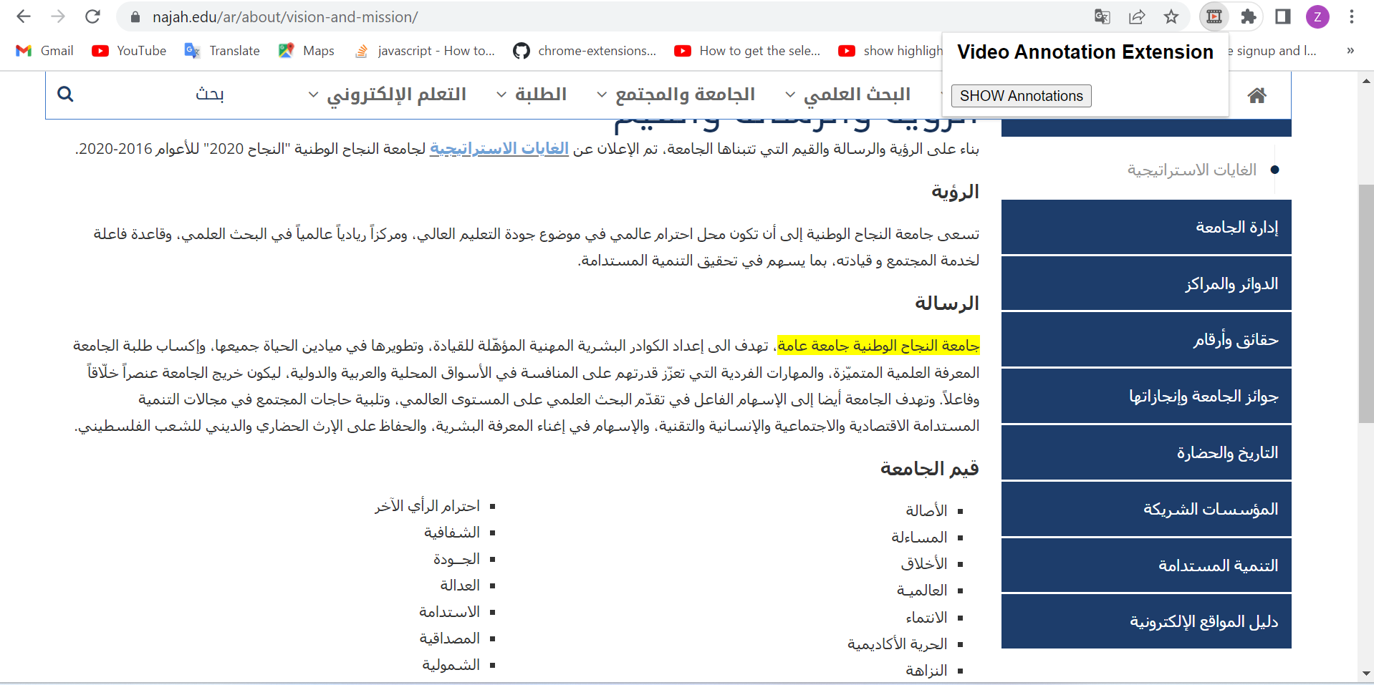
HOW IT WORKS

Slide 10
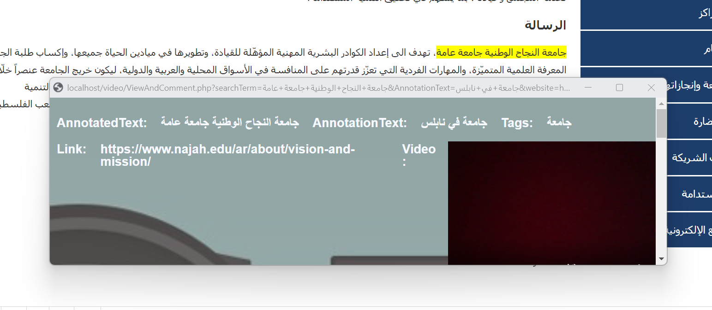
HOW IT WORKS

Slide 11
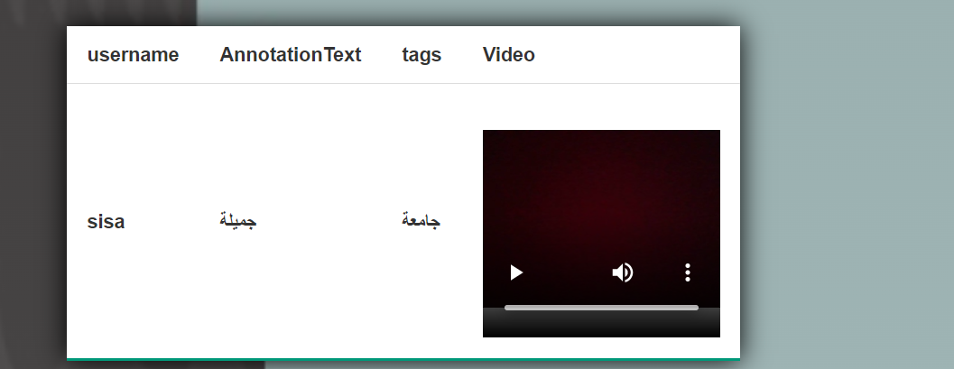
HOW IT WORKS

Slide 12
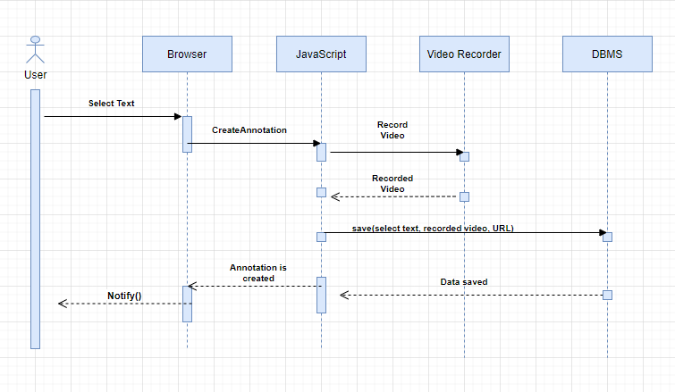
Sequence Diagram

Slide 13
Future Work
Merge our extension with past our colleagues Audio extension.
Enhancing the searching method about Annotated text in the active web page in order to highlight.

