Slide 1


iCashier
transforming the landscape of online business warehousing
firaduation Project 2
September 2023
Dana Aqel Aya Jabali

Slide 2



Agenda
3
Introduction
4
Features
5
Motivations
6
Hardware Modules
7
Constraints
8
Future Work

Slide 3
Introduction
automate item scanning and sorting, bill computation and bin tracking, addressing the need to eliminate harsh environments and reduce human-related errors in the workplace

Slide 4


Features
01
02
03
04
Detecting and scanning items
Computing bill in reference to inventory
Sorting items according to scanning status
Keeping track of number of items in each sorting bin

Slide 5
Motivations
Substitute human workers
Minimize the need for human intervention
in order preparations
Improved efficiency and precision
Eliminating harsh work conditions
Decrease the number of workers in terrible work environments
Avoid human errors in order preparations

Slide 6

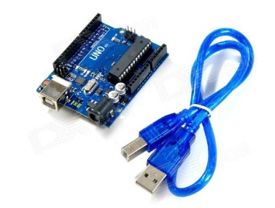
Hardware Modules
Microcontroller
Arduino Uno R3

Slide 7
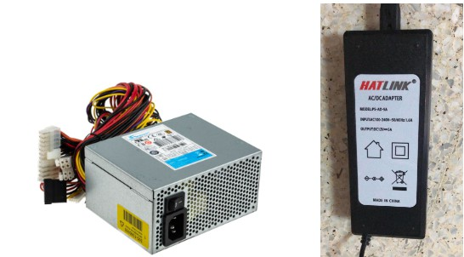


Hardware Modules
Power Supply
Computer power supply
12v power supply

Slide 8
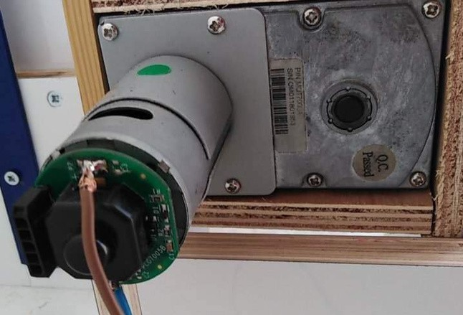
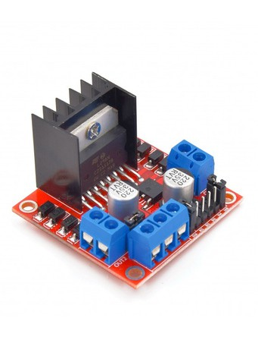
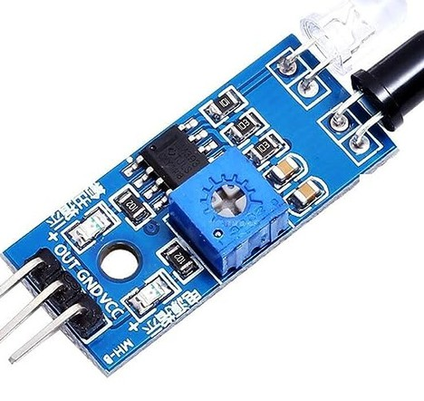

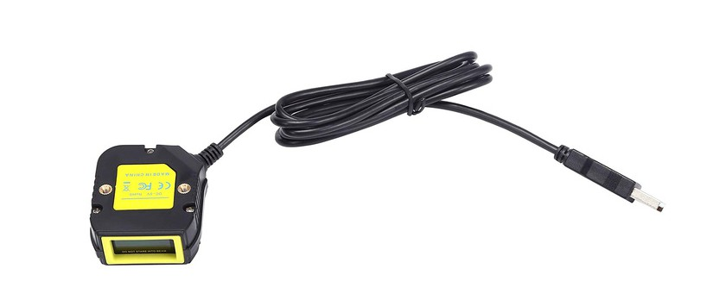
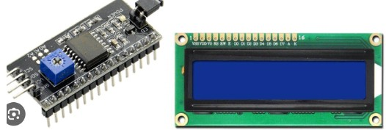
Hardware Modules
Main Belt
DC motor H-Bridge IR sensors
Barcode Scanner LCD and I2C

Slide 9
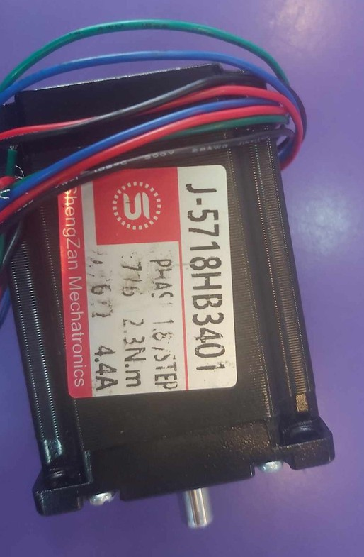
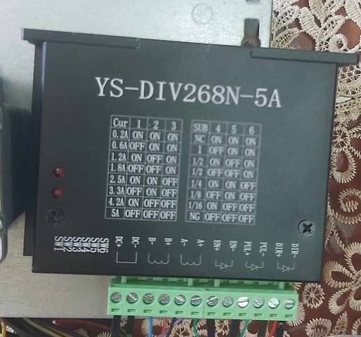


Hardware Modules
Bin Belt
Stepper motor Stepper motor driver

Slide 10



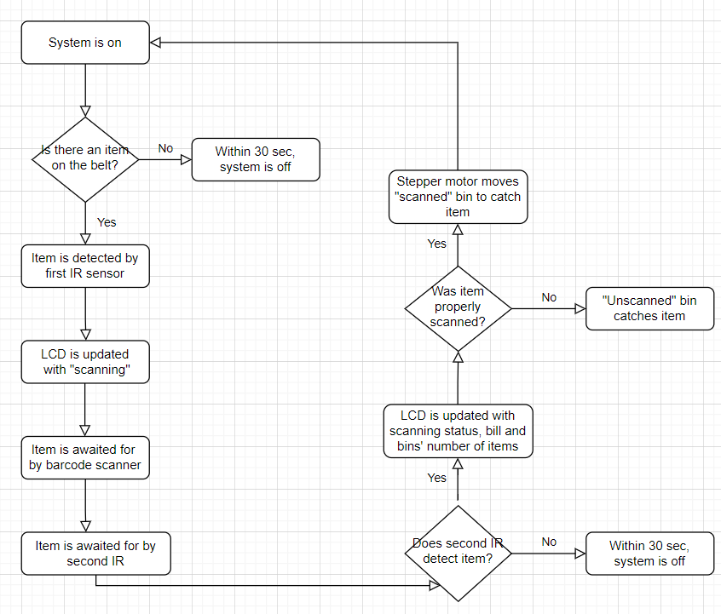
Overview

Slide 11



Constraints
i.
barcode scanner and IR sensor sensitivity
ii.
expensive hardware modules
iii.
system physical vulnerability
iv.
lack of real team work

Slide 12
Future Work
i.
securing perfect operational environment
ii.
resizing system to handle multiple items
iii.
developing app to monitor system and receive notications
iv.
implementing a packaging feature

Slide 13
Thank you!

