Slide 1
An-Najah National University
Faculty of Engineering
Civil Engineering Department
Calculating Pavement Maintenance Priority Index (PI) Utilizing Artificial Intelligence (Fuzzy Logic) through Mobile Application
Prepared by:
Jad Wael Obeid
Eyad Nheed Abu Saleh
Samed Azmi Odeh
Abdulrahman Yasser Hussein
With the help of Computer Engineering students:
Shima Osamah Fawzi Haj Mohammad
Areej Mohammad Imair
Supervisor: Dr.Amjad Issa

Slide 2
Project Outline
Introduction
Literature Review
Data Collection
Methodology
Building Model using Fuzzy Logic
Conclusion and Recommendations

Slide 3
Introduction
Currently, the Palestinian Municipality is using the Operation Maintenance Manual (OMM) for prioritizing their pavement maintenance and identifying the section with highest priority. The municipality is using the PI equation, which is composed from four indicators: Pavement Condition, Importance of the Road, Peoples Complains, and Functional Classification of the road.

Slide 4
The OMM gain the following weights for the above-mentioned indicators 0.75, 0.10, 0.08 and 0.07, respectively. However, through consulting different experts, they declared that these weights could be modified. Moreover, they stated that the 0.75 weight for the PCI is too high.
Accordingly, the project team proposed to identify a membership function using Artificial Intelligence and Fuzzy Logic at specific to deal with this issue. The team with the help of Dr. Anas Toma from Computer Engineering Department utilizing MATLAB program to build the membership function to identify the weights of the 4 indicators and developing of rules.

Slide 5
Study area
The study area is presented in the next slide . The total area of Nablus governorate is about 605 squared kilometres, this area includes a lot of roads that are considered critical and important as they serve institutions, NGOs, organizations and governmental buildings. The main included roads are Rafidia, Haifa, Yasser Arafat, Mohammad Bin Rashed, Tunis, Yafa, Fadwa Toqan etc...

Slide 6
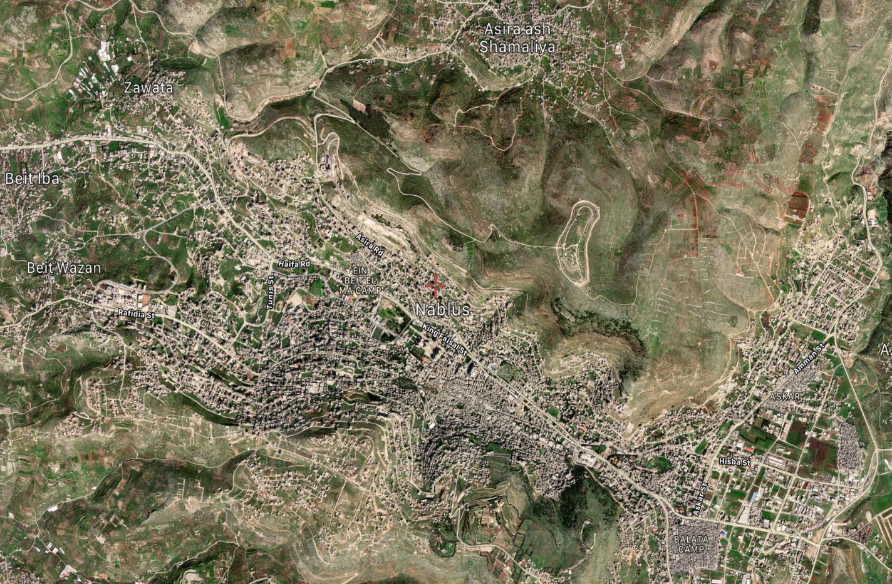
Study area

Slide 7
Project Objective and Significance
The main objective of the project is to upgrade (if needed) the current equation used by the MDLF in the Operation and Maintenance Manual (OMM), in terms of the calculation of maintenance priority index. The project team will check the weights of the four indicators, PCI , FC , IM and C. The calculating of the pavement priority index will be by utilizing the AI and by using Fuzzy Logic. The output results compared with the MDLF model.

Slide 8
The second objective is to create a mobile application, which will help us as engineers to calculate the PCI of a road section of our choice through image processing. This application will combine the field work measures, PCI calculation, Image Processing and the Fuzzy PI calculations in one mobile application which will make calculating the PI of the road simple, fast and with a significant decrease in the cost value of such type of operation.

Slide 9
Project Constraints
Data Collection: It is expected to face difficulty in data collection as the municipality divided their roads into 300m equal sections. The project team will visit public works department in Nablus municipality in order to collect the required data. However, it is expected that some of the required data will be missing from the Municipality or not all roads will have recent data.
The output model of Fuzzy Logic may not be compatible with the one adopted by the MDLF. Accordingly, the project team will seek for the proper model, which will minimize error.
The lack of high quality cameras to enhance the overall result given by the imagine processing part.

Slide 10
Artificial Intelligence (AI)
Artificial intelligence (AI) is a group of techniques that have quite a potential to be applied to pavement engineering and management. In this study, the project team developed a practical, flexible and out of the box approach to apply genetic algorithms to optimizing the budget allocation and the road maintenance strategy selection for a road network Salini, R.et al, (2015).

Slide 11
Fuzzy Logic (FL)
Fuzzy means lacking clarity and this fuzziness is because of modeling the most similar humane inference through a complex mathematical pattern. Basically, what a fuzzy system does is converting human knowledge to mathematical formula. This important act is done by linguistic variables, if-then fuzzy rules and mapping system (fuzzy engine). Fuzzy systems are based upon knowledge and rules. The heart of a fuzzy system is a knowledge base, which consists of the fuzzy if-then rules. Briefly, the starting point of making a fuzzy system is to collect a set of fuzzy if-then rules from the knowledge of experts or studying in the related field. Next step is combining these rules into their arithmetical forms (Moazami.D.,et al., 2011).

Slide 12
Image Processing
Imagine processing is the use of a digital computer to process digital photographs using an algorithm is known as digital image processing. Digital image processing, as a subsection or branch of digital signal processing, has a number of advantages over analog image processing. It enables a considerably wide age of algorithms to be applied to the input data, as well as avoiding issues like noise and distortion during processing.

Slide 13
Choosing of the Fuzzy system
The use of the membership function plot
Considering more than one parameter for decision making and
Simulates human way of thinking

Slide 14
Methodology
The required data is to be collected from two sources:
1) Nablus Municipality,
2) The experts’ opinion.
All the data collected is considered in the developing of the Fuzzy logic model using the MATLAB application. The data was analysed and ordered in tables. It was also translated in a way that program could understand so that we could start training our program to give the most logical values of the PI. The program is based on the experts’ logic, translating all the scenarios we made into rules that the program will give the best average of all values compared to the PI values found by the municipality.

Slide 15
The program is based on the experts’ logic, translating all the scenarios we made into rules that the program will give the best average of all values compared to the PI values found by the municipality. We will end up having three values for the PI from the municipality, experts and the Fuzzy system. Comparing all the values together, we will prove the difference in all three.

Slide 16
The weights of the 4 factors that the municipality used were our issue in this part because of the large weight of 75% given to the PCI. The Fuzzy system will make average and voting of all the data and we will be lowering the PCI weight to 45%-50%, which will be much logical than the weight used before. At the end, the system will give us any value we need averaged with all the rules made and the experts’ opinions, which will be the most considerable value to be chosen for any PI value needed.

Slide 17
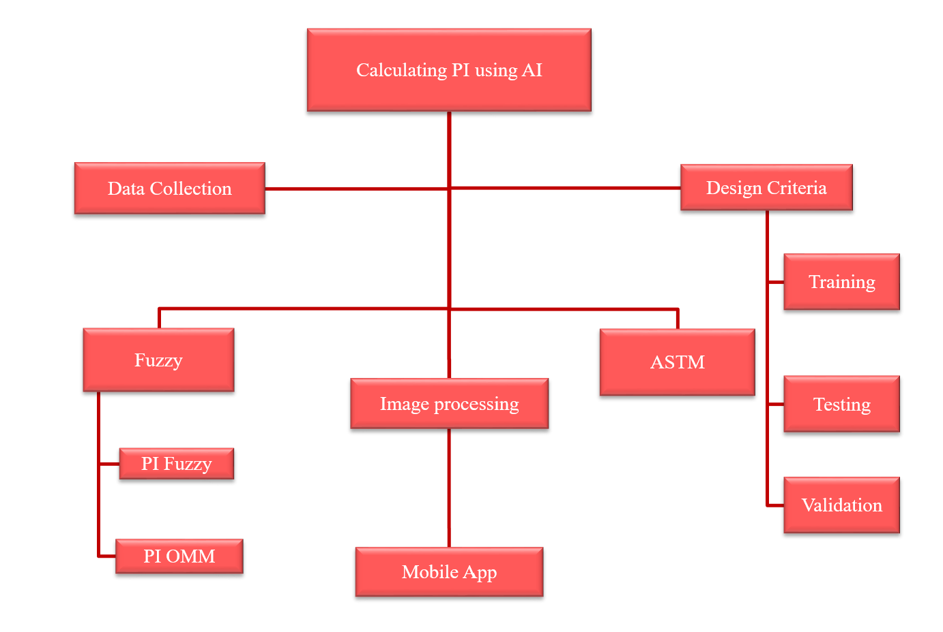

Slide 18
Design Criteria &Development of PI Membership Function
Design Criteria
The development of the membership functions is achieved by using the MATLAB. The team built the model through creating the sets of the Fuzzy needed for building the membership functions, to ensure the required number of rules, Training, Testing and Validating the model.
Development of PI Membership Function
The project team will develop the membership functions for the PI and the four relevant indicators by using MATLAB program and considering the data collected from the different resources.

Slide 19
Imagine Processing & The Mobile application
Imagine Processing
The imagine processing application is made using codes on Python program and put in the mobile application which will be using the mobile’s camera to take the imagines of distresses in the field.
The Mobile application
The mobile app made combined the ASTM standards and image processing into one portable app, which is extremely useful for engineers and made the work much easier and less costly.

Slide 20
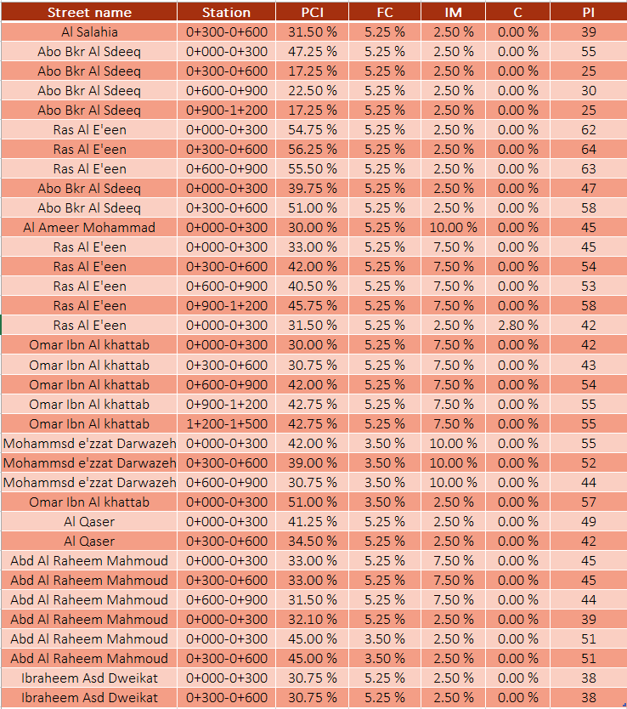
Data Collection
The municipality engineer provided us with the required data for a sample of different important roads in the city. A sample of the data analyzed and arranged in the Excel sheet shown below.

Slide 21
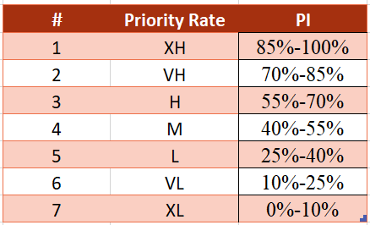
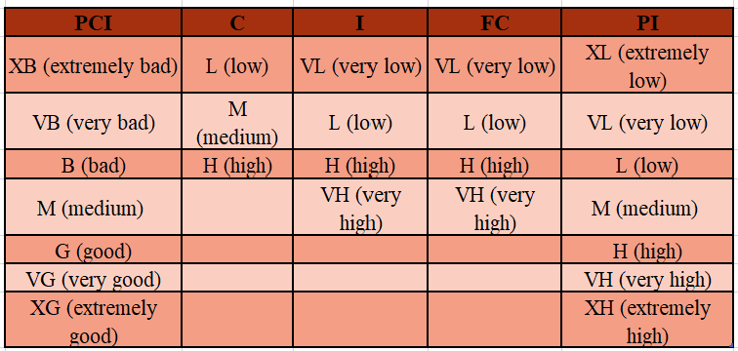
The ranges of the PI built in the Fuzzy system from 1 to 7 are shown in table below:

Slide 22
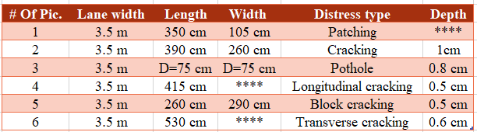
A sample of the performed calculations is shown in the table below.

Slide 23
Building Model Using Fuzzy Logic
  Design Criteria
The development of the membership functions is achieved by using the MATLAB. The team built the model through implementing the following steps:
Creating the sets of the Fuzzy needed for building the membership functions.
Development and adding the rules.
Collecting the needed data.
Training the model
Testing the model
Validating the model

Slide 24
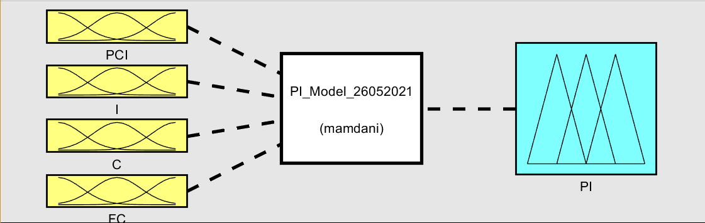
    Creation of sets
The Model was developed by adding inputs and rules according to the four indicators included in calculating the PI which are the PCI, I, C, and FC. The structure of the PI model is illustrated in the Figure.

Slide 25
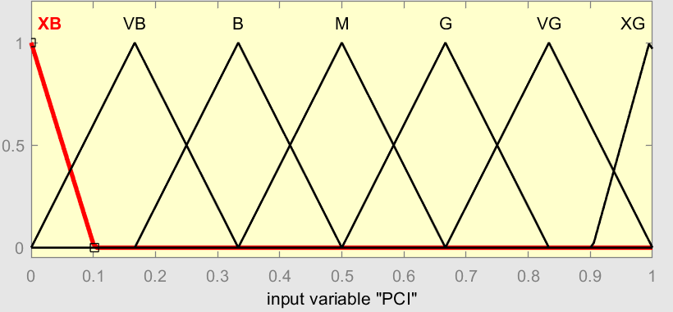
The membership functions for the four indicators are developed as illustrated in the following figures
Membership function plot of PCI (Pavement Condition Index)

Slide 26
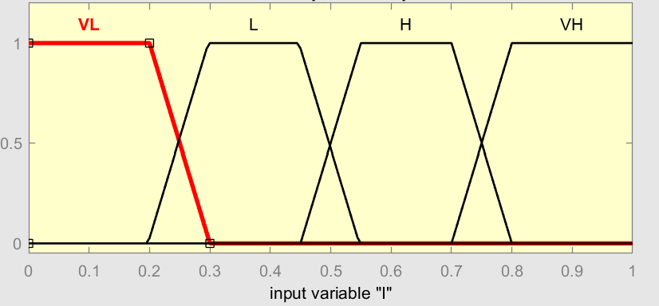
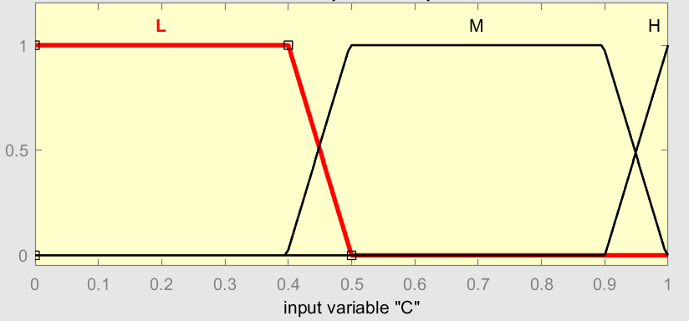
Membership function plot of I (Importance of the Road)
Membership function plot of C (People Complains)

Slide 27
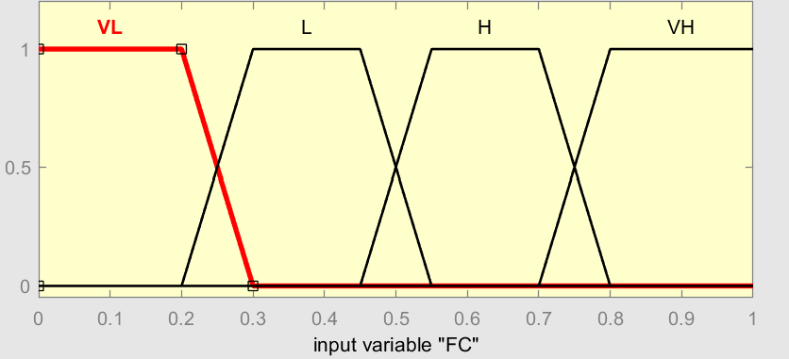
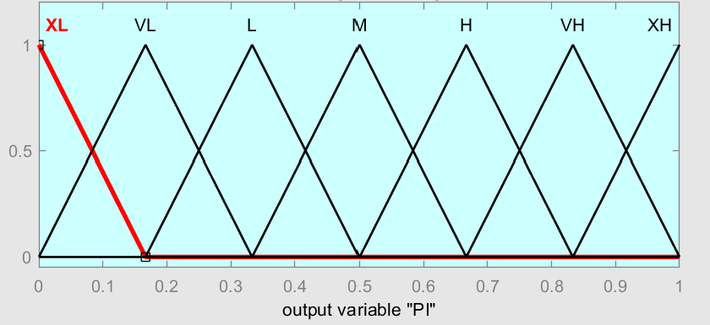
Membership function plot of FC (Functional Classification)
Membership function plot of PI (Priority Index)

Slide 28
Development and adding the Rules
    The abbreviation of the rules and their arrangements are presented in Tables below.
    More ranges are added as mentioned in our first report to help increase the accuracy (Extremely High, Extremely Low) which made the ranges go from 5 sets to 7 sets.

Slide 29
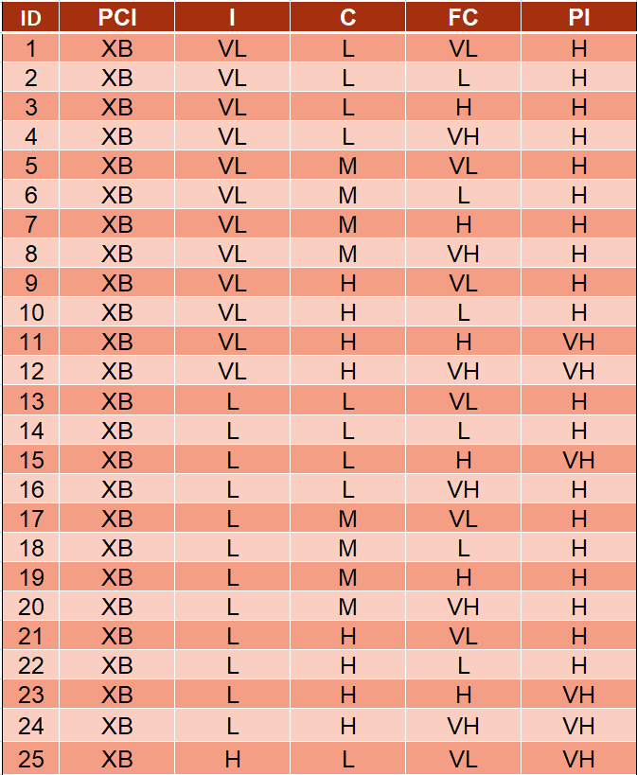
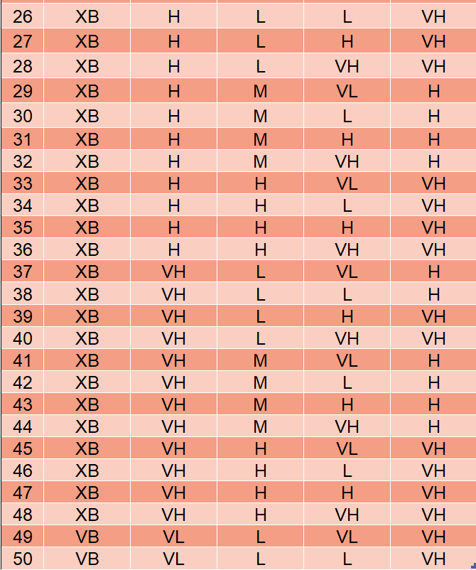

Slide 30
Results and Comparison
The weights of the four indicators were reviewed and updated by project team because they believe that the weight of the PCI indicator at specific is very high (overestimated). On the contrary, the weight of the remaining indicators seems underestimated as stated in the Operation and Maintenance Manual (OMM) comparing with the literature. The weight of the PCI is 75%. After taking our experts’ opinions, PCI weight decreased from 75% to 50%. The PI value is calculated using equation 1 as shown below (OMM):
PI = ∑ Wi × Fi………… (1)

Slide 31
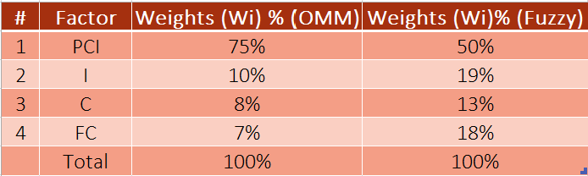
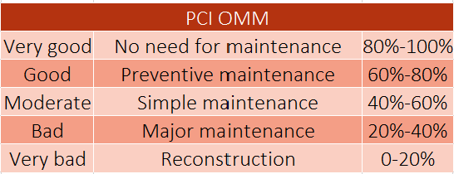
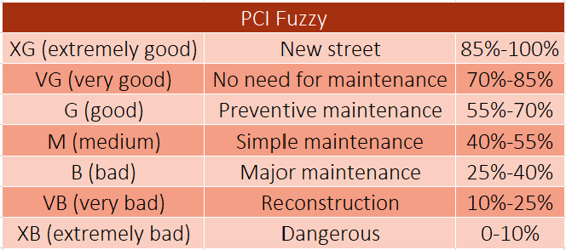
The modified weights were the average values obtained from experts. Moreover, the ratings of the PCI were changed from Very Good to Very Bad. The modified changes are presented in the tables below .
Ratings from OMM Ratings from Fuzzy Logic

Slide 32
As shown in the tables of ratings, the ratings of fuzzy system are converted to 7 ranges other than 5. This will give us more accurate ratings for the system as a whole. The fuzzy system membership functions will merge between those 7 ranges and give the user the average of the rate as a final value to be considered which also enhanced the accuracy or the system.
The other three indicators’ rates not changed because they are not given a range until now and they were used just as they are in the OMM. The reason behind not changing their values or merging them was that we got acceptable values of PI from the Fuzzy system. To enhanced the final results, change of ratings may be done in our future work on this project. The three factors’ ratings are shown in the tables below (OMM).

Slide 33
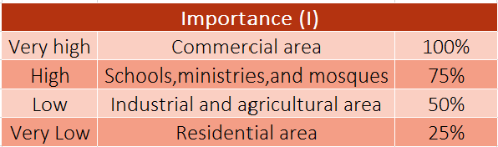
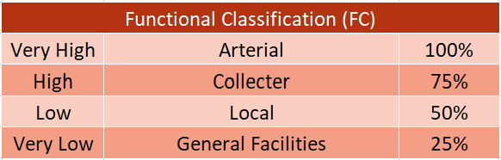
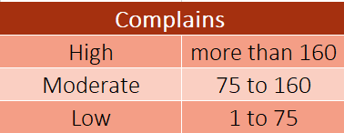

Slide 34
PI Comparisons
Three PI values were calculated and compared to each other. The first PI value is the PI calculated from equation within the OMM weights, the second PI is calculated with the modified equation respecting the weights stated by the experts’ opinions. The third and final PI is the one calculated using the Fuzzy logic system. Our program has three machine learning steps, the first one is training the data, then testing and finally validating. The data used in the previous three steps are provided by our advisor that were collected during the last two years. The three different PI values are shown in the tables below .

Slide 35
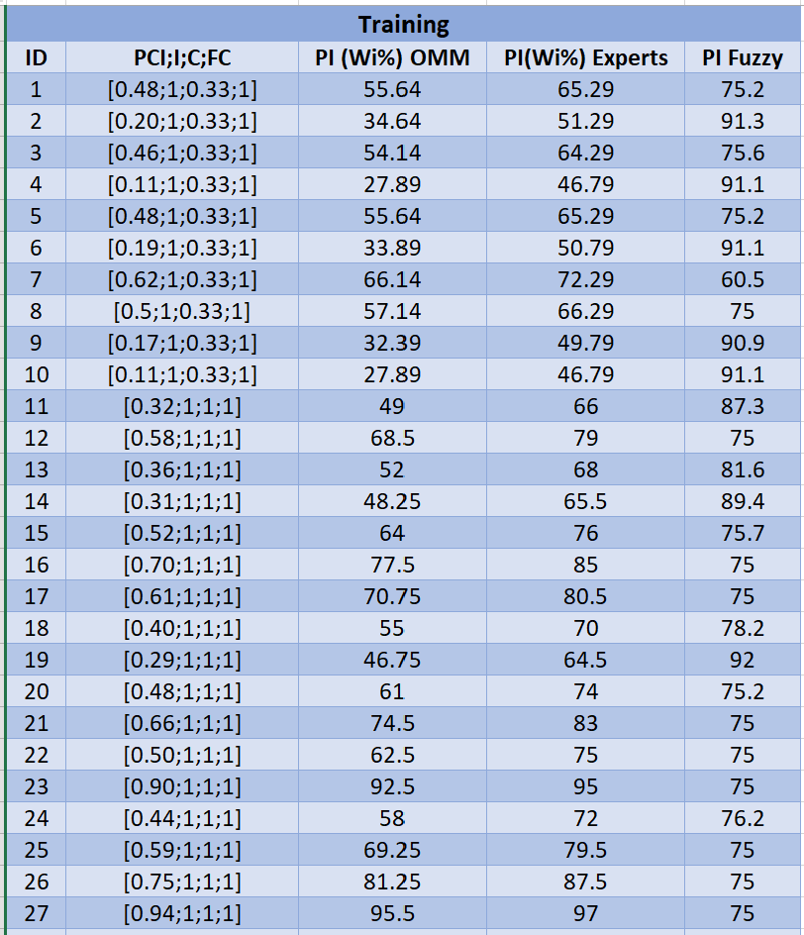
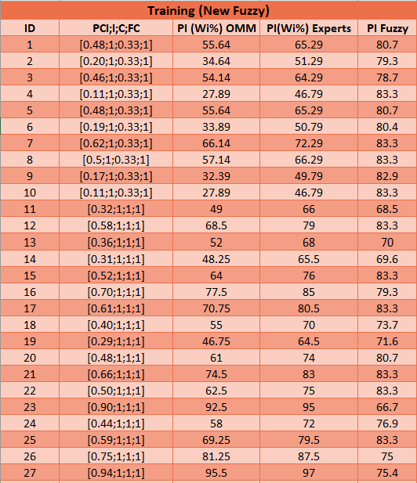

Slide 36
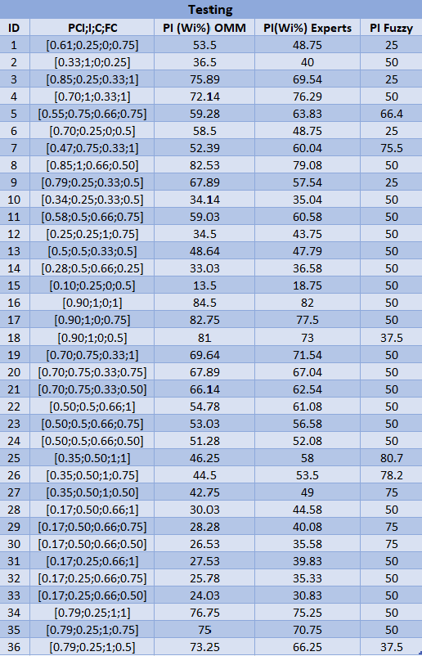
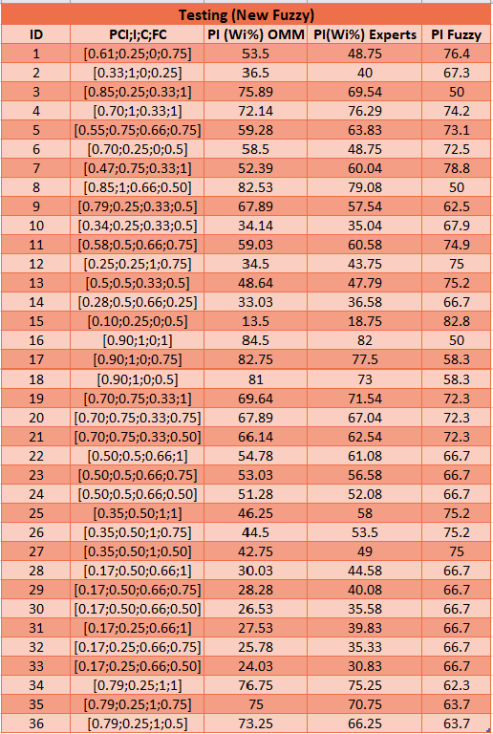

Slide 37
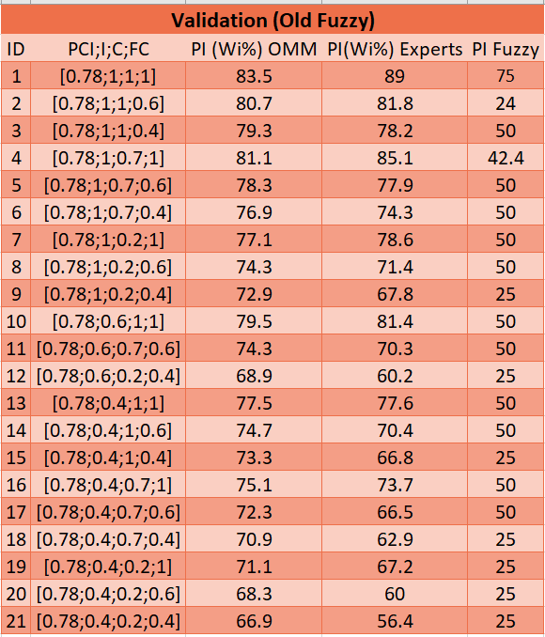
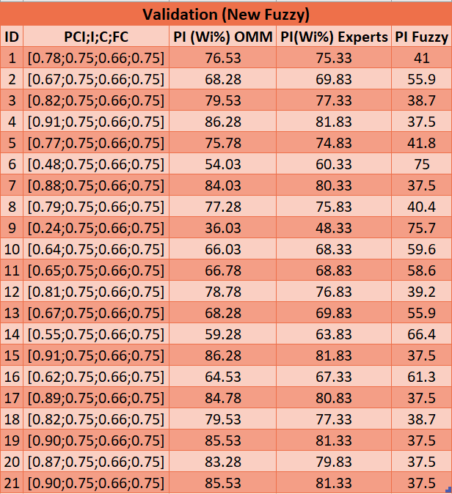

Slide 38
The calculated PI values from three sources vary slightly. However, the noticeable difference was between OMM values and the remaining two PI values. Therefore, this shows that the OMM weights used in the PI equation were not close to what the experts actually suggested.
Some of the PI values are not so accurate because the system needs more time to have enough training and fed with more rules so that it could give the least error for its results, which is the PI.
The new tables also shows more variation in the results and this is because of the new 300 rules added to the system’s database.

Slide 39
The Mobile Application
Our team with the help of our teammates in the computer engineering department was able to create a mobile app that combines all our work including the Image Processing, ASTM standards, and Fuzzy Logic into one portable, easy to use and reliable mobile application. This process is made by converting all the data into codes and made as an app. The manager connected directly to a server and with the technicians in the field controls this mobile app.
The technicians can easily and directly take imagine, find results and send them directly to server which will be accessed by the manager and given the approval to the results then saved to the server and sent to the service department in the Municipality to take action if needed.

Slide 40
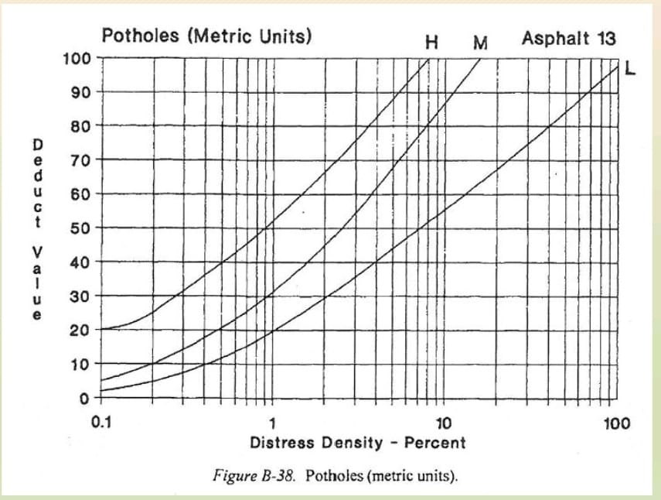
ASTM standards
All the data transformed into codes using Python by our computer engineering teammates and put into the mobile app. All the data used are shown below:

Slide 41
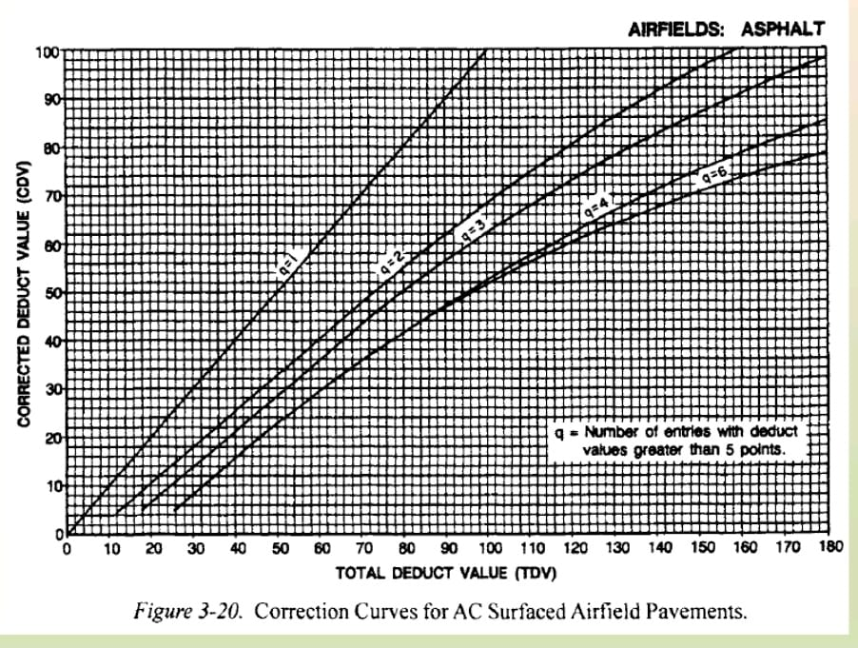
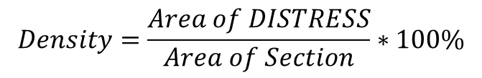
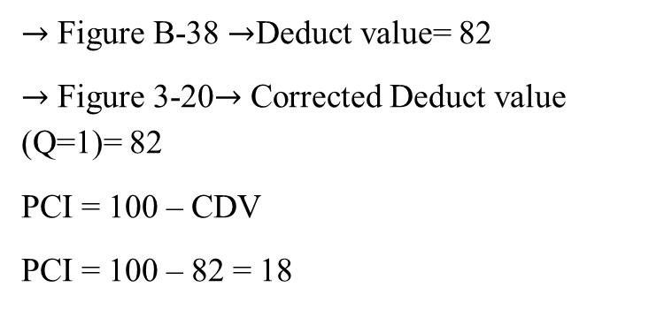
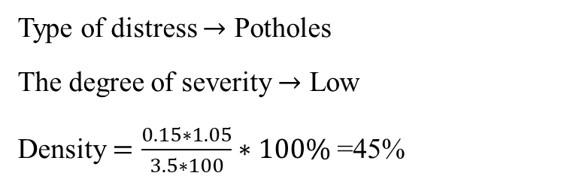
$$Density=\frac{Area of DISTRESS}{Area of Section}∗100\%$$
$→$ Figure B-38 $→$Deduct value= 82
$→$ Figure 3-20$→$ Corrected Deduct value (Q=1)= 82
PCI = 100 – CDV
PCI = 100 – 82 = 18
Type of distress $→$ Potholes
The degree of severity $→$ Low
Density $=\frac{0.15∗1.05}{3.5∗100}∗100\%$ =45%

Slide 42
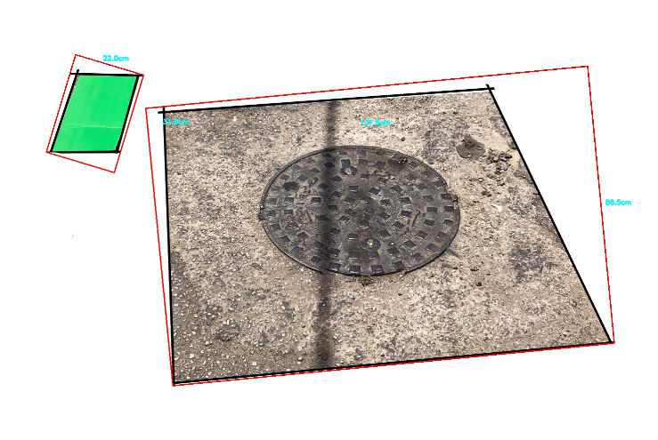
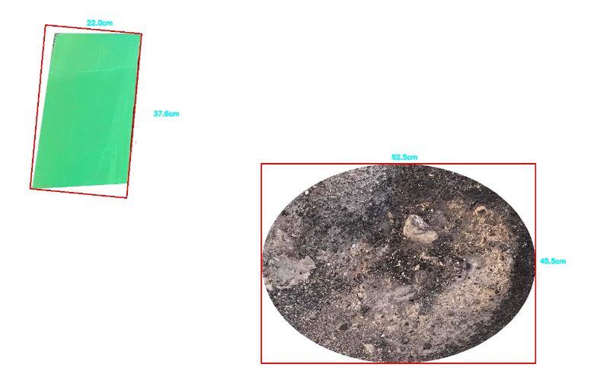
Image Processing
The image processing applied by taking images using the mobile phone’s camera through the mobile app. Before taking the image the technician should put a reference object with known dimensions on the top right of the imagine because the program reads the image from the left to the right. An example is illustrated below:

Slide 43
After the team have the area and its dimensionality, area is found to calculate the density value. We need to find the PCI value at the end through equations for each problem type and the severity value low, medium, and high.

Slide 44
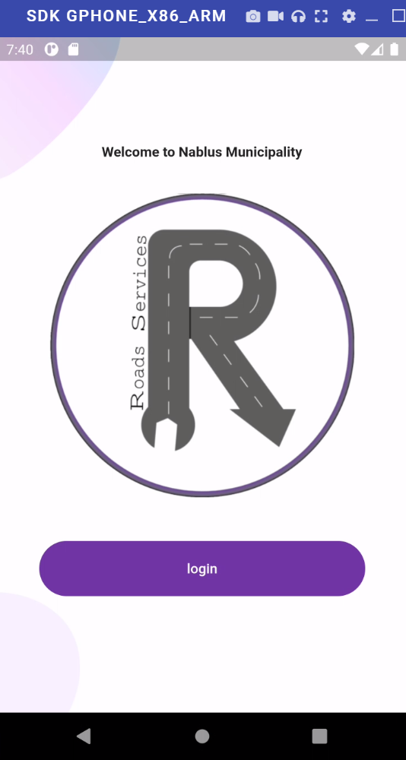
The Mobile Application Implementation
The mobile app way of use and sample pictures illustrated systematically and explained as follows:
Main screen when the app opens with the app logo.

Slide 45
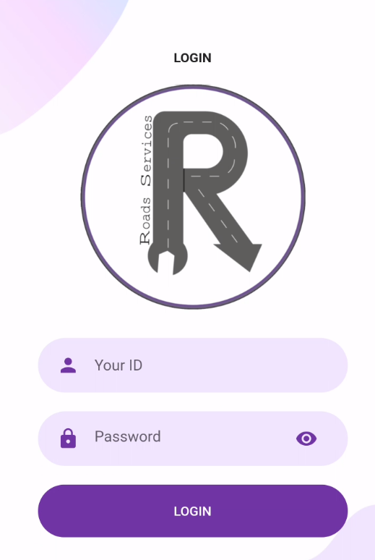
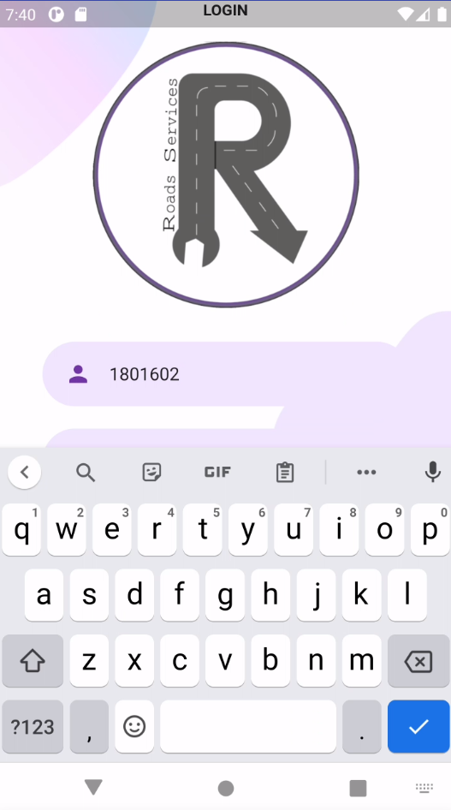
The login screen where you enter your ID and password.

Slide 46
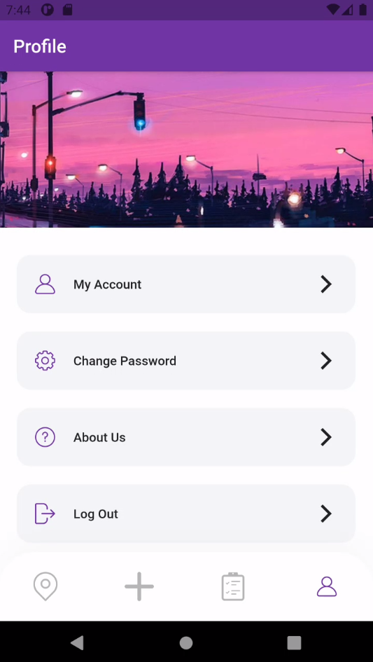
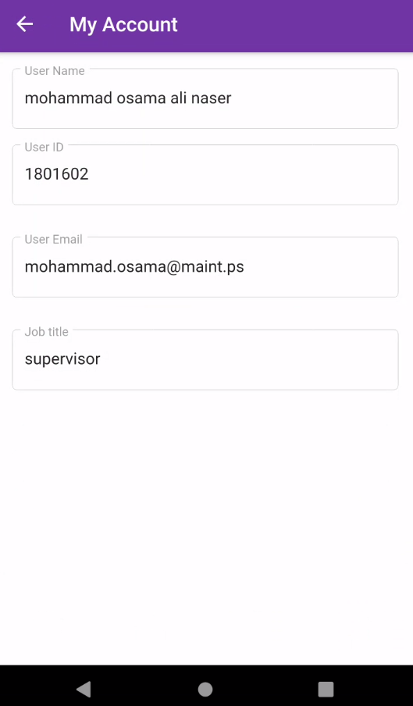
The following pic shows when the password isn't correct then after it had been corrected it will be routed to profile page.

Slide 47
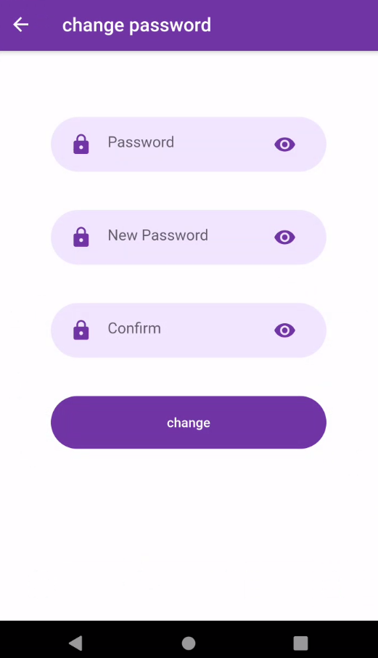
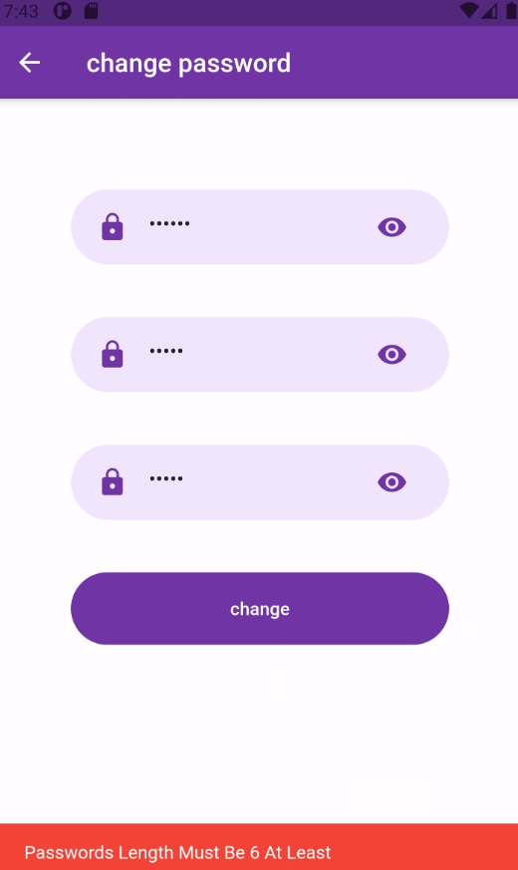
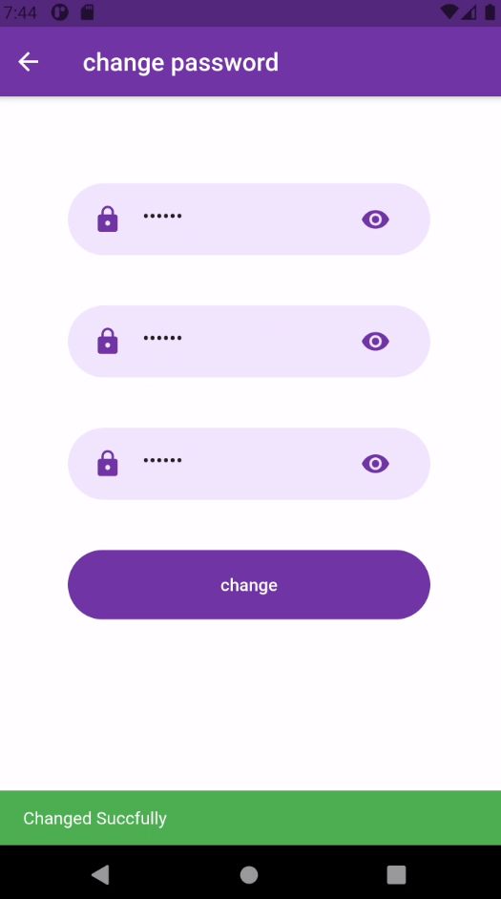
You can also change your password or create one that has to 6 or more digits

Slide 48
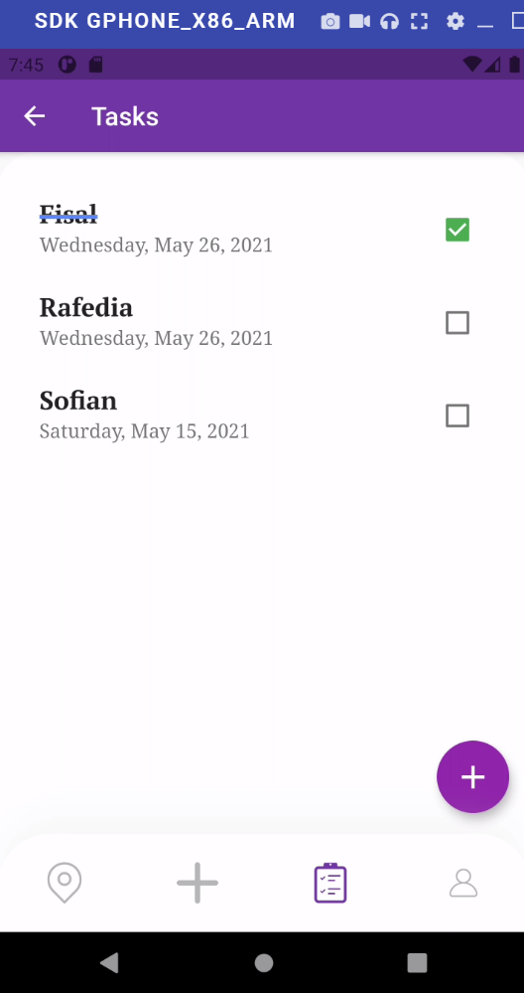
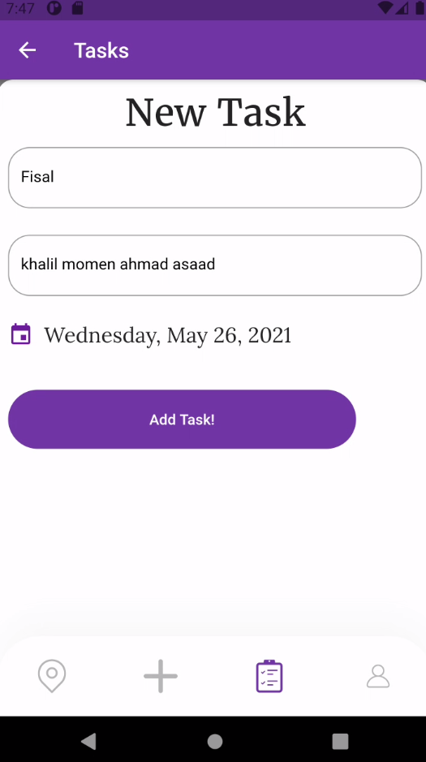
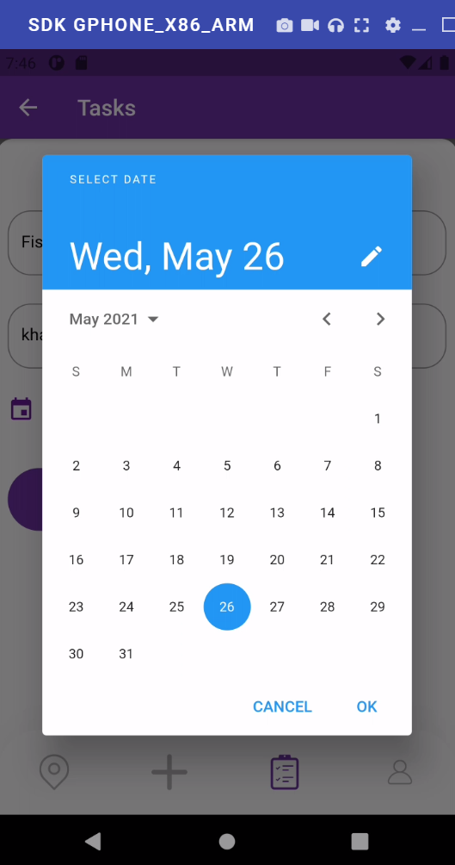
Task Screen where the tasks needed to be worked on are added with the street name and dates.

Slide 49
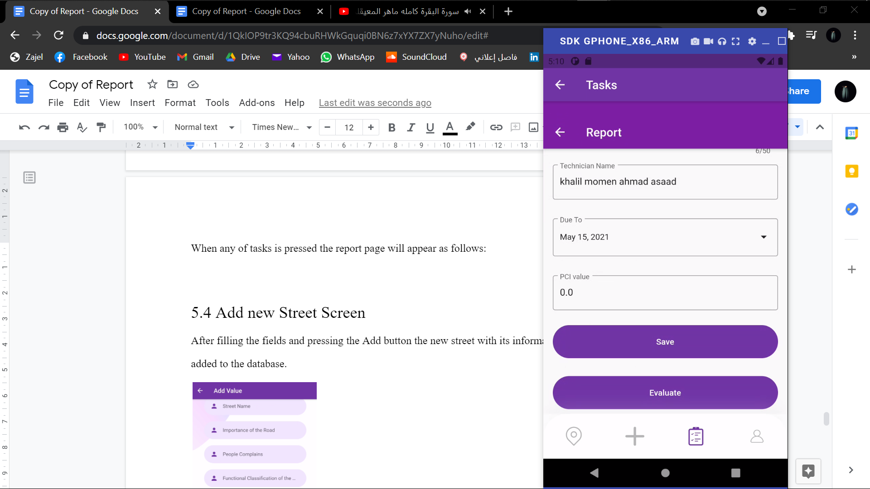
When any of the tasks is pressed the report page will appear as follows:

Slide 50
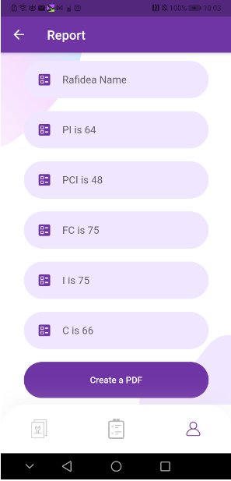
And when evaluate button is pressed the PI value will be calculated and the final report page will be shown
And it can be converted to PDF as is shown:

Slide 51
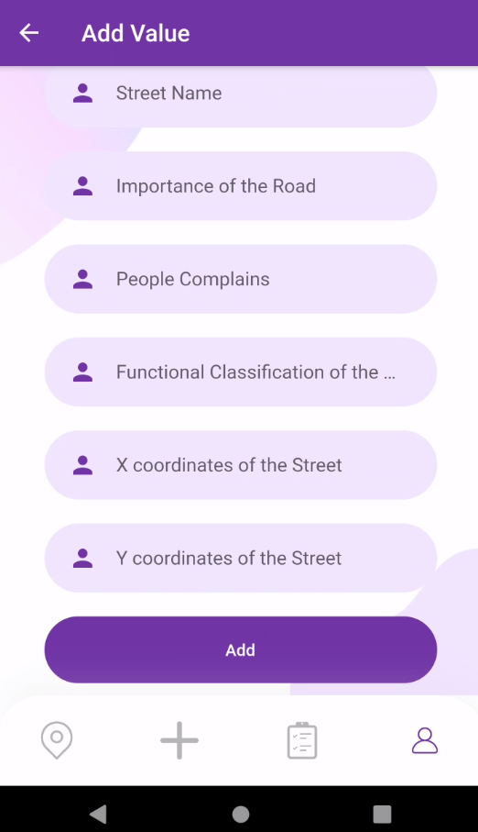
Adding new streets is done as follows:
After filling the fields and pressing the Add button the new street with its information will be added to the database.

Slide 52
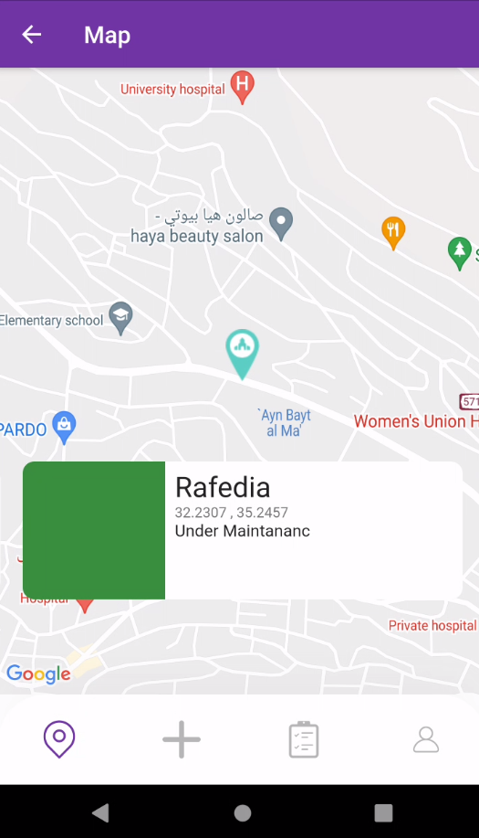
Each street is presented as this picture; the color indicates the Street situation bad (red) to good (green).
Map Screen

Slide 53
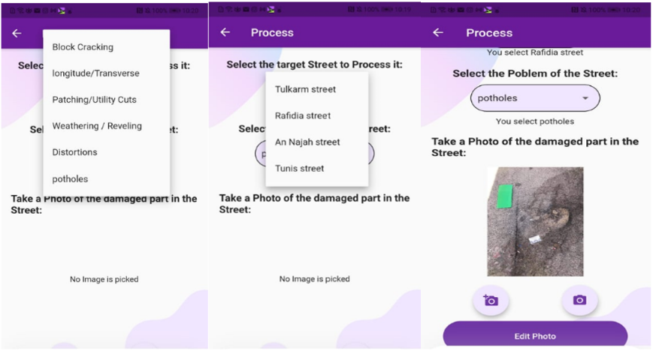
First, the user gets the entire streets name from the database and select one, then select the problem in the street from the database, after that we chose the image from the gallery or from camera:
Image Processing

Slide 54
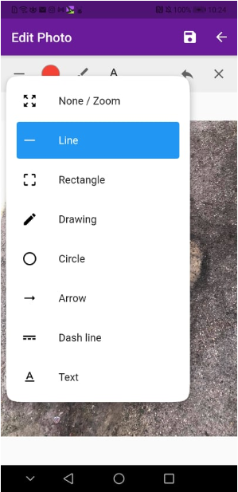


Then edit the photo to surround the area of damage:
Image Processing part 2

Slide 55


Apply Processing
The result of edit

Slide 56
Conclusion and Recommendations
The project team used the Fuzzy logic to examine the PI equation in the OMM. The results indicated that there is a tangible difference between the two values of the PI. However, when comparing the PI resulted from Fuzzy logic and PI from expert’s opinion, the results were close and strong correlation is achieved.
The use of the proposed mobile application is expected to lower the cost of inventory and data collection related to the pavement distresses.
The technician will only take a photo for the nominated distress and upload the photo with the results of Pavement Condition Index (PCI) and Priority Index PI to the server. Moreover, the team used the image processing through mobile app to investigate and calculate PCI and as a result calculating the PI. The dealing with app is easy and well-trained workers from Nablus Municipality department of public works can handle it.

Slide 57
Recommendations and Future Work
Based on the results concluded, the team recommend the following:
To add more rules to the system in order to improve the results.
To consider new indicators in the PI equation such as Average Daily Traffic, Maintenance Cost, etc., and re-distribute weights accordingly.
To increase the sample size in order to get more confidence results
To adopt the mobile app by the Palestinian Municipality to facilitate the process of data collection and PCI estimation.
To use a more advanced technology in image processing such as the car mounted-measurement cameras that give better accuracy and save time and cost needed.

Slide 58
THE END

