Slide 1
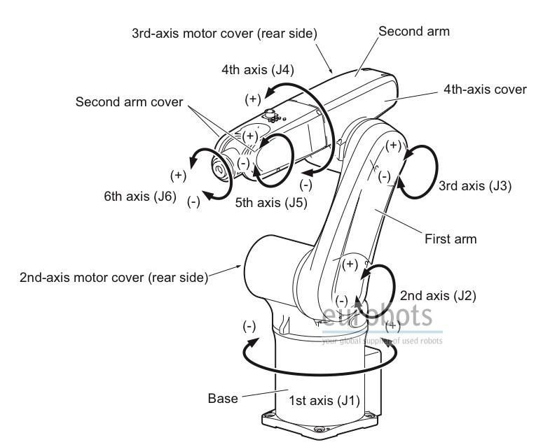
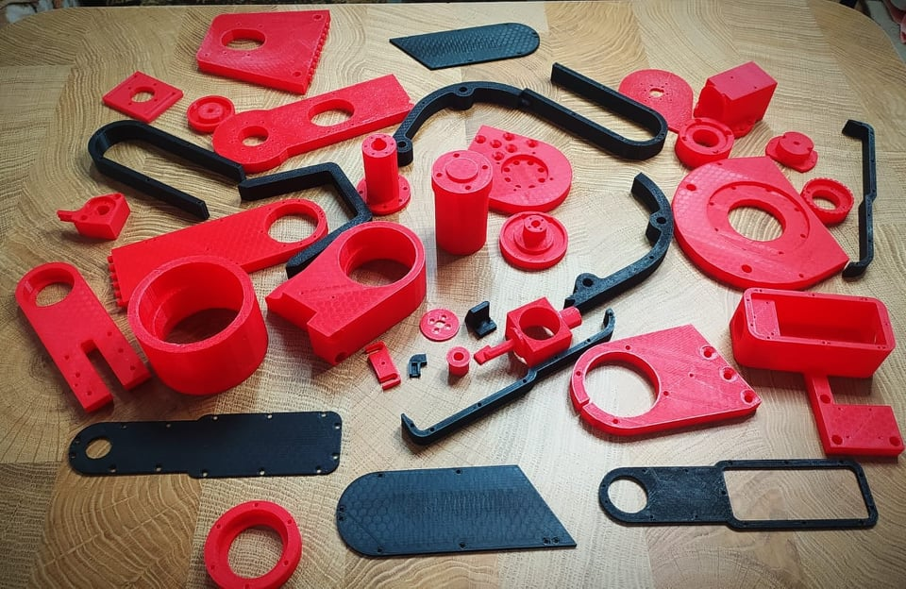
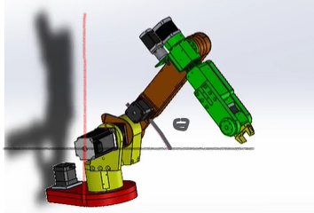
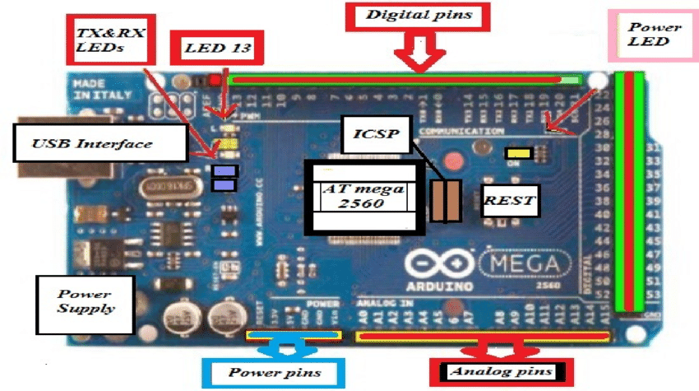
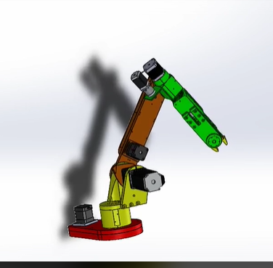
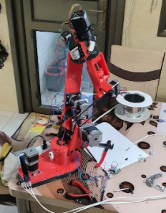
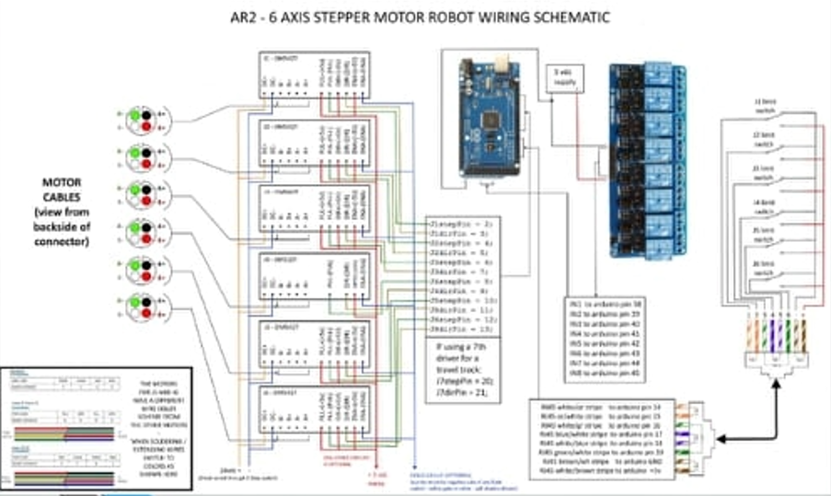
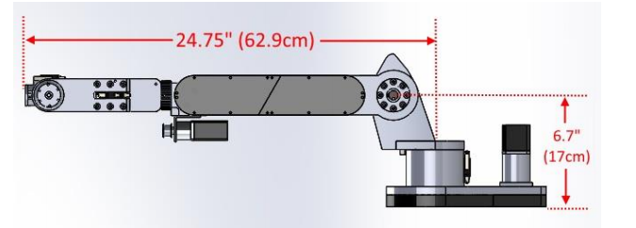
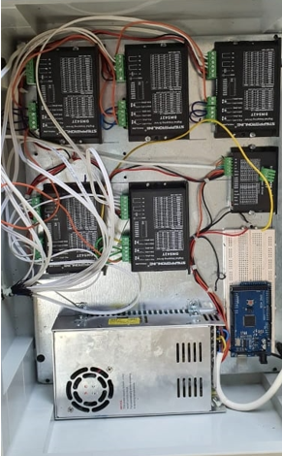
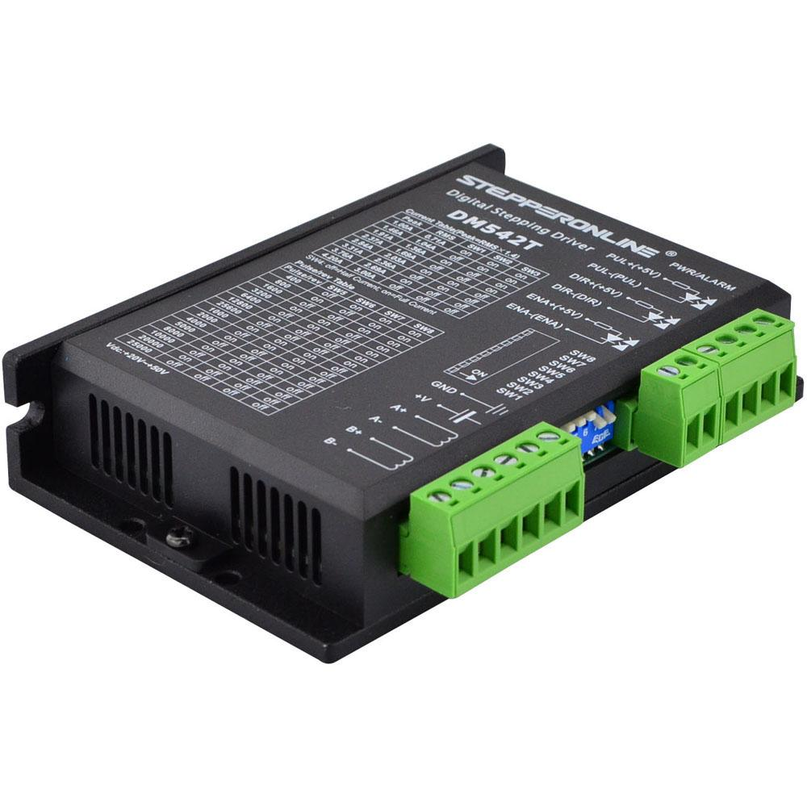
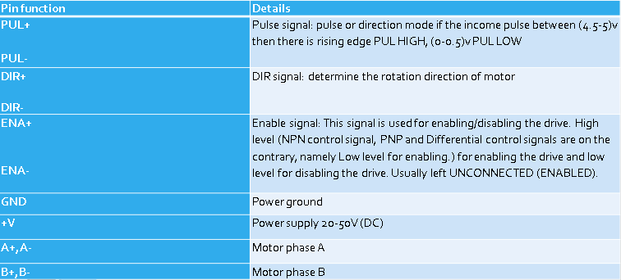
Industrial Robotic Arm
Names: Abd AL-Rhman Khwaireh, Mutaz Alul, Noor AL-Deen Salah , Harith Bane fadel
Supervision: D.Omar Tamimi, D.Mahmoud Assad Dwikat
Abstract
Kinematic analysis
3D parts
Controller AT-mega2560
Simulation
The idea of the project is designing and building robotic arm, this robot will use achieve/ help in industrial field as welding process, Transporting goods, which can be used for personal purposes such as helping with kitchen work
To build this project must be accuracy in design is high, Studying the weight of the loads that the robot can carry, selecting a suitable actuators for each joint, each actuator need to driver, assembly robotic arm.
Robotic Arm
Advantages
Standard project
Products more accurate.
Less period of time to give final product.
less workers.
Number of products will be more than traditional ways.
More reliability than human.
Reach – 24.75 inches (62.9cm)
Payload – 4.15 lbs (1.9kg)
Accuracy - .01mm
Repeatability - .75mm
6 axis arm
Aluminum parts : 50% hardness.
Forward and inverse movement
Disadvantages
Regular maintenance
high price depending on the application, need professional persons in robotics field
Complex construction
Control board
Results
Our project with new idea as a graduation project with a lot of challenges but these challenges encourage us to improve our skills and it made a combination between two types of engineering also it made a new friendship between Palestinian university and Tunisian university we exchanged information with Tunisian students and they gave us a perfect simulation on solid work software so as a conclusion from this project in future this field will be more common in our country
Driver operation

