Slide 1
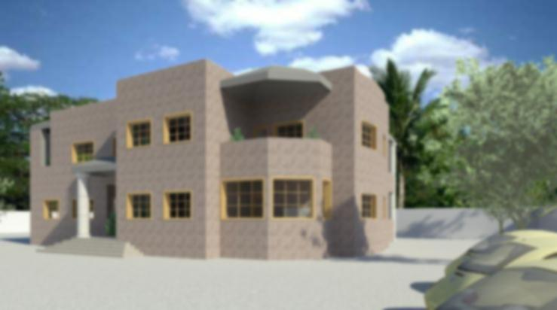
}السلام عليكم ورحمة الله وبركاته{

Slide 2
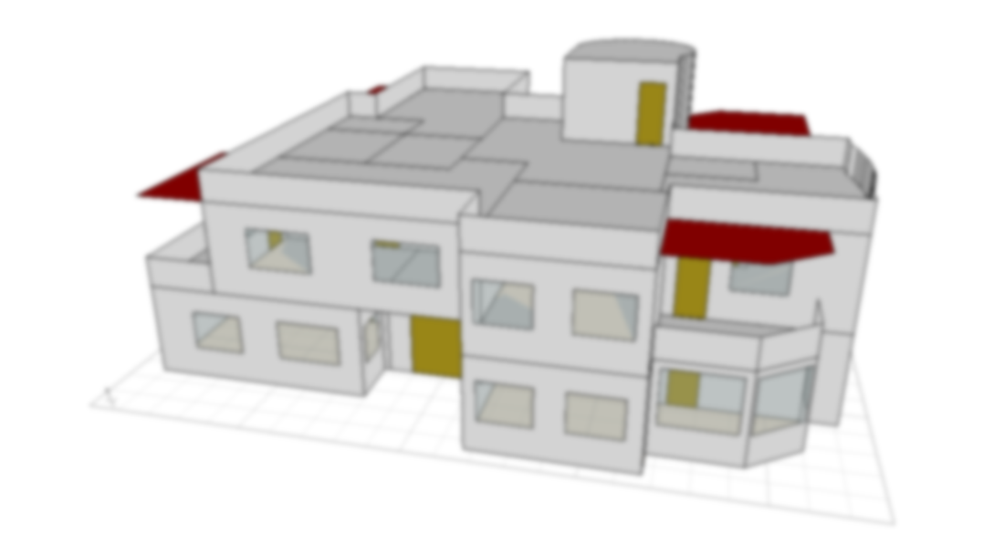

An-Najah National University
Faculty of Engineering
Building Engineering Department
Graduation Project II
Villa
Prepared by:
Muna Sbaihat
Supervisor:
Dr. Eehab Hejazi
2015

Slide 3
Outlines:
The site of the Villa.
Architectural design.
Electrical design.
Environmental design.
Mechanical design.
Structural and Seismic design.
Safety design.

Slide 4
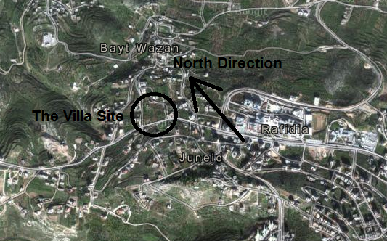
Site of the Villa:
Site and Location: 7000 m²

Slide 5
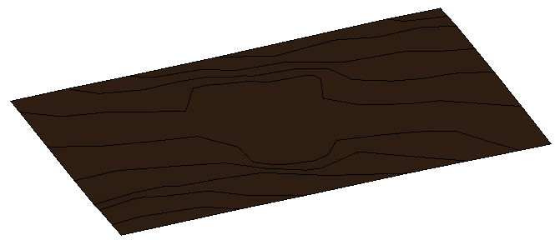
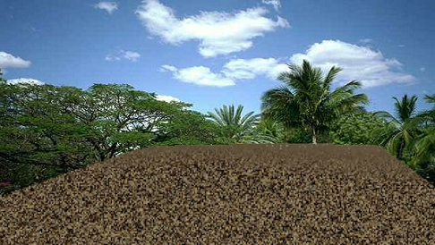
Site of the Villa:
Site and Location: The Land

Slide 6
Architectural Design

Slide 7
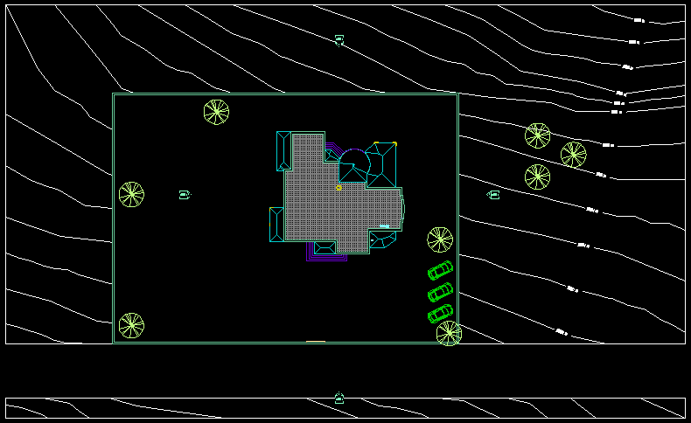
The Site Plan of the Villa:

Slide 8
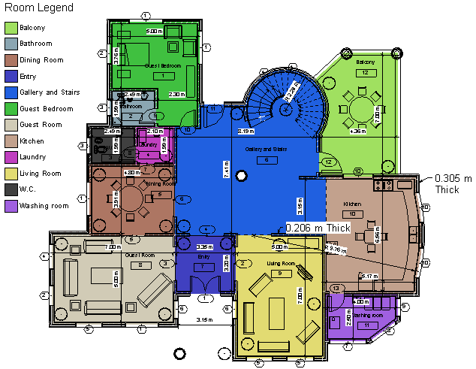
Ground Floor (Area = 293.55m²):

Slide 9
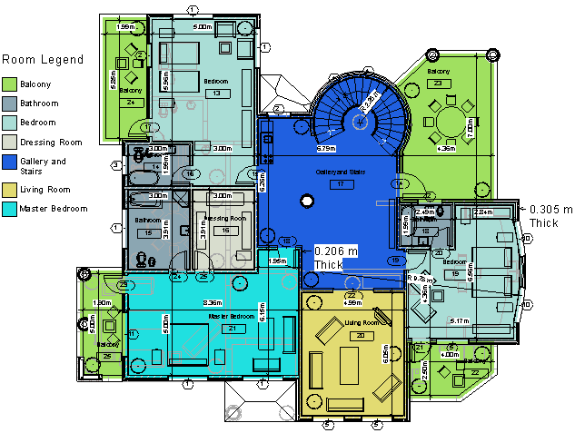
First Floor (Area = 313.65m²):

Slide 10
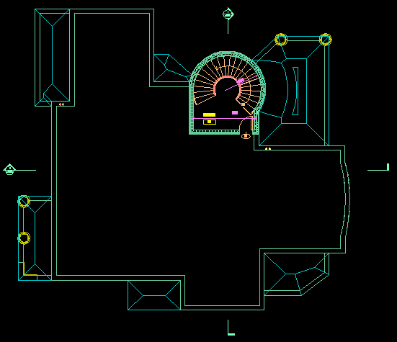
Roof Plan (Area = 313.65m²):

Slide 11
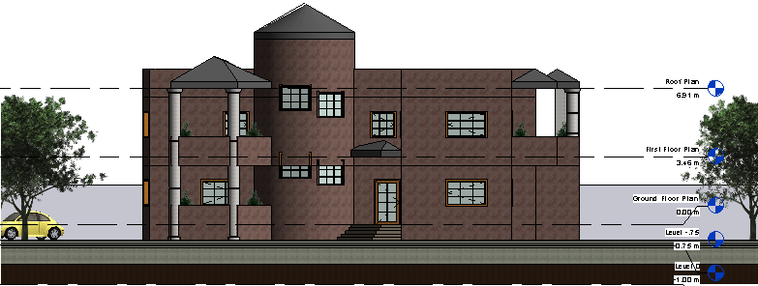
North Elevation:

Slide 12
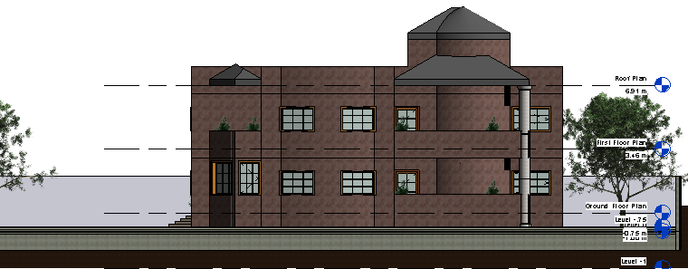
East Elevation:

Slide 13
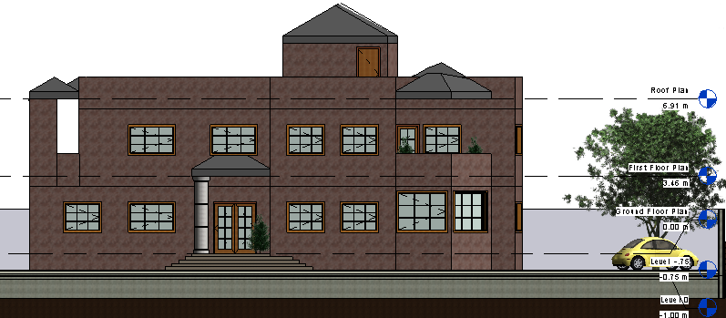
South Elevation:

Slide 14
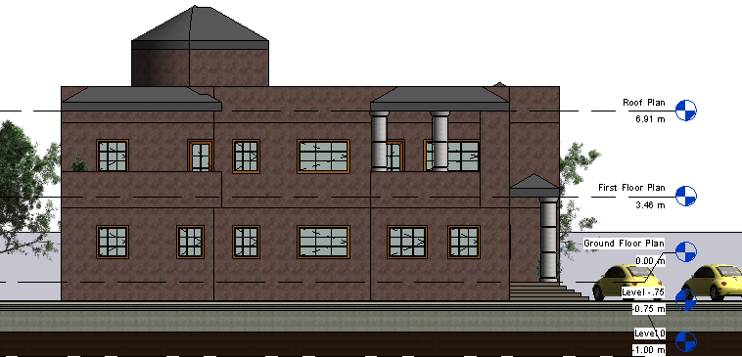
West Elevation:

Slide 15
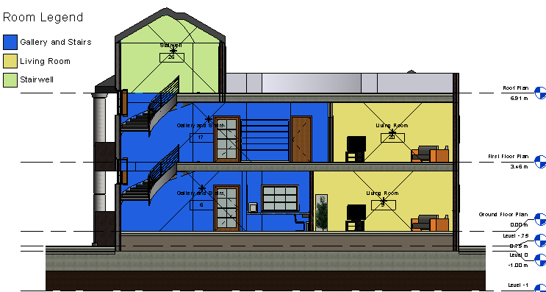
Stairs Section:

Slide 16
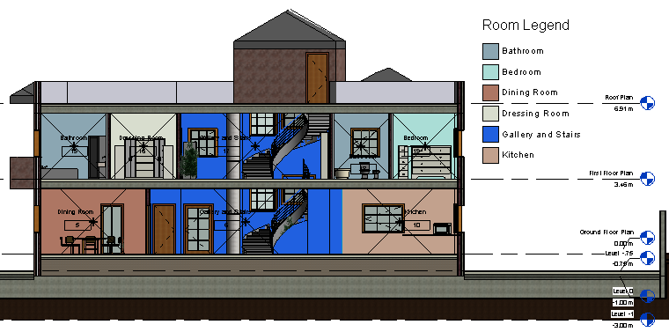
Villa Section:

Slide 17

3D view for my Villa:

Slide 18
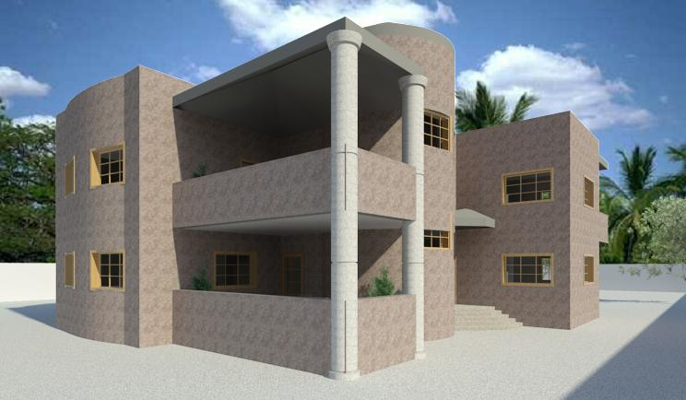
3D view for my Villa:

Slide 19
Electrical Design

Slide 20
Lux values for each space in residential buildings, due to Egyptian code:
Space |  | Intensity of illumination (lux)
Residential buildings | Stairs | 120
 | Corridors | 60
 | Living room:
 | General | 150
 | Reading | 300
 | Dining room | 120
 | Bedroom | 120
 | Kitchen:
 | General | 120
 | Above work surfaces | 500
 | Bathroom: | 300
 | Office Room:
 | General | 300
 | Above work surfaces | 500

Slide 21
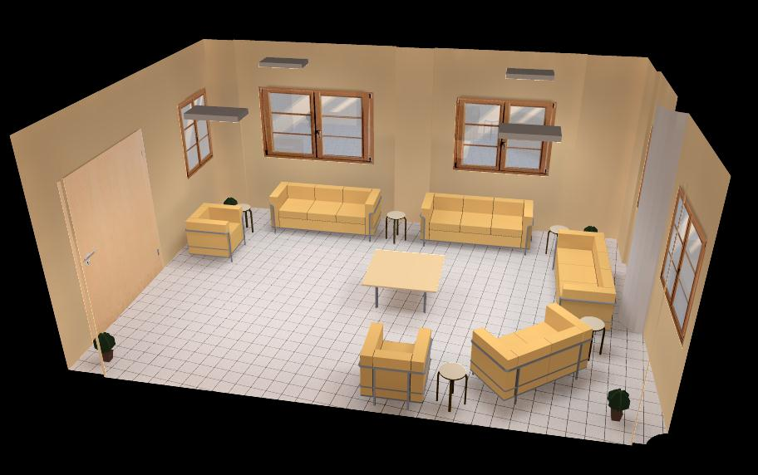
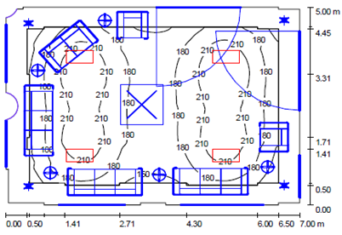
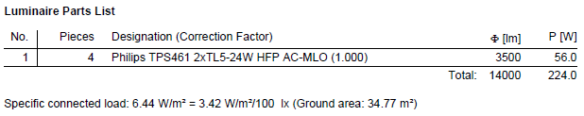
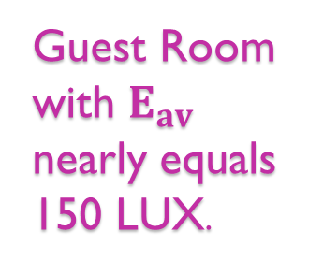
Guest Room:
Guest Room with $E_{av}$ nearly equals 150 LUX.

Slide 22
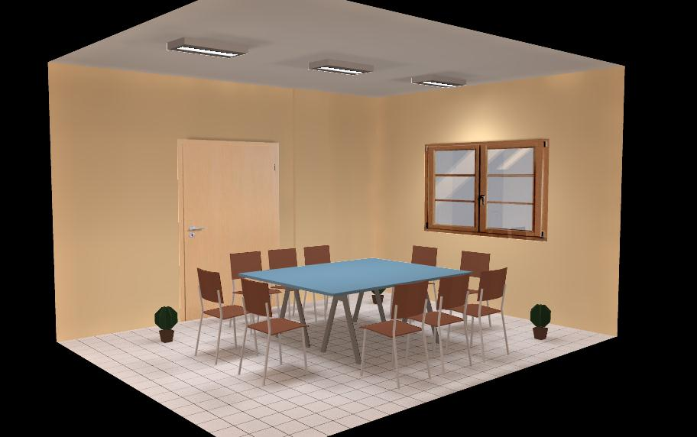
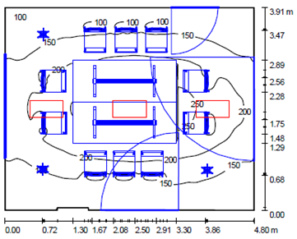
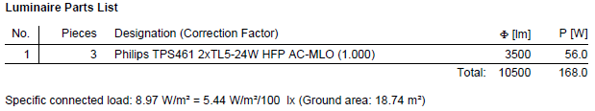
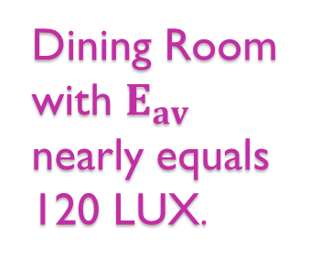
Dining Room:
Dining Room with $E_{av}$ nearly equals 120 LUX.

Slide 23
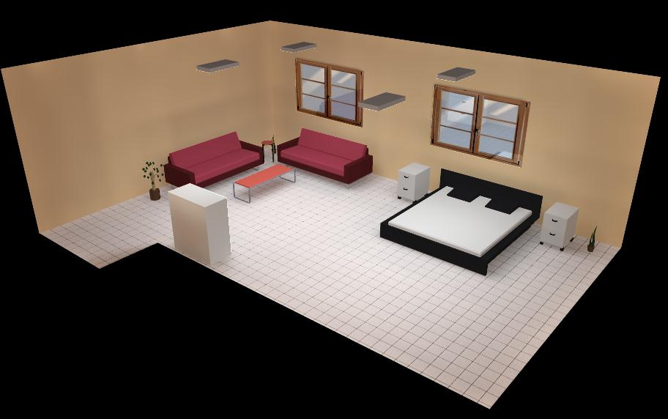
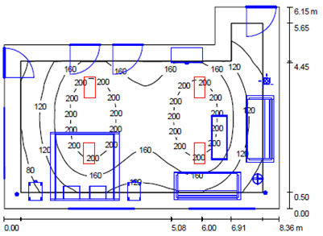
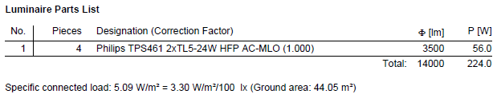
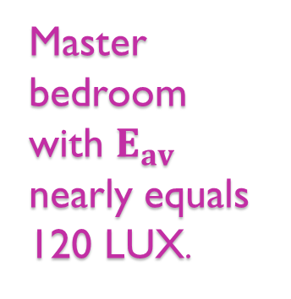
Master Bedroom:
Master bedroom with $E_{av}$ nearly equals 120 LUX.

Slide 24
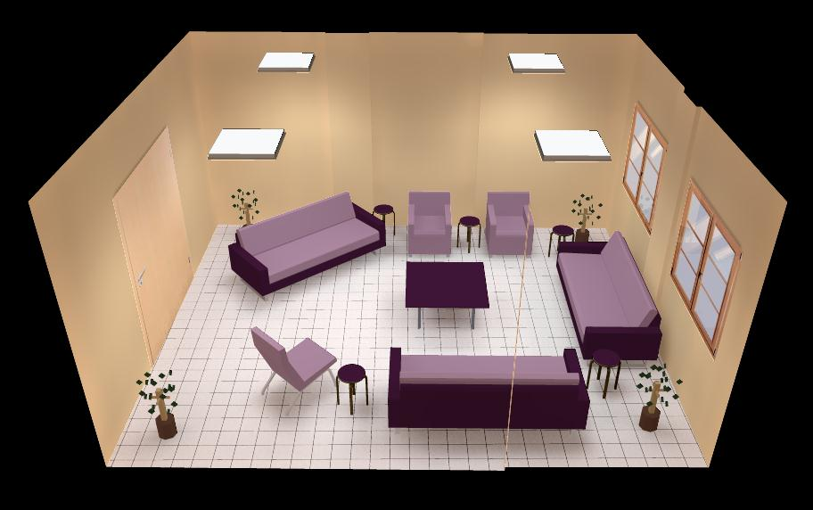
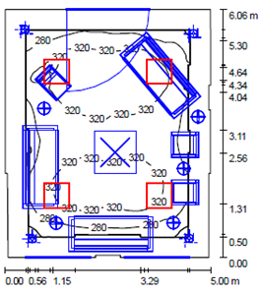
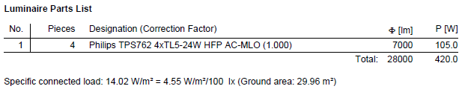
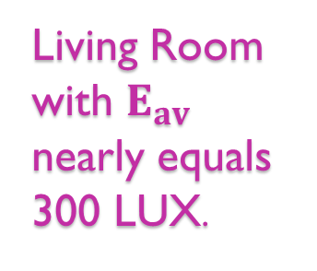
Living Room:
Living Room with $E_{av}$ nearly equals 300 LUX.

Slide 25
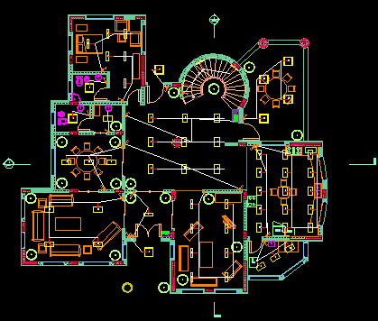
AutoCAD drawing shows location of switches and lamps for the ground floor:

Slide 26
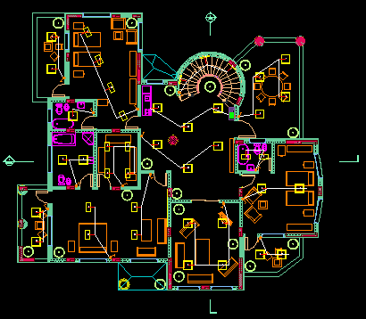
AutoCAD drawing shows location of switches and lamps for the first floor:

Slide 27
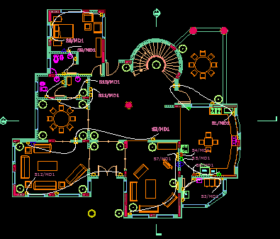
AutoCAD drawing shows location of sockets for the ground floor:

Slide 28
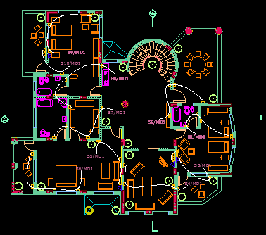
AutoCAD drawing shows location of sockets for the first floor:

Slide 29
Environmental Design

Slide 30
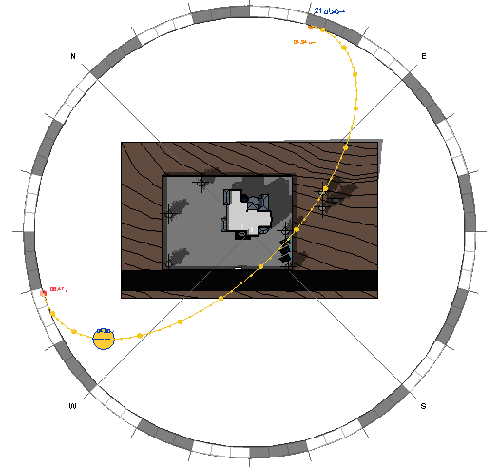
Orientation of the Villa:

Slide 31
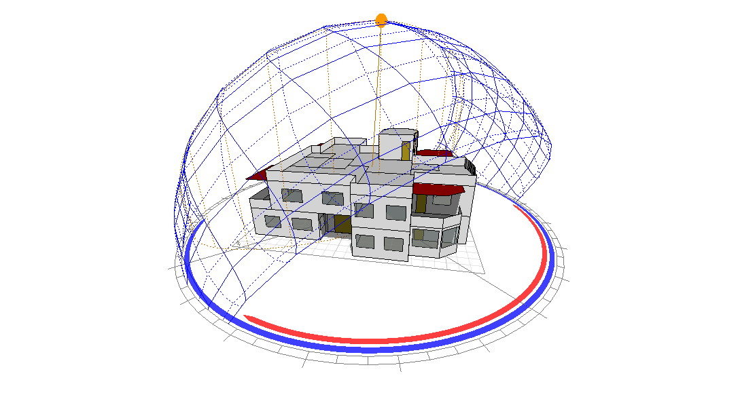
Sun Bath:

Slide 32
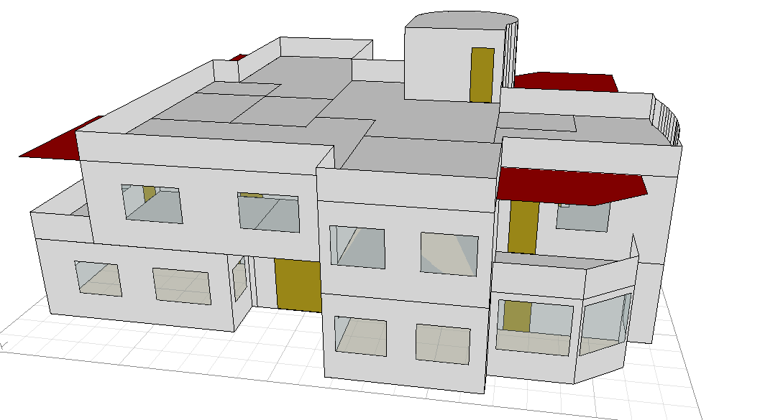
Ecotect model for the Villa:

Slide 33
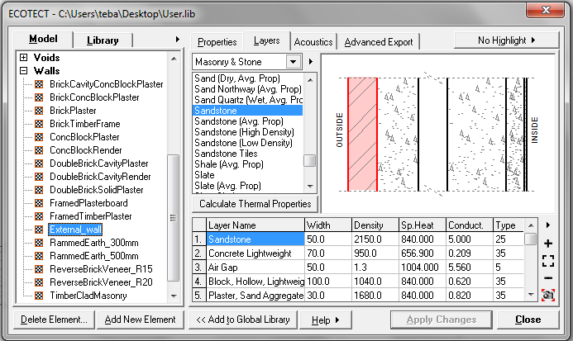
Layers for the external walls:
U-Value of the external wall shown in the figure, is equals to 0.23 (W/m².K), from Eotect program.
Layer | Width (mm) | Density | Sp. Heat | Conduct.
Sandstone | 50.0 | 2150.0 | 840.000 | 5.000
Concrete Lightweight | 70.0 | 950.0 | 656.900 | 0.209
Air Gap | 50.0 | 1.3 | 1004.000 | 5.560
Block, Hollow, Lightweight, 150m# | 100.0 | 1040.0 | 840.000 | 0.620
Plaster, Sand Aggregate | 30.0 | 1680.0 | 840.000 | 0.820
Plaster Building (Molded Dry) | 5.0 | 1250.0 | 1088.000 | 0.431

Slide 34
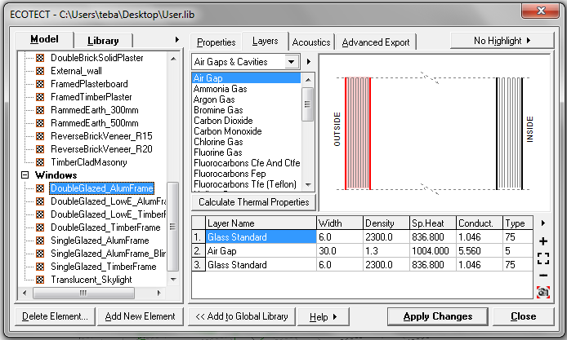
Layers for the windows:
U-Value of the windows shown in the figure, is equals to 2.71 (W/m².K), from Eotect program.
Layer | Width (mm) | Density | Sp. Heat | Conduct.
Glass Standard | 6.0 | 2300.0 | 836.800 | 1.046
Air Gap | 30.0 | 1.3 | 1004.000 | 5.560
Glass Standard | 6.0 | 2300.0 | 836.800 | 1.046

Slide 35
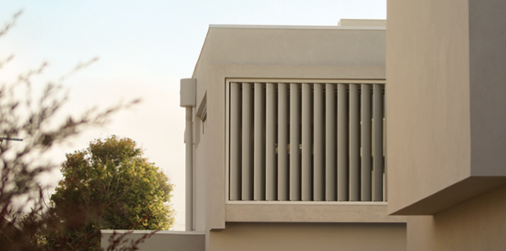
For windows in east, west and north elevations I used vertical louvers:

Slide 36
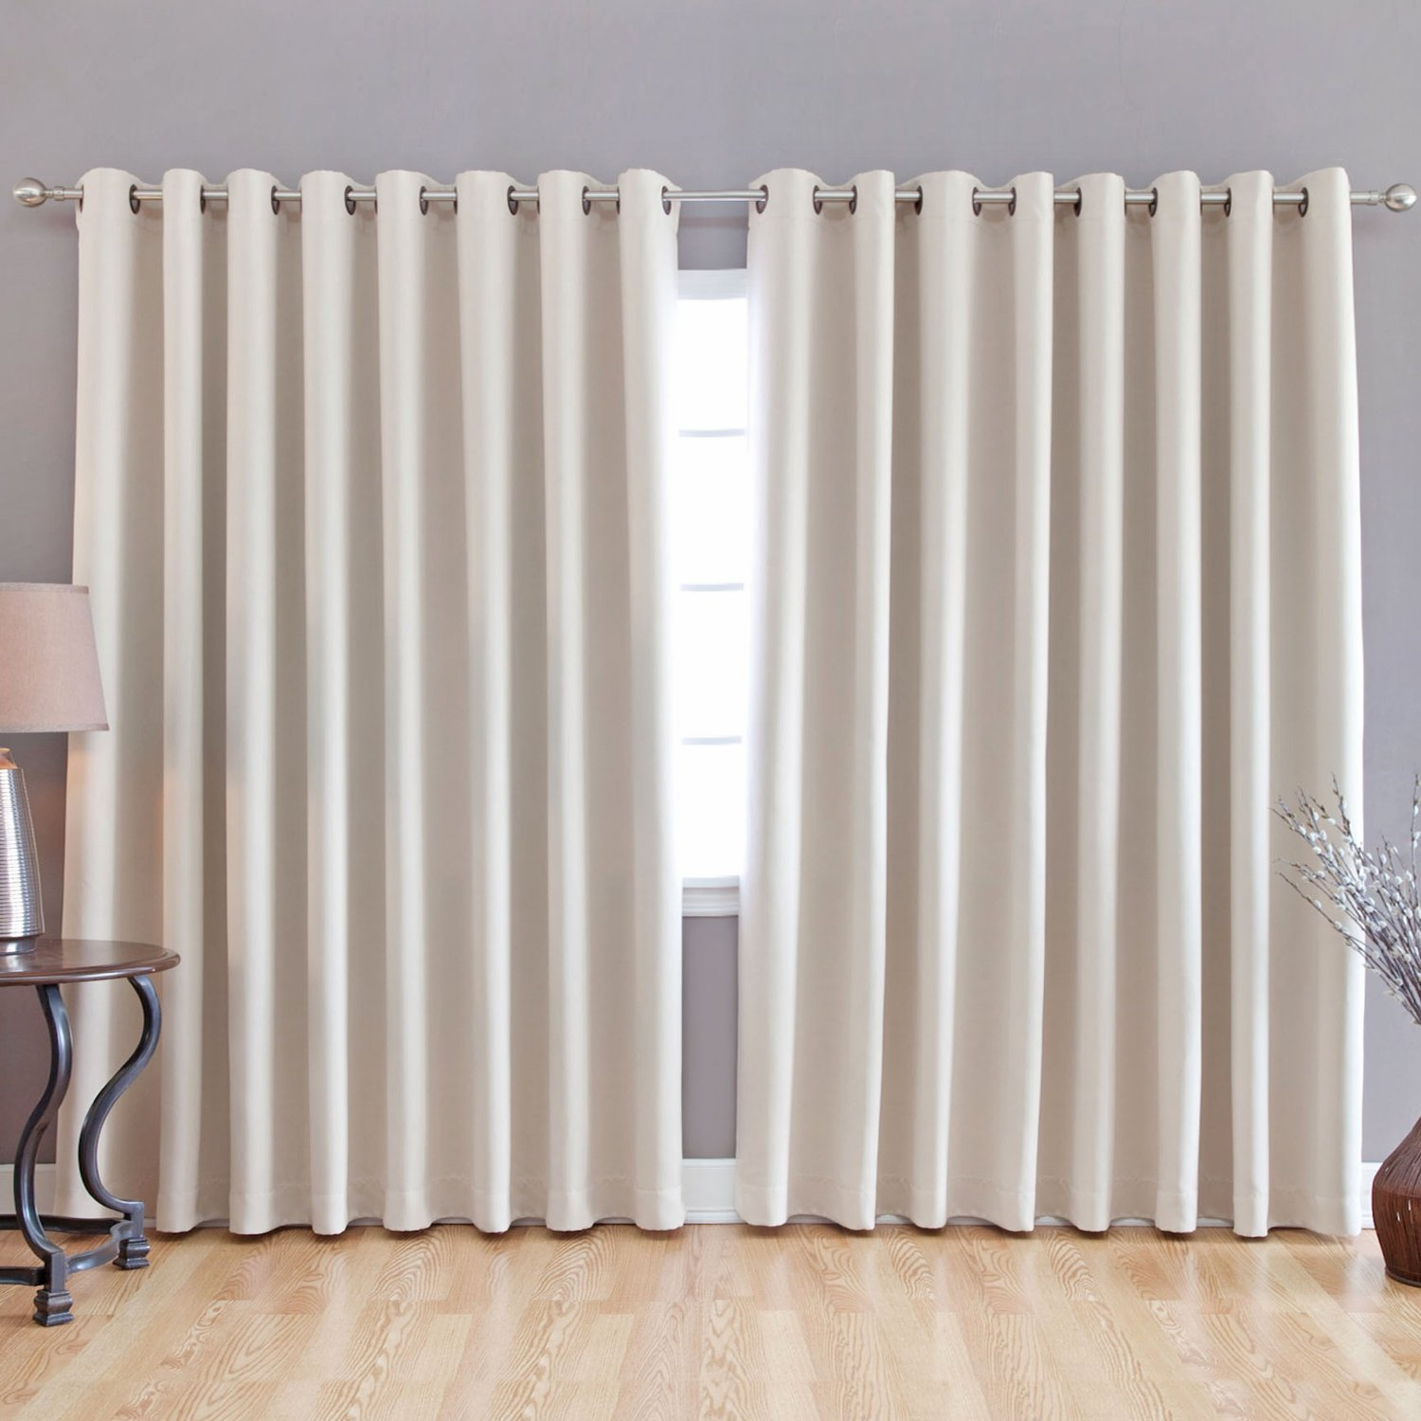
For windows in south elevation I used internal curtains:

Slide 37
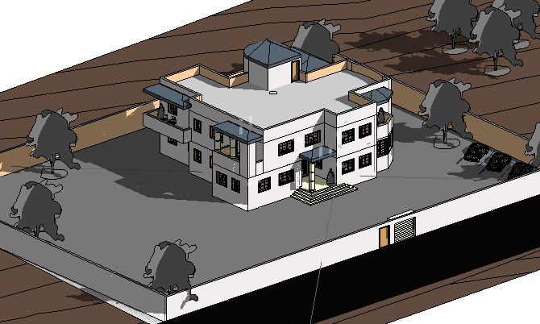
In addition to existence of some deciduous trees in the back and sides of the Villa.

Slide 38
Thermal Calculations:
The suitable range for total heating and cooling loads per one meter in any building is between 30 Kwh and 80 Kwh; in my Villa it is about 58.076 Kwh and this is good.

Slide 39
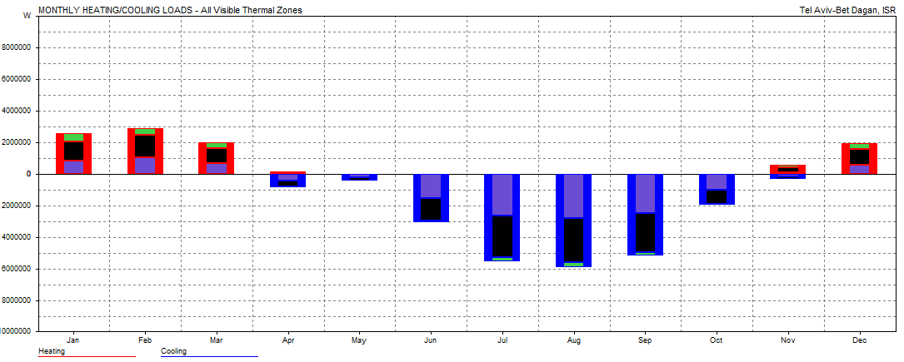
Thermal Calculations:

Slide 40
Mechanical Design

Slide 41
In my Villa mechanical design consists of:
Water supply system
Drainage system design

Slide 42
Water supply system:
The main water supply of my villa is from the public water.
Two small tanks on the roof of the villa with capacity of 5000m³.
Pump between the main supply line and the small tanks on the roof.

Slide 43
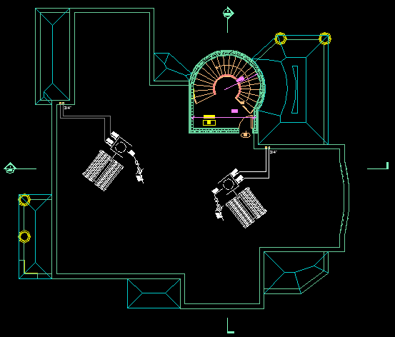
Water supply system:
Tanks on the roof

Slide 44
Water supply system:
In my project I divided the villa for two zones, and I calculated the suitable size of the pipes for vertical and horizontal feeders and the critical branches
Total fixture units for zone1 = 36 FU’s, and water demand = 28 gpm.
Total fixture units for zone2 = 15 FU’s, and water demand = 15 gpm.

Slide 45
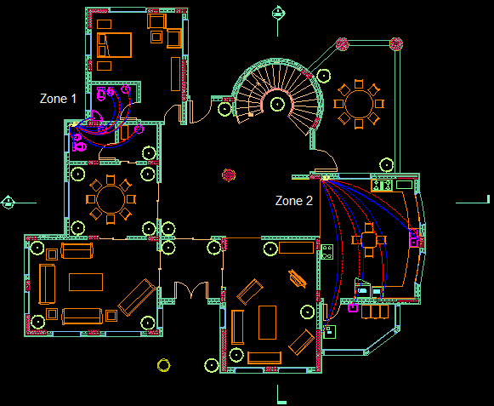
Water supply system:
The main two zones for water supply for the ground floor.

Slide 46
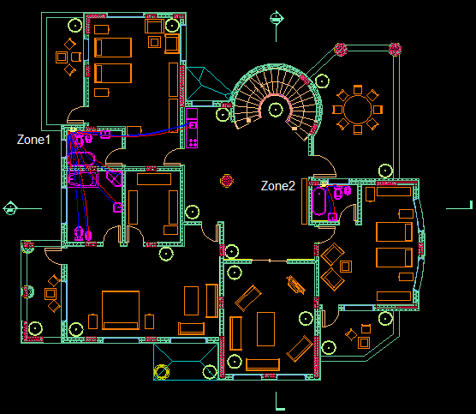
Water supply system:
The main two zones for water supply for the first floor.

Slide 47
Water supply system:
By calculations and using all tables and figures needed I found that:
The suitable diameter for vertical feeder (2"), horizontal feeder (1") and branches (3/4") for both zones in the ground and first floors.
I used the galvanized steel for the vertical feeder and PVC for horizontal and branches.

Slide 48
Water supply system:
For hot water supply I used two solar collectors on the roof of the villa.
Hot water pipes diameters will be the same of the cold water pipes diameters used.

Slide 49
Drainage system design:
To try making the building environmentally-friendly building, the drainage system was divided into three types:
Black water: to public sewage network.
Gray water: for irrigation.
Storm water: can be used again.

Slide 50
Drainage system design:
By using suitable tables:
Fixture unit | Drainage fixture unit | Diameter size (inch)
Shower head | 2 | 2
water closet with flush meter tank | 4 | 4
Wash up basin | 2 | 2
Dishwasher | 2 | 2
Washer | 2 | 2
Bidet | 1 | 2
Kitchen sink | 2 | 2
Bathtub | 2 | 2
Stacks, vents and manholes with diameter = 4”.

Slide 51
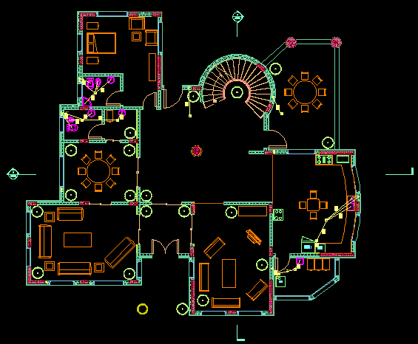
Drainage system design:
Autocad drawing shows a plan of drainage fixture units for the ground floor:

Slide 52
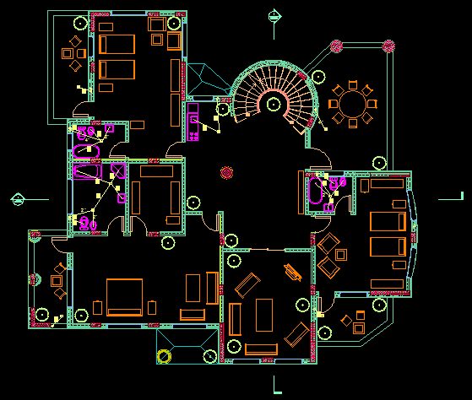
Drainage system design:
Autocad drawing shows a plan of drainage fixture units for the first floor:

Slide 53

Drainage system design:
Sewage:

Slide 54
Structural and Seismic Design

Slide 55
Design codes:
The American Concrete Institute code ACI 318-08.
The seismic design according to UBC-97.
The analysis and design were done using SAP2000 program.

Slide 56

Design Data:
Concrete compressive strength:
For slab fc’ = 24$M_{pa}$.
For columns fc’ = 28$M_{pa}$.
Yielding strength of steel:
$F_{y}$ = 420$M_{pa}$.
Bearing capacity of soil:
Bearing capacity = 250 KN/$m^{2}$.

Slide 57

Design Data:
Structural system:
One way ribbed slab with hidden beams.
Slab thickness:
For slab as one end continues use = $\frac{L_{n}}{18.5}$= $\frac{5.45}{18.5}$ = 0.29 m.
For beams as simply supported use =$\frac{L_{n}}{16}$ = $\frac{4.9}{16}$ = 0.3 m.
Then I will use ribbed slab with hidden beams with thickness of 0.3m.

Slide 58
Beams dimensions:
Beam | Dimensions (m) | Bottom Steel | Top Steel | Stirrups
B1 | .6 * .3 | 5 ø 14 | 7 ø 18 | 2 ø 8/ 10cm
B2 | .8 * .3 | 6 ø 16 | 5 ø 16 | 2 ø 10/ 10cm
B3 | .3 * .3 | 3 ø 12 | 3 ø 12 | 1 ø 8/ 10cm
B4 | .6 * .3 | 4 ø 16 | 4 ø 16 | 1 ø 8/ 10cm
B5 | .8 * .3 | 7 ø 16 | 7 ø 18 | 2 ø 10/ 10cm
B6 | .8 * .3 | 6 ø 14 | 6 ø 14 | 2 ø 10/ 10cm
B7 | .8 * .3 | 6 ø 12 | 5 ø 12 | 1 ø 10/ 10cm
B8 | .8 * .3 | 6 ø 14 | 5 ø 12 | 2 ø 10/ 10cm
B9 | .4 * .3 | 5 ø 12 | 5 ø 12 | 1 ø 8/ 15cm
B10 | .4 * .3 | 5 ø 14 | 5 ø 16 | 1 ø 10/ 13cm
B11 | .8 * .3 | 5 ø 12 | 6 ø 14 | 2 ø 10/ 10cm
B12 | .8 * .3 | 8 ø 16 | 10 ø 18 | 2 ø 10/ 10cm
GB | .35 * .5 | 4 ø 14 | 4 ø 14 | 1 ø 10/ 25cm

Slide 59
Columns dimensions:
Column | Dimensions (m) | Reinforcement
 |  | Longitudinal | Ties
C1 | 0.6 * 0.25 | 8 ø 16 | 1 ø 10/ 25cm
C2 | 0.6 diameter | 12 ø 20 | 1 ø 10/ 25cm

Slide 60
Footings dimensions:
Footing | Dimensions (m) | Longitudinal Reinforcement | Transverse Reinforcement
F1 | 1.80*1.40*0.30 | 6 ø 14 | 8 ø 14
F2 | 1.60*1.60*0.30 | 7 ø 14 | 7 ø 14
F3 | 3.00*1.00*0.30 | 1 ø 14/ 15cm | 1 ø 14/ 15cm
F4 | 2.50*2.50*0.30 | 1 ø 14/ 15cm | 1 ø 14/ 15cm

Slide 61

Distribution of columns and shear walls in the Villa:

Slide 62

Simple 3D model from SAP2000 program:

Slide 63

Compatibility check, deformed shape:

Slide 64

Equilibrium check:
Check | Manual value | SAP value | Error %
Live load | 1910.58 KN | 1872.491 KN | 2%
Super imposed dead load | 5687.44 | 5801.548 | 2%
Dead load | $$7454.18$$ | $$7488.66$$ | 0.46%

Slide 65


Seismic Check:
Design Data:
W = 13290.208 KN
fc’= 280 Kg/cm².
$F_{y}$ = 4200 Kg/cm².
Soil Type: $S_{c}$
Location: Nablus
$C_{a}$ = 0.24
$C_{v}$ = 0.32
I = 1
$C_{t }$= 0.0488
R = 4.5

Slide 66

Natural Period (T) for the Villa:
T (manual) = $C_{t}$* ${h_{n}}^{\frac{3}{4}}$ = 0.208 sec
T (SAP.) = 0.217
% Error = 4.3%.

Slide 67

Structural details:
1) Slab

Slide 68

1) Slab

Slide 69

1) Slab

Slide 70

2) Beams

Slide 71

2) Beams

Slide 72

2) Beams

Slide 73


3) Columns

Slide 74

3) Columns

Slide 75

4) Footings

Slide 76


4) Footings

Slide 77

5) Shear walls

Slide 78


6) Stairs

Slide 79
Safety Design

Slide 80

Safety Signs used and distributed in the Villa:

Slide 81


Safety Signs used and distributed in the Villa:
Extinguishers
Danger electricity

Slide 82


Safety Signs used and distributed in the Villa:
Emergency light
Fire alarm

Slide 83

Safety Signs used and distributed in the Villa:
Smoke detector

Slide 84

AutoCAD drawing shows the distribution of safety signs and tools in ground floor of my villa:

Slide 85

AutoCAD drawing shows the distribution of safety signs and tools in first floor of my villa:

Slide 86


