Slide 1
Hardware Graduation Project 2
STADIUM ROBOT
Supervisor: Dr.Raed Qadi
Presented By:
Kariem AbuAisheh
Yazan Mansour

Slide 2
CONTENT
01
Introduction
02
Features
03
Design & Components
04
Calculations
05
Challenges & Limitations
06
Future Work
07
Conlusion

Slide 3
INTRODUCTION
01
General Background:
  General Background.
  Objectives.
Our project focused transforming the process of marking football fields by introducing an automated Stadium Robot that paints the lines of a football field,
02
Objectives:
  Boost automation in sports field maintenance.
  Autonomously paints lines on a football field.
  Users input field dimensions(Coordinates, Length and width).
  Saves time and reduces physical effort.

Slide 4
FEATURES
01
Football Stadium Line Marker
02
Manual Drawing
03
Mixing
04
Cleaning System
05
Solar Cell Charging

Slide 5
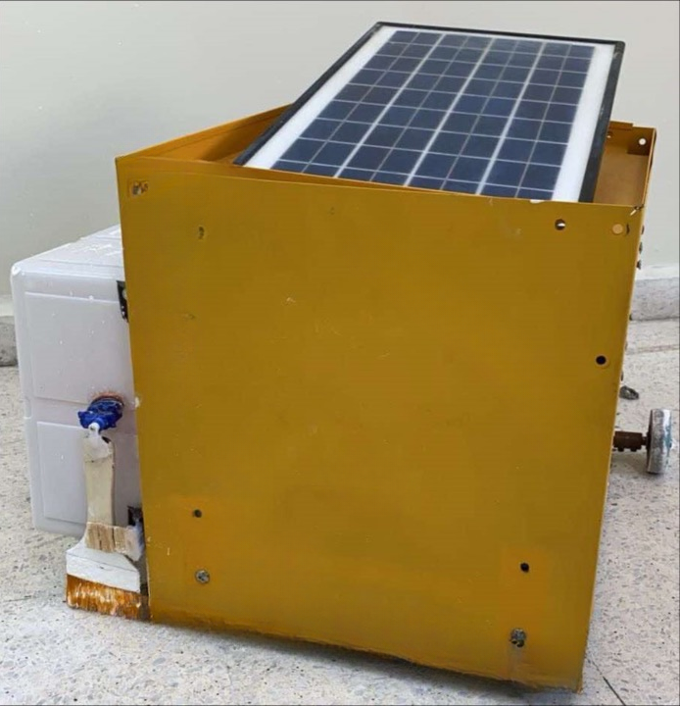
DESIGN & COMPONENTS

Slide 6
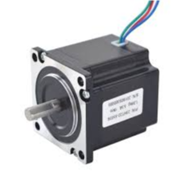
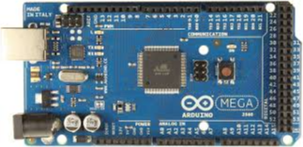
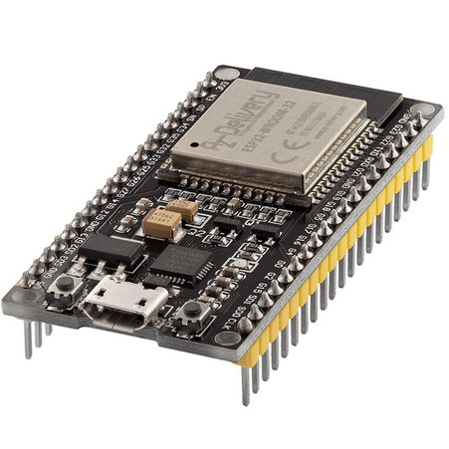
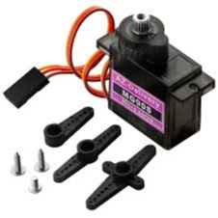
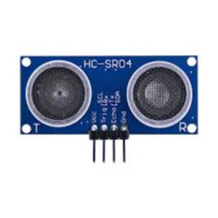
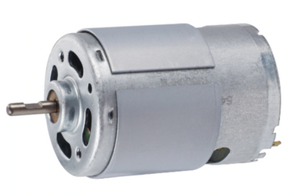
DESIGN & COMPONENTS
ARDUINO MEGA
ESP32
STEPPER MOTOR
DC MOTOR
SERVO MOTOR
ULTRASONIC

Slide 7
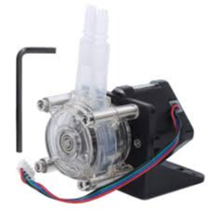
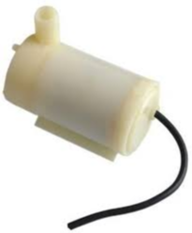
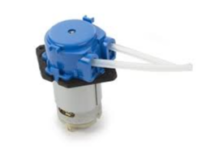
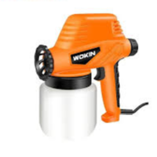
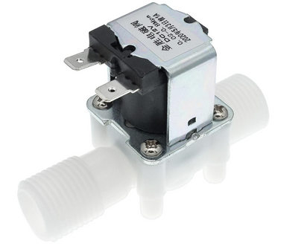
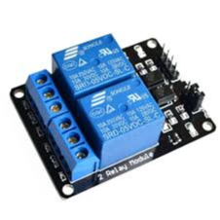

DESIGN & COMPONENTS
TARGET AUDIENCE
PERISTALTIC PUMP
MINI PERISTALTIC PUMP
WATER PUMP
By targeting these diverse audience segments, our marketing agency ensures a customized and impactful approach that aligns with the specific needs and goals of each client.
PAINT GUN
ELECTRIC VALVE
DUAL CHANNEL RELAY
Thynk Unlimited

Slide 8
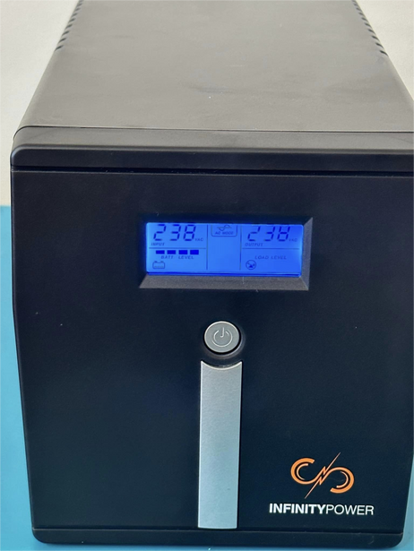
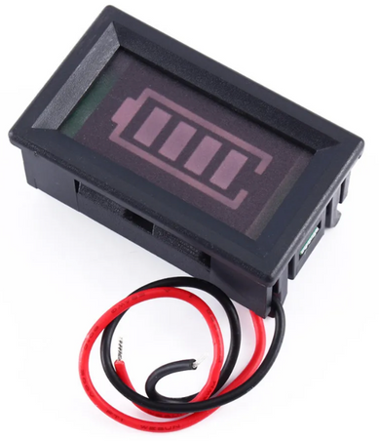
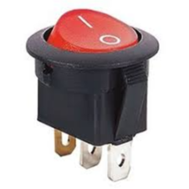
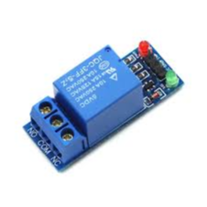
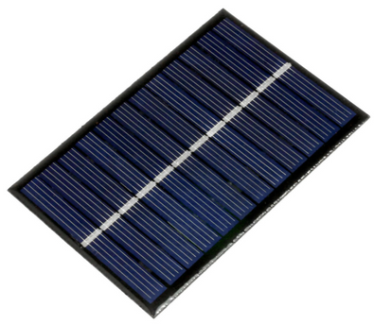
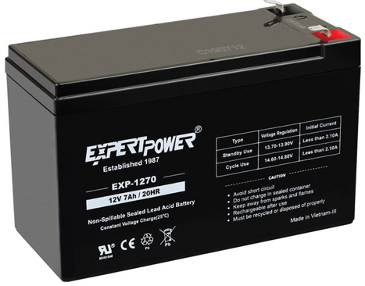
DESIGN & COMPONENTS
TARGET AUDIENCE
UPS
BATTERY INDICATER
SWITCH
By targeting these diverse audience segments, our marketing agency ensures a customized and impactful approach that aligns with the specific needs and goals of each client.
RELAY
SOLAR CELL
ACID BATTERY
Thynk Unlimited

Slide 9
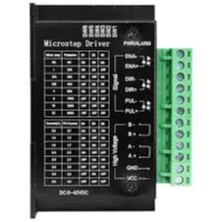
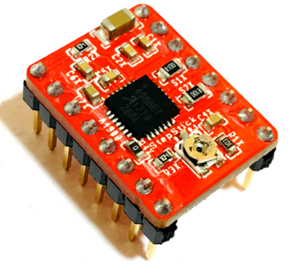
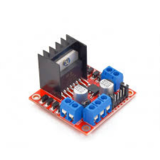
DESIGN & COMPONENTS
TARGET AUDIENCE
By targeting these diverse audience segments, our marketing agency ensures a customized and impactful approach that aligns with the specific needs and goals of each client.
DRIVER A4988
H-BRIDGE
TB6600 4A DRIVER
Thynk Unlimited

Slide 10
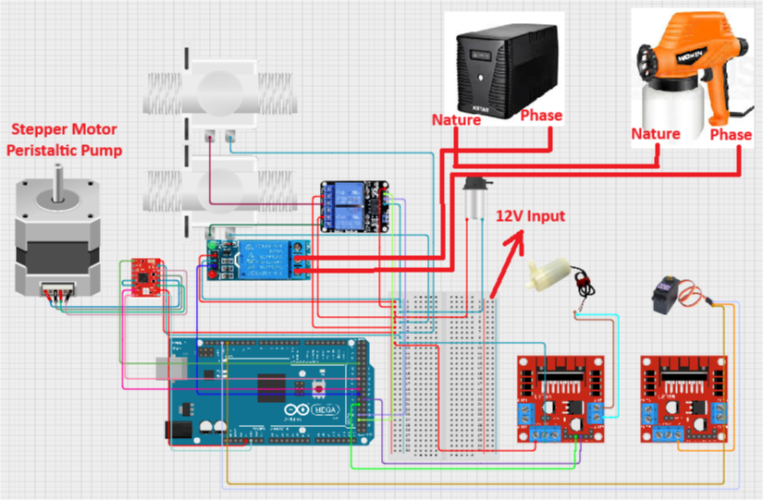
DESIGN & COMPONENTS
PAINT SYSTEM

Slide 11
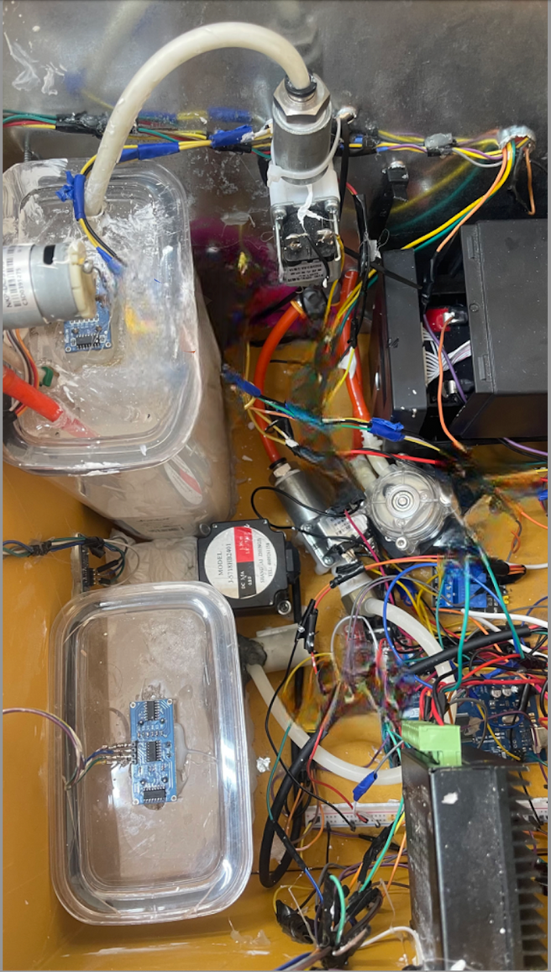
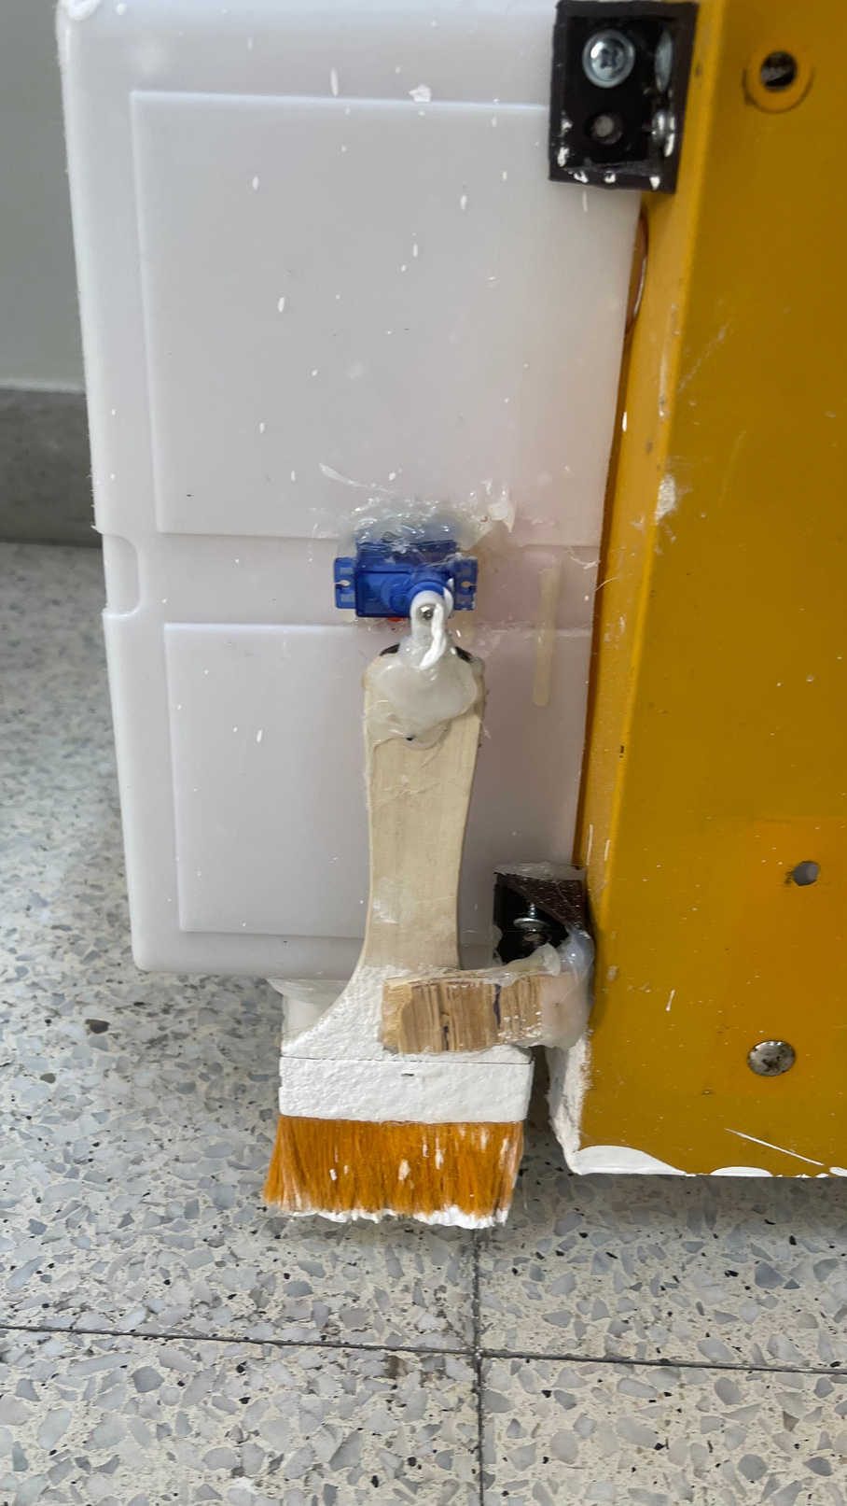
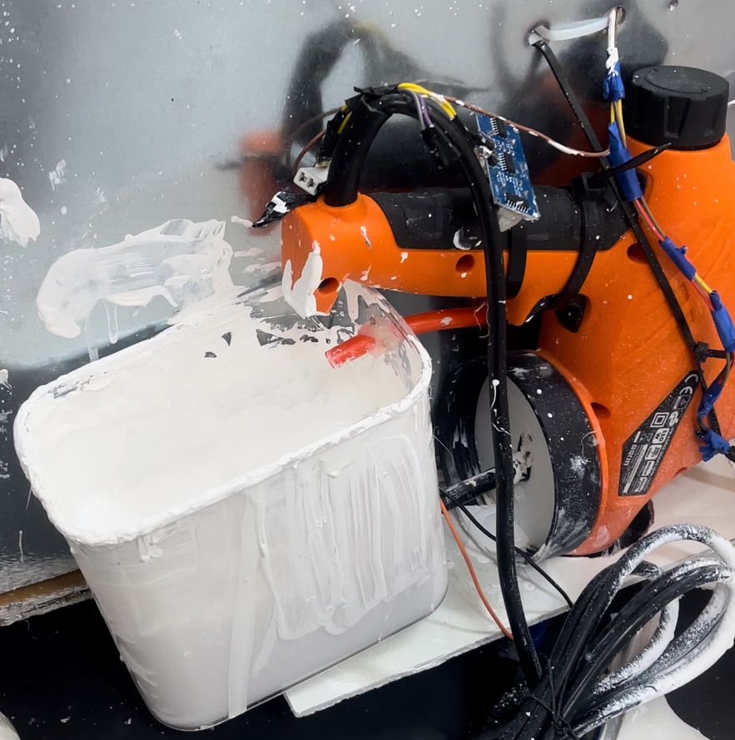
DESIGN & COMPONENTS

Slide 12
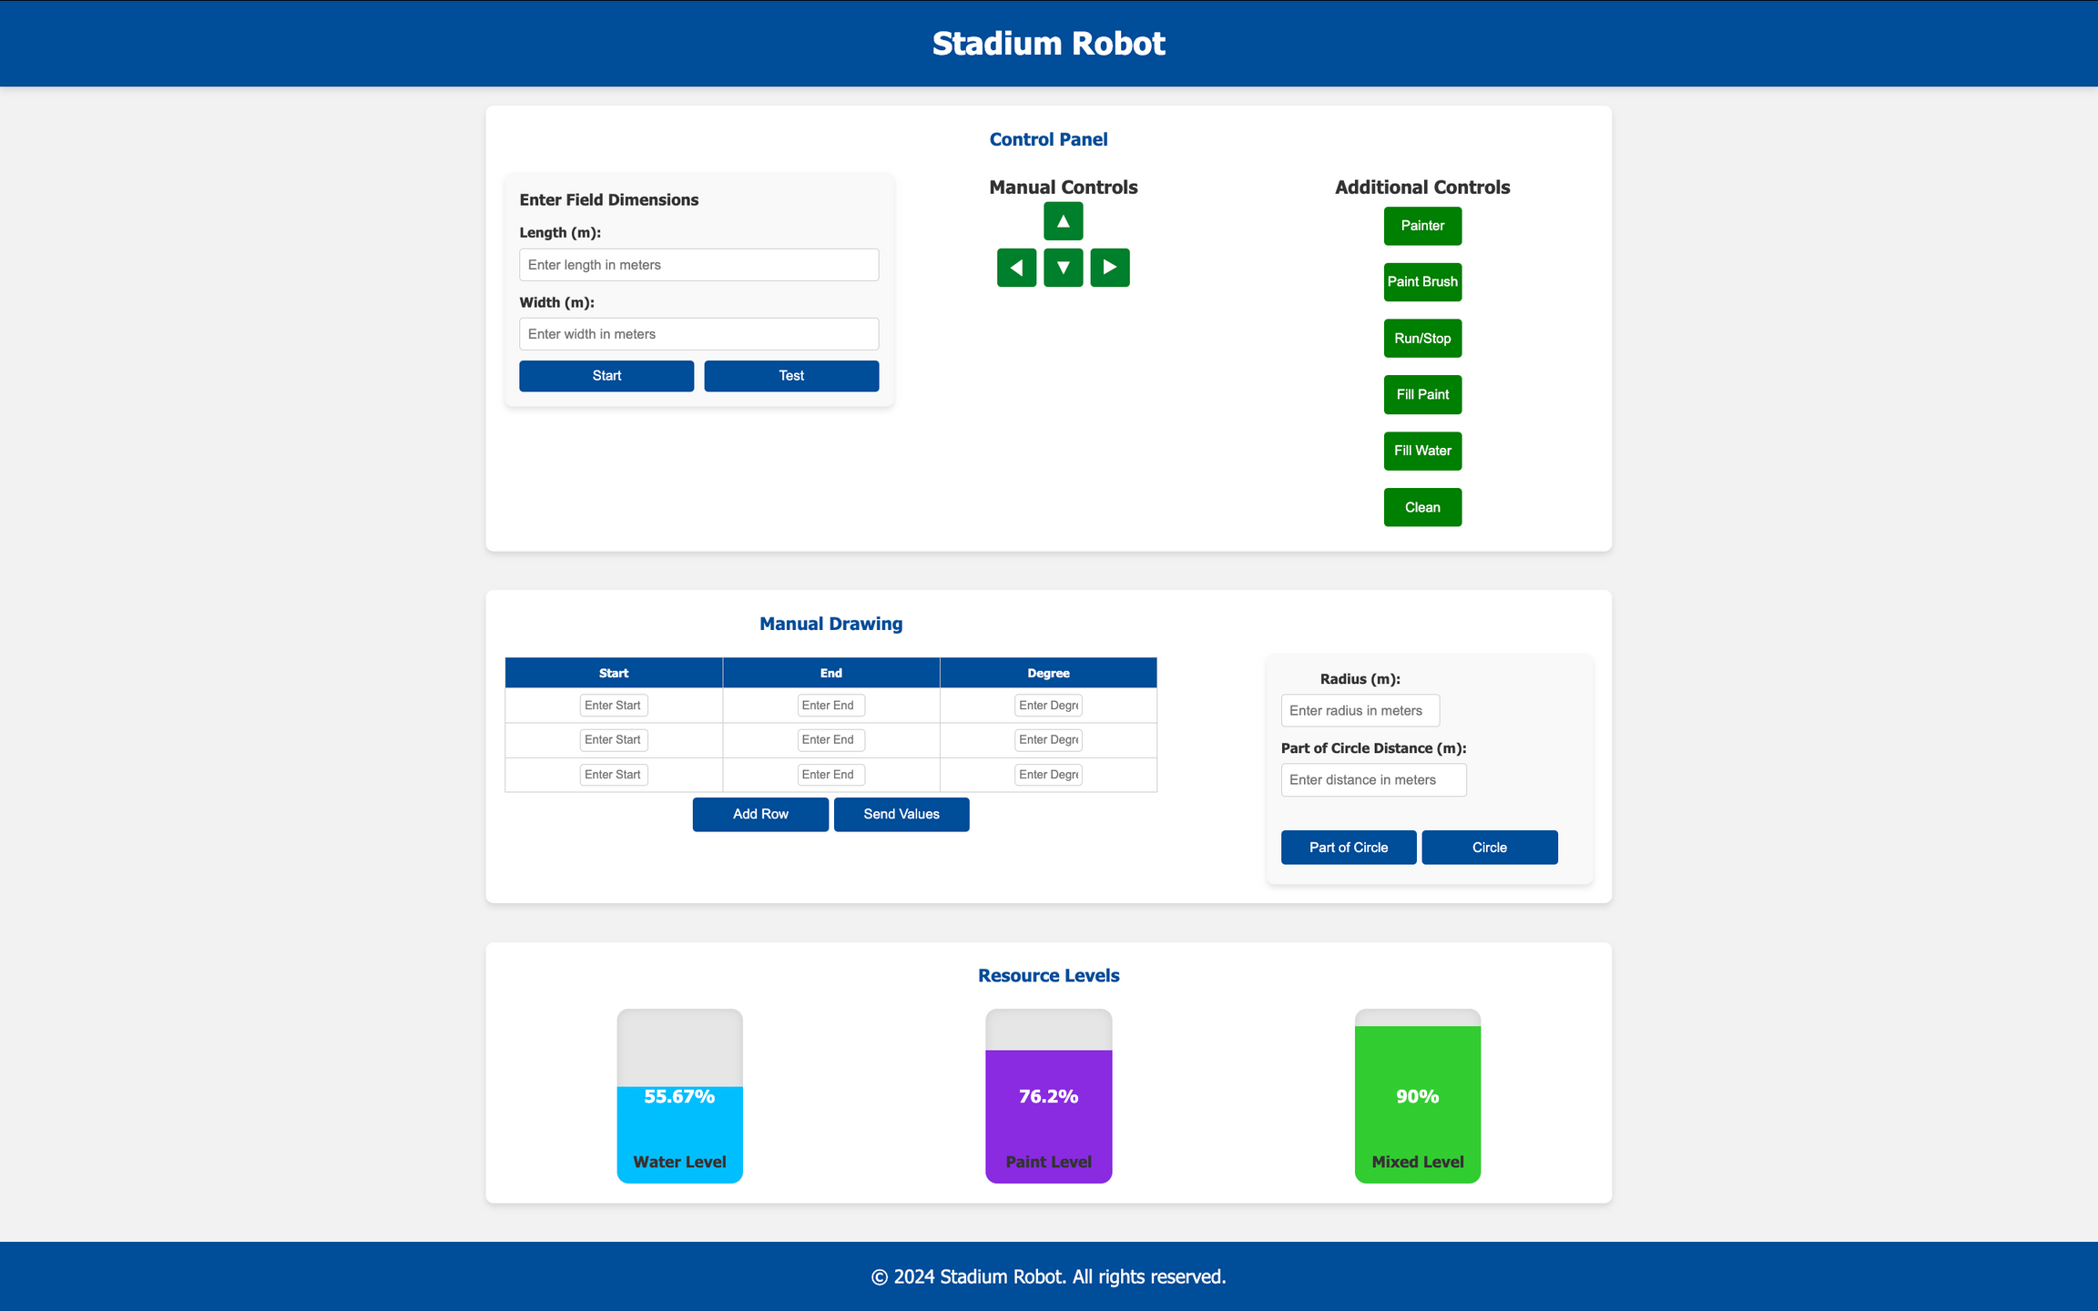
SOFTWARE
DEVELOPMENT

Slide 13
CALCULATIONS
Battery
CM to Steps
Stepper motor=3A
3A*3=9A
Paint Gun=110W
110W/12V=9.1A
STEPS_PER_REV = 400
STEPS_PER_CM = STEPS_PER_REV / (1.25 * 2.4)
steps = distance * STEPS_PER_CM
Circle
Curve Line
Distance=2πR
Arc length=(Angle/360)×2πR

Slide 14




LIMITATIONS & CHALLENGES
Weight
Electricity
Which Stadium Robot weights about 35kgm.
challenge to feed the paint gun with 220v and the whole Stadium Robot.
Space & Feedback
Floor
Which there’s no enough space to paint a full stadium and cannot use GPS inside the buildings.
Stadium Robot needs unobstructed surface.

Slide 15
FUTURE WORK
Automated Cleaning System
Navigation System
Which Stadium Robot Cleans before start painting.
Using GPS component and LIDAR sensor.
Improve User Interface
Expanded Field Marking Functionality
  Enhance the user interface to feature more
intuitive controls and real-time feedback.
  Allow User to enter a drawing.
Enhance Stadium Robot capabilities to include marking different types of sports fields, such as volleyball or badminton.

Slide 16
CONCLUSION
CONCLUSION
  Summary
  Recommendations
Summary
The Stadium Robot project successfully achieved its primary goal , automated solution for lining, By utilizing affordable components.
Recommendations
  Decrease Weight: Use lighter materials for enhanced portability and ease of operation for the robot.
  Optimize Power Management: Standardize battery capacities to ensure more consistent and reliable performance.
  Improve Paint Application: Modify the paint system to achieve smoother and consistent line marking in different field conditions.

Slide 17
THANK YOU
FOR YOUR ATTENTION

