Slide 1



Archive
.com
Discover the Palestine Archive, where cutting-edge technology meets a commitment to preserving cultural heritage. This digital platform offers interactive features and resources, enhancing our understanding of Palestinian history and culture.
Dr . Hanal Abu Zant
Eng.Yazan Abu Alhayja
Eng.Ibrahim Abd alhadi

Slide 2


Features of the App
Expanded Content: Continuously adding more documents, photos, and personal stories to enrich the archive.
Global Accessibility: Ensuring the app is available in multiple languages to reach a wider audience.
Interactive Chatbot: Enhancing user experience with a chatbot that provides instant answers to questions and guides users through the archive.

Slide 3
User Interface
INTUITIVE NAVIGATION
The app features a simple and clear menu, allowing users to effortlessly browse through various sections such as documents, photos, personal stories, videos, martyrs, prisoners, and news.
SEARCH FUNCTIONALITY
A robust search bar enables users to quickly find specific items or topics of interest.
CHATBOT ASSISTANCE
An integrated chatbot is available to provide instant answers to queries.
A clean, modern design with high-quality images and well-organized content ensures that users can focus on the rich historical material without distraction.
VISUAL APPEAL

Slide 4
Limitation
  Ensuring safe storage and preventing unwanted access to sensitive data.
  Special focus on data pertaining to prisoners and martyrs.
  Adherence to laws and guidelines on data protection.
PRIVACY AND DATA SECURITY
  Preventing the spread of false information by ensuring the historical data provided is correct.
  Implementing strong procedures for confirming and validating information prior to publishing.
  Maintaining the legitimacy of the archive.
DATA ACCURACY
MULTILINGUAL ASSISTANCE
  Supporting a wide range of languages to serve a varied user base.
  Ensuring content localization and translation are done correctly.

Slide 5
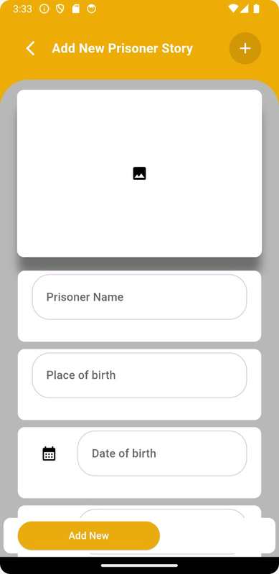
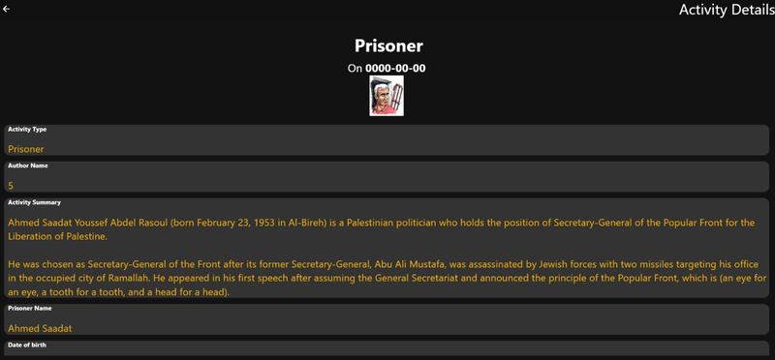
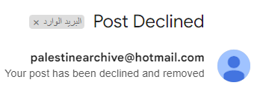
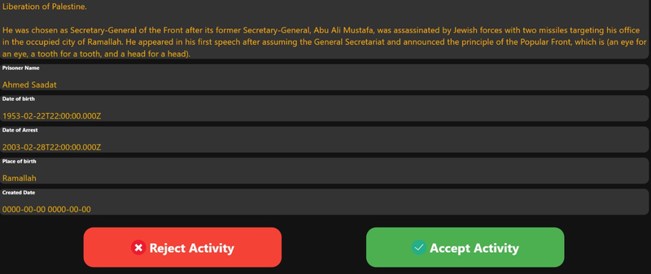

Adding media material Process
Select material and add
Admin page Accept/Reject
User notification about the post

Slide 6
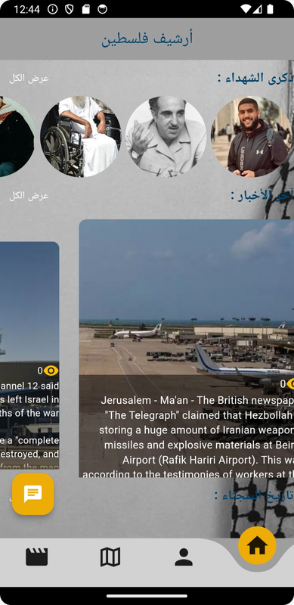
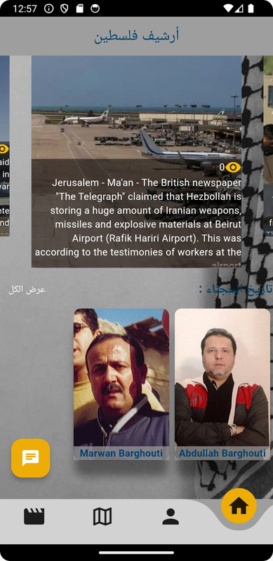
Main Page View

Slide 7
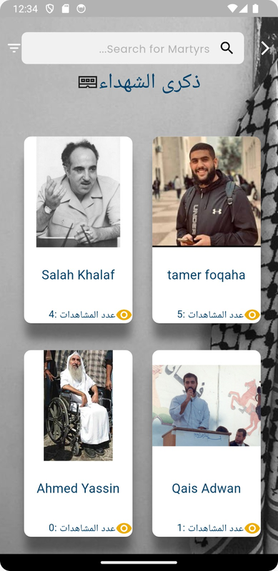
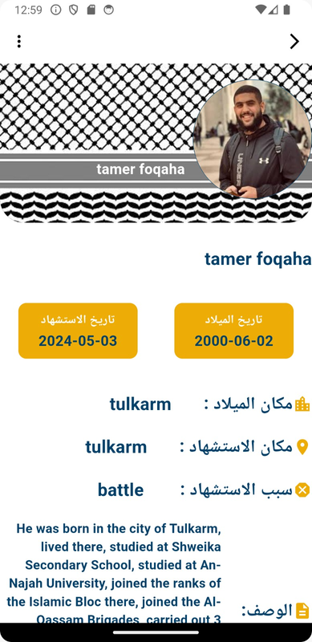
Martyrs Page View

Slide 8
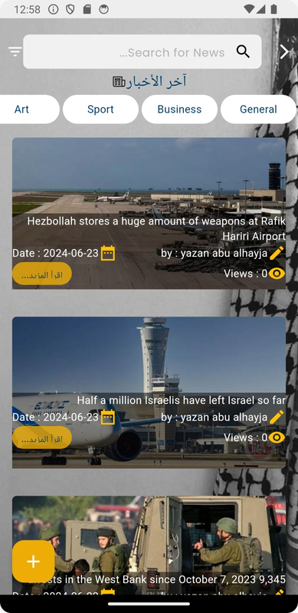
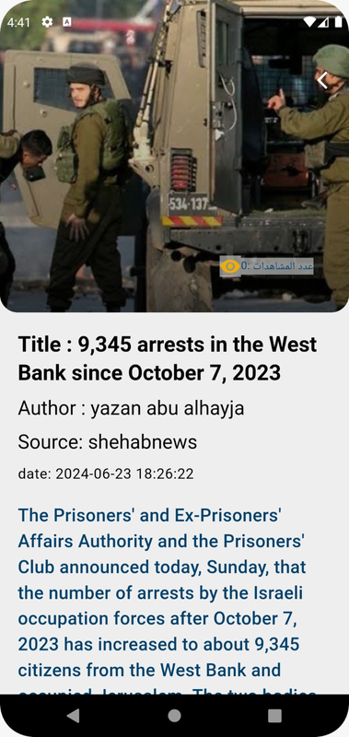
News Page View

Slide 9
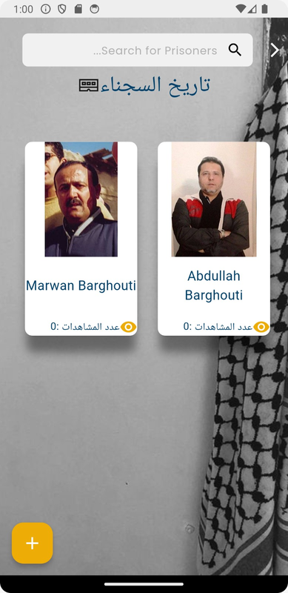
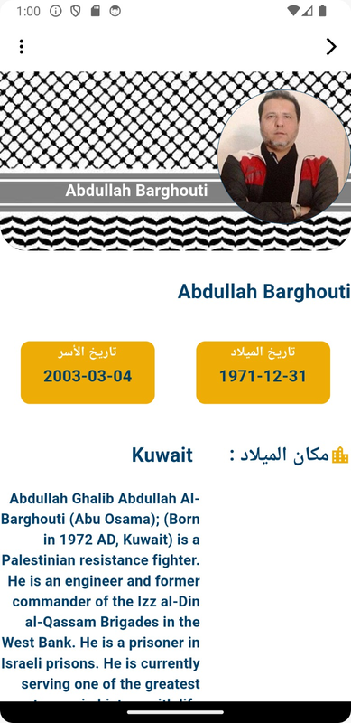
Prisoners Page View

Slide 10
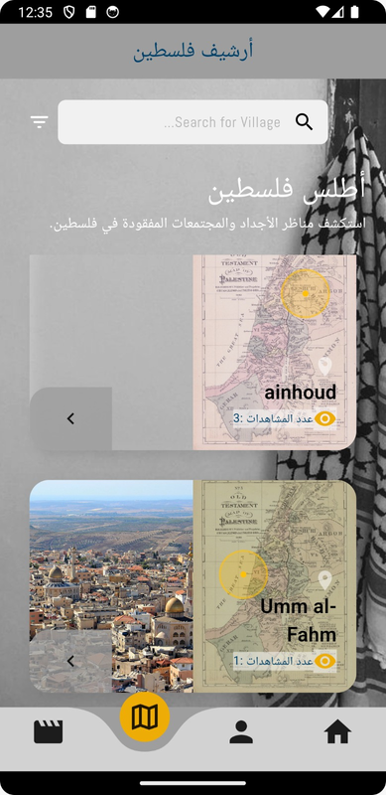
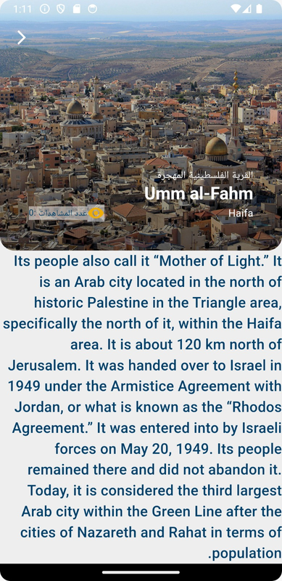
Viliges Page View

Slide 11
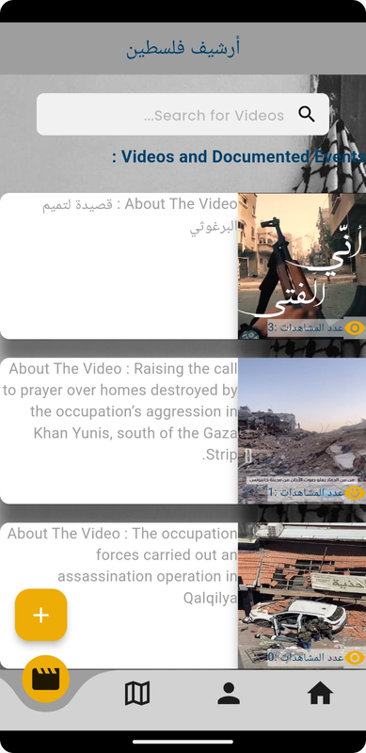
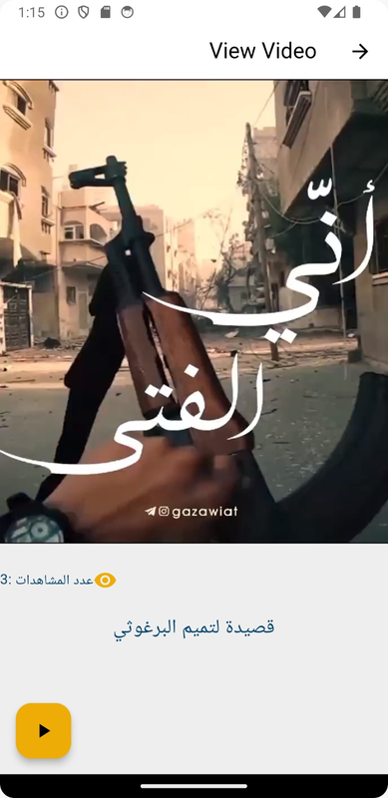
Videos Page View

Slide 12
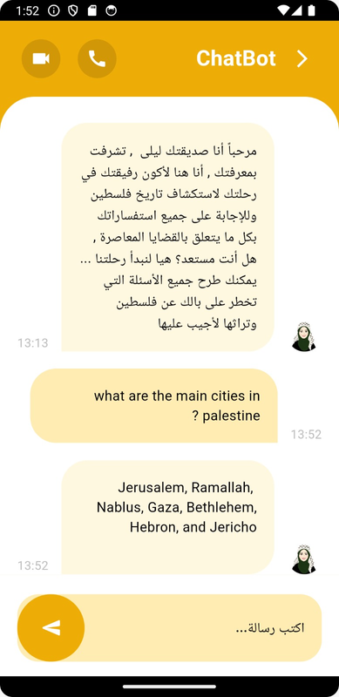
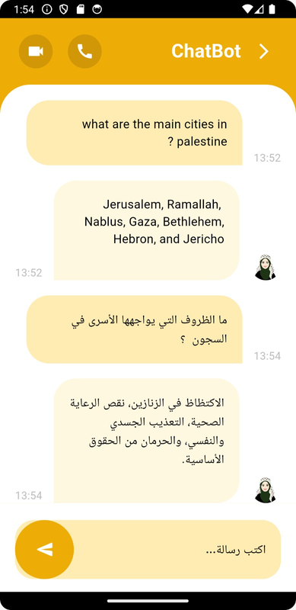
Chat Bot
  Bilingual Support: Communicates in both English and Arabic.
  Local Database Integration: Retrieves accurate information quickly from a secure database.
  Data Integrity: Ensures reliable, unaltered historical content.
  Instant Assistance: Provides 24/7 support and guidance.
  User-Friendly Interaction: Offers a natural, engaging conversational interface.

Slide 13
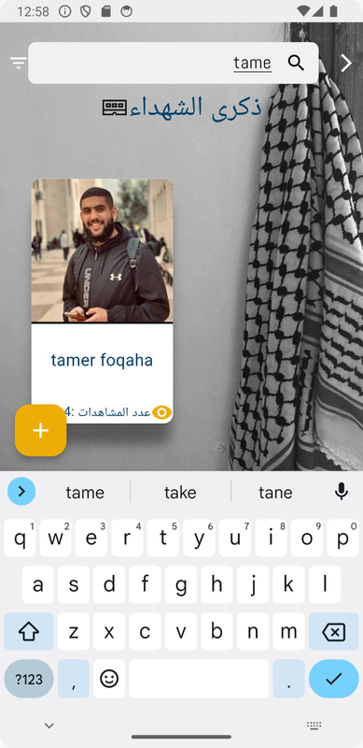
Search and Filter options
Name - Search method
Type - Based Filtering
Filter news based on genre preferences, allowing personalized searching for
Preferences that match your desires.

Slide 14
Page Views
When users describe a specific page, views on it increase, which helps in arranging users’ preferences and displaying the most viewed at the beginning of the page to help users not search for a well-known personality.

Slide 15
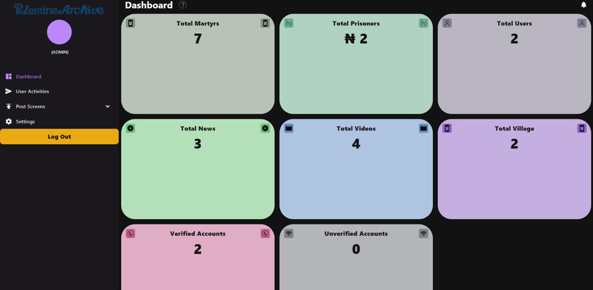
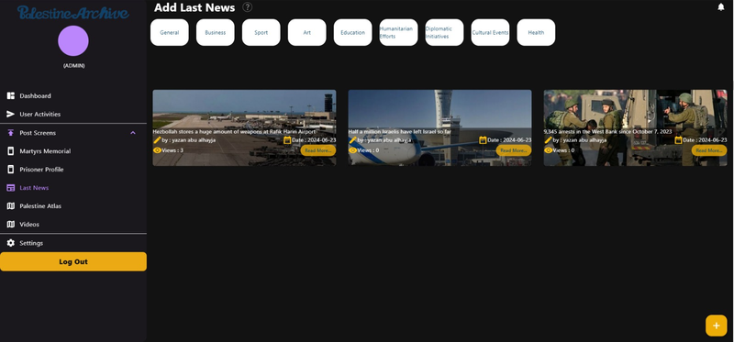
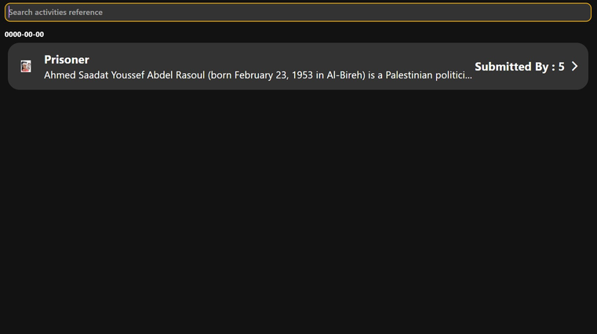
Admin Page Views

Slide 16
Future Updates and Enhancements
  Enhanced Search Filters
  Locate the village on the map
  Create connections between questions in the chatbot
  Add news from news sites

Slide 17
Thank you

