Slide 1
Artificial Arm
Prepared by : Bahir Mohammed
Ashwas Salah

Slide 2
Outline
Introduction
Components
Mythology and design
Conclusion
Future improvement

Slide 3
Introduction
What is the content of the project ??
How we came up with this idea?

Slide 4
Overview
Flex sensor
1
Servo motor 1
Arduino Uno
Servo motor 2
Flex sensor 2
Glove
Robotic hand
Flex sensor 3
Servo motor 3
Servo motor 4
Flex sensor 4
Servo motor 5
Flex sensor 5

Slide 5
Components:
1-Robotic Hand
A robotic hand can be any of a number of mechanical devices that are designed to manipulate objects in a way that is similar to the human hand
It can be used for many different jobs and functions that may be too tedious, difficult or dangerous for a human to do

Slide 6
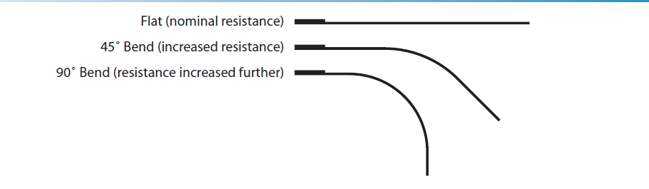
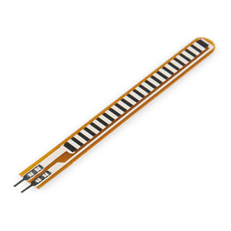
2-Flex sensor
A Flex and Force sensor. This is a flexible sensor which changes its output when it is bent or when force is applied on it.
This sensor has two output wires.
The resistance between these two wires varies when the sensor is bent or when subjected to a force.

Slide 7
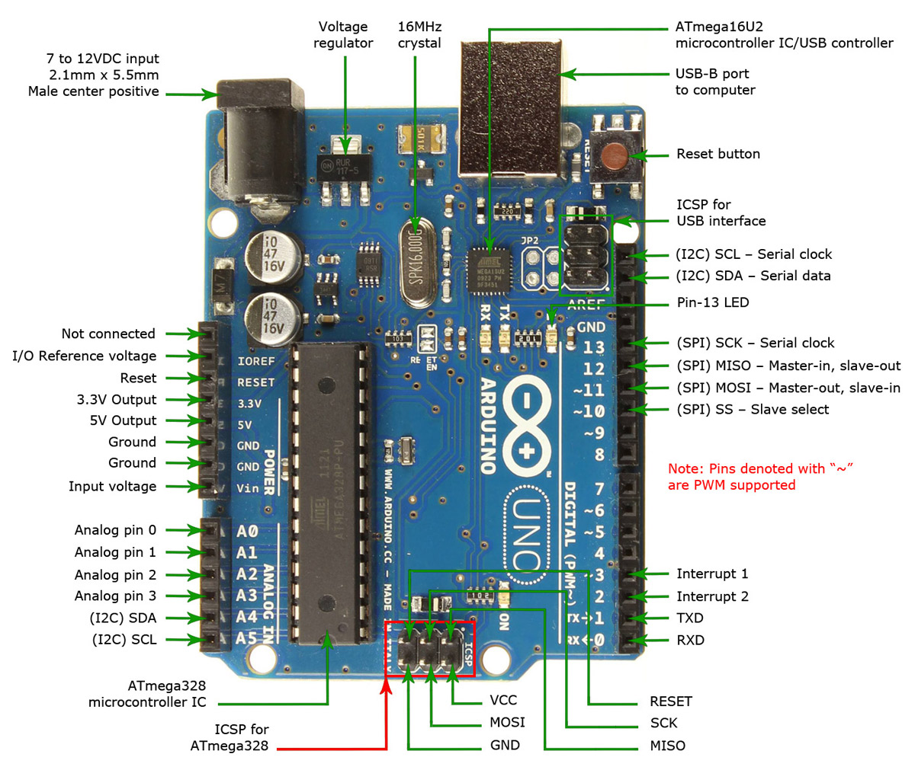
3-Arduino
Open Source Hardware.
Flexible and easy to use.
Inexpensive.
It operates at a high, fixed frequency.
Arduino has built-in PWM.
Receives and sends analog signal and turn it into a digital signal .

Slide 8
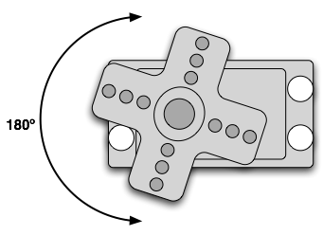
4-Servo Control
Ground (0V)
Power (+5V)
Control (PWM)
PWM freq is 50 Hz (i.e. every 20 millisecs)
Pulse width ranges from 1 to 2 millisecs
  1 millisec = full anti-clockwise position
  2 millisec = full clockwise position

Slide 9
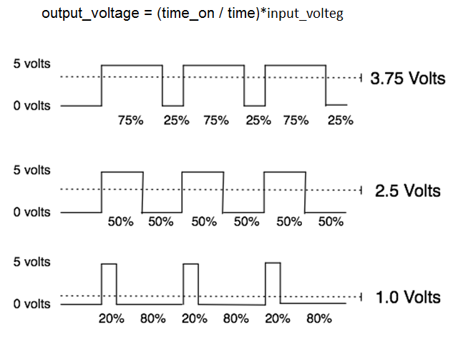
PWM - duty cycle
Output voltage is averaged from on vs. time period

Slide 10
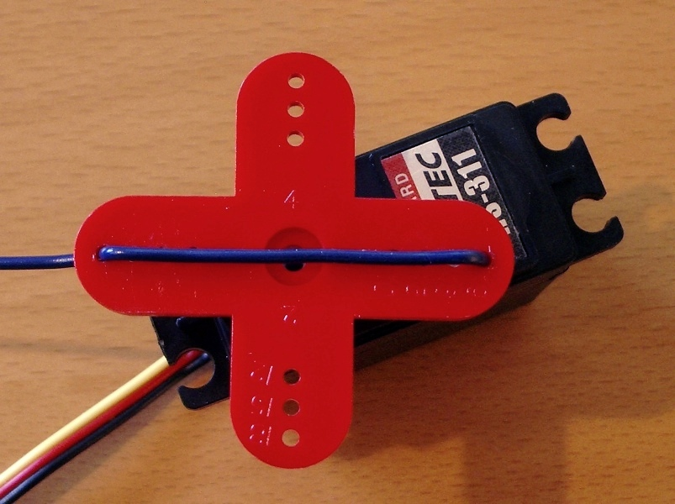
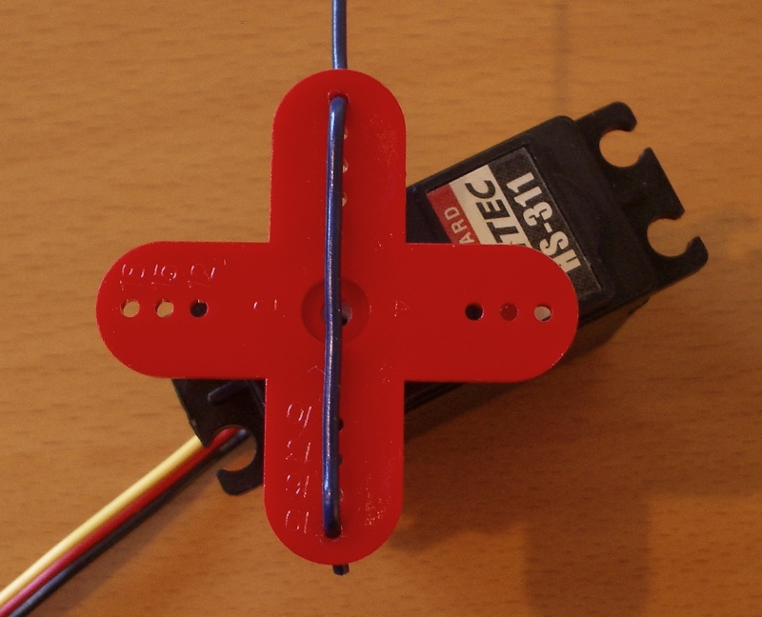
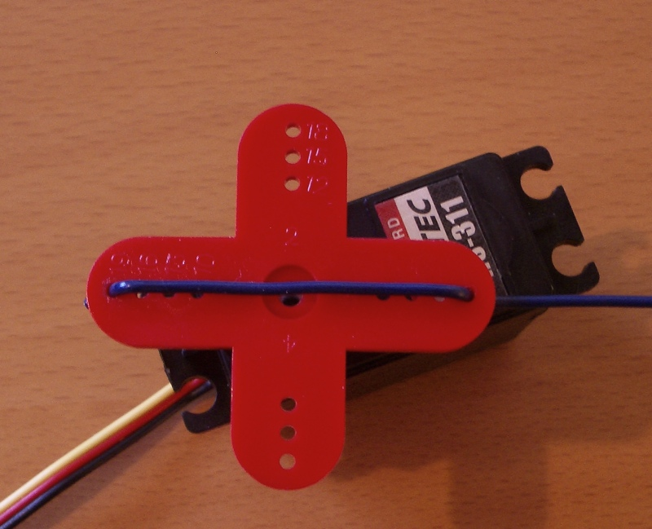
Servo Movement
0 degrees
90 degrees
180 degrees
1000 microsecs
1500 microsecs
2000 microsecs
In practice, pulse range can range from 500 to 2500 microsecs
Notes:
Put the red “arm” on your servo. Needs a philips screwdriver.
Many commercial servo drivers have a calibration setting to deal with servo variability

Slide 11
Methodology and design
Connect the Servo
Glove
Making the Sensor Circuit
Add the Strings

Slide 12
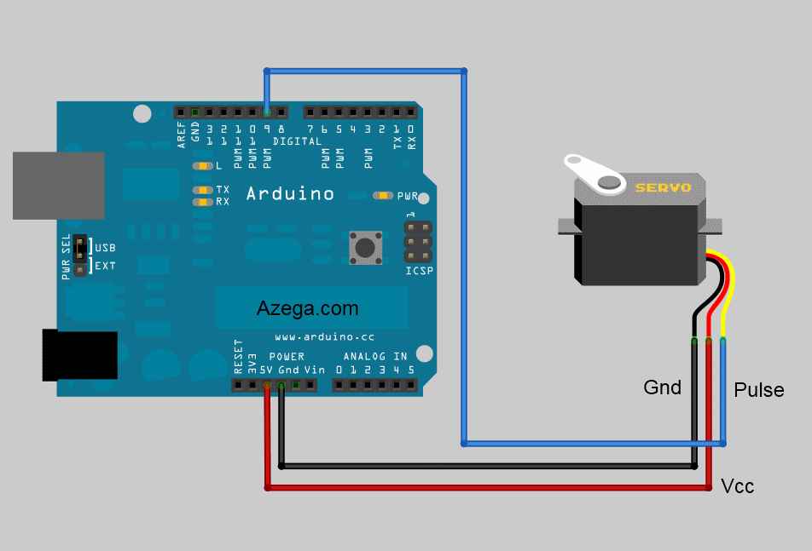
connect servo to Arduino

Slide 13
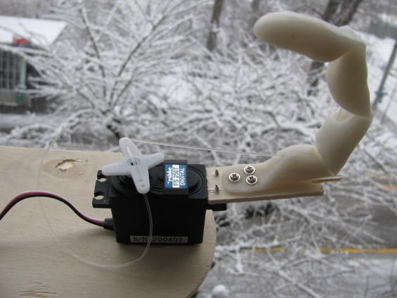
Add the Strings
It use to Connect the servo with fingers, after this step we determined the rotation angle of the servo for each finger.

Slide 14
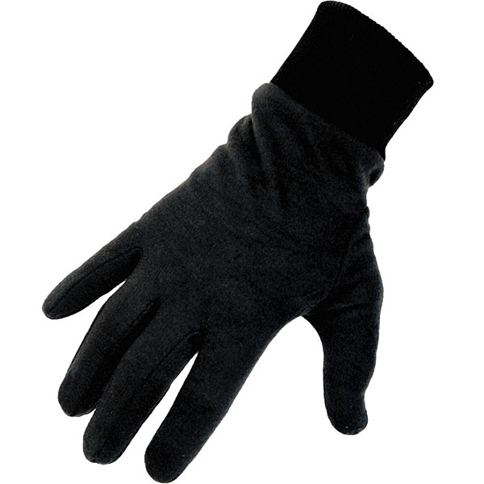
Glove

Slide 15
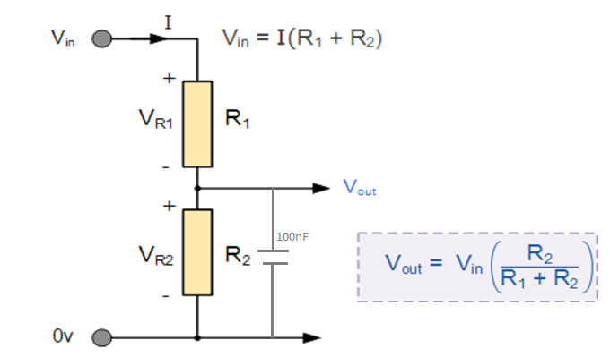
Making the Sensor Circuit
The flex sensors require a circuit in order for them to be compatible with Arduino.

Slide 17
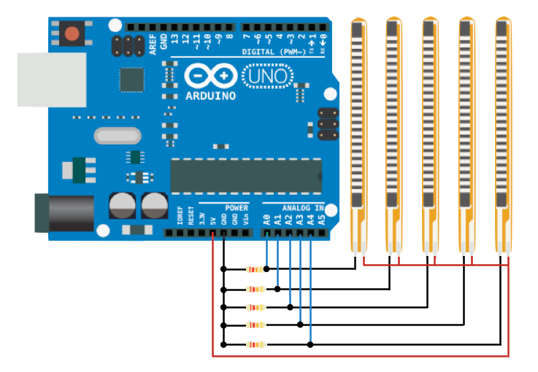
Making the Sensor Circuit
The main GND (ground) wire, which is connected to all the individual GND wires from the sensors, gets plugged into the Arduino's GND. The +5V from the Arduino goes to the main positive voltage wire, and each blue wire gets plugged into a separate analog input pin.

Slide 18
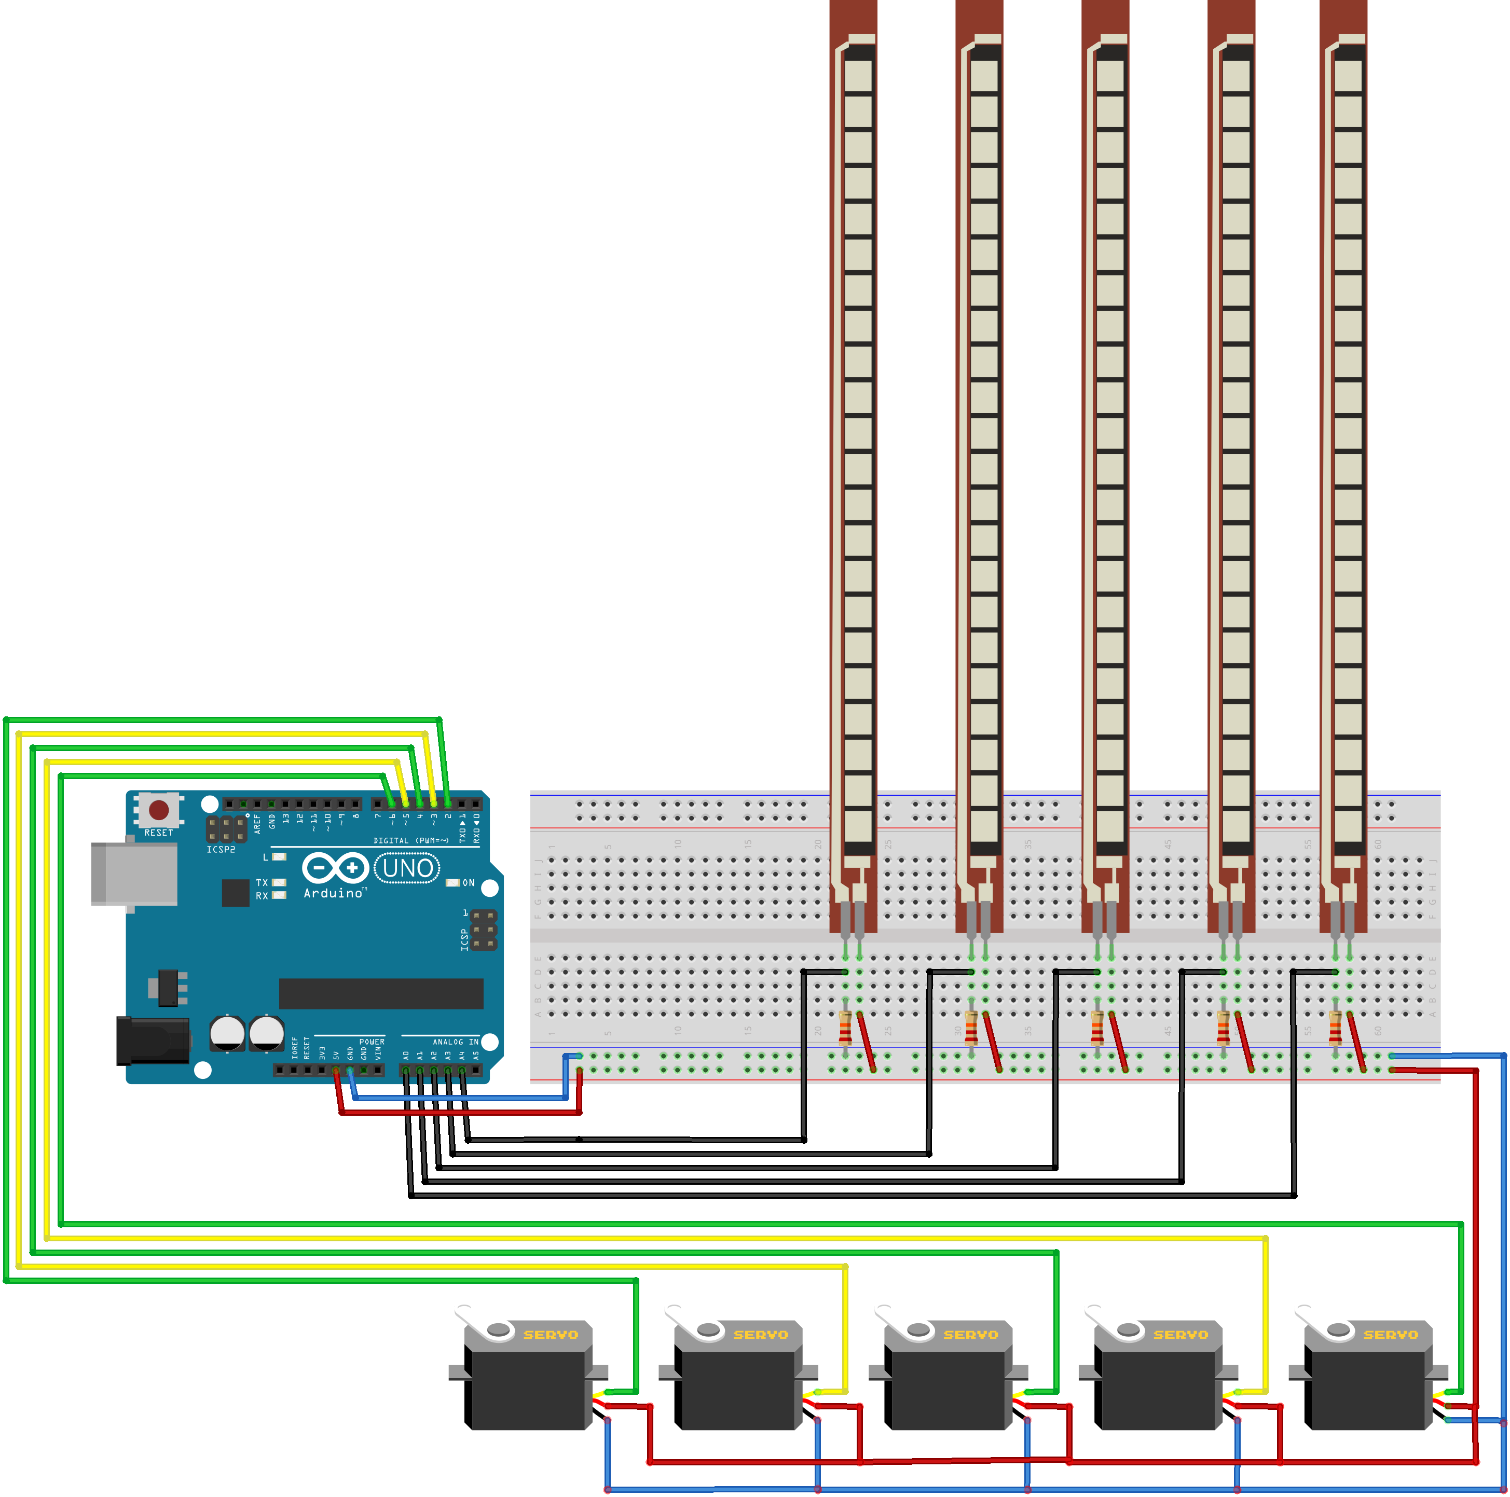
Project in simple form

Slide 19
Conclusion
although simplicity of the theoretical side, but the practical side is much more complicated, and we think, it has many uses in industrial manufacturing, medical research, and anything we want to be able to do with precision that is unsafe to touch
interesting modification would be to make it wireless (that is, you wouldn't need a wired connection between the glove and hand).

Slide 20
Thank you
Any question ??

