Slide 1
Accu-Vital Monitor
Presented by : Aya Ghazal and Menna Alkhayat
Supervisor :Dr. Sufyan Samara

Slide 2
INTRODUCTION
A multi-parameter patient monitoring system is a compact and portable device designed to facilitate easy movement and use in healthcare settings. Its portability enables flexible monitoring capabilities, enabling healthcare professionals to make informed decisions and provide timely interventions.

Slide 3
MOTIVATION
Doctors and nurses must record patient vital values on paper and transfer them to a hospital system database, which requires effort, a tedious routine, lack of real-time monitoring, and the potential for mistakes. Traditional measuring methods are too heavy and nurses have difficulty moving them around.
What the problem?

Slide 4
GOALS
Save time and effort
To ensure accuracy
Fast measurements
ensure their comfort at work
data entry must be checked.
fast measurements saved safely for patient benefit.

Slide 5
Overview of The System
The ESP32 microcontroller was used to create a health care device that is compact, integrates many medical devices, and is easy to use on a mobile device.

Slide 6
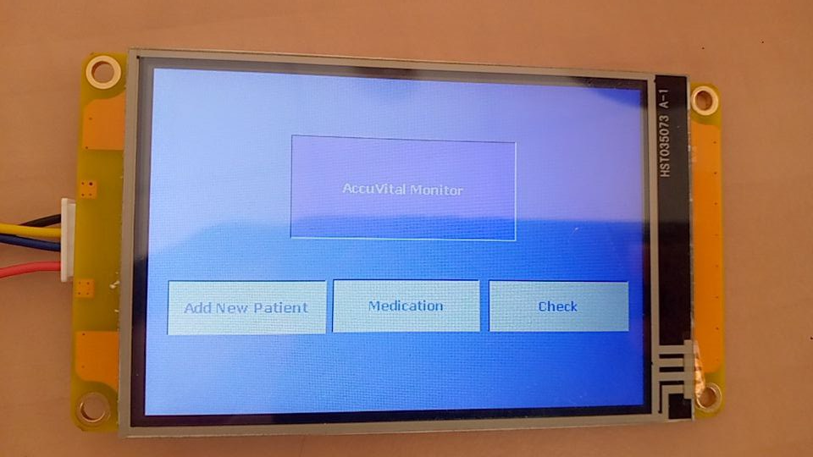
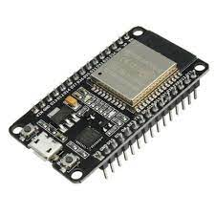
Implementation
ESP-WROOM-32
Nextion Display

Slide 7
All Feature
blood sugar
Medicine
Add new potion
Mobile App
ECG
Checkups frequently

Slide 8
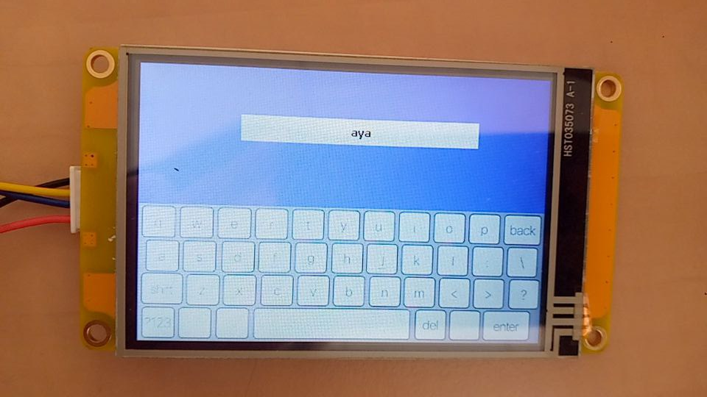
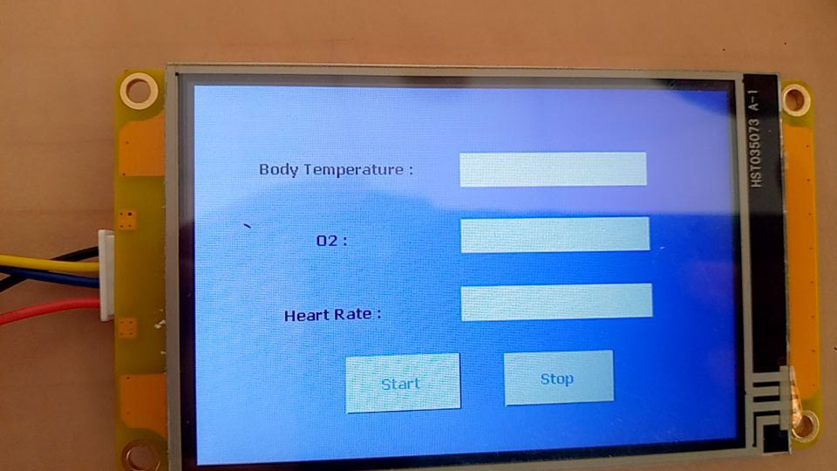
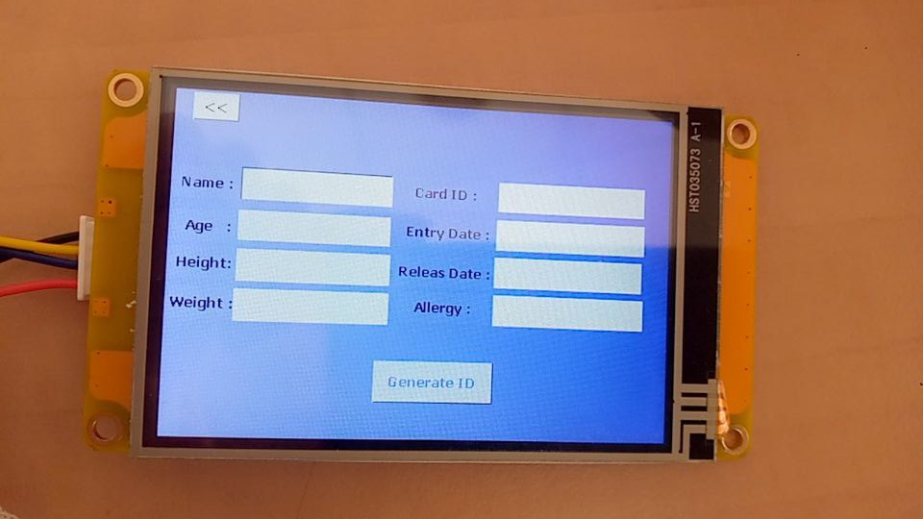
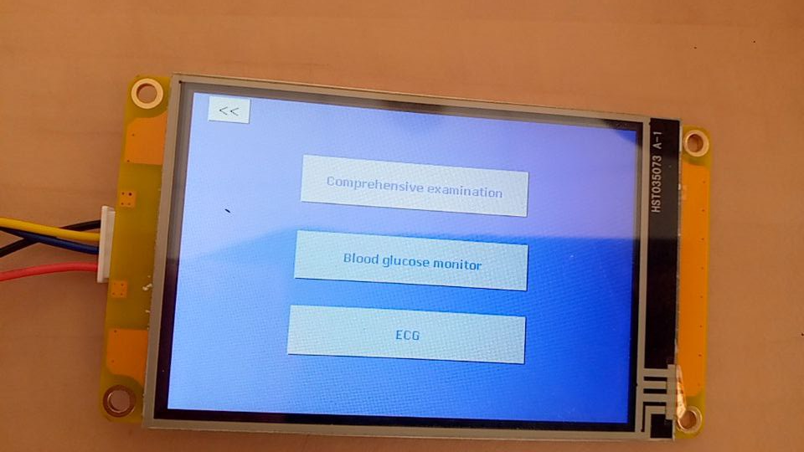
Feature and Design

Slide 9
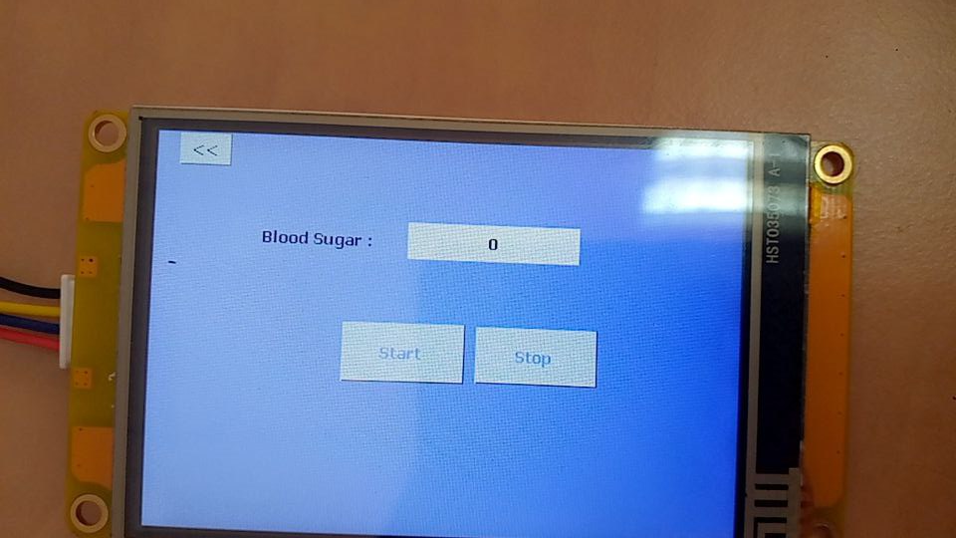
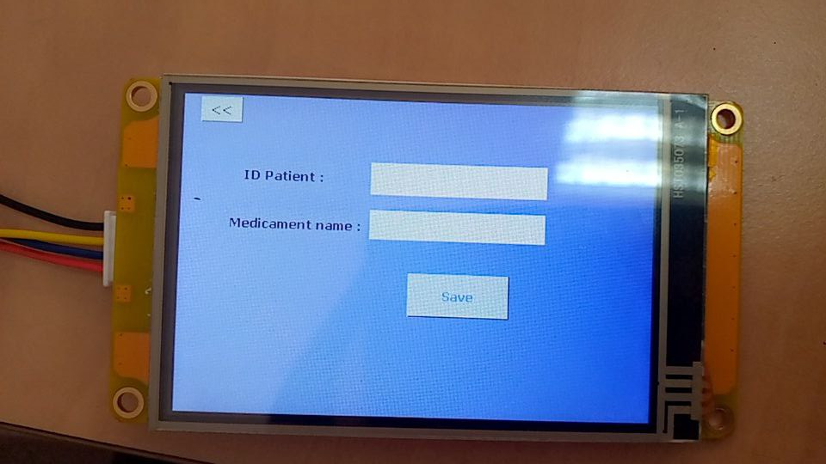
Feature and Design

Slide 10
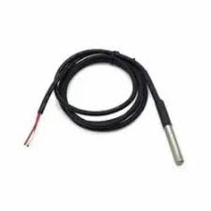
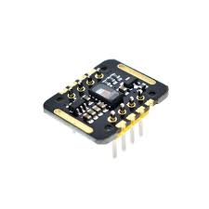
Checkups frequently
DS18B20 Temperature Sensor
The accuracy of the sensor itself is within 0.5 °C
MH-ET Live MAX30102 Heart Rate Sensor Module Pulse Detection Blood Oxygen
accuracy rate of the MAX30102 measurement is 97.11% and 98.84%, for heart rate .

Slide 11
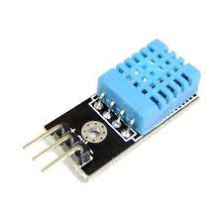
Humidity Sensor
humidity levels between 30% and 60% for comfort and health.

Slide 12
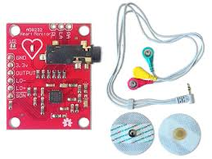
ECG
AD8232 heart monitor
Accuracy values reaching more than 90% indicate the reliability of the implementation results

Slide 13
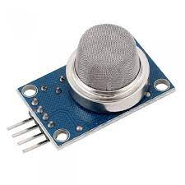
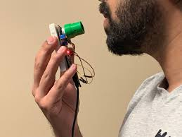
Blood Glucose Measurement
MQ-136 Gas

Slide 14
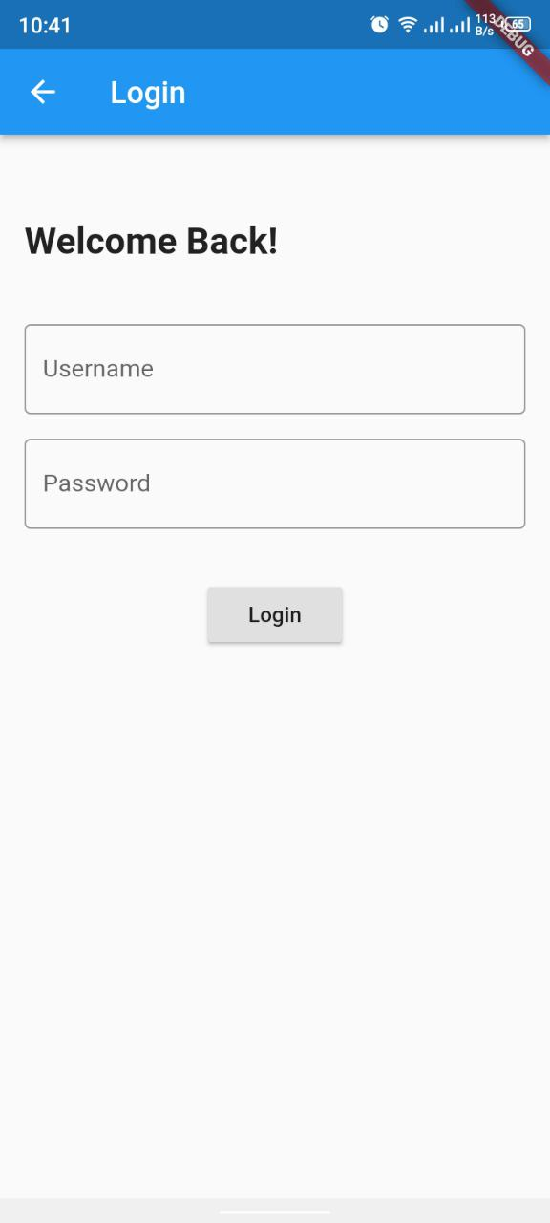
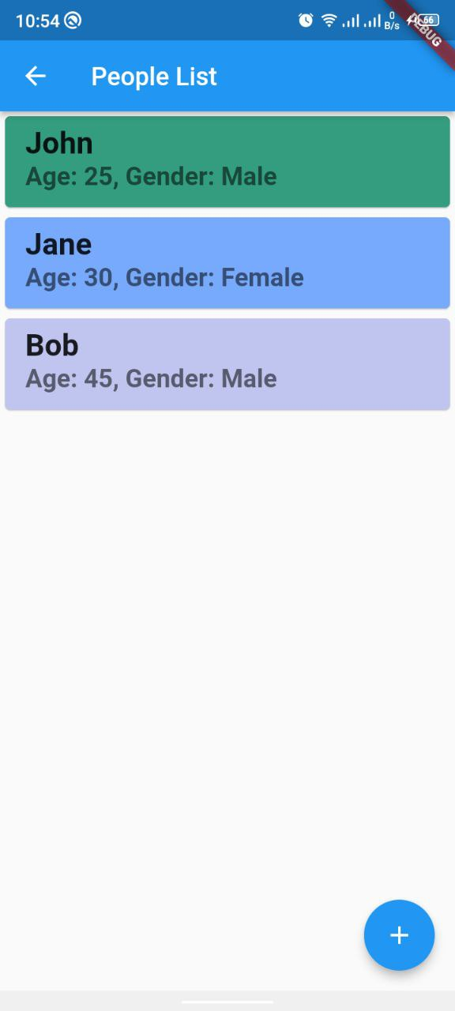
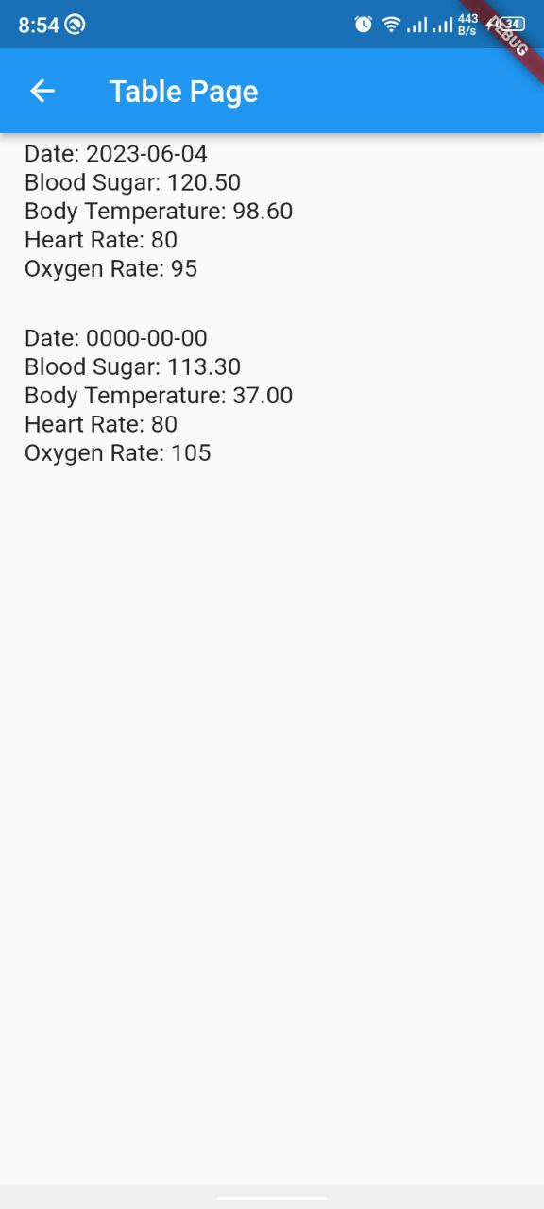
MOBILE APP

Slide 15
CONCLUSION
AccuVital Monitoring is a lightweight and easy-to-carry product that measures vital values such as temperature, heart rate, oxygen level, blood sugar, and electrocardiogram. Data is stored in a database without human interaction or paper record.

Slide 16
Future Work
enhancing the effectiveness of the outcomes
Integration with IoT Platforms
adding more sensors

Slide 17
DEMO
Do you have any questions?

Slide 18
ALTERNATIVE RESOURCES

