Slide 1

Submit by:
Noor Khalifa
Asala Hamed
Donia AbuJaish

Slide 2
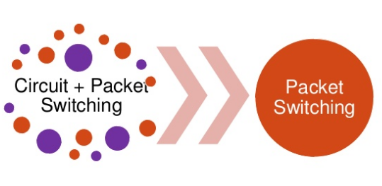
What is LTE ?
Long Term Evolution (LTE) is a fourth generation technology which is standardized in the Release 8 specifications by the 3GPP.
It is capable of providing high data rates (100 Mbps in downlink and 50 Mbps in uplink) as well as support high speed mobility.
It has a completely packet switched core network architecture unlike its predecessor UMTS which is capable of supporting both the Circuit Switched (CS) as well as Packet Switched (PS) core networks.
LTE is an all IP network .

Slide 3
Advantages
Provides low latency.
Higher network throughput.
Increased data transfer speed.
higher bandwidth.
the requisite Quality of Service (QoS).
Improvements over 3G network

Slide 4
Solutions for Supporting Voice over LTE
1. Circuit Switched Fall Back (CSFB)
This solution provides the operators with flexibility to roll out LTE as a data only overlay network and use the existing CS network for supporting voice functionality.
CSFB is needed because LTE is a packet-based all-IP network that cannot support circuit-switched calls.
When an LTE device is used to make or receive a voice call or SMS, the device "falls back" to the 3G or 2G network to complete the call or to deliver the SMS text message

Slide 5
Disadvantages of LTE CSFB
the above solution itself is the problem.
1. handover between 3g and 4g might cause loss of network connectivity.
2. Call setup time delay.
3. Impact on coverage and handoff for 2G and 3G.
4. No support for simultaneous voice/data over LTE - No LTE during voice call.

Slide 6
Solutions for Supporting Voice over LTE
2. Voice over LTE (VOLTE)
In this solution, voice functionality is provided by the IP Multimedia Subsystem (IMS).The IMS network is mainly used to provide all the basic services for voice that are provided by the existing CS networks.
In addition, it also provides enhanced multimedia services like video conference, real time gaming etc.

Slide 7
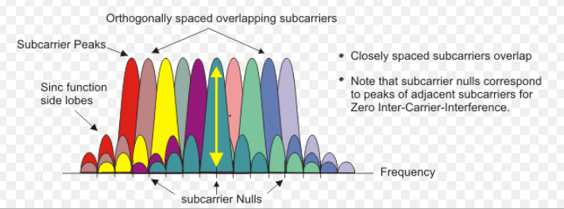
LTE Technologies
Orthogonal Frequency Division Multiplexing (OFDM)
is a digital multi-carrier modulation scheme that extends the concept of single subcarrier modulation by using multiple subcarriers within the same single channel. Rather than transmit a high-rate stream of data with a single subcarrier.
OFDM makes use of a large number of closely spaced orthogonal subcarriers that are transmitted in parallel.

Slide 8
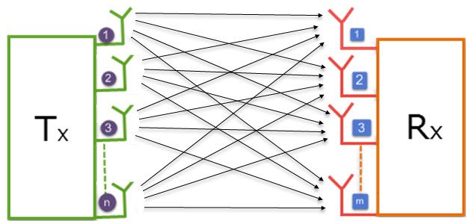
Continued…
2. Single Carrier Frequency Division Multiple Access (SC-FDMA) in the uplink
which has a very high Peak to Average Power Ratio (PAPR), High PAPR requires expensive and inefficient power amplifiers with high requirements on linearity, which increases the cost of the terminal and drains the battery faster
3. MIMO

Slide 9
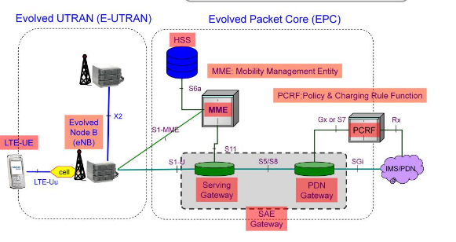
LTE Architecture

Slide 10
LTE Network Elements
E-UTRAN
comprises of the E-Node B’s that are interconnected to each other over the X2 interface and connected to the core network elements over the S1 interface.
Evolved Node B (eNB)
are responsible in scheduling and allocation of the radio resources for the users in the LTE network ,Supports air interface and Provides radio resource management functions .
EPC
The EPC is the core network comprising of four elements which are Mobility Management Entity (MME), Serving gateway, Packet Data Network (PDN) gateway and Home Subscriber Server (HSS).
UE
The internal architecture of the user equipment for LTE is identical to the one used by UMTS and GSM which is actually a Mobile Equipment (ME).

Slide 11
LTE physical Layer
Data generator : The function of this block is to generate the simulated input data.
Channel coding : comprises error detection using the CRC (Cyclic Redundancy Check) detector and error correction using Turbo codes .
Mapper : The bandwidth efficiency of communication systems is increased by modulating the coded bit stream into symbols.
Pilot : are used for synchronization and Channel estimation purposes, also used to detect channel gains for every sub-carriers.
OFDM : contains the IFFT and the Cyclic Prefix (CP) insertion, The function of the IFFT is used to convert signals from frequency domain to time domain the function of the CP insertion block is to prevent the (ISI) and (ICI).

Slide 12
Continued…
Channel models : In order to measure the performance of wireless communication, it is necessary to describe the wireless channel with statistical models.
Channel Estimation : is one of the most important stages in the LTE receiver and essential solution to recover the transmitted signal with minimum interference and is the main thing we need to concentrate for improving the channel capacity
Channel equalization : is the process of reducing amplitude, frequency and phase distortion in a channel with the intent of improving transmission performance.

Slide 13
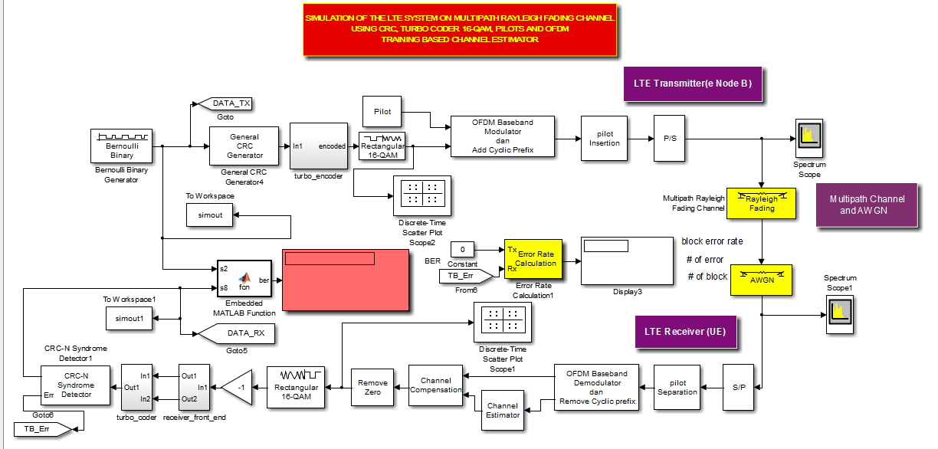
LTE downlink simulator
The basic idea in our project gives a description of LTE downlink physical layer.
The LTE downlink simulator simulates the downlink communication from one (eNodeB) to one User Equipment (UE) using an AWGN channel and Rayleigh channel .

Slide 14
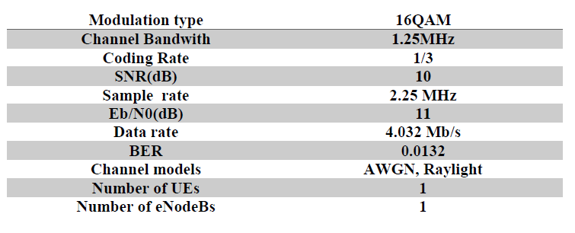
Results and Discussion
Parameter Setting :
The channel parameters used for these simulations are summarized in Table:

Slide 15
Continued…
Output symbol from IFFT before & after added long CP
Figure : output symbol from IFFT before inserting CP
Figure : output symbol from IFFT after added long CP

Slide 16
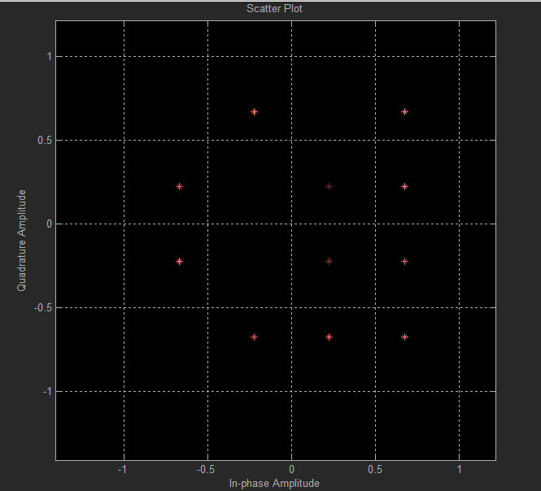
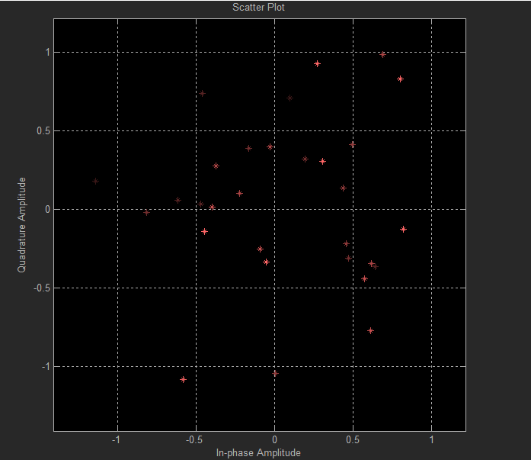
Continued…
The constellation diagram
Figure: the16qam constellations of transmitted signals
Figure: the 16qam constellations of received signals

Slide 17
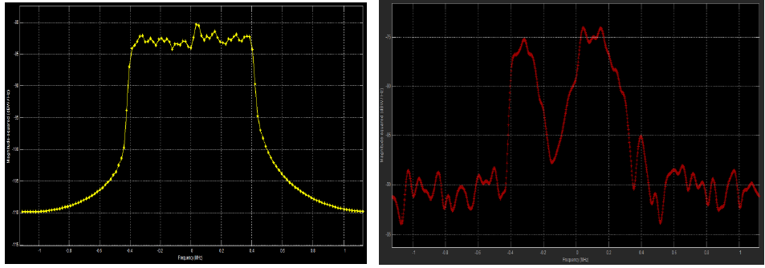
Continued…
Model Performance
1. Fixed channel :
Figure : Signal spectrum before and after the channel (fixed channel)

Slide 18
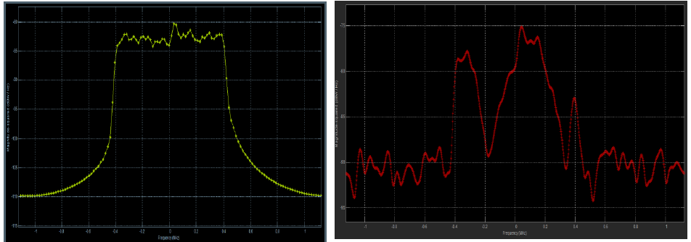
Continued…
Channel in motion
Figure: Signal spectrum before and after the channel (40 Hz Doppler effects)

Slide 19
Conclusion
In this project an overview of the Long-term Evolution of the UMTS is presented. LTE intends to support high peak data rates (100 Mb/s in the downlink and 50 Mb/s in the uplink), to improve the system capacity and coverage. It also efficiently supports packet data transmission, etc. OFDM has been adopted as the downlink transmission scheme of LTE .
This project gives a description of LTE downlink physical layer. It contains a complete description of LTE block diagram consisting of channel coding, mapping and OFDM generator with the basic 3GPP OFDM parameter.

