Slide 1



Health Tracker Windows –phone & Android Applications
Done by:
Iman Abu-Mazen
Beesan Imad Zraiqi
Supervised by :
Dr. AlaDin Al-Masri

Slide 2

Outline:
Introduction
The problem
Windows-Phone app
Android app
Demo
Questions

Slide 3

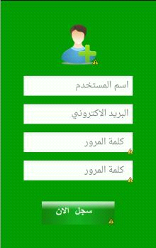

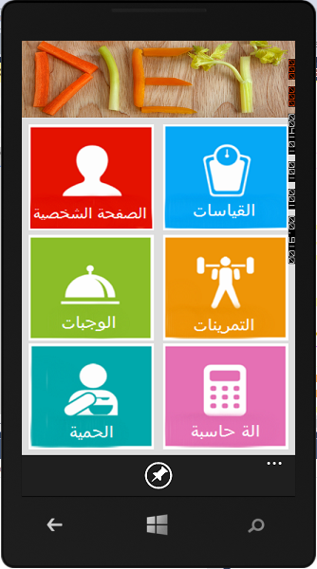
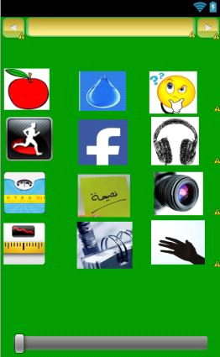
Introduction

Slide 4
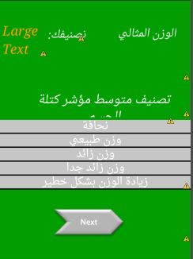
Problems
Which diet to try
Which exercise regimen to follow

Slide 5
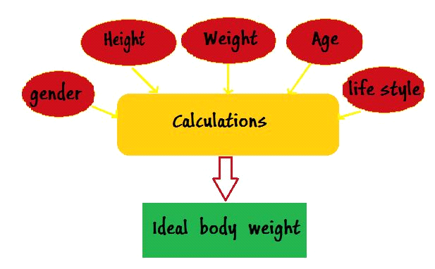
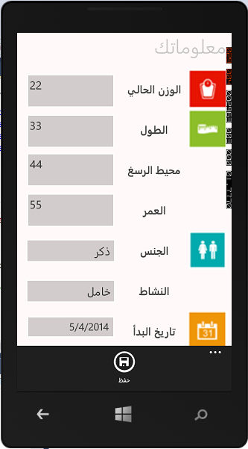
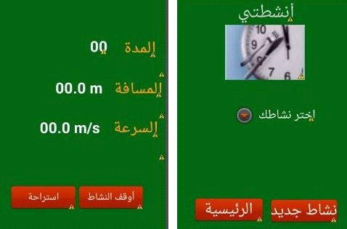
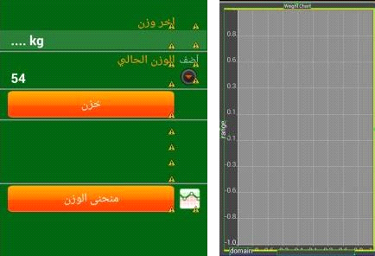
Calculations

Slide 6
Demo for all parts

Slide 7
Questions ??

