Slide 1
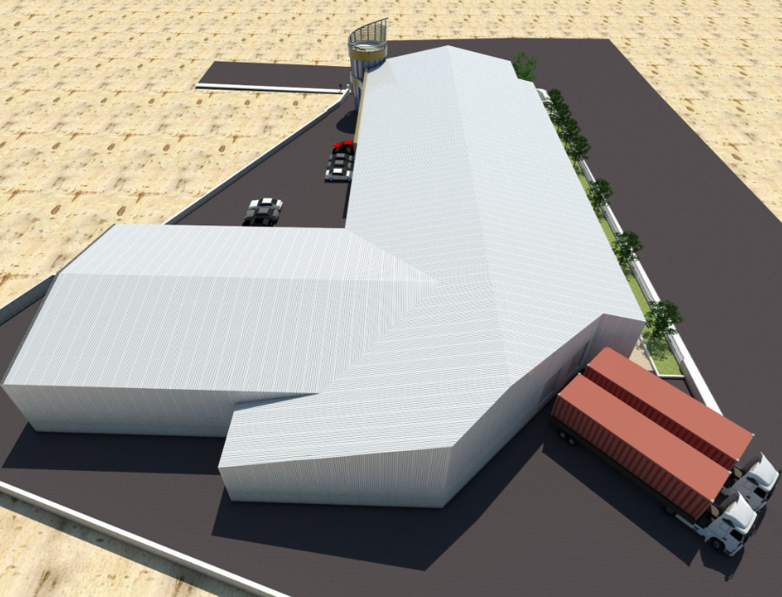
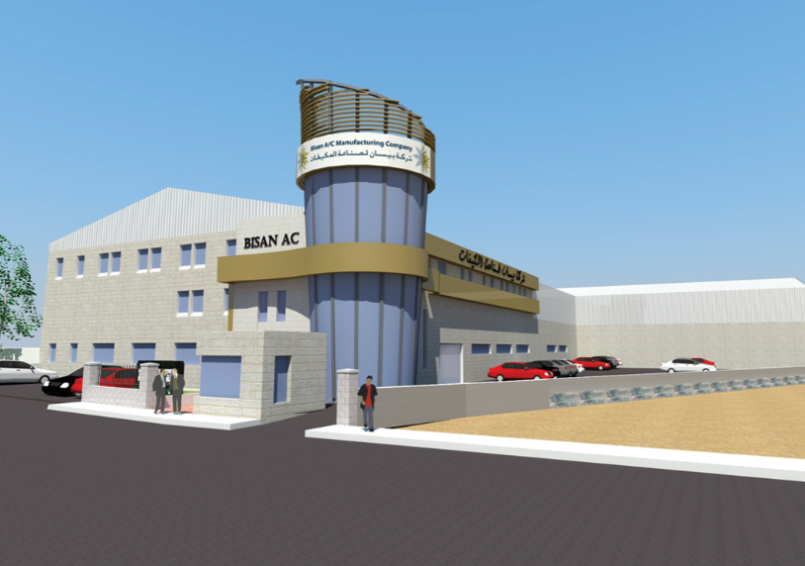
Reanalysis and Design of
Bissan Air Condition Factory
Graduation Project 2
Wednesday 16/05/2018
- Osama Dwaikat - Osama Bsharat - Waseem Kittaneh - Salah Hanaysheh

Slide 2
Contents
Introduction
Preliminary Design
3D Static Analysis and Design
3D Dynamic Analysis and Design
Concrete design
Steel design

Slide 3
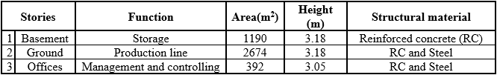
Project Description
Location
It is located at east of Tulkarm at 120 m elevation above mean sea level. It’s extended over an area 2900 m²
Stories and usage

Slide 4


Slide 5
Codes and Standards
American Concrete Institute (ACI 318-14).
American Society of Civil Engineers (ASCE 7-10).
American Institute of Steel Construction (AISC 360-16).
International Building Code (IBC -2012).
American Society for Testing and Materials (ASTM A615M).

Slide 6
Materials
Reinforcement Concrete
Rebar Steel
Structural Steel
Roof Sheeting
Glass
Cable
Bolts
Weld

Slide 7
Loads Types
Dead Load
Superimposed dead load
Live Load
Snow Load
Soil pressure
Wind Load
Earthquake load

Slide 8
SD Load
In our structure, it is about these elements:
SD on concrete Slabs (tiles, partitions, false ceiling,…etc)
Masonry Wall
Steel Roof (solar panels, lighting and HVAC system)
Minaret

Slide 9
Wind Load
Z (q_{z}) = 0.0613 * K_{z} * K_{zt} * K_{d} * V² *I
K_{d}: Directionality factor.
K_{zt}: Topographic factor.
K_{z}: Pressure-exposure coefficient depends on roughness, exposure and the height.
I: Importance factor depends on occupancy type.
v: basic wind speed (m/sec)

Slide 10
Wind Load
K_{d} = 0.85
K_{zt} = 1
v = 130 km/hr = 36.11 m/sec
I = 1 (Occupancy type I)
K_{z}= 1.27 (Roughness C and Exposure D)
P _{design} = P _{ext} - P _{int}
P_{int or ext} = q_{z}* G * C_{p}
G: Gust factor.
C_{p}: pressure coefficient.

Slide 11
Loads values
Superimposed dead load
Office slab = 4.77 kN/m2
Ground slab = 3.27 kN/m2
Masonry Wall loads = 17.5 kN/m
Steel roof = 0.6 kN/m2
Minaret glass wall = 0.64 kN/m2
Live load
Office slab = 2.5 kN/m²
Ground slab = 6 kN/m²
Steel roof = 1 kN/m²
Minaret = 3 kN/m²
Snow load
Steel roof = 0.6 kN/m²
Wind load
Walls = 0.77 kN/m²
Roof = 0.80 and 0.77 kN/m²
Soil Pressure
q = 19 kN/m

Slide 12
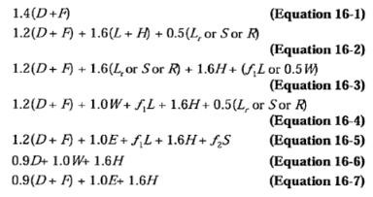
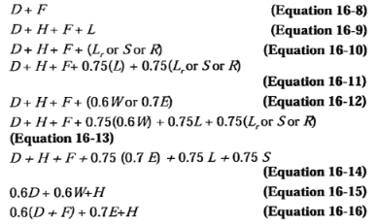
Combinations
Strength Combinations
Service Combinations

Slide 13
Preliminary Design
Slabs
Office
Ground
Basement
Beams
Office
Ground
Columns
Office
Ground
Basement
Shear Wall

Slide 14
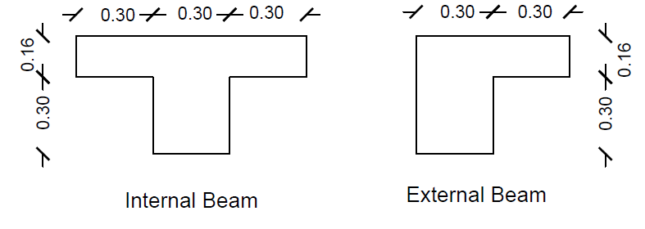
Office Beams and Slab
Assumptions
Columns Dimensions (40*25 cm)
α_{fm} < 2
Beams dimensions
➔ h = 0.16 m

Slide 15
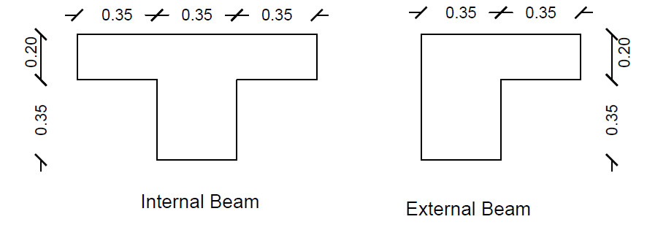
Ground Beams and Slab
Assumptions
Columns Dimensions (40*25 cm)
α_{fm} < 2
Beams dimensions
➔ h = 0.20 m

Slide 16
Basement Slab
Blind slab:
h = 0.15 m
It used to cover the backfill

Slide 17
Columns
Ground columns
Assume ρ = 1%
Based on calculations:
➔ 180 x 180 mm
But the used dimension is:
➔ 250 x 400 mm
Basement columns
Assume ρ = 1%
Based on calculations:
➔ 275 x 275 mm
But the used dimension is:
➔ 250 x 400 mm

Slide 18
Shear Wall
Assumptions:
γ _{soil} = 18 kN/m³
Ø_{soil} = 30˚
Wall Thickness is 25 cm
V_{u} = 48.34 kN
ØVc = 119 kN

Slide 19
3D Static Analysis and Design
Modeling in SAP2000
Analysis Verifications
Deflection
Results

Slide 20



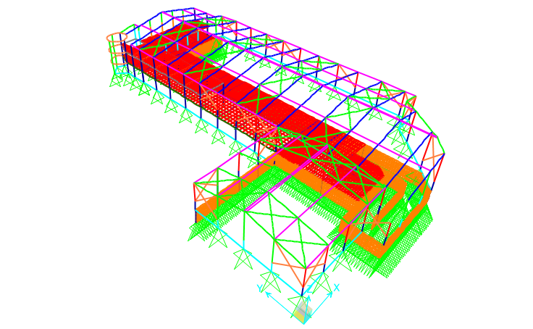


Modeling in SAP2000

Slide 21
Analysis Verifications
Compatibility check
Deflection
Equilibrium check
Internal Forces
Dead Load
Superimposed Dead Load
Live Load
Snow Load
Lateral Load

Slide 22
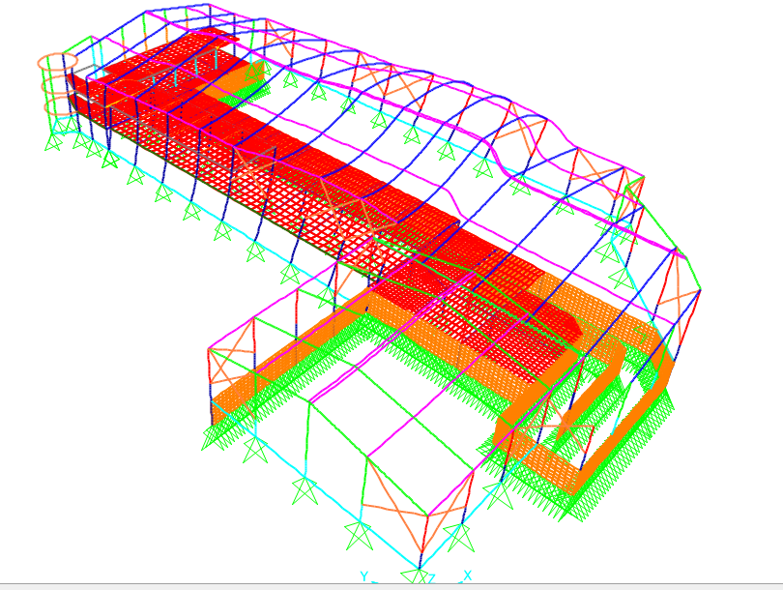
Compatibility check
From the figure, it is clear that the component of the structure looks compatible with each other.

Slide 23
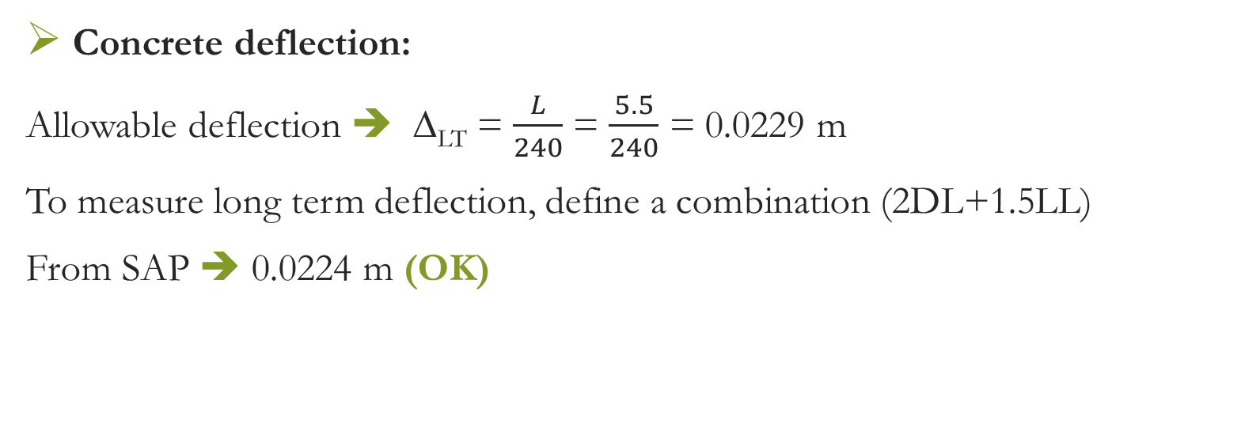
Deflection Computations
Concrete deflection:
Allowable deflection ➔ ∆_{LT} = $\frac{L}{240}$ = $\frac{5.5}{240}$ = 0.0229 m
To measure long term deflection, define a combination (2DL+1.5LL)
From SAP ➔ 0.0224 m (OK)

Slide 24

Deflection Computations
Steel deflection limit:
Live load deflection = $\frac{L}{180}$
Snow and wind load deflection = $\frac{L}{180}$
Dead + Live deflection = $\frac{L}{120}$

Slide 25
Deflection Computations
Live load deflection :
Δ_{allowable} = 158 mm.
From SAP ➔ Δ = 90 mm (OK)
Snow and wind load deflection :
Δ_{allowable} = 158 mm.
From SAP ➔ Δsnow = 54.30 mm (OK)
Δwind = 22.80 mm (OK)
(Dead + Live) deflection :
Δ_{allowable} = 237 mm.
From SAP ➔ Δ = 194.50 mm (OK)

Slide 26
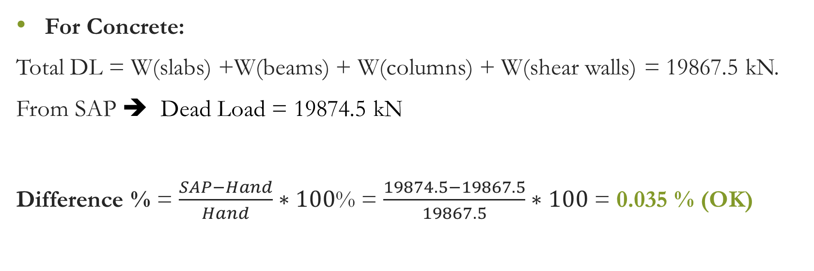
Gravity Loads (Dead)
For Concrete:
Total DL = W(slabs) +W(beams) + W(columns) + W(shear walls) = 19867.5 kN.
From SAP ➔ Dead Load = 19874.5 kN
Difference % = $\frac{SAP−Hand}{Hand}∗100$% = $\frac{19874.5−19867.5}{19867.5}∗100$ = 0.035 % (OK)

Slide 27
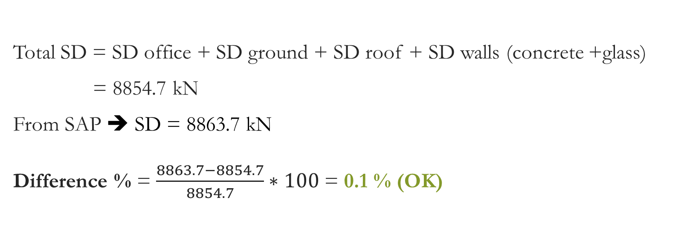
Gravity Loads (SD)
Total SD = SD office + SD ground + SD roof + SD walls (concrete +glass)
= 8854.7 kN
From SAP ➔ SD = 8863.7 kN
Difference % = $\frac{8863.7−8854.7}{8854.7}∗100$ = 0.1 % (OK)

Slide 28
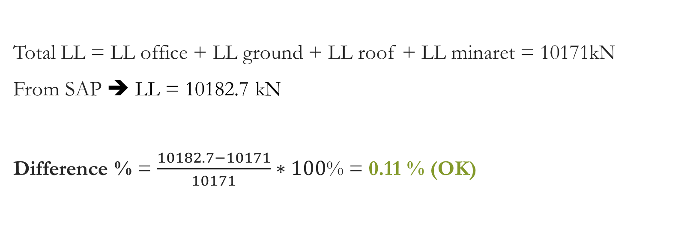
Gravity Loads (Live)
Total LL = LL office + LL ground + LL roof + LL minaret = 10171kN
From SAP ➔ LL = 10182.7 kN
Difference % = $\frac{10182.7−10171}{10171}∗100$% = 0.11 % (OK)

Slide 29

Gravity Loads (Snow)
Total SL = 1586.8 kN
From SAP ➔ Snow Load = 1590.7 kN
Difference % = $\frac{1590.7−1586.8}{1586.8}∗100$% = 0.25 % (OK)

Slide 30
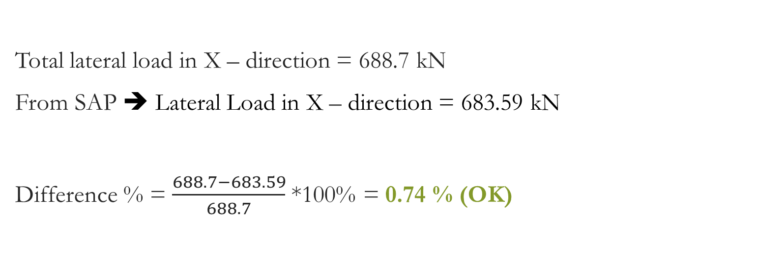
Lateral Load
Total lateral load in X – direction = 688.7 kN
From SAP ➔ Lateral Load in X – direction = 683.59 kN
Difference % = $\frac{688.7−683.59}{688.7}$ *100% = 0.74 % (OK)

Slide 31

Lateral Load
Total lateral load in Y – direction = 404 kN
From SAP ➔ Lateral Load in Y – direction = 411.7 kN
Difference % = $\frac{411.7−404}{404}$ *100% = 1.92 % (OK)

Slide 32
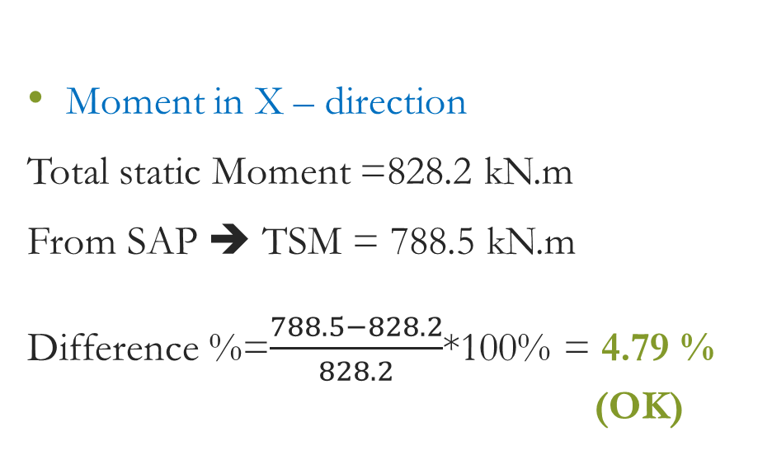
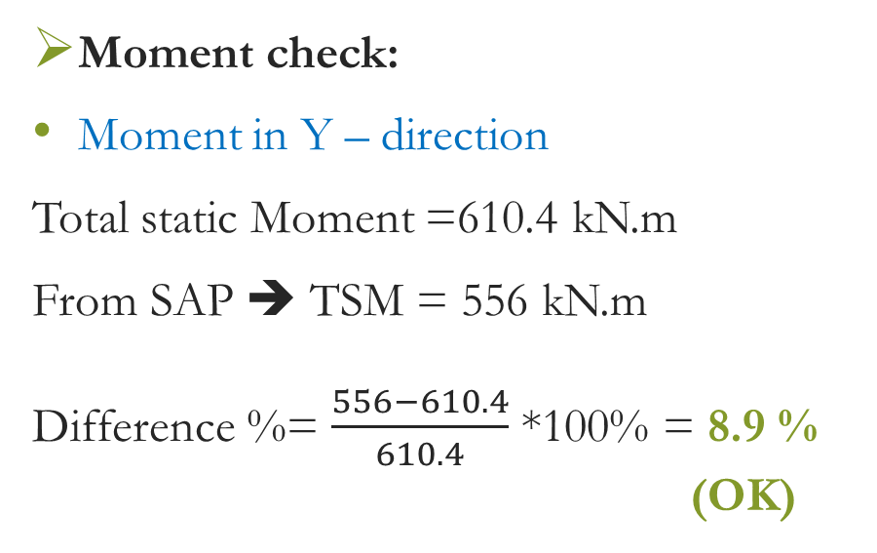
    Internal forces
Moment check:
Moment in Y – direction
Total static Moment =610.4 kN.m
From SAP ➔ TSM = 556 kN.m
Difference %= $\frac{556−610.4}{610.4}$ *100% = 8.9 %
(OK)
Moment in X – direction
Total static Moment =828.2 kN.m
From SAP ➔ TSM = 788.5 kN.m
Difference %=$\frac{788.5−828.2}{828.2}$*100% = 4.79 %
(OK)

Slide 33

Internal forces
Shear check:
Vu = 85.48 kN
From SAP ➔ Vu = 82.23 kN
Difference % = $\frac{82.23−85.48}{85.48}$ * 100% = 3.8 % (OK)

Slide 34

Results
Concrete sections
static design
Columns
Group A | 0.60 x 0.25
Group B | 0.55 x 0.50
Group C | 0.80 x 0.45
Beams
Ground | 0.60 x 0.40
Office | 0.60 x 0.40
Tie | 0.60 x 0.30
Slabs
All | 0.25
Wall
All | 0.25
Steel sections
static design
Columns | Tube 140*140*12.5
 | H400*237
 | H400*314
 | H400*422
Ring beam | 120*120*12.5
Rafters | HE400M
 | HE280M
Girder | HE400M
Purlins | 120*84*7.1
Bracing | 100*100*10
Cables | Diameter = 22 mm

Slide 35
3D Dynamic Analysis and Design
Mass source definition
Irregularity check
Mass participation ratio
Period check
Seismic analysis
Seismic checks
Results

Slide 36
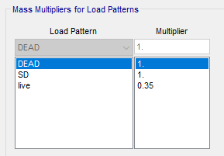
Mass source definition
All SD load and 35% of live load
considered as permanent mass.

Slide 37
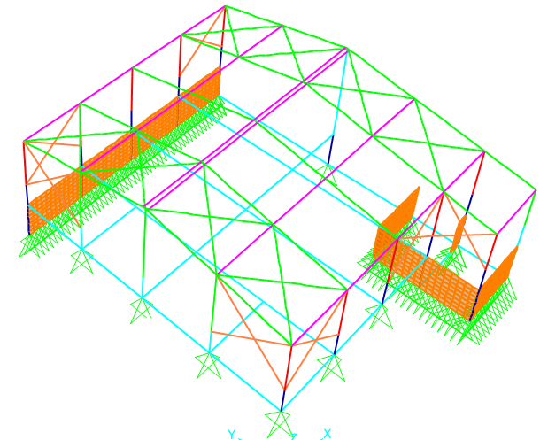
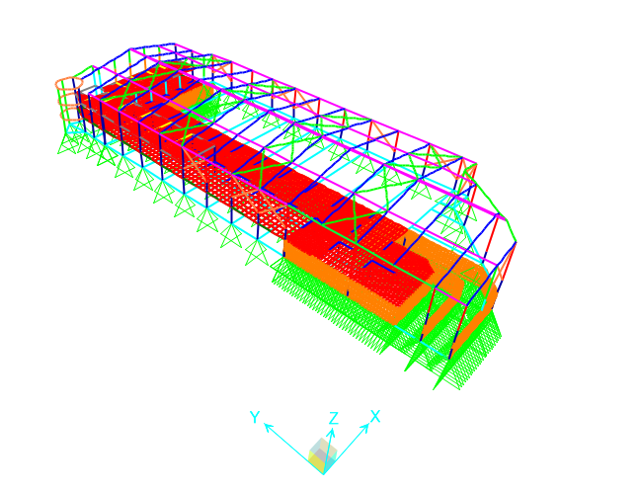
Irregularity check
Block A
Block B

Slide 38
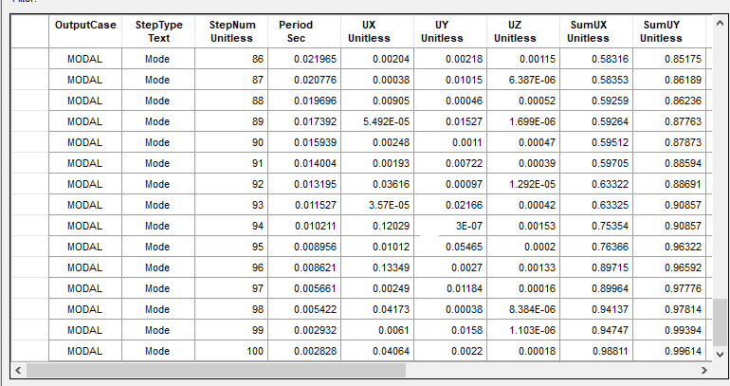
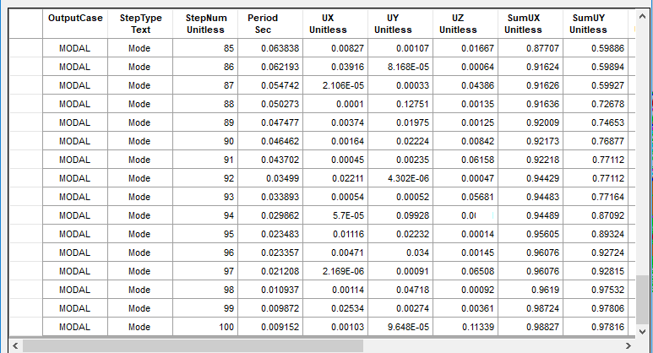
Mass participation ratio
Ritz vectors method was used to determine the most expected modes of the modal analysis of structure.

Slide 39
Period check
 | Approximation | Rayleigh | SAP
Block A | 0.61 | 0.577 | 0.586
Block B | 0.64 | 0.74 | 0.7

Slide 40
Seismic analysis
Seismic parameters
Equivalent static definition
Response spectrum definition

Slide 41
Seismic parameters
Based on S_{s} = 0.375, S₁ = 0.1875
F_{a} = 1.2
F_{v} = 1.6125
S_{DS} = 0.3
S_{D1} = 0.2
Seismic design category “D”
Site classification “C”
Seismic importance factor I = 1
Response modification factor R = 4.5
Seismic zone factor Z = 0.15

Slide 42
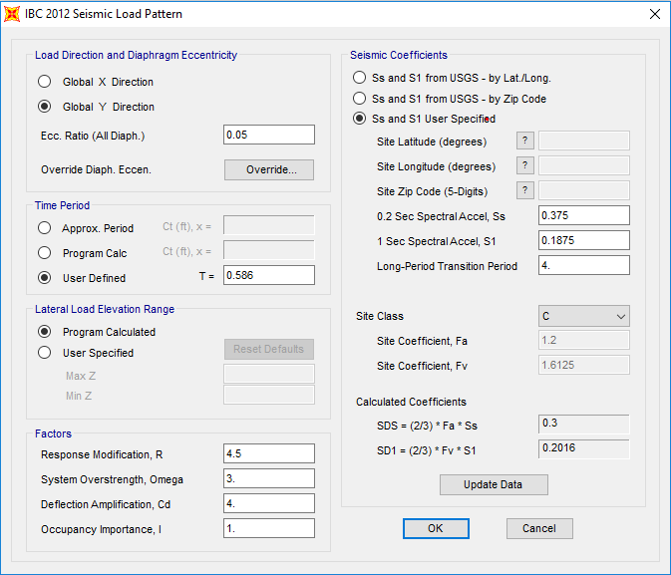
Equivalent static definition
According to IBC-2012

Slide 43
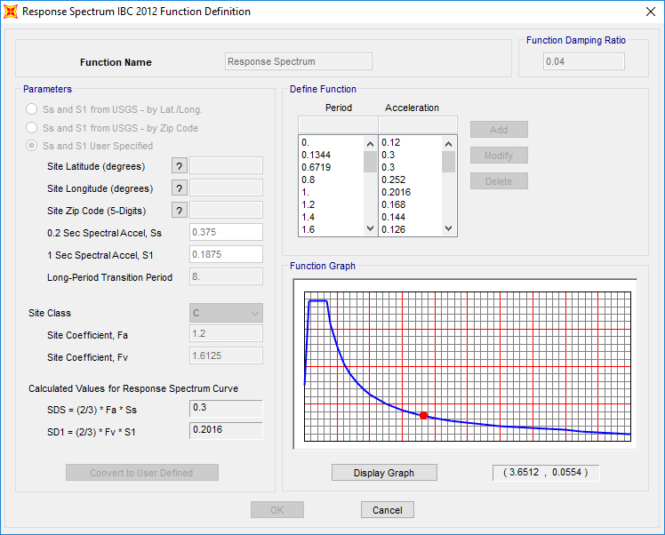
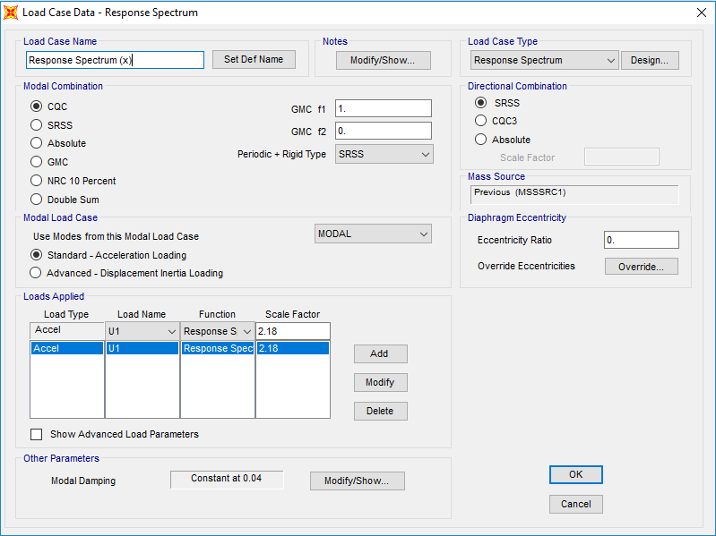
Response spectrum definition

Slide 44
Seismic checks
Base shear
 | V (kN) | V_{min} (kN) | V_{max} (kN) | V_{SAP} (kN)
Block A | 146 | 28.35 | 162 | 137
Block B | 2181 | 423.2 | 2050 | 2006

Slide 45

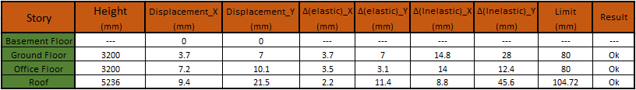
Seismic checks
Block A
Drift check
Block B

Slide 46
Results
Concrete sections
dynamic design
Columns
Group A | 0.60 x 0.25
Group B | 0.55 x 0.50
Group C | 0.80 x 0.45
Group D | 0.40 x 0.40
Beams
Ground | 0.60 x 0.40
Office | 0.60 x 0.40
Tie | 0.60 x 0.30
Slabs
All | 0.25
Wall
All | 0.25
Steel sections
dynamic design
Columns | Tube 140*140*12.5
 | H400*237
 | H400*314
 | H400*509
Ring beam | 120*120*12.5
Rafters | HE400M
 | HE280M
Girder | HE400M
Purlins | 120*84*7.1
Bracing | 120*84*12.5
Cables | Diameter = 22 mm

Slide 47
Concrete design
Slabs
Beams
Columns
Shear walls
Footings

Slide 48
Slabs
Ground slab
Max moment = 28.8 kN.m/m
A_{s} = 450 mm²/m. ➔ Use 4Ø12/m.
Office slab
Max moment = 27.4 kN.m/m
A_{s}= 450 mm²/m ➔ Use 4Ø12/m.
Blinding slab (15 cm)
A_{s} = 270 mm²/m ➔Use 4Ø10/m.

Slide 49

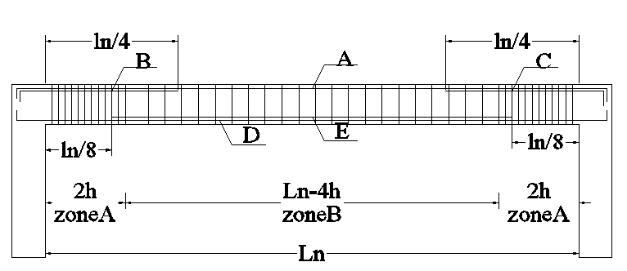
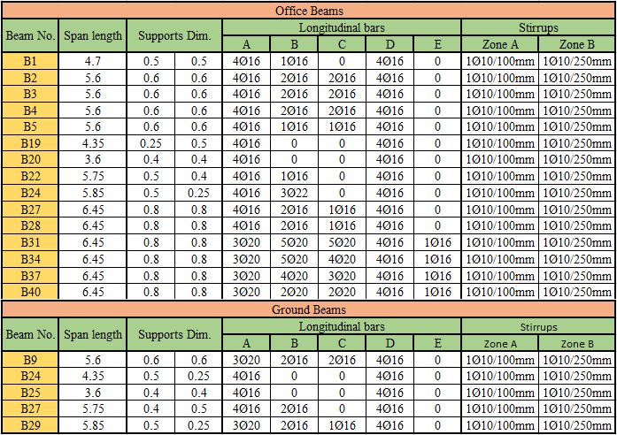
Beams
Simply supported

Slide 50
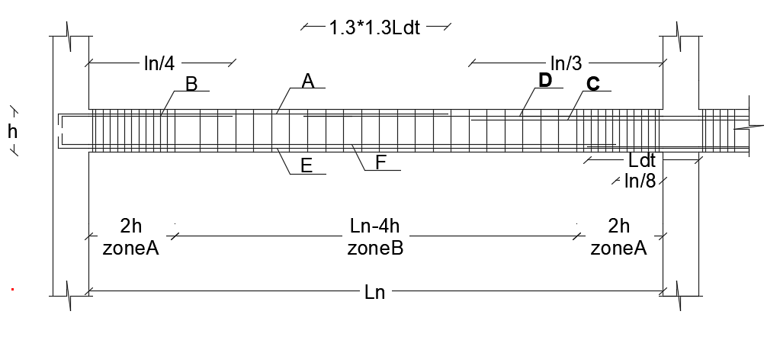
Beams
One-end continuous

Slide 51
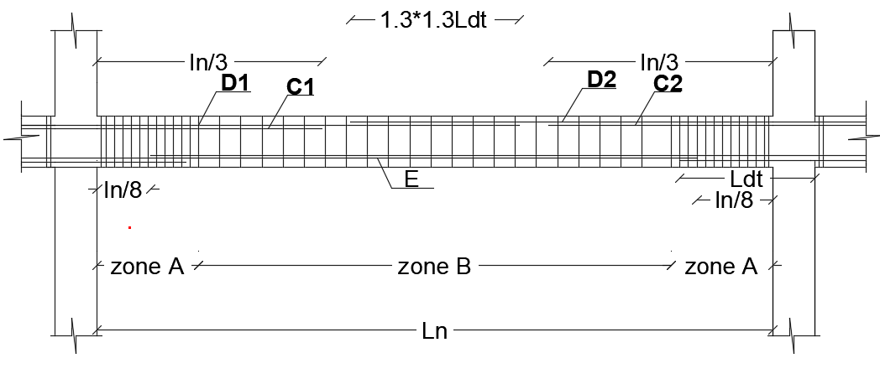
Beams
Two-end continuous

Slide 52
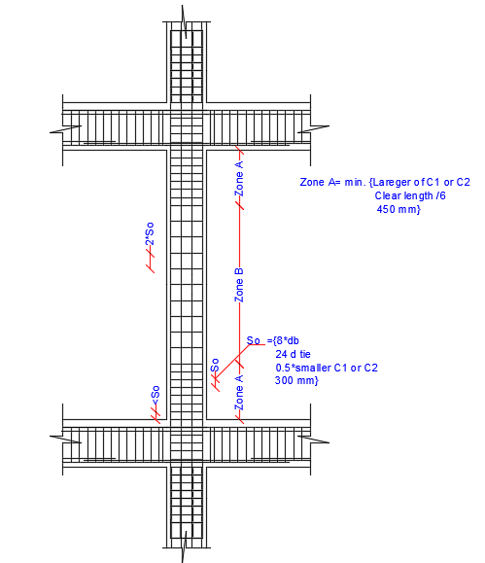
Columns

Slide 55
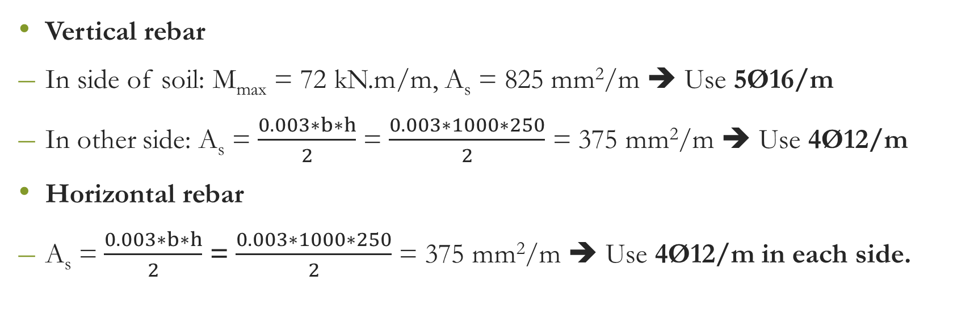
Shear walls
Vertical rebar
In side of soil: M_{max} = 72 kN.m/m, A_{s} = 825 mm²/m ➔ Use 5Ø16/m
In other side: A_{s} = $\frac{0.003∗b∗h}{2}$ = $\frac{0.003∗1000∗250}{2}$ = 375 mm²/m ➔ Use 4Ø12/m
Horizontal rebar
A_{s} = $\frac{0.003∗b∗h}{2}$ = $\frac{0.003∗1000∗250}{2}$ = 375 mm²/m ➔ Use 4Ø12/m in each side.

Slide 56
Footings
Footing | Column | Load Limit (KN) | Footing Dimension (m) |  |  | Area Of Bottom Reinforcement (mm^2)
Name | Dimension (m) | Service Load | Length | Width | Depth | As, Cal. | Minimum | No. of Bars
F1 | 0.6*0.25 | Less than 500 | 1.6 | 1.25 | 0.35 | 387.1 | 630 | 5Ø14/m
F2 |  | 500-750 | 1.95 | 1.6 | 0.35 | 722.8 | 630 | 5Ø14/m
F3 | 0.4*0.4 | --- | 1 | 1 | 0.35 | 95.7 | 630 | 5Ø14/m
F4 | 0.8*0.45 | --- | 2.4 | 2.05 | 0.35 | 997.8 | 630 | 5Ø16/m
F5 | 0.55*0.5 | Less than 500 | 1.25 | 1.25 | 0.35 | 186.8 | 630 | 5Ø14/m
F6 |  | 500-850 | 1.85 | 1.85 | 0.35 | 645.6 | 630 | 5Ø14/m
F7 | Combined Column | --- | 2.4 | 1.9 | 0.35 | 697.0 | 630 | 5Ø14/m
F8 | Combined footing | --- | 3 | 2.1 | 0.35 | 963.0 | 630 | 5Ø16/m
Wall | Wall footing | --- | --- | 1.2 | 0.35 | 98.7 | 630 | 5Ø14/m

Slide 57
Steel member design
Tension Capacity
Compression Capacity
Buckling
Moment Capacity
Lateral Torsional Buckling
Shear Capacity
Beam-Column Capacity

Slide 58
Tension Capacity
ØT_{n} = Ø * F_{y} * A_{g}
ØT_{n}: Tension capacity for the member.
Ø: Reduction factor. In tension Ø = 0.9
F_{y}: Yielding stress of steel.
A_{g}: Gross sectional area of the member.
Group | Sections Name | SAP
 |  | ØTn(kN) | Tu(kN)
Columns | TUBO 140*140*12.5 | 1424.112 | 0
 | H400*314 | 8935.6 | 0
 | H400*237 | 6746.4 | 0
 | H400*509 | 14475.6 | 0
Rafter | HE400M | 7282.5 | 0
 | HE280M | 5361.4 | 0
Ring Beam | TUBO120*120*12.5 | 1207 | 65.7
Girder | HE400M | 7282.5 | 0
Purlins | TUBO120*84*7.1 | 602 | 0
Bracing | TUBO120*84*12.5 | 999.7 | 133.45
Cable | Dia. 22 mm | 285 | 274

Slide 59
Compression Capacity
Ø Pn = Ø * Fcr * A_{g}
Ø P_{n}: Compression capacity for the member.
Ø : Reduction factor, In compression Ø = 0.9
F_{cr}: Critical stress on the member.
A_{g}: Gross area of the member.
Buckling

Slide 60
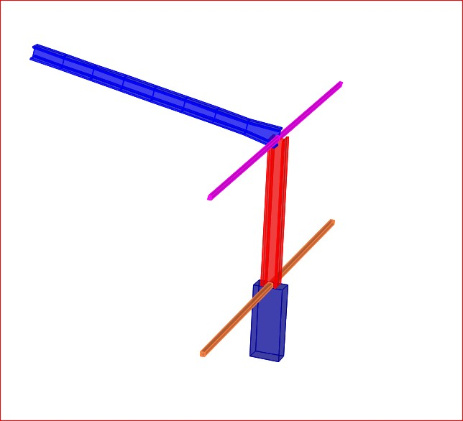
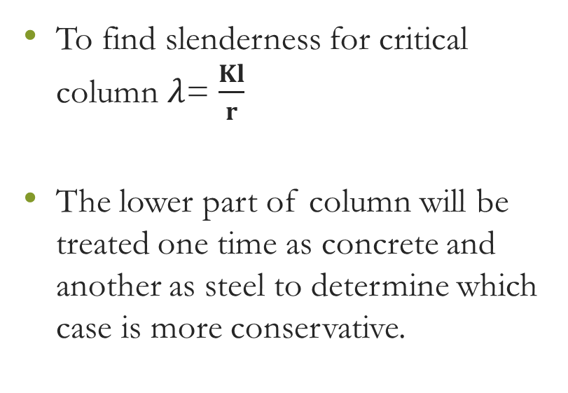
Buckling
To find slenderness for critical column $λ$= $\frac{Kl}{r}$
The lower part of column will be treated one time as concrete and another as steel to determine which case is more conservative.

Slide 61
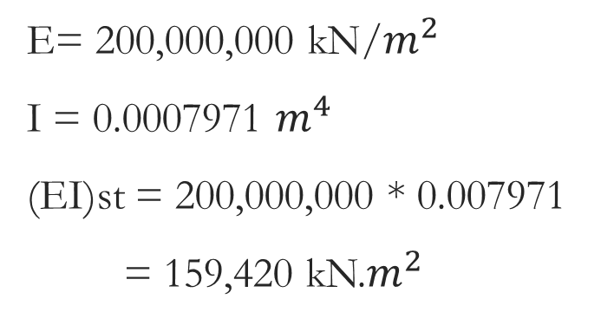
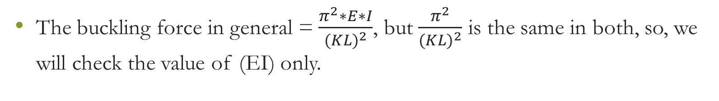
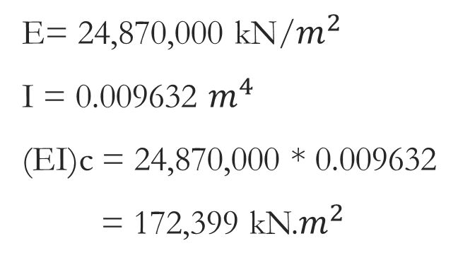
The buckling force in general = $\frac{π^{2}∗E∗I}{{(KL)}^{2}}$, but $\frac{π^{2}}{{(KL)}^{2}}$ is the same in both, so, we will check the value of (EI) only.
Steel
Concrete
E= 200,000,000 kN/$m^{2}$
I = 0.0007971 $m^{4}$
(EI)st = 200,000,000 * 0.007971
= 159,420 kN.$m^{2}$
E= 24,870,000 kN/$m^{2}$
I = 0.009632 $m^{4}$
(EI)c = 24,870,000 * 0.009632
= 172,399 kN.$m^{2}$
(EI)_{st} < (EI)_{c}

Slide 62
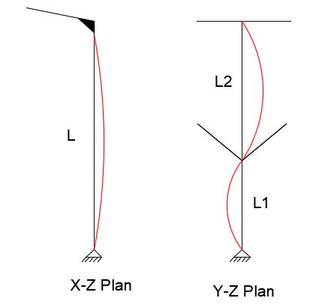
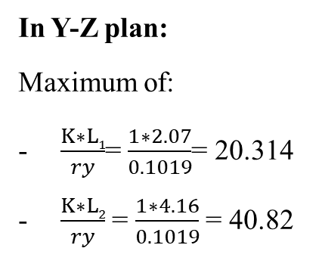
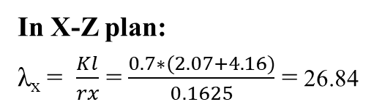
Buckling
In X-Z plan:
λ_{x} = $\frac{Kl}{rx}$ = $\frac{0.7∗(2.07+4.16)}{0.1625}$ = 26.84
In Y-Z plan:
Maximum of:
$\frac{K∗L1}{ry}$= $\frac{1∗2.07}{0.1019}$= 20.314
$\frac{K∗L2}{ry}$ = $\frac{1∗4.16}{0.1019}$ = 40.82
λ_{y} = 40.82
Since λ_{y} > λ_{x} Use λ = 40.82

Slide 63
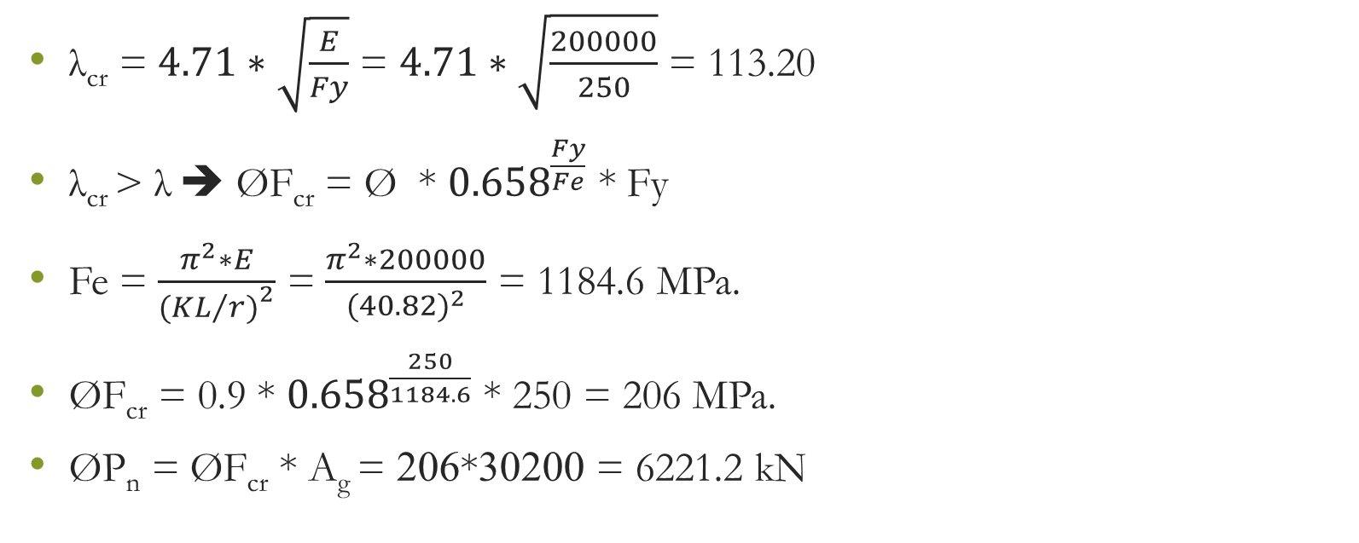
Buckling
λ_{cr} = $4.71∗\sqrt{\frac{E}{Fy}}$ = $4.71∗\sqrt{\frac{200000}{250}}$ = 113.20
λ_{cr} > λ ➔ ØF_{cr} = Ø * ${0.658}^{\frac{Fy}{Fe}}$ * Fy
Fe = $\frac{π^{2}∗E}{{({KL}/{r)}}^{2}}$ = $\frac{π^{2}∗200000}{{(40.82)}^{2}}$ = 1184.6 MPa.
ØF_{cr} = 0.9 * ${0.658}^{\frac{250}{1184.6}}$ * 250 = 206 MPa.
ØP_{n} = ØF_{cr} * A_{g} = 206*30200 = 6221.2 kN
From SAP:
ØP_{n} = 6179.5 kN.
Maximum load = 192.5 kN.
6221.2 kN > 192.5 kN ➔ Ok

Slide 64
Group | Sections Name | SAP
 |  | ØPn(kN) | Pu(kN)
Columns | TUBO 140*140*12.5 | 935 | 202.7
 | H400*314 | 8204.8 | 275
 | H400*237 | 6179.5 | 192.5
 | H400*509 | 13382.3 | 359.8
Rafter | HE400M | 6826.3 | 417.2
 | HE280M | 3549.8 | 173.6
Ring Beam | TUBO120*120*12.5 | 1185.3 | 0
Girder | HE400M | 5557 | 30.7
Purlins | TUBO120*84*7.1 | 138 | 0
Bracing | TUBO120*84*12.5 | 150 | 111.7

Slide 65
Moment capacity
Bending moment capacity ØM_{n} = ØM_{p} ➔ If no lateral torsional buckling
ØM_{p,} = Ø * Z * F_{y}
Ø : Reduction factor in moment = 0.9
Z: Plastic section modulus.

Slide 66
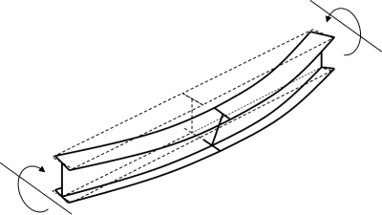
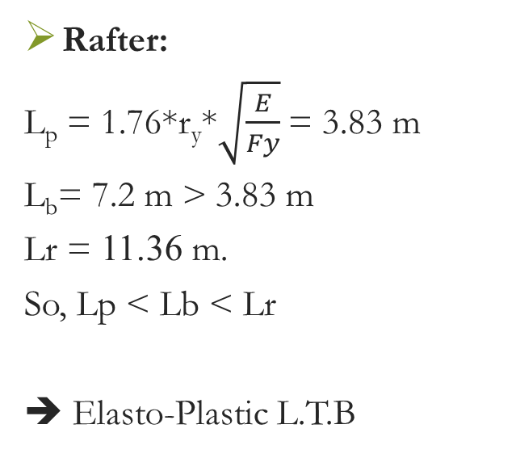
Moment capacity
Lateral Torsional Buckling
Rafter:
L_{p} = 1.76*r_{y}*$\sqrt{\frac{E}{Fy}}$ = 3.83 m
L_{b}= 7.2 m > 3.83 m
Lr = 11.36 m.
So, Lp < Lb < Lr
➔ Elasto-Plastic L.T.B

Slide 67
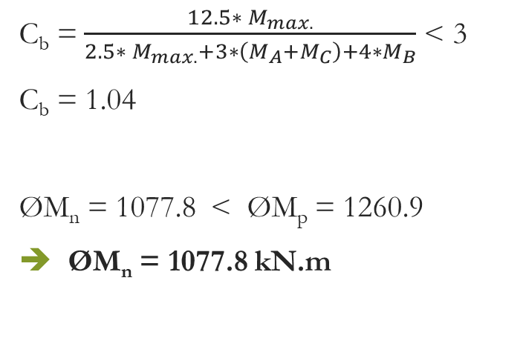
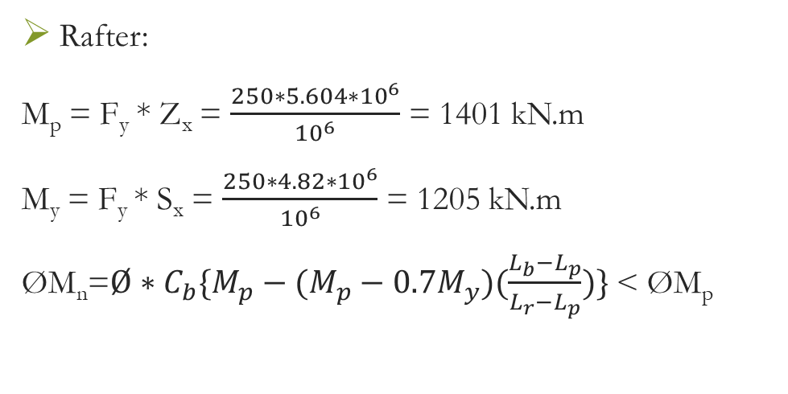
Moment capacity
Lateral Torsional Buckling
Rafter:
M_{p} = F_{y} * Z_{x} = $\frac{250∗5.604∗{10}^{6}}{{10}^{6}}$ = 1401 kN.m
M_{y} = F_{y} * S_{x} = $\frac{250∗4.82∗{10}^{6}}{{10}^{6}}$ = 1205 kN.m
ØM_{n}=$Ø∗C_{b}\{M_{p}−{(M_{p}−0.7M}_{y})(\frac{L_{b}−L_{p}}{L_{r}−L_{p}})\}$ < ØM_{p}
C_{b} =$\frac{12.5∗ M_{max.}}{2.5∗ M_{max.}+3∗\left(M_{A}+M_{C}\right)+4∗M_{B}}$ < 3
C_{b} = 1.04
ØM_{n} = 1077.8 < ØM_{p} = 1260.9
➔ ØM_{n} = 1077.8 kN.m

Slide 68
Group | Sections Name | SAP
 |  | ØMn(kN) | Mu(kN)
Columns | TUBO 140*140*12.5 | 68.3 | 49.5
 | H400*314 | 1433.5 | 1036
 | H400*237 | 1055.9 | 547.6
 | H400*509 | 1236.9 | 839.6
Rafter | HE400M | 1244.5 | 618.3
 | HE280M | 662.6 | 319
Ring Beam | TUBO120*120*12.5 | 48.36 | 31.4
Girder | HE400M | 432 | 157
Purlins | TUBO120*84*7.1 | 24 | 14.5
Bracing | TUBO120*84*12.5 | 37.8 | 2

Slide 69

Beam-Column Capacity
To check capacity, use interaction diagram which consist from these equations
$\frac{Pu}{2∅Pn}$ + $\frac{Mu}{∅Mn}$ < 1 , if $\frac{Pu}{∅Pn}$ ≤ 0.2
$\frac{Pu}{∅Pn}$ + $\frac{8∗ Mu}{9∗ ∅Mn}$ <1 , if $\frac{Pu}{∅Pn}$ ≥ 0.2

Slide 70
Group | Sections Name | ØPn(kN) | Pu(kN) | Pu/ØPn | ØMn(kN) | Mu(kN) | Beam – Column capacity | Result
Columns | TUBO 140*140*12.5 | 935 | 202.7 | 0.217 | 68.3 | 49.5 | 0.86 | Ok
 | H400*314 | 8204.8 | 275 | 0.034 | 1433.5 | 1036 | 0.74 | Ok
 | H400*237 | 6179.5 | 192.5 | 0.031 | 1055.9 | 547.6 | 0.53 | Ok
 | H400*509 | 13382.3 | 359.8 | 0.027 | 1236.9 | 839.6 | 0.69 | Ok
Rafter | HE400M | 6826.3 | 417.2 | 0.061 | 1244.5 | 618.3 | 0.53 | Ok
 | HE280M | 3549.8 | 173.6 | 0.049 | 662.6 | 319 | 0.51 | Ok
Ring Beam | TUBO120*120*12.5 | 1185.3 | 0 | 0.000 | 48.36 | 31.4 | 0.65 | Ok
Girder | HE400M | 5557 | 30.7 | 0.006 | 432 | 157 | 0.37 | Ok

Slide 71
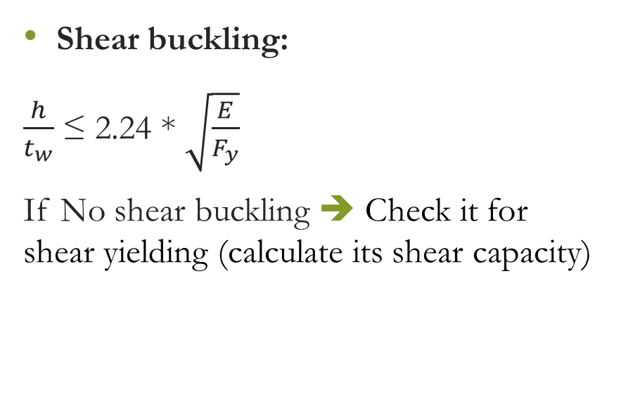
Shear capacity
Shear buckling:
$\frac{h}{t_{w}}$ ≤ 2.24 * $\sqrt{\frac{E}{F_{y}}}$
If No shear buckling ➔ Check it for shear yielding (calculate its shear capacity)
Shear Yielding:
ØV_{n} = Ø * 0.6 * F_{y} * A_{web}
Ø: Reduction factor, in shear = 1
A_{web}: Gross sectional area of the member, which is parallel to shear force.

Slide 72
Group | Sections Name | SAP
 |  | ØVn(kN) | Vu(kN)
Columns | TUBO 140*140*12.5 | 343.5 | 20.16
 | H400*314 | 1459.5 | 195.38
 | H400*237 | 1049.7 | 144.8
 | H400*509 | 2617.7 | 44.5
Rafter | HE400M | 1351 | 163.8
 | HE280M | 854 | 124
Ring Beam | TUBO120*120*12.5 | 276.45 | 44.6
Girder | HE400M | 1351 | 97.6
Purlins | TUBO120*84*7.1 | 188 | 3
Bracing | TUBO120*84*12.5 | 276.4 | 0

Slide 73






Steel Connections Design
Steel Connections Design

Slide 74
Steel Connections Design
n | Connection Type
1 | Bracing | Column | 6 | Rafter | Tube Column
 | Tube 120x84x12.5 | H400x314 |  | HE 400M | Tube 140x140x12.5
2 | Purlins | Rafter | 7 | Girder | Column - flange
 | Tube 120x84x7.1 | HE 400M |  | HE 400M | H 400x314
3 | Cable | Rafter | 8 | Girder | Column - top
 | 22 mm diameter | HE 400M |  | HE 400M | H 400x509
4 | Rafter | Column | 9 | Rafter | Rafter
 | HE 400M | H 400x314 |  | HE 400M | HE 400M
5 | Rafter | Column | 10 | Rafter | Rafter
 | HE 280M | H400x237 |  | HE 280M | HE 280M
18 | Rafter | Column | 11 | Rafter | Girder
 | HE 280M | H400x237 |  | HE 400M | HE 400M

Slide 75

Cable connection
By assuming 15 mm thickness:
Weld fracture check
R_{n} < ∅ (ƩL) (a cos 45) (0.6 F_{EXX}) ➔ a = 8 mm
Tear-out check
R_{n} < ∅ (0.6 F_{u})*2*L_{c}*t_{p} ➔ L_{c, min} = 51 mm
Bearing check
R_{n} < ∅*C*F_{u}*d_{b}*t_{p} = 274*10³ < 343*10³ ➔ Ok

Slide 76

Base plate connection
Base plate
12 | Tube 140x140x12.5 | on column 60x25
13 | Tube 140x140x12.5 | on slab
14 | H 400x509 | on slab
15 | H 400x314 | on column 55x50
 |  | and column 45x80
16 | H 400x237 | on column 55x50
17 | Tube 120x120x12.5 | Ring beam

Slide 77



Base plate connection
Tension check ➔ d_{b} = 17.86 mm
Shear check ➔ d_{b} = 13.11 mm
For top bolts ➔ Use d_{b} = ⅞”
Shear-tension interaction
$\frac{F_{t} }{ØF_{nt}}$ + $\frac{F_{v} }{ØF_{nv}}$ ≤ 1.3 = 0.99 < 1.3 (Ok)
Bearing check
R_{n} ≤ Ø*C*F_{u}*d_{b}*t_{p}
47.5 kN < 160 kN ➔ Ok
Notes:
Tear-out check:
Since edge distance = 35.56 mm > 2 (15.875) = 31.75 mm
No tear-out failure.

Slide 78

Base plate connection
Assume $5/4$’’ diameter.
Tension check
69.7 kN < 112.54 kN
Shear check
105.5 kN < 162.6 kN
Shear-tension interaction
$\frac{F_{t} }{ØF_{nt}}$ + $\frac{F_{v} }{ØF_{nv}}$ ≤ 1.3 = 1.268 < 1.3 (Ok)
Bearing check
18 kN < 343 kN ➔ Ok
Notes:
Tear-out check:
Since edge distance = 35.56 mm > 2 (15.875) = 31.75 mm
No tear-out failure.

Slide 79


Base plate connection
Yielding failure:
M_{yield} = F_{y} * S_{x} = 245 * $( \frac{\frac{t^{2}∗b}{6}}{{10}^{6}} )$ = $( \frac{\frac{{15}^{2}∗500}{6}}{{10}^{6}} )$ = 4.6 kN.m
T _{@one side in flange} = $\frac{T}{2}$ + $\frac{M}{D}$ = $\frac{276}{2}$ + $\frac{191}{0.4}$ = 615.5 kN
M’ = 615.5 * 0.03 = 18.47 kN.m
M_{stiffener} =18.47 – 4.6 = 13.87 kN.m
A_{stiffener} = $\frac{\left(\frac{13.87}{0.03}\right)∗103}{0.9∗3∗245}$ = 699 mm²
t = $\frac{699}{70}$ = 10 mm

Slide 80
At the END ..

Slide 81
THANK YOU

