Slide 1





Leukemia Diagnosis Using Microscopic Digital Images
Maha Assad Khader
Rawan Raed Radi
Supervisor
Dr. Naser Abu-Zaid

Slide 2

Introduction
Although there has been great progress in various aspects of medicine, full treatment of cancer remains an obstacles until today. This produces fear and anxiety feelings for many persons, that may be due to the late detection of this disease in the body.
Through this project, various theories were used to help the discovery early cancer, and then we progressed to precisely define the stage of cancer in the infected bodies and getting best result.

Slide 3
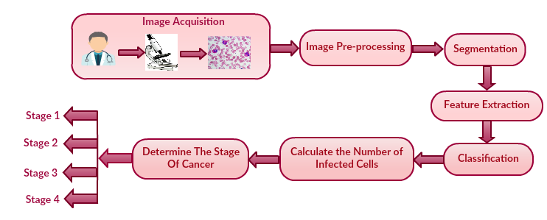
What is the overall Methodology of this system?
The proposed system for leukemia detection consists of various functional blocks:

Slide 4
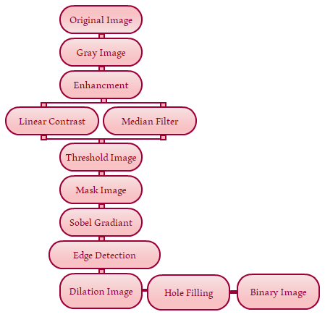
Image Pre-Processing and Segmentation Steps

Slide 5
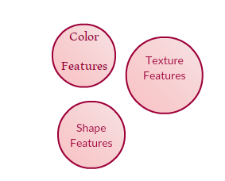
Feature Extraction and Classification
Feature extraction is the process of converting the image into data so that we can check these values and finally differentiate between the cancerous and non-cancerous data.
Based on the values of the image feature extraction classifier that tests image into either infected or not infected class.

Slide 6
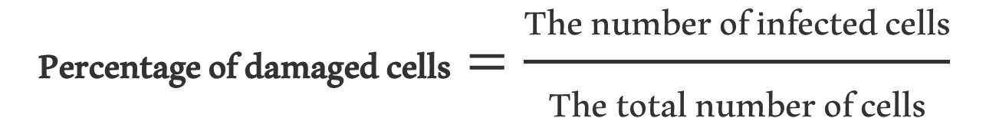
Calculate the Percentage of damaged cells
To calculate the percentage of damaged cells we can:
Calculate the total number of cells in the original image.
We make a counter to count the number of infected cells.
Count the percentage of damage cells using the eq.
$$\text{P}\text{ercentage} \text{of} \text{damaged} \text{cells}=\frac{\text{T}\text{he} \text{number} \text{of} \text{infected} \text{cells}}{\text{T}\text{he} \text{total} \text{number} \text{of} \text{cells}}$$

Slide 7
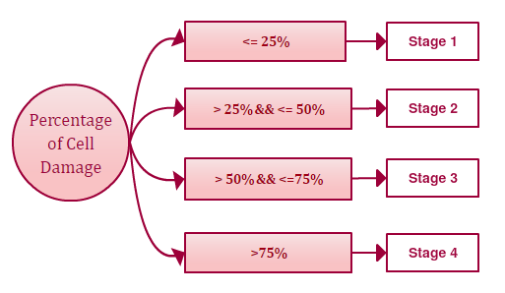
Determine the stage of cancer
We can determine the stage of cancer depending on the percentage of cell damage to obtain four stages:

Slide 8
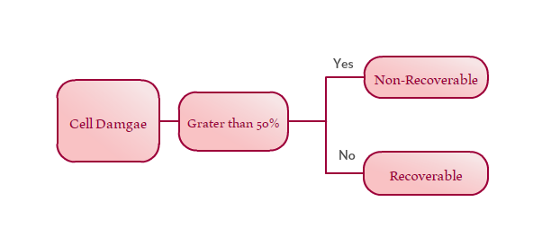
Can the cancer cell be recovered?
We can determine whether the cancer maybe can be recovered or not depending on the percentage of cell damage:

Slide 9
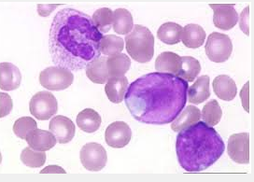
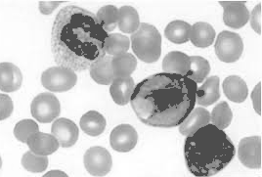
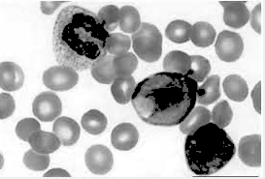
Image Pre-Processing Results
Original Input Image
Grayscale Image
Linear Contrast

Slide 10

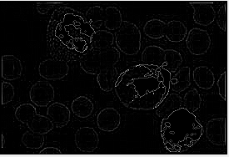
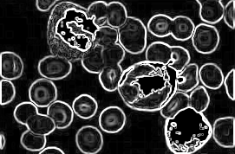

Image Segmentation Results
Threshold Image
Mask Image
Sobel gradient Image Edge detection Image

Slide 11
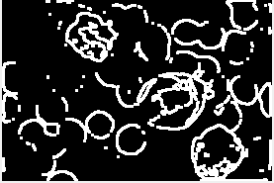


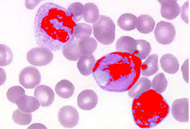
Dilation Image
Hole Filling Image
Binary Image
Red spot over WBC’s

Slide 12
Conclusion
In this project, it’s possible completely and automatic identify and classify of leukocytes through microscopic images.
Determination of caner stage.
As future work the software that we developed maybe converted into a mobile application.
Data for public can be loaded from cloud.

