Slide 1

Foundation Design for a multi-story residential Building in Tulkarm city
Graduation Project II
Prepared By:
  Osaid Odeh
  Abdullah Hussein
  Mohammed Barham
  Mohannad Othman
Under Supervision Of:
Dr. Mohammed Ghazal

Slide 2
Outline of the project
Introduction
Objectives
Methodology
Modeling
Conclusion

Slide 3
Introduction
A project to design the foundations of a residential building, (Al-Kholod Building). The area of the plan is 570 meter square, and the proposed building consists of 10 floors.
A test pit was made along the building on the northern side to reveal the foundation soil, it was found that it was composed of a top layer of dark soil of a thickness of 1.6 m, followed by a formation of soft pink poplar with a thickness of 60 cm, then soft and moist poplar appears to a depth of 2.5 m, and a bearing capacity of 1.5 kg/cm2
The existing soil is that the top soil of silty clay mixed with stones of high plasticity

Slide 4
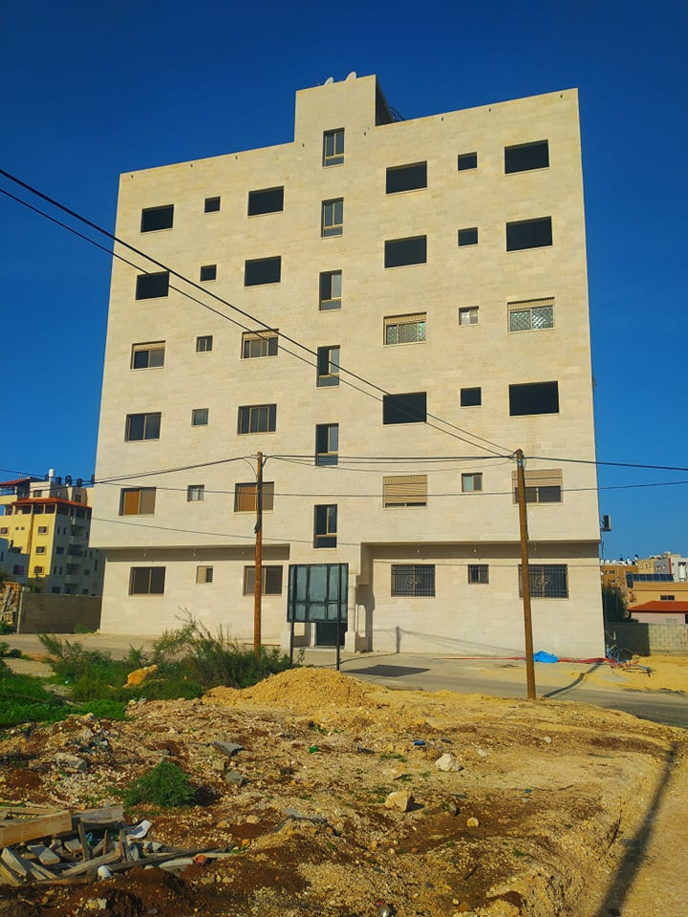
Al-Kholod Building

Slide 5
Objectives
We calculated the loads on the columns
we calculated the area of the footings in both cases for the building
We redesigned the foundations of the building in two cases

Slide 6
Methodology
Drawing the plans of the building
Loads Calculation
Shear wall Calculation
Design the foundation of the building in two cases Raft & Piles
Modeling
Retaining wall calculation
Conclusion

Slide 7
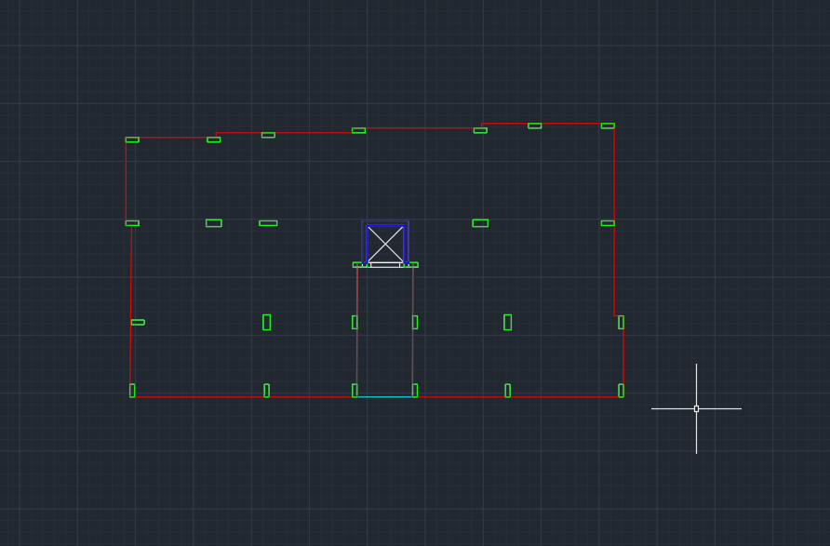
Drawing the plans

Slide 8
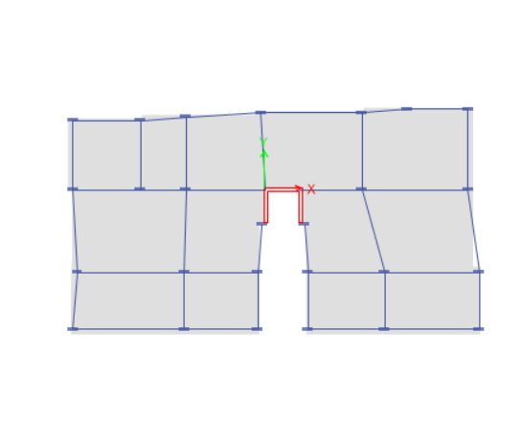
Loads Calculation

Slide 9
Loads Calculation
#Column | Service load | Ultimate load
C1 | 454.83 | 596.9
C2 | 708.95 | 942.942
C3 | 381.44 | 492.30
C4 | 402.53 | 521
C5 | 662.81 | 880
C6 | 400 | 522.57
C7 | 877.18 | 1167
C8 | 1415.98 | 1903
C9 | 524.55 | 683
C10 | 537.75 | 701
C11 | 1346.15 | 1807
C12 | 742.91 | 982
C13 | 725.4 | 958.58
C14 | 864.36 | 1153
C15 | 1089.87 | 1459

Slide 10
Loads Calculation
C16 | 849.26 | 1100
C17 | 799.29 | 1038.75
C18 | 1456.75 | 1960.7
C19 | 971.46 | 1293
C20 | 378.47 | 492.67
C21 | 534.37 | 704
C22 | 529.64 | 697.7
C23 | 412.24 | 946.13
C24 | 744.63 | 996
C25 | 372.448 | 491
C26 | 429.87 | 563

Slide 11
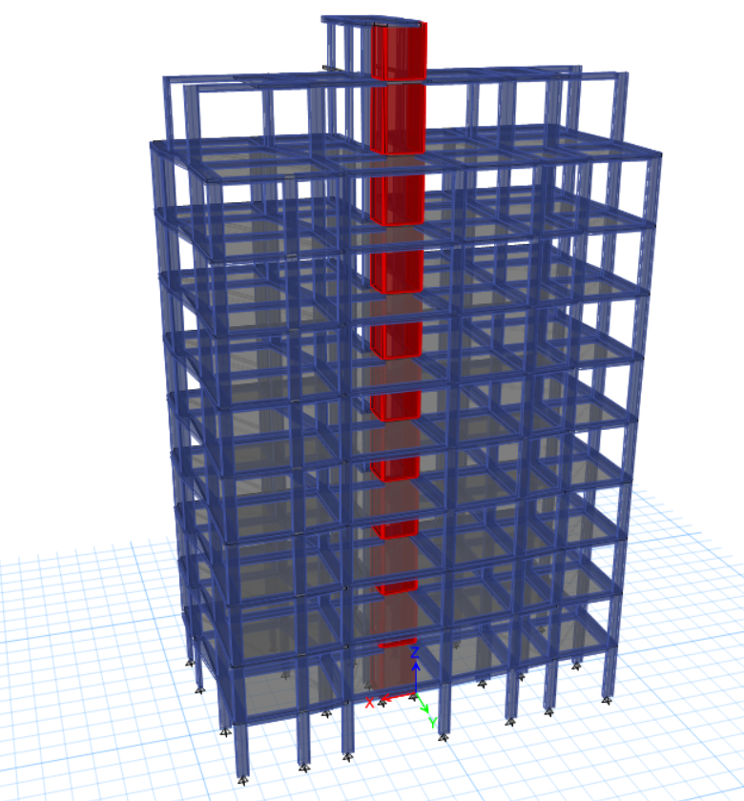
Loads Calculation

Slide 12
Design of foundation
First Option (Raft Foundation):
Raft foundation is one of foundation that is used when the load of structure is very large or the soil capacity is small to transfer the load as pressure on the soil avoiding to make the value of the pressure under the foundation to be larger than the allowable bearing capacity and it also used since the soil is clayey soil which has swilling and expansion properties so to avoid the differential settlement the raft foundation is used. Also raft foundation is used when the needed area of ​​footings is larger than 60% of building, and it can be used to reduce settlement.

Slide 13
Total service load on the base(Ps)= 454.83+708.95+381.44+405.53+662.81+400+988.18+400+877.18+1415.98+524.55+537.75+1346.15+742.91+725.4+864.36+1098.87+849.36+1089.87+849.26+799.29+1456.75+971.46+378.47+534.37+529.64+412.24+744.63+372.488+ 429.87=18612.808 KN
Area of footing = Service load / Bearing Capacity
18612.808/150=124.08 m2 use area of footing 170 m2

Slide 14
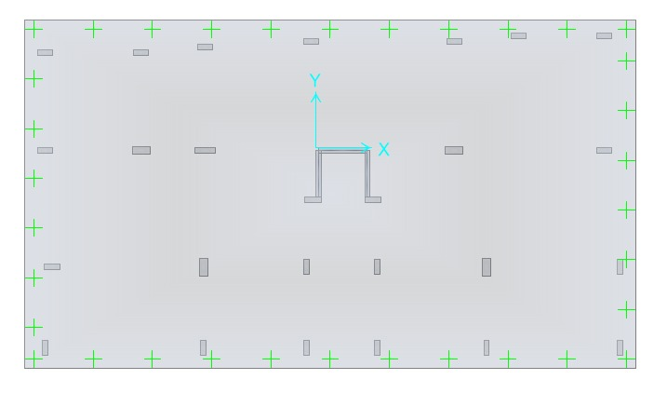
Raft foundation has been modeled in SAFE 2016

Slide 15
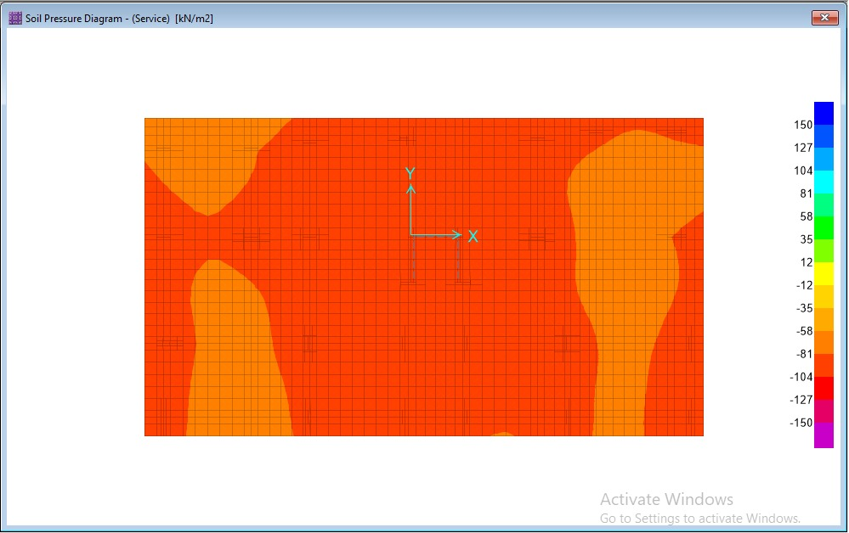
Bearing capacity check:
q=150kn/m2
qall=150kn/m2
q<=q all … ok

Slide 16
Check bearing capacity manually: to check mat foundation for soil failure: by taking reference lines on X and Y directions at left between corner of the mat foundation:
∑PiXi=(.275*597)+(.518*1168)+(.275*959)+(.275*493)+(3.80*705)+(3.80*1153)+(6.14*698)+(6.14*1460)+(6.075*1903)+(6.075*942)+(9.87*493)+(9.87*683)+(10.10*351)+(500*10.30)+(10.30*1106)+(947*10.05)+(12.10*1038)+(12.12*428)+(12.30*350)+(702*12.475)+(12.475*521)+(880*16.475)+(16.475*1807)+(1960*15.30)+(15.30*996)+(17.65*492)+(564*20.80)+(1294*20.80)+(21.37*983)+(523*21.37)=286282.8
∑PiYi = (.275*597)+(3.255*1168)+(7.5*958)+(492*11.10)+(11.10*705)+(1153*7.5)+(11.30*698)+(1460*7.5)+(3.223*1903)+(943*275)+(.275*492)+(683*3.225)+(5.70*350)+(500*5.80)+(7.4*1106)+(946*11.5)+(7.4*1038)+(428*5.8)+(5.7*350)+(701*3.225)+(.275*521)+(880*.275)+(3.225*1807)+(1960*7.5)+(11.50*996)+(492*11.70)+(11.70*563.90)+(1293*7.5)+(3.225*982)+(522*.275)=156730.375
Xp = ∑PiXi/∑Pi=286282.8/26690= 10.75 m
Yp = ∑PiYi/∑Pi=156730.375/26690= 5.87 m
∑Mx=26690(10.78-10.735)= - 322.676 Kn.m
∑My= -740 Kn.m
ၒmax=26690/287 + (-322676*0.95/3926.917) + ( -740*.0325/12101.465) = 92.93 KN/m2 < 150 KN/m2
Difference =( q safe - q manual )/ q manual *100%
= (150-92.93)/92.93=6.141% less than 10% ok.

Slide 17
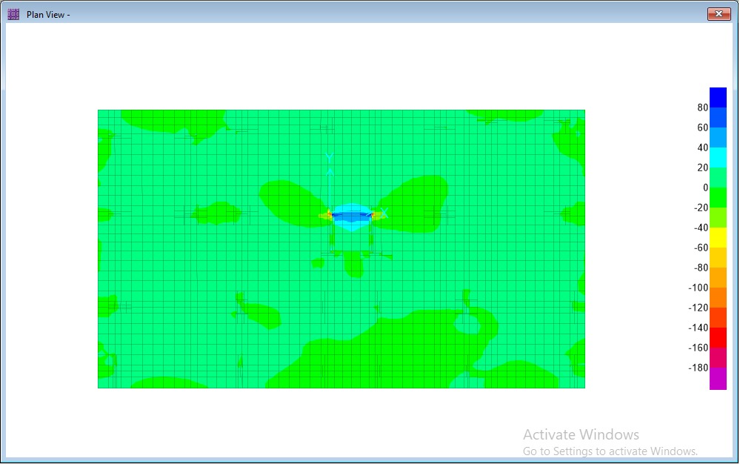
Raft thickness:
In Raft foundation the thickness can be determined by checking the diagonal tension shear that will be imposed in the raft. The maximum ultimate load will be used in calculation.
Mat thickness controlled by wide beam shear. And punching shear, punching shear is more critical. punching shea given in this equation:
Vu=Pu-qu*d
Thickness can be determined by a check column with high load and minimum area. wide beam shear check
Vu=80kn/m
⦸ Vc = .75/6 * √30 * 1000 * 510/1000
=350KN/M
⦸ Vc>Vu.. OK

Slide 18
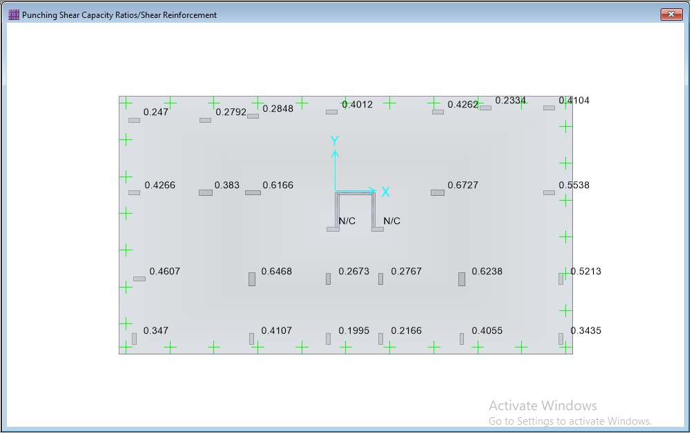
Punching shear:
Max value = 0.6727 less than 1
So it’s OK

Slide 19
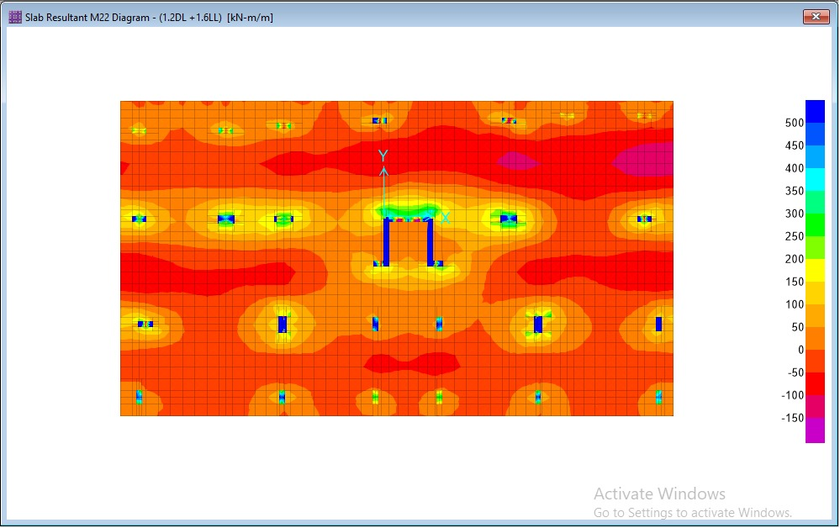
flexure design : use d =51 cm h=60cm cover =9 cm
assume the needed area of steel to resist moment is 10⦸20/m
⦸M=⦸*As*fy*(d-(As*fy)/(1.7fَc*b)=
.9*3140*420*(510-(3140*420)/(1.7*30*1000))*10^-6=
621.18KN.M/M
Mu=250KN.M/M
Since
621.18>250
⦸M>Mu
the used reinforced covers the reqiured reinforceement
use10⦸20/m

Slide 20
Second option design (Piles Foundation):
Pile is a deep foundation which is used since the upper part of the soil is a week and the bearing capacity is small and can't carry the building.
Piles have to types:
1- End bearing pile which its strength depends on the lower strata of the soil and its strength which the load transfers to it.
2- Friction Pile which its strength depends on transferring the load on the soil as friction force which makes the surface of the pile very important.
Piles are made mainly from material of wood, steel and concrete. These piles are driven or drilled into ground and connected to pile caps. Depending upon type of soil, pile material and load transmitting characteristics piles are classified later. Figure 2.7 shows an example of this type of foundation
Since we design the pile cap, there are many things that shall be taken into consideration such as load center , pile center and pile cap centroid shall be the same to avoid the moment effects.

Slide 21
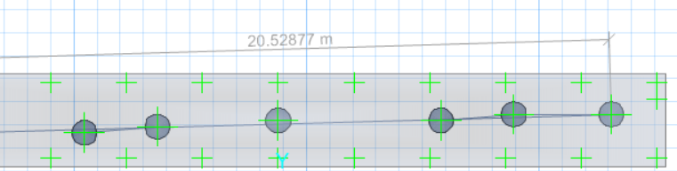
Assume that the pile diameter is 80 cm, length 20 m and strength 1500 KN
The structural design for all pile is:
pile diameter =80cm
area gross=πr^2=5027cm^2
As min = 0.01*5027=50.27cm^2
use 20⦸22mm
since there is a variation on reactions of a grouping process is done
Group (C23,C24,C25,C26,C27,C28)
PS=744.63kn
Pu=996.02
Number of piles = Service load /Pile capacity
Number of piles = 744.63/1500=1 pile
thickness:
d(cm)=√Pu (KN)
d(cm)=√996.02=32cm

Slide 22
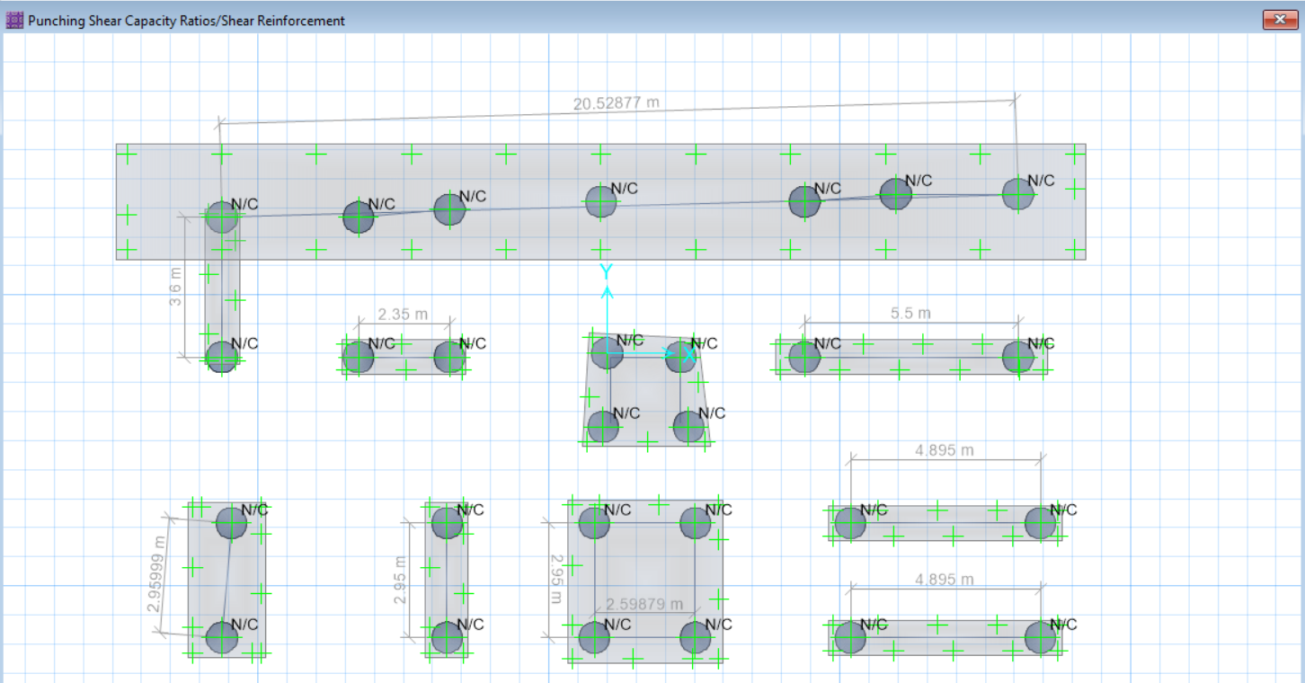
Punching shear check
N/C that means the ratio =0 punching shear =0. so it’s ok .

Slide 23
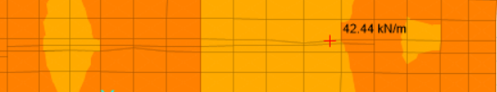
Wide beam check :
Vu(safe) 42.44 KN/m
⦸ Vc =⦸/6 * √fَc * bw * d
⦸ Vc = .75/6 * √30 * 1000 * 710/1000
⦸ Vc=470kn
⦸ Vc> Vu ….. (ok)

Slide 24
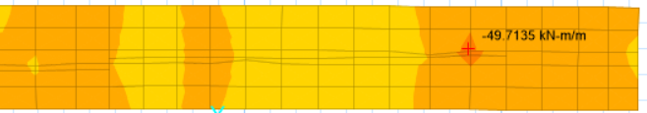
flexure design:
Mu safe = 49.71 KN.mlm
ၒ=.85fَc/fy * (1-(√1- (2.61Mu/b*d*d*fَc)).
=.85*30/420 * ( 1- (√1- (2.61*49.71*10^6/1000*710*710*30))
ၒ=0.00025
ၒ min = 0.0018
ၒ< ၒmin
ၒmin=0.0018*1000*750
As min=1350 mm2/m
use As min =1350 mm2/m
use 7 ⦸16/m

Slide 25
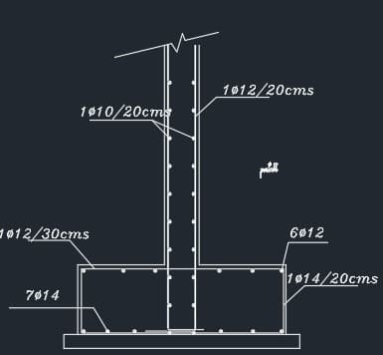
Retaining Wall Design:
Height: 2 m
Thickness: 20 cm
reinforcement density: 0.0033
Area: 6Ø12/200mm

Slide 26
Conclusion
At the end of this special project, we have designed this building in 2 different ways which are Piles &Raft foundation.
And we were able to get different results. We have used ETABS program to analysis to get the reaction values and use it in the designing of foundation in different conditions. and then SAFE 2016 to analyze and design the different types of footings, and then ASPID RETAIN to design the retaining wall ,these programs are common and professional.

Slide 27


