Slide 1

An - Najah National University
Faculty of Engineering
Industrial Engineering Department
An Evaluative Study of Innovation Management Practices in
Manufacturing Firms in Palestine
Prepared by:
Reem Salahat
Sonya Al-Qaisi
Heba Al-Haj Ahmad
Rasha Rabaya
Supervised by:
Dr. Husam Arman

Slide 2

Creativity is the generation of new ideas
Innovation is the process of transformation of creative ideas into desired outputs
Innovation Management is the process of capturing and managing organizational innovation through the stages of the innovation cycle

Slide 3

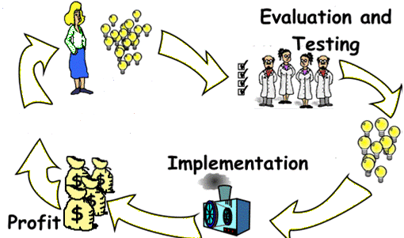



Slide 4


Service
Product
Radical
Incremental
Process
Commercial/ marketing
Organizational
Market pull
Technology Push

Slide 5


A result of increased awareness of the role of the Palestinian product in supporting and improving the local economy and increasing its chances in competing in the international markets.
More and more enterprises find that innovation is becoming the critical source and driver for survival and development, and because of the important effect of the innovation management in improvement product development process and product quality.
This research was chosen as a topic to our graduation project
Innovation management

Slide 6

Evaluate the current situation of innovation process management
Identify if a relationship between the level of innovation management and size of firms
Introduce a conceptual model

Slide 7


Research Questions
Data Analysis
Best Model
Research Methods

Slide 8

What is the level of innovation management process in Palestinian manufacturing firms?
Does the size of the company affect on the level of innovation management?
What is the best practice that could be applied in the manufacturing companies regarding this process?

Slide 9

Questionnaires
Case Studies

Slide 10

Quantitative data :analyzed by using software's such as SPSS program, EXCEL program
Qualitative data : analyzed by studying the current situation in Palestinian companies.

Slide 11
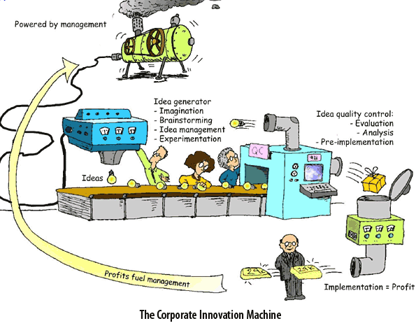

Suggesting best practice for innovation management which can be applied in Palestinian manufacturing companies

Slide 12

Evaluation the Current practice of innovation management in manufacturing sector

Slide 13


Strategy
Processes
Linkages
Organization
Learning

Slide 14

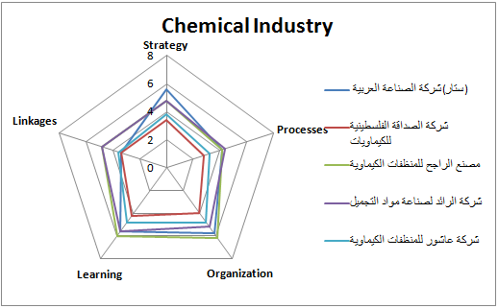
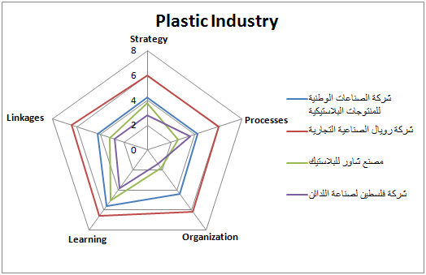
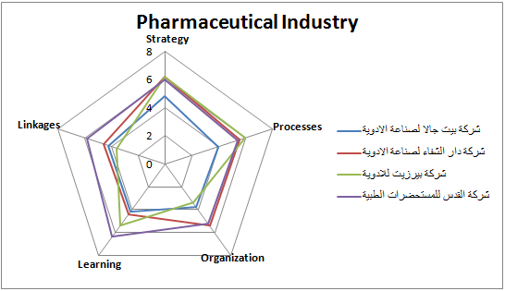

Slide 15
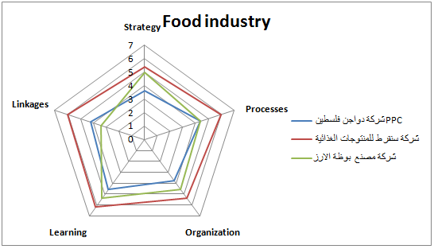
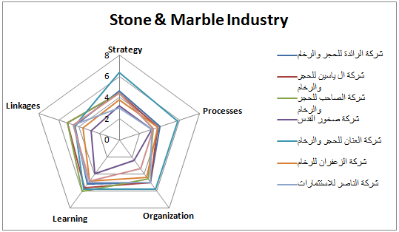
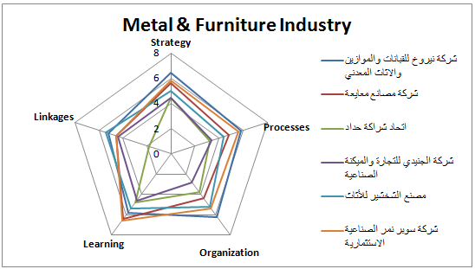

Slide 16
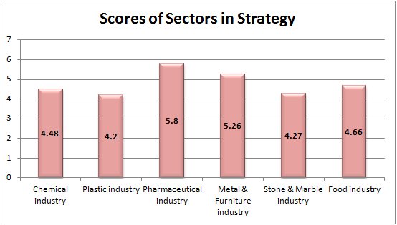
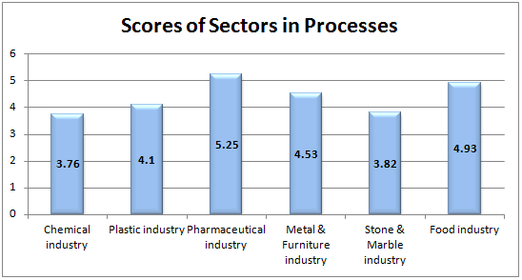
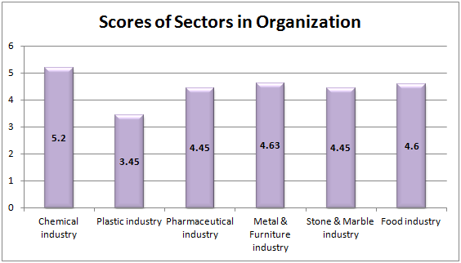
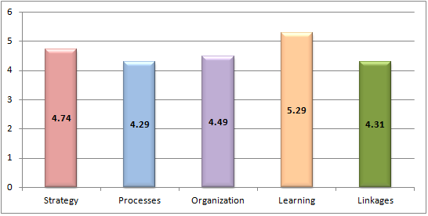
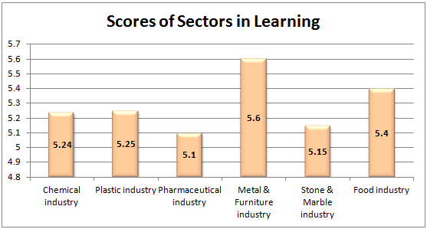
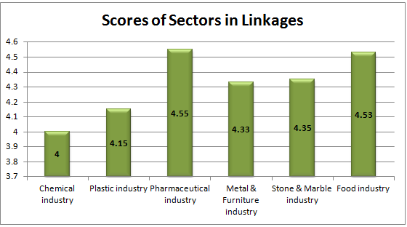

Slide 17
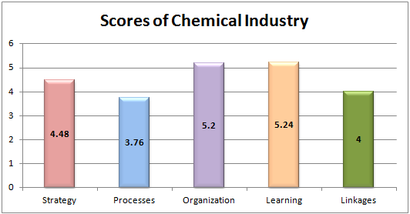
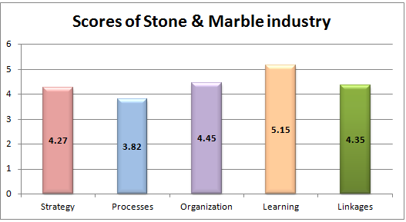
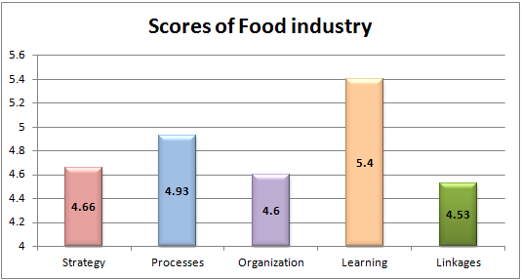
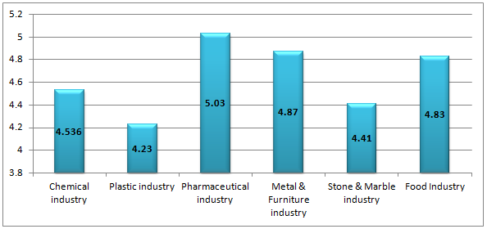
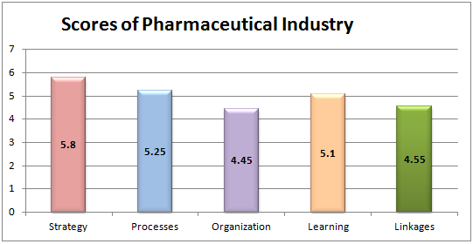
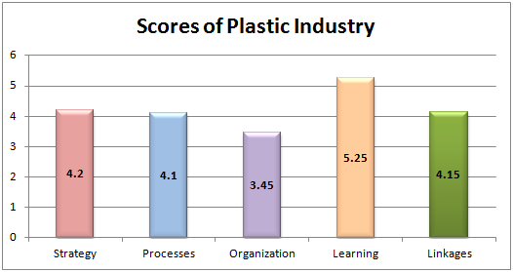
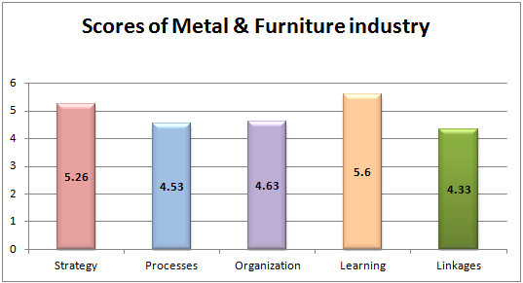

Slide 18
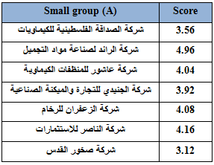
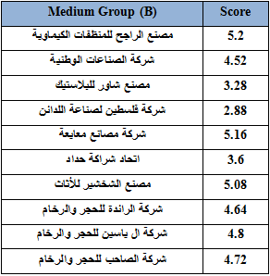
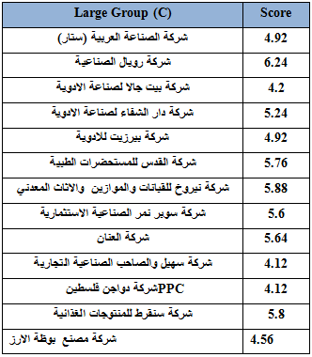
It has been studied if the size of the company affect on the innovation process or not?

Slide 19

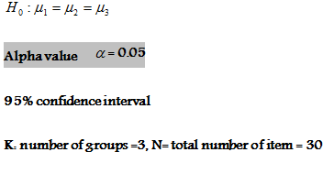
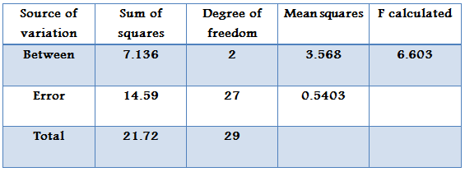
Null hypothesis means there is no statistically significant differences between the large, medium and small firms

Slide 20

The probability value P = 0.0046
F table (2, 27) = 3.3541
By using P-value:
If P-value < , reject the null hypothesis
0.0046 < 0.05, so the null hypothesis rejected
By using F table:
If F calculate > F table, reject the null hypothesis
F table = 3.3541
F calculates = 6.603
6.603 > 3.3541, so the null hypothesis rejected

Slide 21

Palestinian manufacturing companies have a good level of products development process, but lack the management of this process (innovation management).
Although there are common points between these companies that represent different sizes, but there are differences should be taken into account. The most important differences:
Interest
Motivation
Challenges
Development team
Documentation

Slide 22
The conceptual model.
The proposed innovation management process includes five phases:
Planning phase
Detail design phase
Testing and development phase
Production ramp-up phase
Concept development phase

Slide 23

Planning phase
This phase begins with corporate strategy which includes assessment of technology developments. The output of the planning phase is the mission statement, business goals, key assumptions, and constraints.

Slide 24

Concept development phase
A concept is a description of the form, function, and features of the product .

Slide 25
During this phase, many front-end activities should be done:
Identifying customer needs
Identifying product specification
Concept generation, selection and testing
Project planning

Slide 26
Detail design phase
This phase aims to:
Prepare the product architecture
Decompose the product into subsystems
Standards parts to be purchased are identified .

Slide 27
Detail design phase
Detail design phase outputs :
1.geometric layout.
2.functional specification of each product.
By the end of this phase control documentation for the product should be ready by the drawings or computer files.

Slide 28
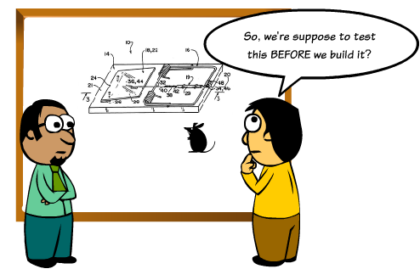
Testing and Development phase
During this phase Prototype is an excellent mean for testing ideas.

Slide 29
Testing and development phase
Four purposes for prototyping :
1.Learning.
2.Communication:
3.Integration prototypes are used to ensure that components and subsystems of the product work together as expected.
4.Milestones

Slide 30
Production ramp-up phase
The purpose of the ramp-up is to train the work force and to work out any remaining problems in the production process.
Products produced during production ramp-up are sometimes supplied to preferred customers .
At some point in the gradual transaction, the product is launched and becomes available for widespread distribution.

Slide 31
Note
All the previous phases need for phase review at the end of each one; in order to ensure that all the steps were performed as planned, and the more important issue that should be taken into account is the documentation process for each step was mentioned; this action helps to discover any mistakes and avoid it in the next innovation process.

