Slide 1
Evaluation and Redesign of Amman Street
By:
Qusai Naeem Zeri
Mahmoud Khaled Ismail
Moad Raed Odeh
Mofeed Kamal Ghanme
Supervision: Dr . Khaled Al-Sahili

Slide 2
Introduction
Project
( Study Area )
( Amman Street)
Nablus
Roads and Intersections
Geometry
Traffic
Pavement

Slide 3
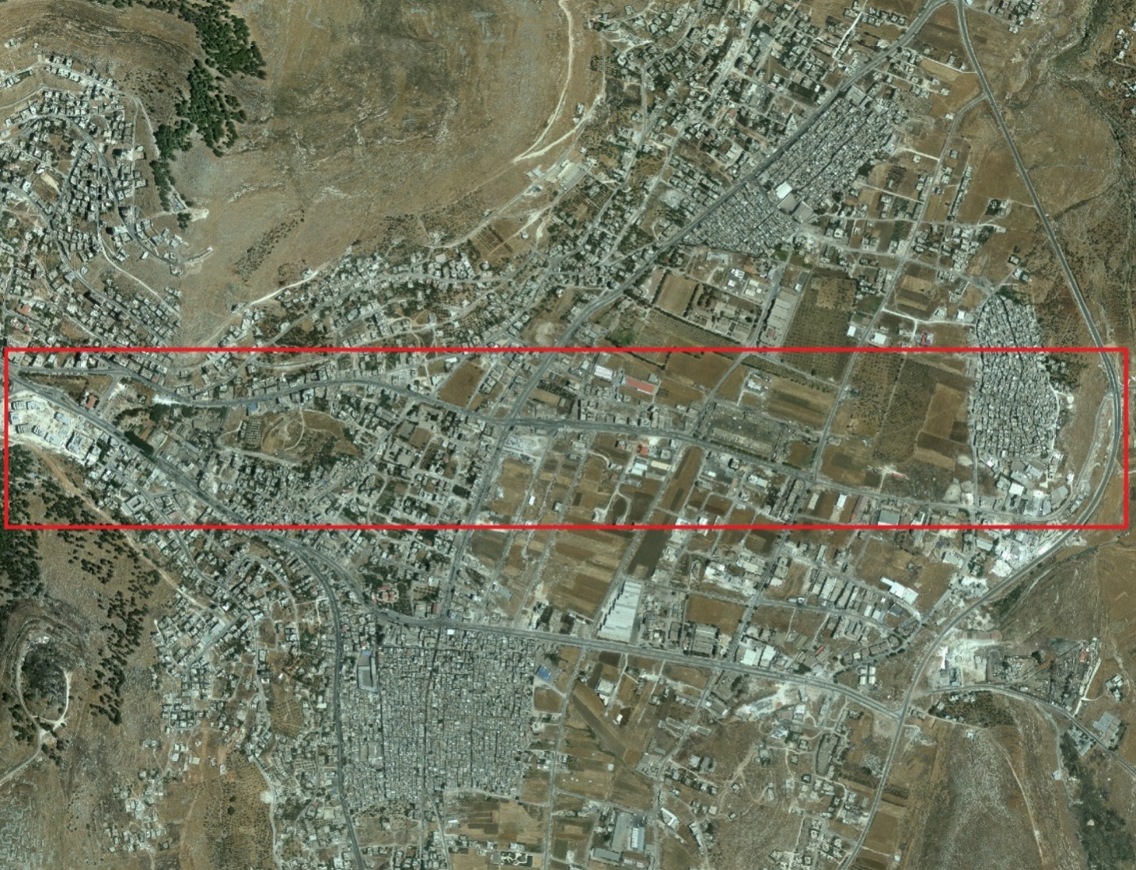
Study Area

Slide 4
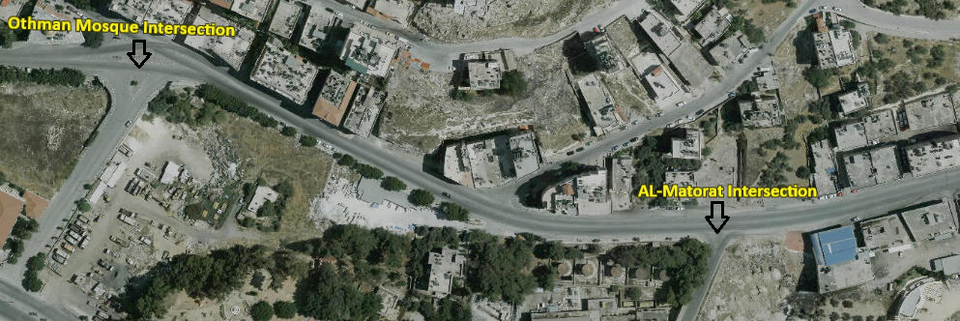
Study Area

Slide 5
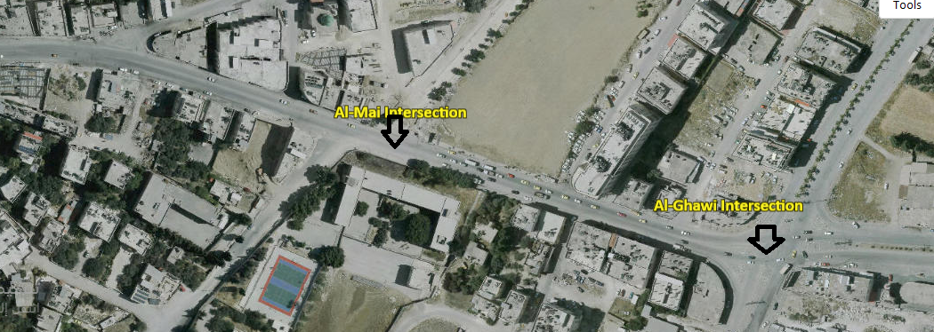
Study Area

Slide 6
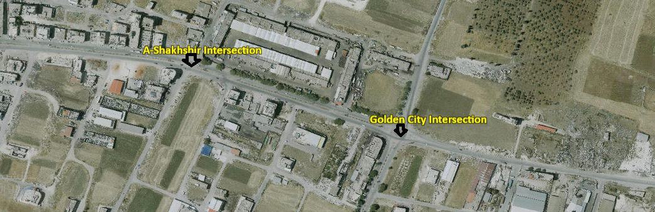
Study Area

Slide 7
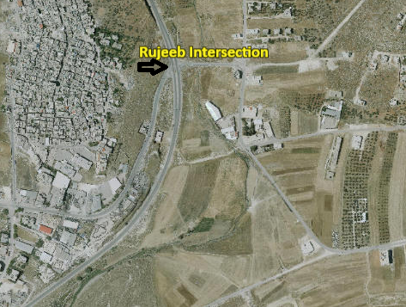
Study Area

Slide 8
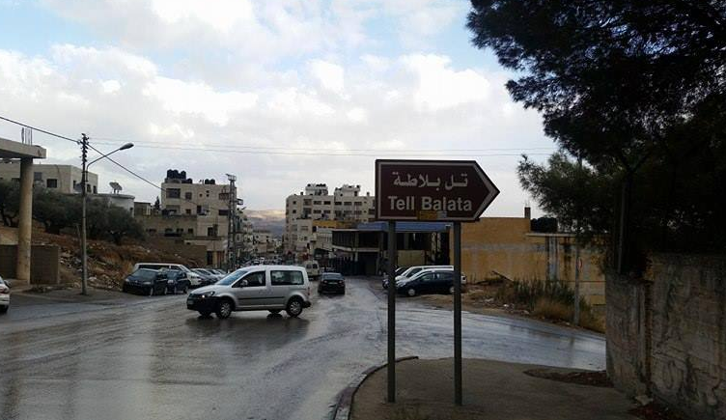
Problem Definition
Congestion on Amman Street

Slide 9
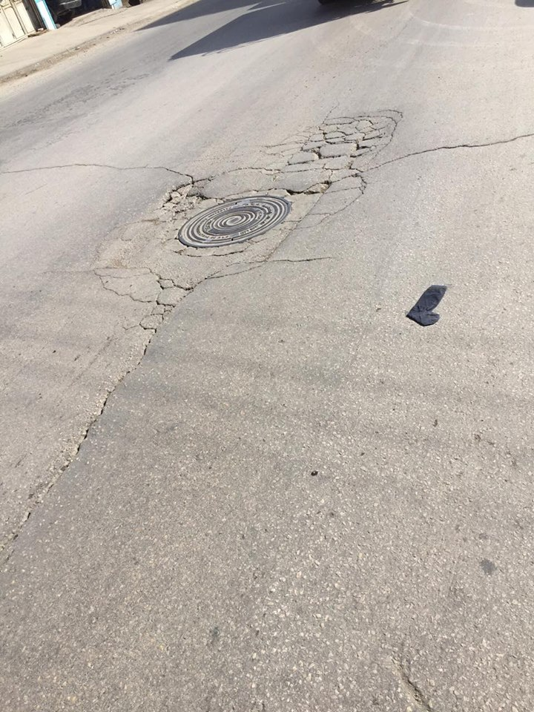
Problem Definition
Defects of Pavement

Slide 10
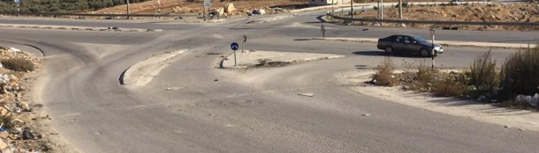
Problem Definition
Geometry Problems

Slide 11
Data Collection
Vehicles Counting
Data Collection for Amman Street (veh/hr)
 | Al-Amidest to Al Ghawi | Al-Ghawi to the End
PH | 7:15 to 8:15 AM | 1:30 to 2:30 PM
PHV | 2026 | 1393

Slide 12
Pavement Inventory
Surface Defects in Each Midblock
No. Midblock | Rutting | Pothole | Drop Shoulder | Bleeding | Raveling | Alligator | Block | Transvers | longitudinal | Patching
1 |  |  |  |  |  |  |  |  |  | 
2 |  |  |  |  |  |  |  |  |  | 
3 |  |  |  |  |  |  |  |  |  | 
4 |  |  |  |  |  |  |  |  |  | 
5 |  |  |  |  |  |  |  |  |  | 
6 |  |  |  |  |  |  |  |  |  | 

Slide 13
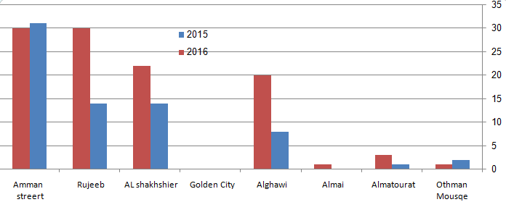
Summary of Accident

Slide 14
Data Analysis
PH, PHV & PHF for Intersections
No. Intersection | Intersection | PH | PHV | PHF
1 | Othman Mosque | 7:15 - 8:15 | 2368 | 0.89
2 | Al- Maturate | 7:15 - 8:15 | 2433 | 0.91
3 | Al-Mai | 7:15 - 8:15 | 2092 | 0.89
4 | Al- Ghawi | 1:30 - 2:30 | 2258 | 0.90
5 | A-Shakhshir | 3:15 - 4:15 | 1546 | 0.89
6 | Golden City | 7:15 - 8:15 | 974 | 0.89
7 | Rujeeb | 7:15 - 8:15 | 1023 | 0.88

Slide 15
Data Analysis
LOS from Synchro
NO. | Intersection Name | LOS (based on Delay) | ICU (%) | LOS
1 | Othman Mosque | _ | 96.6 | F
2 | Al- Matorat | C | 146.5 | H
3 | Al-Mai | F | 132.1 | H
4 | Al- Ghawi | _ | 96.8 | F
5 | A-Shakhshir | F | 71.6 | C
6 | Golden City | _ | 62.8 | B
7 | Rujeeb | C | 49.2 | A

Slide 16
Data Analysis
Warrants of Traffic Signals
Intersections | Summary
Othman mosque | Met (warrant 2 satisfied )
AL-Matorat | Met (warrant 2 satisfied )
AL-Mai | Not met
AL-Ghawi | Met (warrant 2 satisfied )
Al-Shakhshir | Not met
Golden City | Not met
Rujeeb | Not met

Slide 17
Pavement Analysis and Design
Design ESAL = 1.6 – 1.8 millions
Layer | Thickness (cm)
Asphalt | 7
Base course | 20
Subbase | 20

Slide 18
Data Analysis
LOS for Link
 |  | LOS
PTSfd | 93.45 % | E (closed for F)
ATSd( mil/hr) | 22.98

Slide 19
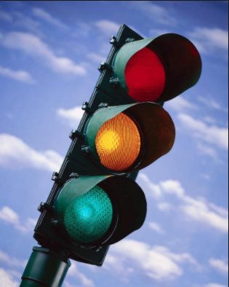
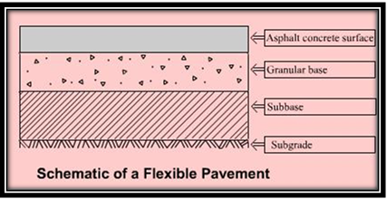
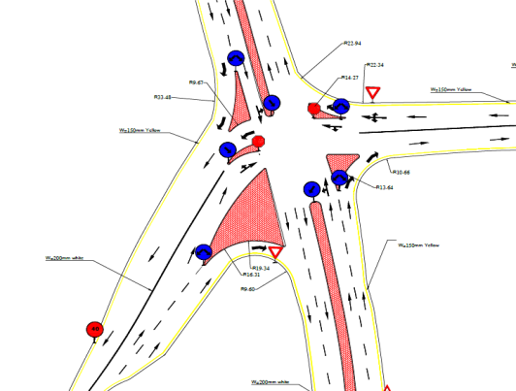
Solution and Design
Traffic
Pavement
Geometry

Slide 20
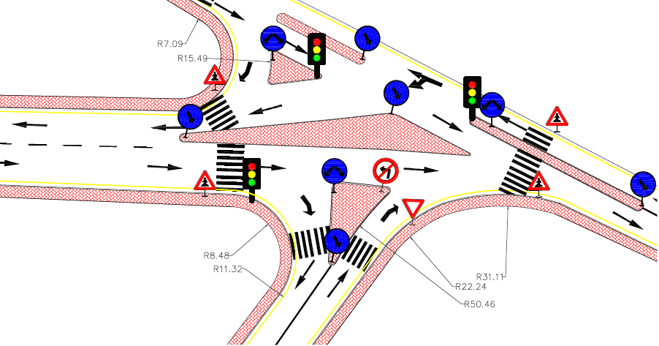
Design Othman Mosque Intersection

Slide 21
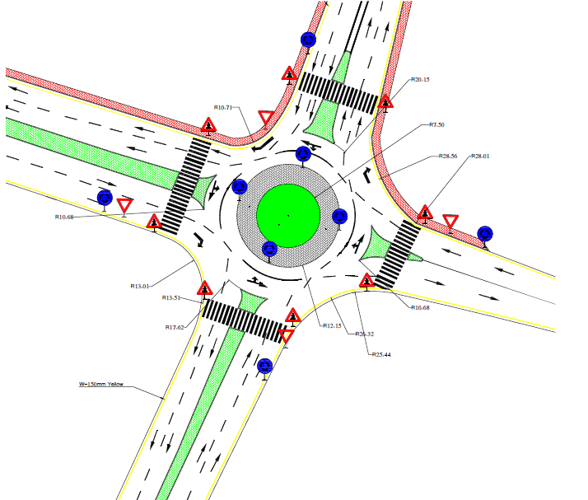
Design Golden City Intersection

Slide 22

Design Rujeeb Intersection

Slide 23
Conclusions and Recommendations
Amman Street and its intersections were evaluated based on traffic, geometric, and pavement conditions.
The street has several defects
Pavement design was provided.
Intersection improvement included traffic control, geometric, and operational improvements.
The new design consists of
Two lane highway.
Cross section includes, shoulder or sidewalk, median at some sections, parking lanes,
The approximate cost estimate is $1.15 millions

Slide 24


