Slide 1

Chemical Robotic Arm
Prepared By: Hulwh Amjad , Aya Sabbah & Aysha Aqil.
Supervisor :
Dr. Emad Natsheh.
Dr. Manar Qamhieh.

Slide 2
Outline
Overview.
Components.
Design.
Constraints.
Future Work.
Demo.

Slide 3
Overview
Our project consists of two parts. The first part is the glove which is responsible of controlling the arm .The second part is the robot arm that controlled by the glove to move up ,down ,rotate left or right to hold objects

Slide 4
The Goal
In our life most of us deal with chemical materials in the laboratory as a student or at work .As we know most of these materials are dangerous and my cause skin burns or anything else

Slide 5
Outline
Overview.
Components.
Design.
Constraints.
Future Work.
Demo.

Slide 6
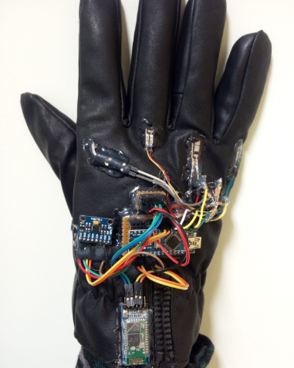
The Glove

Slide 7
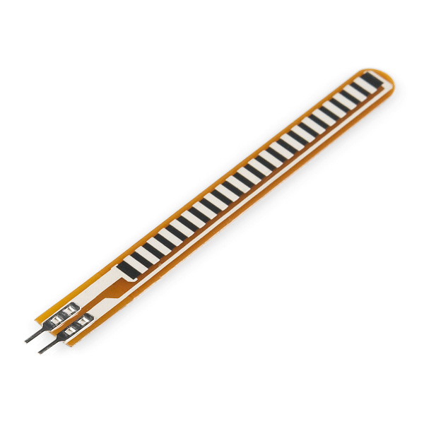
Flex Sensors

Slide 8
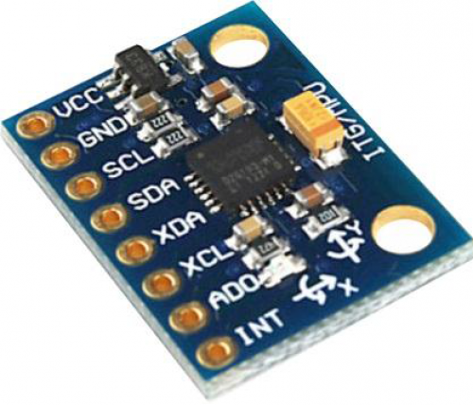
MPU6050

Slide 9
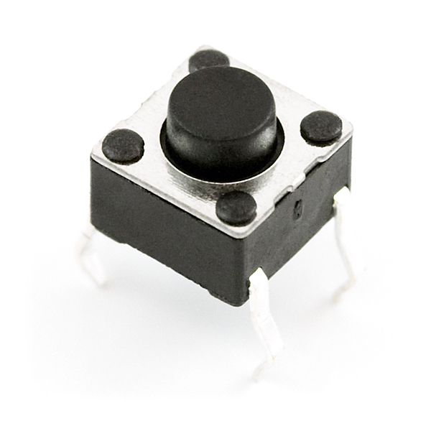
Push Button

Slide 10
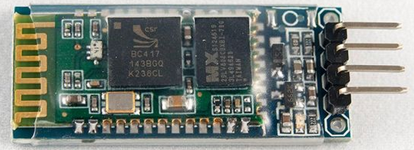
Bluetooth Hc-06

Slide 11
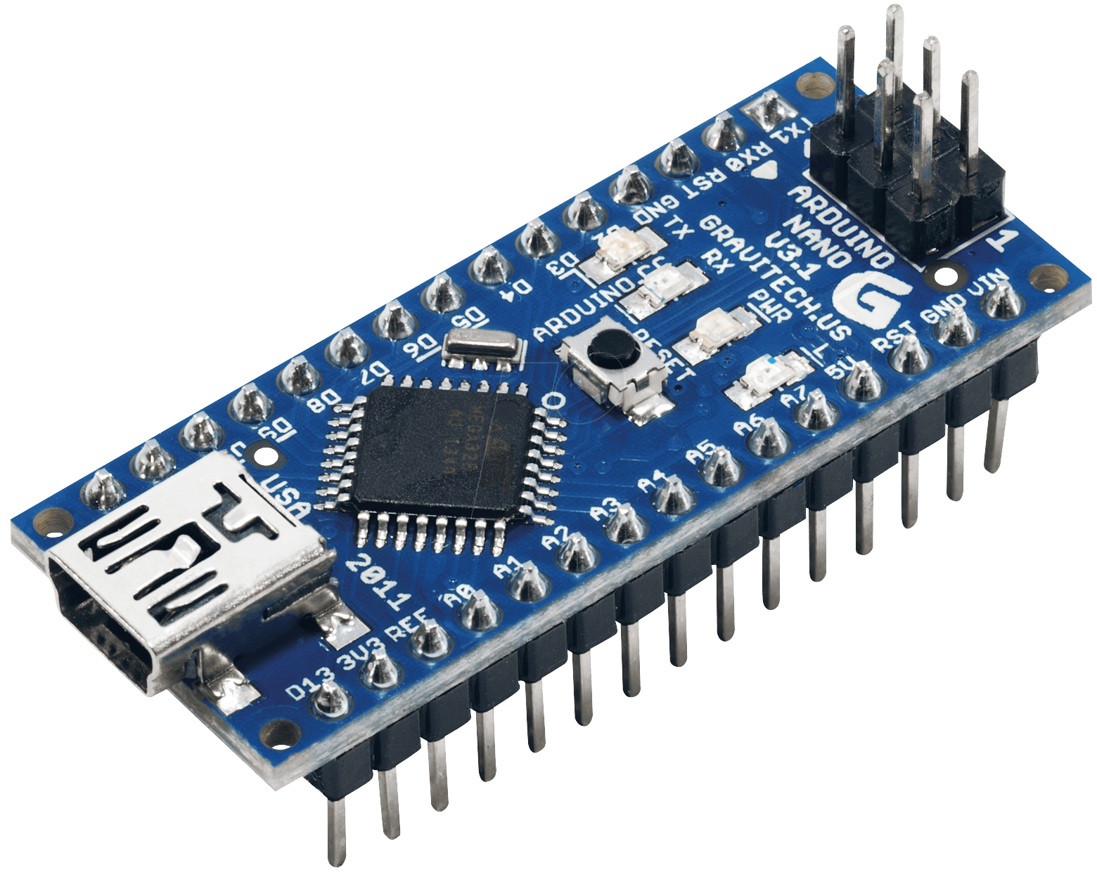
Arduino Nano

Slide 12
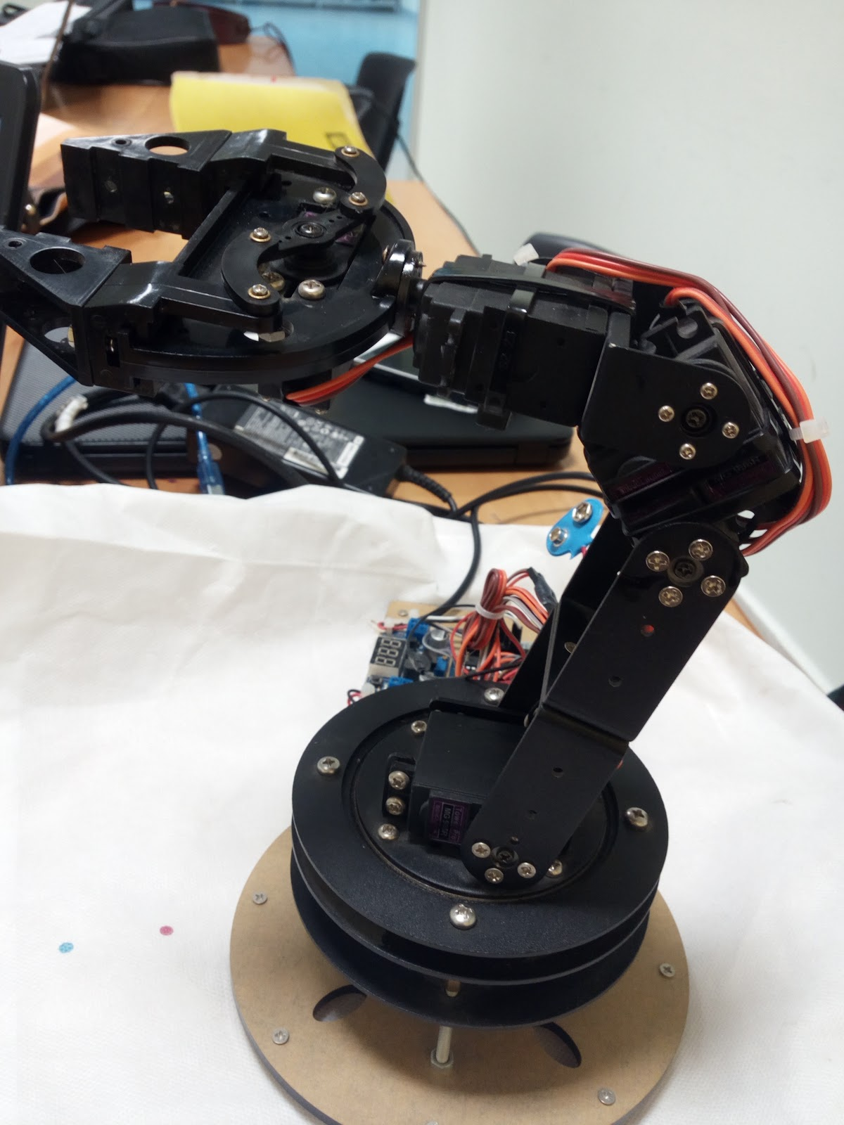
The Arm

Slide 13
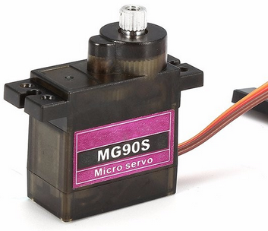
Servo Motors

Slide 14
Bluetooth Hc-06

Slide 15
Push Button

Slide 16
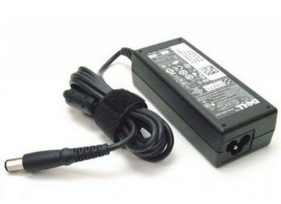
Voltage Source

Slide 17
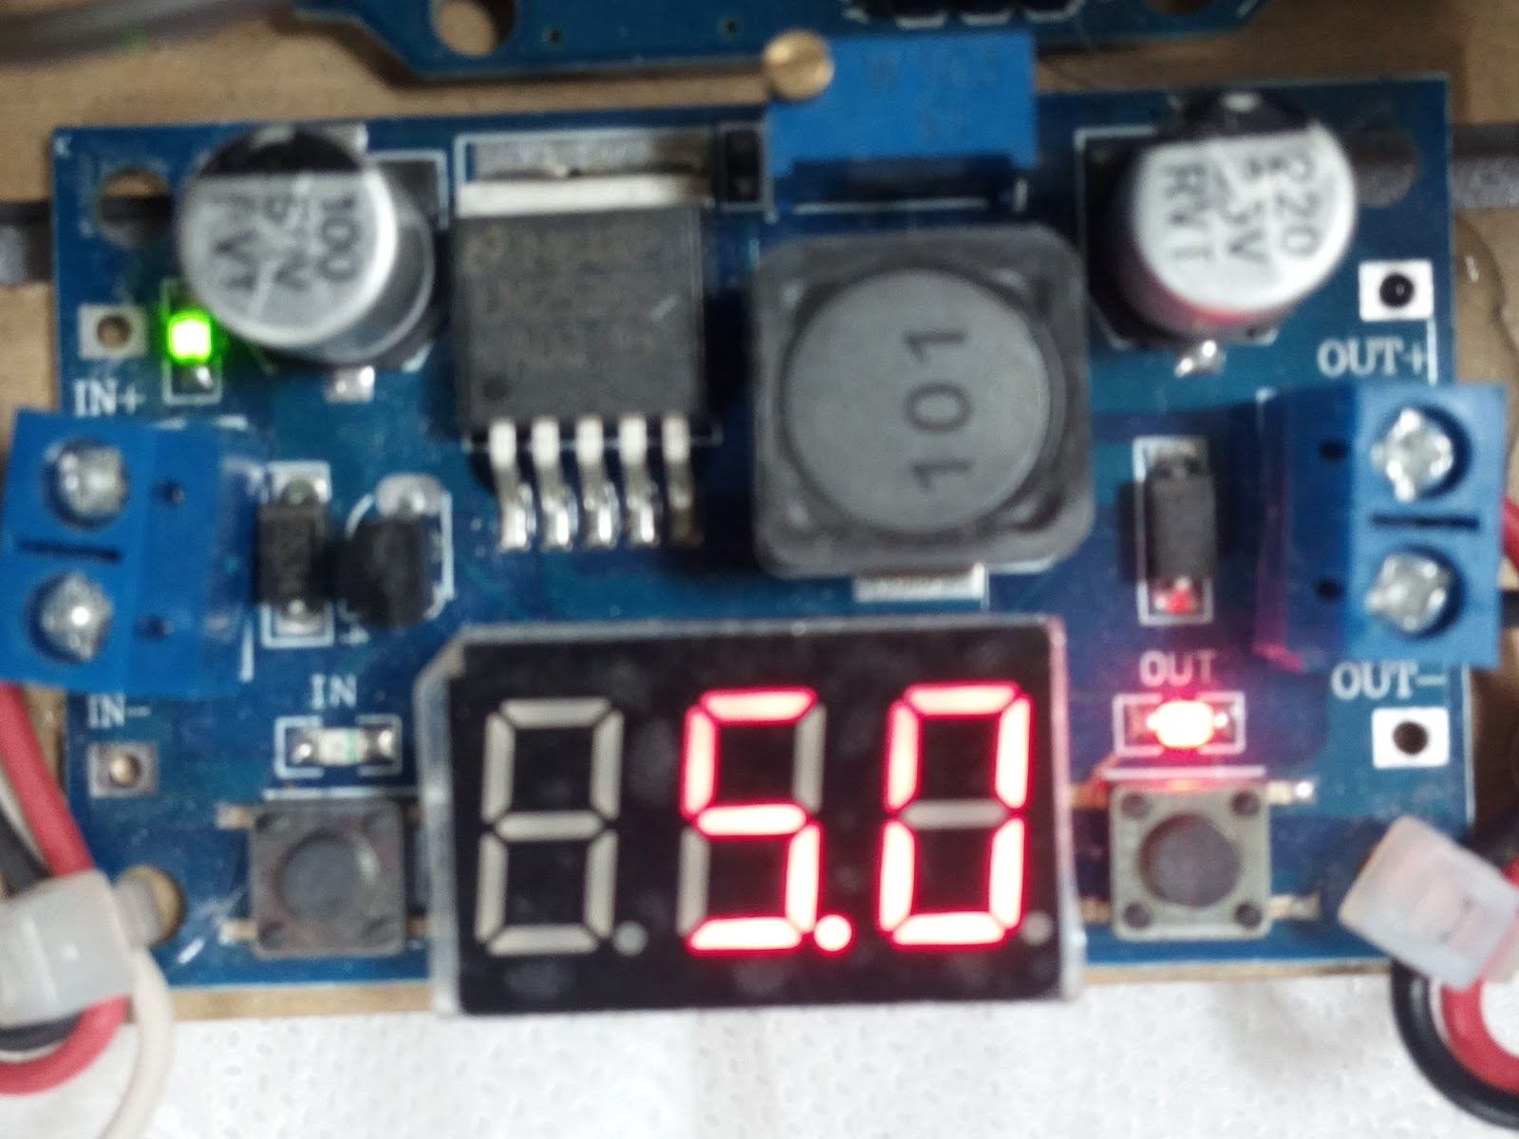
Voltage Regulator

Slide 18
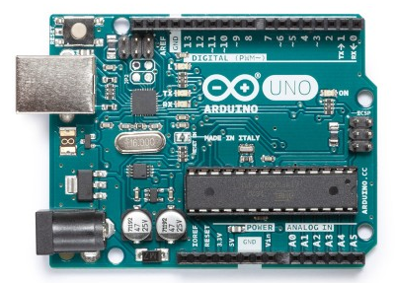
Arduino Uno

Slide 19
Outline
Overview.
Components.
Design.
Constraints.
Future Work.
Demo.

Slide 20

The Design Of The Glove
Let’s start with a short Demo.

Slide 21
Outline
Overview.
Components.
Design.
Constraints.
Future Work.
Demo.

Slide 22
Constraints
Choosing the suitable design for Arm.
The high cost of some component.
The difficulty of catching the object using flex.
Needing for external power source.
The arduino can record a limited number of movement.

Slide 23
Outline
Overview.
Components.
Design.
Constraints.
Future Work.
Demo.

Slide 24
Future Work
Add sensors such as, gas sensor, temperature sensor to detect the chemical reaction properties and shows them on a LCD.
Convert it to mobile robotic arm ,so it become more flexible and practical.
Make it a full glove.

Slide 25
Outline
Overview.
Components.
Design.
Constraints.
Future Work.
Demo.

Slide 26
THANKS!
Any questions?

