Slide 1


An-Najah National University
Faculty of Engineering and Information Technology
Industrial Engineering Department
Institutional development for the Faculty of Engineering and IT departments

Slide 2

Eng. Suleiman Daifi
Bara’a Majdi Sawalhi
Deema Abbas Hanbali
Yaman Adnan Asfour
Majd Tareq Aghbar

Slide 3

Outline :
Definition of documentation
Suggested project
Objectives of the project
Significance of the project
Main output
Constraints
Earlier course work
Literature review
Methodology
Results and findings
Conclusions and Recommendations
Problem statement

Slide 4
Problem Statement
The Faculty of Engineering and IT at An-Najah National University was established in the year 1979, at which time it offered just a single degree, the Bachelor of Civil Engineering. As the demand on engineers in other disciplines has increased the faculty of engineering kept introducing new programs. Currently the engineering faculty houses 17 academic engineering and IT department so engineering college become a large college and there is no available procedural manual for the deanship and the departments, which negatively affects the performance of employees and the quality of the activities at the college.

Slide 5





Documentation
Suggested
Project
Constraint
II
Introduction
Main
Output
Objective

Slide 6

Suggested Project
In our project “Institutional development for the faculty of engineering and IT departments" we will develop a procedure manual for the deanship and the departments of engineering college by documenting the standard operating procedures . In order to facilitate the process of carrying out the activities and the distribution of tasks by job title description.

Slide 7

Definition Of Documentation
Documentation means a written or description of any action, activity, or event which helps the respective team member, their supervisor, and the organizational leadership understands the team member’s work experiences, and helps all with decision making and support the members in service to the mission and goals of the organization.

Slide 8
Objectives Of The Project
Develop written SOP’s
Improve SOP’s, flowcharts and forms
Institutionalize the processes in the engineering college and engineering departments
Develop a coding system for SOP’s and forms

Slide 9
Significance Of The Project
Significance
Increasing Quality
Stop spending money or wasting time
Better management control and reporting
Increasing productivity
Reducing performance time
Achieve consistent repeatable processes

Slide 10
Main Output
The actual output that has been drawn from this project and that will help in achieving the goals that mentioned above is:
As well as, reviewing all the forms that used in the department and improving them to be more effective in conducting the procedures.
Representing them by flow charts and written standard operating procedures, which were done for 27 processes of department's operations.
Documenting all the processes that implemented in the engineering college and departments.

Slide 11

Constraints
Converting the flow charts to a clear and understandable operating procedures
Countless cases and several different situations per procedure
The lack of forms that help in the application of procedures
The time period of few months for project’s completion
Communication with the employees in the departments to get information about the functions that they perform

Slide 12

Earlier Course Work
In our work we use some courses that we learned, to help us carrying out our project, courses that we use the most are :
Total Quality Management (TQM)
Methods engineering
Project management life cycle

Slide 13
Literature Review
Organizational Structure
Job Description
Total quality management (TQM)
Institutional development
Flow chart
Standard Operating Procedure

Slide 14
Methodology
Literature review
Designing data collection form
Distributing the form to the departments heads
Identifying the main processes implemented
Interviewing the departments heads
Developing As- Is processes flowcharts
Reviewing the designed flow charts

Slide 15
Methodology cont’d…
Converting the flowcharts to documented procedures
Collecting all the forms used
Reviewing the existing forms that are used
Creating new forms for the needing steps
Distributing a copy draft of the procedures to the heads of departments for reviewing
Naming the procedures and their own forms

Slide 16
Results and Findings
The As-Is procedures, flowcharts, and forms used were improved.
All procedures and forms were coded
About 30 written SOP’s attached with their forms and flowcharts were collected in a separate manual.
Data including activities and functions was collected.
All forms and templates used were collected.
About 30 AS-Is operating procedures for all department’s activities were developed.
About 30 flowcharts which describe the procedures were developed.

Slide 17
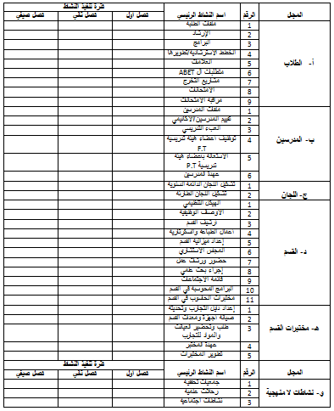
The needed data were collected using this form:

Slide 18
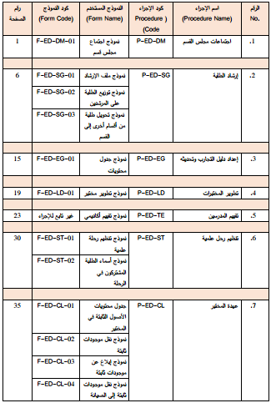
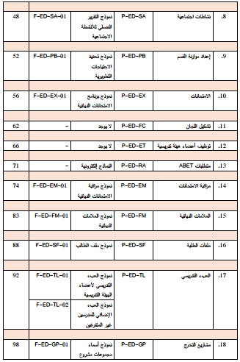
The following tables show all gathered forms related to each procedure

Slide 19
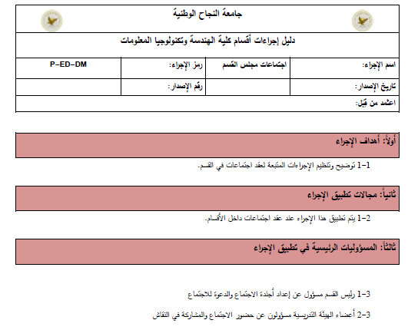
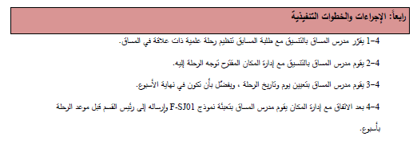
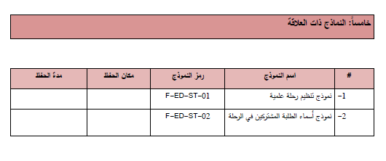
Sample of developed operating procedure:

Slide 20
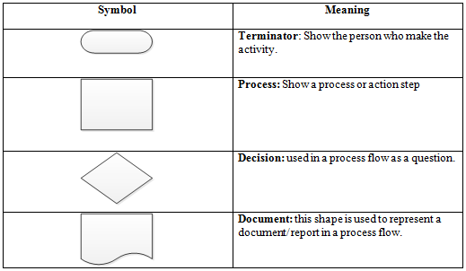
Symbols used in developing the flowcharts

Slide 21

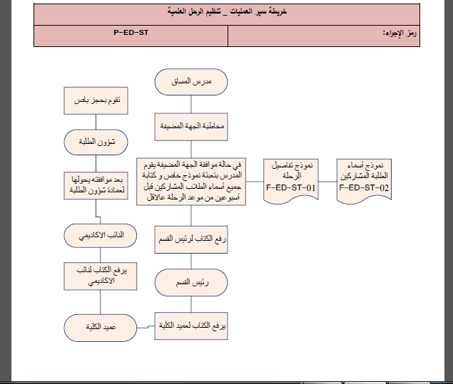
Sample of the developed process flowcharts

Slide 22
Naming the procedures
The letter “P”
To symbolize procedure
The symbol “ED”
To symbolize Engineering Department
Example
“SG” to symbolize students guidance
Full Name
P-ED-SG

Slide 23
Naming the procedure’s forms
The letter “F”
To symbolize form
The symbol “ED”
To symbolize Engineering Department
Example
01, 02, 03,…
Numbering
“SG” to symbolize students guidance
Full Name
F-ED-SG-01

Slide 24
Sample of coded procedures and forms

Slide 25
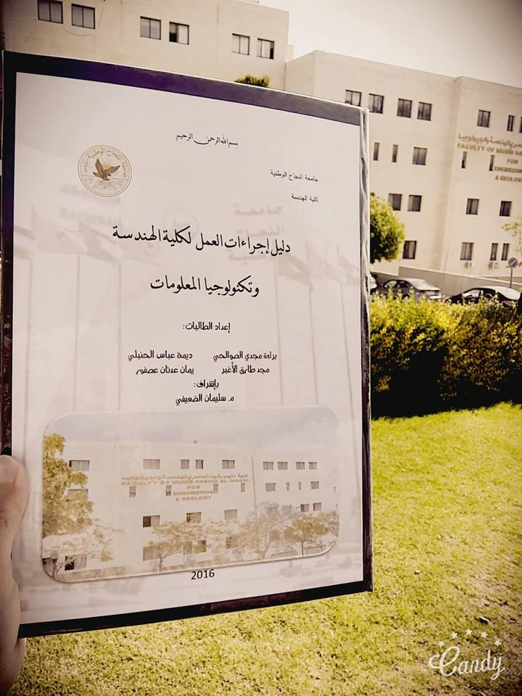

Slide 26
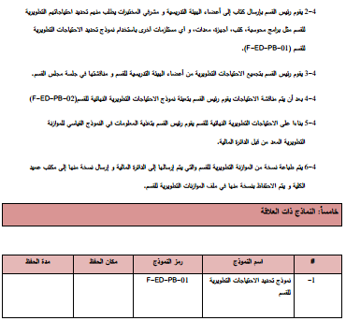
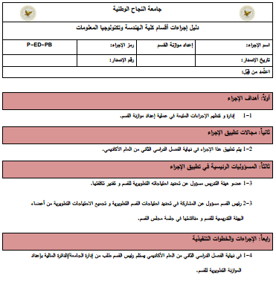
Sample of developed SOP attached with its flowchart and forms

Slide 27
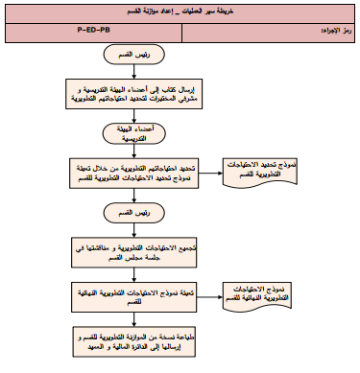
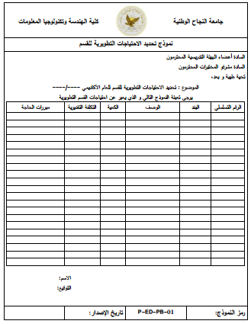

Slide 28
Conclusions
Improved SOP’s writing skills
Increased skills in designing SOP’s forms
A good background about the importance of documentation process, standard operating procedures SOP’s and flow charts

Slide 29
Improve data collection and dealing with employees’ skills
A development of about thirty flow charts for multiple SOP’s which describe a clear detailed image about all faculty’s functions
Practicing the use and mean of flow chart’s symbols

Slide 30
Recommendations
Study and approve all SOP’s developed during this project’s work by the administrative body in the Deanship of Engineering college.
Document all flow charts designed for the current situation and keep them as a reference.
Develop computerized system for the developed SOP’s and flow charts system.

Slide 31
Develop flow charts and SOP's for the activities of the deanship of the engineering college as we applied on the head departments of the college to improve the quality of the college's work.
Our project provide essential and important base that need to be developed to help the college to obtain ISO certification that all institutions aims to get it.
Move to another college in case of the completion of the engineering college's work.

Slide 32

Thanks for listening

