Slide 1


Slide 2

Outline
Objectives of the Project.
Study Area.
Questionnaire Analysis.
Network Analysis.
Future Demand Estimates.
Design Criteria
EPANET Analysis
Cost estimate

Slide 3

Objectives
To design the water distribution network for Yasid village, as the network should meet the residential needs for present and future.
To solve the problem that occurs for purchasing water by tanks.
To reduce cost and effort.

Slide 4
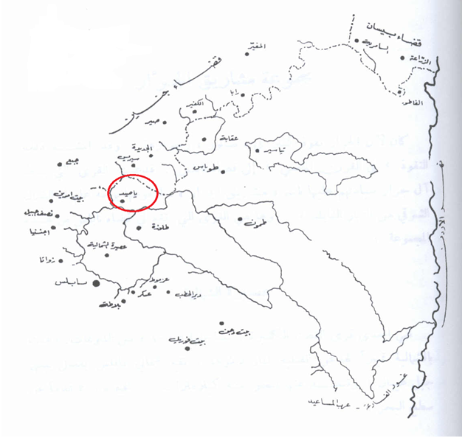
Study Area

Slide 5
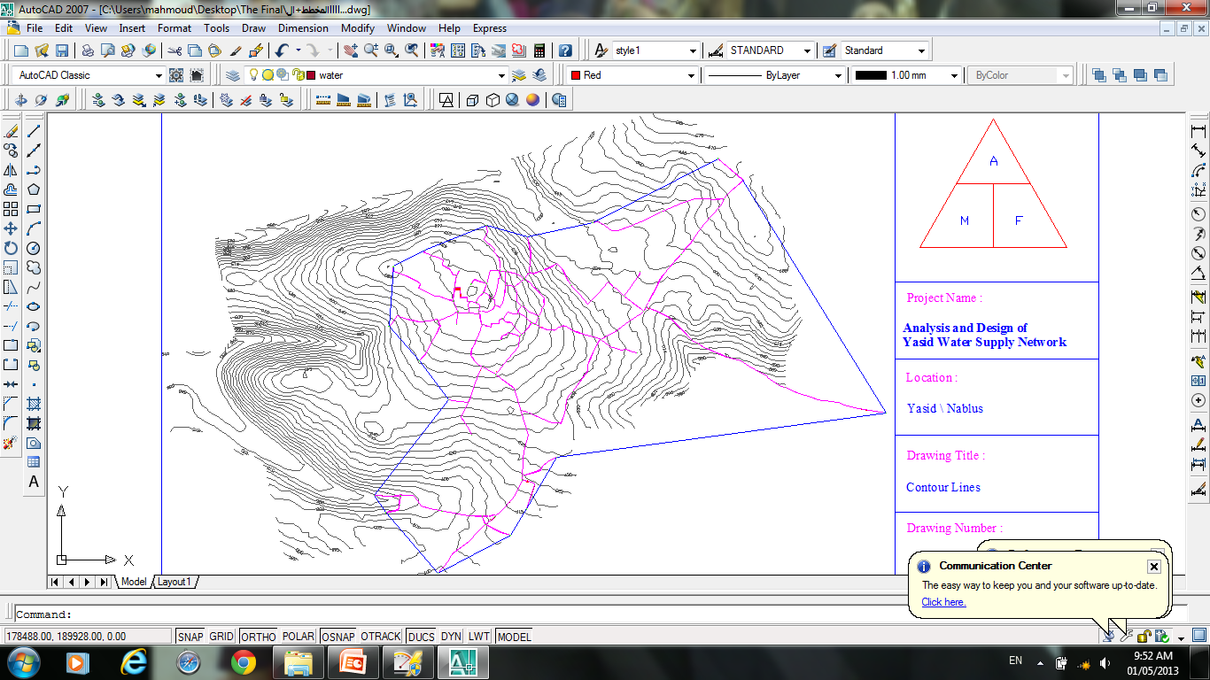

Slide 6
General information about Yasid.
Population at (2012): 2824 capita.
Area of the village is 9,222 donums.
built-up area = 43 donums.
Around (860) donums is Irrigated area.

Slide 7
Questionnaire Analysis
Questionnaire Analysis
(A)

Slide 8
Questionnaire Analysis
(B)

Slide 9
Questionnaire Analysis
(C)

Slide 10
Questionnaire Analysis
(D)

Slide 11
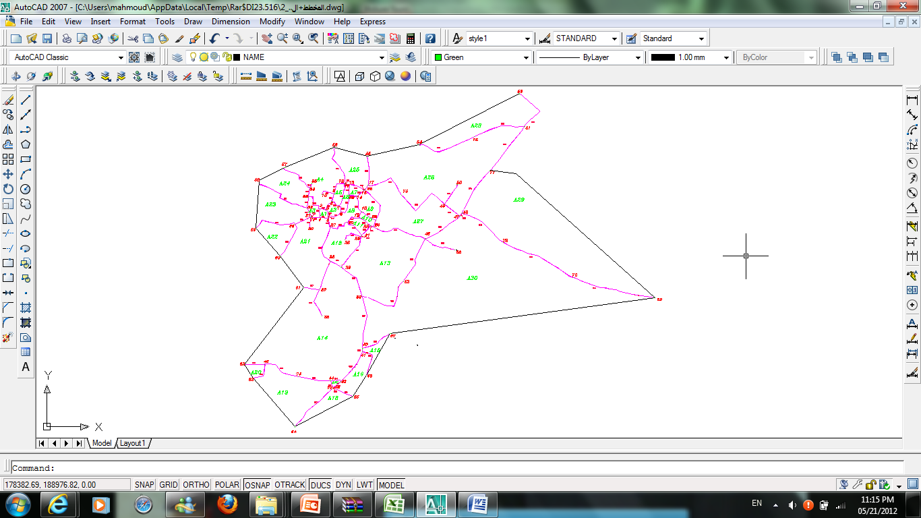
Network Analysis

Slide 12
Future Demand Estimates
The design period is 30 years.
The growth rate in Palestine is equal to 2.178%.
Population at (2042): 5390 capita.
Average water consumption per capita per day is equal to 90.36.
The consumption rate due to WHO standards = (100-150) (L/c/d) .
PWA standards 120(L/c/d) the consumption rate will be used.
UFW=0.25(for new network)
Demand=160 (L/c/d).
Density=3.2 capita/donums.

Slide 13
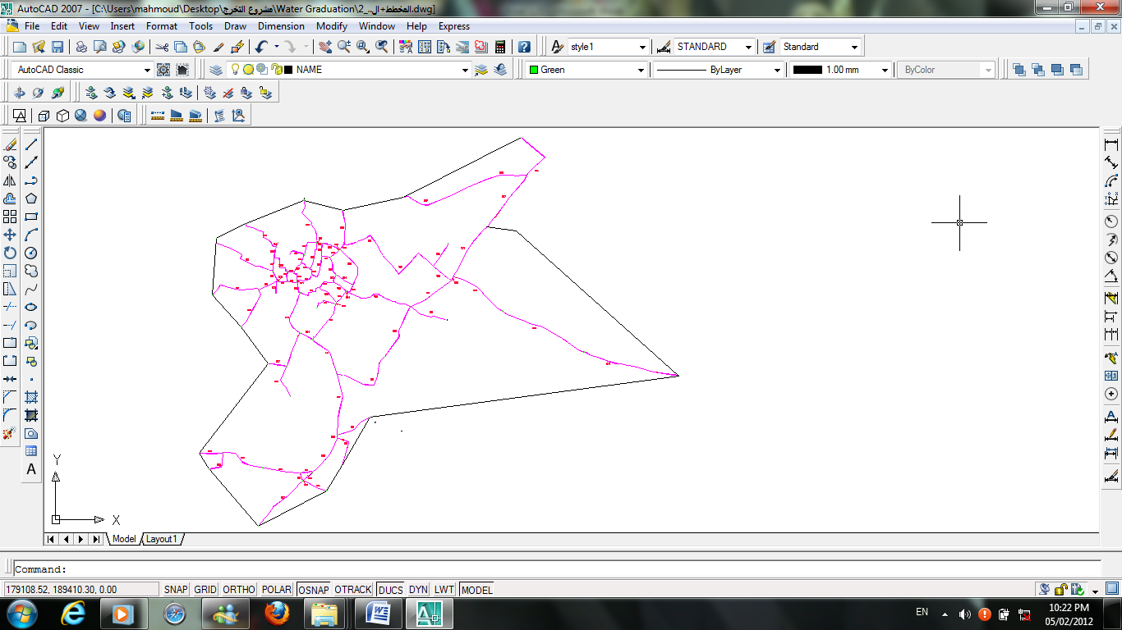
Pipes in the Network

Slide 14
Pipes in the Network
Pipes ID | From | To | Length (m) | Diameter (in) | C
501 | 1 | 5 | 38.89 | 4 | 130
502 | 3 | 4 | 41.46 | 4 | 130
503 | 2 | 3 | 29.59 | 4 | 130
504 | 1 | 2 | 44.32 | 4 | 130
505 | 1 | 71 | 40.6 | 4 | 130
506 | 2 | 33 | 109.11 | 4 | 130
507 | 31 | 32 | 45.35 | 4 | 130
508 | 31 | 36 | 89.83 | 2 | 130
509 | 36 | 60 | 200.04 | 1 | 130
510 | 36 | 59 | 217.77 | 1 | 130

Slide 15
Nodes

Slide 16
Demand on Nodes and their Elevation
Nodes ID | Elevation | Demand (L/day) | Demand (L/sec)
1 | 683 | 3144.16 | 0.036
2 | 687 | 2543.16 | 0.029
3 | 687 | 2586.72 | 0.030
4 | 684 | 1137.59 | 0.013
5 | 683 | 3025.23 | 0.035
6 | 681 | 1444.40 | 0.017
7 | 684 | 1257.63 | 0.015
8 | 686 | 2862.43 | 0.033
9 | 685 | 868.14 | 0.010
10 | 688 | 2021.97 | 0.023

Slide 17
Design Criteria
Pressure constraint
(20-100)m
Velocity constraint
    (0.1-3.0)m/s

Slide 18
EPANET Analysis
Hazen William Equation
Inputs
For Pipes :
1-Pipe ID
2-Start Node and End Node
3-Length
4-Diameter
5-Roughness
For Nodes :
1-Node ID
2-X and Y Coordinates
3-Elevation
4-Base Demand

Slide 19
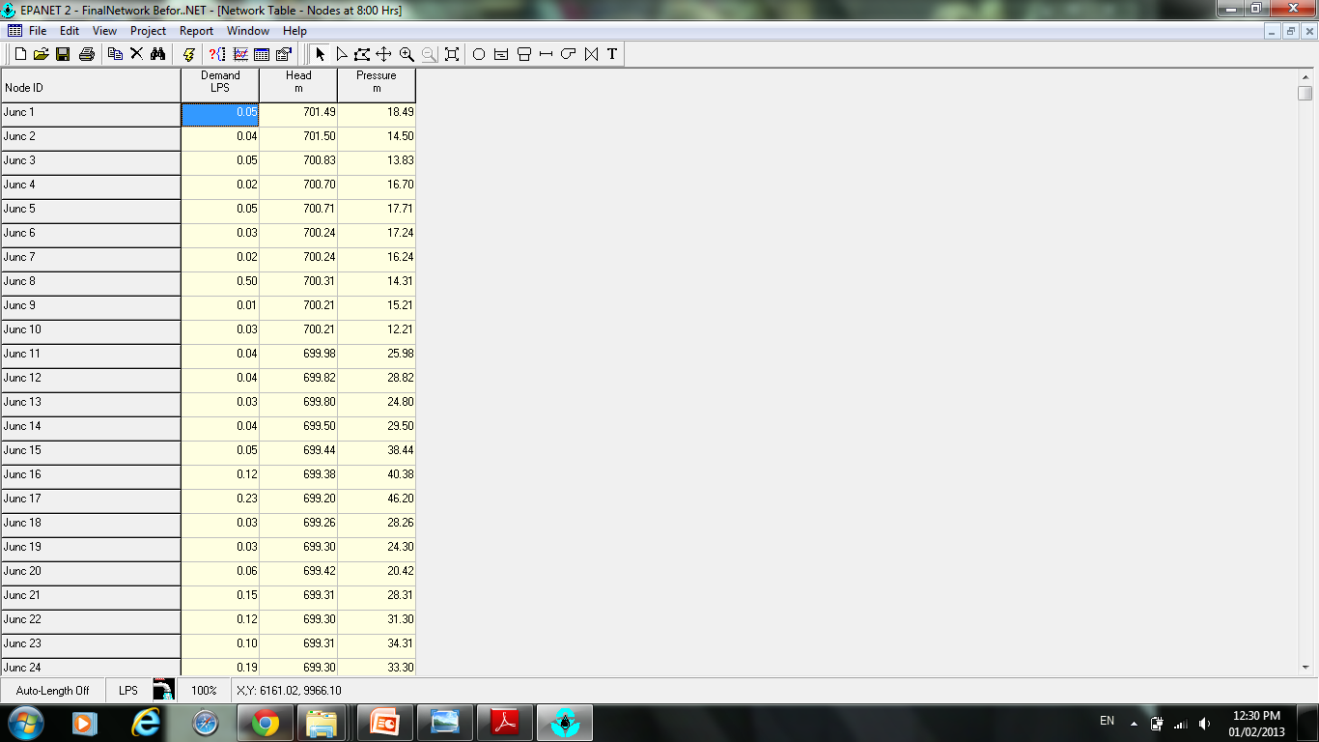
Before

Slide 20
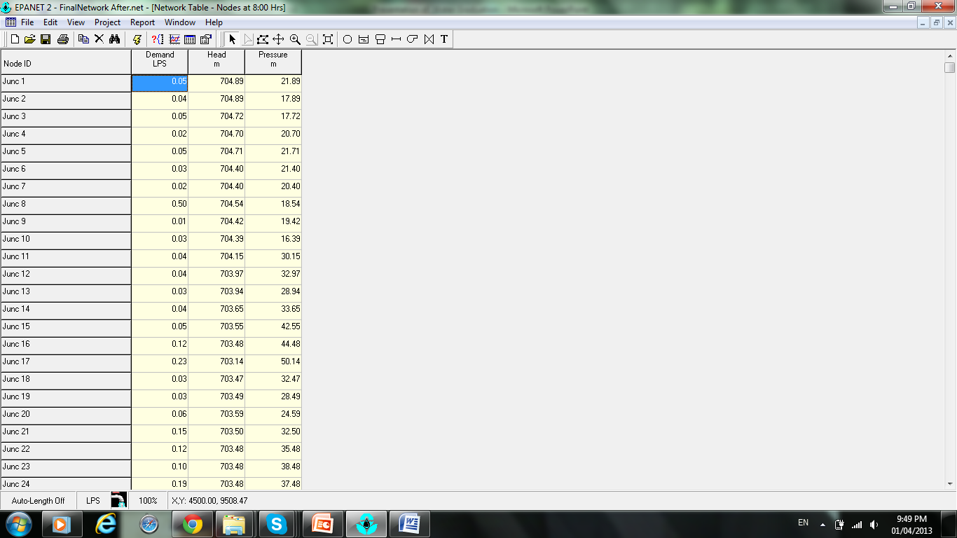
After

Slide 21
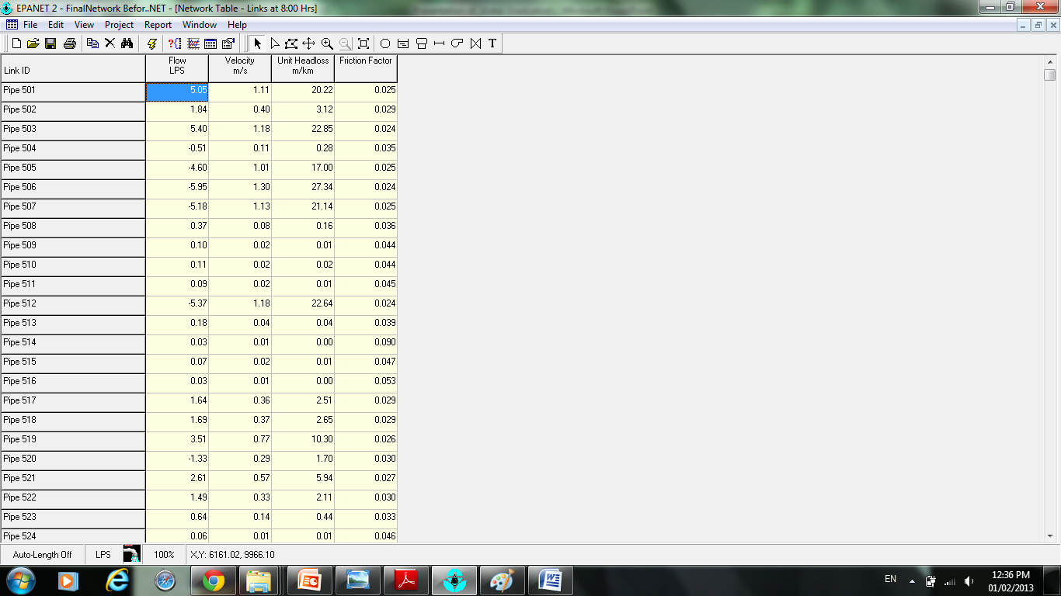
Before

Slide 22
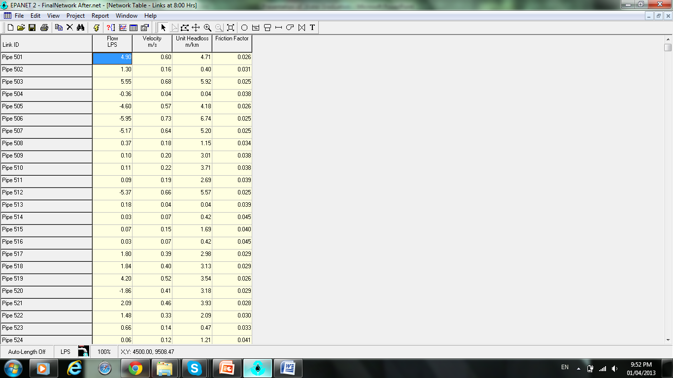
After

Slide 23
Cost estimate
Cost of Pipes :
Pipe Diameter (in) | Pipe Length (m) | Cost / length ($/m) | Total cost ($)
1.00 | 4,666.35 | 17.11 | 79841.25
2.00 | 2,452.43 | 25.00 | 61310.75
3.00 | 3,294.24 | 33.68 | 110950
4.00 | 475.07 | 39.74 | 18879.30
Total |  |  | 270981.30
Cost of Reservoir:
for 1000m3 reservoir = 230,000 $
Total Cost = 501,000$

Slide 24
The cost of the network is 93 $/Capita which is near the range for donors agency that is between (100-200) $/Capita.

Slide 25
Conclusion
1.Estimated demand for water for Yasied in the following 30 years.
2.Complete Analysis and Design of Yasied Water Distribution Network.
3.Total Cost for Network and Reservoir.

Slide 26

Thanks For Your Attention.
Any Question??

