Slide 1

An-Najah National University
Faculty of Engineering
Electrical Engineering Department
Graduation Project 2 (63569)
CNC ROUTING MACHINE
Instructor: Dr. Samer Mayaleh
Prepared by: Mohammed Samaneh.
Mohammed Masoud.

Slide 2
CNC TECHNOLOGY
Computerized Numerical Control:
Using computer to control operation of machine tools via specially coded instructions.

Slide 3
CNC MACHINE IMPORTANCE
CNC machine can improve a lot of manufacturing fields in Palestine.
CNC machine can reduce importing from outside cause it can produce needed pieces.
National CNC machine can save people money cause no need to spend on charge it from outside.

Slide 4
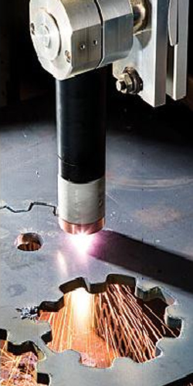
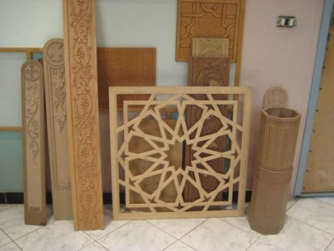
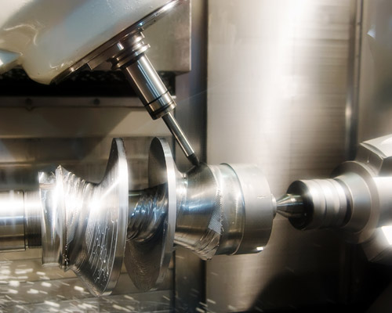
A LOT OF APPLICATIONS

Slide 5
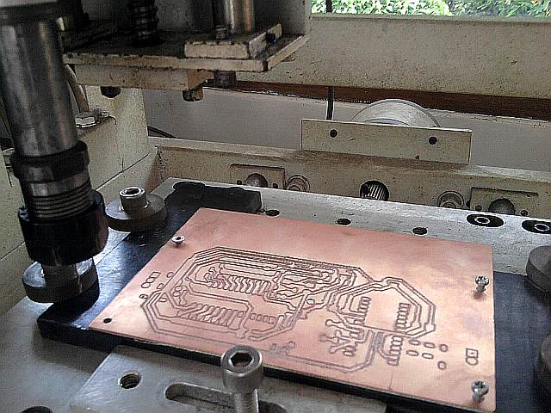
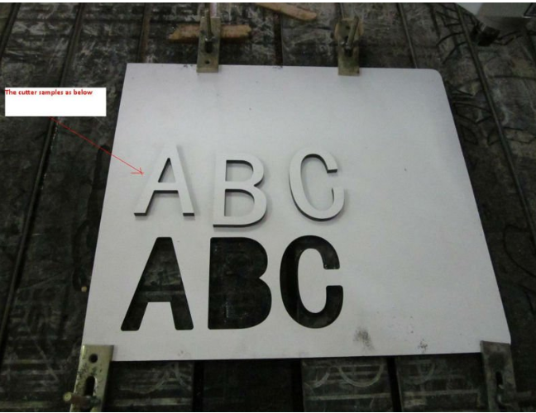
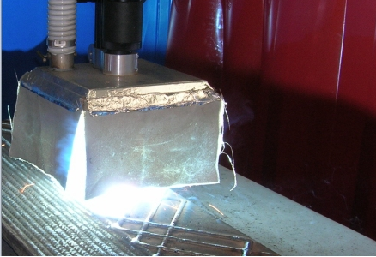
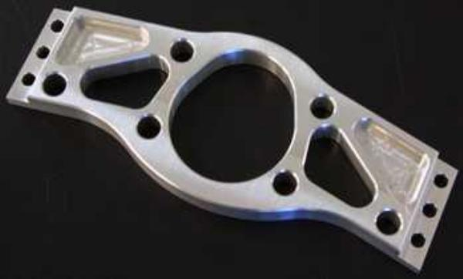

Slide 6
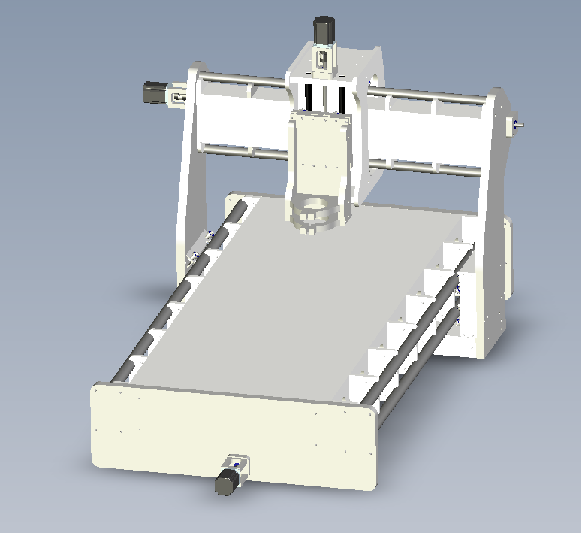
OVERVIW

Slide 7
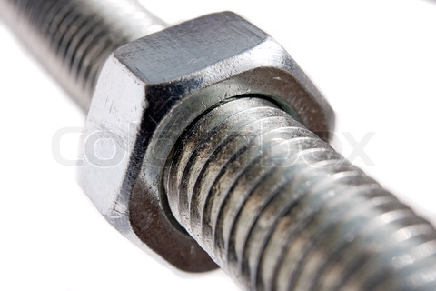
MECHANICAL DRIVE
How to convert rotational movement of motor into translational movement ?

Slide 8
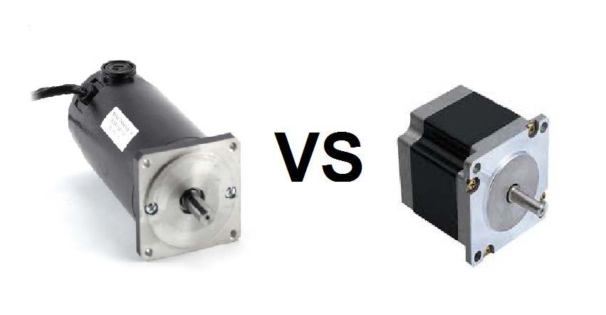
MOTORS
SERVO vs. STEPPER

Slide 9
MOTORS
Servo: closed loop, higher resolution & complex drive.
Stepper motor: open loop, enough resolution & simple drive.

Slide 10
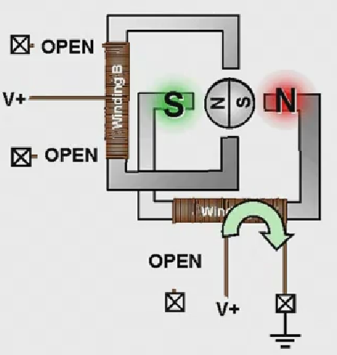
Uni-polar stepper motors have two coils/windings per phase.

Slide 11
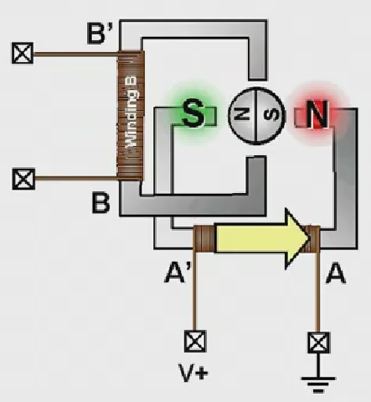
Bipolar two-phase stepper motors have one winding per phase.

Slide 12
TORQUE ISSU
An 8 wire NEMA 23 stepper motor may produce:
305 oz-in using uni-polar driver
425 oz-in using bipolar driver
(1 oz-in = 0.0070 N-m)

Slide 13
STEPPING MODES
Wave step
Half step
Full step

Slide 14
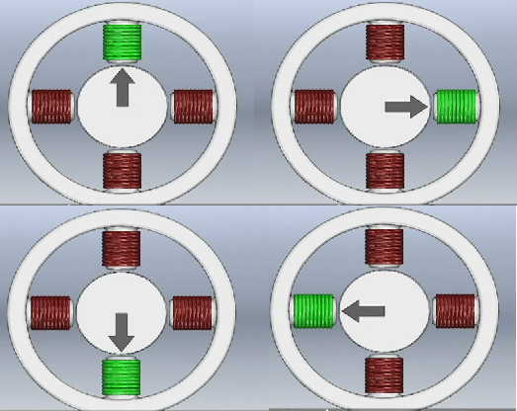
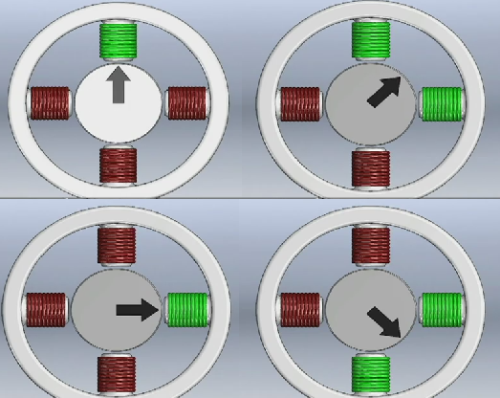
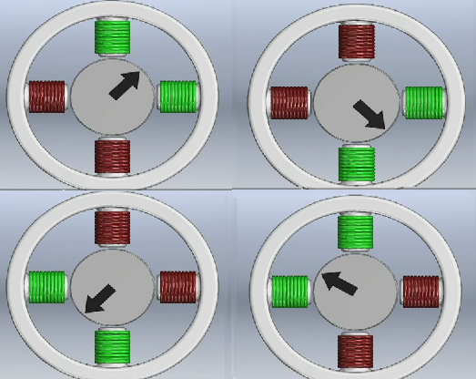
WAVE STEP
HALF STEP
FULL STEP

Slide 15
MACHINE RESOLUTION
One revolution (200 steps) ………… 2.0 mm
Quarter revolution (50 step) ……… 0.5 mm
0.01 mm per step

Slide 16
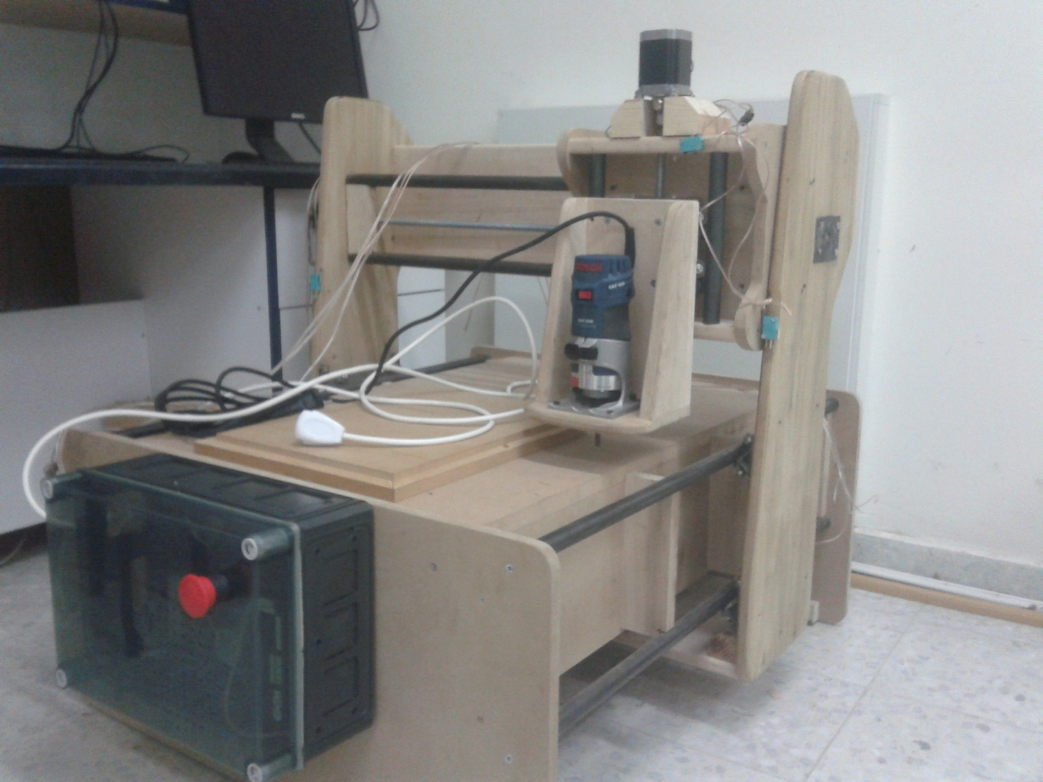
MECHANICAL STRUCTURE

Slide 17
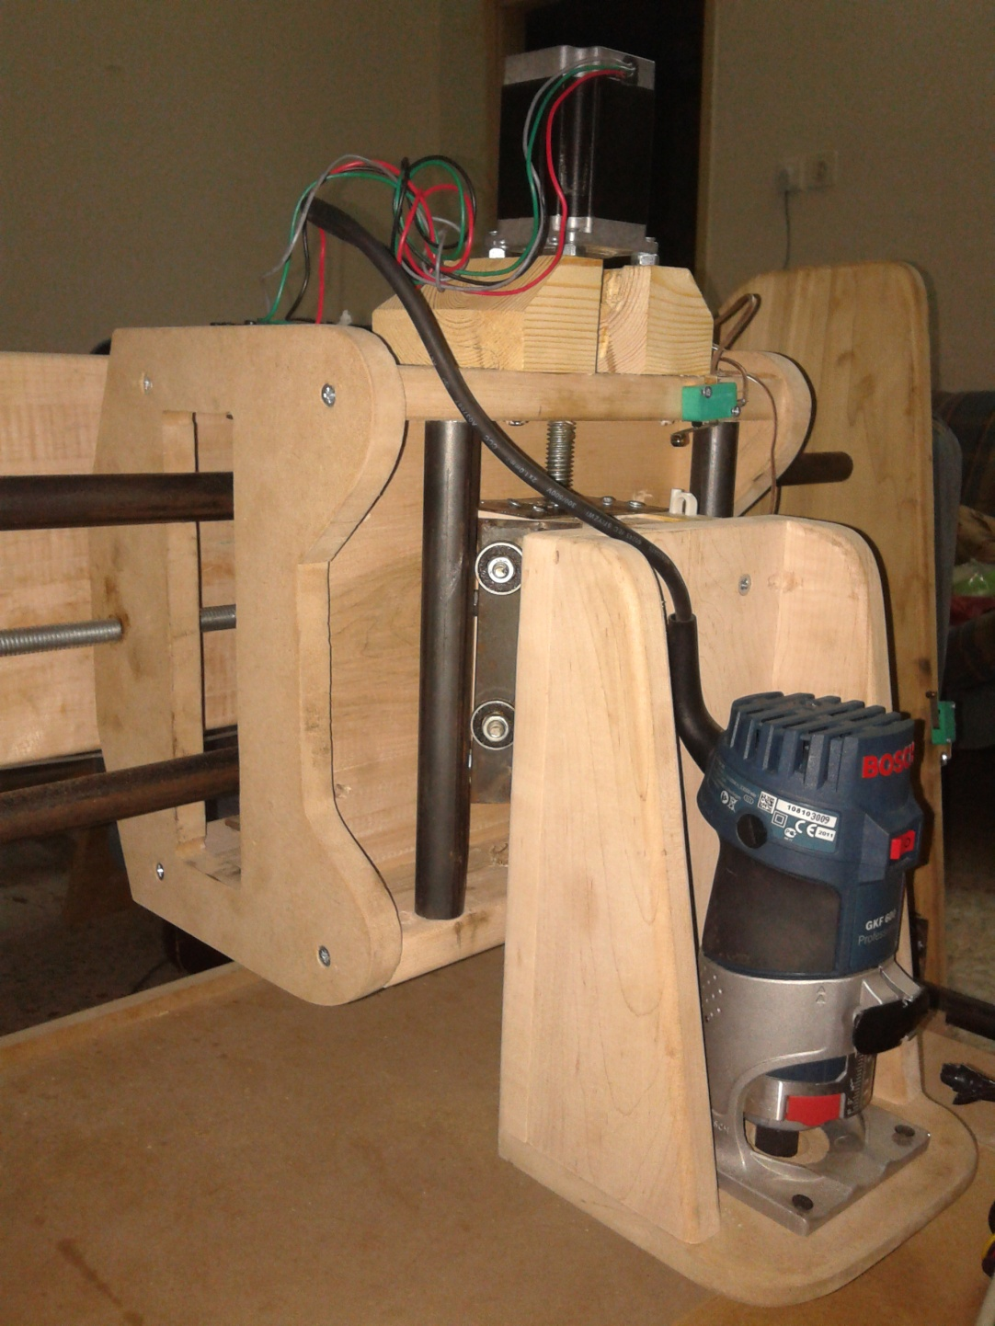
Z-AXIS OF THE MACHINE

Slide 18
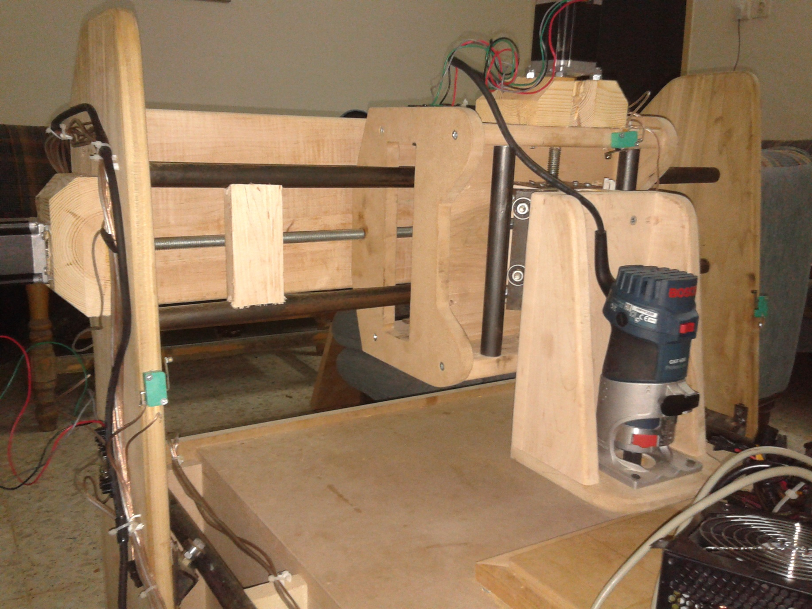
Y-AXIS OF THE MACHINE

Slide 19
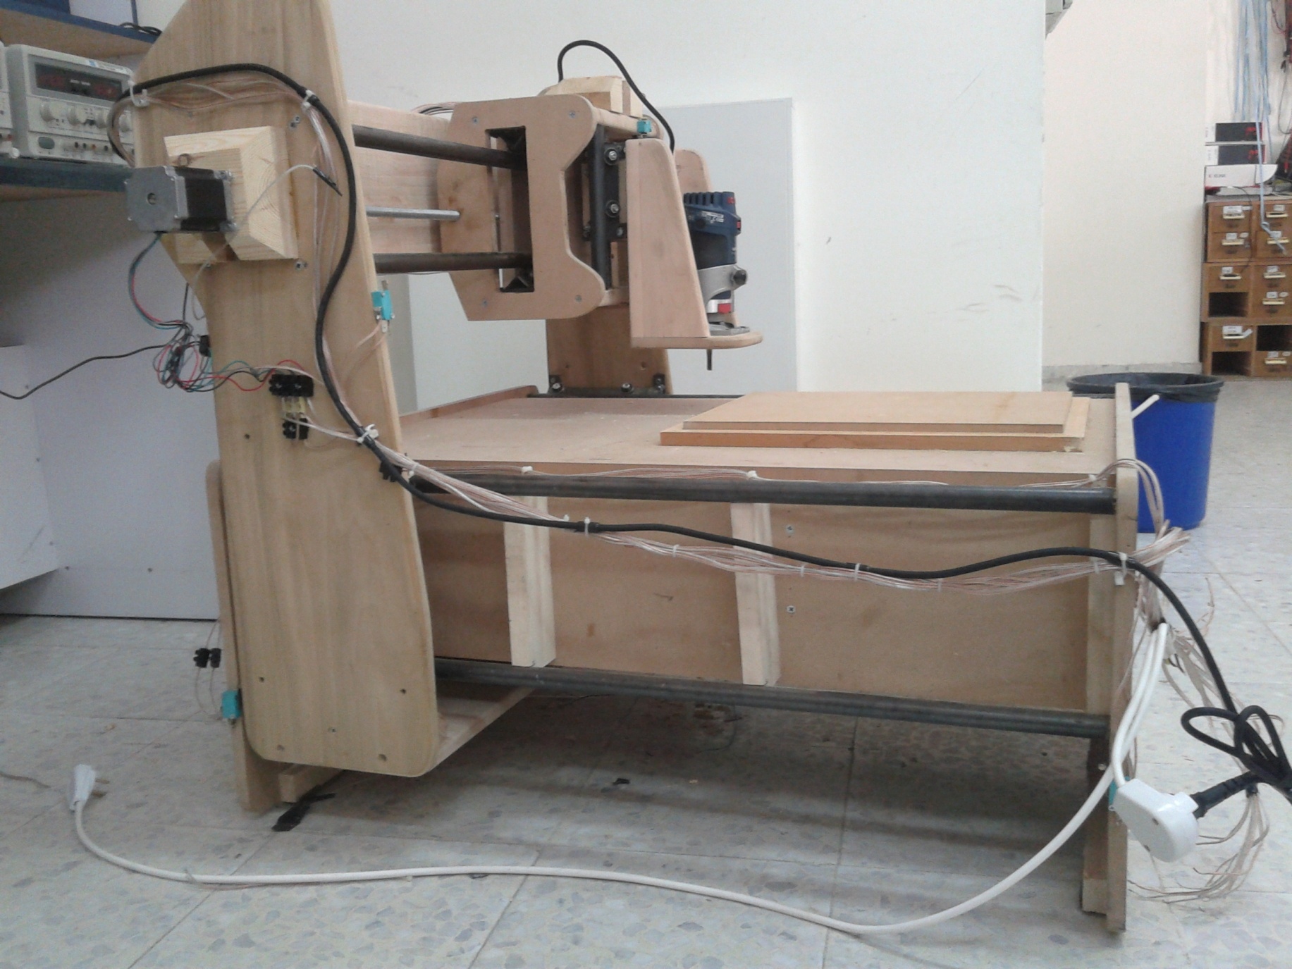
X-AXIS OF THE MACHINE

Slide 20
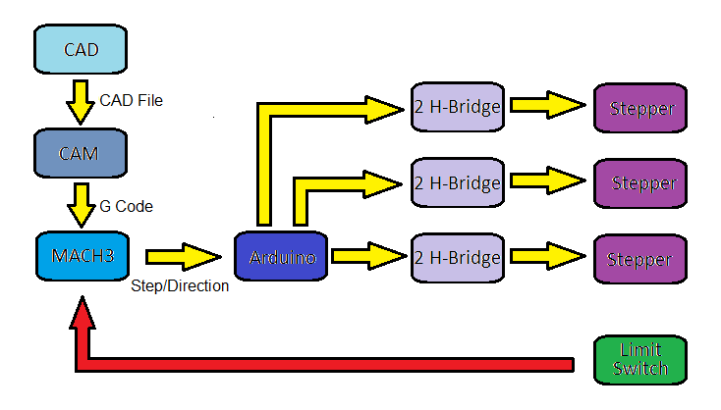
CNC SYSTEM

Slide 21
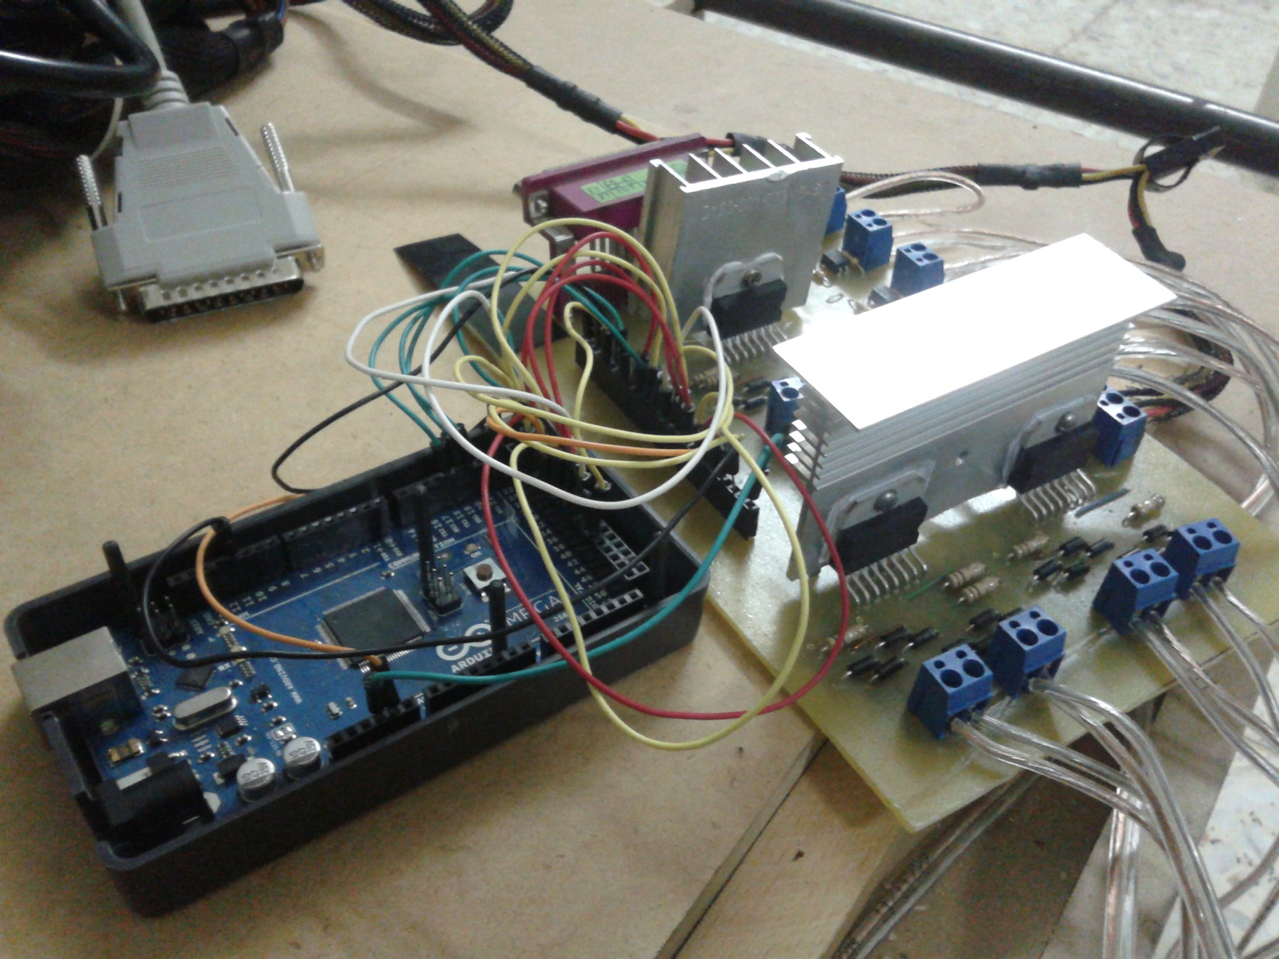
DRIVE CIRCUIT

Slide 22
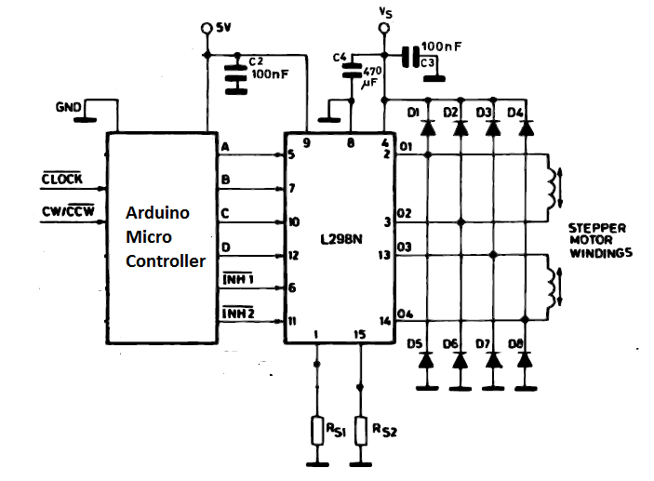
0
SCHIMATIC OF DRIVE CIRCUIT

Slide 23
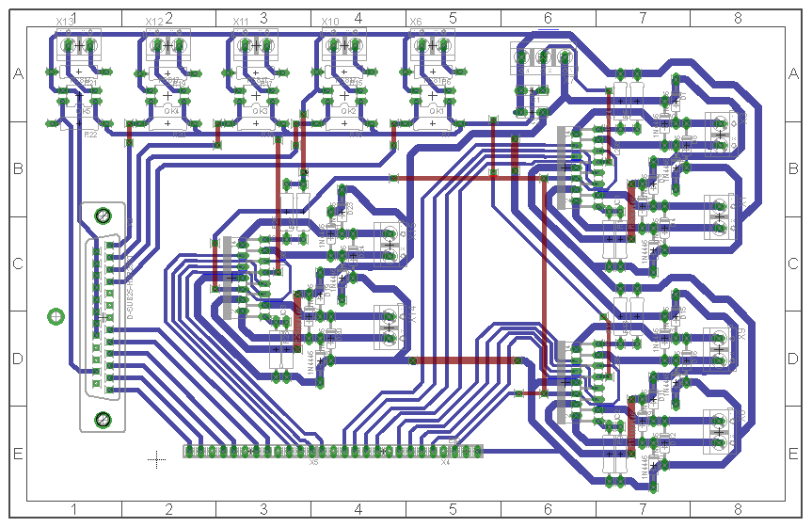
PCB OF DRIVE CIRCUIT

Slide 24
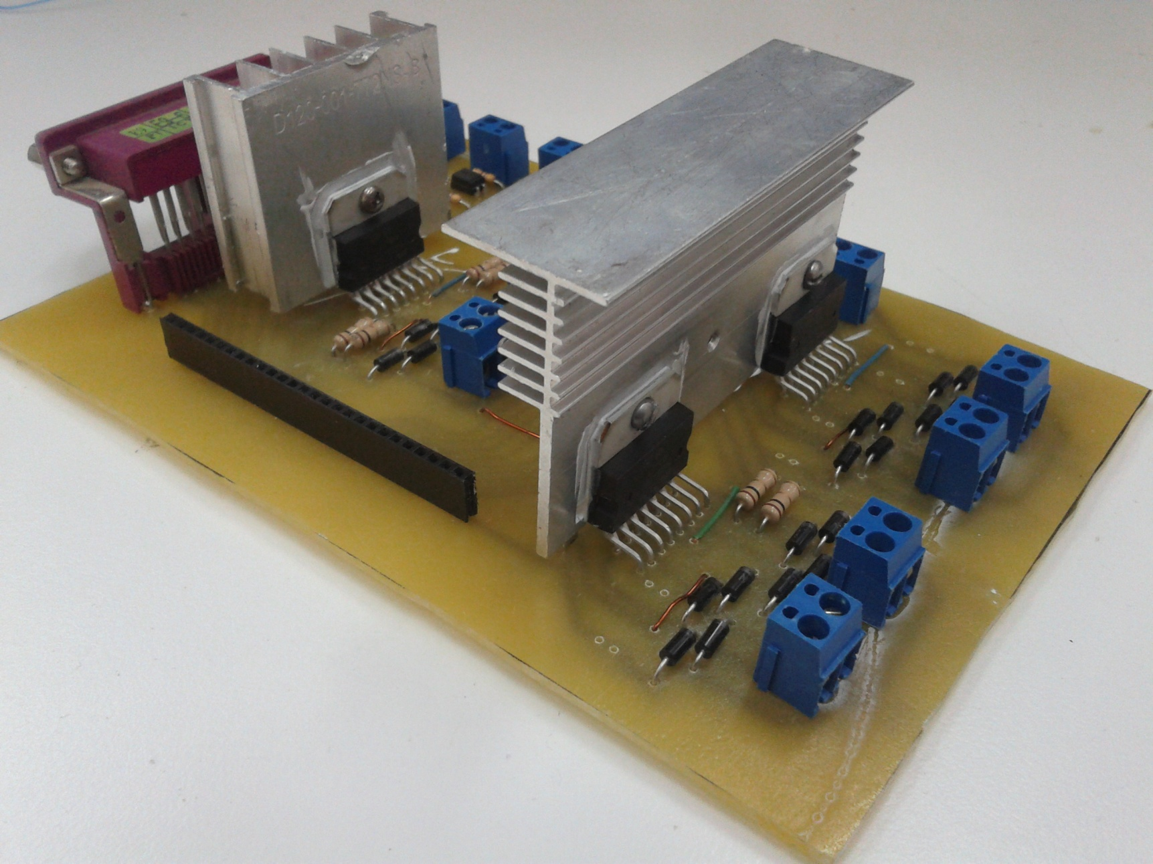

Slide 25

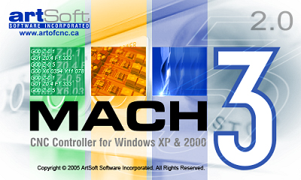

SOFTWARES

Slide 26
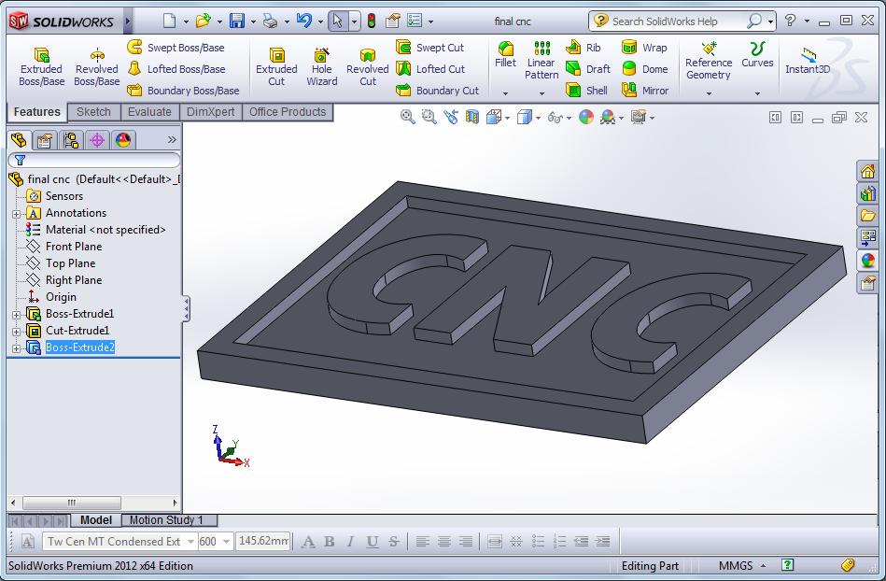
CAD SOFTWARE

Slide 27
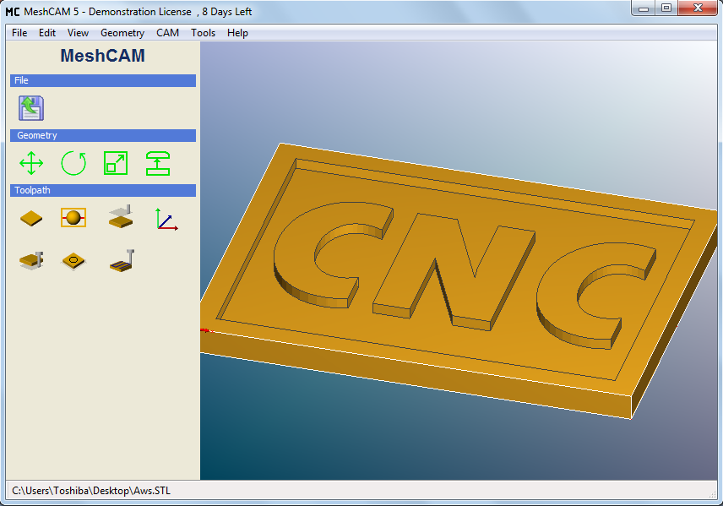
CAM SOFTWARE

Slide 28
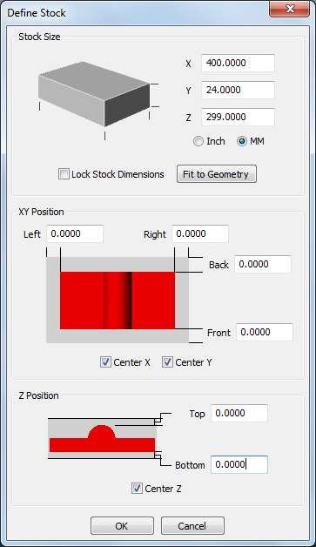

Slide 29
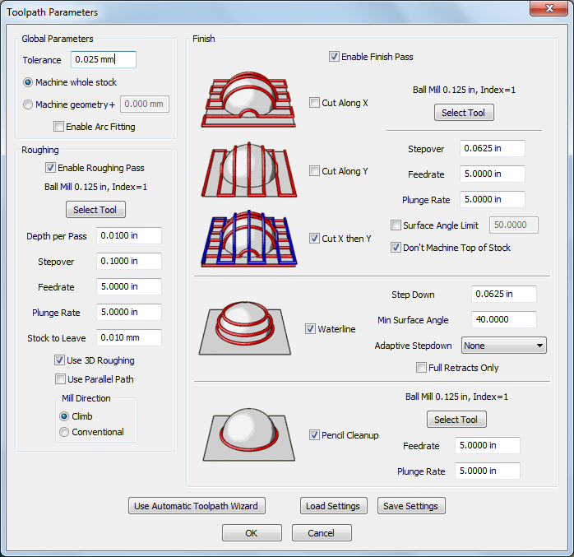

Slide 30
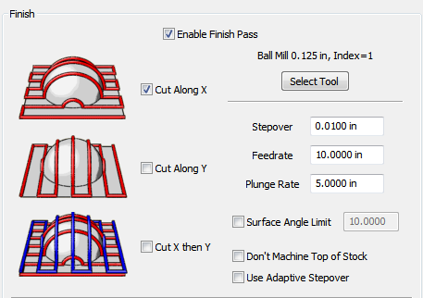

Slide 31
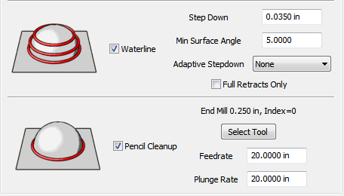

Slide 32
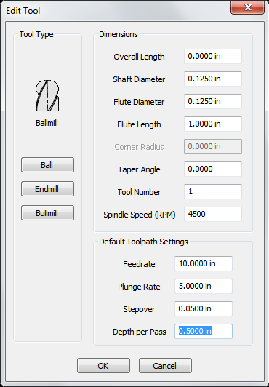

Slide 33
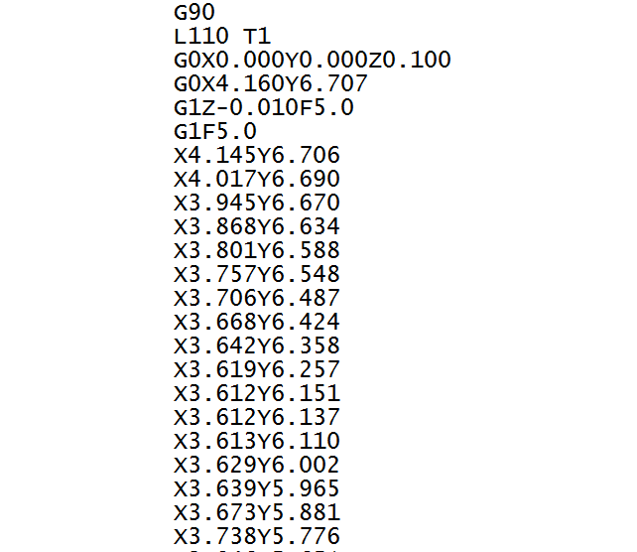
G CODE

Slide 34
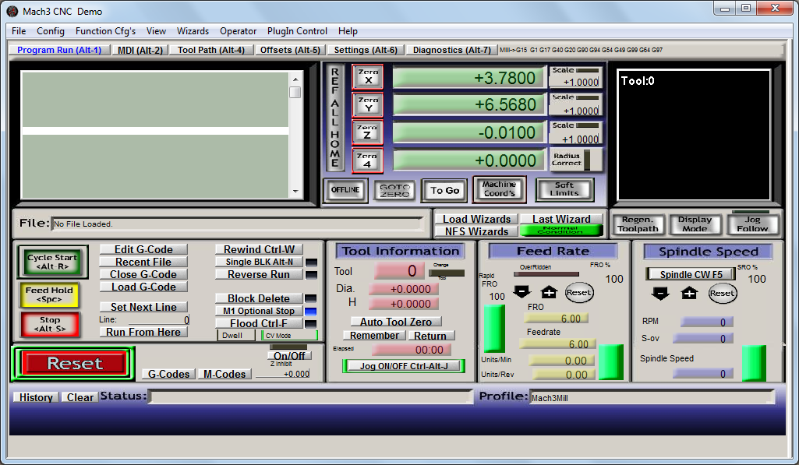
MACH3 SOFTWARE

Slide 35
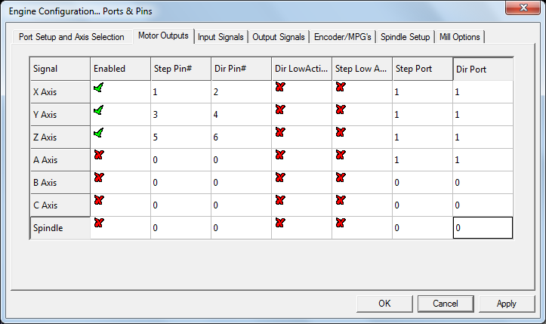
MOTOR OUTPUT

Slide 36
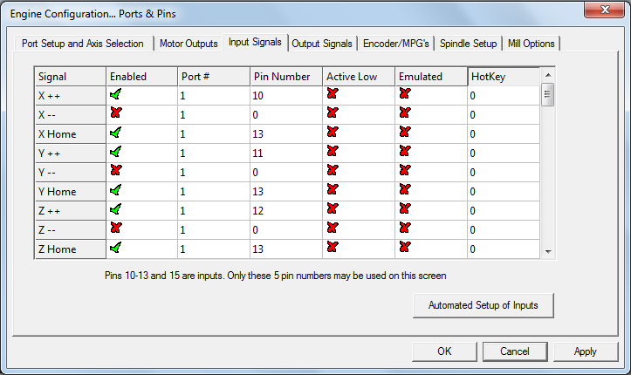
INPUT SIGNALS

Slide 37
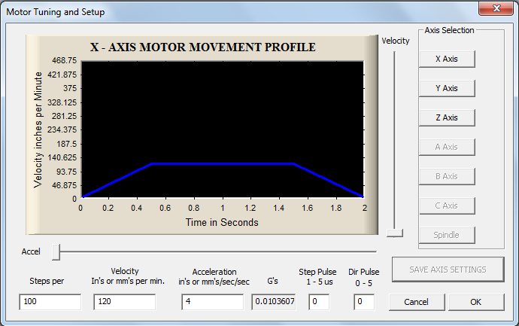
MOTOR TUNING

Slide 38
FINAL RESULT

Slide 39
THANK YOU
FOR LISTENING

