Slide 1

Seismic Design of Al- Tira Tower Building
Prepared by:
Abd-karim Jamal Saad
Mohammd Riyad
Shaymaa Ahmad
Supervisor: Dr. Munther Diab

Slide 2
The Presentation Consist Of Three Chapter:
1- Chapter One :General Describe For The Project1.
2- Chapter Two: Dynamic Loads.
3-Chapter Three : Design and Detailing For The Element Of The Project.

Slide 3
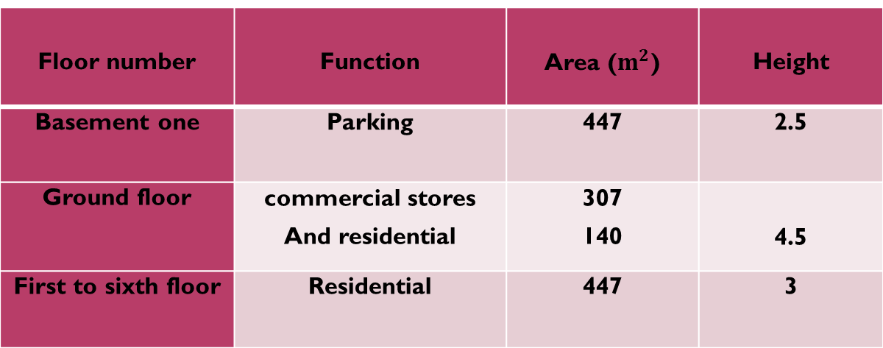
Chapter One.
1-About The Project:
" Al-Tira Tower Project " is located in Nablus city. It's a building of eight floors; and will be used as commercial, residential and parking building of masonry walls and total area equals 3601 m2.
Floor number | Function | Area ($m^{2}$) | Height
Basement one | Parking | 447 | 2.5
Ground floor | commercial stores And residential | 307 140 | 4.5
First to sixth floor | Residential | 447 | 3

Slide 4
Design Codes:
The structure is designed using practice codes and specifications that control the design process.
These codes are:
ACI 318-14 : American Concrete Institute provisions for reinforced Concrete structural design.
IBC-2012: International Building Code.
Material
  Concrete strength for column footing and shear wall 28 Mpa.
  Concrete strength for slab and beam element 24 Mpa.

Slide 5
  Design alternatives:
In project one we have check in two alternatives and use more acceptable by advantages and disadvantages .
The first alternatives
solid slab:
On the positive hand, it's safe ,stable and has an acceptable cost, but on the opposite hand, it is not a common practice in residential building, and it has problem in isolation.
The second alternatives :
ribbed slab:
it has acceptable cost, and it's very good in isolation and it’s the common practice for residential building, but it has not good in the earthquake.
Finally , we have use solid slab.

Slide 6
Chapter Two
Dynamic Loads
2.1:Torsion Problem and the solution.
2.2:Type of the structure:
2.3: Design response spectrum for the structure.
2.4: The dynamic analysis method used.
2.5: Hand calculation for lateral seismic force.
2.6: SAP calculation for lateral seismic force.
2.7: Load combination.

Slide 7
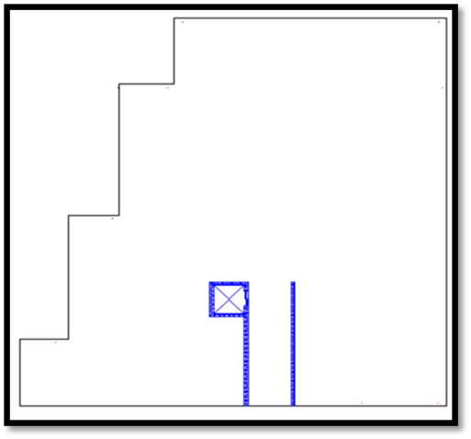
2.1:Torsion Problem and the solution:
Many problems were appeared due to earthquakes and the building not being able to resist the loads because of torsion of the building .Therefore, many models were made to solve this problem were the dimensions of the columns were increased and shear walls were added .
The following figures show origin shear walls and after added shear wall
Modal 1: before add shear wall

Slide 8
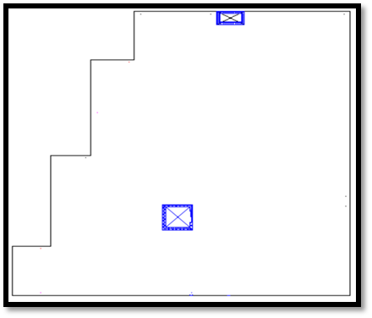
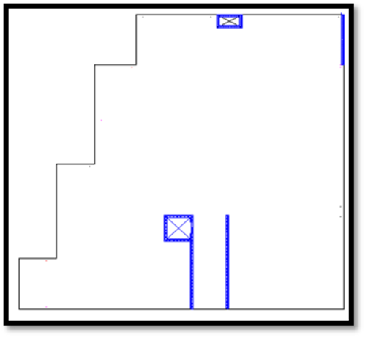
Modal 2 : After add shear wall
Modal 3 : After add shear wall
Finally , modal 3 was used.

Slide 9
2.2:Type of the structure:
The system type of the project is shear wall resisting system because the shear walls resist more than 75%.
For shear wall:
My hand calculations:
∑ Force in x-direction =4949.56 KN
∑ Force in y-direction = 1929.91 KN
From SAP:
%x = 4949.56 / 6079.22 *100
= 81.4%
%y = 1929.91 / 2393.372 *100
= 80.6% .

Slide 10
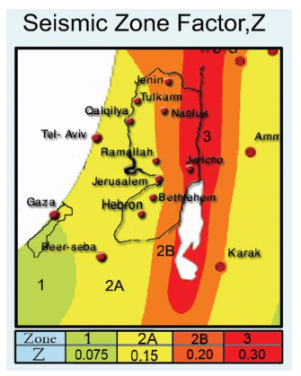
2.3: Design response spectrum for the structure:
-Z=0.2 g
-site class = B
(for rock)
-S1=1.25*Z=0.25
-Ss =2.5 Z =0.5

Slide 11
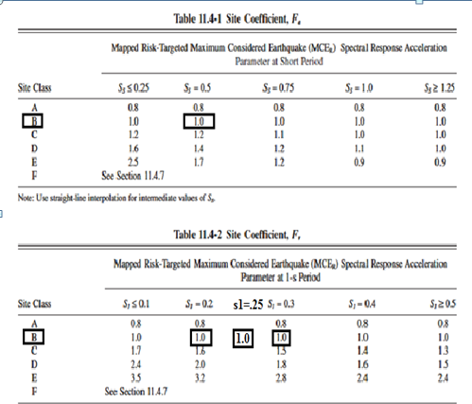
Now, Fa=1 and Fv=1 for site class B and S1 and Ss values

Slide 12
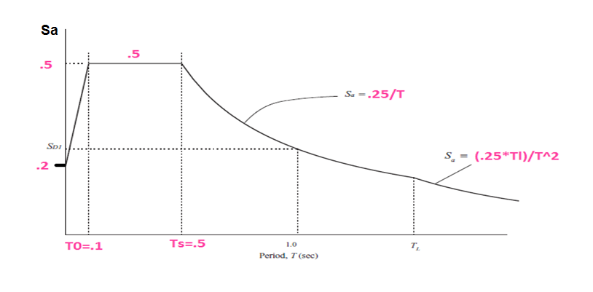
SMs=Fa*Ss=0.5…… SDs=SMs=0.5
SM1=Fv*S1=0.25.... SD1=SM1=0.25

Slide 13
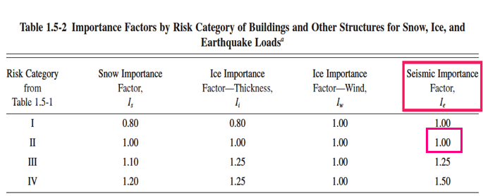
Importance Factor Value:

Slide 14
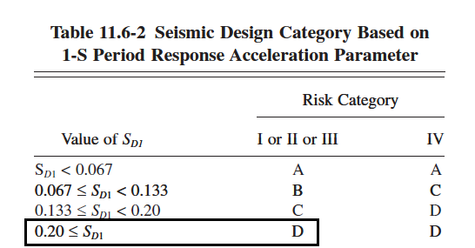
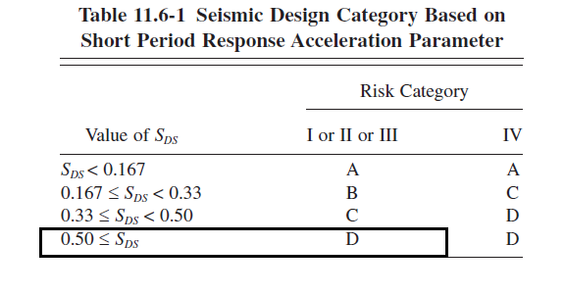

Slide 15
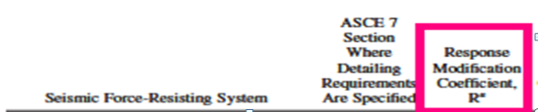
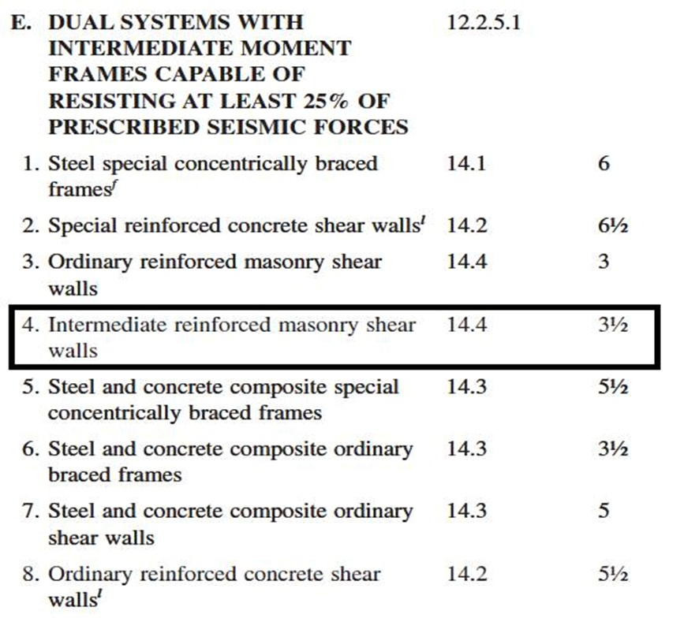

Slide 16
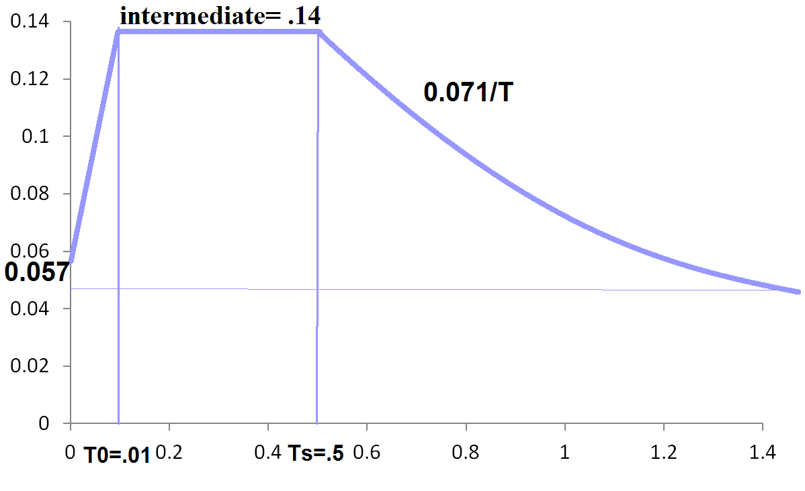
Design response spectrum for rock soil and intermediate frame

Slide 17
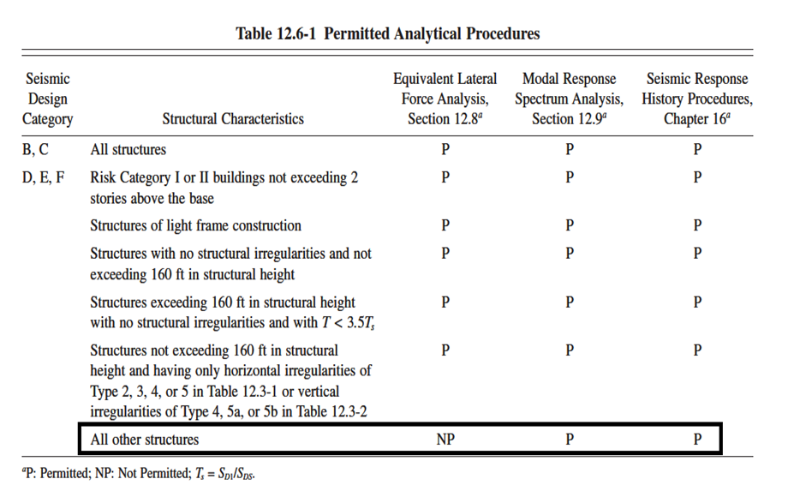
2.4 The dynamic analysis method used :

Slide 18
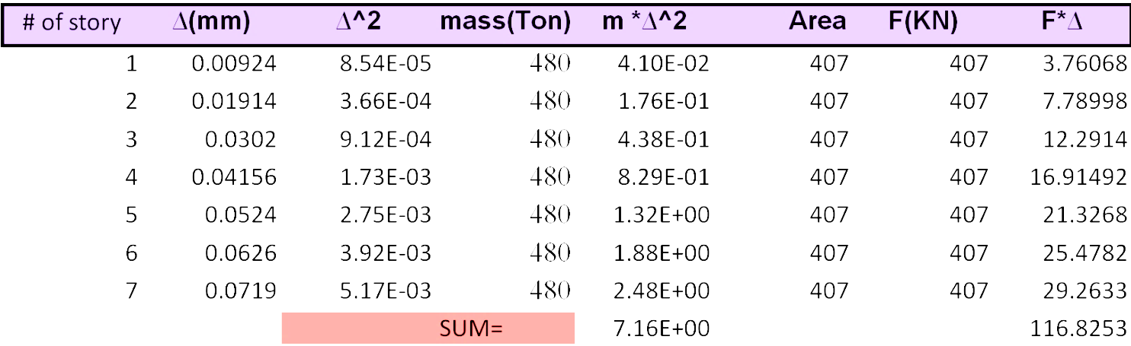
2.5 Hand calculation for lateral seismic force:
T=from Rayleigh method =2π(ƹ(m*∆2) /ƹ(F*∆))0.5
Mass for each story = (DEAD+SID)/ 7*10=33665.45/70=481 ton apply 1 kN/m2 for each slab in each floor in the X direction:

Slide 19

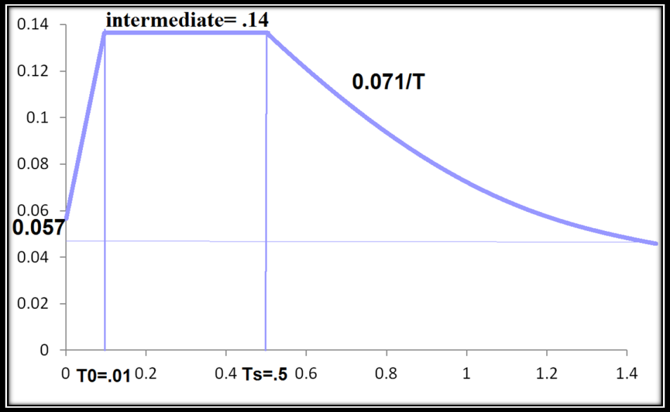
T =2π(7.16/116.82).5=1.55sec.
The value from Sap and Rayleigh method very close …….ok
Cs = 0.071 / 1.55 = 0.0458
Total weight = 33665.45
V=Cs*W
= 0.0458 *33665.45
=1542.1 KN

Slide 20
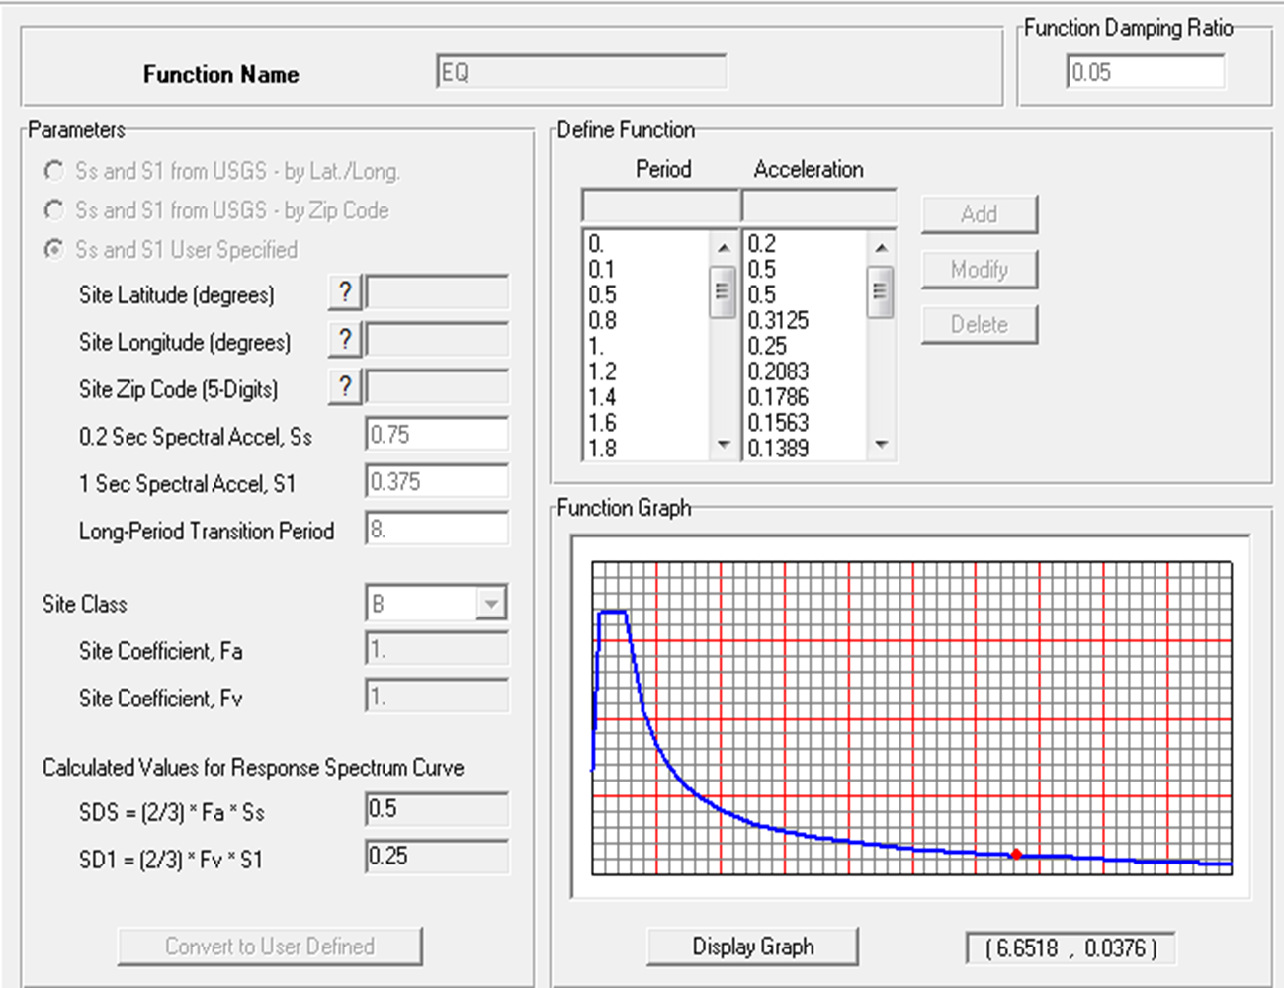
2.6 SAP calculation for lateral seismic force:
E=ϼEh + Ev ………….. (ϼ = 1.3)
Eh=EX+EY
EX=Ex+0.3Ey
EY=Ey+0.3Ex

Slide 21
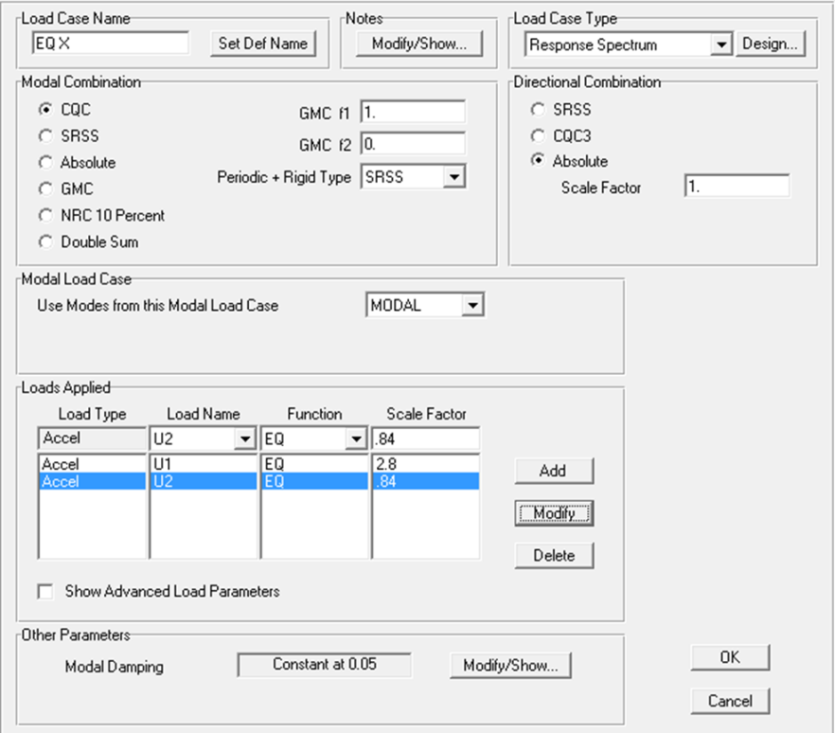
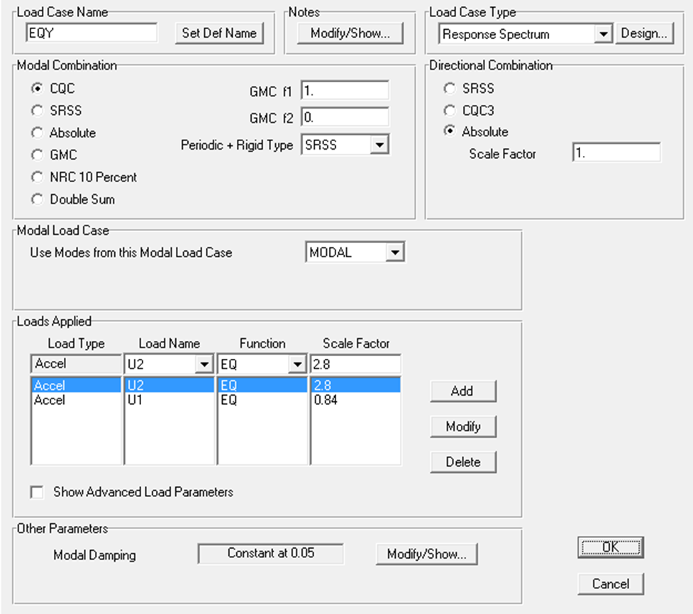

Slide 22
2.7: Load combination.
1) 1.2 D +1.6 L
2) 1.4D
3) 1.3 D + 1.0 L +1.3 EQ
4) 1.3 D + 1.0 L -1.3EQ
5) 0.8D + 1.3E Q
6) 0.8 D – 1.3 EQ

Slide 23
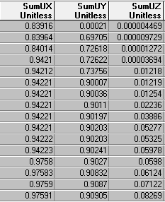
Modal mass participation ratio:

Slide 24
Chapter Three
Design And Detailing
3.1: Final sections.
3.2:Check Drift.
3.3: Design of slabs.
3.4: Design of beams.
3.5: Design of columns.
3.6: Design of shear wall.
3.7: Design of stair.
3.6: Design of mat foundation.

Slide 25
3.1: Final Sections:

Slide 26
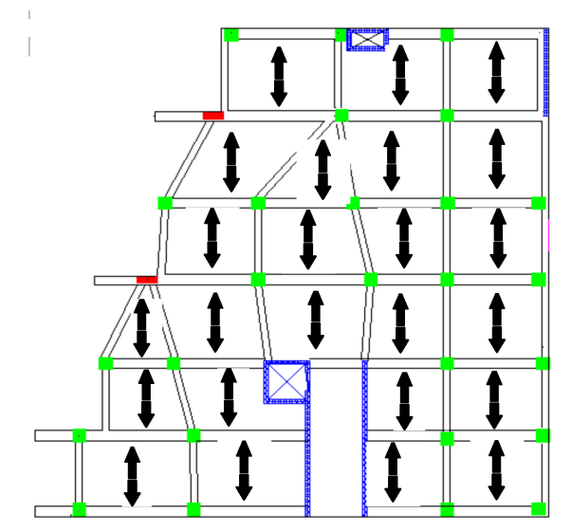
For slabs:

Slide 27
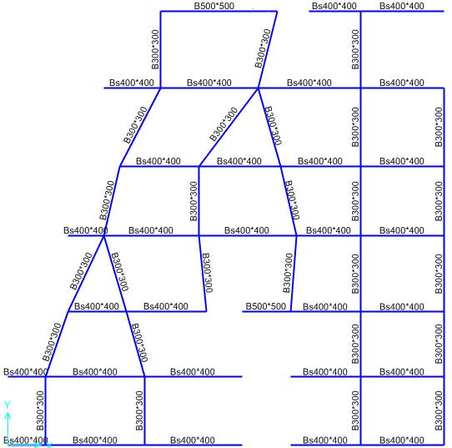
For Beams:

Slide 28
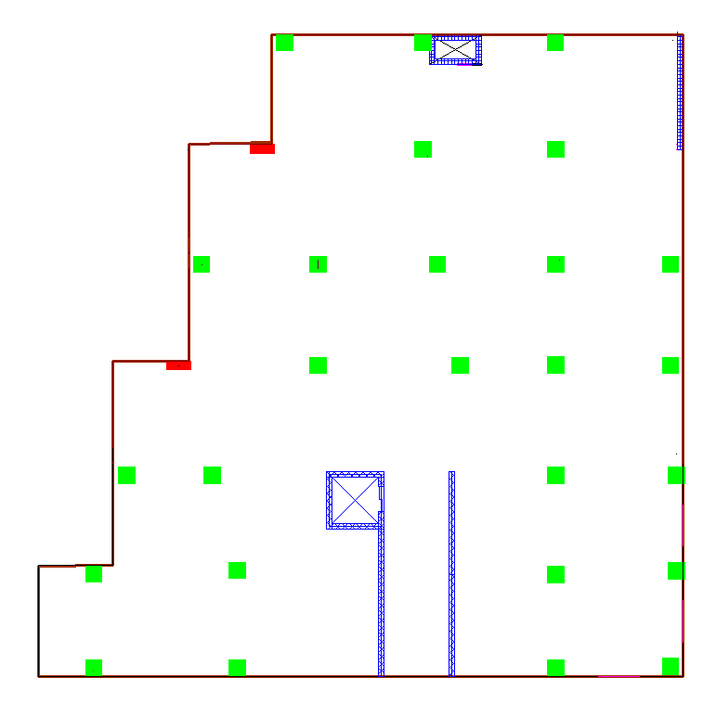
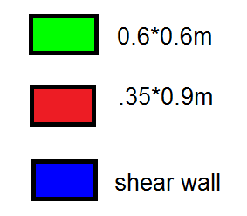
For Columns:

Slide 29
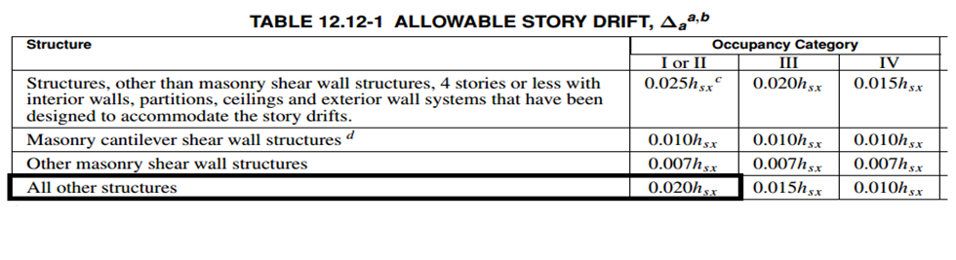
3.2 Check Drift :
So ∆_{max} = 0.02*h
H for each story = 3250 mm
∆_{max} = 0.02*3250 = 65 mm

Slide 30
From SAP modal:
Deflection of 8th floor = 91.25mm → ΔS = 91.25-81.19 = 10.06 mm.
Deflection of 7th floor = 81.19 mm. →ΔS = 81.19-69.4 = 11.79 mm.
Deflection of 6th floor = 69.4 mm. →ΔS = 69.4-56.61 = 12.79 mm.
Deflection of 5th floor = 56.61 mm. →ΔS = 56.61-43.13 = 13.48 m
Deflection of 4th floor = 43.13 mm. →ΔS = 43.13-29.34 = 13.79 mm.
Deflection of 3rd floor = 29.34 mm. →ΔS = 29.34-15.73 = 13.61 mm.
Deflection of 2nd floor = 15.73 mm. →ΔS = 15.73-.337 = 15.353 mm.
Deflection of 1stfloor = .337 mm. →ΔS = .377 – 0 = .337mm.
Deflection at the base = 0 mm. →ΔS = 0 mm.
The critical case at the first floor.
ΔS(max) =15.353 mm.
Maximum limitation = = 0.02* 3250 = 65 mm.
15.353 mm< 65 mm →OK

Slide 31
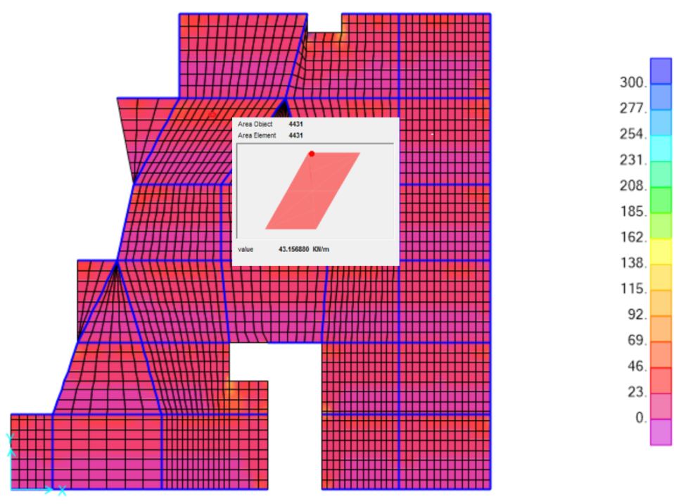
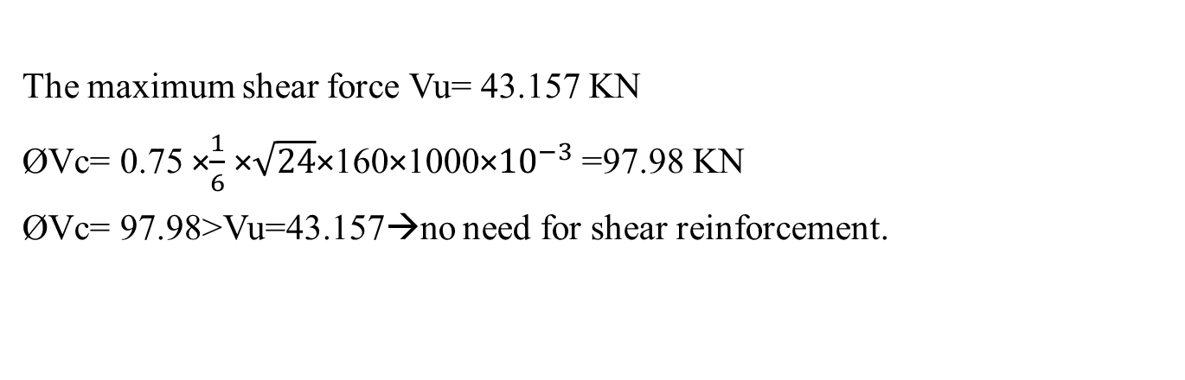
3.3: Design of slabs:
Check for shear :
From sap:
The maximum shear force Vu= 43.157 KN
ØVc= 0.75 ×$\frac{1}{6}$ ×$\sqrt{24}$×160×1000×${10}^{−3}$ =97.98 KN
ØVc= 97.98>Vu=43.157→no need for shear reinforcement.

Slide 32
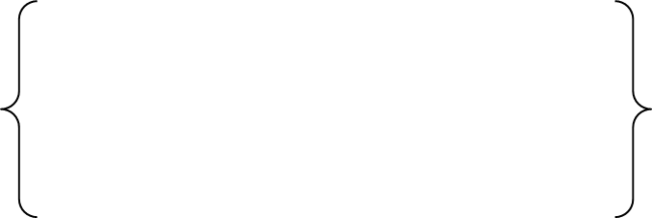
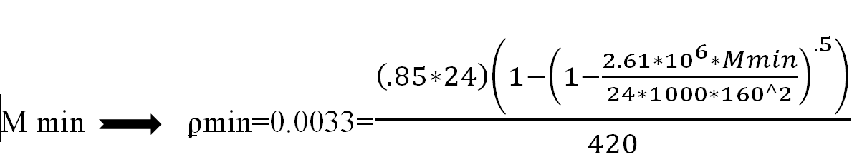
Analysis and Design for flexure :
ϼmin= max 1.4/ Fy =(0.0033)
0.25*fc^{.5}/Fy = .25*(24^.5)/420=
(0.0029)
=0.0033.
As min=0.0033*bw*d=0.0033*1000*160=528mm² → use 4ɸ14
Mmin= 30.9kN.m/m.

Slide 33
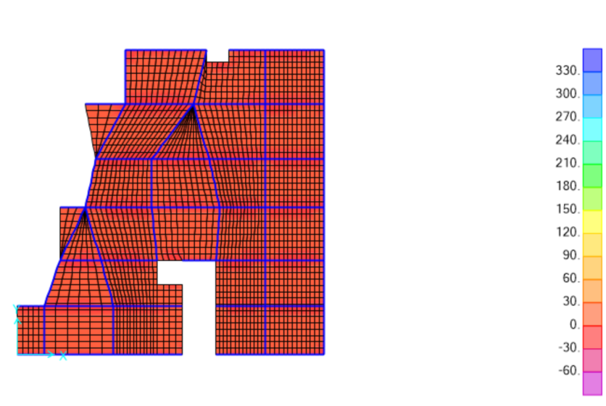
For the slabs which is in the y direction (M22):

Slide 34
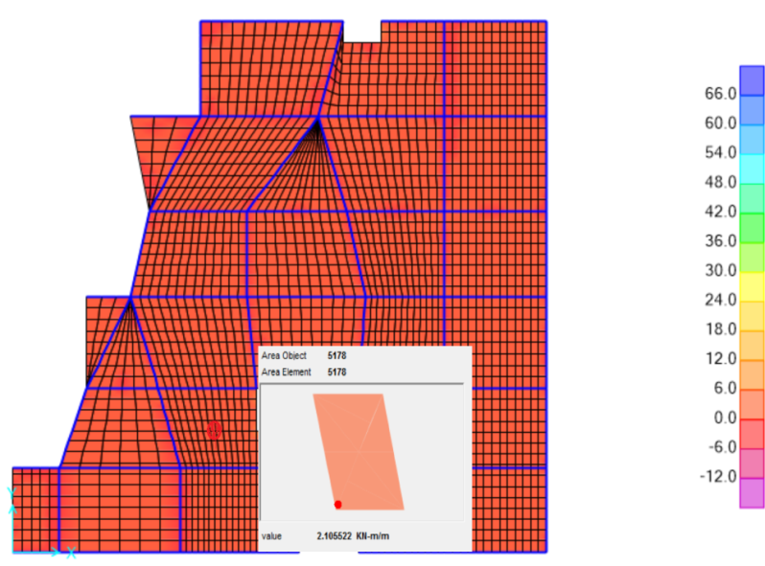
For the slabs which is in the x direction (M11)

Slide 35
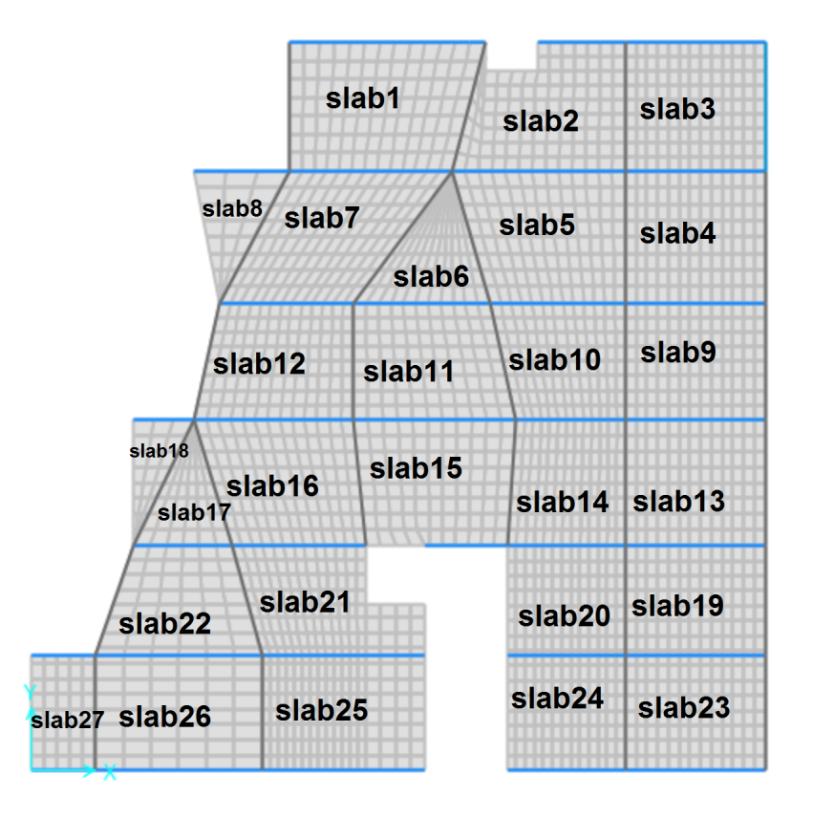

Slide 36
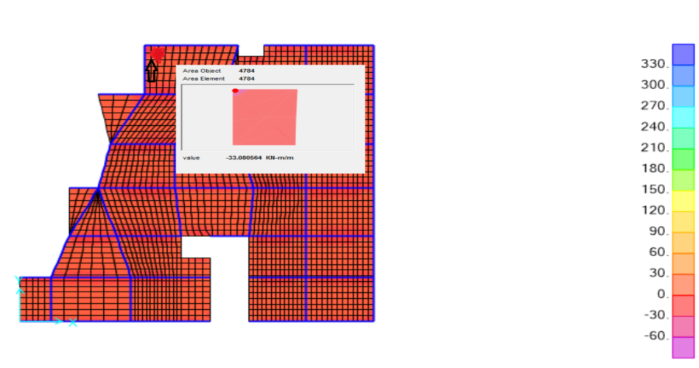
Max moment =-33KN.m/m which falls in slab1
The value from sap shown in figure below:
ϼ=.85*241-1-2.61*106*3324*1000*160^2.5420
Note: Foe other moment use Asmin
ϼ =3.53*10⁻³…..As=3.53*10⁻³*1000*160=565.3mm² 4ɸ14

Slide 37
For shrinkage steel :
Shrinkage steel is used in order to prevent and control cracks in slab due to change in temperature.
b =1000 mm
As shrinkage= 0.0018× b×h
= 0.0018 *1000 *200 = 360 mm²
Use 3Ø 12/ m
use space between bars 250 , so we need 4 Ø12 /m

Slide 38
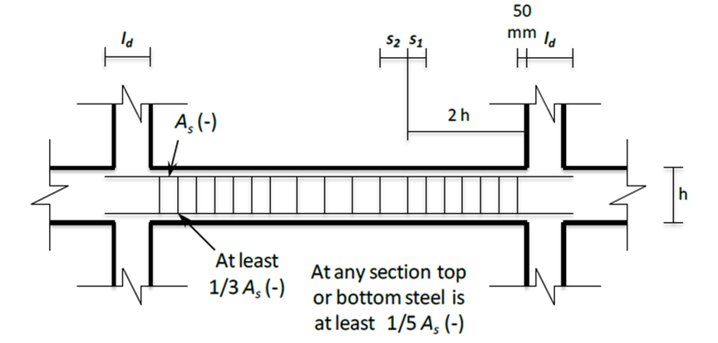
3.4 Beam Detailing:
-According to the code intermediate design detailing shall satisfy the following requirements:

Slide 39
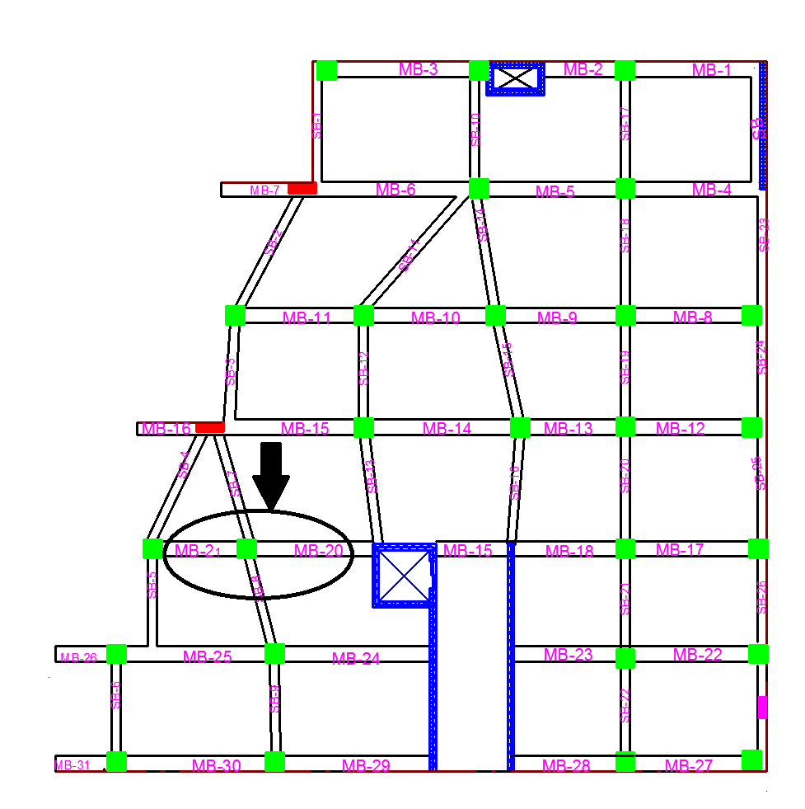
For Beams 20 and 21 :

Slide 40
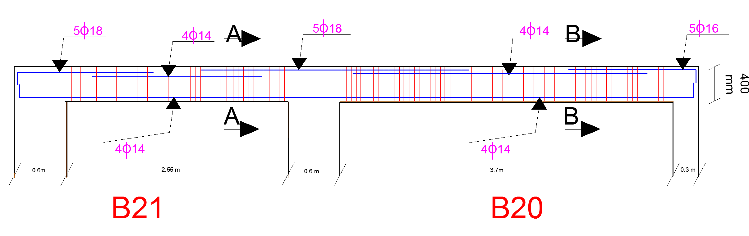
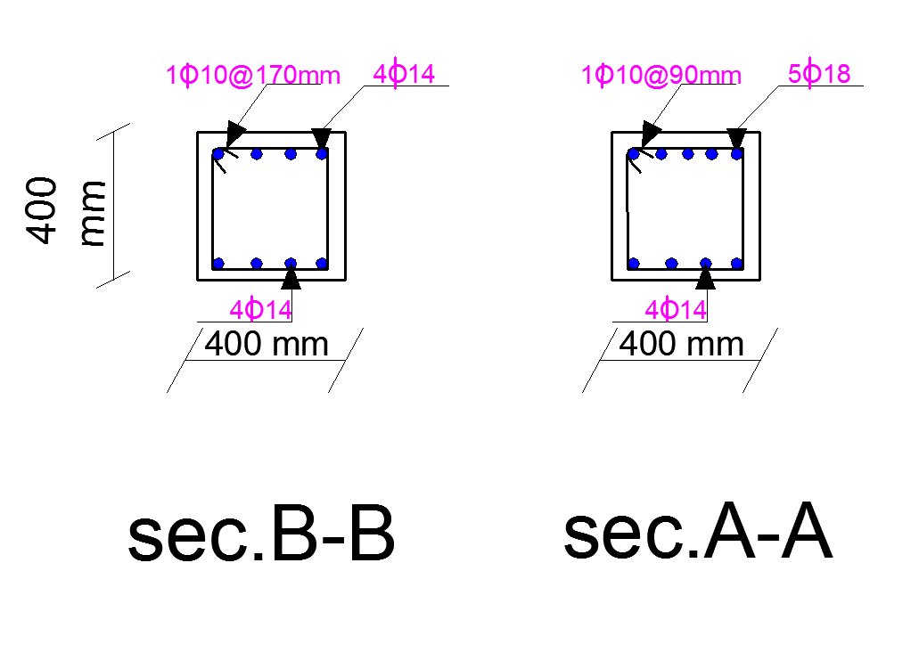
Beam 20 & 21 Detailing :

Slide 41
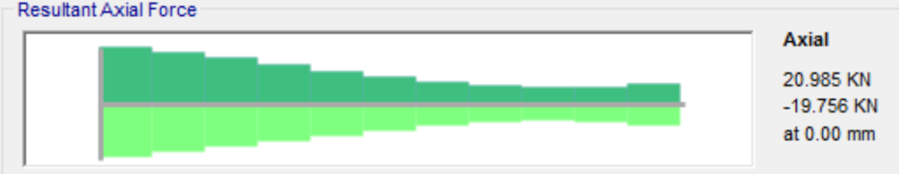
Check for axial force :
0.1*fcˋ*Ag > axial force
0.1*24*400*400 = 384 KN >21 KN → Ok

Slide 42
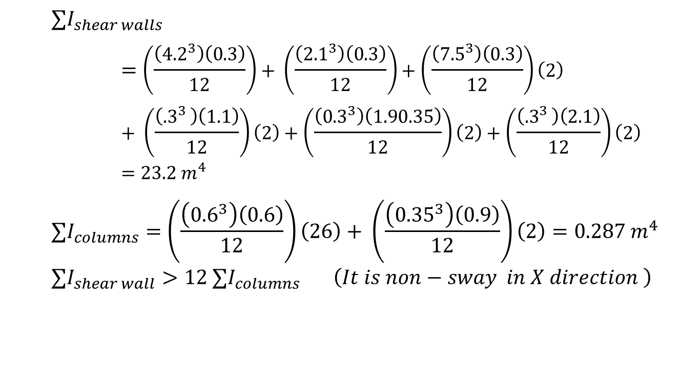
3.5: Design of columns:
  Sway –Non-sway Check:
If the stiffness of shear walls is larger than (12 * the stiffness of columns )in any direction, the columns are non-sway in that direction .
In the X-direction:
$$∑I_{shear walls}=\left(\frac{\left({4.2}^{3}\right)\left(0.3\right)}{12}\right)+ \left(\frac{\left({2.1}^{3}\right)\left(0.3\right)}{12}\right)+\left(\frac{\left({7.5}^{3}\right)\left(0.3\right)}{12}\right)\left(2\right)+ \left(\frac{\left({.3}^{3}\right)\left(1.1\right)}{12}\right)\left(2\right)+\left(\frac{\left({0.3}^{3}\right)\left(1.90.35\right)}{12}\right)\left(2\right)+\left(\frac{\left({.3}^{3}\right)\left(2.1\right)}{12}\right)\left(2\right)=23.2 m^{4}$$
$$∑I_{columns}=\left(\frac{\left({0.6}^{3}\right)\left(0.6\right)}{12}\right)\left(26\right)+ \left(\frac{\left({0.35}^{3}\right)\left(0.9\right)}{12}\right)\left(2\right)=0.287 m^{4}$$
$$∑I_{shear wall}>12 ∑I_{columns} \left(It is non−sway in X direction \right)$$

Slide 43
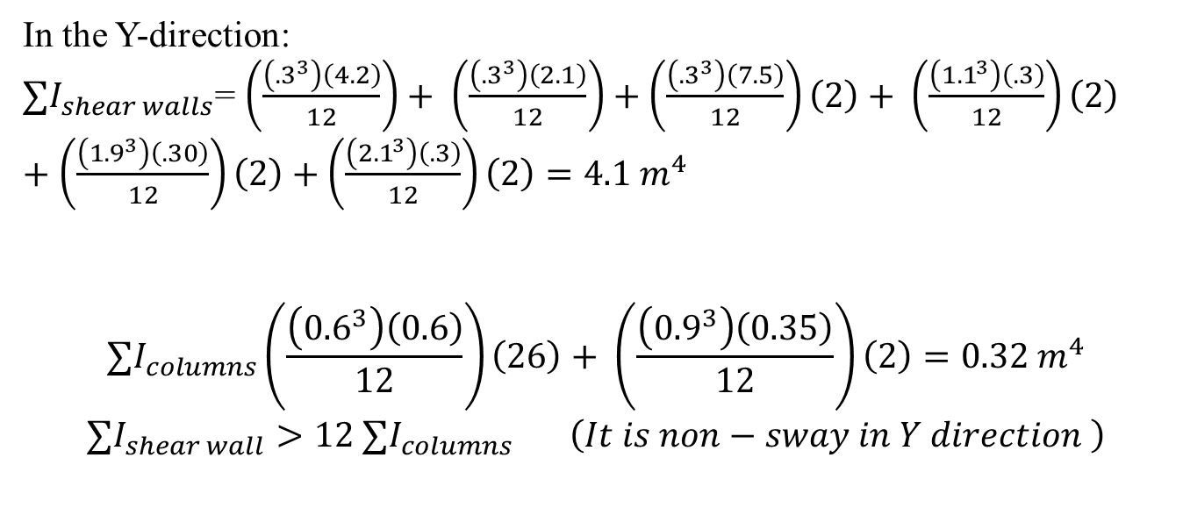
In the Y-direction:
$∑I_{shear walls}$= $\left(\frac{\left({.3}^{3}\right)\left(4.2\right)}{12}\right)+ \left(\frac{\left({.3}^{3}\right)\left(2.1\right)}{12}\right)+\left(\frac{\left({.3}^{3}\right)\left(7.5\right)}{12}\right)\left(2\right)+ \left(\frac{\left({1.1}^{3}\right)\left(.3\right)}{12}\right)\left(2\right)+\left(\frac{\left({1.9}^{3}\right)\left(.30\right)}{12}\right)\left(2\right)+\left(\frac{\left({2.1}^{3}\right)\left(.3\right)}{12}\right)\left(2\right)=4.1 m^{4}$
$$∑I_{columns}\left(\frac{\left({0.6}^{3}\right)\left(0.6\right)}{12}\right)\left(26\right)+ \left(\frac{\left({0.9}^{3}\right)\left(0.35\right)}{12}\right)\left(2\right)=0.32 m^{4}$$
$$∑I_{shear wall}>12 ∑I_{columns} \left(It is non−sway in Y direction \right)$$

Slide 44
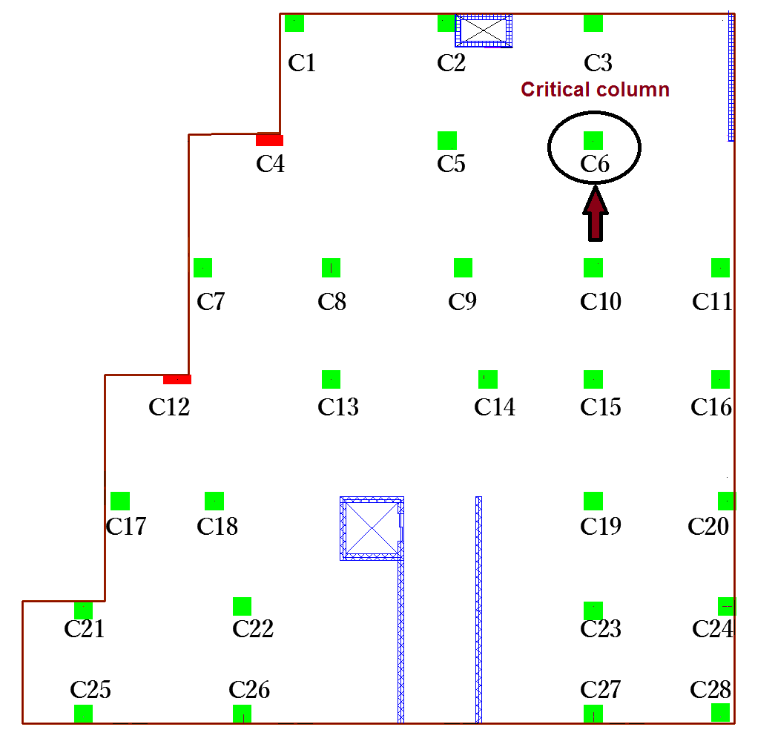
Slenderness Check:
Check for critical column (C6) shown in figure:

Slide 45
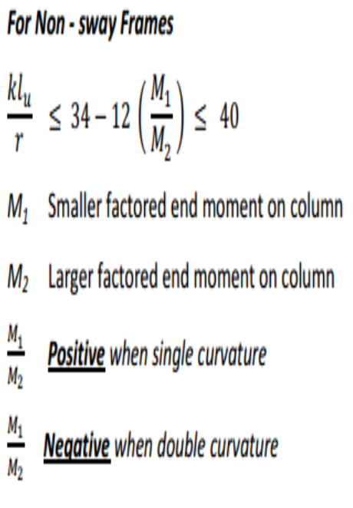
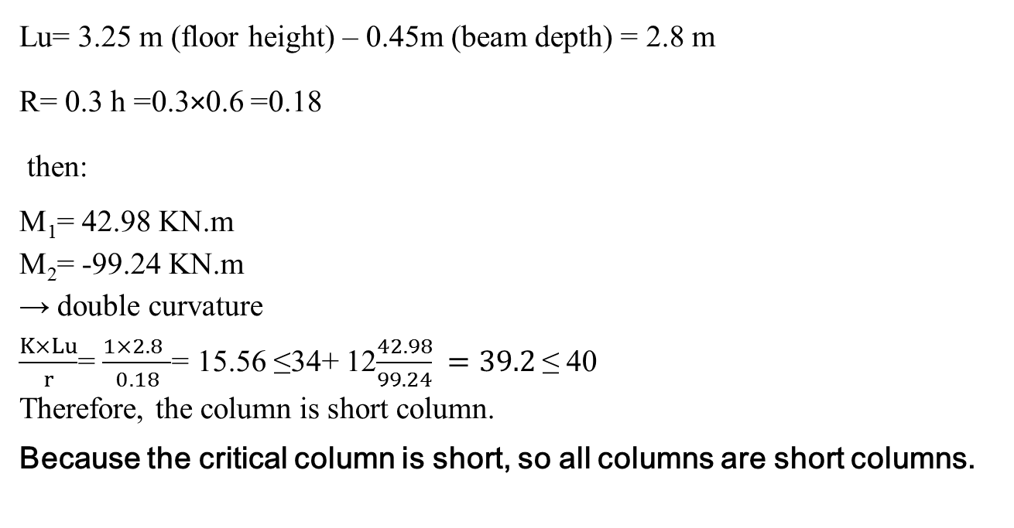
Lu= 3.25 m (floor height) – 0.45m (beam depth) = 2.8 m
R= 0.3 h =0.3×0.6 =0.18
then:
M₁= 42.98 KN.m
M₂= -99.24 KN.m
→ double curvature
$\frac{K×Lu}{r}$= $\frac{1×2.8 }{0.18}$= 15.56 ≤34+ 12$\frac{42.98}{99.24} =39.2$≤ 40
Therefore, the column is short column.
Because the critical column is short, so all columns are short columns.

Slide 46
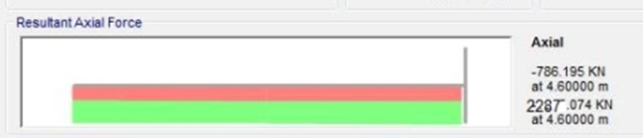
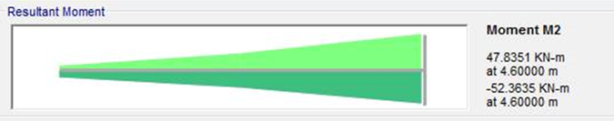
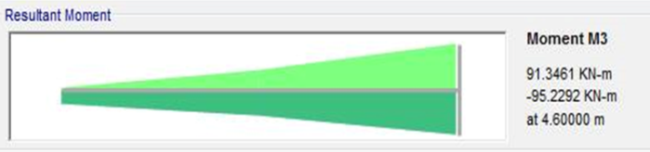
Check SAP results:
We check the sap results for the column shown below

Slide 47
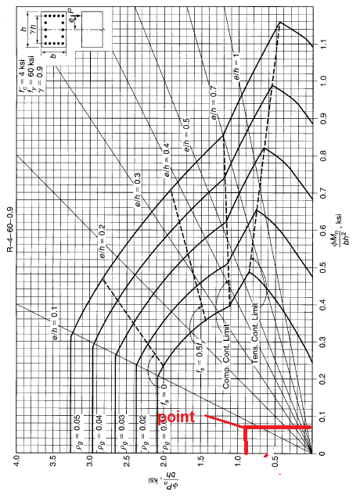
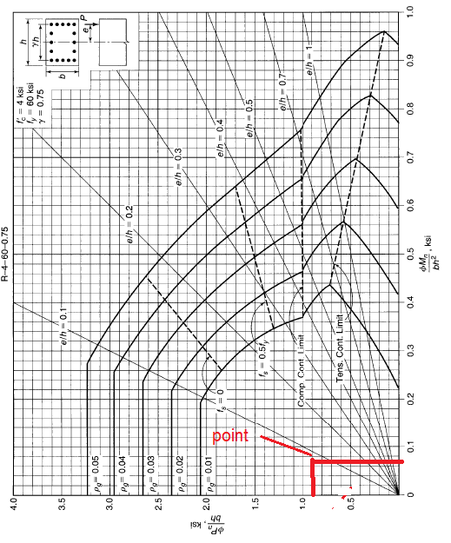
Ɣ=600-2*(cover=60)/600 = 0.8
Note that ϼ<1% for both values of Ɣ(0.9 and 0.75) in M22 and M33 , so its ok forƔ=0.8

Slide 48
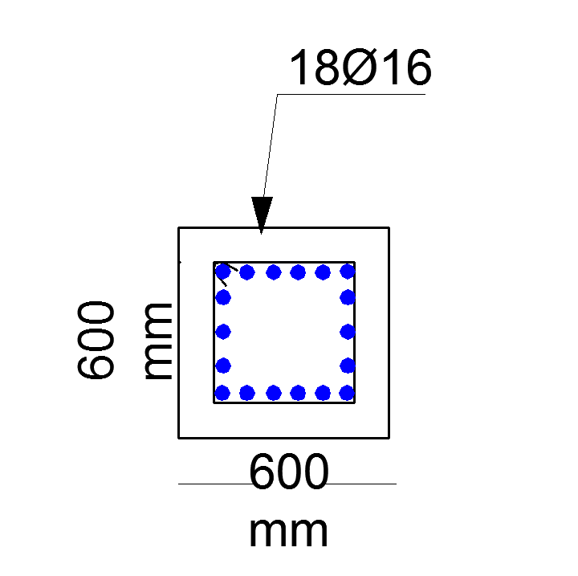
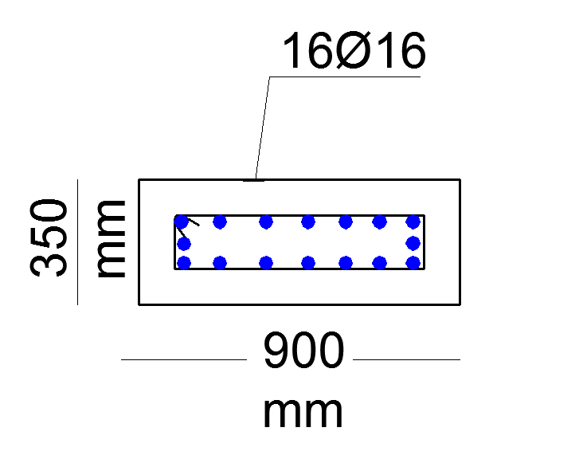
column 1 detailing
C4 section detailing

Slide 49



Column Detailing:
According to the code intermediate design detailing shall satisfy the following requirements:
Sample calculation for C6 (600*600 mm)

Slide 50




Slide 51

Final longitudinal section for C6 :

Slide 52

3.6 Design of shear wall:
For shear wall 2

Slide 53

Analysis and design of SW-2:
Axial load=3994KN
Max. Moment in Y-direction = 32027KN.m
Shear force in the long direction =125 KN
Shear force in the short direction =2220KN
Use two layers of 5Ø16/1m for vertical steel

Slide 54


From SAP the interaction diagram of the SW-2
As you see the point within the curve, so it’s ok.

Slide 55


Check for shear in the long direction (Y):

Slide 56

Analysis and design of SW-4:
Axial load=5863KN
Max. moment in Y-dir=1527KN.m
Shear force in the long direction =159 KN
Shear force in the short direction =245KN
Use two layers of 5Ø16/1m. for vertical steel

Slide 57


From SAP the interaction diagram of the SW-2
As you see the point within the curve, so it’s ok.

Slide 58


Slide 59


- Detailing for shear wall2:

Slide 60

- Detailing for shear wall4:

Slide 61



3.7: Design of stair.
h = $\frac{L}{20}$ =$\frac{3.3}{20}$ = 16 cm ……. Use h = 15cm, d =10cm
And the thickness of flights = $15cm$ .
Average step height is given as:
$h_{avg.}$ = $\frac{t}{\cos{ ∝}}$+$\frac{R}{2}$=$\frac{15}{\cos{31}}$ + $\frac{13.5}{2}$ = 24.3cm > 15 cm → OK

Slide 62

Stair Loading
Take superimposed = 5
Live load
Live load on stairs is 4 KN/m2
Ultimate load
Wu = 1.2(0.15*25+4) +1.6(5) = 17.3 KN/m2
W service = .15*25+4+5 = 12.75 KN/m2
Checking deflection requirements for serviceability
Max. Deflection (SAP) = 0.6 mm.
Allow deflection < L/280 =11 mm. → Ok

Slide 63

Check for shear
V max =19.3 KN.
ϕVc =1.1*0.75* (√fc *b*d)/6=1.1*0.75 * (√24 *1000*100)/ (6*1000) = 90KN > Vmax
No need for shear reinforcement

Slide 64


Bending Moment
M11
M22

Slide 65

Reinforcement for landing and flight :
Because the maximum moment use As min ,so used Asmin for all moment in both direction.
Use 4ϕ 10 /1m

Slide 66

7.8: Design of mat foundation:
This sort of foundation used when ∑ P/qall > 60% of area of plan .
∑ P/qall = 66523/250 = 266 m2
Total area = 407 m2
266/407 = 65% > 60% , So Mat Foundation is recommended
The plan view of mat foundation.

Slide 67

-Loads on mat foundation:

Slide 68

-Concrete B350 is used for mat foundation :

Slide 69


We assume thickness of mate foundation equal 500 mm
Sub grade modulus =K*Q allowable= 100*250= 25000 kN/m³

Slide 70

-Checks of the footing :
- Compatibility:

Slide 71

-Deflection :
By SAFE:
Max deflection from SAFE is 0.78mm.
By hand:
Δ allowable = qall/K= 250/25000= 0.01 m= 10 mm.
Δ allowable > max deflection .............. So it's ok.

Slide 72

- Punching shear:
By SAFE:
We notice that no punching shear occurs, because the ratio of bunching shear is less than one.

Slide 73

By hand:

Slide 74




First area: Interior column
Pu from sap =2287 kN.
ΦVcp=0.75*$(\frac{1}{3})$*$√28$*(4*1030)*430*10⁻³.
= 2398kN > pu…So it’s ok.
Second area: Edge column.
pu from sap= 1105 kN.
ΦVcp=0.75*$(\frac{1}{3})$*$√28$*(2*815+1030)*440*10⁻³.
= 1548.3kN > pu............. So it’s ok.

Slide 75


Reinforcement:
Take 7Φ14/m top and bottom steel in both direction

Slide 76
Thank You
☺

