Slide 1



H EA L U P
BY : Dana Hamdan & Manar Sadaqa
Supervisor : Dr.Abdallah Rashed

Slide 2


CONTENT
1
2
3
4
5
Introduction
OBJECTIVES
TOOLS USED
FEATURES
FUTURE WORK

Slide 3




INTRODUCTION
THE PROBLEM
ACCESSING HEALTHCARE IS OFTEN FRUSTRATING—LONG WAITS, DIFFICULT SCHEDULING, AND POOR COMMUNICATION BETWEEN PATIENTS AND DOCTORS. THESE INEFFICIENCIES LEAD TO DELAYS IN TREATMENT AND A LACK OF CONVENIENCE IN MODERN HEALTHCARE.

Slide 4

HEAL UP
HEAL UP IS A WEB AND MOBILE APP THAT SIMPLIFIES HEALTHCARE. IT STREAMLINES APPOINTMENT BOOKING, ENHANCES DOCTOR-PATIENT COMMUNICATION, AND PROVIDES EASY ACCESS TO MEDICAL RECORDS—MAKING HEALTHCARE FASTER, EASIER, AND MORE EFFICIENT FOR EVERYONE.

Slide 5
OBJECTIVES
1
Simplify Appointment Management
2
Enhance Accessibility to Healthcare Services

Slide 6
3
Streamline Prescription and EHR Management
4
Streamline Prescription Ordering from Home
5
Improve Communication Between Patients and Doctors

Slide 7






TOOLS USED
BACKEND
FRONTEND
DATABASE
FIREBASE
GOOGLEMAPS
STRIPE

Slide 8



HEAL UP
FEATURES
MOBILE APPLICATION

Slide 9

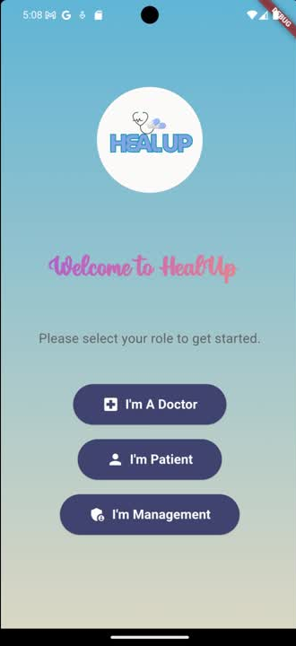



Welcome Page:

Slide 10
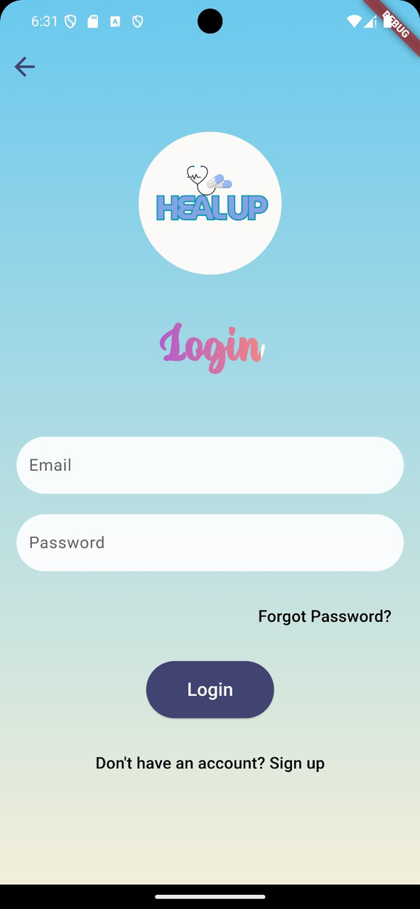
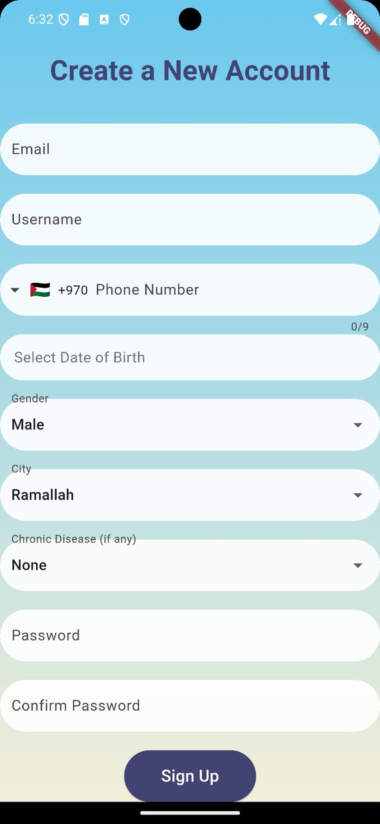
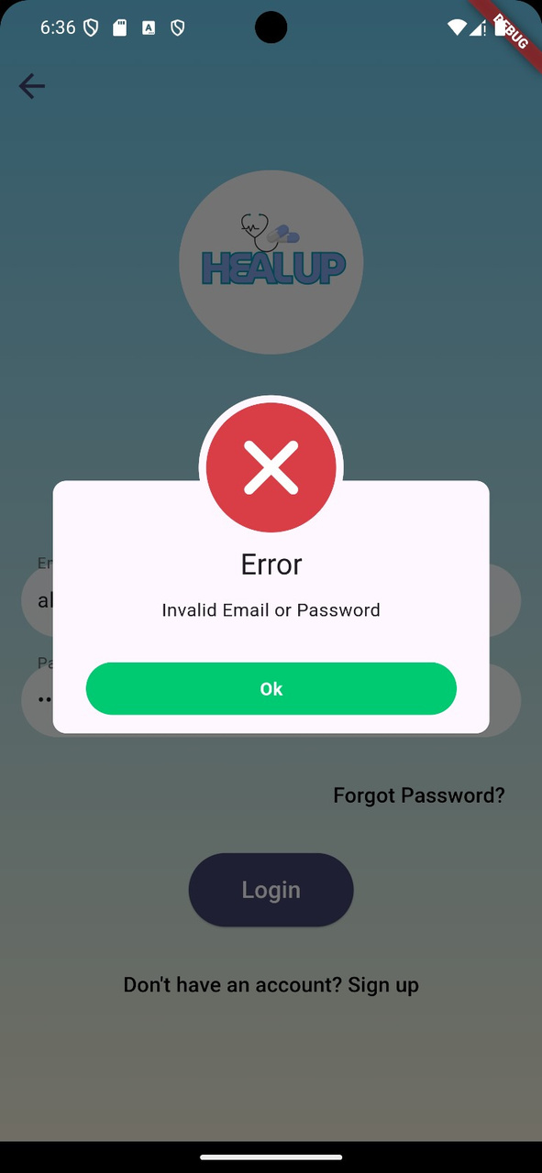
Patient Login & sign up

Slide 11
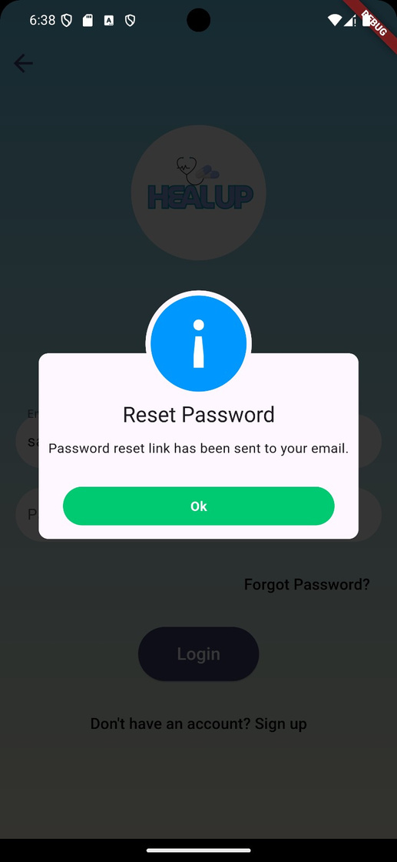
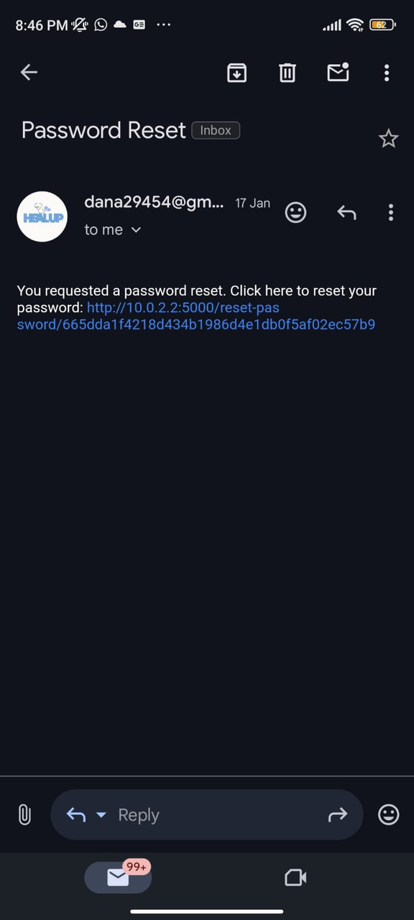
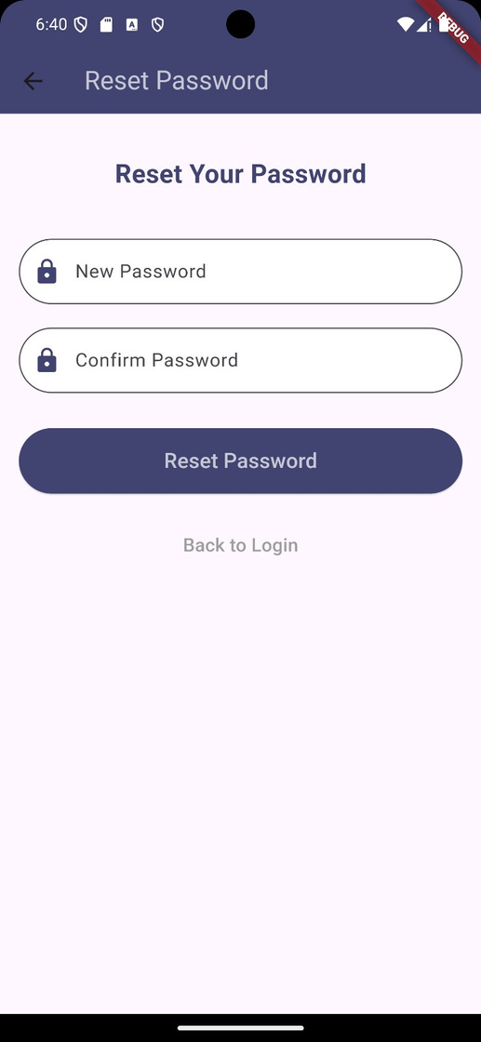
Reset Password

Slide 12
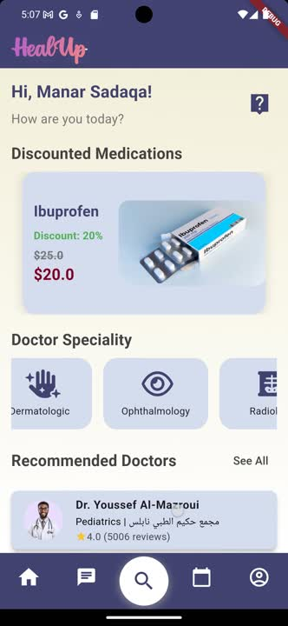


Home Page:

Slide 13
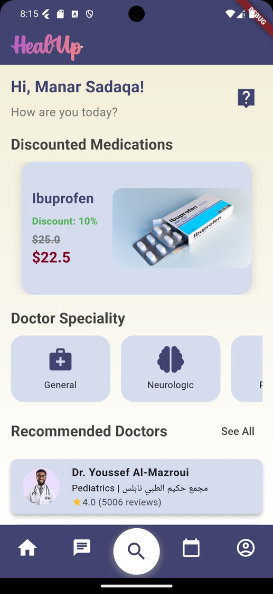
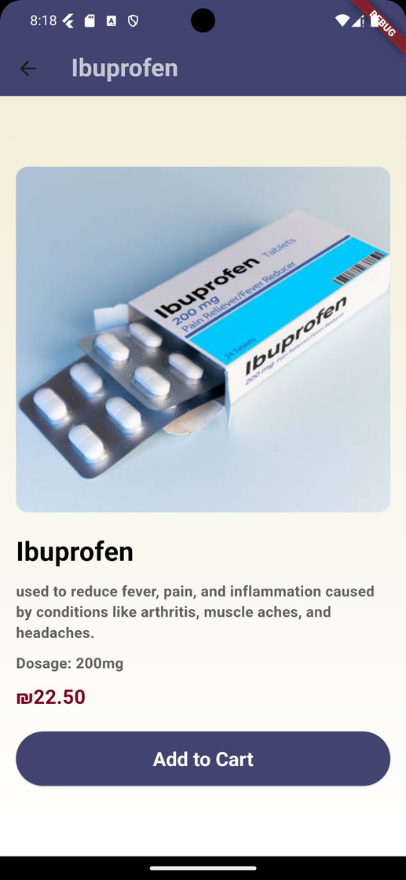
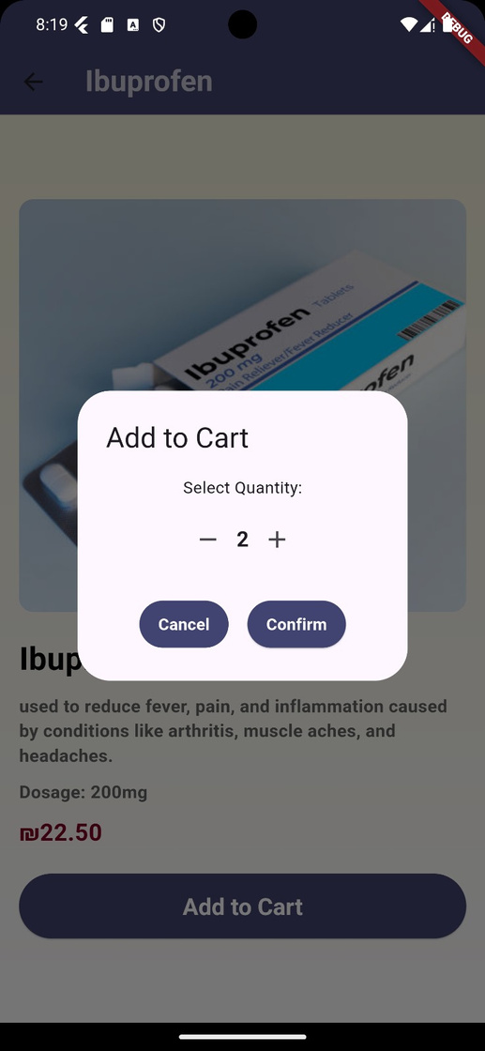
Discount Medication

Slide 14
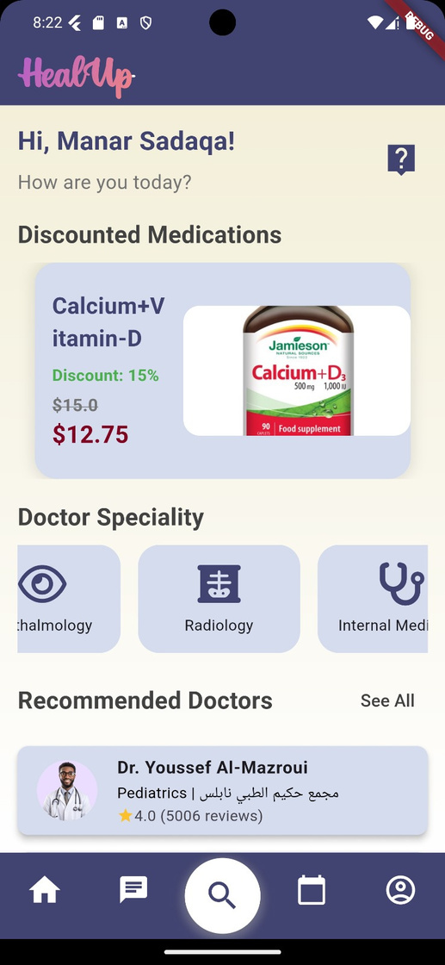
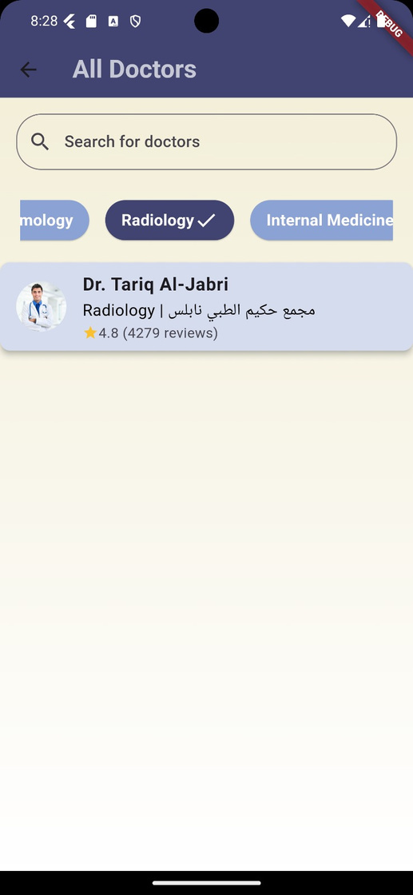
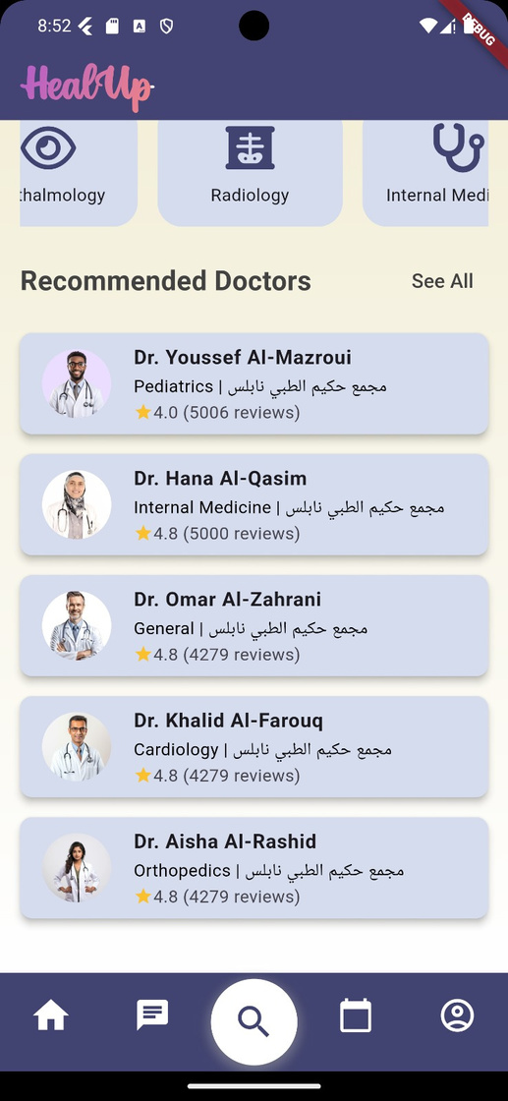
Doctors Speciality & Recommended Doctors

Slide 15
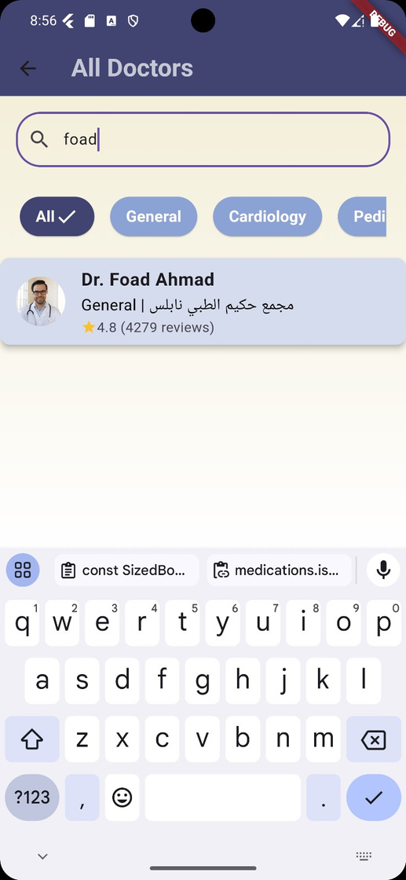
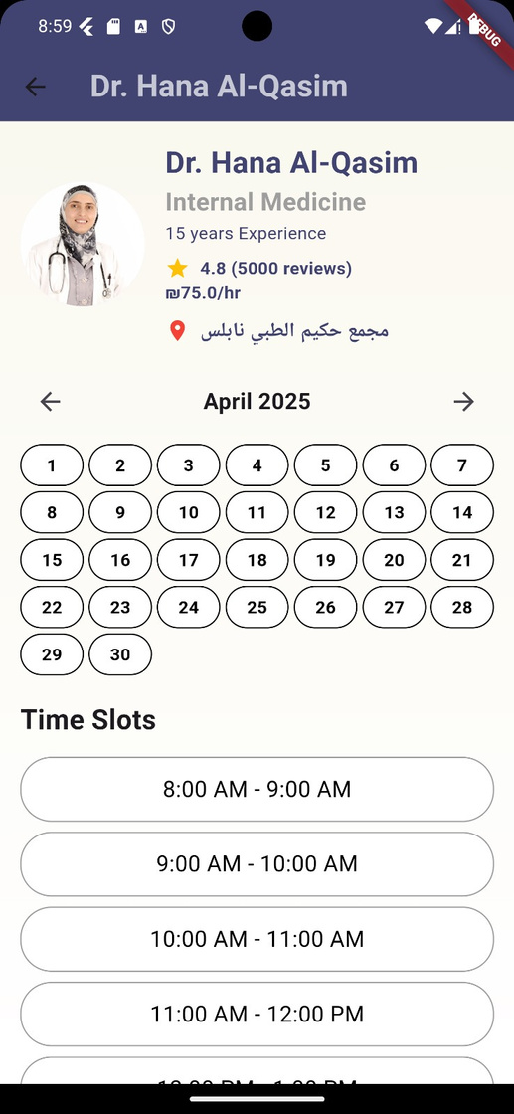
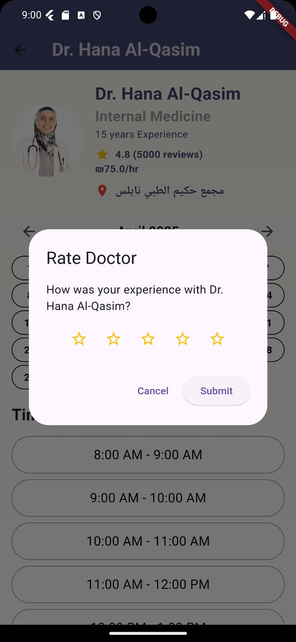
Book Appointemnt

Slide 16
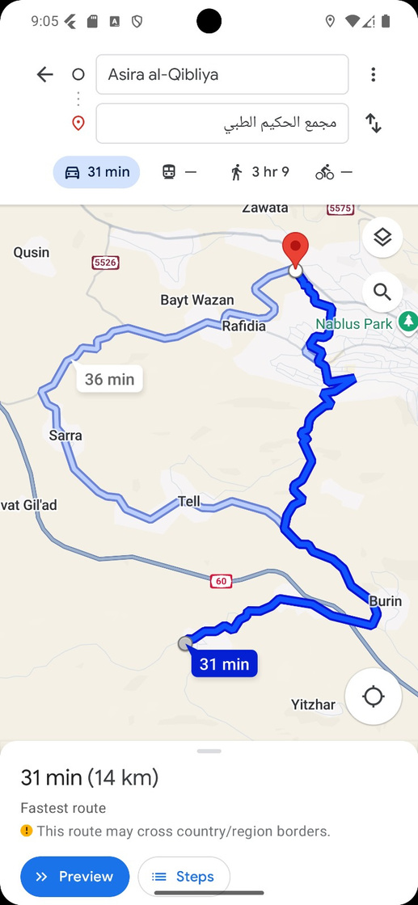
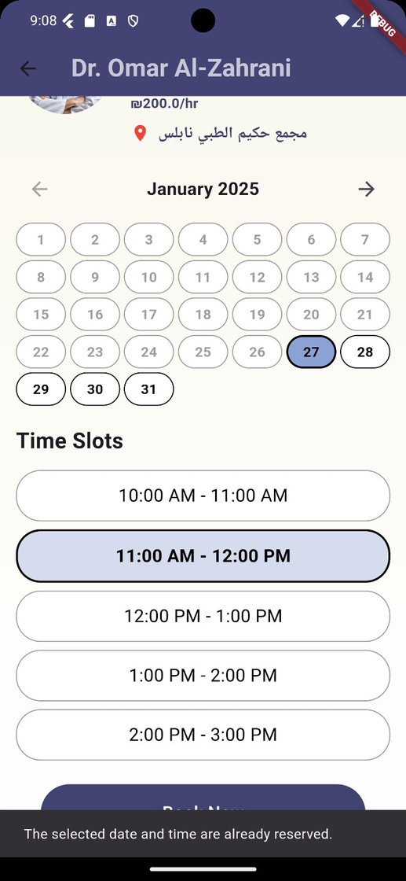
Book Appointemnt

Slide 17
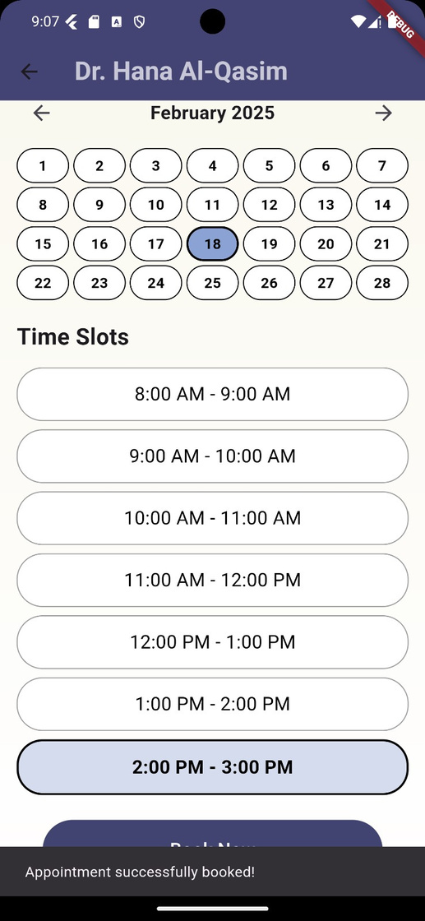
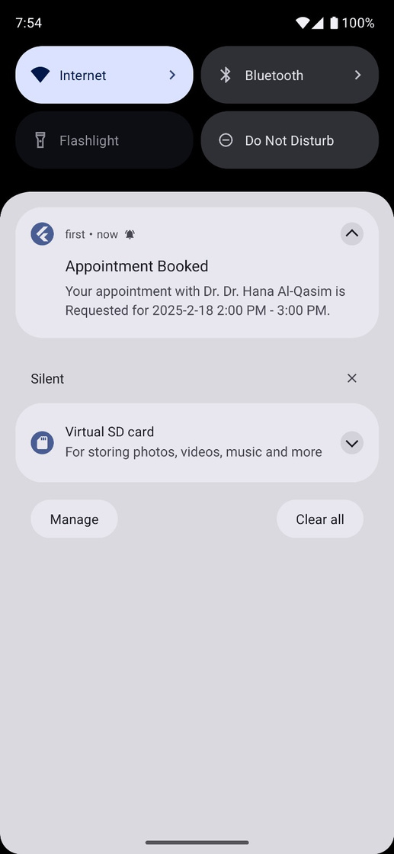
Book Appointemnt

Slide 18
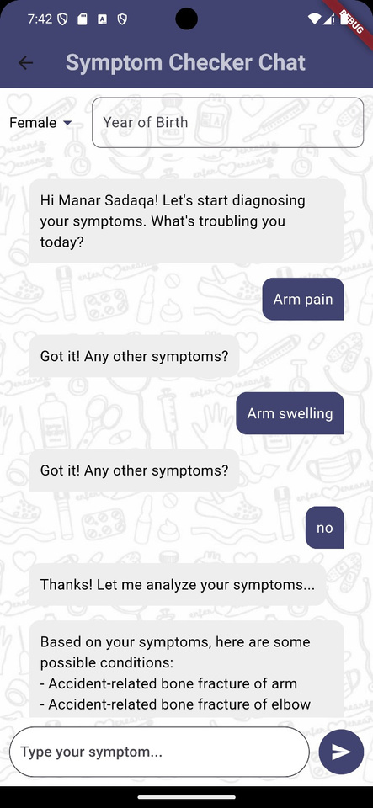
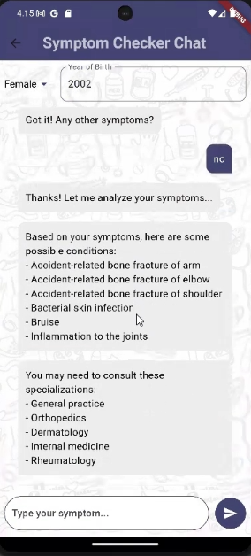

ChatBot:Symptom Checker Chat

Slide 19
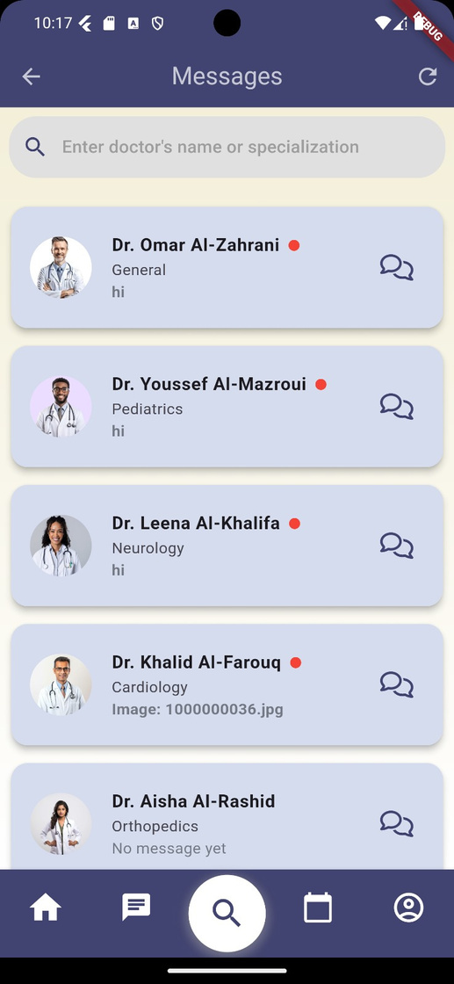
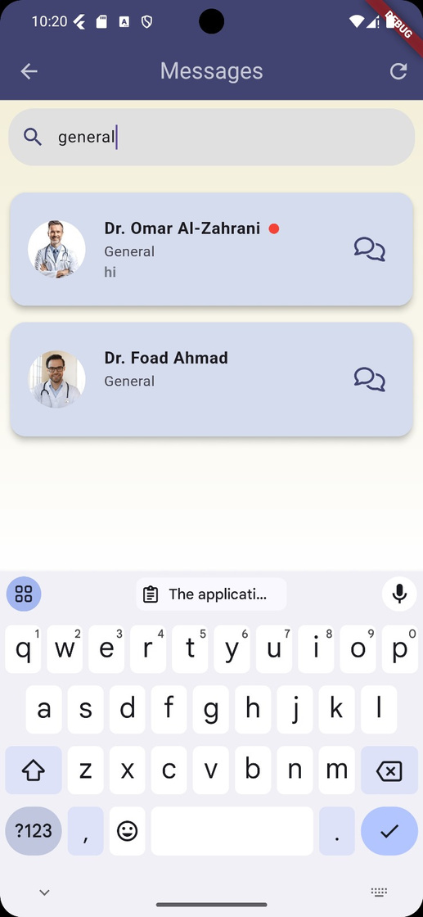
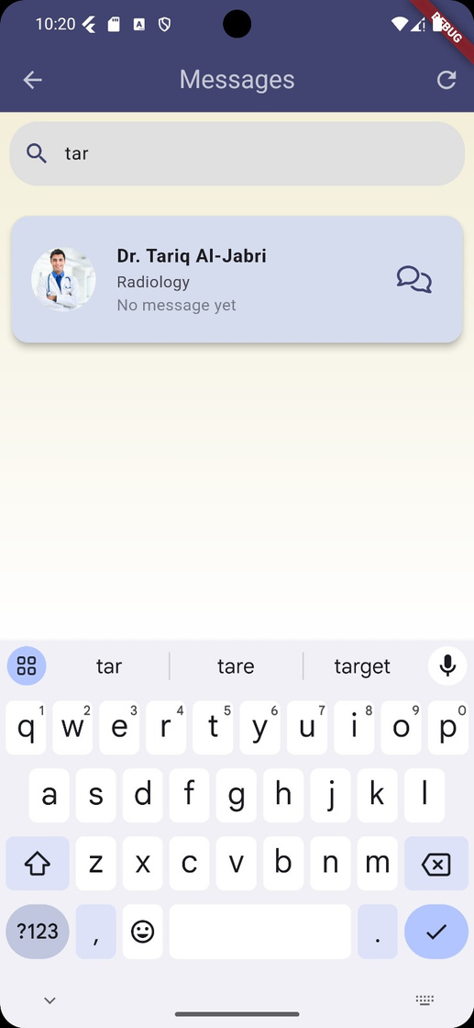
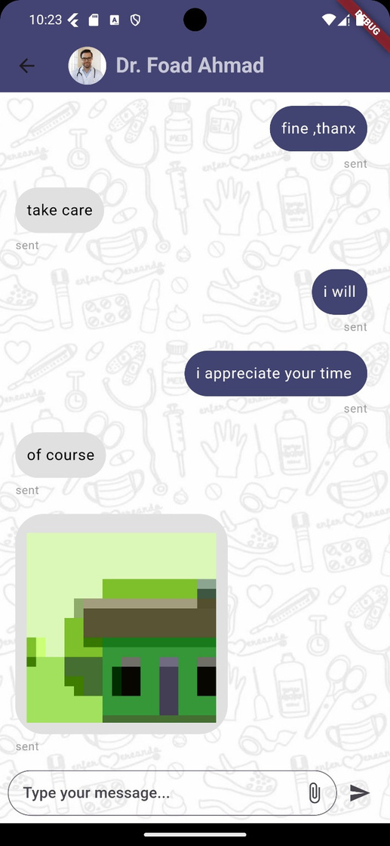
Patient Chat

Slide 20
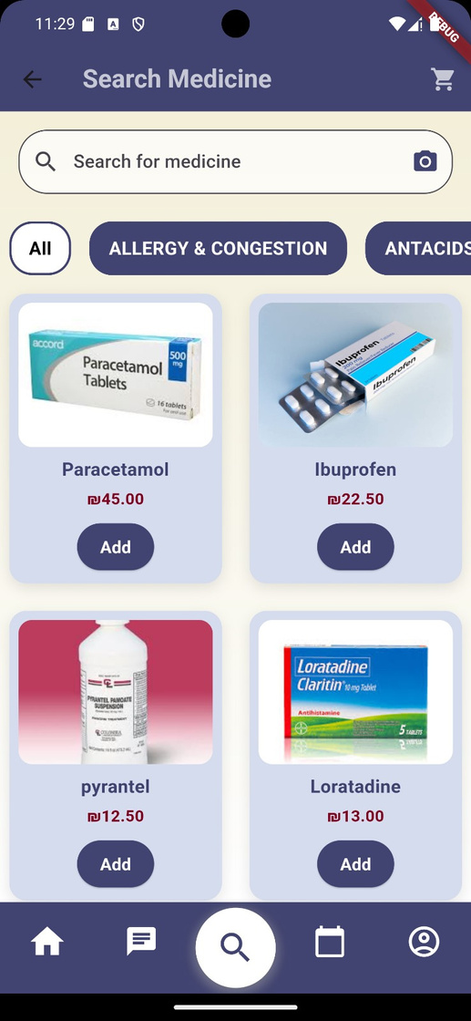
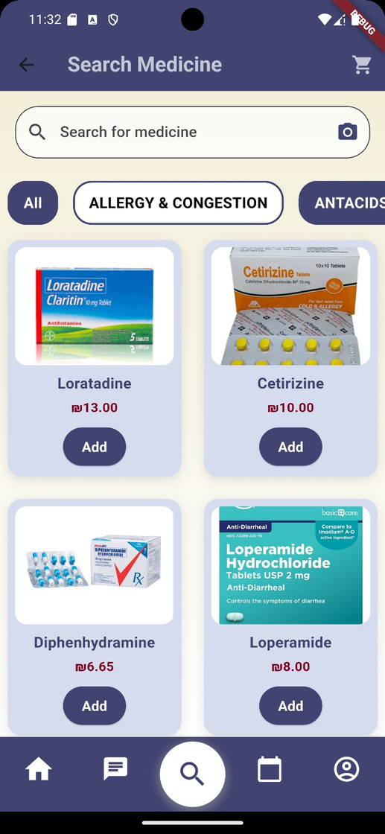
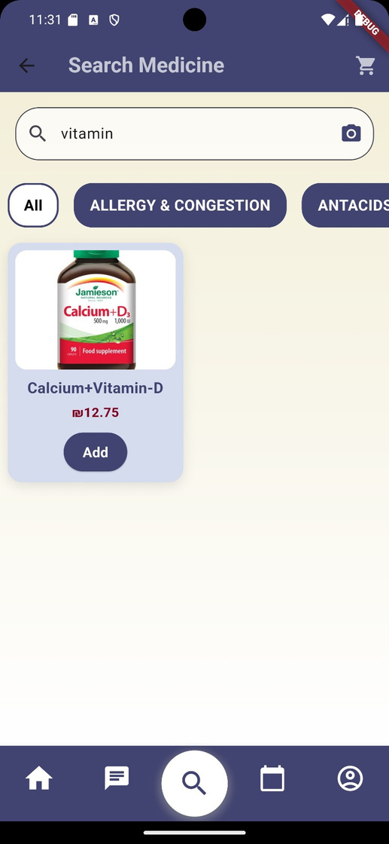
Search for medications.

Slide 21
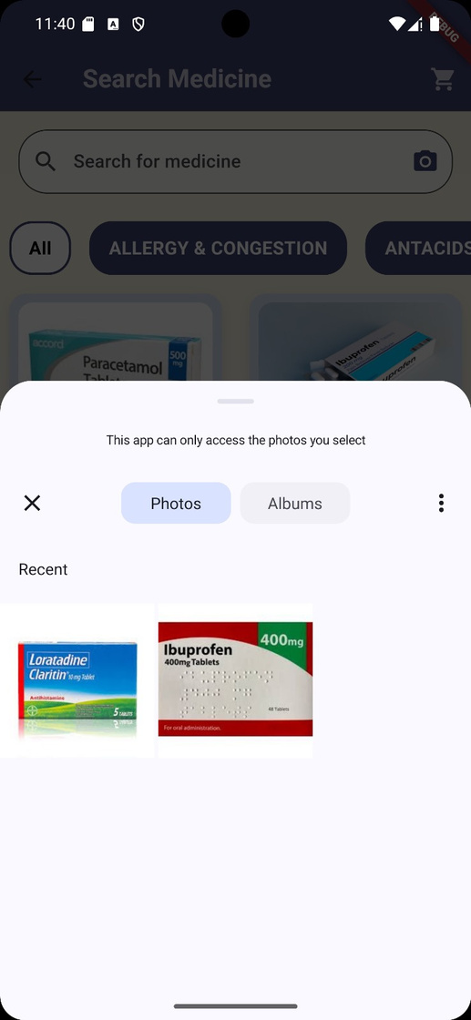
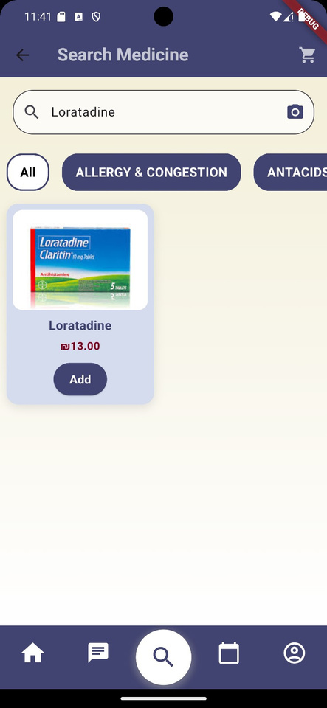
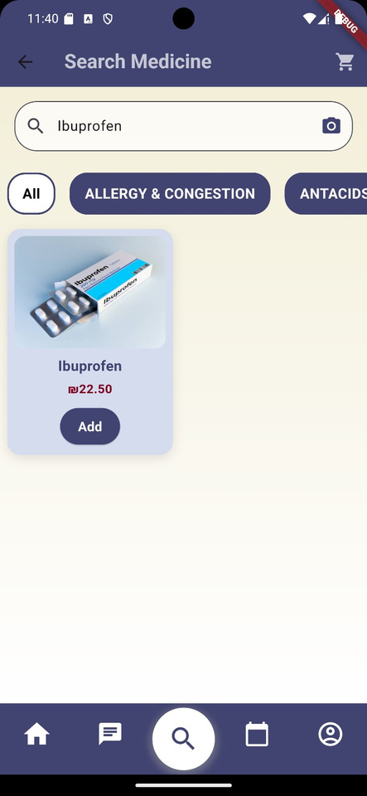
Search for medications by camera.

Slide 22
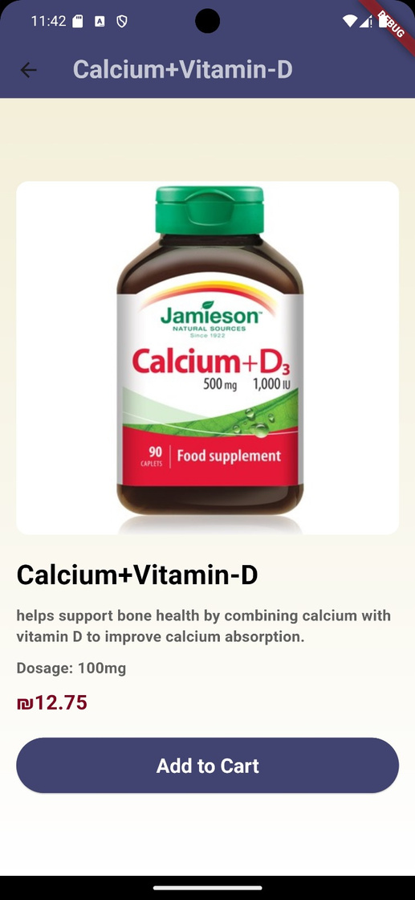
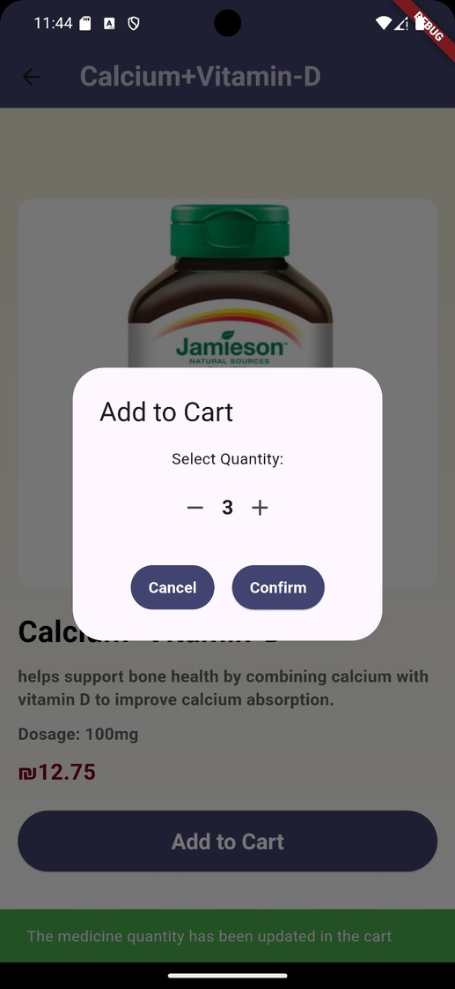
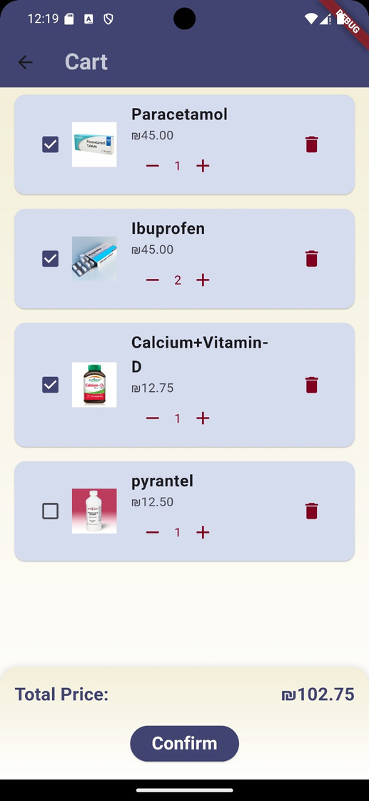
Order Medications.

Slide 23
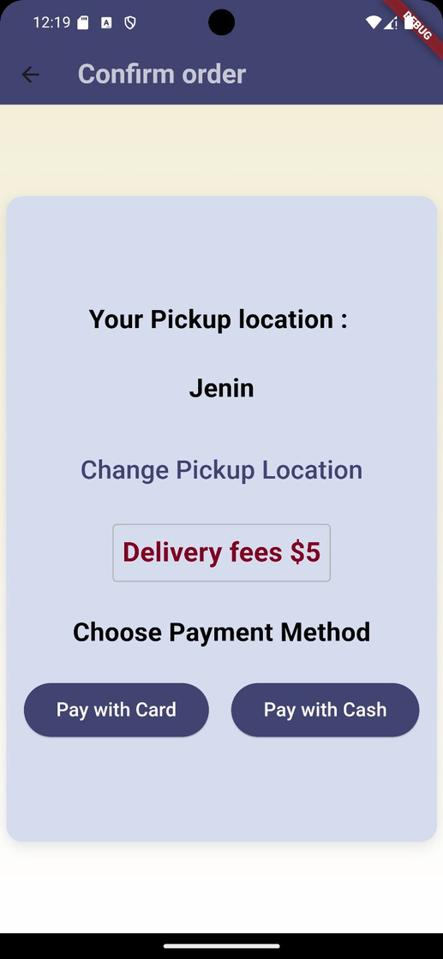
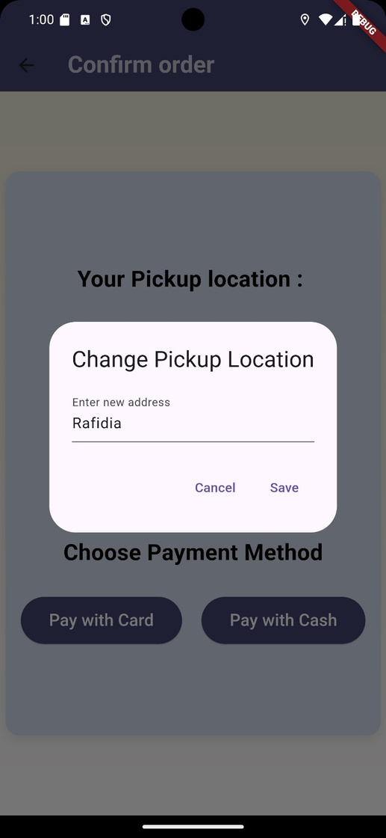
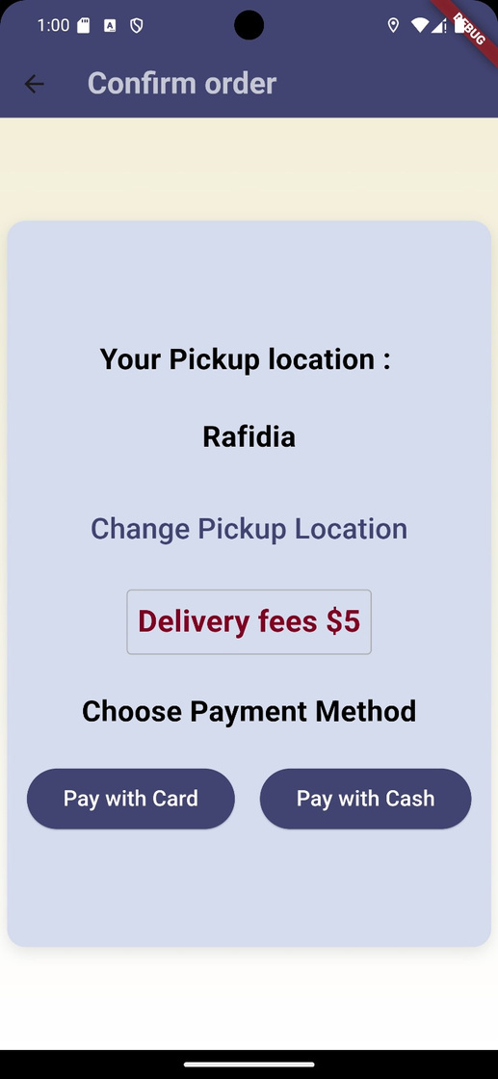
Confirm Order

Slide 24
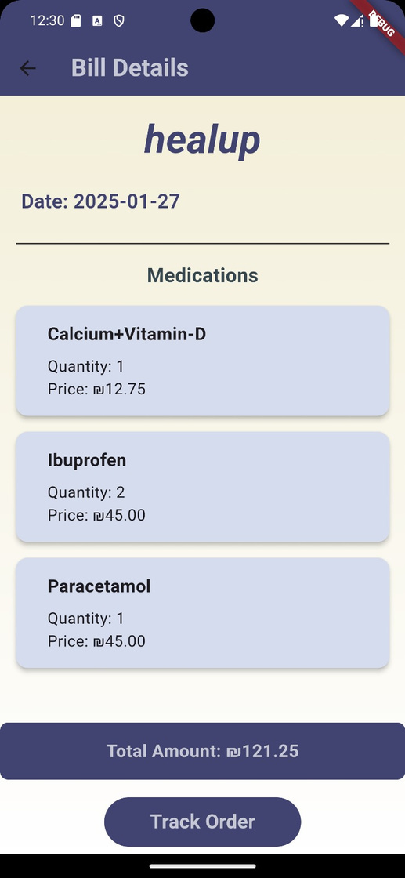
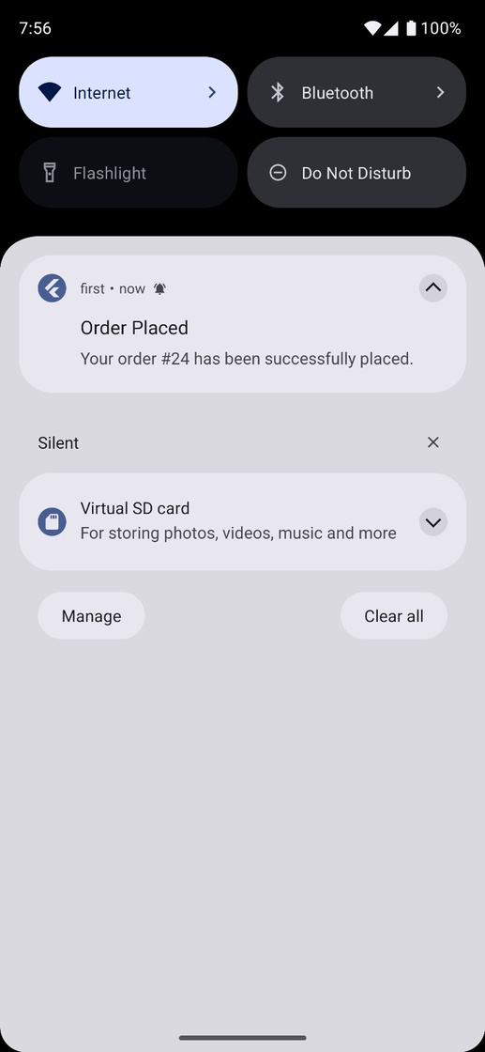
Payment Options: Cash

Slide 25
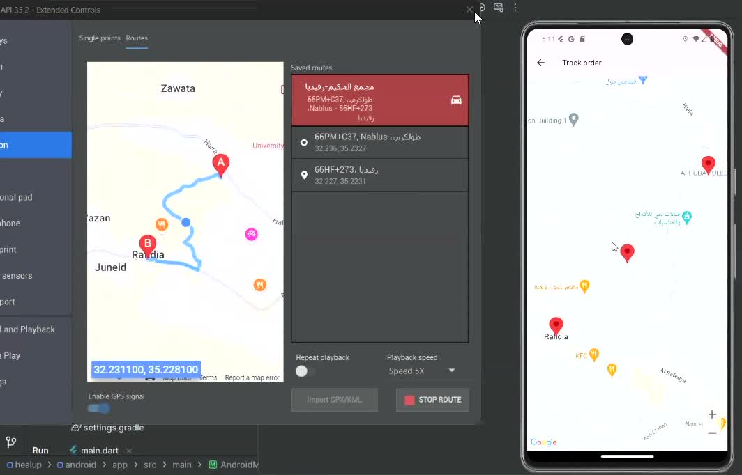
Tracking Orders

Slide 26
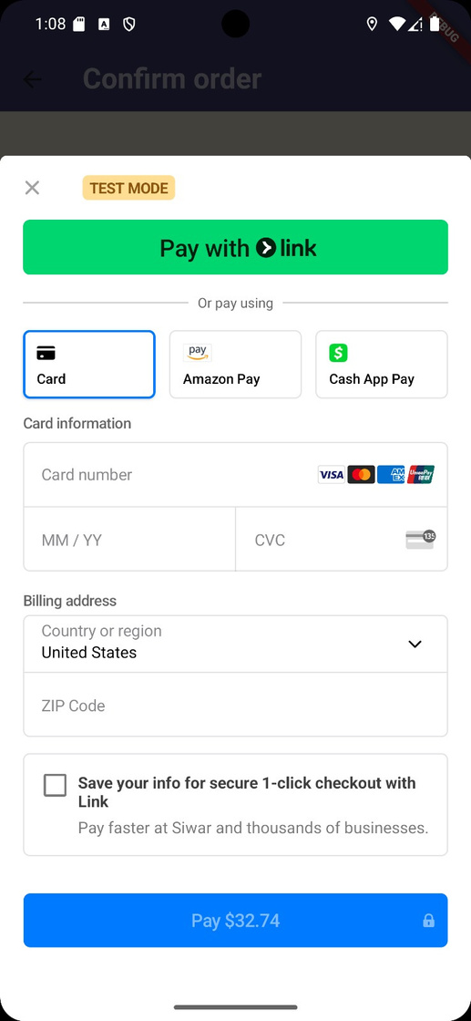
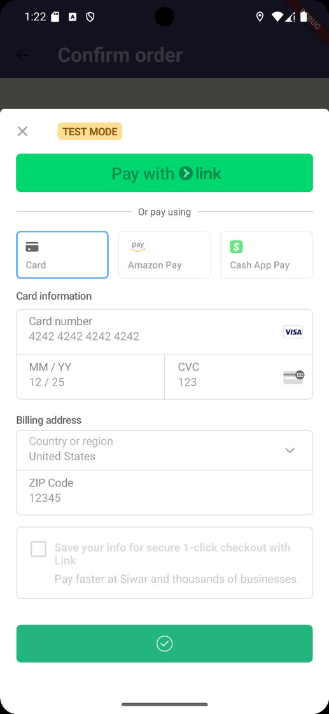
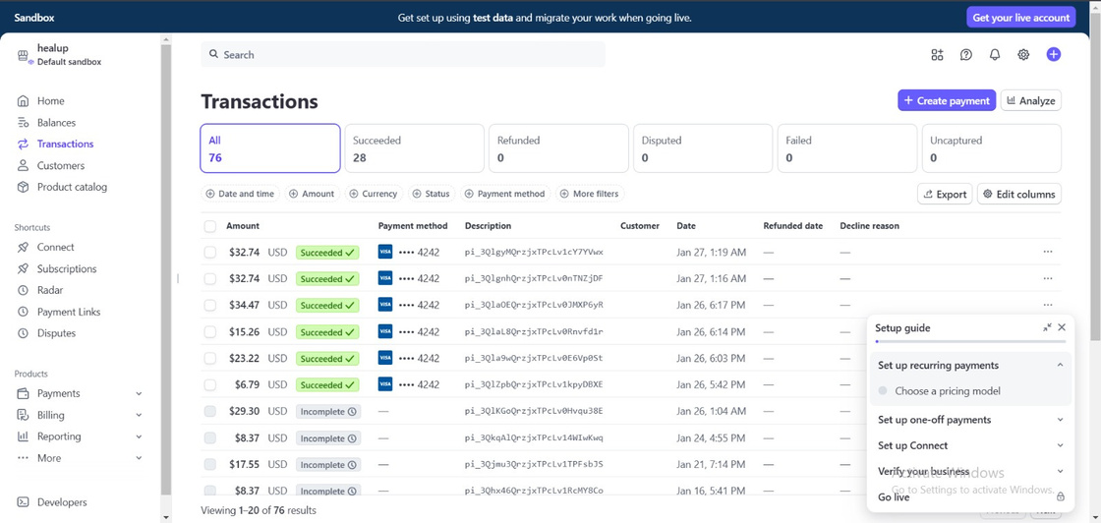
Pay With Card

Slide 27
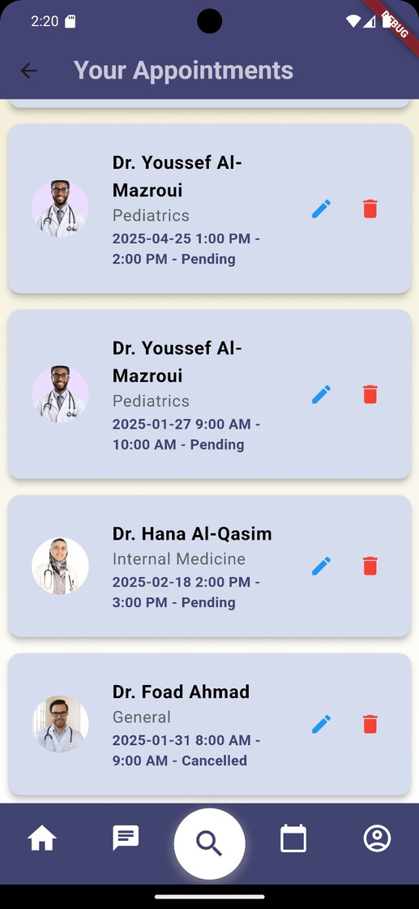
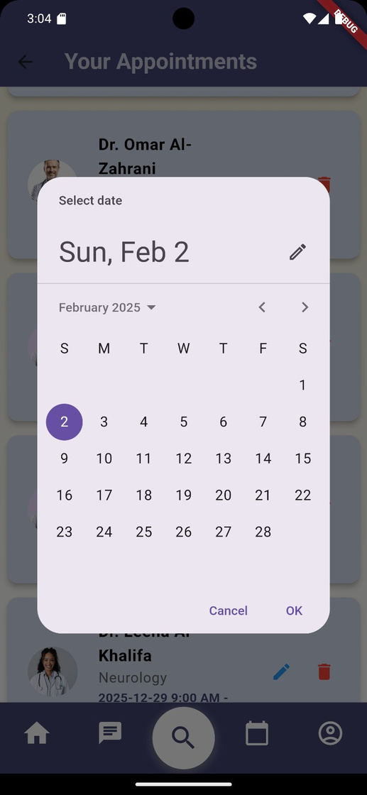
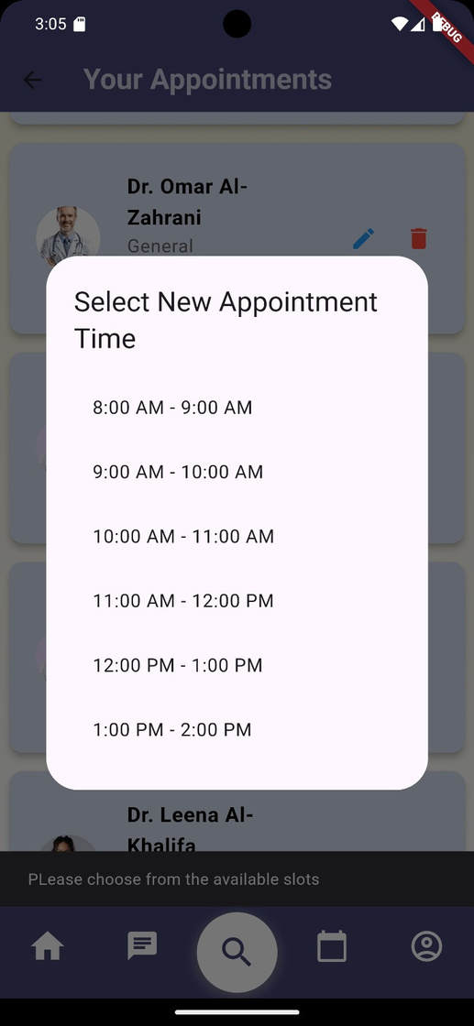
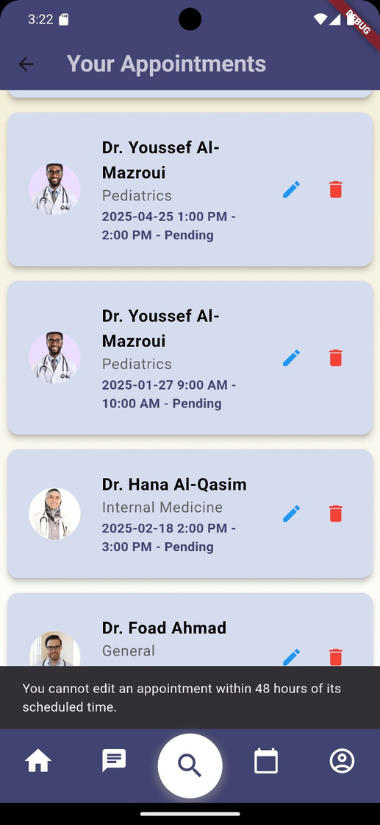

Schedule Appointemnt

Slide 28
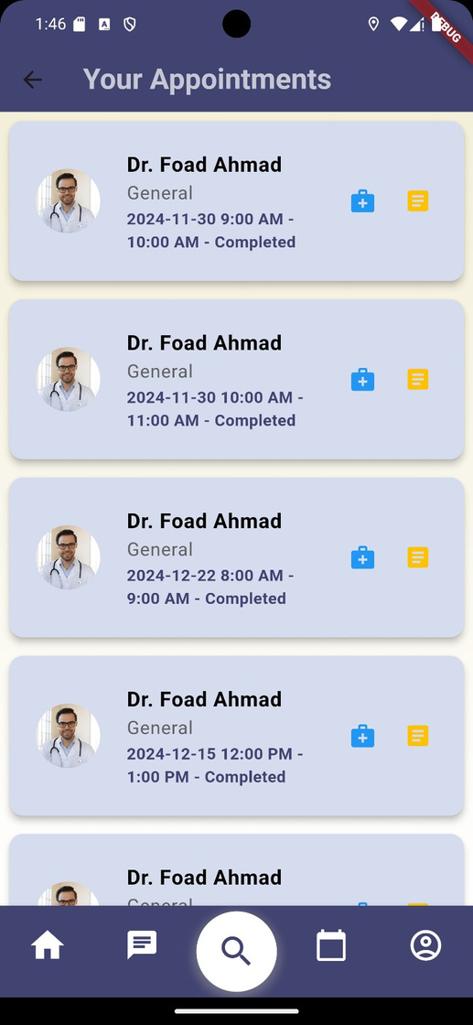


Order Prescription

Slide 29



Patient Report

Slide 30



Patient Profile

Slide 31




Settings

Slide 32


Notifications

Slide 33


MOBILE APPLICATION
DOCTOR

Slide 34


Doctor Login page:

Slide 35




Doctor Appointments

Slide 36



Doctor Appointments

Slide 37




Write a prescription for an appointment.

Slide 38


Write a prescription for an appointment.

Slide 39



Write a report for an appointment.

Slide 40



Search for Patient Old Records: By Patient Name

Slide 41



Search for Patient Old Records: By Doctor Name or Appointemnt Date

Slide 42



Doctor Chat tab : Doctors Section

Slide 43



Doctor Chat tab : Patient Section

Slide 44



Doctor Profile :

Slide 45




Settings

Slide 46
MOBILE APPLICATION
ADMIN

Slide 47


Admin Login page:

Slide 48



Patient List

Slide 49


Patient List

Slide 50



Doctors List

Slide 51




Doctors List

Slide 52




Medications List

Slide 53




Medications List

Slide 54




Medications List

Slide 55


Orders List:

Slide 56


Orders List:

Slide 57



Admin Page:

Slide 58




Admin Page:

Slide 59
WEBSITE
APPLICATION
PATIENT

Slide 60





Slide 61
WEBSITE
APPLICATION
DOCTOR

Slide 62



Slide 63
WEBSITE
APPLICATION
ADMIN

Slide 64



Slide 65

FUTURE WORK
01
MULTILINGUAL SUPPORT
02
DIGITAL WALLET INTEGRATION

Slide 66
FUTURE WORK
03
EXPANDED DATABASE
04
AI ENHANCEMENTS

Slide 67
THANK YOU

