Slide 1

An-Najah National University
Faculty of Engineering & Information Technology
Department of Building Engineering
A comprehensive design of a Reformatory
Ehab Abu Dher
Insaf Majdi
Ithar Rezq
Lamees Marayta
← Prepared by →
Supervisor: Haitham Sawalha

Slide 2
Outline:
Definition of the Reformatory.
Architectural Design.
Environmental Design.
Structural Design.
Mechanical And Safety Design.
Electrical design.
Quantity Survey And Cost Estimation.
1
1

Slide 3
What is the Reformatory
Reformatory: is an institution where young offenders are sent as an alternative of prison.
Main goal: to rehabilitate and make them good citizens in their countries.

Slide 4
Architectural Aspects

Slide 5
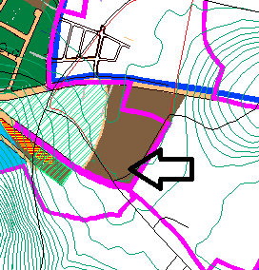
Site Analysis
Annual average of humidity
(61%).
20,000 m²
BN 38dB
Wind speed 10 Km/hr.

Slide 6
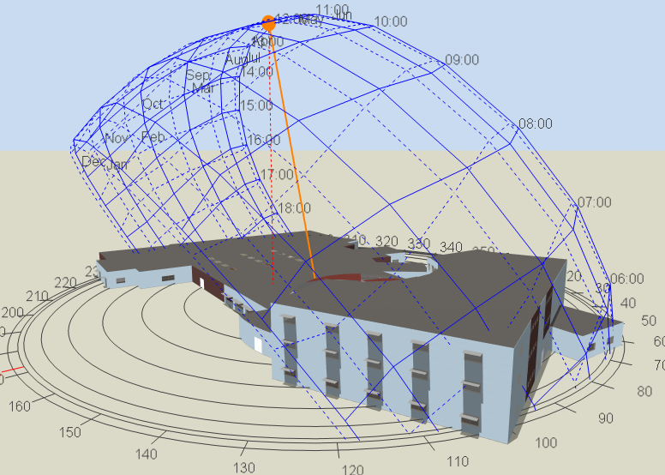
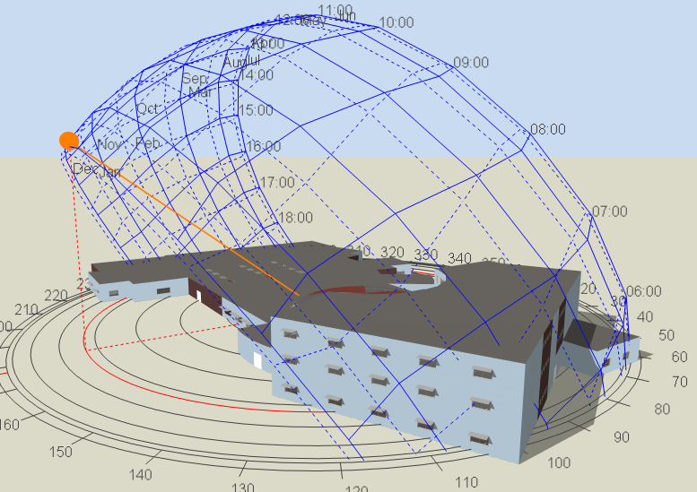
Sun path
Summer:
Winter:

Slide 7
Reformatory departments
Dormitories.
Security
Educational
Public Services.
Administration
Parking
Vocational

Slide 8
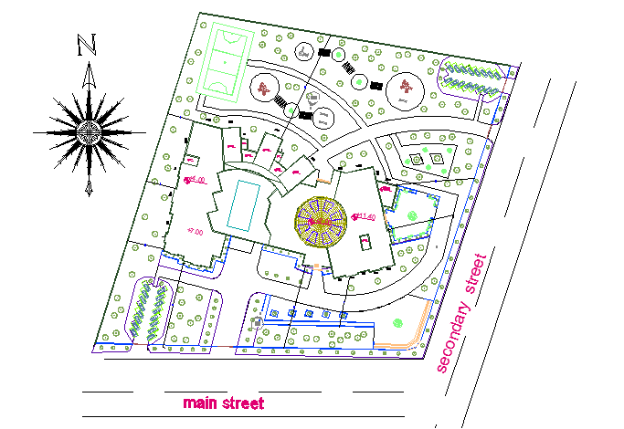

Slide 9
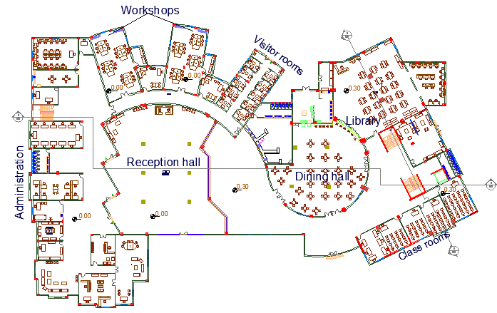
Ground Floor plan:

Slide 10
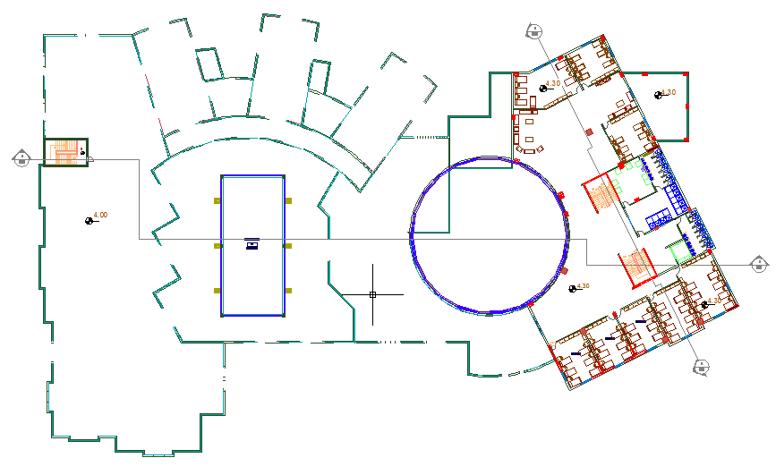
First Floor plan:

Slide 11
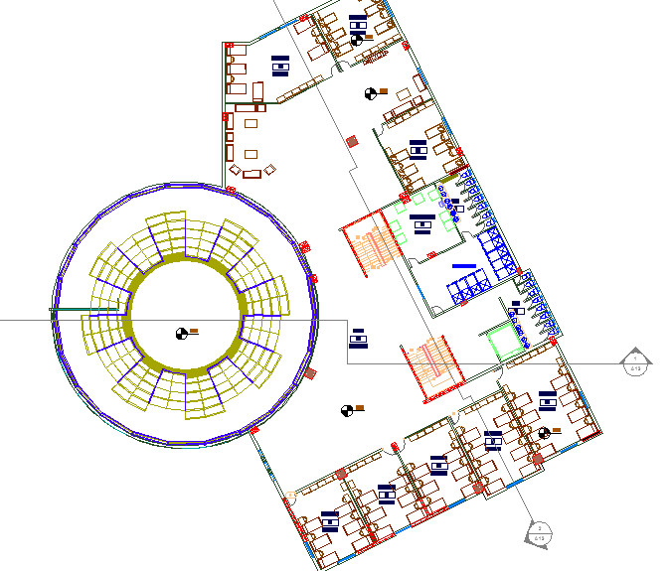
Second Floor plan:

Slide 12
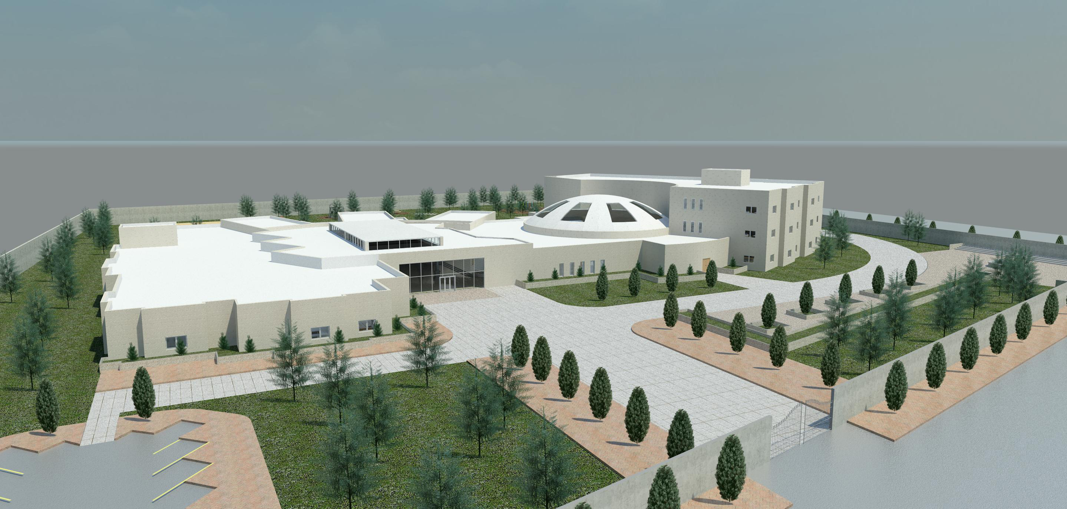
General view of the reformatory:

Slide 13
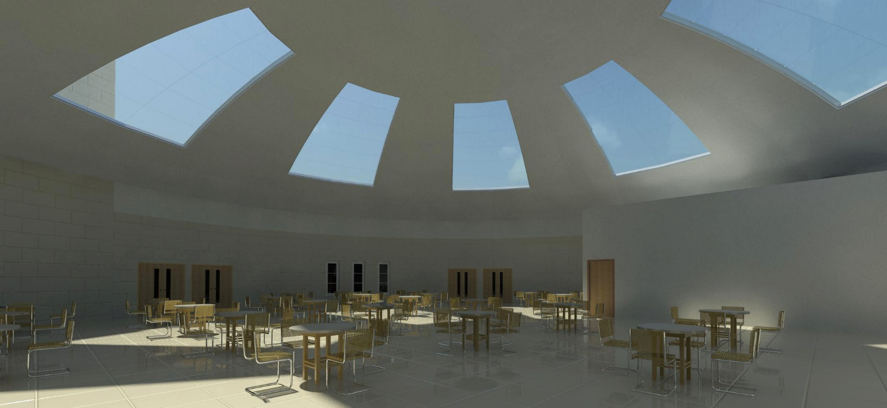
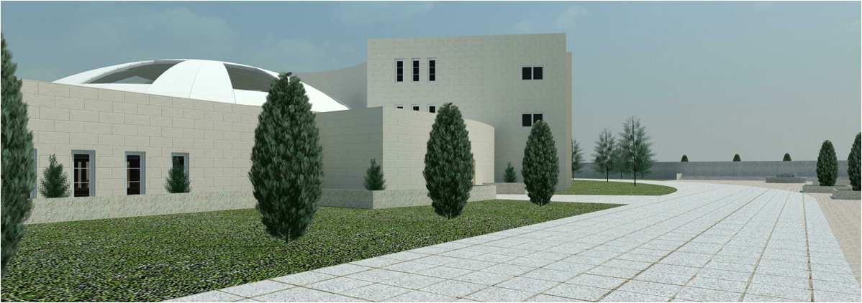
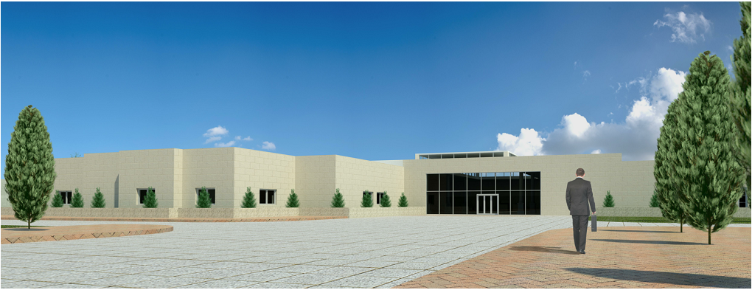
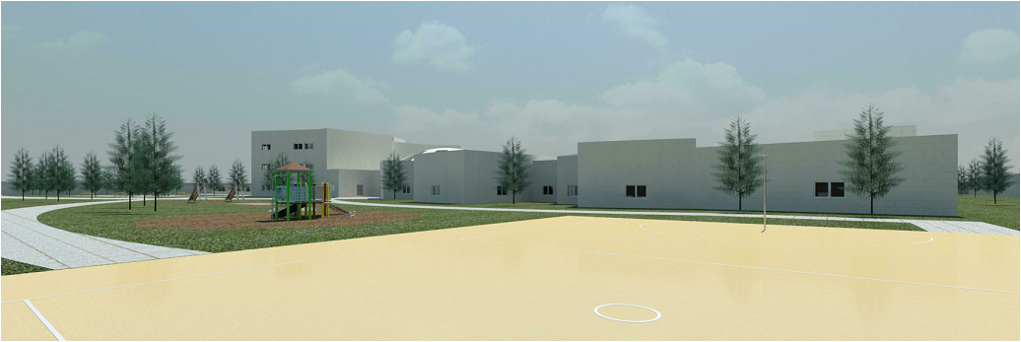
Some views from the reformatory

Slide 14
Some views from the reformatory

Slide 15
Some views from the reformatory

Slide 16
Some views from the reformatory

Slide 17
Environmental Aspects

Slide 18
Environmental Aspects
Environmental Aspects
Thermal and energy simulation.
Acoustical Analysis.
Natural lighting analysis.

Slide 19
Thermal Analysis
External wall (30cm)
Roof:
Floor:
Limestone (50 mm)
Concrete (80 mm)
Polystyrene (50 mm)
Block (100 mm)
Plaster (20 mm)
Asphalt (10 mm)
Concrete foam (40 mm)
Polyurethane (50 mm)
Concrete (200 mm)
Plaster (10 mm)
Tiles (10 mm)
Mortar (30 mm)
Sand (150 mm)
Polystyrene (50 mm)
Concrete (300 mm)
U-Value = 0.525 W/m2.k
U-Value = 0.45 W/m2.k
U-Value = 0.9 W/m2.k

Slide 20
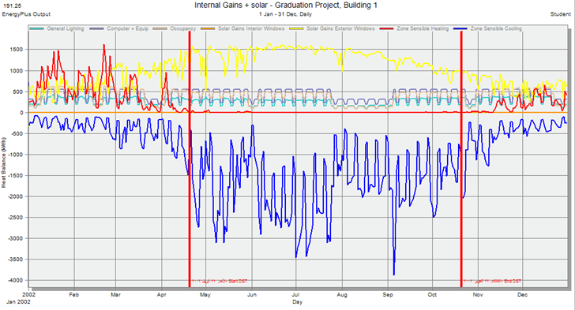
Energy simulation
Maximum Cooling = 523.41 kW
Maximum Heating = 361.14 kW

Slide 21
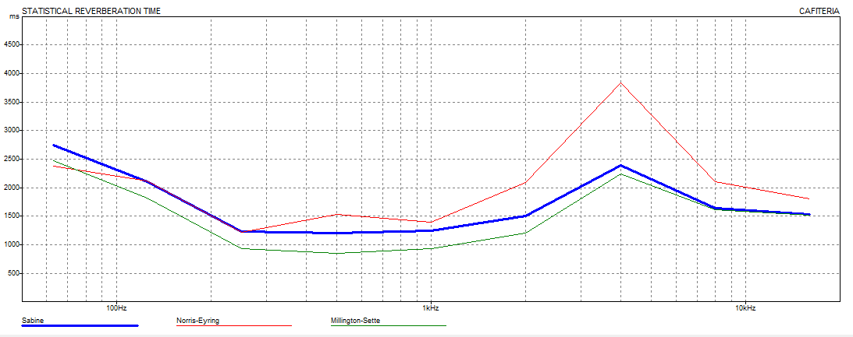
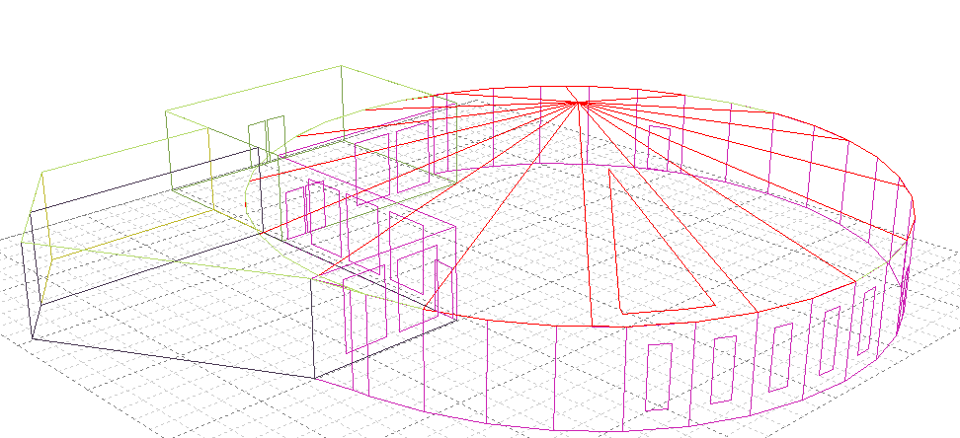
Acoustical analysis
Reverberation time (RT60):
Cafeteria:
RT60 range (1 – 1.8)
Freq. | Total Absorption. | Sabine RT(60) | NOR-ER RT(60) | MIL-SE RT(60)
63Hz | 183.3 | 2.75 | 2.38 | 2.48
125Hz | 238.8 | 2.11 | 2.12 | 1.82
250Hz | 409.5 | 1.28 | 1.21 | 0.93
500Hz | 420.4 | 1.20 | 1.53 | 0.85
1kHz | 402 | 1.25 | 1.40 | 0.94
2kHz | 322.1 | 1.51 | 2.09 | 1.21
4kHz | 156.8 | 2.39 | 3.83 | 2.25
8kHz | 100.2 | 1.64 | 2.11 | 1.61
16kHz | 90.8 | 1.53 | 1.81 | 1.51

Slide 22

Room | DF %
Classroom | 3.584
Bedrooms | 4.139
Computer room M | 4.918
Director | 4.414
E-Learning G.F | 6.484
Internal Space | 3.857
Supervisor | 2.701
Teachers Room G.F | 5.066
Visitors M | 3.369
Natural Lighting
  Natural Lighting:
  Avg. DF for the building
  Daylight factor for some of the main spaces:

Slide 23
Structural Design

Slide 24
Design Data:
Concrete Fʹc = 24 MPa for slabs.
Concrete Fʹc = 28 MPa for beams, columns, and footings.
Allowable Bearing Capacity of Soil = 200 kN/m²
Loads:
Super imposed load = 6.6 kN/m²
Live load = 3.5 kN/m²

Slide 25
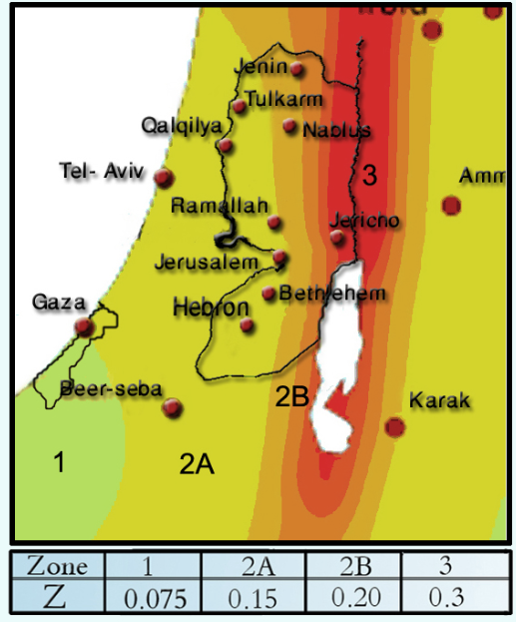
Seismic Design Data
Standard Occupancy, I = 1.0
Soil Profile Type is SD
R = 5.5
Ca = 0.28
Cv= 0.4
Location → Nablus
Zone =2B → Z=0.20

Slide 26
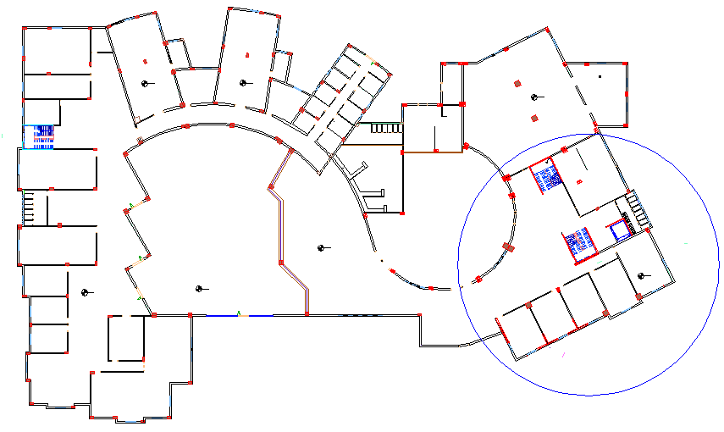
Structural plan

Slide 27
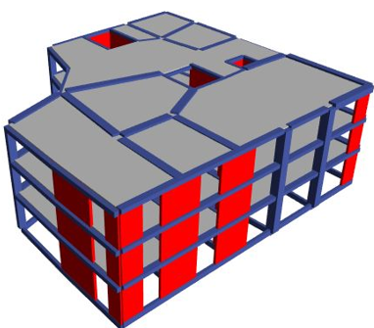
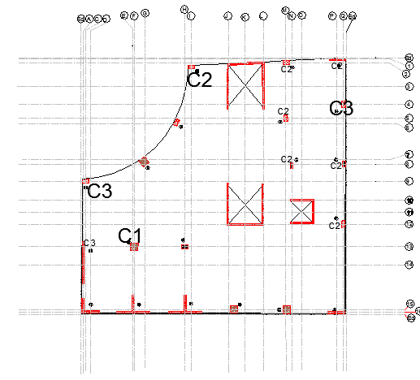
Plan of structural designed block
Model from ETABS
2500m2@3floors

Slide 28
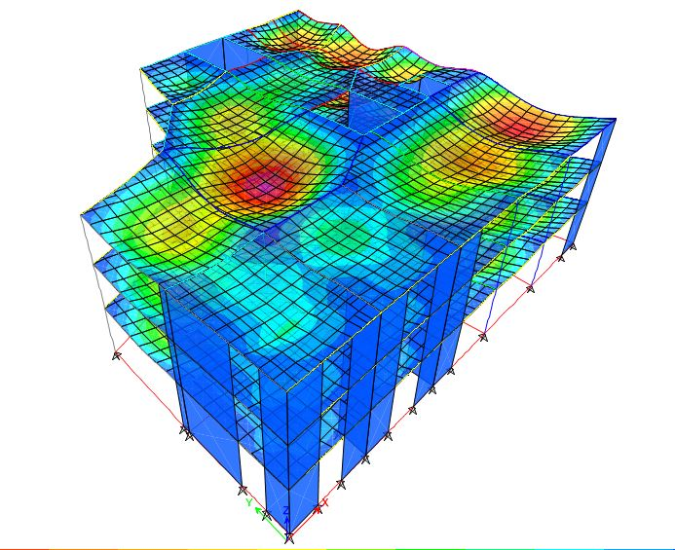
Deformed shape of the building:
The model is valid for:
1- Compatibility.
2- Equilibrium.
3- Stress & Strain relationship.

Slide 29
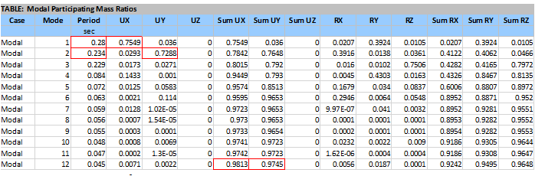
Dynamic checks:
Period check:
→ T standard = 0.4409 sec
→ From ETAB 0.28

Slide 30
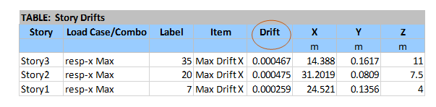
Drift check:
Maximum drift available = 7.1 mm
Story drifts in X-Direction:

Slide 31
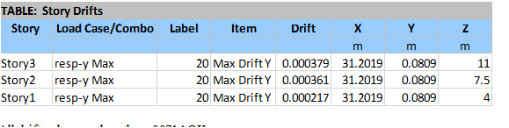
Drift check:
Story drifts in Y-Direction:

Slide 32
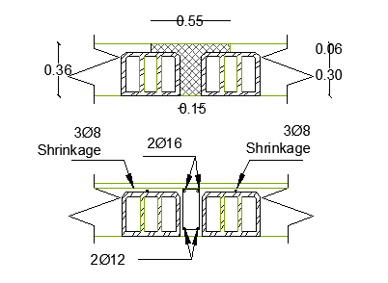
Results:
1) Slab design:
Reinforcement:
Thickness= 360mm
2∅12 mm/rib
As shrinkage 3∅8 mm/m

Slide 33
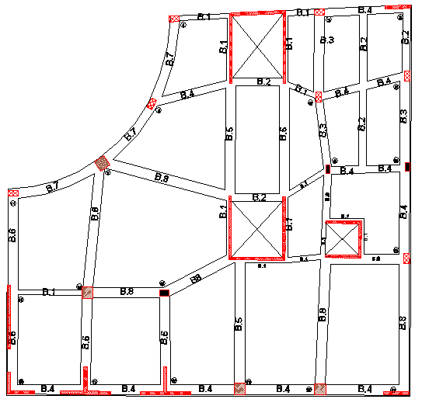
layout

Slide 34
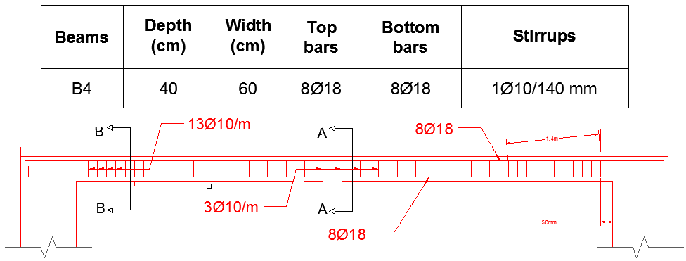
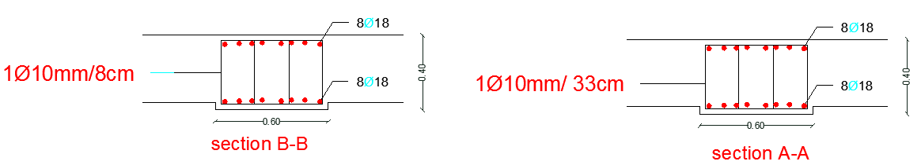
Beam design details:

Slide 35
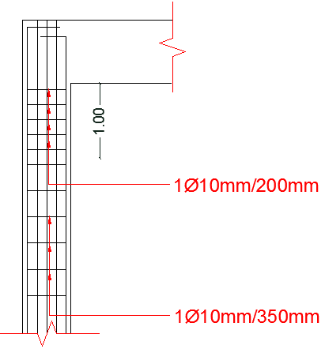
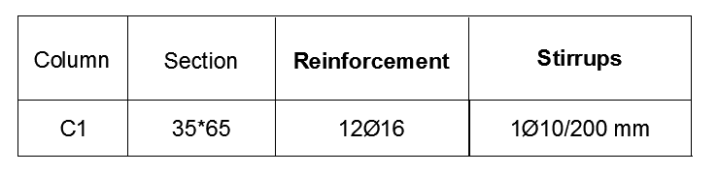
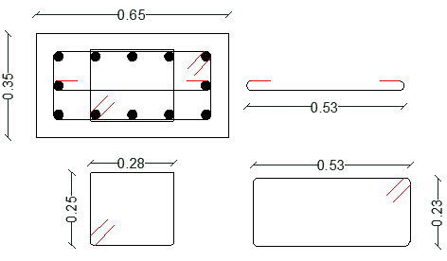
3) Column 1 design details:

Slide 36
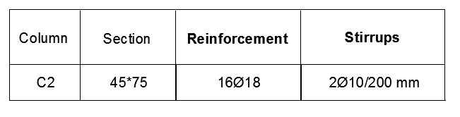
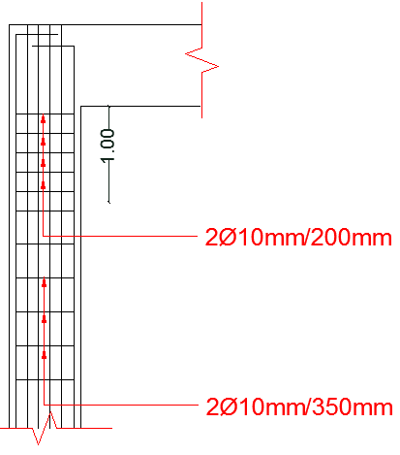
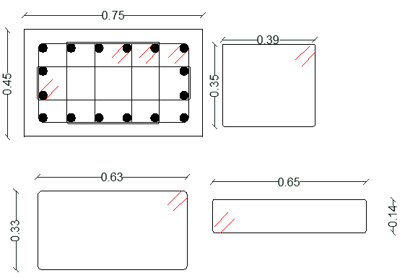
Column 2 design details:

Slide 37
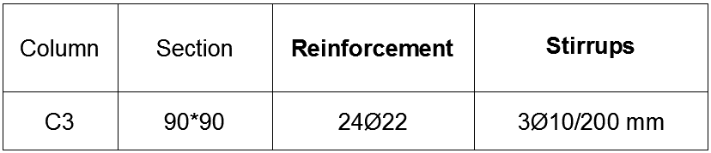
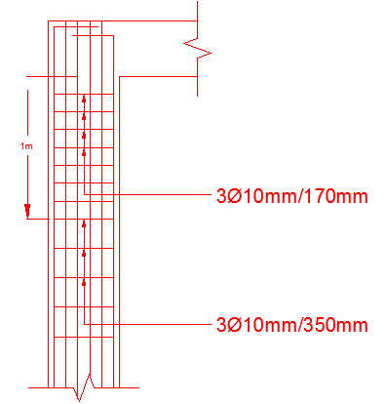
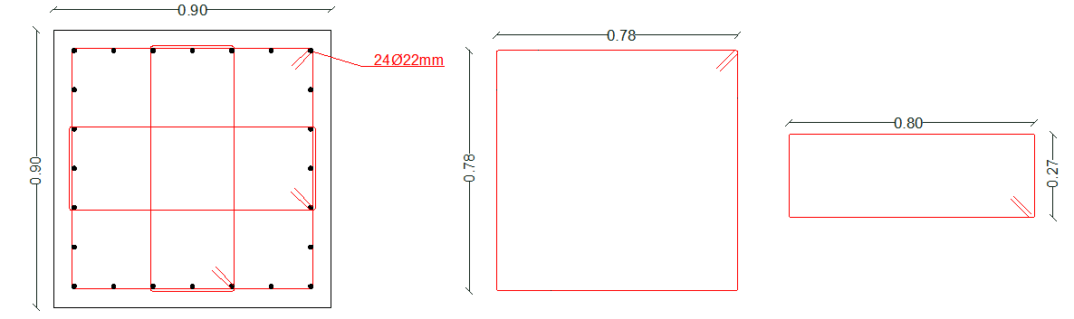
Column 3 design details:

Slide 38
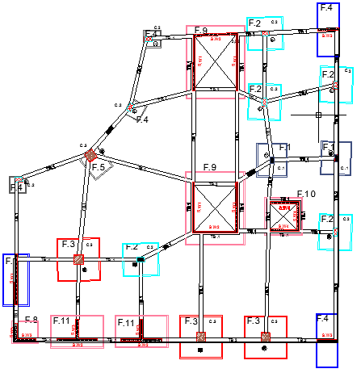
4) Footings
Distribution layout

Slide 39
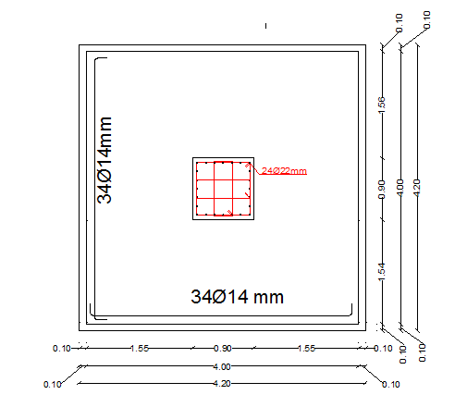
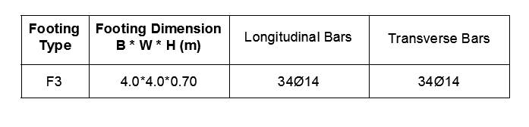
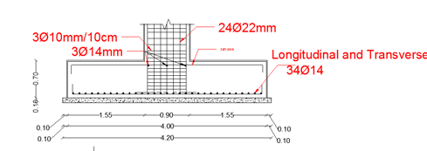
Footing 3 design details:

Slide 40
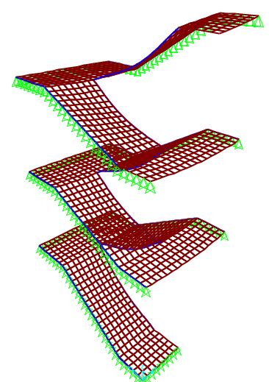
5) Stairs design
Stair model on SAP

Slide 41
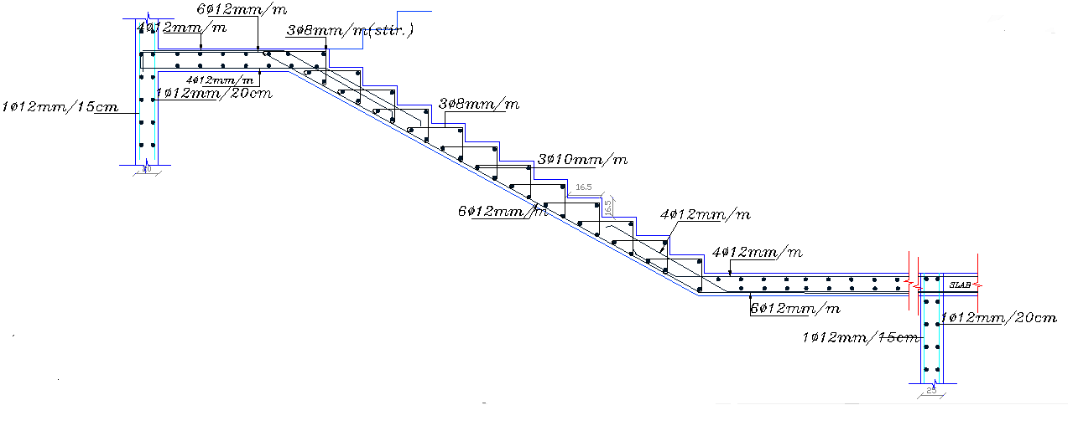
Stairs design details
→ Take A_{s,min} = 450mm² → 4Φ12/m

Slide 42
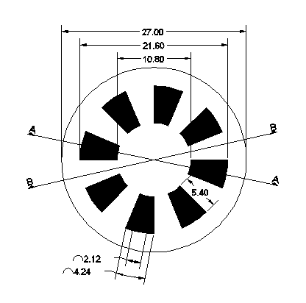
5) Dome design
Hoop Direction:
Use 8∅12 mm/m in the hoop direction.
Use 4∅12 mm/m as two faces.
Meridian Direction:
Use 8∅12 mm/m in the Meridian direction.
Use 4∅12 mm/m as two faces.

Slide 43
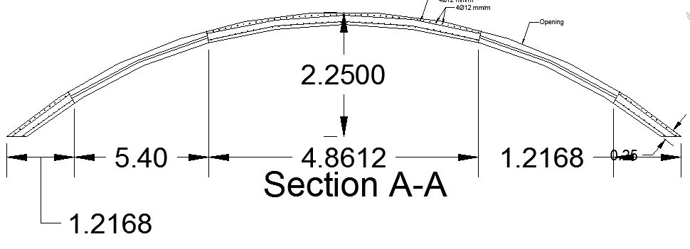
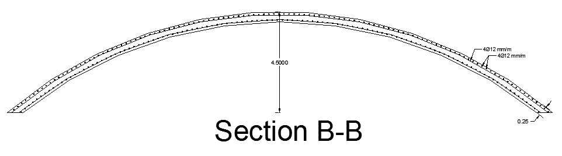
Dome design details

Slide 44
Mechanical Aspects

Slide 45
Mechanical Aspects
HVAC system.
Water supply.
Sanitation system.
Fire resistance system
Mechanical Aspects

Slide 46
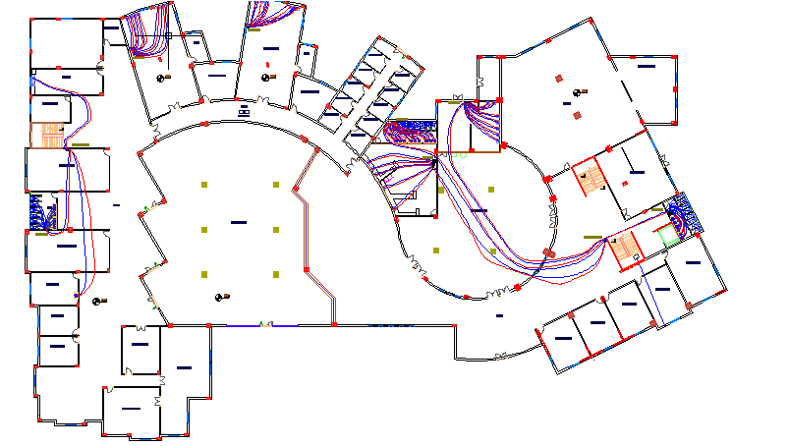
1) Water supply system

Slide 47
Water supply system
Administration unit:
Floor/Pipe | Vertical | Horizontal | Branch
Ground floor | 1.5 in | 1.5 in | ¾ in
Workshop unit:
Floor/Pipe | Vertical | Horizontal | Branch
Ground floor | 1.5 in | 1.25 in | ¾ in

Slide 48
Water supply system
Rest units:
Floor/Pipe | Vertical | Horizontal | Branch
Ground floor | 1.5 in | 1.5 in | ¾ in
First floor | 1.5 in | 1.5 in | ¾ in
Second floor | 1.5 in | 1.5 in | ¾ in

Slide 49
2) Sanitation system
Each W.C represents 4Dfu…………. pipe 4".
Each Lavatory represent 1Dfu…………… pipe 2".
Each kitchen sinks Represent 2Dfu………… pipe 2".
Main stack 4". Use ventilation stack 4''.

Slide 50
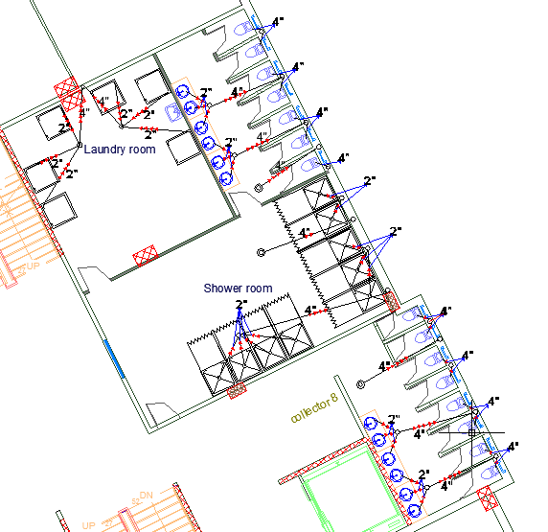
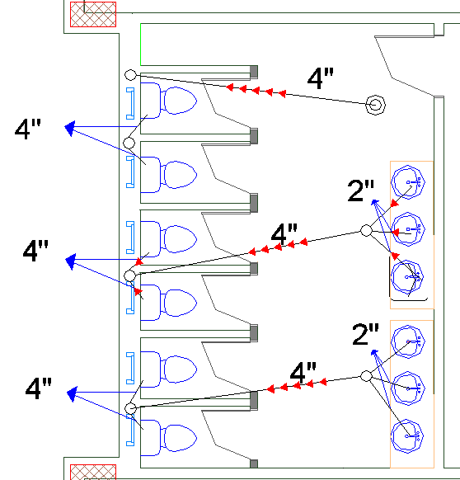
Sanitation system on the plan

Slide 51
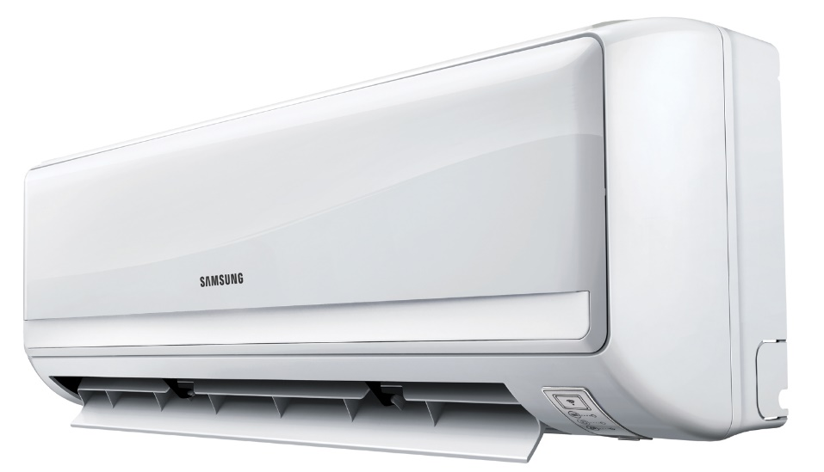
3) HVAC system design
The method of the HVAC system is VRF system, which allow for cooling and heating at the same time.
The internal unit that is used is suspended on walls unit.

Slide 52
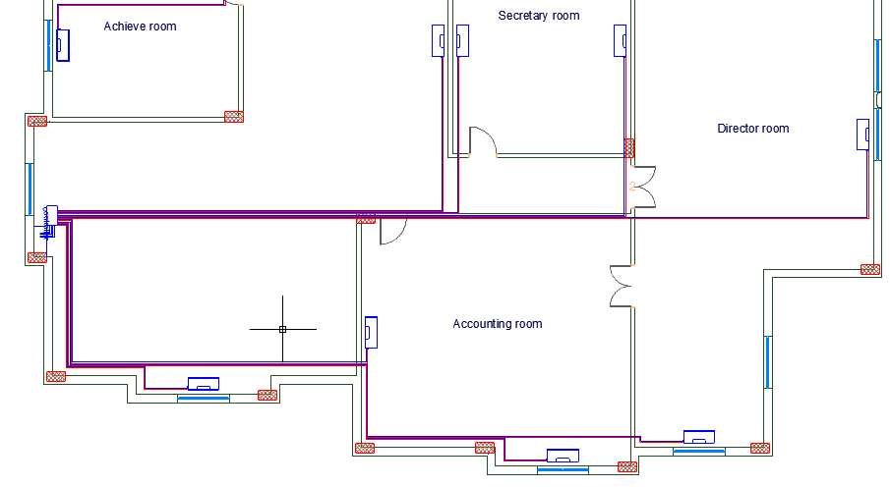
HVAC Units distribution for the administration block.

Slide 53


4) Fire resistance system

Slide 54

Escape route

Slide 55
Artificial Lighting

Slide 56


1) Classroom
Walls’ reflection factor = 40.1 %.
Ceiling’s reflection factor = 46.1 %.
Floor reflection factor = 75.6 %.
E(avg) = 313 Lux
U = 0.6 UGR = 16.7

Slide 57

Classroom luminaire

Slide 58


2) Bedroom
Walls’ reflection factor = 29.0 %.
Ceiling’s reflection factor = 70 %.
Floor reflection factor = 75.6 %.
E(avg) = 208 Lux
U = 0.82 UGR < 10

Slide 59

Bedroom luminaire

Slide 60


3) Accounting room
Walls’ reflection factor = 34.9%.
Ceiling’s reflection factor = 70 %.
Floor reflection factor = 75.6 %.
U = 0.96 Ugr = 18.4
E avg = 606

Slide 61

Accounting room luminaire

Slide 62
Quantity survey & cost estimation

Slide 63
Quantity survey & Cost estimation
Beams and tie beams:
Item | Form work (m²) | Concrete (m³) | Steel Ton
Tie beams | 33.8952 | 282.46 | 4.7
Beams (GF) | 67.9184 | 20.37552 | 11.1
Beams (1st F) | 67.9184 | 20.37552 | 11.1
Beams (2nd F) | 67.9184 | 20.37552 | 11.1
Sub total | 238 | 344 | 38
Cost/ unit Nis | 25 | 300 | 2,500
Total cost | 5,950 | 103,200 | 95,130
Total cost of beams and tie beams = NIS 207,280

Slide 64
Quantity survey & Cost estimation
Shear walls and columns:
Item | Form work (m²) | Concrete (m³) | Steel Ton
Columns | 559 | 82.6234 | 11.3
Shear Walls | 1,556 | 194.446 | 8.4
Sub total | 2,115 | 278 | 19.7
Cost / unit Nis | 25 | 300 | 2,500
Total cost | 52,875 | 83,400 | 49,615
Total cost of shear walls and columns= NIS 185,890

Slide 65
Quantity survey & Cost estimation
Slabs:
Item | Form work (m²) | Concrete (m³) | Steel Ton
Slab (GF) | 832.262 | 133.174 | 16.1
Slab (1st F) | 832.262 | 133.174 | 16.1
Slab (2st F) | 832.262 | 133.174 | 16.1
Sub total | 2,497 | 400 | 48.5
Cost / unit NIS | 25 | 300 | 2,500
Total cost | 62,425 | 120,000 | 121,282.5
Total cost of slab = NIS 303,707

Slide 66
Quantity survey & Cost estimation
Footings:
Item | Steel Ton | Excavation (m³) | Concrete (m³)
Footing | 8.1 | 435.1 | 277
Cost / unit NIS | 2.5 | 25 | 300
Total cost | 20,250 | 10,875 | 83,100
Total cost of footing = NIS 114,225

Slide 67
Quantity survey & Cost estimation
Finishing works:
Item | Quantity | Unit | Cost / unit Nis | Total cost
Plastering | 3,544 | (m²) | 16 | 56,704
Painting | 3,544 | (m²) | 17 | 60,248
Tiling | 2,148 | (m²) | 50 | 107,400
Doors | 184 | (m²) | 600 | 110,400
Stone | 1,581 | (m²) | 110 | 173,910
Mortar | 3,544 | (m²) | 20 | 70,880
Internal walls | 500 | (m²) | 25 | 12,500
Glass | 54 | (m²) | 800 | 36,720
Total cost of slab = NIS 628,762

Slide 68
Quantity survey & cost estimation
Final quantity & cost for the block:
Item | Quantity | Unit | Cost/NIS | Total cost
Concrete | 1,300 | m3 | 300 | 390,000
Steel | 115 | Ton | 2,500 | 286,315
Excavation | 435 | m3 | 25 | 10,877.5
Disposal | 544 | m3 | 5 | 2,720
Backfilling | 193 | m3 | 15 | 2,887.5
Formworks | 5,198 | m2 | 20 | 103,952
Finishing work | 15,091 | ----- | ------ | 628,762

Slide 69
Quantity survey & cost estimation
Final cost for the block:
Total cost of the block = NIS 1,425,516
Unit cost = NIS 570/m2

Slide 70


