Slide 1
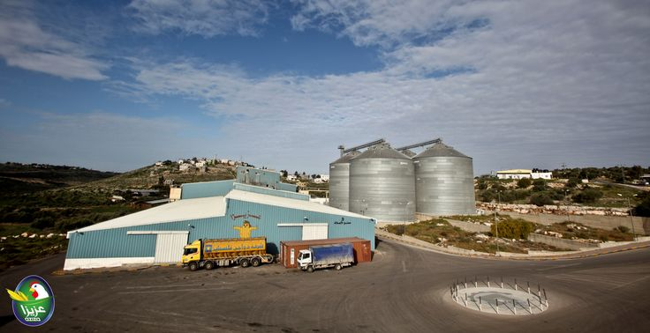
Preparing OHSMS For Palestine Poultry co. (Aziza Feed Plant) Based on OHSAS 18001
Prepared By
Haya Touqan
Mohammad Laboum
Nour Jaber
Shafee'a Nouri
Supervisor
Eng. Suleiman Daifi

Slide 2

Problem statement
Occupational safety and health is the discipline concerned with preserving and protecting human and facility resources in the workplace
Workers at this kind of industry might exposed to different kind of hazards like chemical, mechanical, biological and electrical hazards
AZIZA plant didn’t have a safety system to protect their employees, contractors, visitors. There is a lot of hazard sources at different locations in the plant. To control them and reduce the risks, they should establish an occupational health and safety system

Slide 3
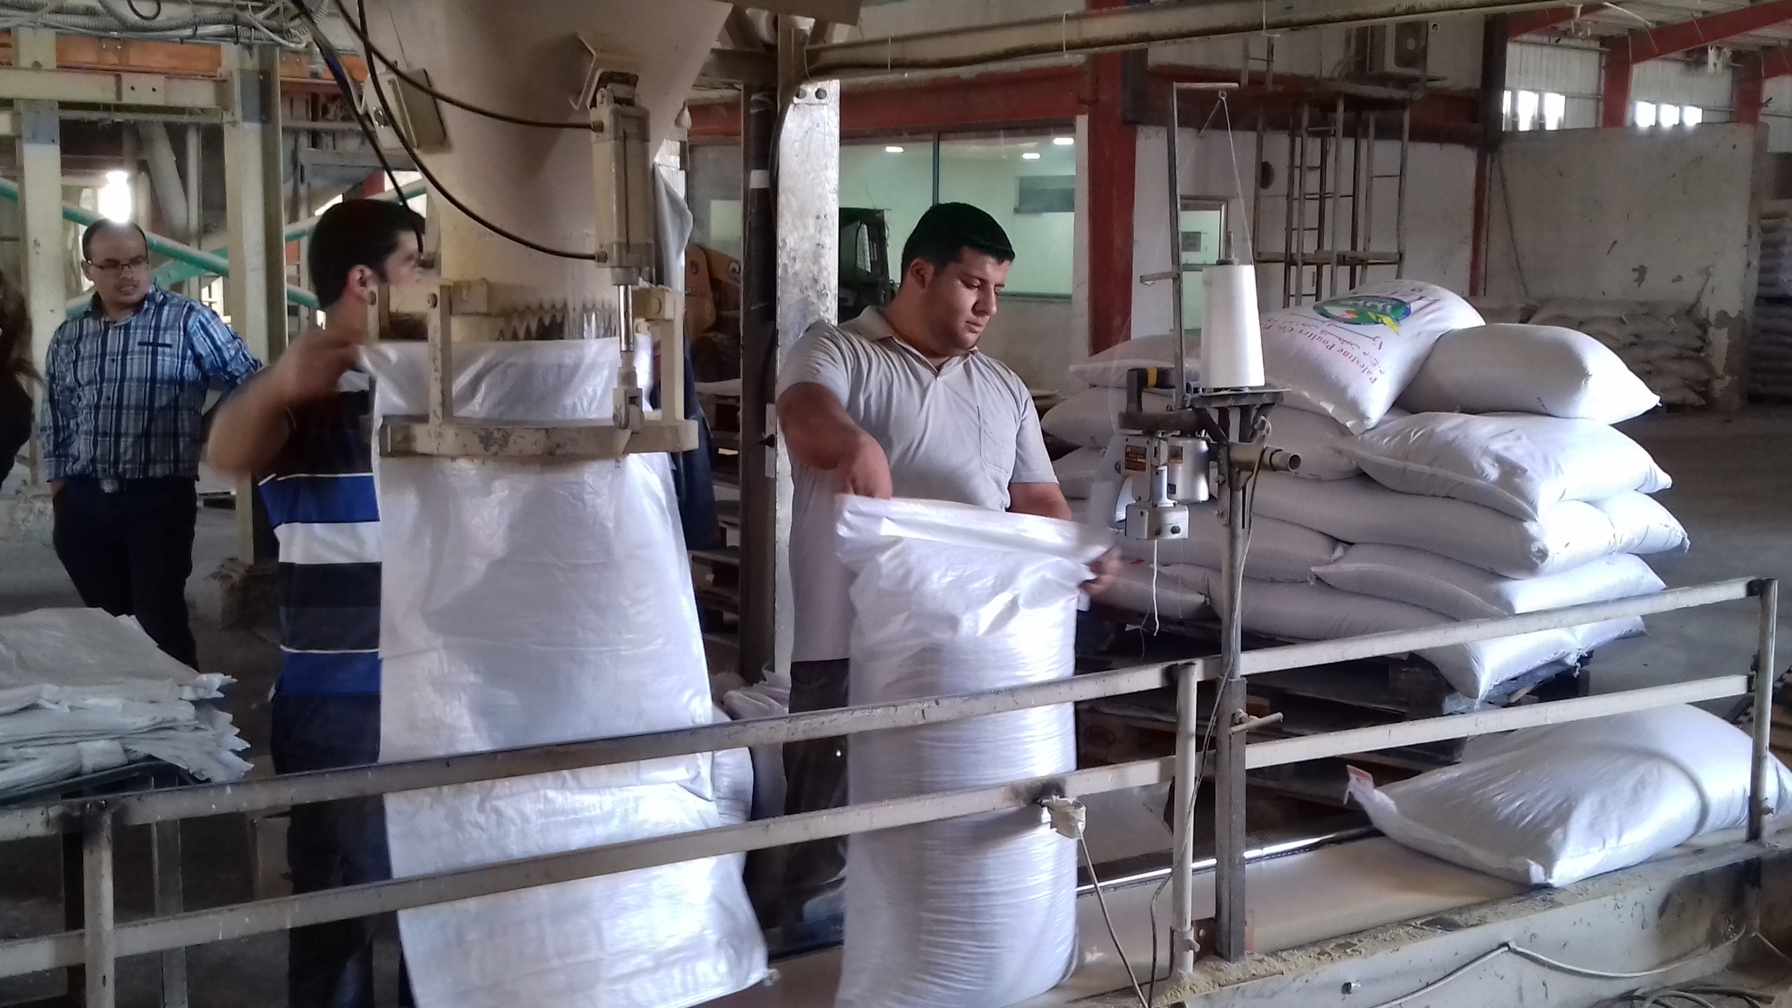
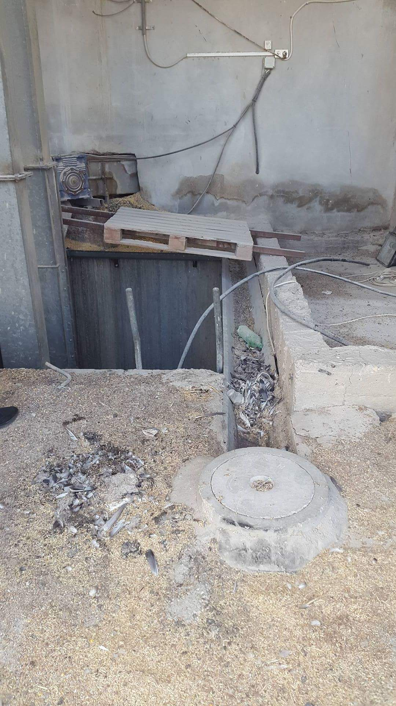
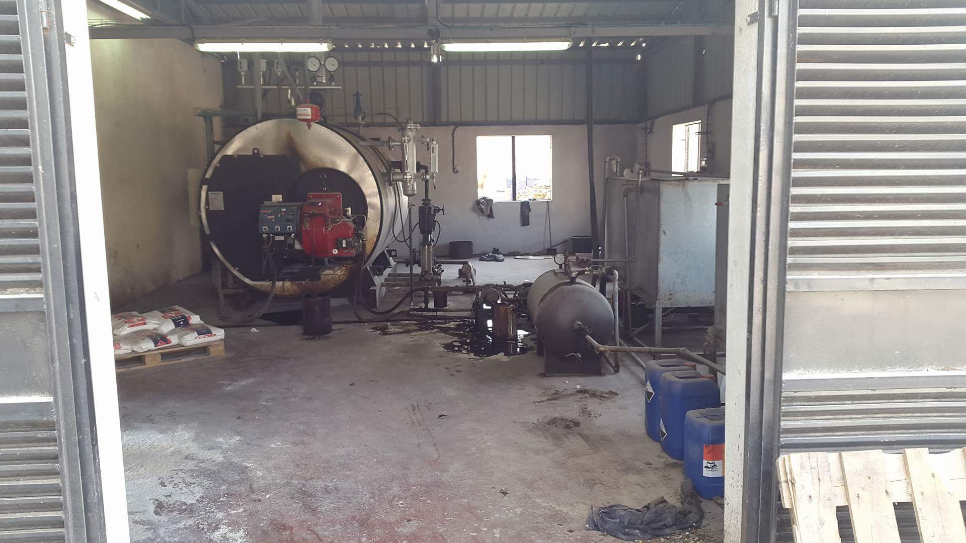
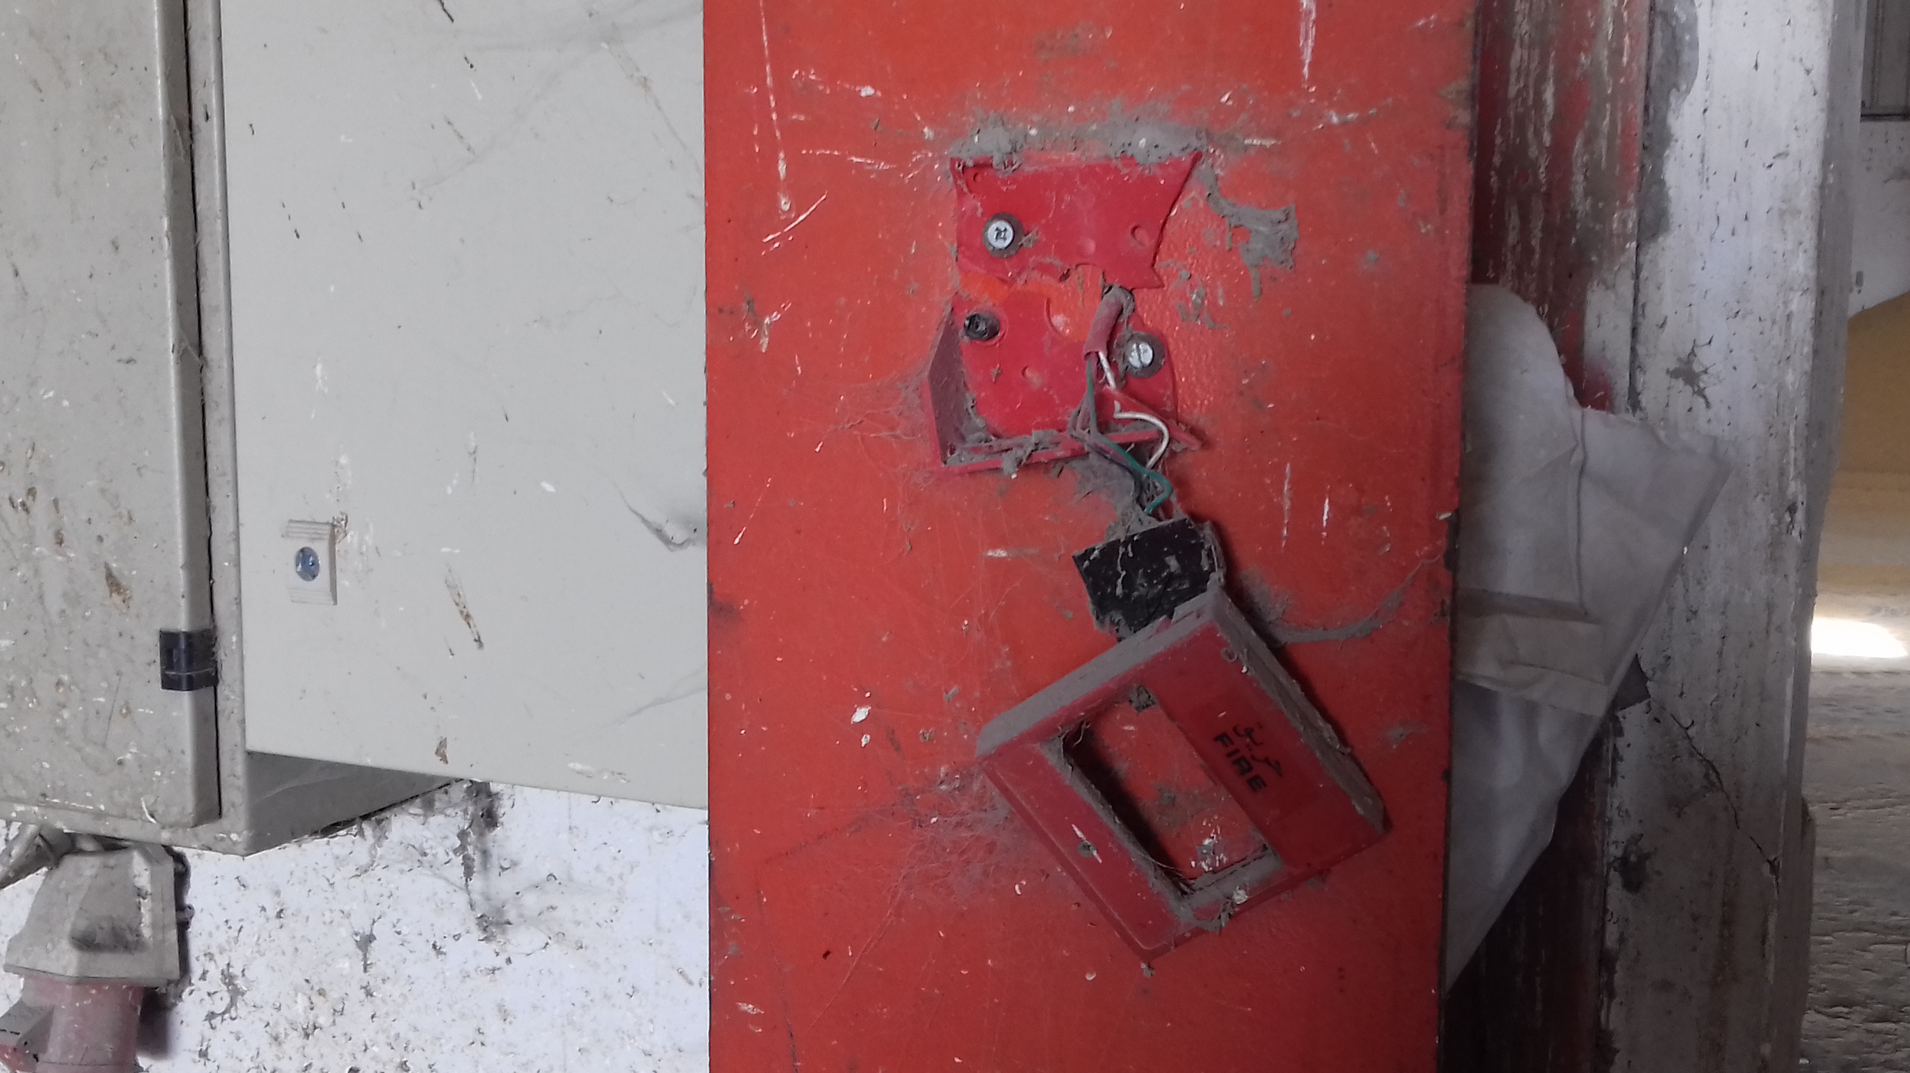
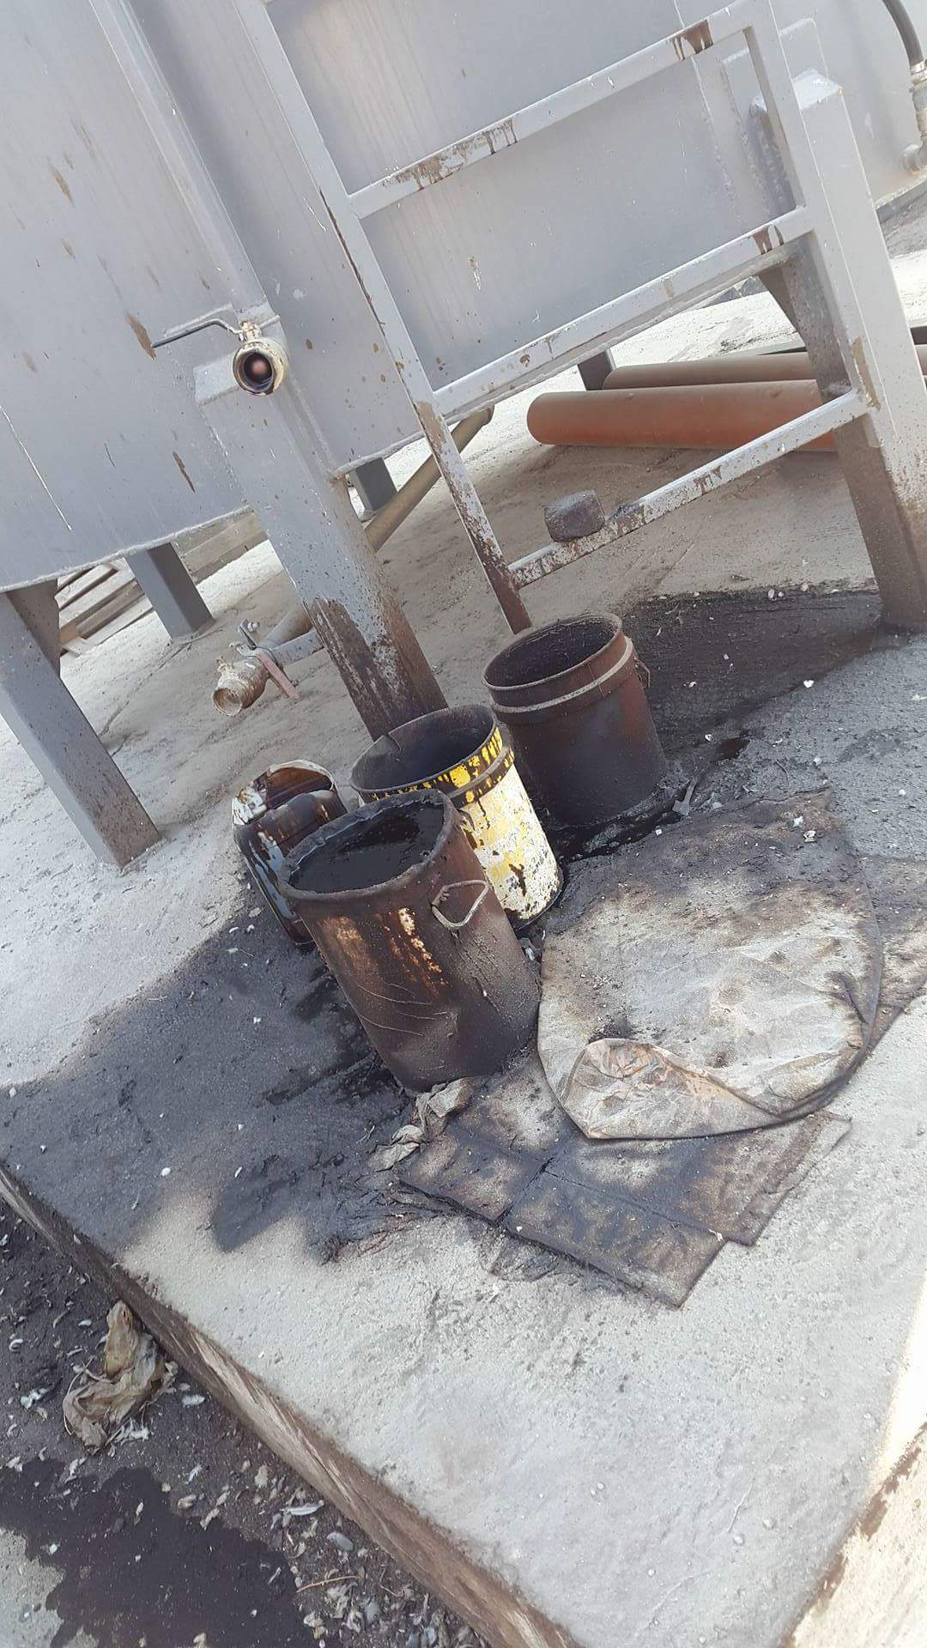
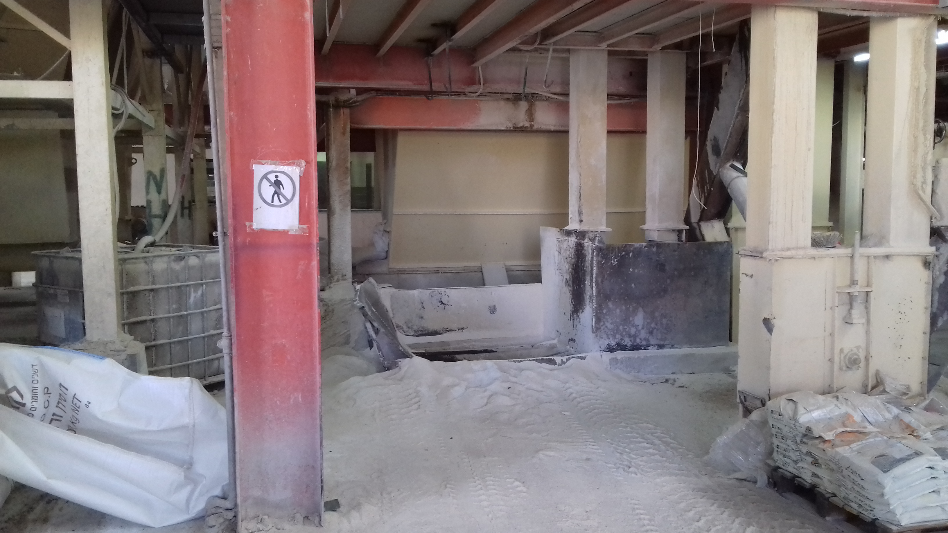

Slide 4
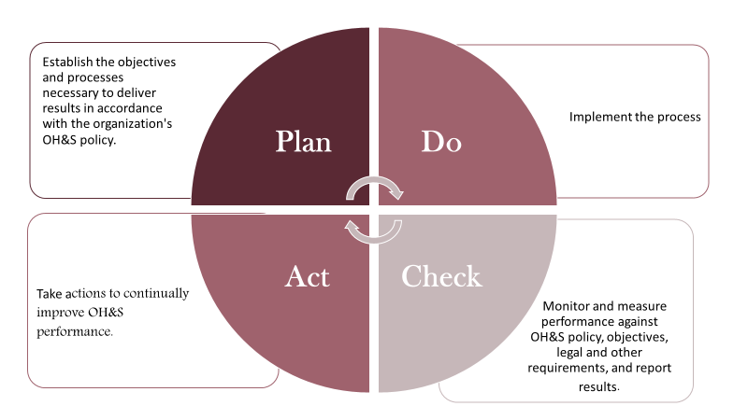
P-D-C-A cycle

Slide 5
Gap Analysis & Determine legal Requirements
This method aims to:
Assess the Gap between the Plant current situation and OHSAS 18001 standard
Determine legal Requirements that must be available in the factories

Slide 6

Health and safety Unit
Health and Safety Officer

Slide 7
OHS Policy
It shows:
  Management responsibilities
  Visitors and contractors responsibilities
  Employee responsibilities
The policy must be:
  Documented
  Communicated to all persons work in the organization
  Reviewed periodically

Slide 8
Hazard identification
Cause and effect diagram for chemical hazards

Slide 9
Cause and effect diagram for physical hazards

Slide 10
Cause and effect diagram for fire hazards

Slide 11
Cause and effect diagram for noise hazards

Slide 12
Cause and effect diagram for biological hazards

Slide 13
Cause and effect diagram for biological hazards

Slide 14
Risk Rating PRPCESS
Hazard | Persons affected | Risks | Likelihood | Severity | Rating | Priority
Fire and Explosion | Staff and other | 1- Death 2- Burn 3- Inhalation of smoke and toxic material 4- Building damage 5- Loss of business and jobs | Medium (2) | High (8) | 5 | 4
Slips, Trips & falls | Staff and other | 1- Bruising 2- Sprains 3- Possible fractures | High (8) | Low (2) | 5 | 5
Work Equipment | Staff | 1- Fractures 2- Cuts 3- Hit by moving part | Medium (4) | Low (2) | 3 | 9
Objects falling from height | Staff and other | 1- Death 2- fractures 3- Bruising 4- Cuts | Medium (4) | Medium (4) | 4 | 6

Slide 15
Hazard | Persons affected | Risks | Likelihood | Severity | Rating | Priority
Electrical | Staff and other | 1- Electric shock 2- Burns 3- Electrical fires and explosions 4- Property damage | Medium (3) | High (9) | 6 | 3
Dust | Staff | 1- Allergies 2- Asthma | High (9) | High (8) | 8.5 | 1
Noise | Staff | 1- Hearing loss 2- Lose concentration within work | High (8) | High (6) | 7 | 2
Chemical | Staff | 1- Poisoning 2- Long term effects 3- Eye and/or skin effects 5- Possible allergic | Medium (3) | Medium (4) | 3.5 | 7
Biological | Staff and others | 1- Diseases 2- Death | Low (1) | High (6) | 3.5 | 8
High: 6-9, Medium: 3-4, Low: 1-2
Rating = (likelihood+ severity)/2

Slide 16
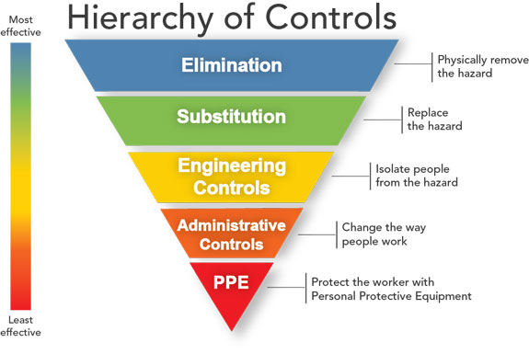
Control process

Slide 17
Controlling hazards includes
Hazards control
Dust
Noise
Electrical
Fire
Physical
Chemical
Biological

Slide 18
Training, Participation & Communication
Persons concerned | Training and awareness description | Responsibility
Health and safety officer | 1- Course training in occupational health and safety. 2- First aid training course. | Plant management
Employees and workers | 1- Hazards that may expose to them in workplace. 2- Warning signs meanings. See appendix G. 3- Firefighting process. See appendix E. 4- Emergency evacuation plan. See appendix H 5- How to behave when an accident occurs 6- How to use equipment and machines in a proper form. | Health and safety officer
Visitors | 1- Compliance with health and safety regulations. 2- Compliance with warning signs. | Health and safety officer

Slide 19
Emergency Preparedness and Response
Emergencies may be natural or manmade and include:
Floods
Fires
Toxic gas releases or Chemical spills
Explosions
Civil disturbances

Slide 20
Main Items That Must Included In Emergency Action Plan
Method for reporting the emergencies.
An evacuation policy and procedure.
Emergency escape procedures and safe areas.
Names, titles, departments, duties and responsibilities and phone numbers of individuals both within and outside the company that needed to perform an emergency plan.
Procedures for employees who remain to perform some operations, such as operate fire extinguishers.
Rescue and medical duties for any workers designated to perform them.
See appendix H

Slide 21
Work environment monitoring and control:
The health and safety officer must make periodically checking of the workplace place departments, handling tools and machines to ensure that they don’t cause harm for employees and take corrective and preventive actions to eliminate hazards that may appear in workplace.
See appendix I.

Slide 22
Noise level Monitoring:
OSHA uses the concept of noise dose, with the exposure to any sound level above 90 dB causing the listener to incur a partial dose.
D=100*(C1/T1 + C2/T2 + .....+Cn/Tn) ≤ 100
where: D: noise dose
C: time spent at specified noise level (h)
T: time permitted at specified noise level (h)

Slide 23
Permissible Noise Exposure
Permissible Exposure to Sound Level
Sound level (dB) | Maximum exposure (hr)
Less than 90 | ∞
90 | 8
92 | 6
95 | 4
97 | 3
100 | 2
102 | 1.5
105 | 1
110 | 0.5
115 | 0.25

Slide 24
Evaluating workers’ exposure to Noise
Sound intensity levels were measured by sound level meter to determine the sound dose that the workers exposed to it at the work place.
Department | Sound intensity level (dB) | Dose (%)
Plant Management Room | 74.8 | -
1st Floor (Mixer and Cooler) | 97.3 | 275.8%
2nd floor (Pellet Machine and Hammer Mill) | 100.5 | 615.3%
3rd floor (Buffer Tanks) | 100 | 400%
4th floor (Sieves) | 100 | 400%
Compounds Mixing Room | 78.2 | -
Row Material Store | 75.8 | -
Filling Department | 90 | 100%

Slide 25
Dust Level Monitoring
Dust levels (mg/m^3) were measured by Microdust pro device to determine the dust level that the workers exposed to it at the work place, the standard level should be 4 mg/m^3 at feed plants.
Department | Dust level(mg/m^3)
Plant Management Room | 0.80
1st Floor (Mixer and Cooler) | 4.47
2nd floor (Pellet Machine and Hammer Mill) | 6.15
3rd floor (Buffer Tanks) | 6.25
4th floor (Sieves) | 7.21
Compounds Mixing Room | 15.3
Row Material Store | 1.86
Filling Department | 1.45

Slide 26
Plant closing plan:
It aims to:
Preventing the birds from entering the plant.
Determine the entries of tracks, workers & visitors.
Establish efficient Ventilation System
(Required Fan Capacity = 20418 𝑚^3/hr )

Slide 27
Incidents Investigation
The plant management should have a procedure for reporting, investigating and analyzing incidents.
All incidents should be investigated.
See appendix J.

Slide 28
Management Review:
It aims to find opportunities for improvement the OH&S management system.
Management review inputs:
Results of internal audits and evaluations of compliance with applicable legal requirements and with other requirements to which the organization subscribes.
The results of participation, communication and consultation.
The OH&S performance of the organization.
The extent to which objectives have been met.
Status of incident investigations, corrective actions and preventive actions.
Changing circumstances, including developments in legal and other requirements related to OH&S.
Recommendations for improvement.

Slide 29
The outputs of management review may include any decisions related to possible changes to:
OH&S performance.
OH&S policy and objectives.
Resources.
Other elements of the OH&S management system.

Slide 30
Conclusion:
The factory is working at low level of safety requirements and the employees have lack of awareness about hazards that may expose to them at the work place
There are some hazards that have high likelihood and severity like fire and explosions which cause huge damage to the factory if it occurs.
Dust, noise and heat affect the employees cumulatively when they expose to them for long periods especially when they Exceed the acceptable limits, dust and noise exceeded the acceptable limits in some plant departments (as shown in tables 8 &9)

Slide 31
By creating a positive, safe and healthy environment for employees, this can positively impact on the company business which leads to:
improve productivity, business performance and staff morale.
Healthy workers are more motivated to stay in work.
Reduction in lost working days.
Reduction in incident levels with increased measures of performance.
Reduce accidents and work-related ill health, sick pay costs and insurance costs.

Slide 32
Recommendations
1. The management is recommended to:
Start working on the high severity and likelihood hazards.
Provide annual health check for all workers to ensure their health is well and they didn’t affect by working environment.
Provide plant closing system and efficient ventilation system as shown in appendix K.
Provide personal protective equipment for workers.
Making suitable work shift system that doesn’t exceed 8 hours to reduce exposure to dust, noise and heat.

Slide 33
2. start a training program for the workers
To increase their awareness of all hazards and their impact.
To increase awareness about firefighting process and providing first aid equipment for medical treatment.
To increase awareness about the meaning of the warning signs.
To deal with emergency evacuation plan.

Slide 34
The safety and health officer is recommended to monitor and check the machines and tools and take measurement for work place environment periodically to take corrective or preventive actions when it needed.
Cleaning the light sources periodically and provide lighting units between the silos.
Establish suitable and safe entrance for silos area.
Moving the first Boiler that locate near the workers and visitors entrance to the eastern side near Second Boiler.

Slide 35

Thank you for listening

