Slide 1

Synthesis of Ag-ZnO Hybrid for photocurrent production.
Prepared by :
Heba Hatem Zaid
Supervisor :
Dr. Shadi Sawalha

Slide 2
Table of content
1
Introduction
2
Problem statement
3
Objective
4
Methodology
5
Characterization
6
Results
7
Conclusion

Slide 3
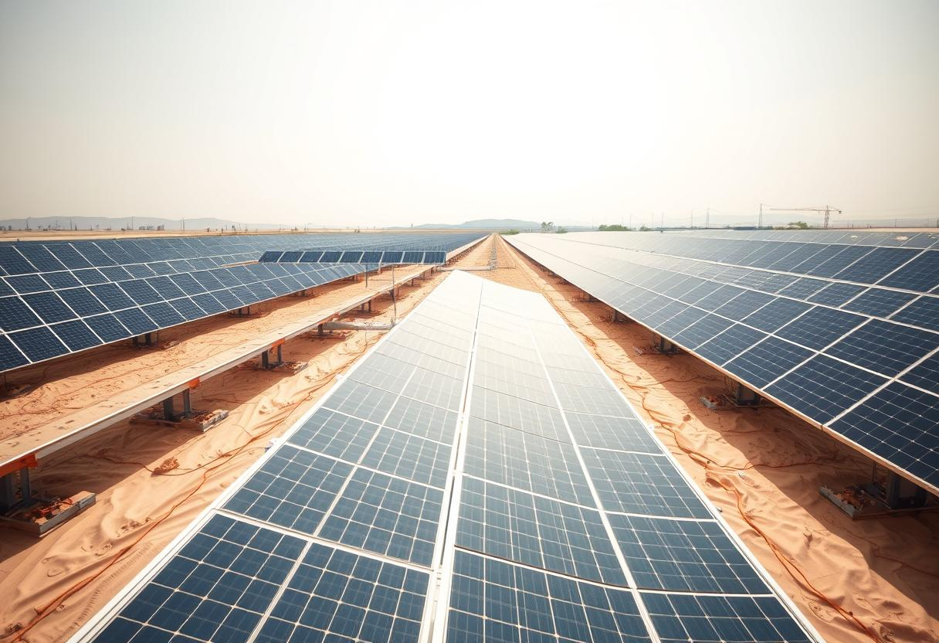
Introduction
Solar cells convert sunlight directly into electricity through the photovoltaic effect, which occurs in semiconductor materials like silicon. These cells are categorized into three generations:
1
2
3
First Generation:
Silicon-based cells, known for high efficiency but with high manufacturing costs.
Second Generation:
Thin-film cells, offering flexibility and lower costs but generally lower efficiency.
Third Generation:
Includes innovative technologies like organic solar cells and dye-sensitized solar cells (DSSC).

Slide 4

Problem statement
Despite advancements in photovoltaic technology, achieving efficient and cost-effective DSSCs remains challenging due to limitations in materials like TiO2. This research aims to explore ZnO and Ag nanoparticles as alternatives to improve electron transport and light absorption, ultimately developing eco-friendly, high-performance DSSCs.

Slide 5




Objective
Develop efficient DSSCs using ZnO and Ag nanoparticles (Ag NPs).
Improve synthesis methods and study their impact on the cells' optical and electrical properties.
Focus on enhancing electron transport and light absorption.
Aim to create high-performance, cost-effective solar cells.

Slide 6
methodology
Synthesis of Silver Nanoparticles
Preparation of zinc oxide nano particles
Preparation of Hybrid Material
Cell preparation

Slide 7

Materials
Ag-NPs | Silver Nitrate (AgNO3) | Ethylene Glycol | Polyvinylpyrrolidone (PVP)
ZnO-NPs | Zinc Sulfate Heptahydrate (ZnSO₄·7H₂O) | NaOH | Isopropyl alcohol
Hybrid | Acetone and Triton X-100 for ZnO-NPs | ZnO-NPs | Ag-NPs

Slide 8
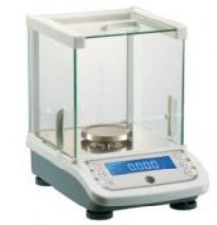
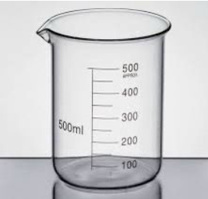
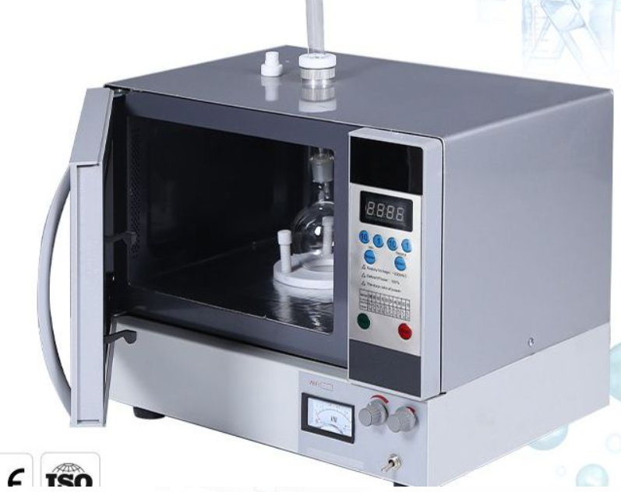
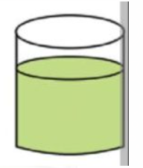

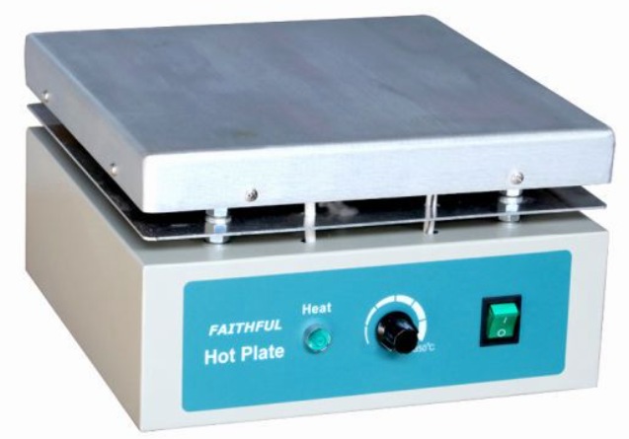
Synthesis of Silver Nanoparticles
dissolve 0.22PVP 40ml of Ethylene glycol
Weight 0.22g of PVP and 0.2g of AgNO3
While stirring, we add 0.22g of PVP Gradually, after completely dissolved We add 0.2g of AgNO3
place in microwave and heat at medium power [400-500 W] for 85s.
Ag-NPs solution

Slide 9

Preparation of zinc oxide nano particles

Slide 10

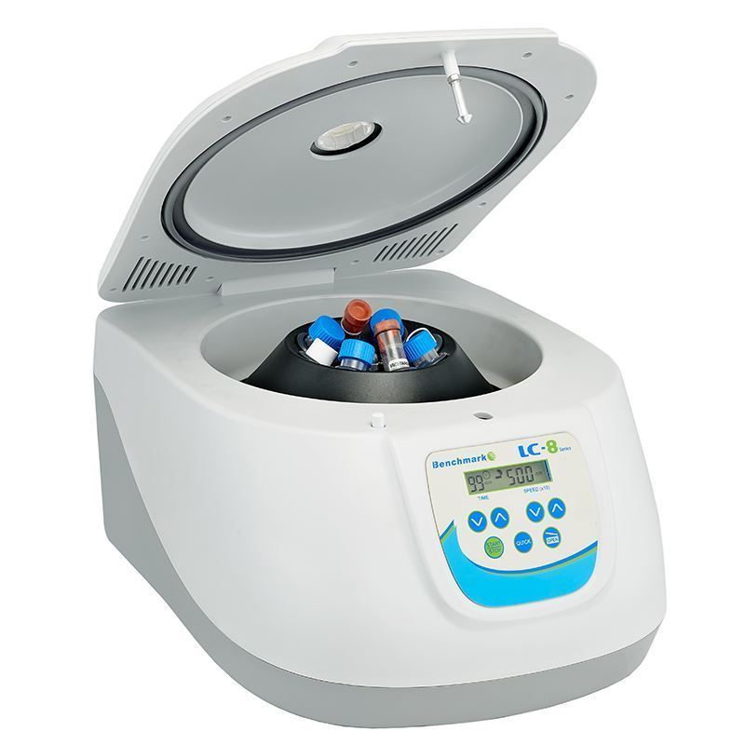
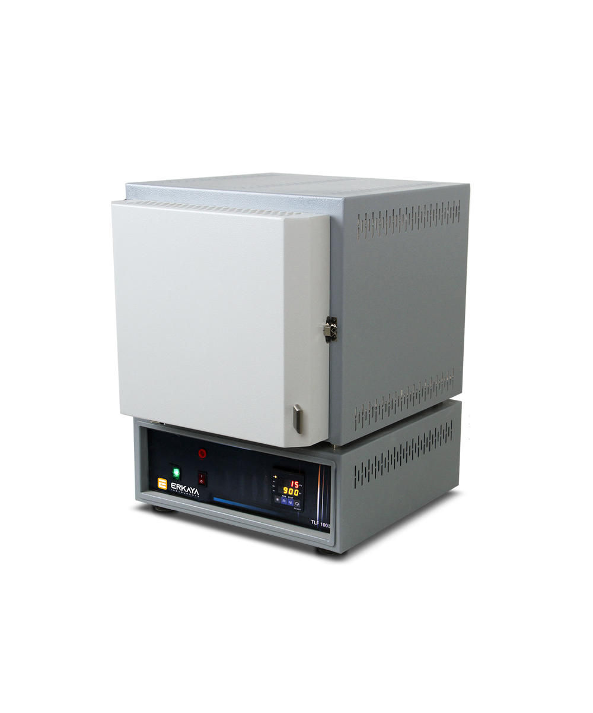
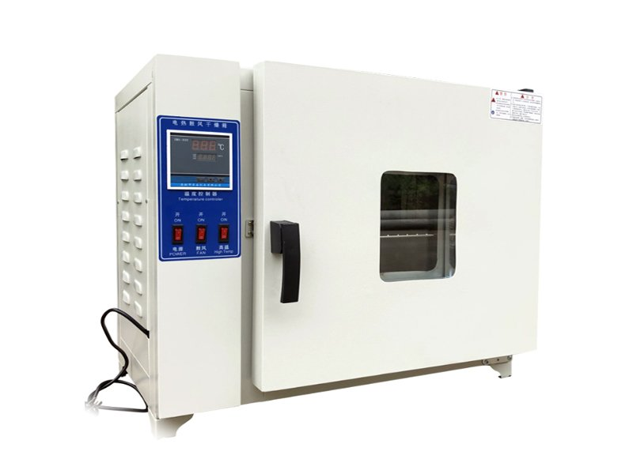


1g ZnSO4.7H20 mixed with 25ml of Isopropyl alcohol and 25ml of distilled water
Centrifuge the mixture three times at 2,500 rpm for five minutes each.
Weight 1g of ZnSO4.7H2O
While stirring, we add
25ml of Naoh dropwise
placed in microwave at medium power [400-500 W] for 5 minutes.
microwave
Furnace
drying oven
After the mixture turns into powder, it is placed in the crucible and covered.
transferred the mixture to the drying oven at 405°C and left it there for 24 hours.
The sample was placed in a furnace at 500°C for 2 hours.
empty the contents of the centrifuge tubes into a beaker.

Slide 11

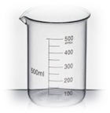
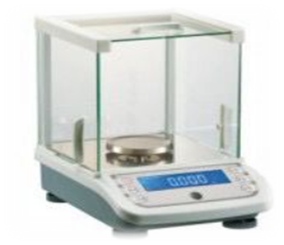
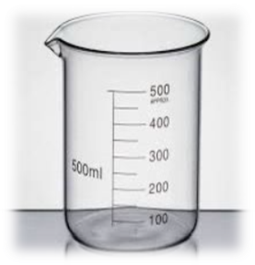
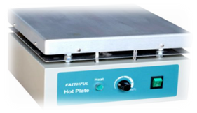

Preparation of Hybrid
Dissolvee 0.1g in a mixture of 0.5 ml acetone and 0.5 ml Triton X-100.
While stirring, add 1ml of Ag-NPs to the mixture and continue stirring to achieve homogeneity.
Weight 0.1g of ZnO-Nps
Hybrid solution

Slide 12
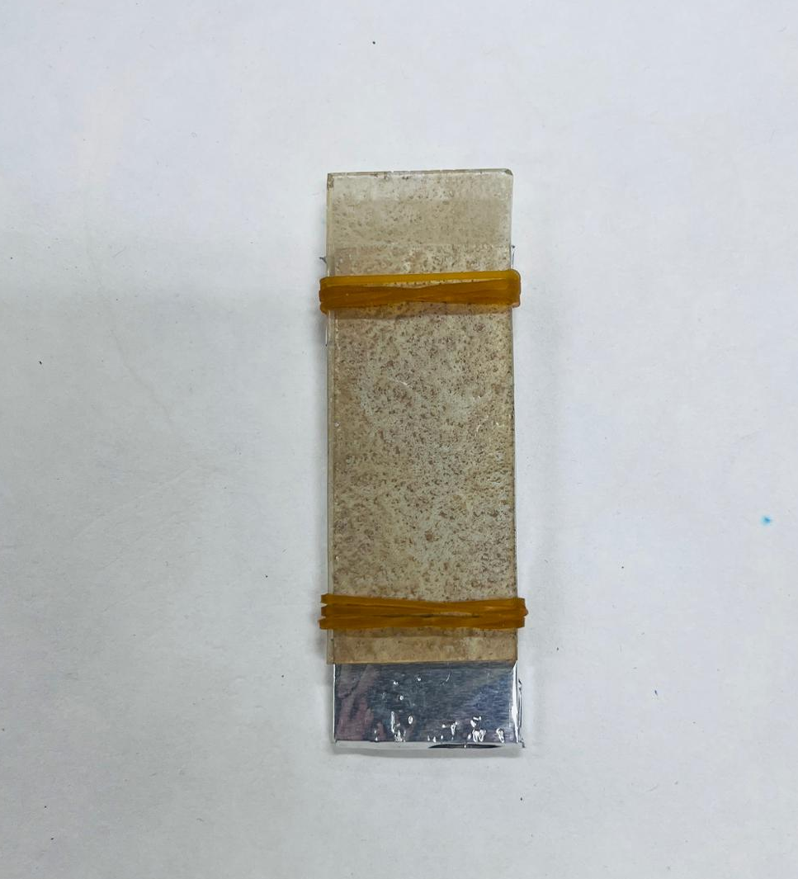
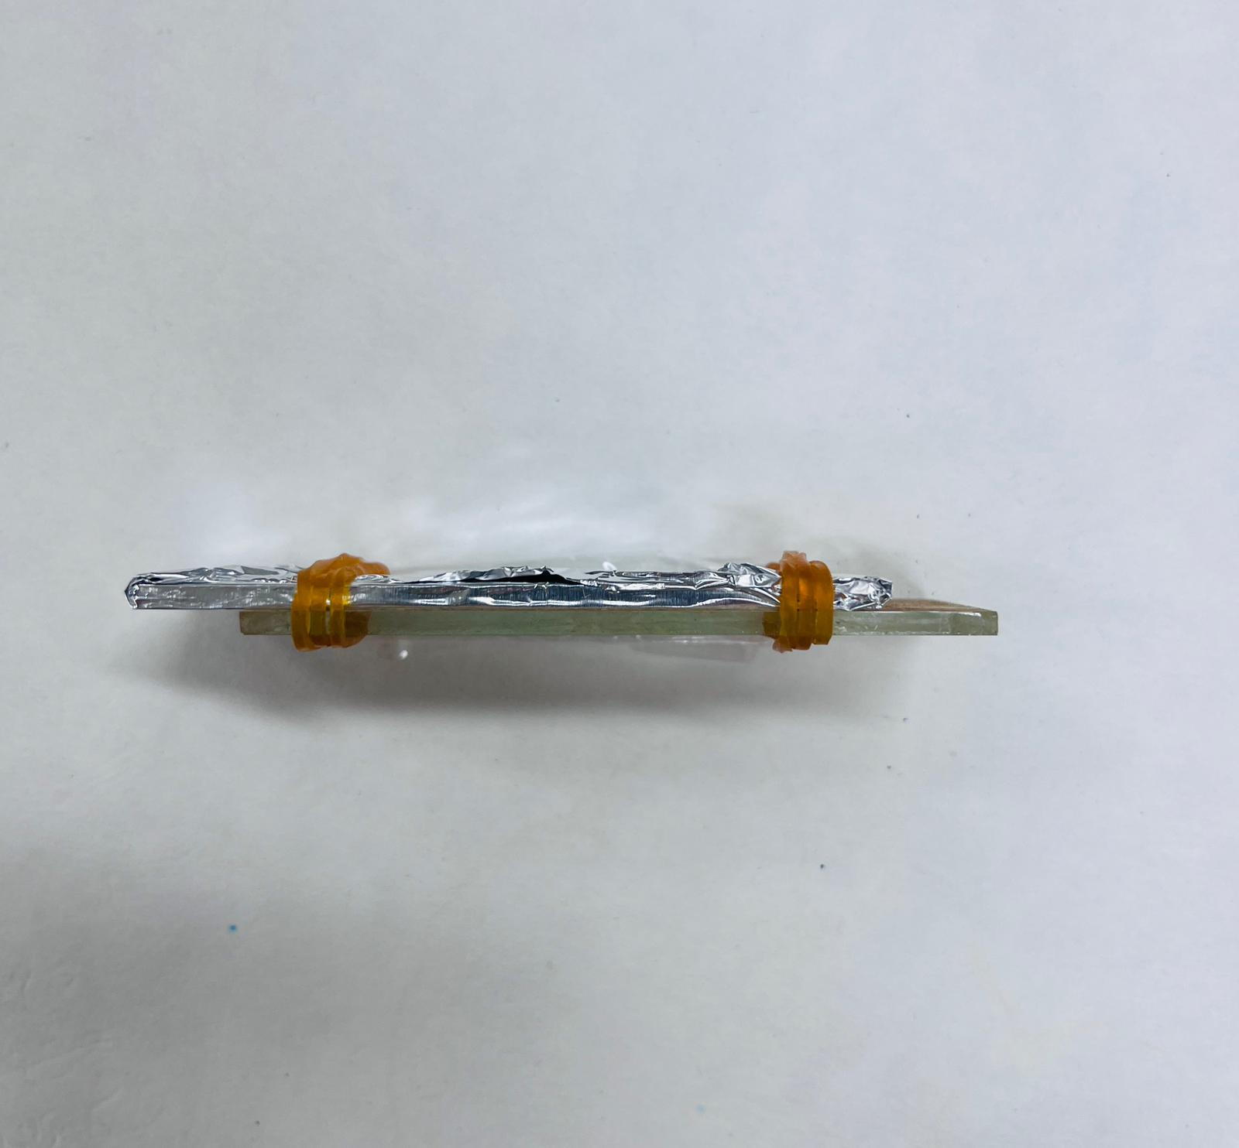
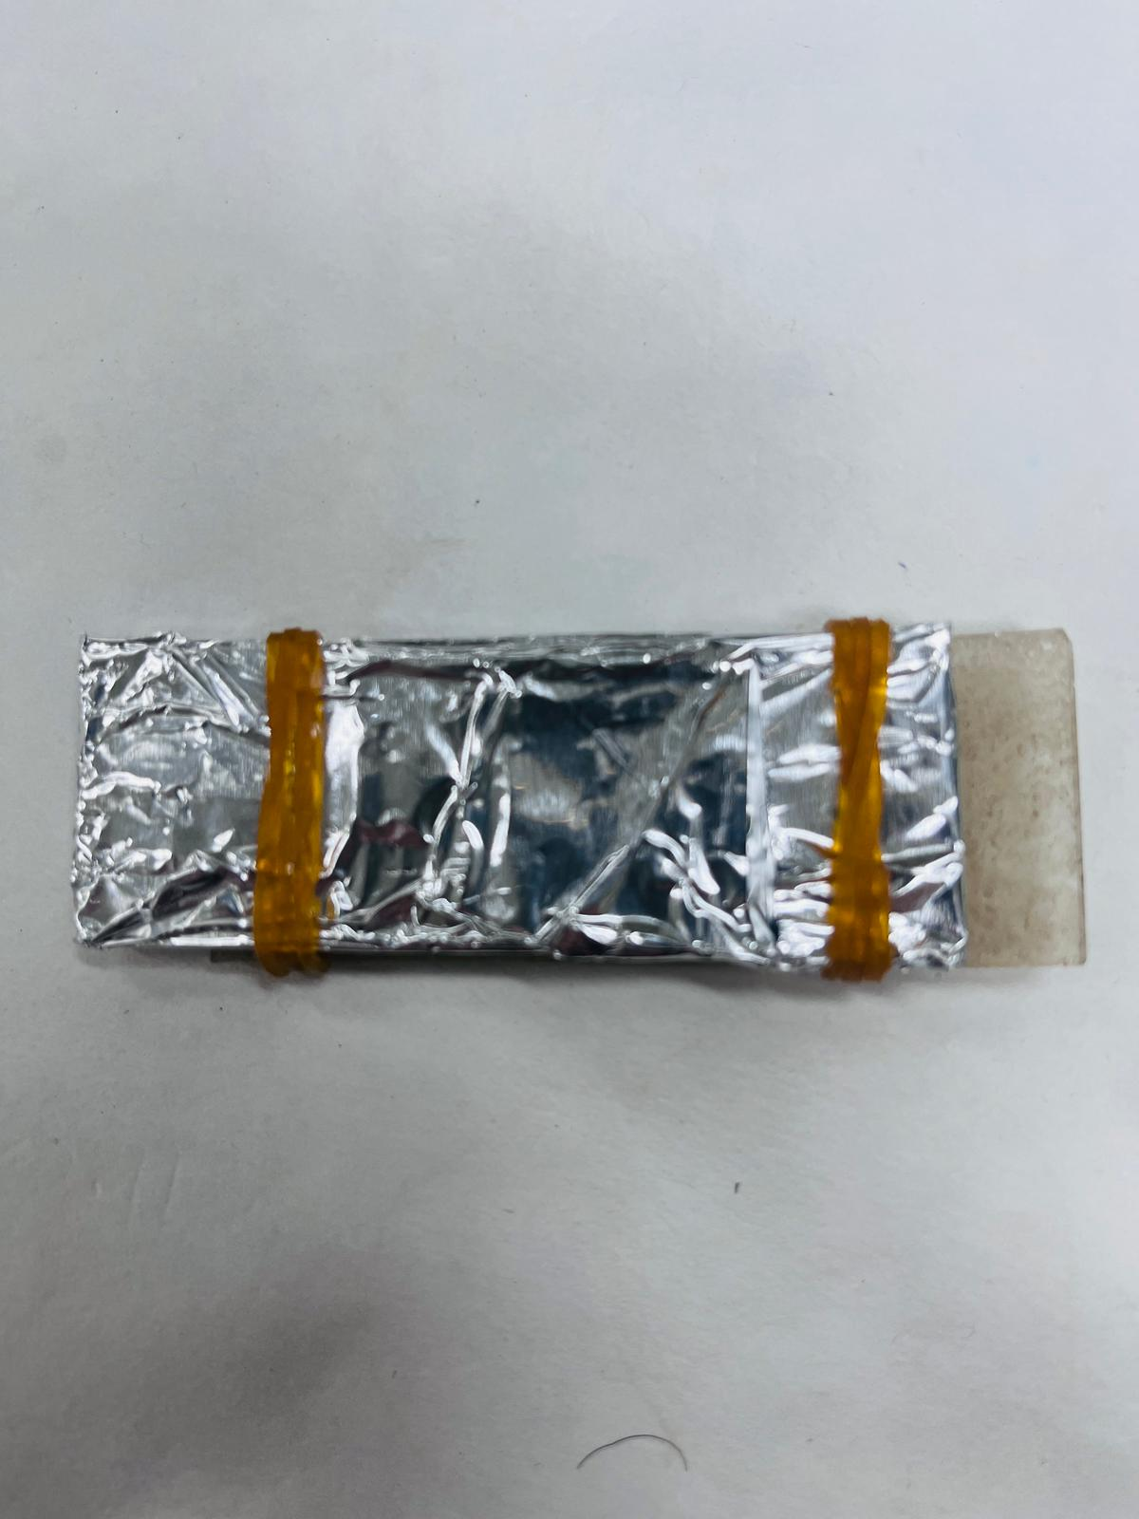
Cell preparation

Slide 13

Characterization

Slide 14
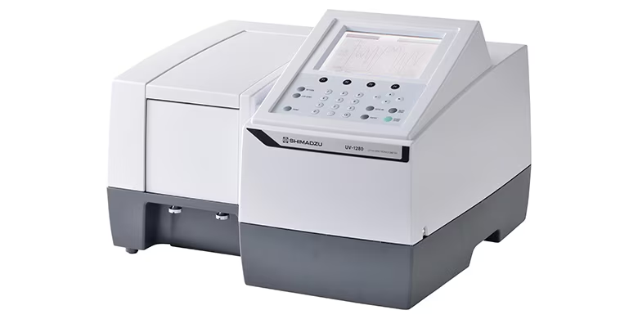
UV-VIS SPECTROPHOTOMETER
The prepared Ag-NPs solution, ZnO-NPs, hybrid solution were examined by the Beckman Coulter DU 800 Spectrophotometer to register the UV–visible spectrum.

Slide 15

Multimeter
The prepared solar cells were tested using a multimeter to measure the I-V curve and evaluate the photocurrent production. This ensured accurate assessment of the electrical performance under applied conditions.

Slide 16
RESULT

Slide 17
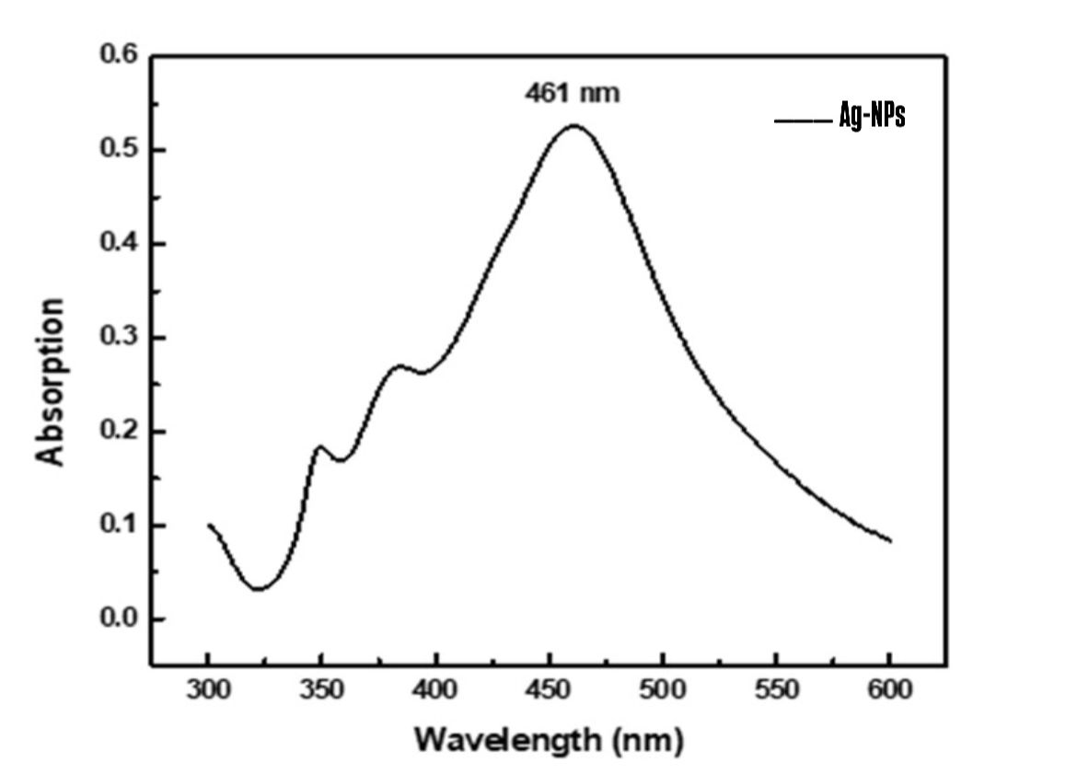
UV-VIS SPECTROSCOPY
UV-vis absorption spectra of synthesized Ag-NPs at medium power (400–500 W)

Slide 18
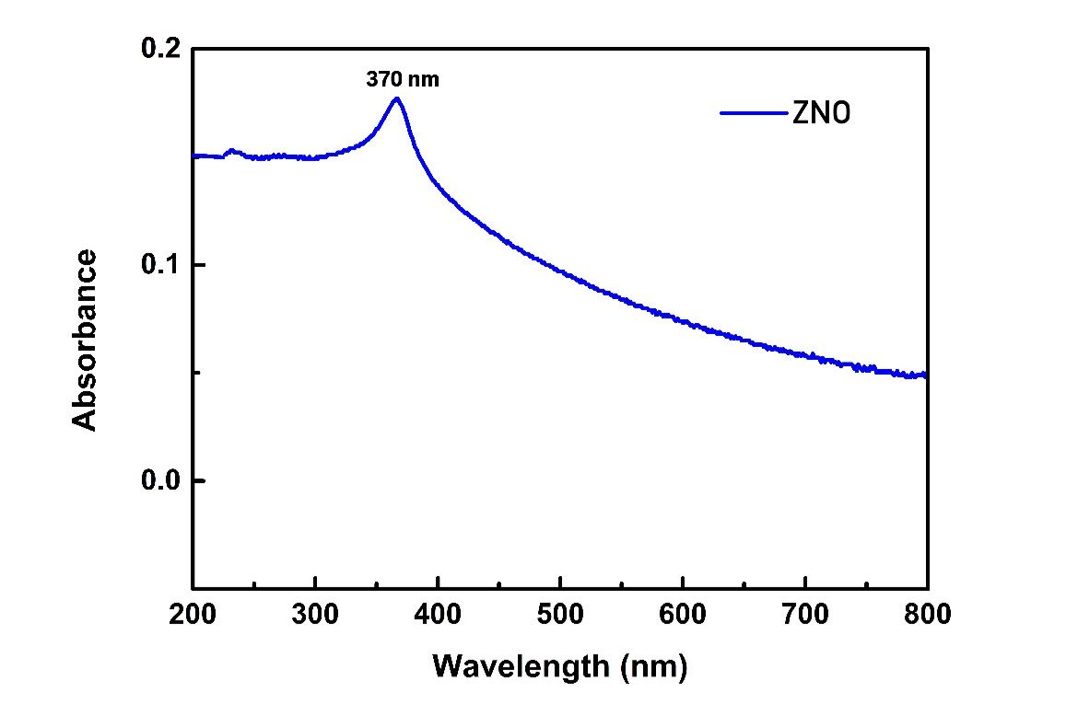
UV-VIS SPECROSCOPY
UV-vis absorption spectra of synthesized ZnO-NPs at medium power (400–500 W)

Slide 19
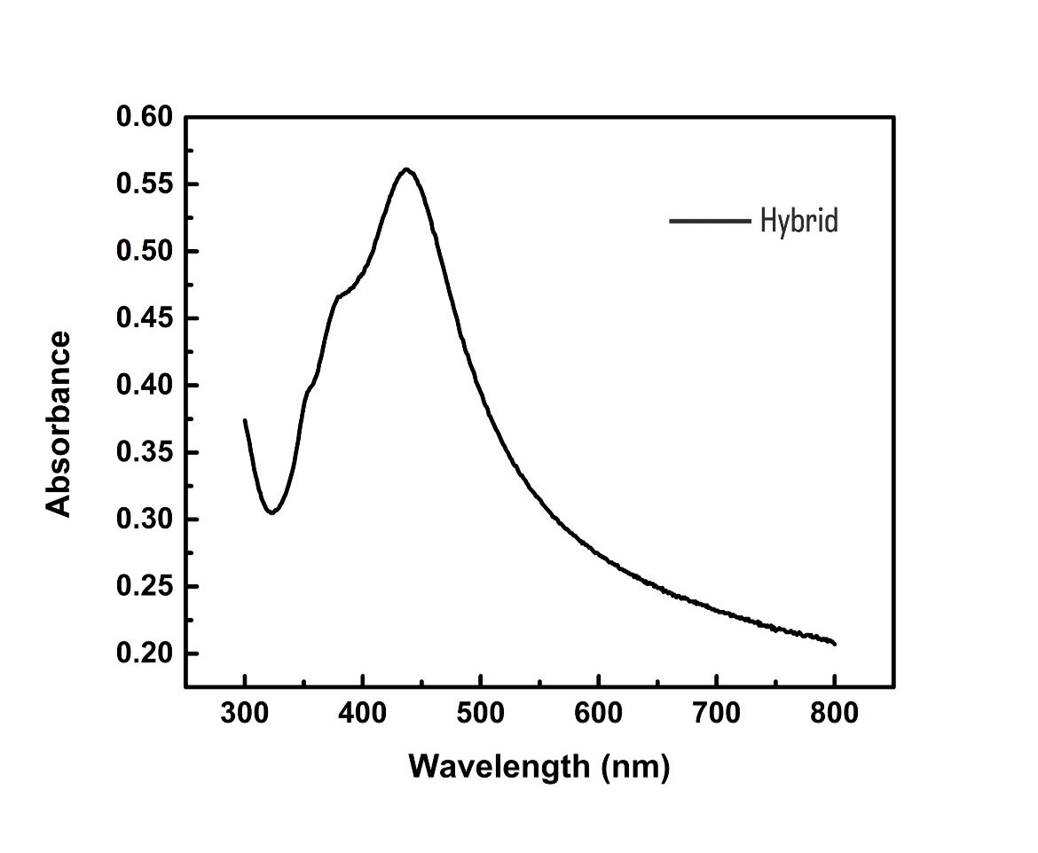
UV-VIS SPECROSCOPY
UV-vis absorption spectra of synthesized Hybrid at medium power (400–500 W)

Slide 20
I-V Curve and Photocurrent Production
I-V curve illustrating the photocurrent performance of ZnO, ZnO-Ag layers, and ZnO-Ag hybrid structures, tested using a potentiostat, highlighting the enhanced current and voltage output of the hybrid structure.

Slide 21
I-V Curve and Photocurrent Production
Short-circuit current (Isc) and open-circuit voltage (Voc) comparison for ZnO, ZnO-Ag layers, and ZnO-Ag hybrid structures, demonstrating the superior performance of the hybrid structure.

Slide 22

Conclusion
Silver nanoparticles (Ag-NPs) and zinc oxide nanoparticles (ZnO-NPs) were successfully synthesized and studied. The results showed that the hybrid structure improved photovoltaic performance by up to 50% compared to single-layer samples, recording Isc=3.34 A and Voci=2.23 V. This enhancement is attributed to the interaction between ZnO and Ag-NPs, plasmonic effects that enhanced light absorption, and reduced charge losses. This study highlights the potential of hybrid structures in energy and optical applications.

Slide 23
Dedication

Slide 24
Thanks'
Do you have any questions?

