Slide 1


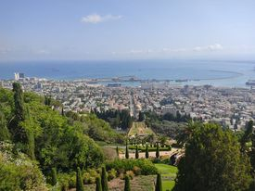
Joury Travel And Tourism
Date: Des 14, 2021

Slide 2




The Team
Vision
Agenda
Introduction
Why do customers choose us
About the company
Feasibility
we never dreamed of success, we work for it
We accomplished what yesterday was a dream
The company problem
Dear Teachers
Mission

Slide 3




Sandy Seddeh
Sojood Nan’a
Aya Alseda

Slide 4
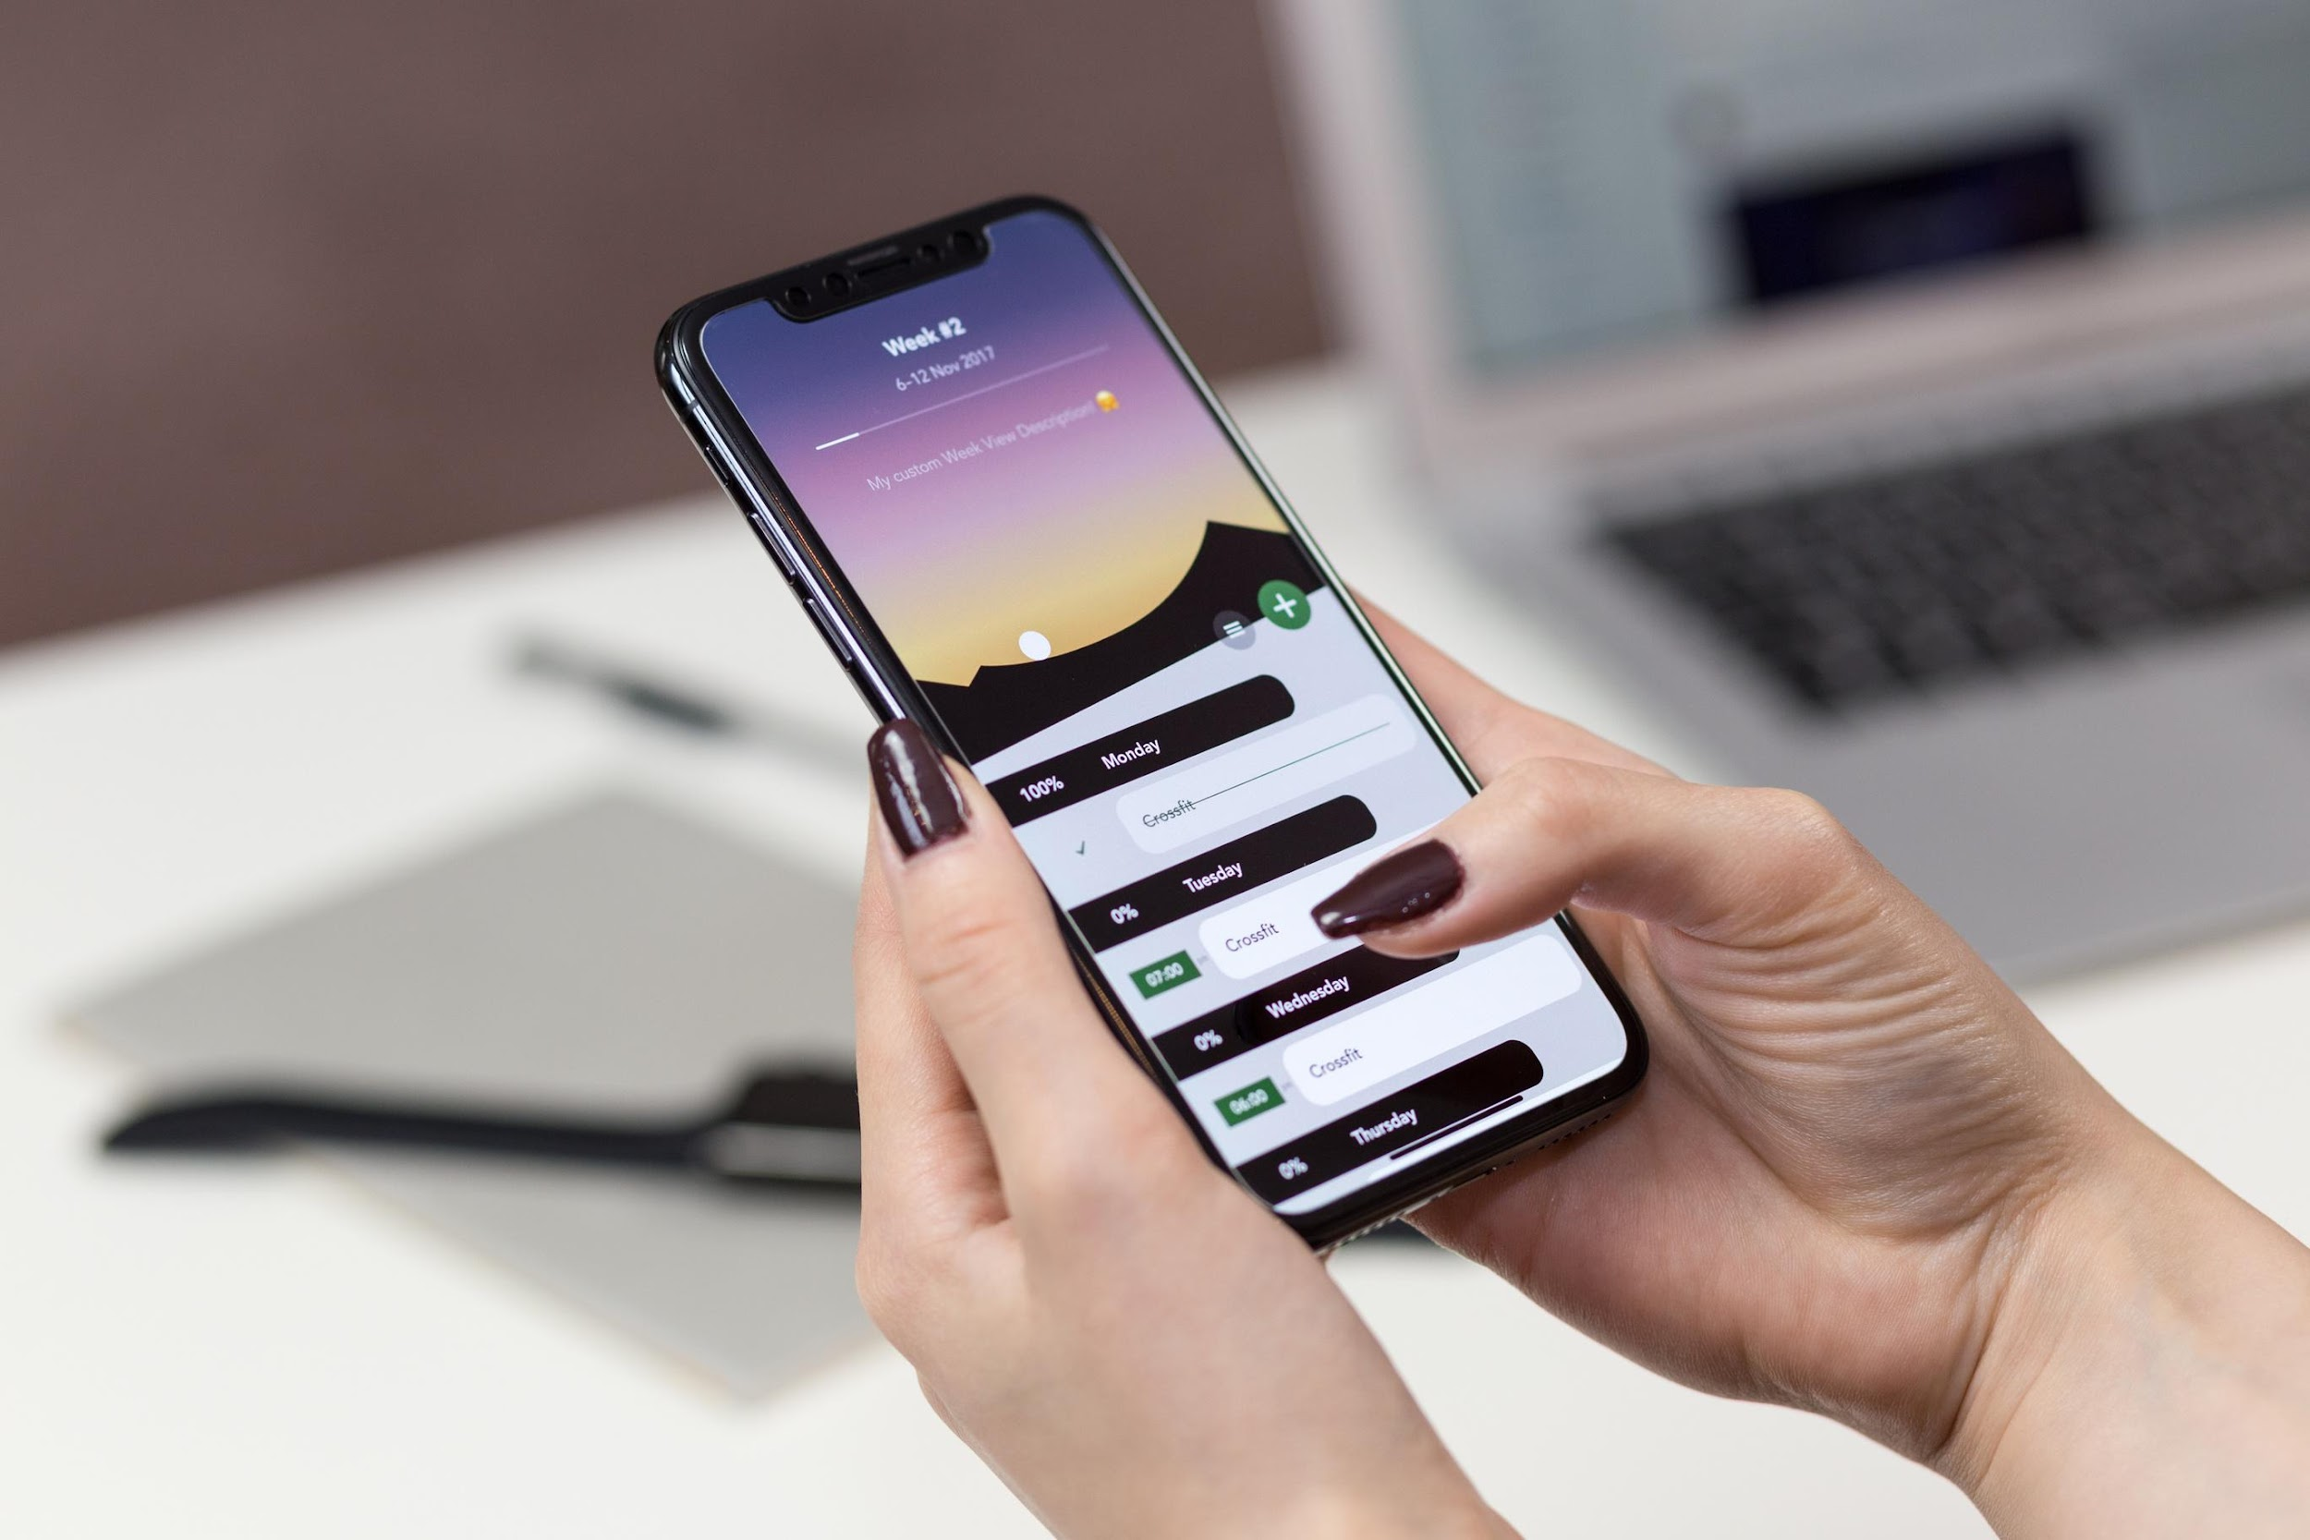


Introduction
We created a website for Joury Tour in the field of tourism using WordPress that displays the tours offered by the company to customers in addition to creating a database to save customer data and provide informational needs for company management and extract reports easily with the ability to make reservations and savings, modify and delete operations, reduce manual work for employees, increase efficiency and customer satisfaction Enable them to suggest the trips they want and save effort and time.

Slide 5

About the company
The Goal
Joury Travel and Tourism was established in 2011, and its director is Louay Joury. The company is located in the city of Nablus / Al-Dawwar, next to the Arab Bank,
with the aim of organizing tourist trips due to the desire of the different segments of society to see and learn about the landmarks of the Palestinian cities.

Slide 6



The company problem
1- Unavailability of an electronic means for the company.
2- The company does not rely on booking via Facebook.
3- Press on the employee who submits the flight reservation requests.

Slide 7



Vision
Providing assistance and comfort to the company and the customer with great accuracy, by building an interactive relationship between the customer and the company by providing the best services and permanent assistance to the customer in a professional and organized manner, and promoting its brand that enjoys credibility and professionalism in providing its various services.
Mission
Create a brand for Joury Travel and Tourism.

Slide 8

Feasibility
Joury Tours
Enable the customer to interact directly with the company through the website
The company needs a special website to register with its flights
Obtaining the necessary reports to take appropriate decisions
Introduce customers to the trips you offer and provide them with different details about them
Transparency in prices so that the customer can choose the flight that suits him

Slide 9

We offer special services:
1- The presence of the feature of the expert system that enables the user to choose the flight that suits him based on the place, date and price.
2- What matters to the customer is the price and we have taken into account the transparency of prices (the price is on hand).
3- The presence of the feature of suggesting a trip.
Why do customers choose us

Slide 10
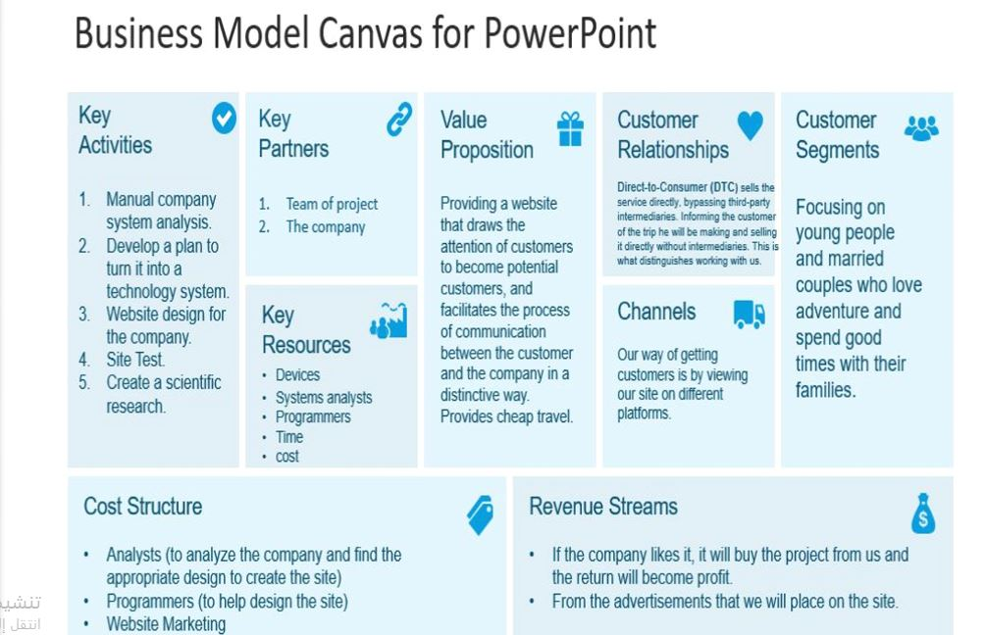

Slide 11
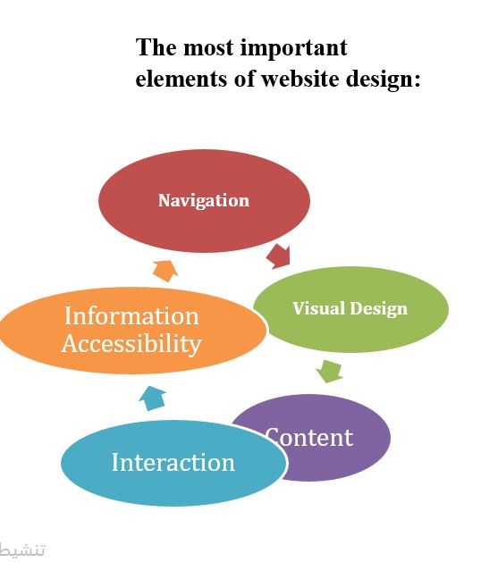

Slide 12
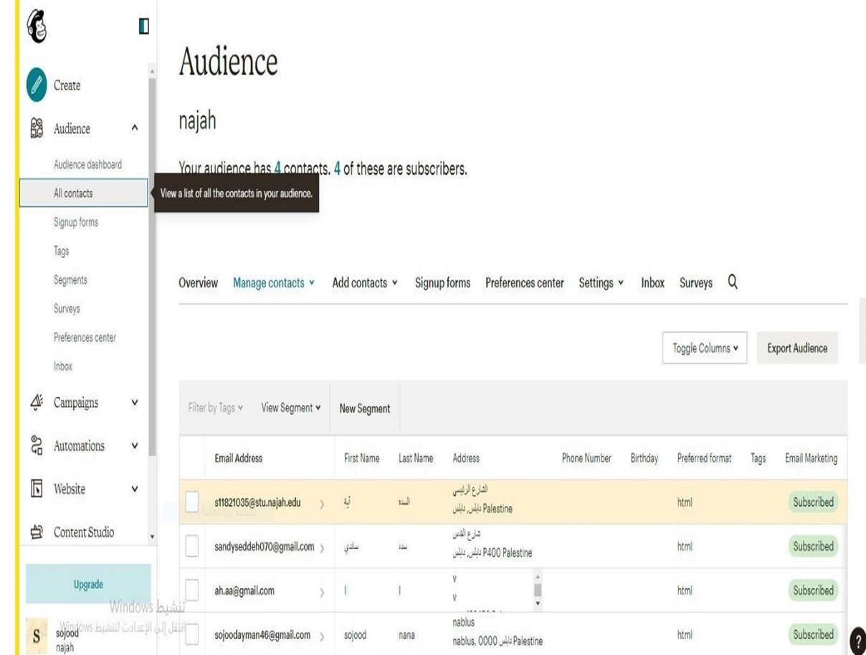

Slide 13
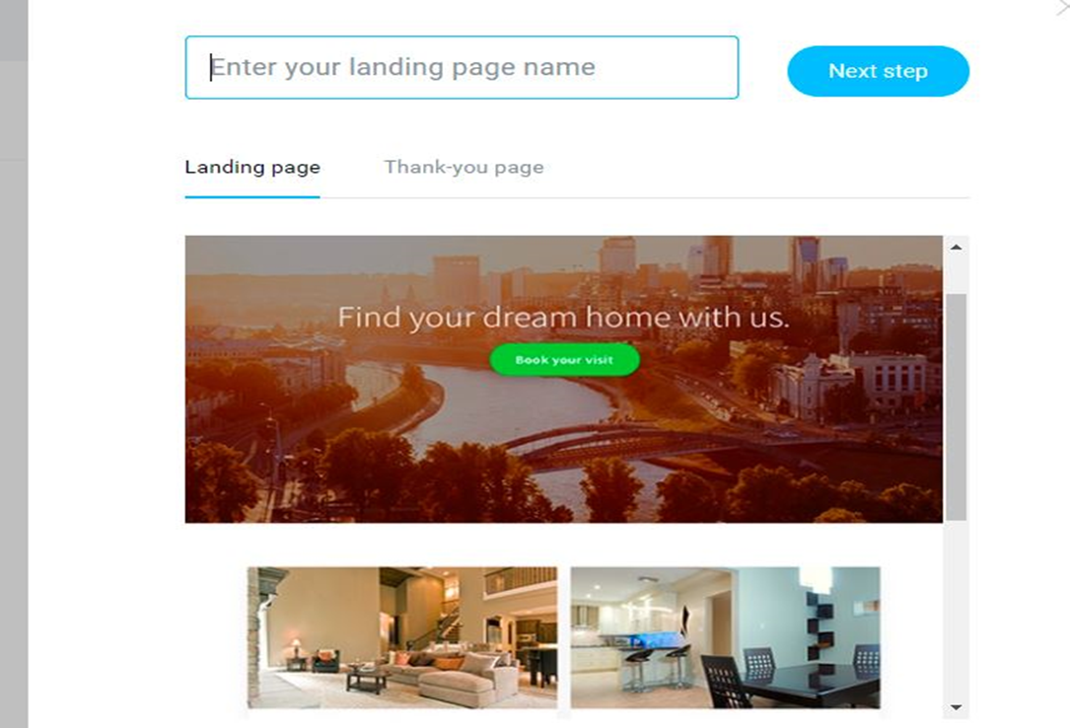

Slide 14
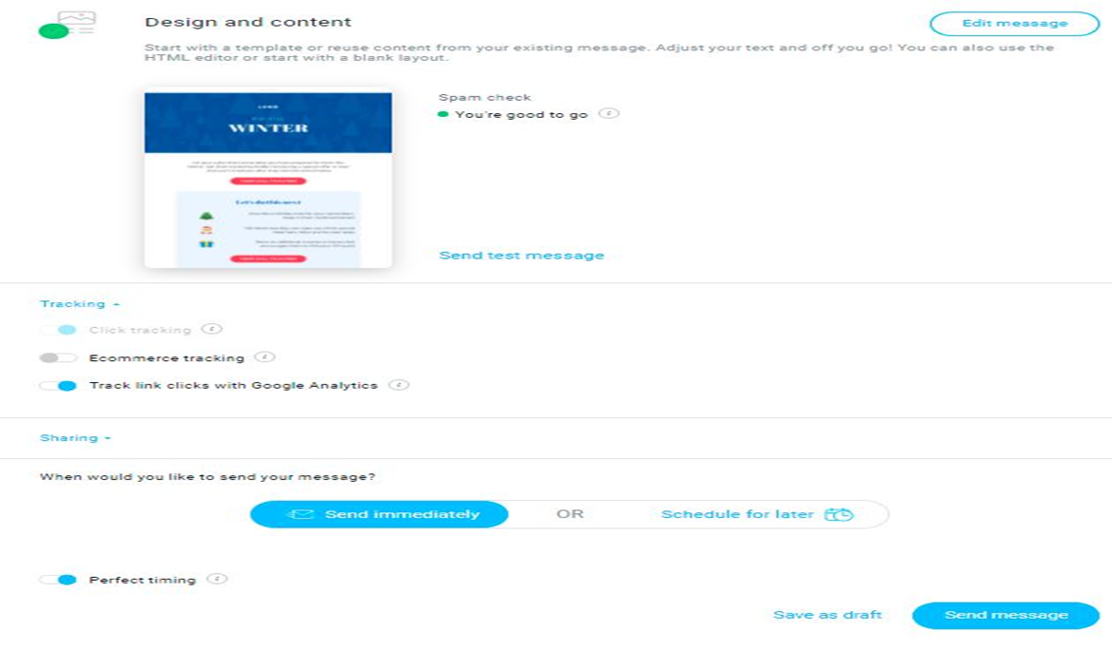

Slide 15
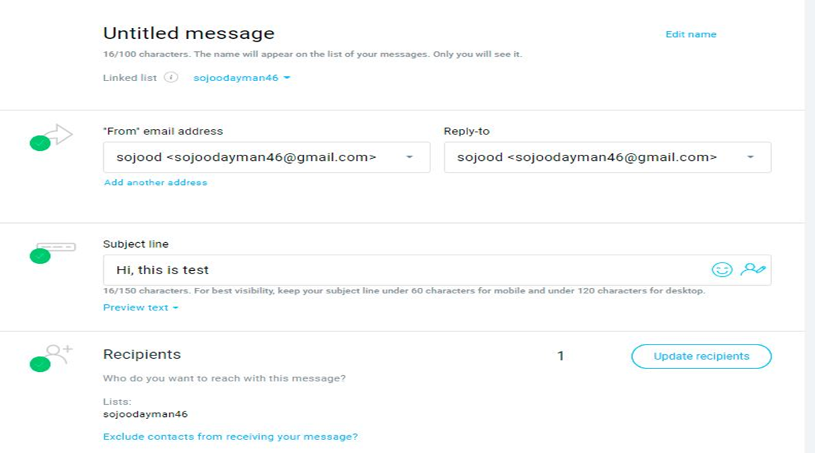

Slide 16
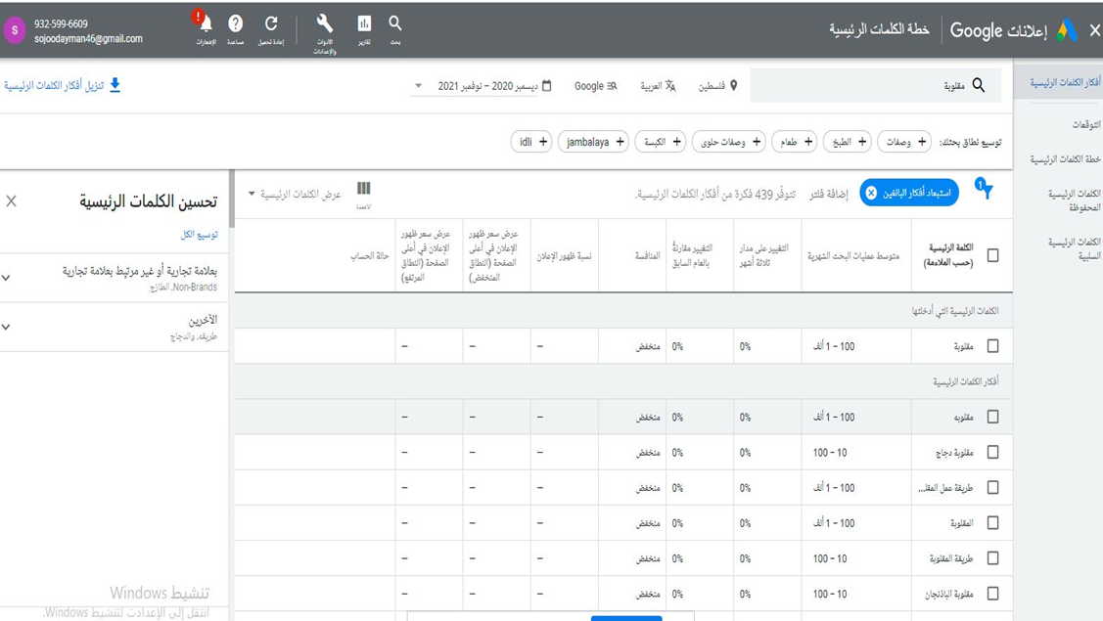

Slide 17
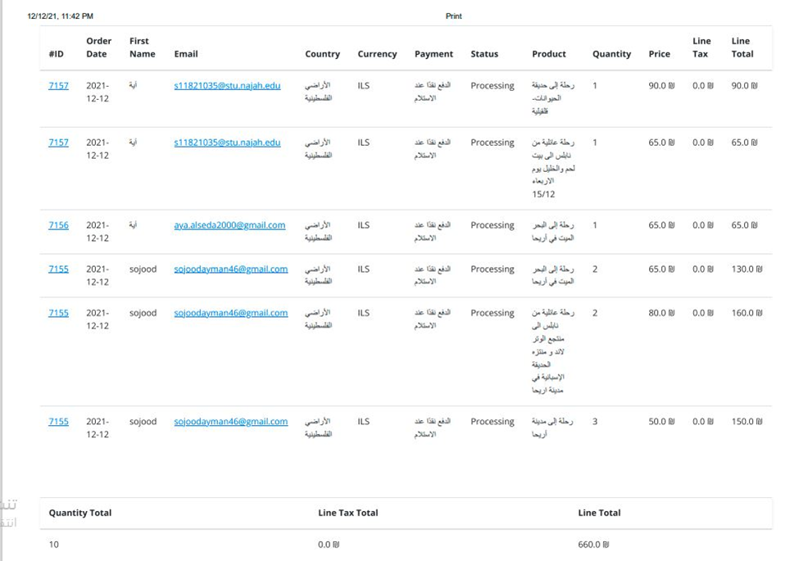

Slide 18
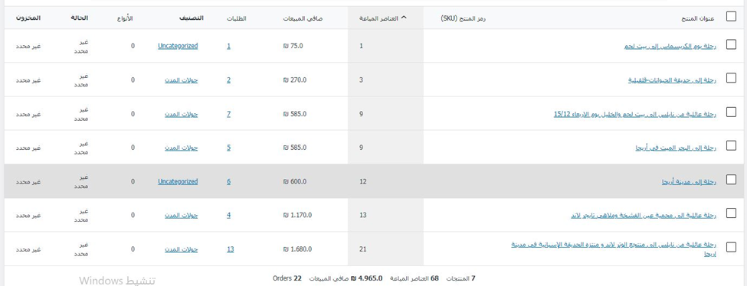

Slide 19



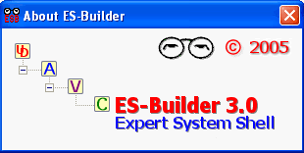
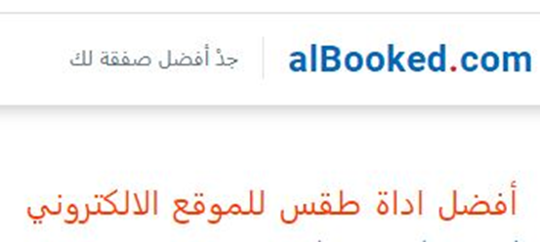





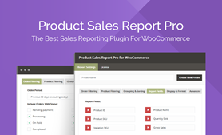


The tools we used
Joury Tours

Slide 20


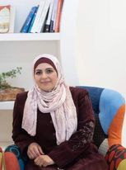
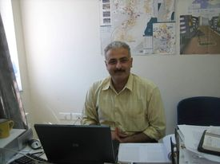
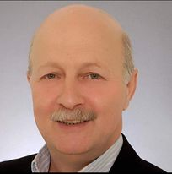
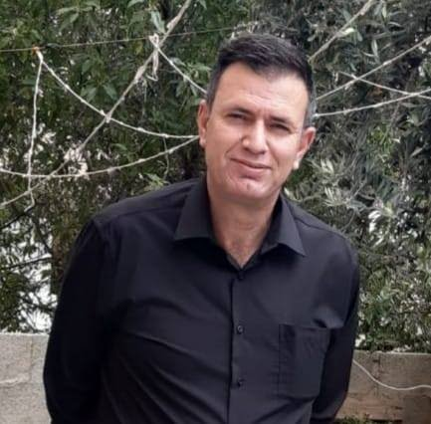
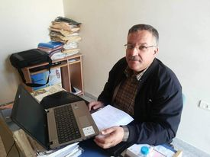
Dear Teachers
Maher Abu Baker
Ahmad Shraideh
Najwan Jamil Deleq
Maher Yousef Arafat
Mohammed Dwikat
Kamal Irshaid
Thank you so much to all

Slide 21

Thank you
Do you have any questions?

