Slide 1

Three Dimensional Design of Al-sakhl Residential Building Under Gravity and Seismic Loads
An-Najah National University
Faculty of Engineering
Civil Engineering Department
Prepared by:
Abdulkarim Ghozzi
Ali Sawalha
Anas Alawneh
Mohammad Yaseen
Supervisor: Dr. Mahmoud Dweikat.

Slide 2
Introduction.
Review of 3D Modeling
Seismic Analysis
Final design and details

Slide 3
Project description
The building is located in Rafedia-Nablus
The building consists of 8 floors, of which 2 are underground basement floors.
The total floor areas of the building are 4786 m2.
It has two parts separated by a construction joint.

Slide 4
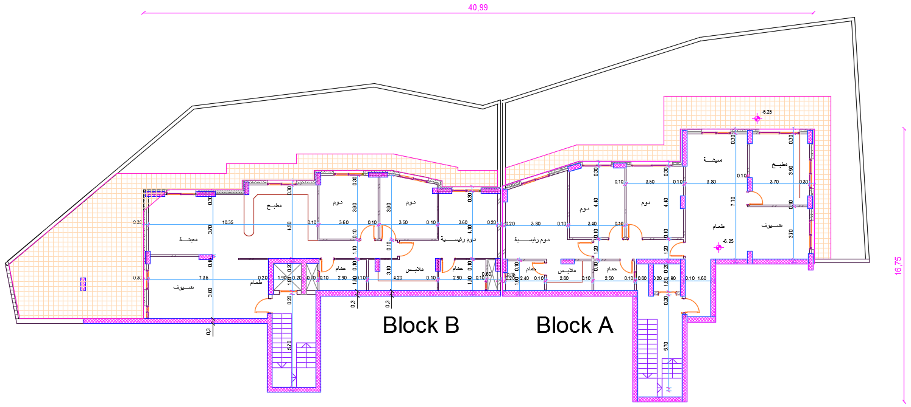
  Basement 2 floor (Residential apartments) :

Slide 5
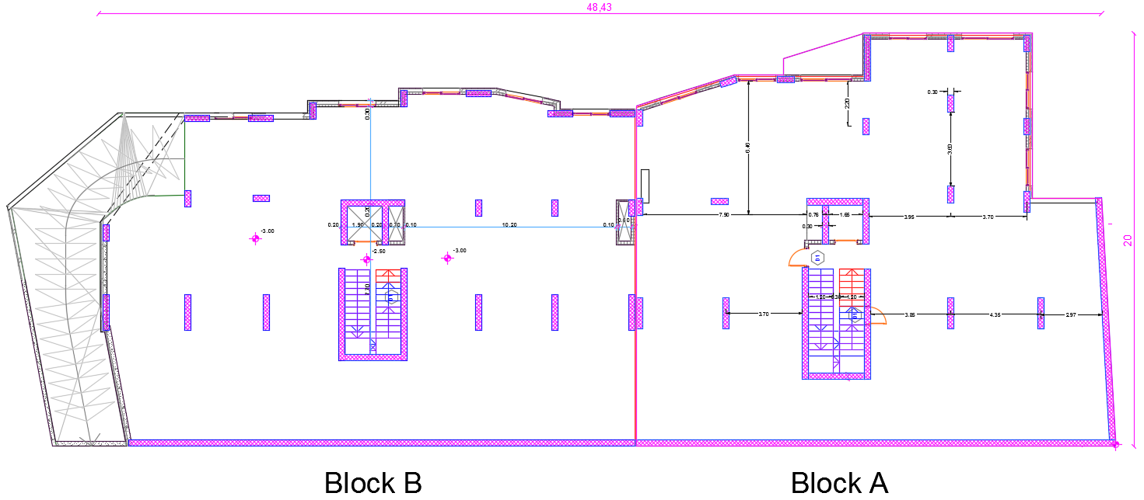
  Basement 1 Floor ( Parking )

Slide 6
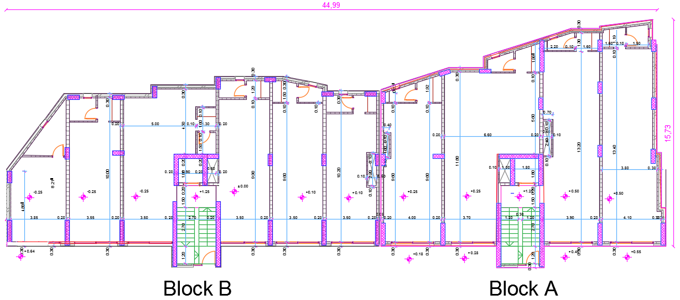
  Ground floor (commercial stores)

Slide 7
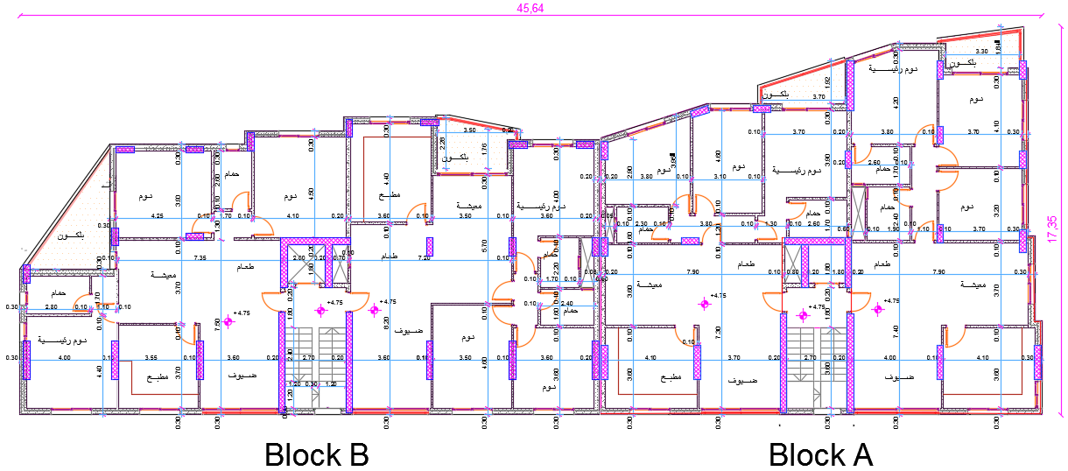
  Repeated floor (Residential apartments):

Slide 8
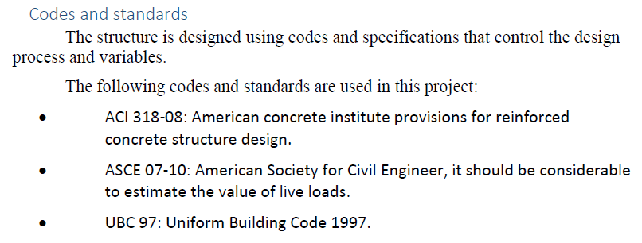
  Assumptions for Design:
8

Slide 9
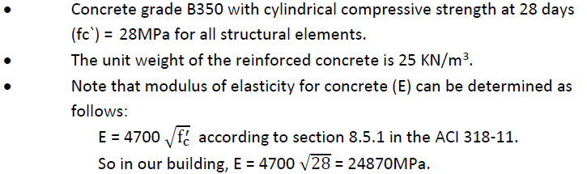
    Structural Materials:
Reinforced concrete
Steel (Rebar, shrinkage mesh and stirrups)
Yielding strength (Fy) = 420MPa.
Modulus of elasticity (Es) = 200GPa

Slide 10
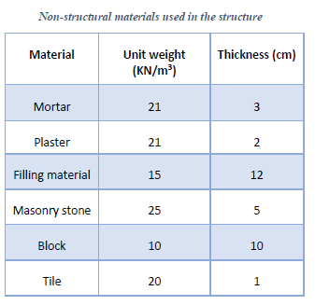
    Non-Structural Materials:

Slide 11
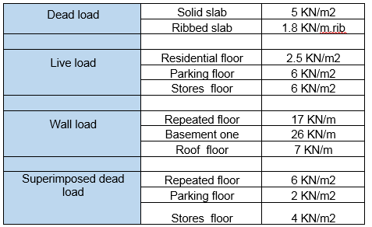
Load Assumptions:
11

Slide 12
Soil Property
Allowable bearing capacity of soil=250 KN/m²
Surcharge Load is assumed to be 20 KN/m²
Unit weight of soil (𝛾𝑠𝑜𝑖𝑙) = 18 KN/m3

Slide 13
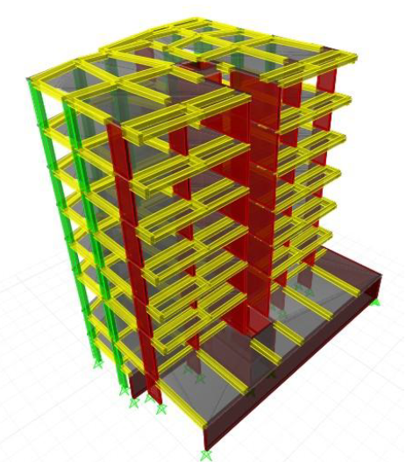
3D Model

Slide 14
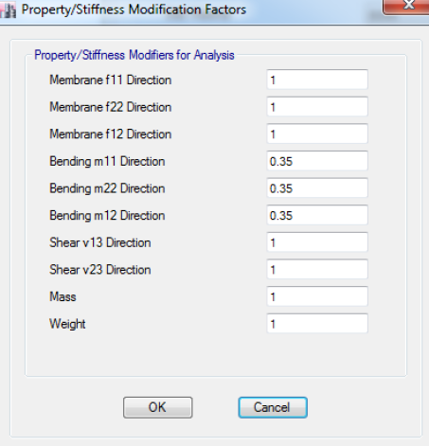
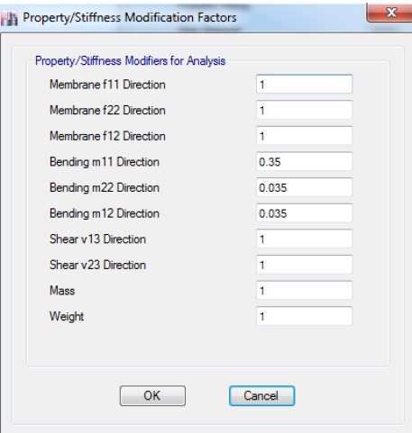
Slab modifiers
One Way Ribbed Slab
One Way Solid Slab

Slide 15
Also, for beams , columns and shear walls the modifiers are as follows:
Beams:
Torsional constant: 0.35
Moment of inertia about 2 axis: 0.35
Moment of inertia about 3 axis: 0.35
Columns:
Torsional constant: 0.7
Moment of inertia about 2 axis: 0.7
Moment of inertia about 3 axis: 0.7
Shear Walls:
Torsional constant: 0.7
Moment of inertia about 2 axis: 0.7
Moment of inertia about 3 axis: 0.7

Slide 16
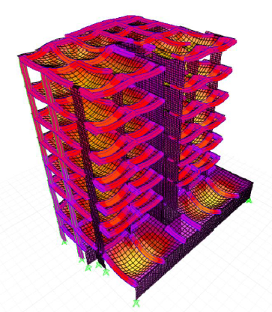
Checks
Compatibility:

Slide 17
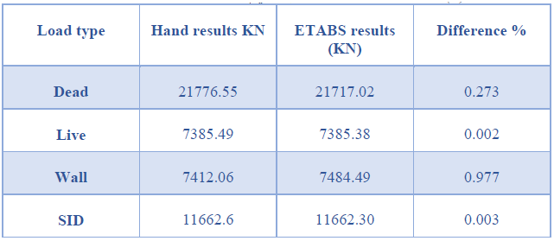
Equilibrium:

Slide 18
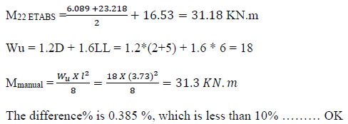
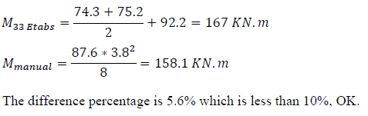
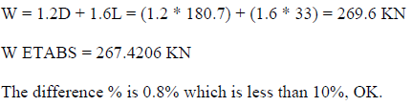
Stress strain relationship check
Check slab
Check Beam
Check Column

Slide 19
Dynamic Analysis
UBC 97 code
Response spectrum analysis method

Slide 20
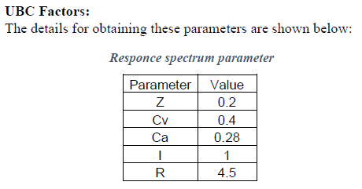

Slide 21
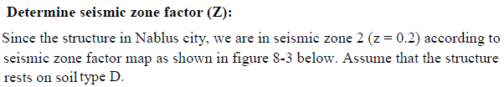
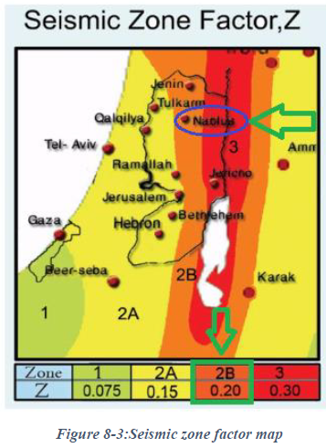

Slide 22
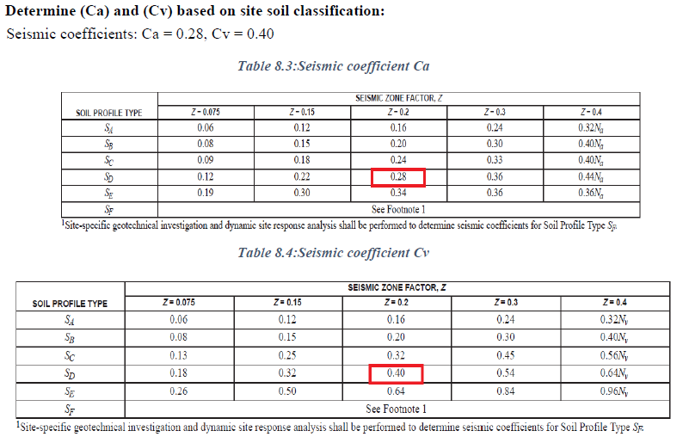

Slide 23
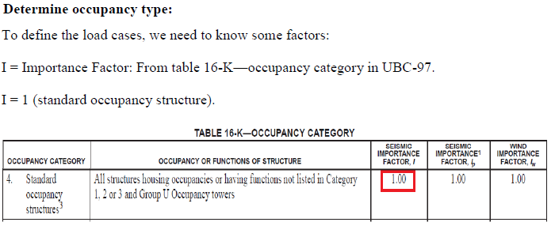

Slide 24
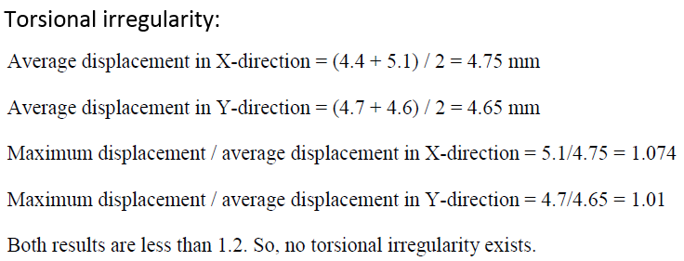

Slide 25
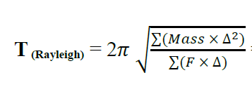

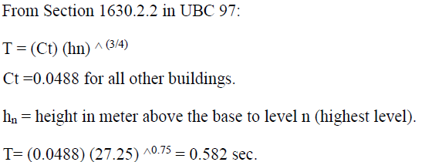
Check Period (T) :
The structure has a period T =0.477 seconds
T = 0.48 sec
T method A :

Slide 26
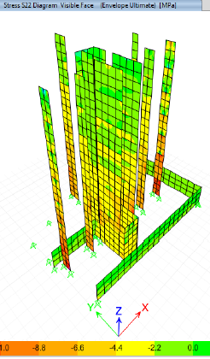

Determine response modification factor ( R ) :
1 KN/m2 load applied over the area.
X-Direction :
Total reaction for shear wall = 1732.4 KN …………. >75%
Total reaction for column = 448.88 KN
Total reaction = 2181.26 KN
Also in Y-direction …… >75%
To decide the type of wall we checked the axial stress:
0.06 * 28 = 1.68 Mpa
Stresses > 1.68 Mpa , then bearing wall

Slide 27
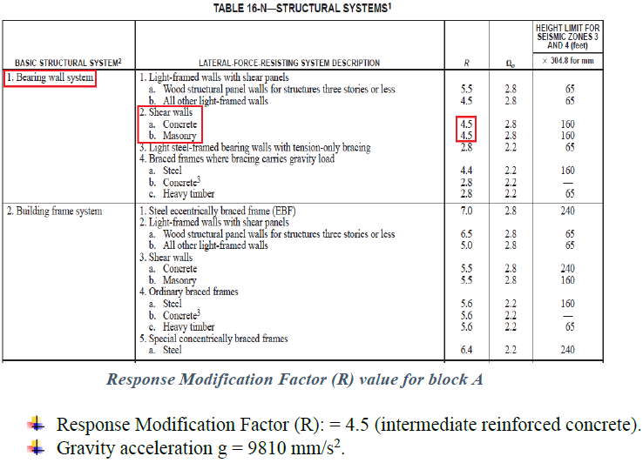

Slide 28
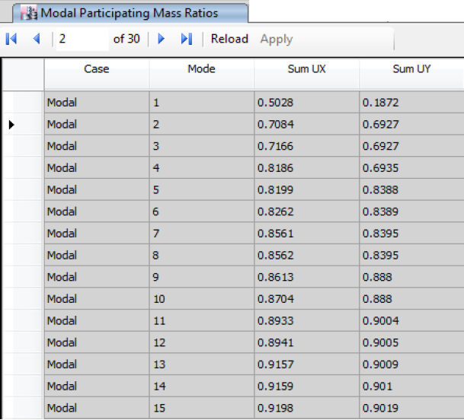
Modal case:

Slide 29
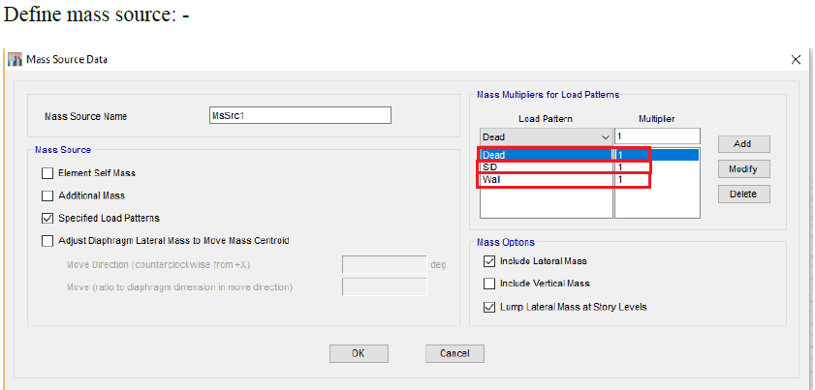

Slide 30
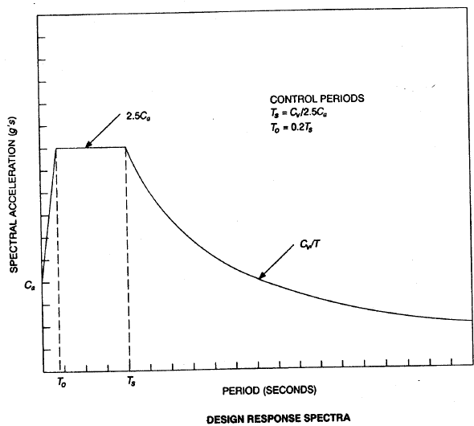
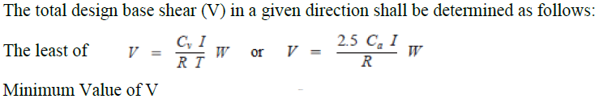
Using response spectrum to determine the design base shear:

Slide 31
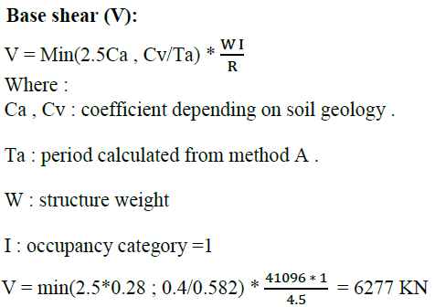

Slide 32
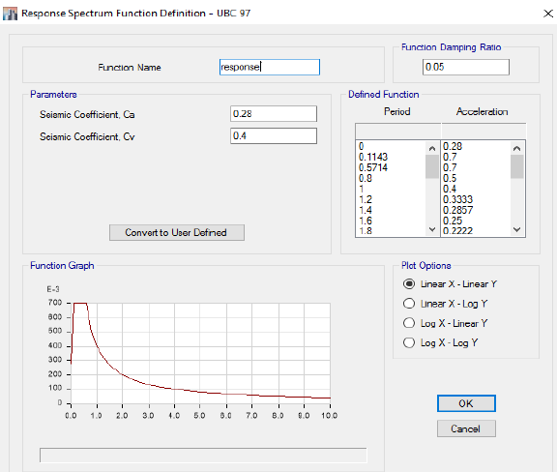
Define Response in ETABS program

Slide 33
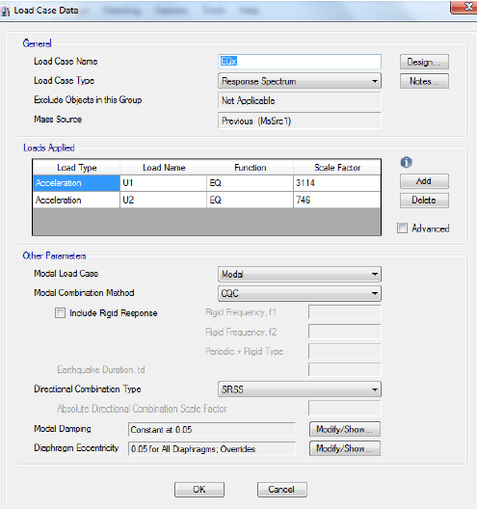

Define load cases

Slide 34
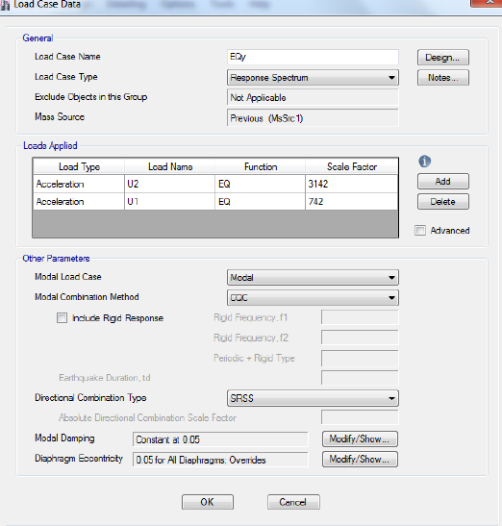
Define load cases

Slide 35
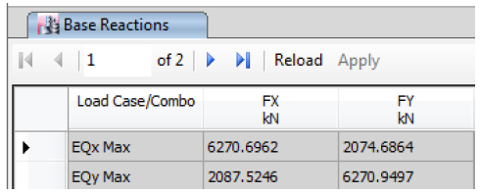

Slide 36
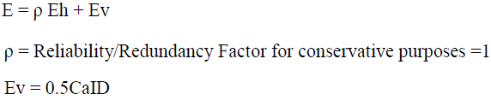
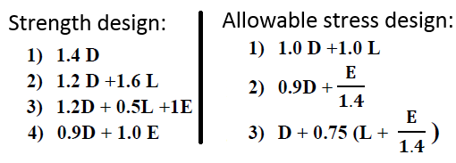
Load combinations

Slide 37

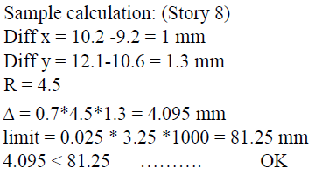
Check Drift :

Slide 38
Design of structural elements
Slabs
Beams
Columns

Slide 39
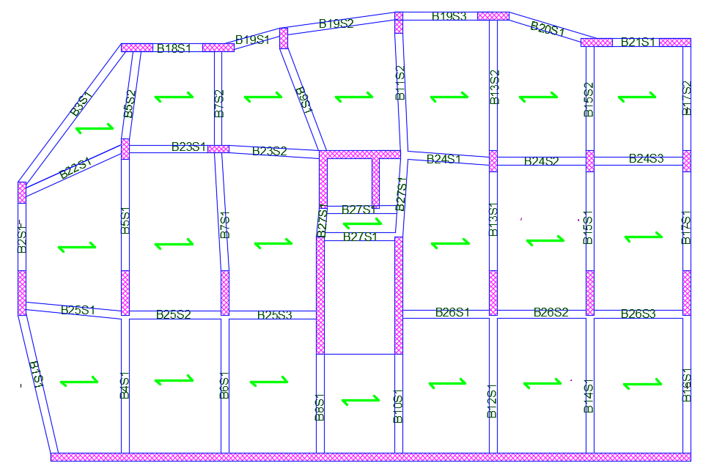
Design of slabs
The structural system for the basement one is one way solid slab(20 cm) with drop beams.
Solid slab in block B, story 2.
An-najah National university

Slide 40
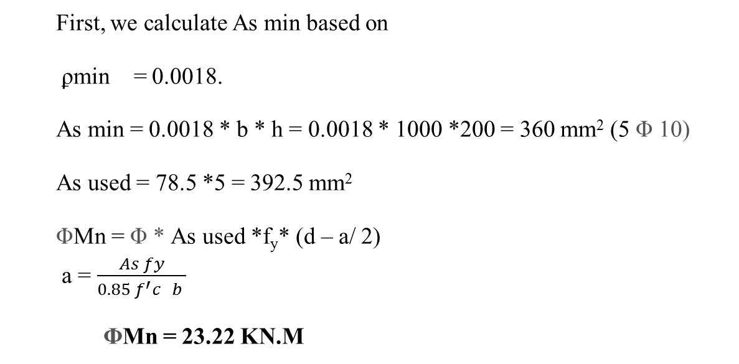
Analysis and Design for flexure

Slide 41
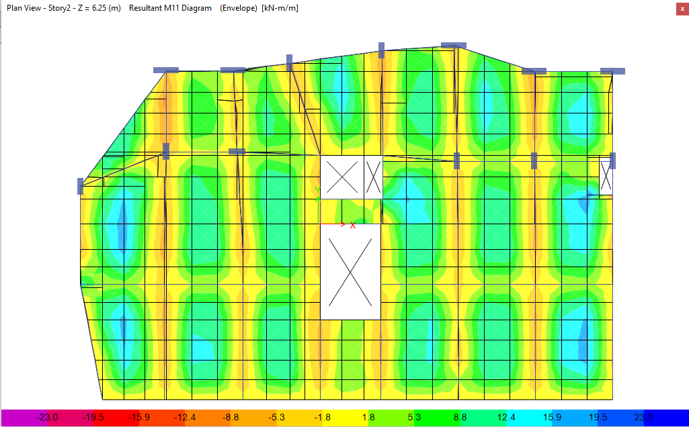
For positive moment.
The values of M22 for the story two

Slide 42
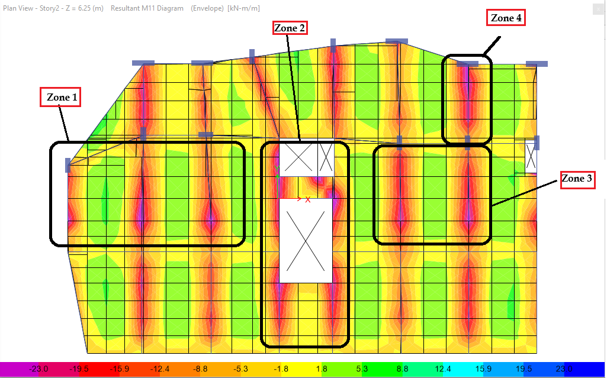
For negative moment.

Slide 43
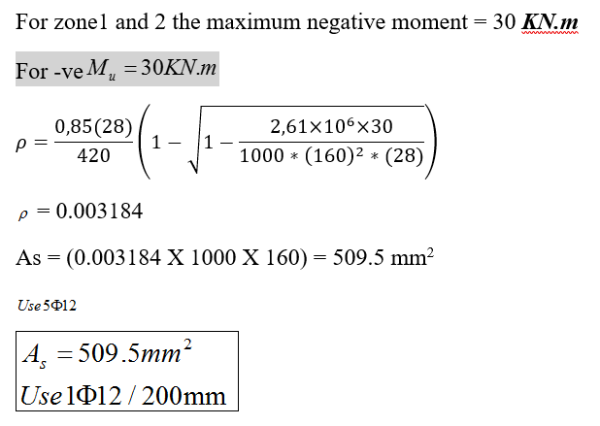
For negative moment.

Slide 44
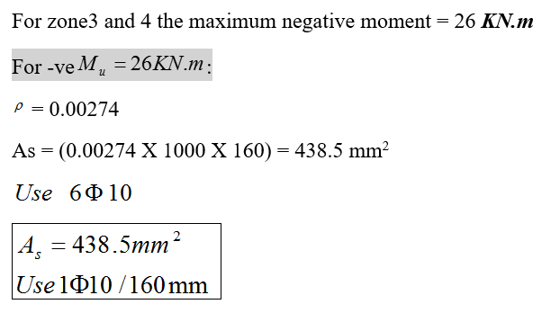
For negative moment.

Slide 45
zone # | Moment sign | Bar
1, 2 | - ve moment | 1ɸ12/200mm
3, 4 | - ve moment | 1ɸ10/160mm
other | - ve moment | 1ɸ10/200mm

Slide 46
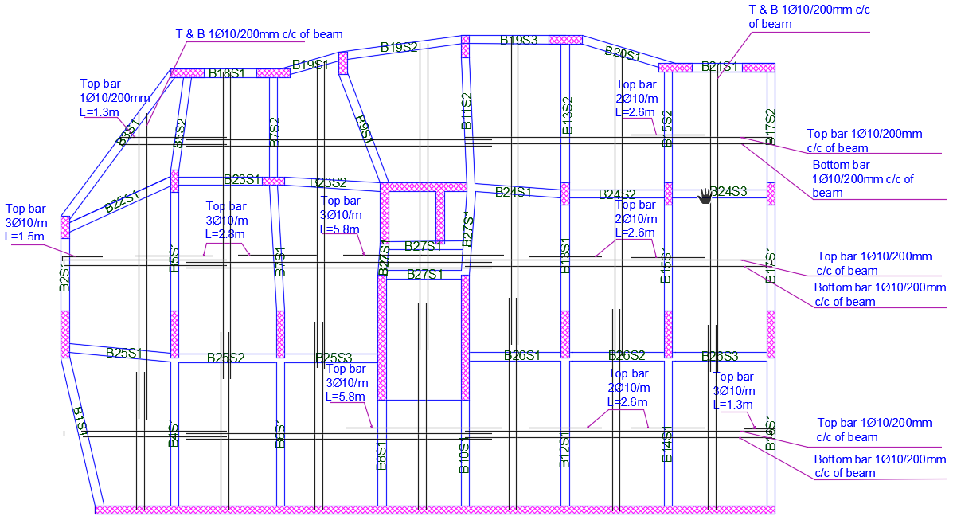

Slide 47
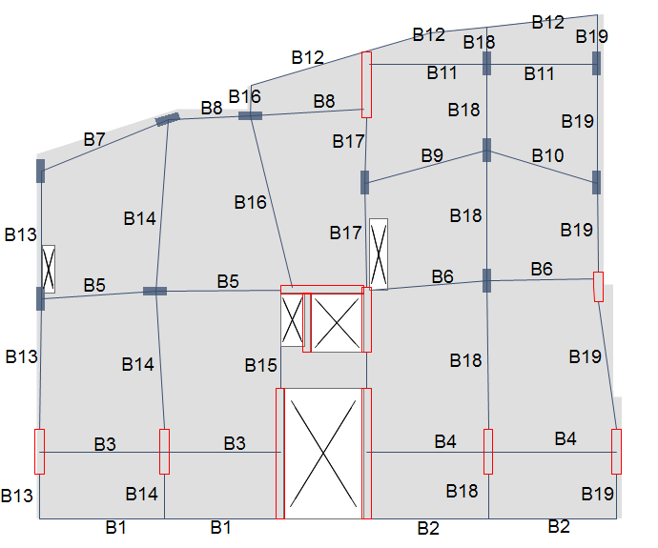
Design Of Beams
Final output was taken from 3-D model.
The following figure shows the final locations and layout of beams in the repeated floor
Beams must be designed against moment and shear.
The values for these forces are obtained from 3D model

Slide 48
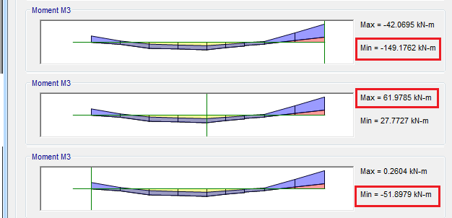
Analysis and Design for flexure and shear
Design for flexure:

Slide 49
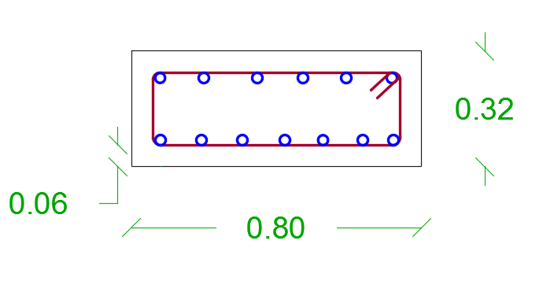
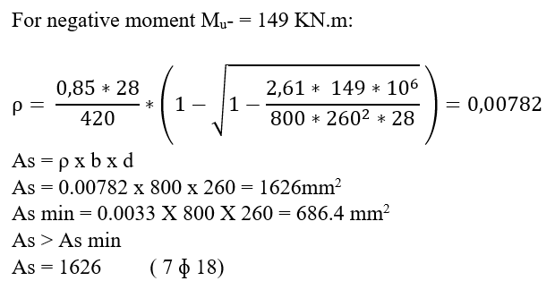
Analysis and Design for flexure

Slide 50
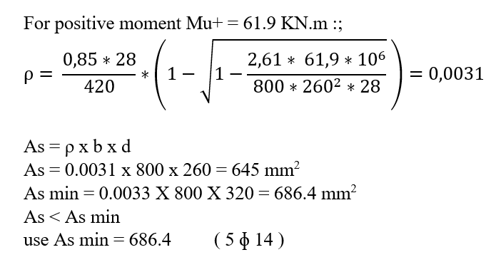
Analysis and Design for flexure

Slide 51

Analysis and Design for flexure

Slide 52
Design for flexure:
Longitudinal reinforcement for B5
 | location | As (mm2) | bars
B5 | Negative – Left | 686 | 5Ø14
 | Positive | 686 | 5Ø14
 | Negative -Right | 1626 | 7Ø18

Slide 53


Design beam (B5) for shear:

Slide 54

Design beam (B5) for shear:

Slide 55

Seismic requirement:

Slide 56

ETABS design result for this beam (B5):

Slide 57

Design of columns

Slide 58

Sway –Non sway Check
In the X-direction:
In the Y-direction:
Slenderness Check
Take Column in block B

Slide 59

Designing the Column under axial force and moment: -
The Ultimate forces on the column: -
P_{u}= 2351 KN.
M_{u}= 59 KN.m < M_{min}
M_{min}= P_{u} (0.015+0.03h) = 2351 * (0.015 + (0.03*0.8)) = 91.69 KN.m
Use M = 91.69 KN.m

Slide 60



Slide 61
by using the interaction diagrams:
Now:
ρ = 0.01
As = 0.01 * 800 * 300 = 2400 mm².
As from ETABS = 2400 mm².
.

Slide 62
Seismic requirement:
So = Min { 300/2 = 150
8*14 =112
24*10 = 240
300 }
So = 112 mm
use So = 110 mm
S1 = Min { 300
16*14 = 224
48*10 = 480 }
S1 = 224 mm
use S1 = 220 mm
lo = Max {800
((3250-320=2930) /5) = 586 }
lo = 800 mm

Slide 63


A longitudinal section in column (C3)

Slide 64

Design of shear wall
Axial = 2367 kN
M_{ux} = 266 KN.m
M_{uy} = 16 KN.m
V_{ux} = 6 KN.m
V_{uy} = 84 KN
Check shear in x direction:-
V_{ux} (6 KN) < $∅$Vc (281 KN) ➔ Ok
Design for shear in y direction:-
𝑉_{uy}/$∅$ = (112 KN) < Vc (360 KN)
Use ρ_{t} = ρ_{t min} = 0.0025
Use 1$∅$12/250 mm on each side

Slide 65


Design for moment around Y axis:-
M_{uy} = 16 KN.m
𝐴𝑠 = 212 mm² On each side of the wall
Design for axial force and moment around X axis:-
ρ_{l} = 0.0025
𝐴𝑠= 1275 mm² or 638 mm² on each side
Total area of steel 638 + 106 = 744mm²
➔ Use 7$∅$12 mm on each side.

Slide 66
Design of mat footing
Thickness = 1000 mm
Checks:
Check stress under mat foundation:
𝜎_{allowable} = −250 kN/m²
𝜎_{maximum} = −162 kN/m²
𝜎_{minimum} = −5 kN/m²

Slide 67
Check punching shear for mat foundation:
Ultimate punching shear-to-punching shear capacity ratios

Slide 68

Reinforcement of Footings

Slide 69

Design of stairs
Own weight = 6 KN/m
SID = 4 KN/m
Live = 5 KN/m
Vu = 55.4 KN
ɸ Vc = 86 KN ➔OK
Mu = 73 KN.m
Use 1 Ø 18 / 150 mm

Slide 70


Slide 71
Seismic joint
𝑠𝑒𝑖𝑠𝑚𝑖𝑐 𝑗𝑜𝑖𝑛𝑡 = Δ𝑀1 + Δ𝑀2 + 2 𝑐𝑚
  = 9 cm

Slide 72




