Slide 1
Realtime Tutoring System
Ata Abu rajab
Supervisor : Dr. Adnan Salman

Slide 2

Definition
This software aims to move the classroom experience into the web

Slide 3

Motivation
Solve the unemployment issue in graduates of educational sciences.

Slide 4
Features
Voice Chat
Realtime writing
Rooms, where each room has its own domain

Slide 5
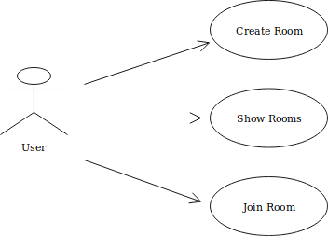
Scenarios and Use cases
Ahmad is a teacher, who creates a room to start tutoring his students.
Ali, one of his students uses the show room functionality to list the available rooms, then he joins his teacher’s room.

Slide 6
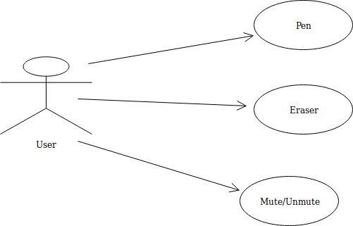
Room page Use cases

Slide 7
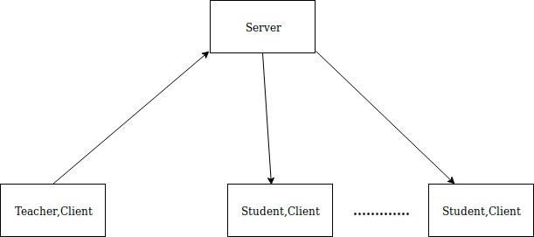
Architectural design
The teacher sends the data to the server, the server broadcasts it to all the students clients in the room

Slide 8
Design and implementation
The application consists of 2 pages, the lobby page, the room page
The lobby page is a large waiting room or reception area, where the users can create new rooms, and even join ones.
The room page is the place where the tutoring is done.

Slide 9
Design and implementation
Create Room functionality :
1- The Client sends an HTTP request along with the room name as a parameter to the server to create the room.
2- The Server allocates the buffers required to create the room, and if there is no error, it responds back with a success message.
3- If a success message is return the browser joins the newly created room.

Slide 10
Design and implementation
Show Room functionality :
1- The Client sends an HTTP request to the server.
2- The server responds with the list of available rooms names.

Slide 11
Design and implementation
Join Room functionality :
1- The browser redirect the client to the room page, passing in the room name as a parameter to the room page.
2- The room name is used as a title for this html page
3- When the client joins the room, the browser establishes a web socket connection with the server passing in the title of the room
4- The server creates a websocket object for this client, and appends this object into the room, which is an array of websocket objects.

Slide 12
Design and implementation
Writing functionality :
1- When the client joins the room, the browser will establish a connection with the server using websocket protocol, and it will pass the name of the room to the server.
2- When you do a mouse click, the browser will draw a small filled circle, but if you hold on the click to draw a shape using the small circles , the shape would be disconnected, because there is a delay between each drawing of a circle, so in order to solve this issue we connect these circles by a line, and a JSON object is then constructed and sent to the server, which contains the coordinates.
3- The server will broadcast each message coming from this user via websocket protocol to all of the clients in his room.

Slide 13
Design and implementation
Audio functionality :
1- When the client joins the room, the browser will establish a connection with the server using websocket protocol, and it will pass the name of the room to the server.
2- The browser will request the access of the microphone from the user, if he accepts the microphone will start streaming the audio data, we process these data and convert it into an array of floating numbers, then we send it to the server via websocket protocol.
3- The server will broadcast each message coming from this user via websocket protocol to all of the clients in his room.
4- The clients who receive these audio data will reverse the processing and play the audio .

Slide 14
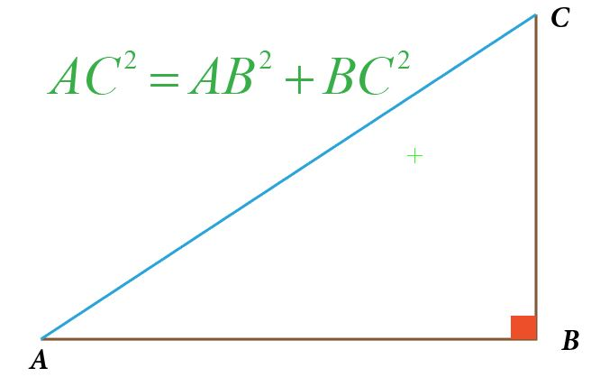
Pythagoras theorem
Lets try our system by explaining pythagoras theorem.

Slide 15
Technologies used
Javascript
Typescript
Jquery
NodeJs
ExpressJs
Pug templating Engine

Slide 16
Future work
Handwriting recognition, Cloud recognition such as : myscript.com
More work into UI
Chat between the students and the teacher
Web cam
Ability to insert images and slides
Payment system

