Slide 1

Digital Gate
Ayman Hunjol
Dawood Halawa
Ashraf Hakawati
Supervisor: Dr. Mai Abusair
An-Najah National University
College of Engineering and Information Technology - Department of Computer Information Systems

Slide 2
Introduction
01
The evolution of e-commerce
Lack of utilizing recommendation systems in online stores
02
03
What does our idea present?

Slide 3
Problem
1
The Customer
No Motivation for customers to buy Products.
2
Online stores
They use the same ordinary system and technique in building online stores which makes the customer less excited since he uses same system in most of online shops.

Slide 4
The primary purpose
01
It is to replace the traditional systems of online stores and to motivate customers to buy and interact with system more.
time lost
02
Reducing time lost in the product searching and ordering process by utilizing online banks and payments providers via internet .
Solution
Digital Gate System

Slide 5
Outline
01
Methodology
02
System Requirements
03
System Implementation
04
Conclusion/ Future Work

Slide 6
Methodology
Current system
Proposed System
Project Methodology
Recommendation System Methodology is represented by offering the Customer Some offers that he may Like or Even Buy it! But it's based on a technique. In the proposed system we will use collaborative filtering algorithms by searching a large group of users or items and finding a smaller list from it with tastes similar to each other.
Most companies use a Non Personalized System which means that every user or visitor will see the same products as the other users.
The project team will use one of the methods used in software engineering (Systems Development Life Cycle) to achieve the system's expected outcomes. The beginning is on collecting the largest quantity of information about similar systems, projects and existing problems.

Slide 7
System Requirements
The system is based on the following key elements :-
01
Admins
02
Customers
03
The System
Retailer

Slide 8


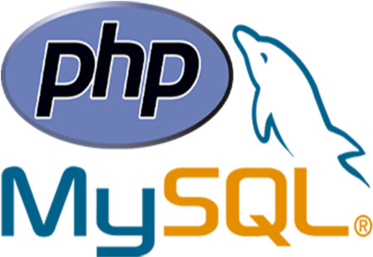
Back-End
System Implementation
Back-End
Front-End
Back-End server
PHP-Laravel
HTML-5
MySQL
Firebase

Slide 9
System Implementation
PHP-Laravel (Back-End)
PHP-Laravel (Back-End)
HTML-5 (Front-End)
HTML-5
(Front-End)
What laravel? Laravel is a free and open source framework. It allows you to develop your own programming languages It provides a lot of features and plugins to link third party packages in the project
Why?
1- Routing system
2- Laravel supports the MVC.
3- Easy to use and utilize PHP
4- High security
5- Eloquent model
What? is a cooperation between the World Wide Web Consortium (W3C) and the Web Hypertext Application Technology Working Group (WHATWG).
Why?
1. Improved parsing rules and compatibility
2. Easy to handle
3. Data Binding
4. Testability
5. Performance

Slide 10
System Implementation
MYSQL server
MYSQL server
-
-
What?
It is a database management system that depends on the SQL language, and MySQL is the second most used open source database management system in the world.
Why?
1. Simple compared to other databases
2. It is powerful and fast at the same time
-.

Slide 11
Conclusion
Digitalgate is designed to provide a web-based application that gives an amazing shopping experience. The application implements a full recommendation system in order to provide an easy and comfortable way to search for products.

Slide 12
Future Work
Many different adaptations and tests have been left for the future due to lack of time.
01
Build RESTful API
02
Working on merchant smartphone app
03
Implementing dynamic recommendation system to adapt to system resources

Slide 13
Thank you

