Slide 1

Business recommender system Based on markets zones and commercial data
Supervisor : Dr. MAI ABUSEIR
BY:
Salsabeel AL zaqa Ruba Egbaria Rania Dameh

Slide 2
CONTENT
01
04
07
INTRODUCTION
ALAYZING DATA
difficulties
02
05
08
PROBLEMS
APPROACH
Future work
03
06
09
MOTIVATING SCENARIO
EVALUATION
WEBSITE

Slide 3

01
INTODUCTION

Slide 4
INTRODUCTION
In many places people are targeted different places to open a business and succeed in it. in the other hand, They may choose an unsuccessful business or the location does not need the type of this business. In this paper we aim to enhance a system that improve the opportunity to choose a business, It is suggested that we make an approach based on many principles of machine learning. The methodology developed a prediction model based on analysis and classification the data using a Clustering Method Based on k-means Algorithm that depends on the same range number of business and cost average in each area. To evaluate the work we generate many tests scenario to show the methodology is successful and solve to problem.

Slide 5

02
PROBLEMS

Slide 6
PROBLEMS
1
The lack of diversity in professions.
1
2
Bad Business Location
2
3
3
Decrease profits

Slide 7

03
MOTIVATING SCENARIOS

Slide 8
MOTIVATING SCENARIOS
First
Second
starting a project with the available money owned by the entrepreneur, with a limited knowledge of the field and its financial requirements in the future, leading to debts.
The lack of diversity in professions in a relatively small geographical area, This may cause reduce sales in frequent stores.
Third
A businessman interested in opening a project with a specific area and capital, without any idea of the commercial shops that the area needs.

Slide 9

04
Analyzing data

Slide 10
ANALYZING DTATA
1
2
3
DELETE
OR FILL UNCOMPLET DATA
DROP
UNNESSERY COLUMN
COLLECT THE DATA

Slide 11
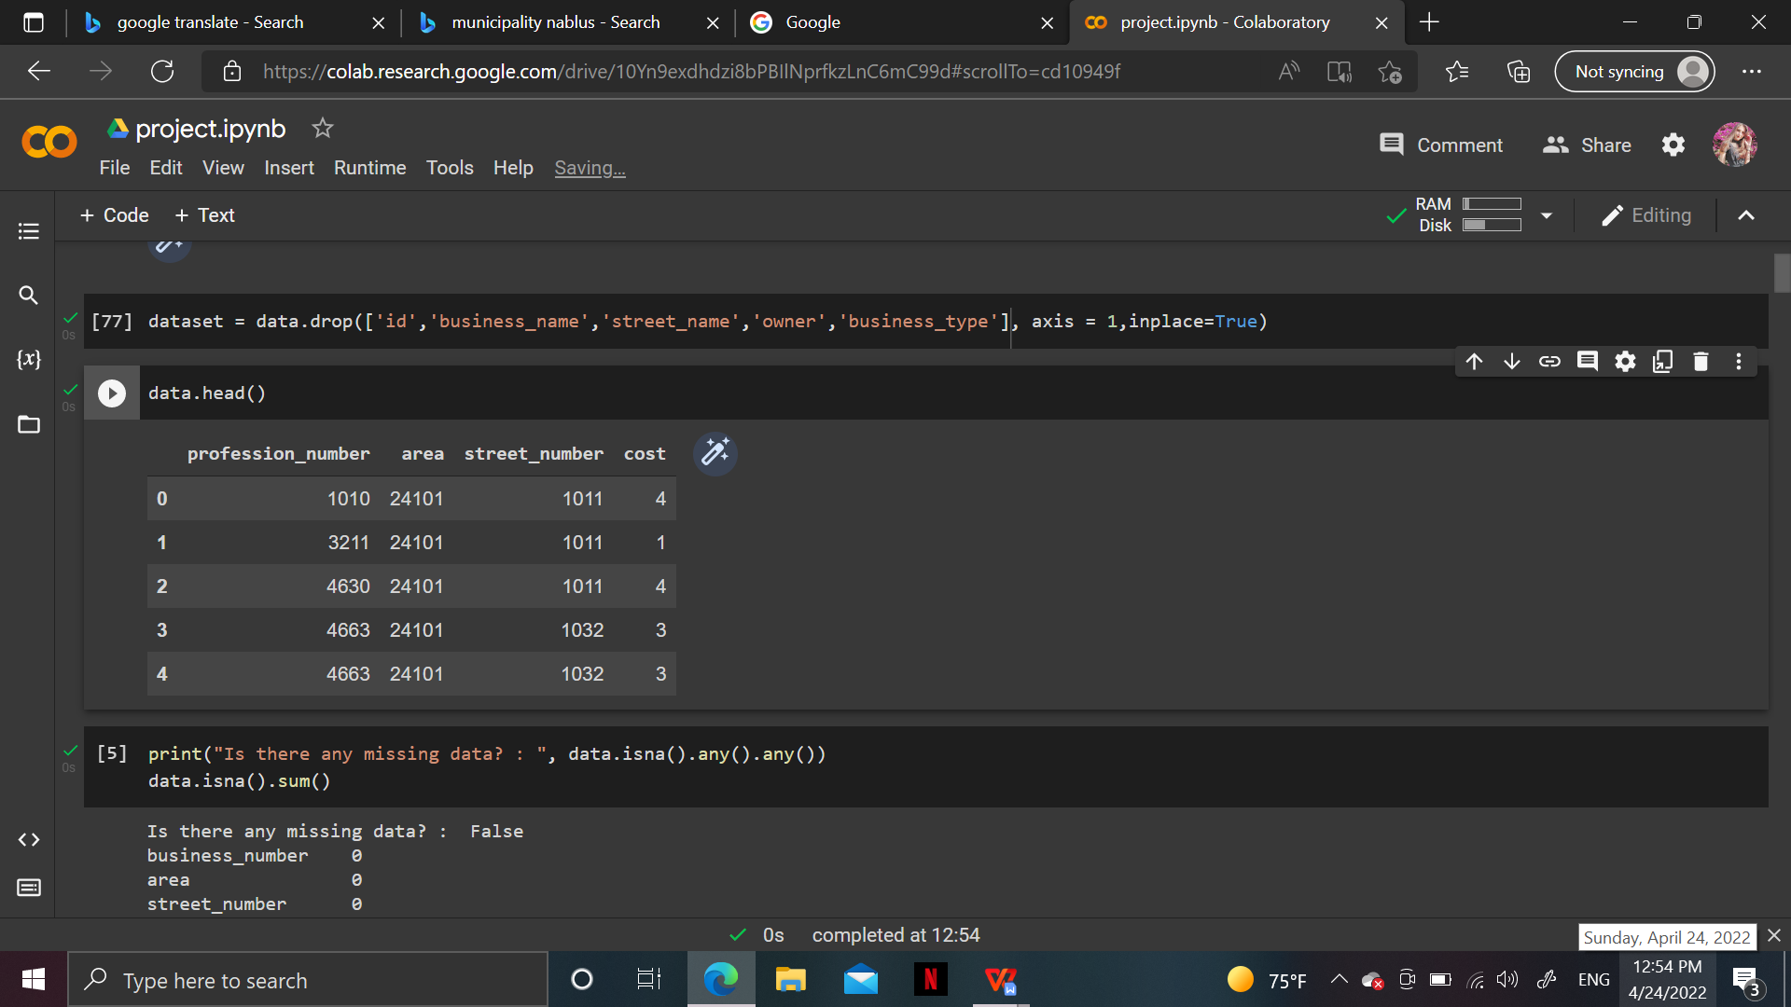
ANALYZING DTATA
Profession number
EX: 1010 → Animal slaughterhouses and meat preparation
Street number
Last 3 number →the street number.
The first number → the street category.
Cost
Degree (1) : 1000000+ Degree (2) : 50K - 999999
Degree (3) : 25K - 49,999 Degree (4) : 15K - 24,999
Degree (5) : 5K - 14,999

Slide 12
05
APPROACH

Slide 13
APPROACH
-1-
we studied the data and how it's related to each other. We used Naive Bayes algorithm for each profession and capital of the business, to get the possibilities. after trying a list of algorithms, we concluded that the Naive Bayes fits our project better. We also extracted the probability between the profession and the street category in Matrix, to show which professions are allowed to be in a particular street, we used Naive Bayes for this purpose and the percentage of the accuracy was 72%, which shows that the performance is good.

Slide 14
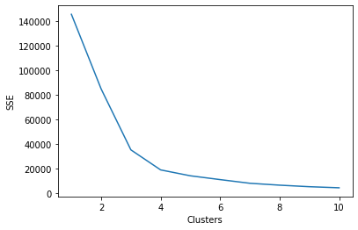
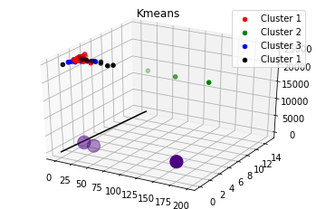
APPROCH
Classify areas using K-means clustering :-
Elbew point
we applied K-means clustering algorithm which is an unsupervised algorithm, we depend on two features as an input for the algorithm, which are the areas and cost. In the outcome the algorithm shows that the best fit is four clusters as shown in the figure below, classifying the areas was according the similarity of shops amount and the business cost average.

Slide 15
APPROACH
Equations:-
First equation :
First eq. : (X - N)/ X = Y
X : the maximum number of shops in a particular profession in the class
N : the amount number of shops in a particular profession in the area
Y : the shortage probability in each area.

Slide 16
APPROACH
Equations:-
Second equation :
Second eq. : Y * Z = U
Y : the shortage probability in each area.
Z : the probability of the profession existent in a specific street category.
U: the final shortage probability.

Slide 17
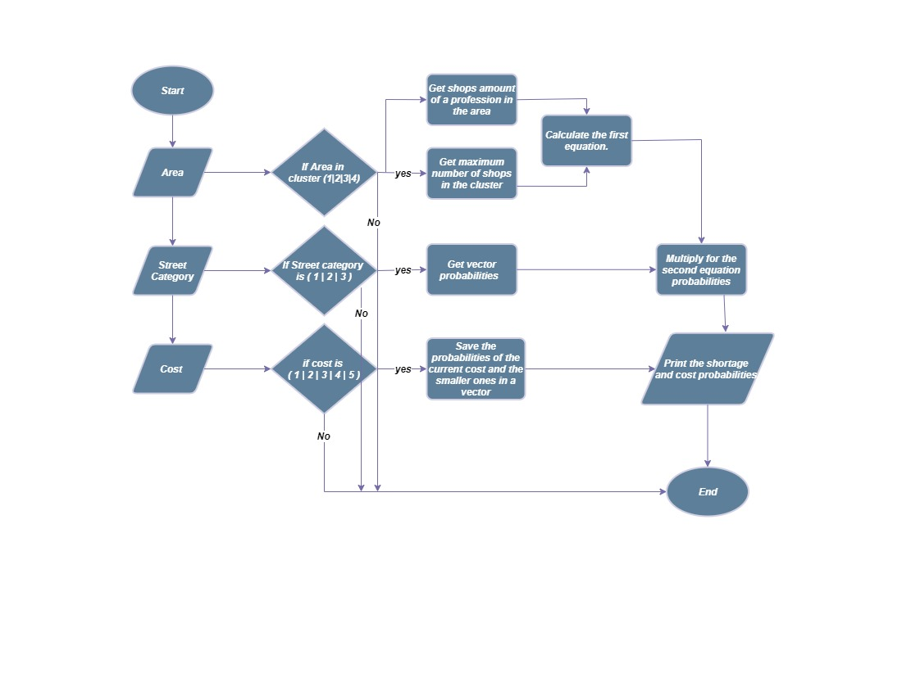

Slide 18
APPROACH
How the classification method works :-
Input ( Area, street category, cost (capital))
Get the area’s cluster - to get the shortage probability in it.
Get the probability of which professions exist in a street category
Get the cost probability

Slide 19
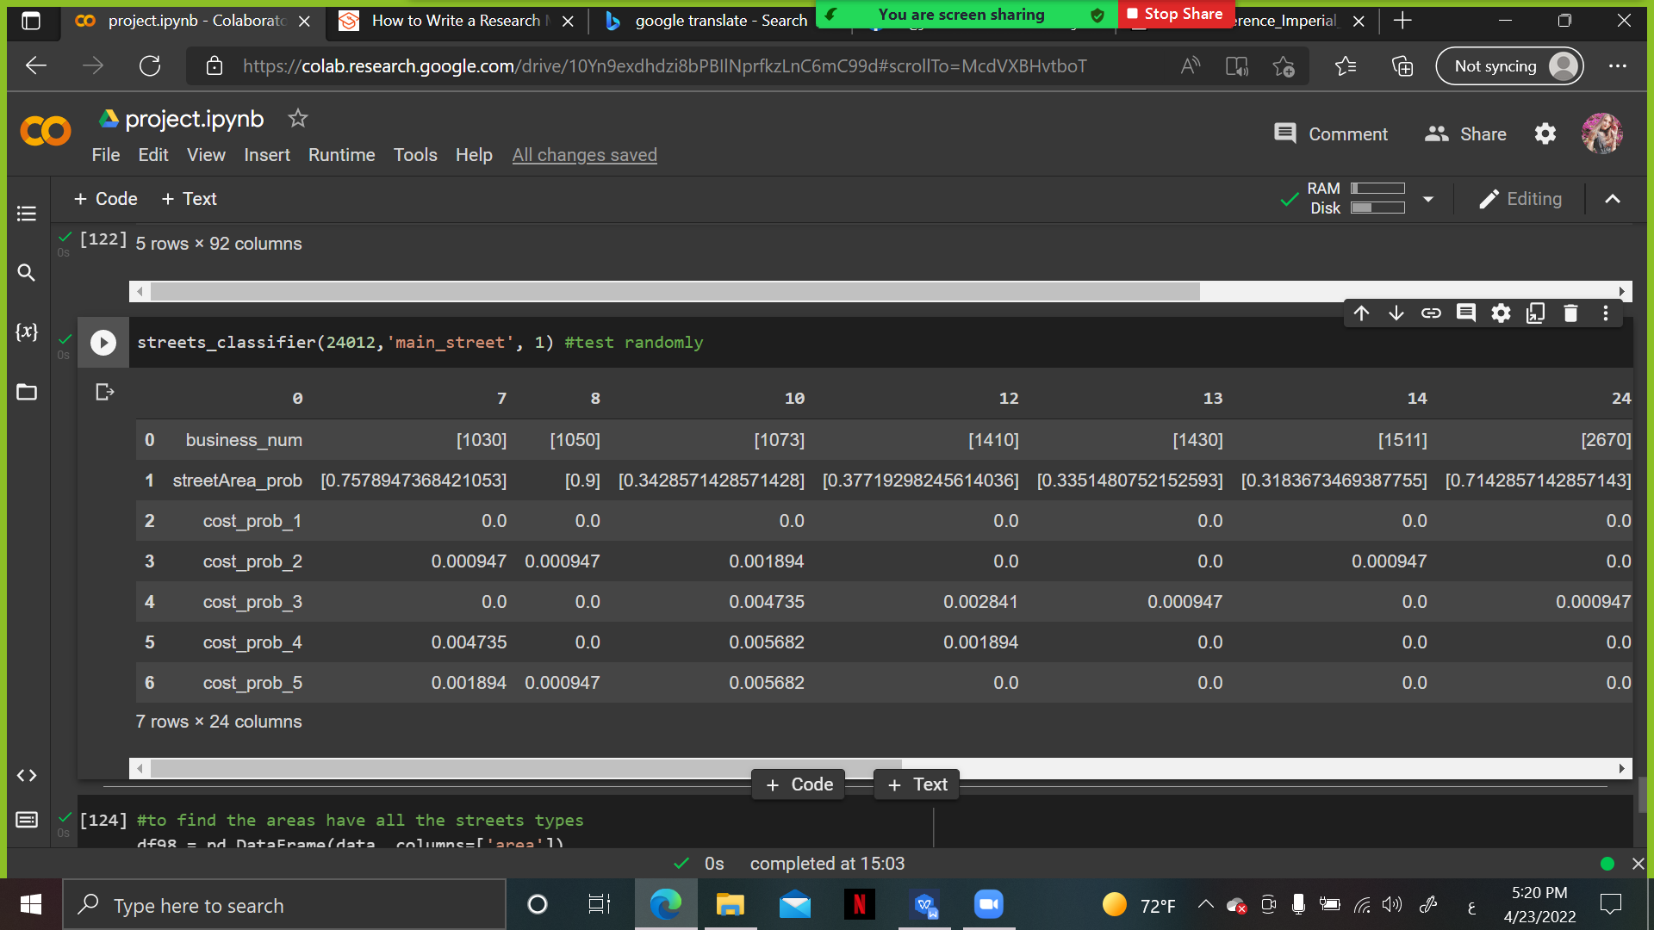

Slide 20
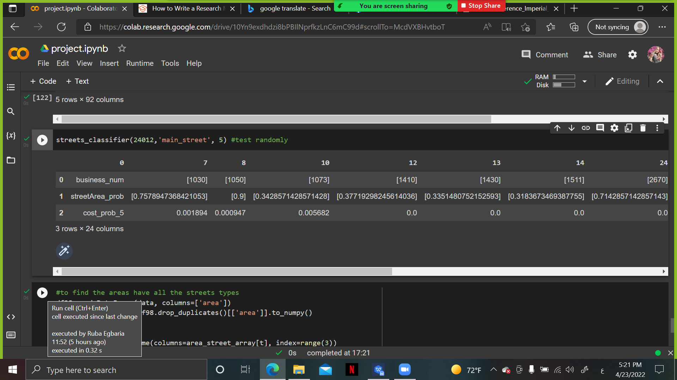

Slide 21
APPROACH
The shortage depending on the profession
It takes the profession number as an input
gives the areas that has shortage in that specific profession

Slide 22
06
EVALUATION

Slide 23
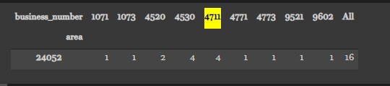
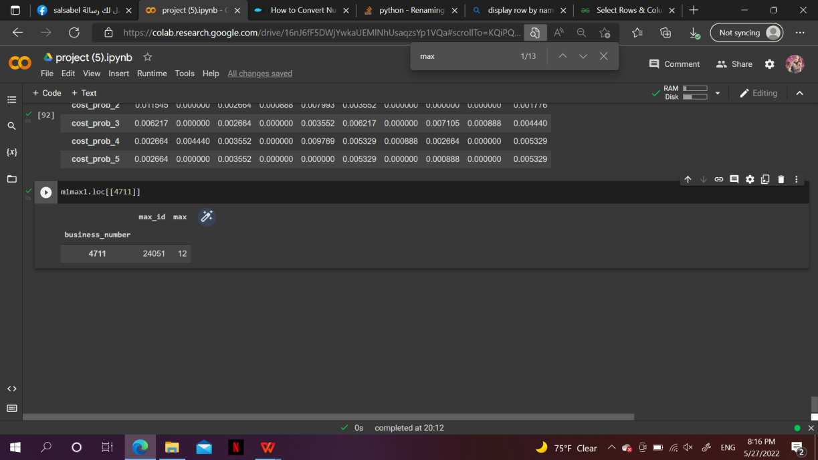
EVALUATION
Taking area 24052 as a testing example
Before manipulating the data

Slide 24
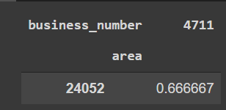
EVALUATION
Before manipulating the data
eq1 -> : (X - N)/ X = Y
-> ( 12 - 4 )/12 = 0.667
eq2 -> : Y * Z = U
First equation probability:

Slide 25
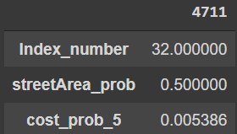
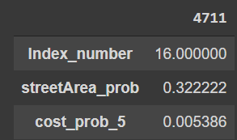
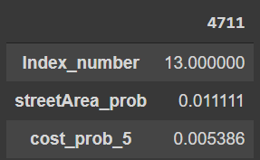
EVALUATION
Before manipulating the data
Y * Z = U
Y = 0.667
Z = 0.6
-> 0.667 * 0.6 =
0.40
Z = 0.386
-> 0.667 * 0.386 = 0.257
Z = 0.013
-> 0.667 * 0.013 = 0.008
Main street probability :
Main - sub street probability :
sub street probability :

Slide 26
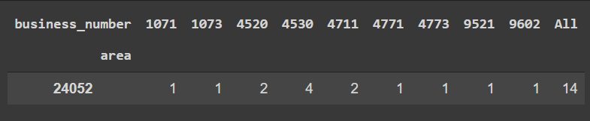
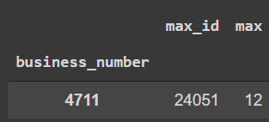
EVALUATION
After manipulating the data

Slide 27
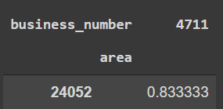
EVALUATION
After manipulating the data
First equation probability:
eq1 -> : (X - N)/ X = Y
-> ( 12 - 2 )/12 = 0.8333
eq2 -> Y * Z = U

Slide 28
EVALUATION
After manipulating the data
Main street probability :
Y * Z = U
Y = 0.833
Z = 0.6
-> 0.833 * 0.6 = 0.5
increased by 0.1
Z = 0.386
-> 0.833* 0.386 = 0.3222
increased by 0.065
Z = 0.013
-> 0.833 * 0.013 = 0.0111
increased by 0.003
Main - sub street probability :
Sub street probability :

Slide 29
 |  |  | Before manipulating the data |  |  | After manipulating the data
List | Street class | Area | Number of markets (4711) | Street Area probability | Profession index in the list | Number of markets (4711) | Street Area probability | Profession index in the list
List 1 | Main street | 24052 | 4 | 0.40 | 38 | 2 | 0.5 | 32
List 2 |  | 24013 | 7 | 0.40 | 40 | 4 | 0.5 | 36
List 3 |  | 24032 | 3 | 0.30 | 50 | 1 | 0.5 | 43
List 4 |  | 24111 | 8 | 0.36 | 35 | 3 | 0.51 | 31
List 1 | Main sub street | 24052 | 4 | 0.25 | 18 | 2 | 0.32 | 16
List 2 |  | 24013 | 7 | 0.26 | 12 | 4 | 0.311 | 10
List 3 |  | 24032 | 3 | 0.19 | 31 | 1 | 0.32 | 18
List 4 |  | 24111 | 8 | 0.23 | 17 | 3 | 0.328 | 11
List 1 | Sub street | 24052 | 4 | 0.0088 | 14 | 2 | 0.0111 | 13
List 2 |  | 24013 | 7 | 0.0090 | 15 | 4 | 0.0100 | 14
List 3 |  | 24032 | 3 | 0.0066 | 16 | 1 | 0.0111 | 16
List 4 |  | 24111 | 8 | 0.0080 | 10 | 3 | 0.01133 | 9

Slide 30
07
difficulties

Slide 31
difficulties
Data :-
Unorganized data.
Uncompleted data.
Gathering the data.
Lack of references .

Slide 32
08
FUTURE WORK

Slide 33
FUTURE WORK
let the customers give suggestions of a new professions.
link more than business man together in the same business.

Slide 34

”
What we do is different for better,
not for the sake of difference.
”
—— Jenny

Slide 35
TNANKS
Supervisor : Dr. MAI ABUSEIR
BY:
Salsabeel AL zaqa Ruba Egbaria Rania Dameh

