Slide 1
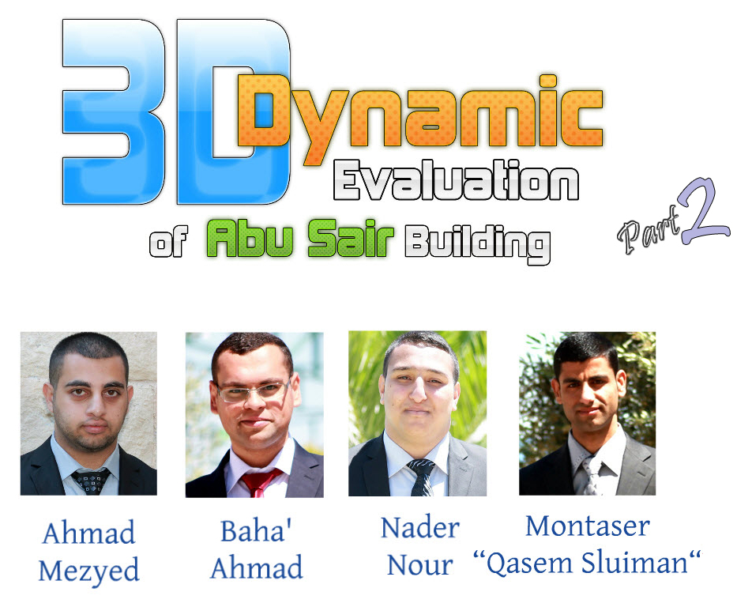

Slide 2
Contents :
Introduction.
Rapid Visual Screening.
3D dynamic evaluation.
Retrofitting.

Slide 3
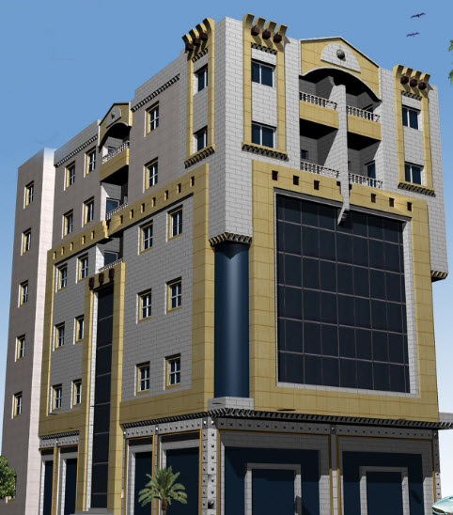
Introduction :
Description :

Slide 4
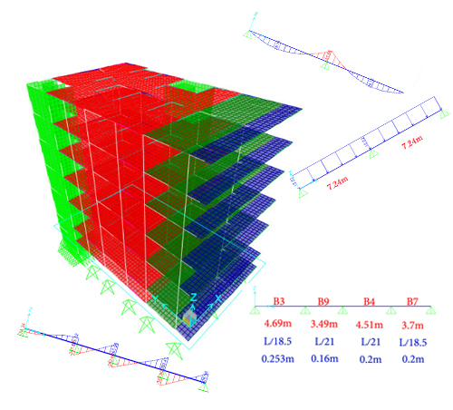
Review for Graduation Project 1
1D models .
3D model.
Design.

Slide 5

In July 2014 , seismic design has become mandatory by using UBC 97 or equivalent as a minimum requirements.

Slide 6

1. Rapid Visual Screening

Slide 7
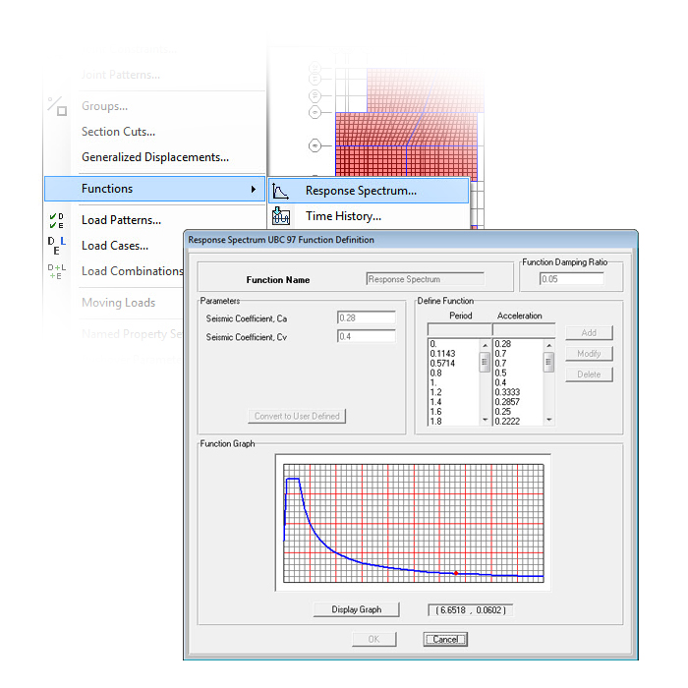
2. 3D Dynamic Analysis
Detailed study.
Structural system.

Slide 8
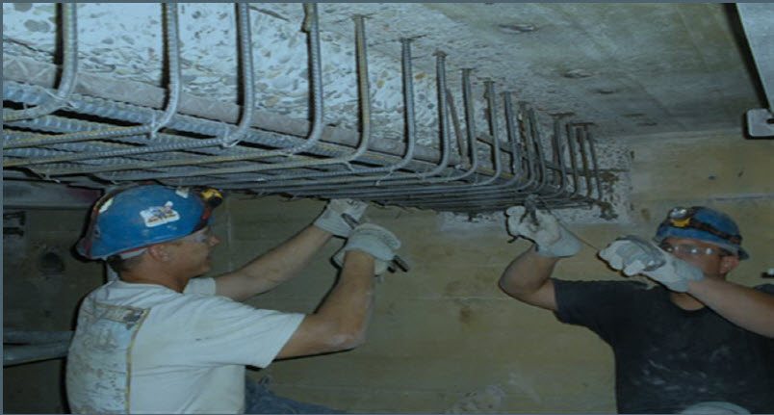
3. Retrofitting

Slide 9
Rapid Visual Screening.
(RVS) study is made for Abu Sair building a conceptual procedure.
This study enable users to classify surveyed buildings into two categories:
Those are safety under earthquakes.
Those may be seismically hazardous and should be evaluated in more details.

Slide 10
Data Collection Form
There are three Data Collection Forms, depend on the seismicity regions:
Low seismicity (L)
Moderate seismicity (M)
High seismicity (H)

Slide 11
Example of data collection form:

Slide 12
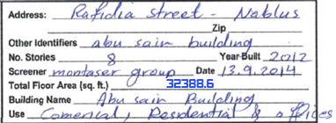
Procedure to complete data collection form.
1-Verifying and updating the building identification information.

Slide 13
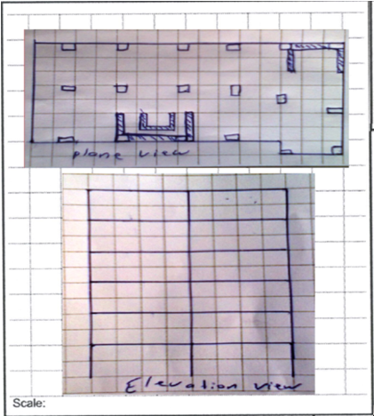
2- Sketching a plan and elevation view.

Slide 14
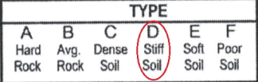
3- Determining soil type.

Slide 15

4- Determining and documenting occupancy and occupancy load.
occupancy

Slide 16


Occupancy load =$\frac{Total area}{number of persons at one unit of area}$
= $\frac{3009}{15.8}$ = 190 occupants.
Occupancy load

Slide 17
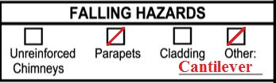
5- Identifying Potential Nonstructural Falling Hazards.

Slide 18
6- Identifying Basic Structural Hazard Score.
“Building Type” is concrete frame with unreinforced masonry infill (C3)

Slide 19
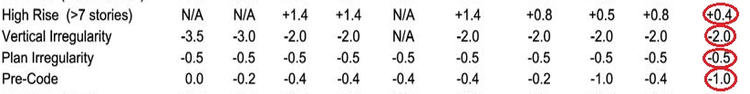
7- Identifying Score Modifiers.

Slide 20
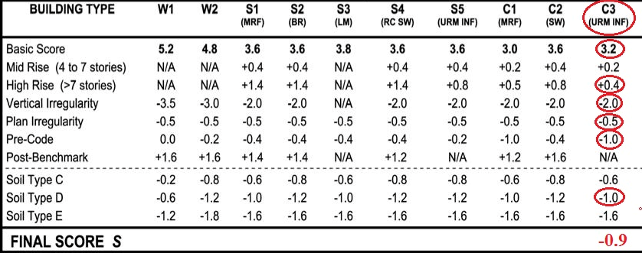
8- Identifying Final Score.

Slide 21
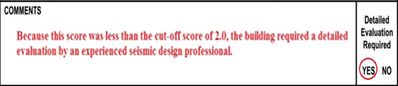
9- Final decision.
The final score (-0.9) is less than the cut-off score (2), it is required a detailed evaluation by an expert seismic design professional.

Slide 22
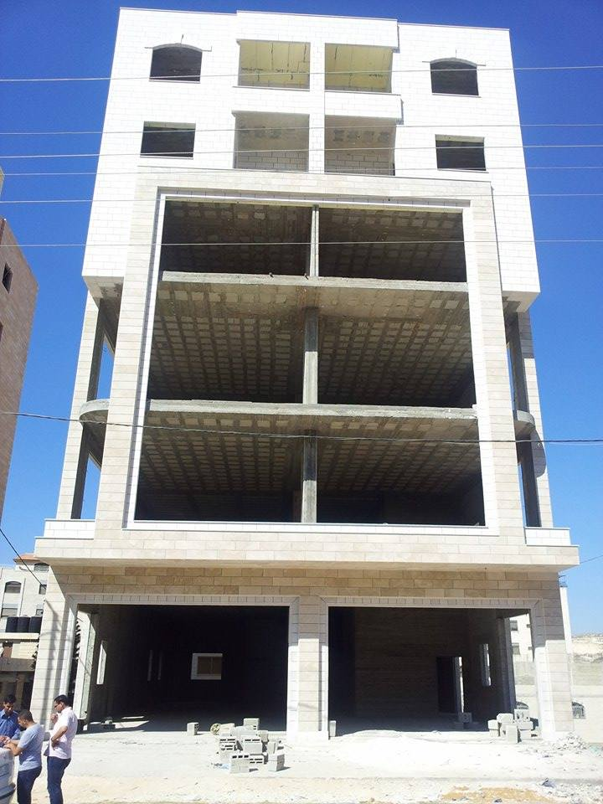
10- Photographing.(for identification purposes)

Slide 23
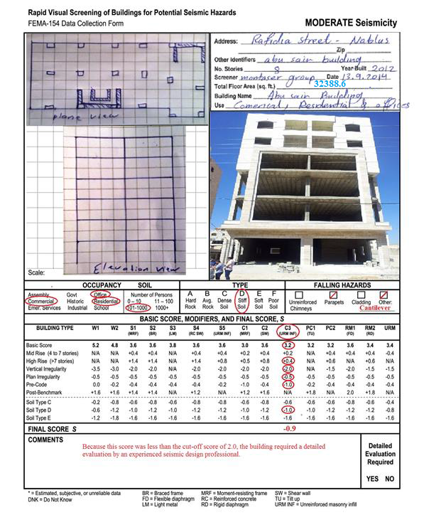
Final RVS form for Abu Sair Building.

Slide 24
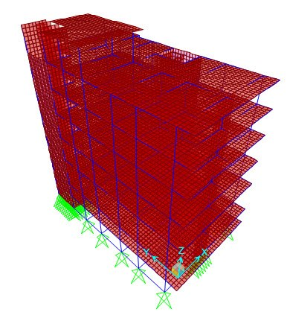
3D Dynamic Evaluation

Slide 25
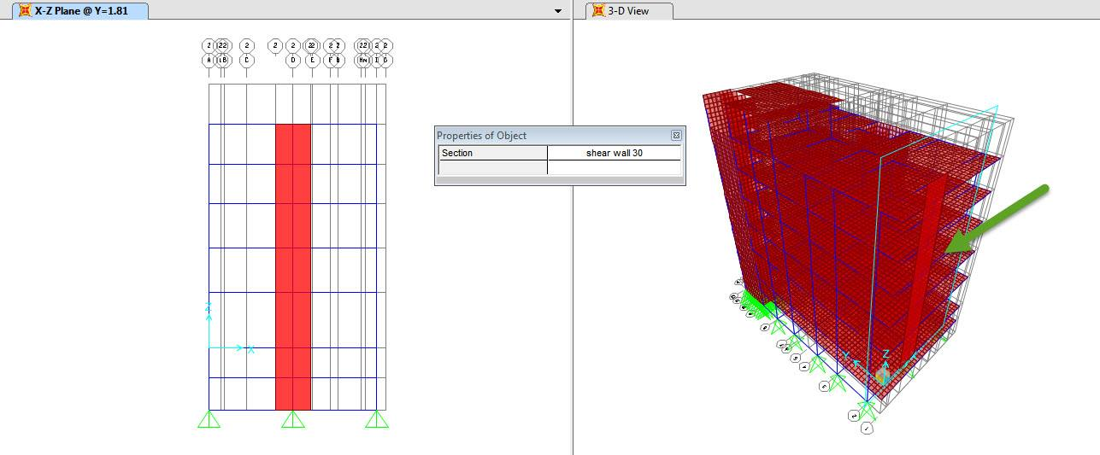

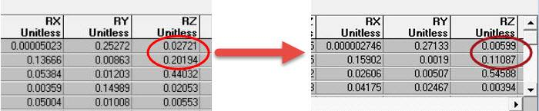
Modal Analysis
    Torsion Problem:

Slide 26
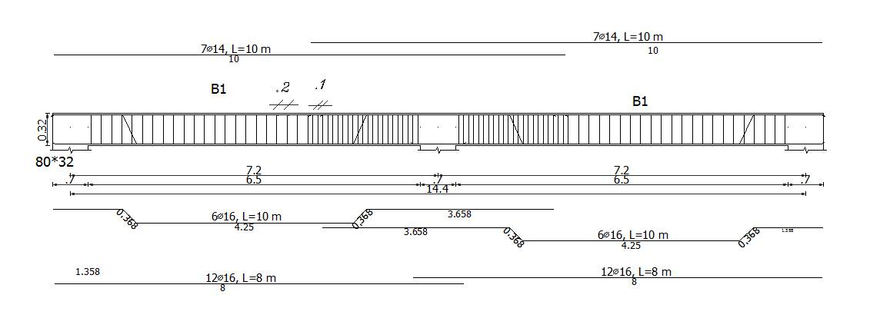
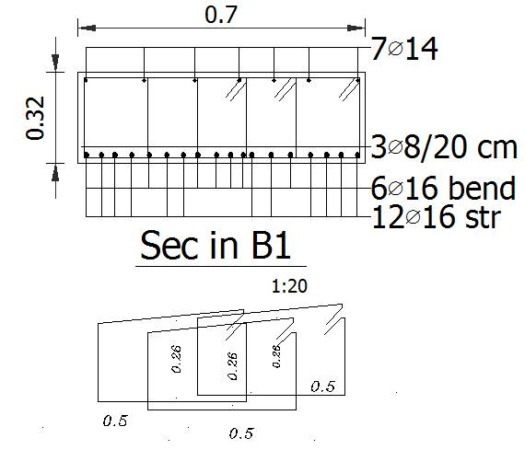
  Structural Detailing

Slide 27
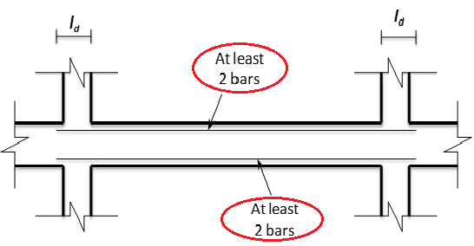
    Ordinary Frame:
➔ all top and bottom steel are extended along the beam.
Ordinary Requirements.

Slide 28
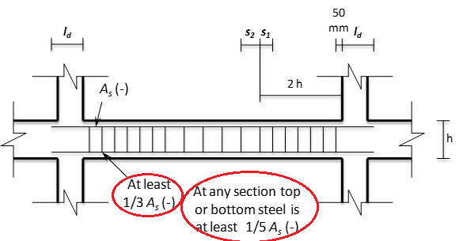
    Intermediate Frame:
➔ 1- Area of steal Requirements ➔ Achieved.
2- Spacing Requirements ➔ Not Achieved.
× Intermediate Requirements.

Slide 29
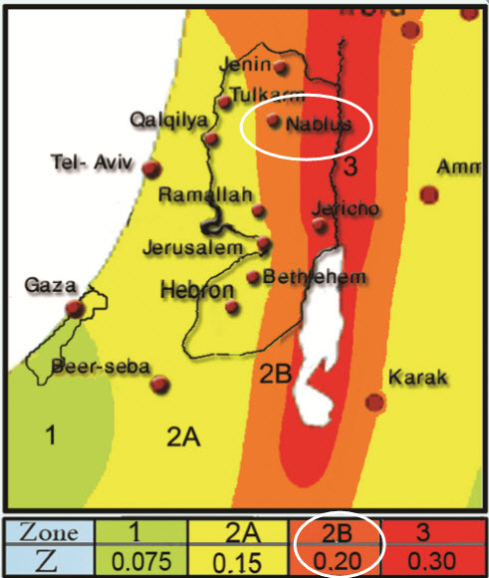
    UBC Factors
Seismic Zones:

Slide 30
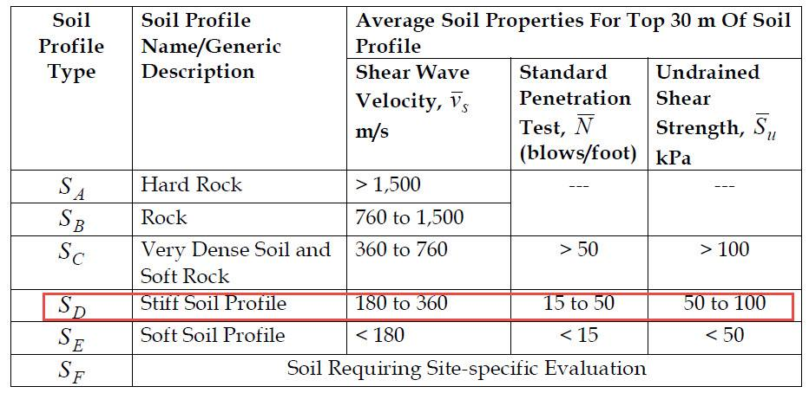
Soil profile:

Slide 31
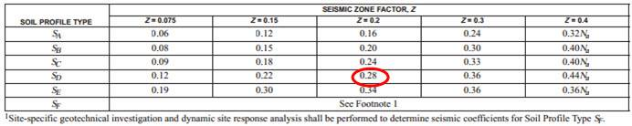
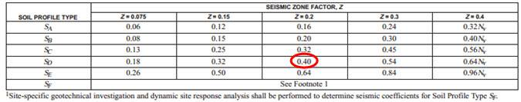
Seismic Coefficients:

Slide 32
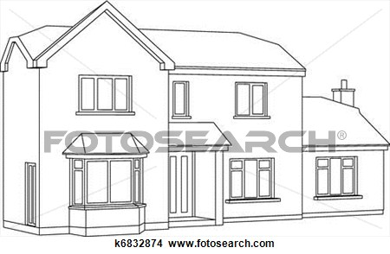
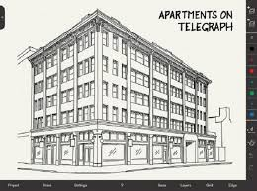
Importance Factor:
I = 1 (Non-essential building).
Lateral-Force Procedure:
Response
Spectrum
Analysis.
Simplified static Static

Slide 33
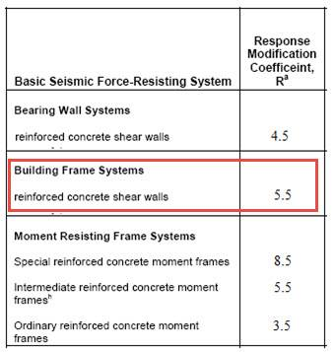
Response Modification Factor:

Slide 34
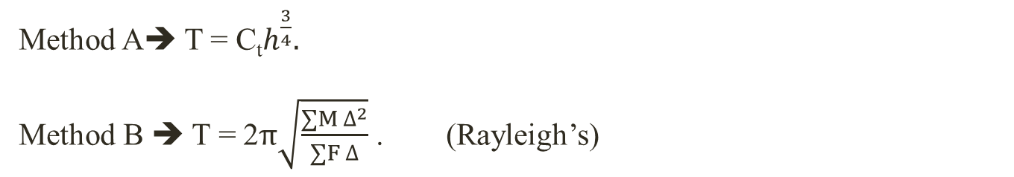
Period:
 | Method A | Method B | SAP | Diff% (Method B & SAP) | Diff% (Method A & B) | Modified T
In X-direction | 0.508 | 1.098 | 1.071 | 2.45% | 53.73% | 0.846
In Y-direction | 0.508 | 0.763 | 0.769 | 0.78% | 33.42% | 0.763
Method A➔ T = C_{t}$h^{\frac{3}{4}}.$
Method B ➔ T = 2$π\sqrt{\frac{∑M ∆^{2}}{∑F ∆}}$ . (Rayleigh’s)

Slide 35
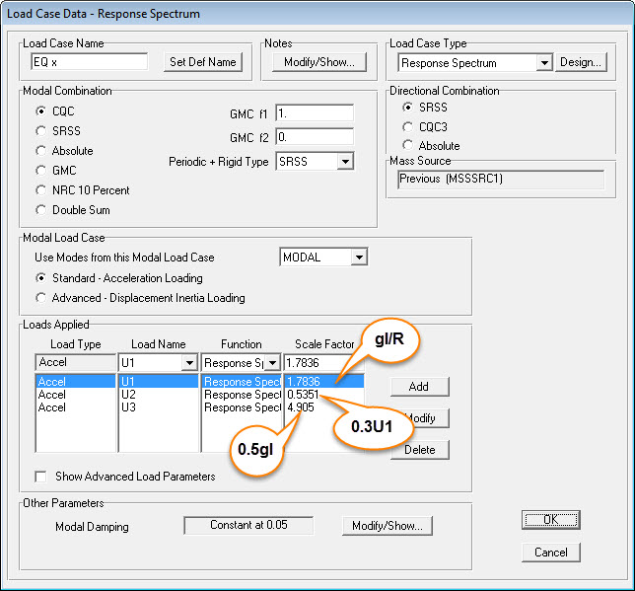

Response Spectrum Analysis on SAP 2000
Load cases:
In X-direction:
E1 = Ex + 0.3 Ey + Ev.
= $\frac{gI}{R}$ W (In X)
+ 0.3 Ex (In Y)
+ 0.5 g I DL(In Z).

Slide 36


In Y-direction:
E2 = Ey + 0.3 Ex + Ev.
= $\frac{gI}{R}$ W (In Y)
+ 0.3 Ey (In X)
+ 0.5 g I DL(In Z).

Slide 37

Base shear:
 | Base shear value(kN) |  | Modification factor | Scale factor | New scale factor
 | Manually | Response Spectrum
In X-direction | 4168.97 | 2275.54 | 1.83 | 1.78 | 3.26
In Y-direction | 4573.91 | 2931.87 | 1.56 | 1.78 | 2.78
Manually ➔ C_{s} = $\frac{C_{v} I}{R T}.$
V = C_{s} X W.

Slide 38
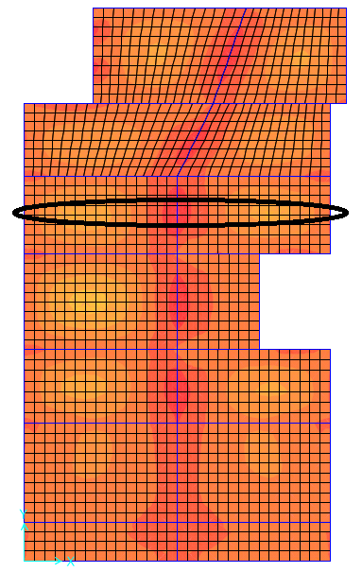
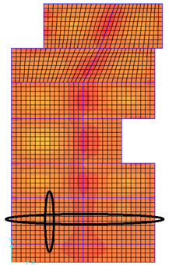
Dynamic Evaluation
Evaluation of slabs:
Evaluation is made for the representative slabs in ground floor.
Representative one way ribbed slab Representative two way ribbed slab

Slide 39
Evaluation of slabs:
Longitudinal Reinforcement:
 | Max Mu(kN.m/rib) | As (mm²) | As min (mm²) | As existed (mm²) | Comment
Positive | 21.18 | 204 | 112 | 402 | OD
Negative | 18.05 | 183 | 112 | 402 | OD
Longitudinal reinforcement comparing in one way ribbed slab.
 | In X-direction |  |  |  |  | In Y-direction
 | Max Mu (kN.m/rib) | As (mm²) | As min (mm²) | As existed (mm²) | Comment | Max Mu (kN.m/rib) | As (mm²) | As min (mm²) | As existed (mm²) | Comment
Positive | 9.15 | 87 | 112 | 402 | OD | 7.52 | 72 | 112 | 402 | OD
Negative | 7.05 | 68 | 112 | 402 | OD | 7.22 | 70 | 112 | 402 | OD
Longitudinal reinforcement comparing in two way ribbed slab.

Slide 40
Evaluation of slabs:
Shear Reinforcement:
Shear reinforcement comparing in slabs
Slab | Vu | ØVc | Comment
One way ribbed slab | 15.59 | 20.66 | No need for shear reinforcement
Two way ribbed lab In X-direction | 10.4 | 20.66 | No need for shear reinforcement
Two way ribbed lab In Y-direction | 5.72 | 20.66 | No need for shear reinforcement
➔The slabs are OK under ultimate load design so they don’t
need retrofitting.

Slide 41
Evaluation of beams:
Beams name | Moment (KN.m) |  | Area of steel mm2 (from SAP) | Sum of area of steel | Area of steel mm2 (from Drawing) | Sum of area of steel | Comment Compare with drawing
B1 | Positive (Bottom) | 107.24 | 1172 | 4786 | 3610 | 8178 | OD
 | Negative(Top) | 292.67 | 3614 |  | 4568
B3 | Positive (Bottom) | 100.71 | 1145 | 3694 | 2412 | 4974 | OD
 | Negative(Top) | 206.3 | 2549 |  | 2562
B4 | Positive (Bottom) | 85.84 | 947 | 3476 | 1809 | 3969 | OD
 | Negative(Top) | 204.79 | 2529 |  | 2160
B5 | Positive (Bottom) | 96.99 | 1080 | 3531 | 1407 | 3743 | OK
 | Negative(Top) | 200.5 | 2451 |  | 2336
B6 | Positive (Bottom) | 128.89 | 1426 | 3632 | 924 | 1797 | UD
 | Negative(Top) | 182.06 | 2206 |  | 873
B7 | Positive (Bottom) | 65.37 | 709 | 2809 | 1078 | 3876 | OD
 | Negative(Top) | 174.75 | 2100 |  | 2798
B8 | Positive (Bottom) | 74.1 | 809 | 2783 | 924 | 2199 | UD
 | Negative(Top) | 165.86 | 1974 |  | 1275
B9 | Positive (Bottom) | 92.53 | 1026 | 3069 | 678 | 2260 | UD
 | Negative(Top) | 170.74 | 2043 |  | 1582
B10 | Positive (Bottom) | 48.44 | 607 | 1774 | 565 | 2229 | OD
 | Negative(Top) | 104.11 | 1167 |  | 1664
B11 | Positive (Bottom) | 38.17 | 520 | 1899 | 565 | 2147 | OK
 | Negative(Top) | 119.09 | 1379 |  | 1582
B12 | Positive (Bottom) | 29.05 | 347 | 705 | 452 | 1356 | OD
 | Negative(Top) | 33.17 | 358 |  | 904
Longitudinal
Reinforcement:

Slide 42
Evaluation of beams:
Shear Reinforcement:
Beams name | Av/S from SAP | No. of stirrups from Drawing | Av from 2 legs of each stirrups in mm2 | Spacing (s) cm | d/2 (d=28cm) | Spacing from drawings cm | Comment (d/2<S<d) ok
B1 | 0.833 | 3 | 301.594 | 36.206 | 14 | 20 | Ok
B3 | 1.143 | 2 | 201.062 | 17.591 | 14 | 20 | OK
B4 | 1.128 | 2 | 201.062 | 17.825 | 14 | 20 | OK
B5 | 1.044 | 2 | 201.062 | 19.259 | 14 | 20 | Ok
B6 | 0.583 | 2 | 201.062 | 34.488 | 14 | 20 | OK
B7 | 0.928 | 2 | 201.062 | 21.666 | 14 | 20 | OK
B8 | 0.583 | 2 | 201.062 | 34.488 | 14 | 20 | OK
B9 | 0.583 | 2 | 201.062 | 34.488 | 14 | 20 | OK
B10 | 0.583 | 2 | 201.062 | 34.488 | 14 | 20 | OK
B11 | 2.528 | 2 | 201.062 | 7.953 | 14 | 20 | Not Ok
B12 | 0 | 1 | 100.531 | 0 | 14 | 20 | Ok

Slide 43
Evaluation of columns:
Longitudinal Reinforcement:
Column | As(mm2) |  | Comment
 | Required | Existed
C1 | 5463 | 2413 | UD
C2 | 5583 | 2413 | UD
C3 | 2100 | 2413 | OK
C4 | 2933 | 2413 | UD
C5 | 2313 | 2413 | OK
C6 | 2559 | 2413 | UD
C7 | 3418 | 2413 | UD
C8 | 4320 | 2413 | UD
C9 | 2100 | 2413 | OK
C10 | 4668 | 2413 | UD
C11 | 5847 | 2413 | UD
C12 | 2100 | 2413 | OK
C13 | 2100 | 2413 | OK
C14 | 2100 | 2413 | OK
C15 | 2800 | 2815 | OK
C16 | 6234 | 2815 | UD
C17 | 5350 | 2815 | UD
C18 | 5093 | 2815 | UD
C19 | 4245 | 2815 | UD
C20 | 5774 | 2815 | UD
C21 | 2800 | 2815 | OK

Slide 44
Evaluation of foundations:
The next tables show comparing between required and existed for: Area of steel, Settlement, Stress and Thickness.
Footing | Column | In x-direction (mm²/m) |  |  | In y-direction (mm²/m)
 |  | As(required) | As(existed) | Comment | As(required) | As(existed) | Comment
F1 | C15 | 1437 | 1783 | OK | 1080 | 1802 | OK
F2 | C20 | 2340 | 1716 | UD | 1319 | 1702 | OK
F3 | C6 | 1448 | 1493 | OK | 1080 | 1497 | OK
F4 | C1 | 1752 | 1440 | UD | 1080 | 1449 | OK
F5 | C16 | 2212 | 1380 | UD | 1185 | 1395 | OK
F6 | C14 | 1080 | 1066 | ≈ OK | 1080 | 1062 | ≈ OK.
Footing | Column | Thickness (cm) |  |  | Settlement (mm) |  |  | Stress (kN/m²)
 |  | Required | Existed | Comment | Allowable | Existed | Comment | Allowable | Existed | Comment
F1 | C15 | 56 | 60 | OK | 10 | 9.8 | OK | 200 | 196.3 | OK
F2 | C20 | 64.1 | 60 | Not OK | 10 | 14.7 | Not OK | 200 | 294.17 | Not OK
F3 | C6 | 47.8 | 60 | OK | 10 | 9 | OK | 200 | 195.35 | OK
F4 | C1 | 60 | 60 | OK | 10 | 2.6 | OK | 200 | 53.4 | OK
F5 | C16 | 64.1 | 60 | Not OK | 10 | 18.2 | Not OK | 200 | 364.18 | Not OK
F6 | C14 | 33.1 | 60 | OK | 10 | 9 | OK | 200 | 180.17 | OK

Slide 45
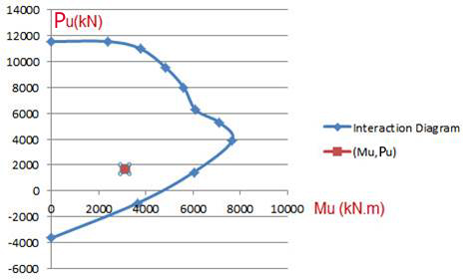
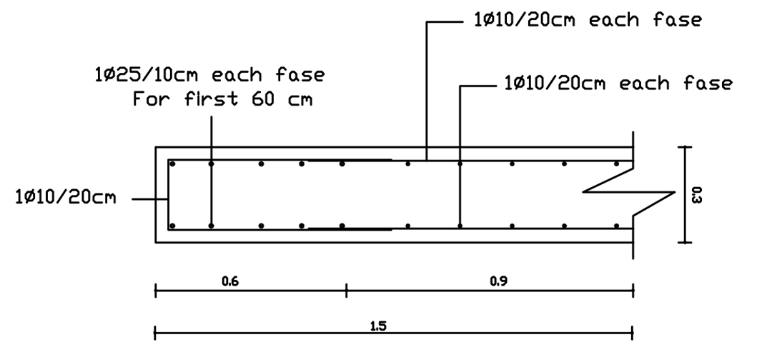
Retrofitting
  Retrofitting for Structural Elements:
  Additional Elements:
Shear wall: to reduce torsional effect.

Slide 46
    Existing Elements:
    Beams: the area of steel existed is not enough to resist moment .
    The following table shows additional longitudinal reinforcement
    for beams:
Beams | As (mm²) |  |  | Number of bars added
 | Existed | Required | Added
B6 | 1797 | 3632 | 1835 | 10Ø16
B8 | 2199 | 2783 | 584 | 4Ø14
B9 | 2260 | 3069 | 809 | 4Ø16

Slide 47
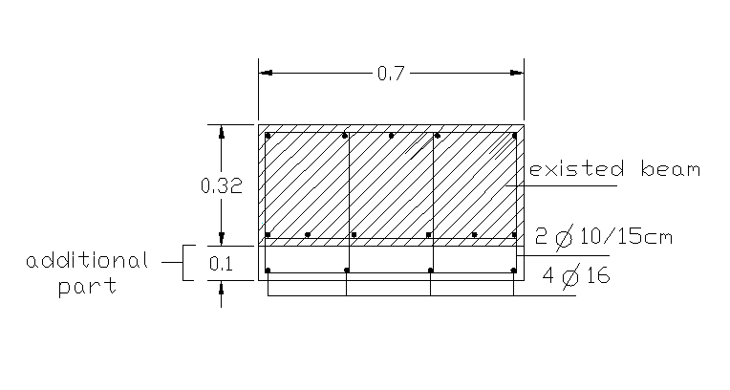
    The used beams in structure are hidden beams so it’s recommended to use one-sided jackets.

Slide 48
Columns:
The problem of columns in the building is represented in:
Inadequate flexural strength and ductility.

Slide 49
The following table shows additional longitudinal reinforcement for columns:
Columns | As (mm²) |  |  | Number of bars added
 | Existed | Required | Added
C1 | 2413 | 5463 | 3050 | 16Ø16
C2 | 2413 | 5583 | 3170 | 16Ø16
C4 | 2413 | 2933 | 520 | 8Ø10
C7 | 2413 | 3418 | 1005 | 8Ø14
C8 | 2413 | 4320 | 1907 | 14Ø14
C10 | 2413 | 4668 | 2255 | 16Ø14
C11 | 2413 | 5847 | 3434 | 18Ø16
C16 | 2815 | 6234 | 3419 | 18Ø16
C17 | 2815 | 5350 | 2535 | 18Ø14
C18 | 2815 | 5093 | 2278 | 16Ø14
C19 | 2815 | 4245 | 1430 | 10Ø14
C20 | 2815 | 5774 | 2959 | 16Ø16

Slide 50
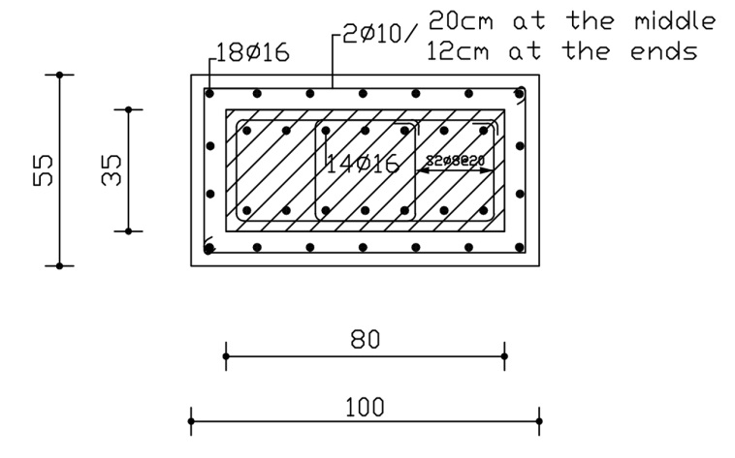
Columns:

Slide 51
Foundations:
The problem of foundations in the building is represented in:
Inadequate flexural and shear strength (Moment and shear).
Stresses and settlement.

Slide 52
Foundations:
Recommendations:
Change stories functions to decrease the load (live load) which make the foundations able to carry the loads.
If the retrofitting is chosen as a solution for foundations, it’s needed to:
Increase the area of footing to reduce stresses and settlement.
Increase the thickness of the foundation to resist shear forces.
Reinforce the additional thickness to resist moment.

Slide 53
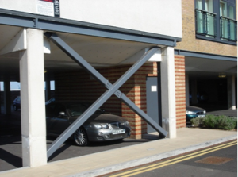
Soft story:
Using truss bracing or reinforced infill walls to solve the problem of
soft story.

Slide 54
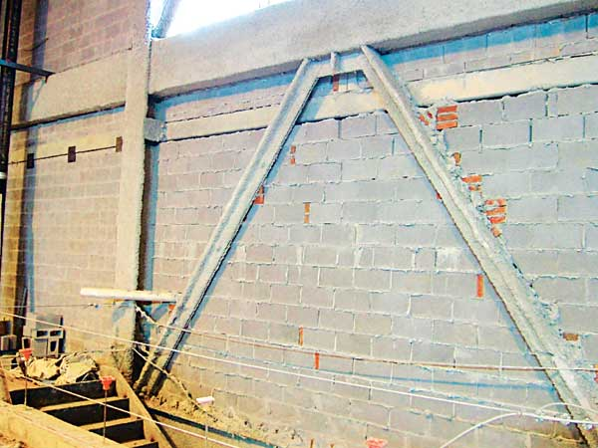
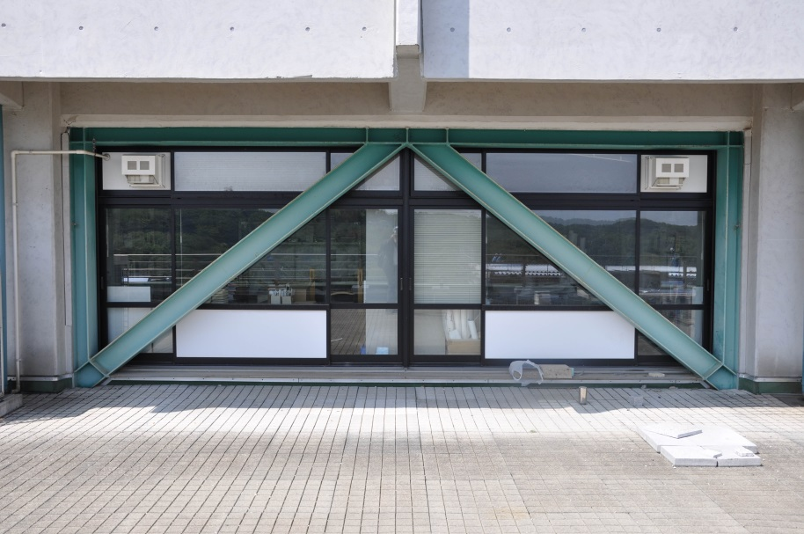
Retrofitting for Non-structural elements:
The existed infill walls need to be braced.
Large openings in doors and windows, need to bracing for them as
possible.

Slide 55
Conclusion
After making dynamic evaluation, it is noticed that the
gravity combination is governed in most elements, which
means that failure in buildings is occurred because they
are not designed in the right way for static loads.
Its difficult to reach intermediate requirements for all elements
of the building.
Detailed study and conceptual study (RVS) give the same indication for the safety of the building.

Slide 56


