Slide 1
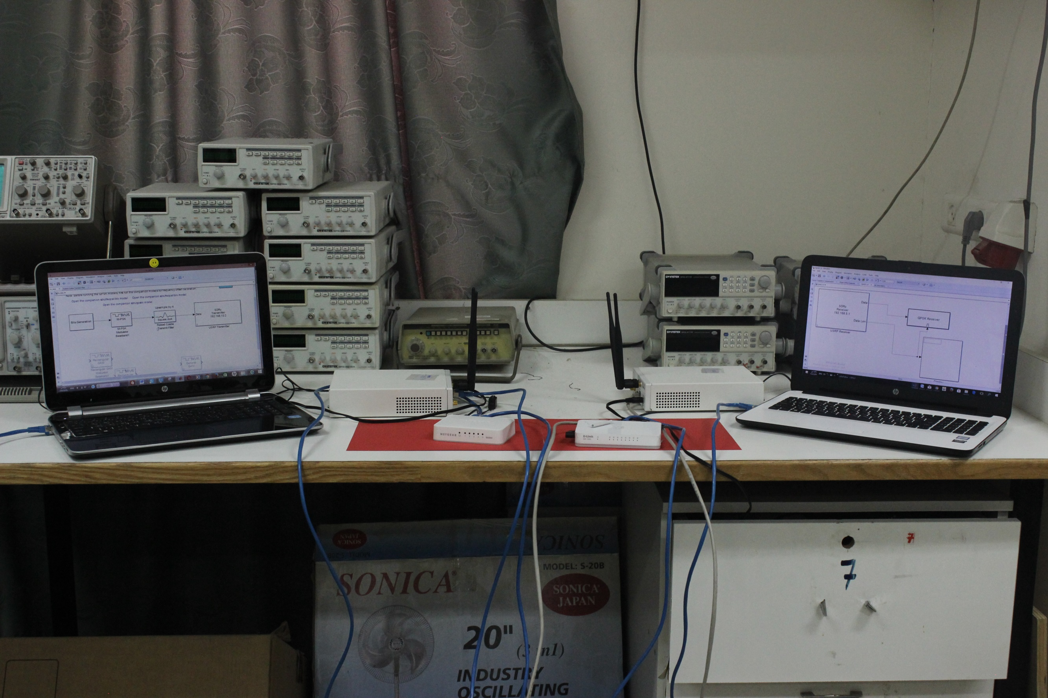
Energy Aware
Software Defined
Radio system using
USRPs

Slide 2
Team Work
Hanadi Salman
Reem Balatiah
Waseem Jaber
Supervisors
Dr. Ahmed Al-Masri
Dr. Yousef Dama

Slide 3

THE BEGINNING POINT
CONTENTS
PROJECT IDEA
PRACTICAL EXPERIMENT
RESULTS

Slide 4





Fossil Fuel Oil
Natural Gas
Traditional Energy
Coal
Nuclear

Slide 5





Solar Energy
Biomass Energy
Renewable Energy
Hydropower Energy
Wind Energy
Geothermal Energy

Slide 6
Green of Telecom
Green Telecom Network
Safe Telecom Waste Disposal
1
2
3
4
Design of Green Central Office Buildings
Green Telecom Equipment

Slide 7

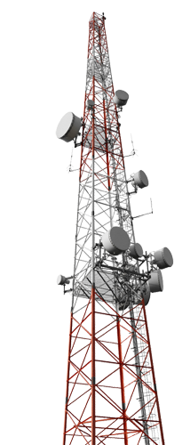

Diesel Generator
with fixed power
DG
Solar
Energy
with variable power
SE

Slide 8
Many of them are in remote locations or difficult accessible places.
Cost of fossil fuels is on increase !
Disadvantages of Diesel Generator
High quantity of carbon emissions from diesel generators.

Slide 9
Advantages of Green system
Renewable energy technology becoming available
reduce the cost of operations of the telecom network.
expand network into rural areas
1
2
3
4
5
reduces carbon emissions and helps us to be environmentally friendly.
create sustainable businesses

Slide 10
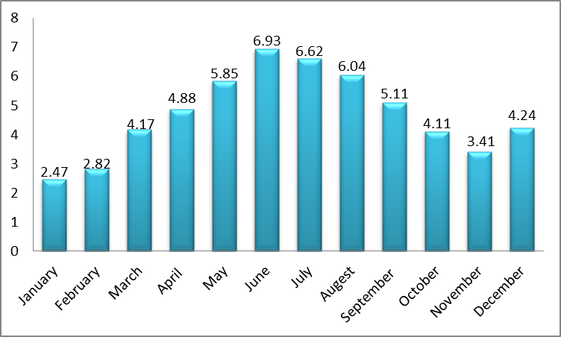
Graph 1
2
Average monthly solar energy – KWh/m (2011)

Slide 11
Graph 2
Daily solar radiation of typical summer day

Slide 12

Telecom System
QUALITY
TIME
Solar Energy with Variable Power
Adaptive Coding and Modulation

Slide 13


The idea of our Project

Slide 14


Po , QPSK
Rx
Tx
SNR
SNR Estimation

Slide 15

Practical Experiment

Slide 16
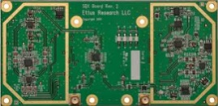


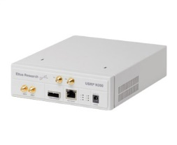
USRP N200
XCVR2450
VERT2450
6
DC input (V)
Wi-Fi Standard : 802.11n
Equipment and Specifications
2.4-5.85
Operating Frequency(GHz)
Current consumption(A)
1.3
Max. Speed (Mbps)
150
Antenna Type : Dipole
ADC Sample Rate(MS/s)
100
2.4& 5
Frequency (GHz)
Gain (dBi)
DAC Sample Rate(MS/s)
2
400
Wight(Kg)
Connector : SMA
1.2

Slide 17
BER Performance of QPSK and 8-PSK

Slide 18

Connection

Slide 19
Graph 1
The comparison between BER performance for F=2.415GHz at different distances for QPSK.

Slide 20
Graph 2
The comparison between BER performance for F=5.815GHz at different distances for QPSK

Slide 21
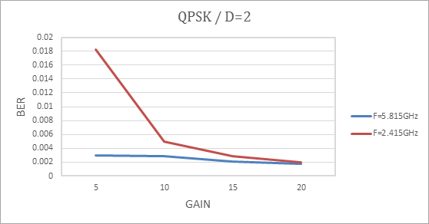
Graph 3
BER performance for D=2m at different frequencies for QPSK.

Slide 22
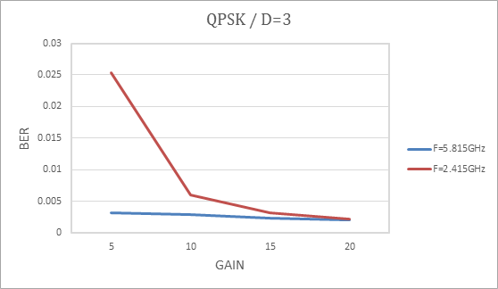
Graph 4
BER performance for D=2m at different frequencies for QPSK.

Slide 23
Graph 5
The comparison between BER performance for F=2.415GHz at different distances for 8PSK.

Slide 24
Graph 6
The comparison between BER performance for F=5.815GHz at different distances for 8PSK

Slide 25
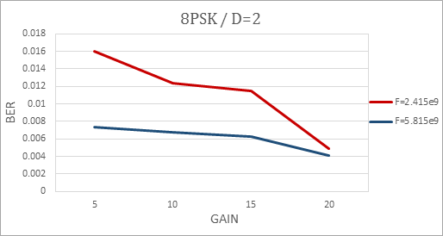
Graph 7
The comparison between BER performance for F=2.415GHz at different distances for 8PSK.

Slide 26
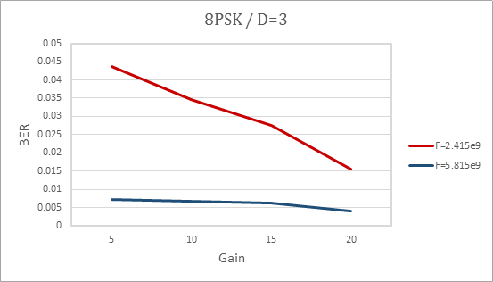
Graph 8
BER performance for D=3m at different frequencies for 8PSK.

Slide 27
Constrains
Inability to create a feedback system
Shortage of work time
Simulink is the solution

Slide 28
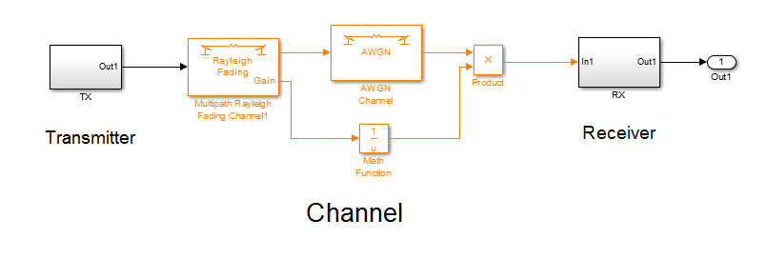
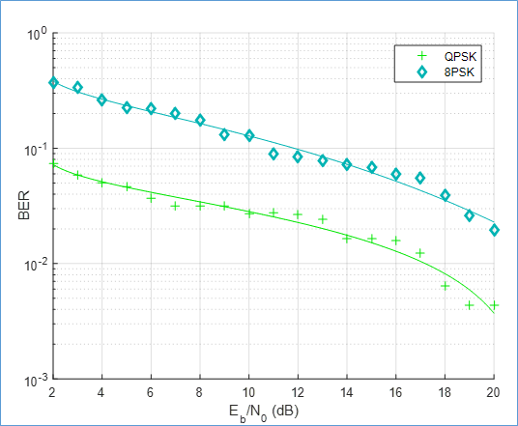

Slide 30
Power = 0.5 Po
Power = 1.5 Po
Power = 2 Po

Slide 31
Comparison
SIGNAL LEVEL | QPSK | 8-PSK
0.5 | 16-20 | -
1 | 10-19 | 19-20
1.5 | 6-16 | 16-20
2 | 5-13 | 13-20

Slide 32
Find Time
Time = BP/Signal Level
1
3
Choose the best option
2
4
Measure Battery Available Power (BP)
Compare Time with To

Slide 33
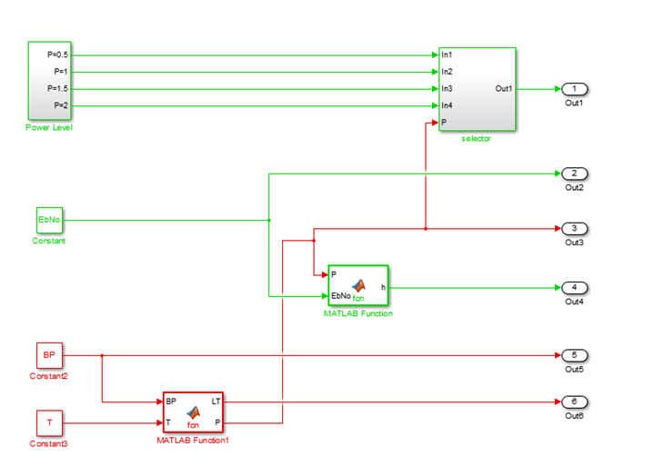

Slide 34

Time of Discussion
Please Be Calm until finished
Thanks for coming!
Time of Dedication

