Slide 1









JUICE
MACHINE
PRESENTED BY
SUPERVISED
Abdullah Sholi
Eng. Haya Samaa’nah
Ala Hamadneh

Slide 2





LIST OF CONTENTS
Components
Future Work
Any Questions ?
Introduction
Constraints
Features

Slide 3







INTRODUCTION
The Juice Machine project is an innovative hardware system designed to automate the process of preparing a customized juice blend. It consists of four distinct stages, each responsible for a specific task in the process.

Slide 4

CONSTRAINTS
  Lack of time and difficulty in transportation to obtain certain parts.
  Difficulty in handling some electronic components .
  Finding an appropriate mechanism for all stages of the project with the simplest components.

Slide 5
FEATURES
  Four-Stage Automation
  Customizable Juice Percentages
  Support for Two Glass Sizes
  User-Friendly Interface
  Cost-Effective Design

Slide 6
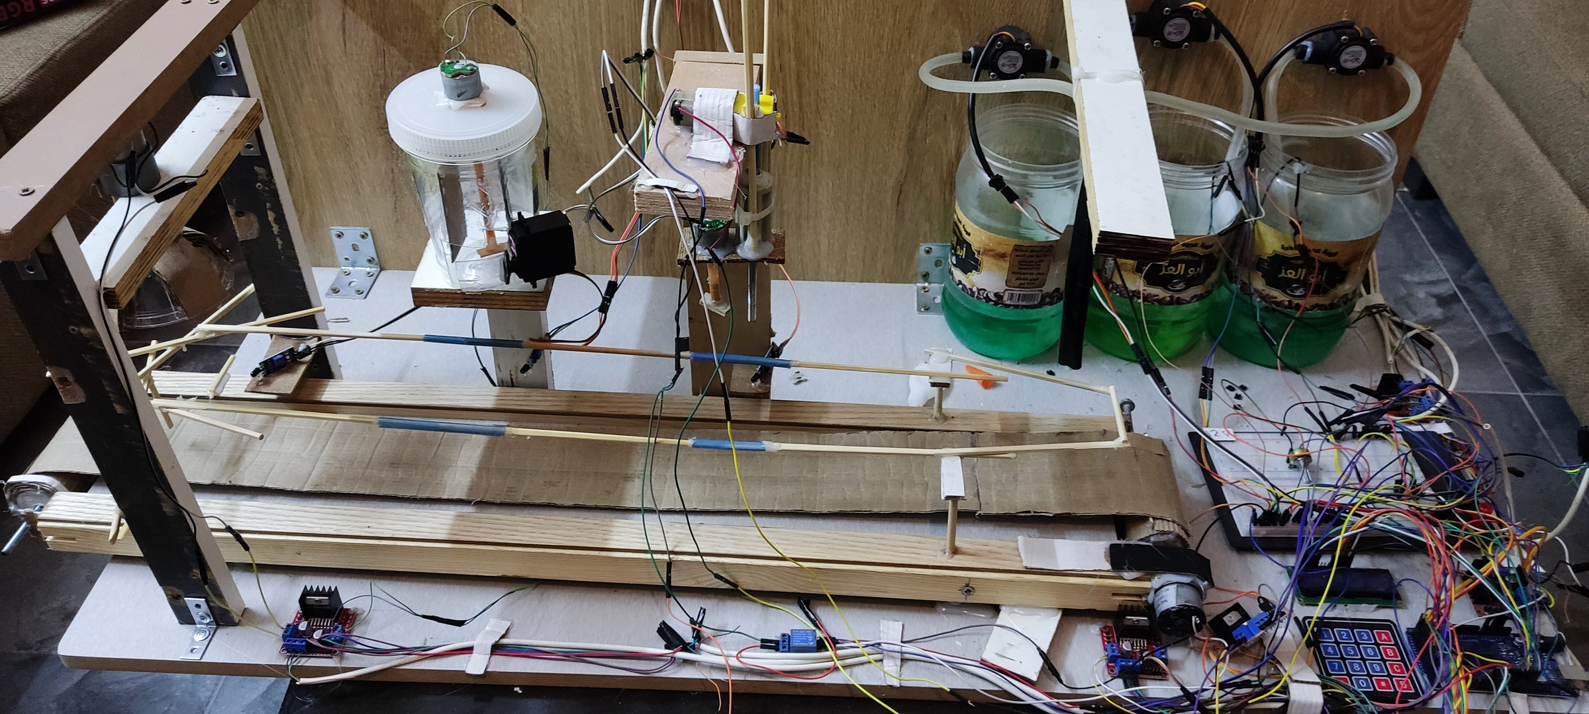

Slide 7
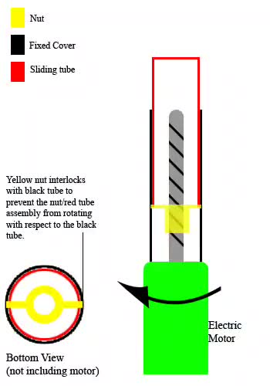
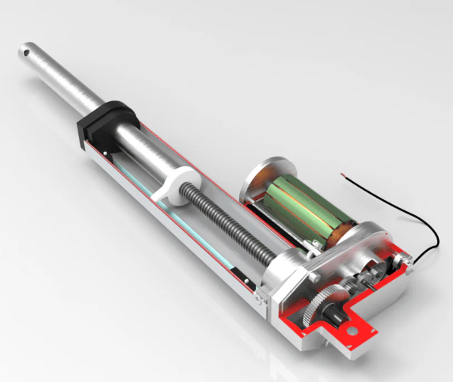
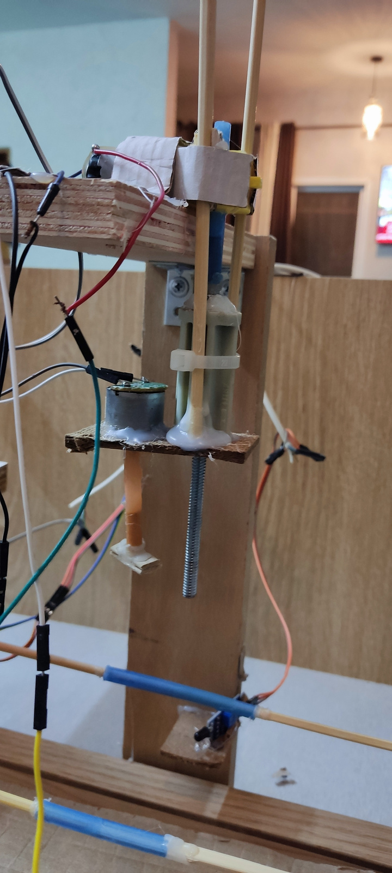
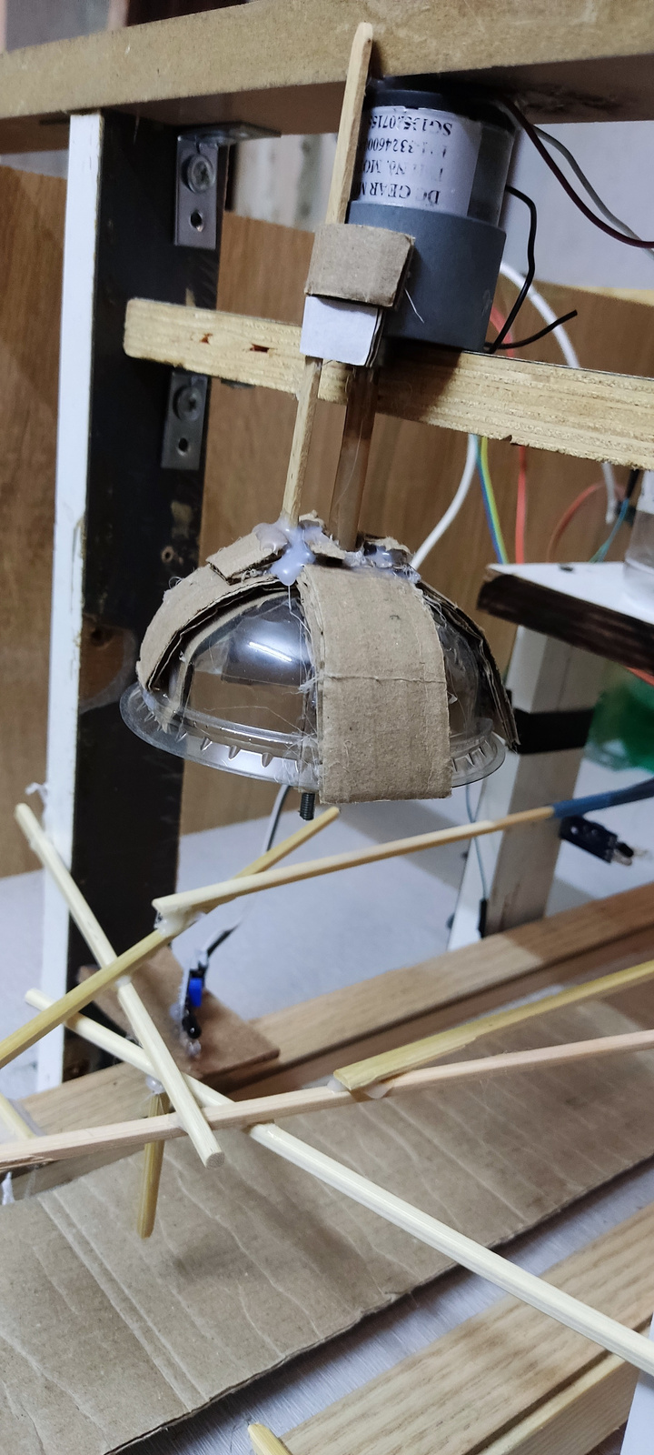
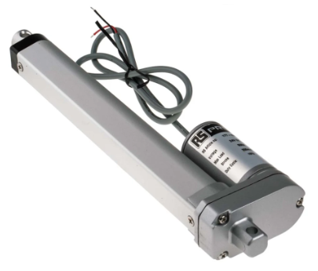
LINEAR ACTUATOR - INTERNAL DESIGN
OUR LINEAR ACTUATORS

Slide 8
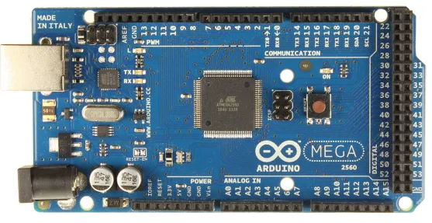
HARDWARE PART
Arduino Mega 2560 Control: Centralized control using an Arduino Mega 2560 ensures coordination of all motors, sensors, and pumps, allowing for efficient operation and easy programmability.

Slide 9
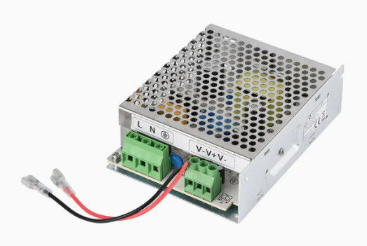
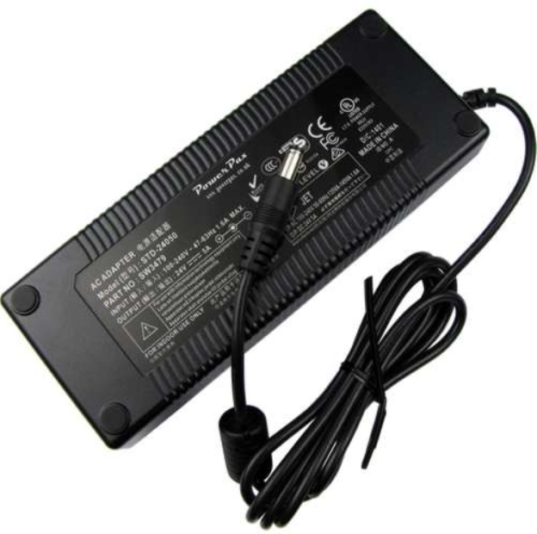
HARDWARE PART
Power Suppliers: Power Supply provide 12 volt 6 A & 24 volt for all project components

Slide 10
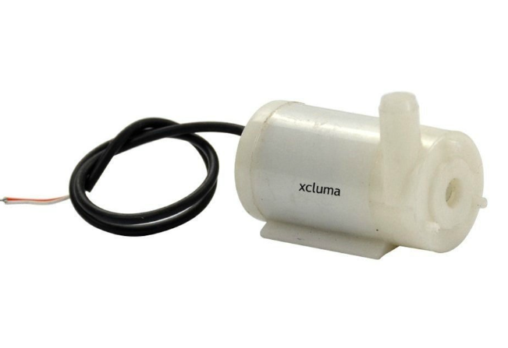
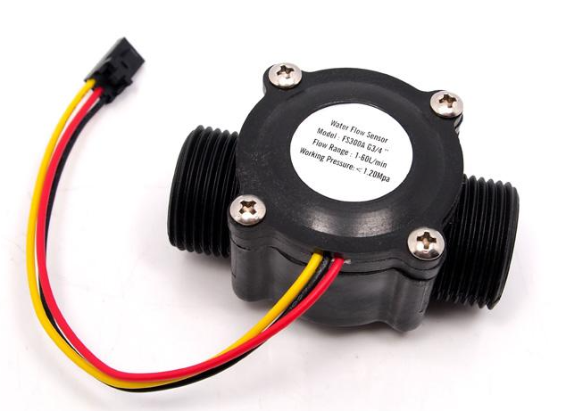
HARDWARE PART
Water Pumbs 5 volt: draw juice from a large container and pour it into the glass.
Water Flow Sensors:
To monitor and measure the amount of liquid being dispensed by each water pump

Slide 11
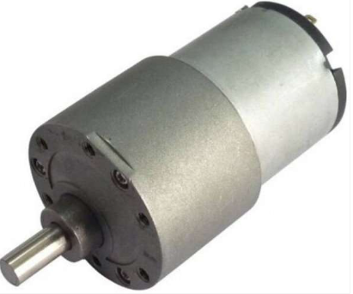
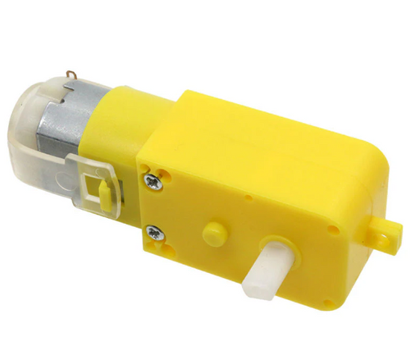
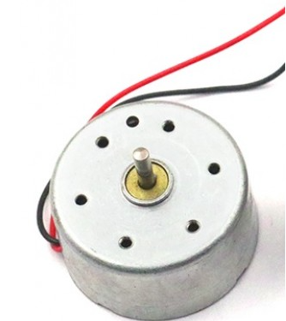
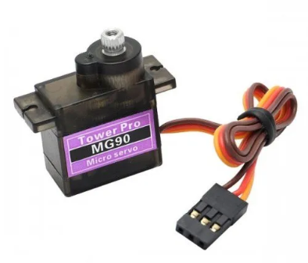
HARDWARE PART
DC Gear Motors
DC Motor
Servo Motor

Slide 12
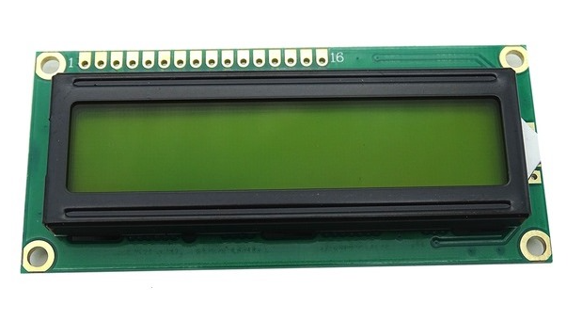
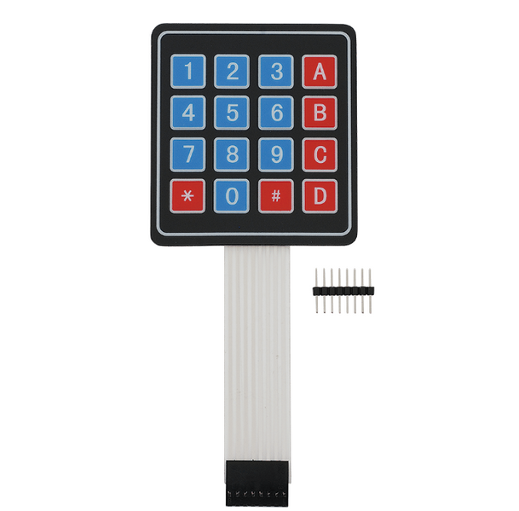
HARDWARE PART
16x2 LCD
4x4 Keypad

Slide 13
FUTURE WORK
  Add another stage to automate the insertion of the glass cover.
  Replace the fine-threaded shaft with a coarse-threaded shaft.
  Replace the cardboard belt with Reinforced Rubber belt.

Slide 14
Any Questions?

Slide 15



THANK
YOU

