Slide 1

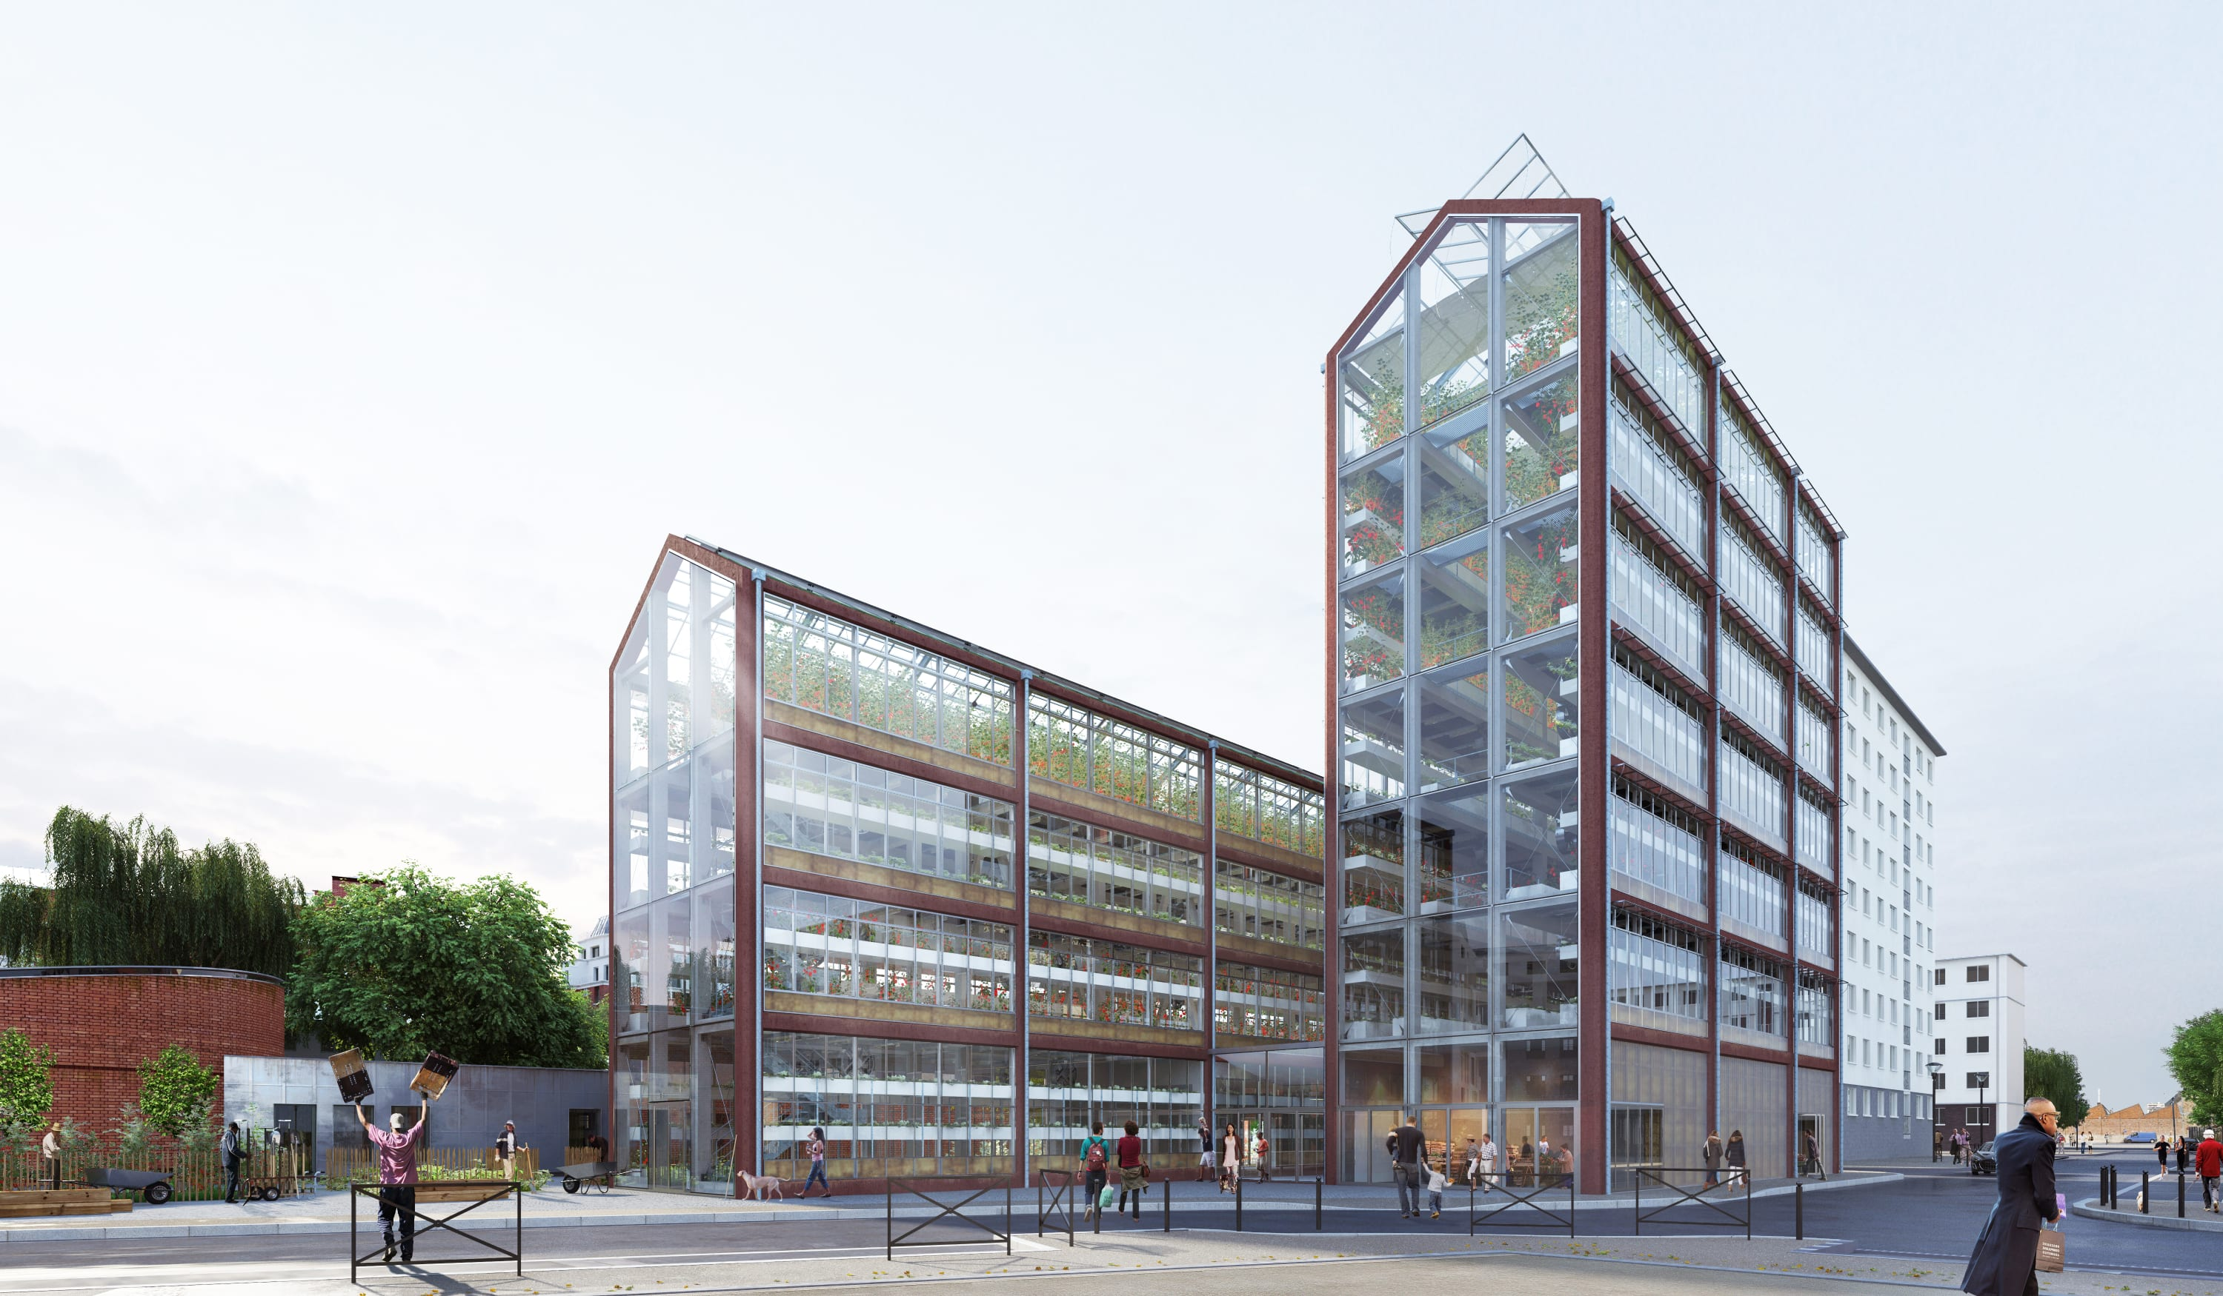
Analysis and Design of Steel Structure Vertical Farm
(Green Sky)
Prepared by:
Khansaa Rawajbeh
Riham Jawabreh
Sandy Sabbarini
Supervisor:
Dr.Mohammad samaneh

Slide 2


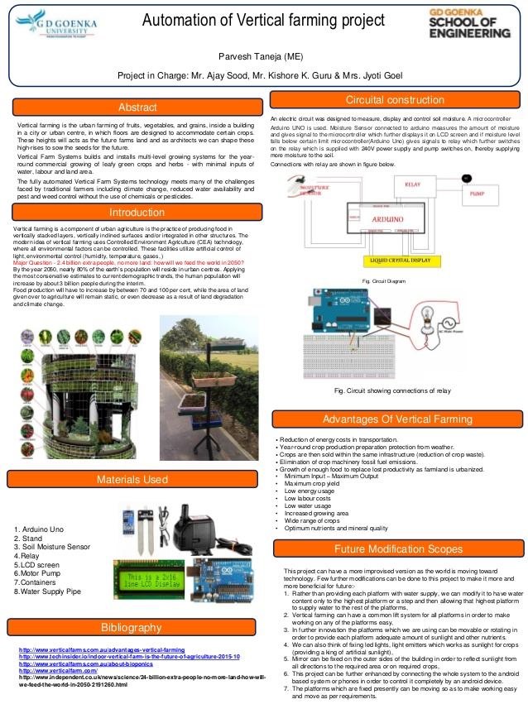
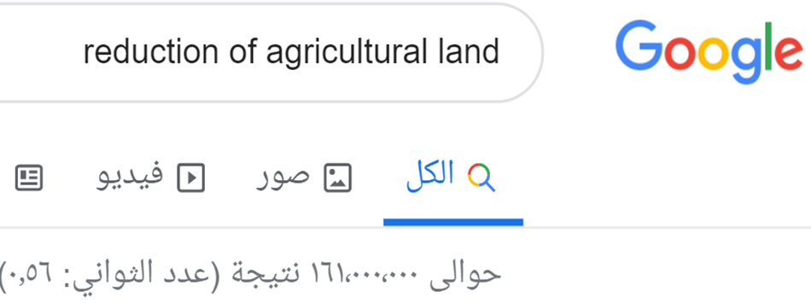
Why we choose this idea? Agriculture Future? ??

Slide 3

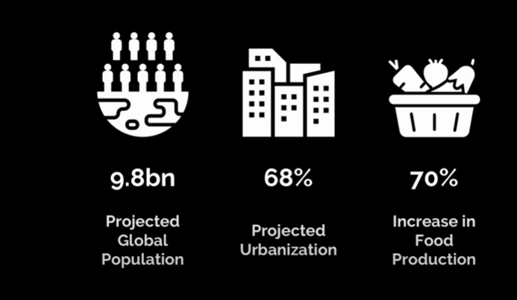
2050
+ +

Slide 4
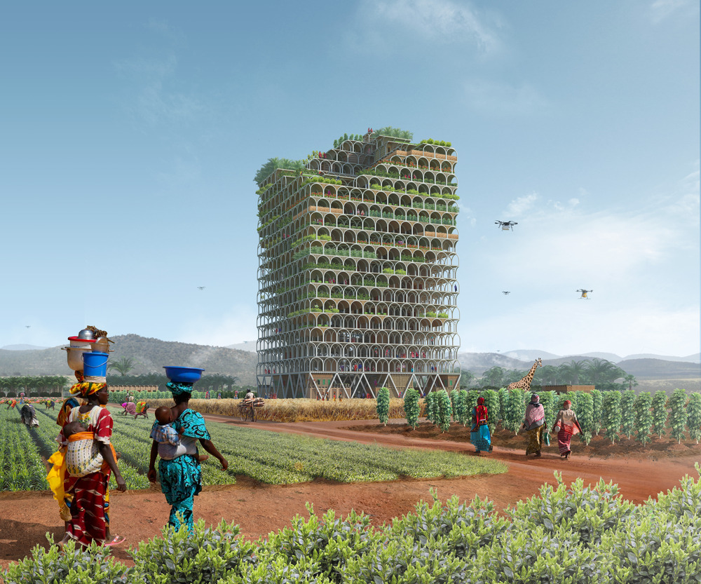
Simple Equation (Green Revolution) =Take the forest to new heights

Slide 5
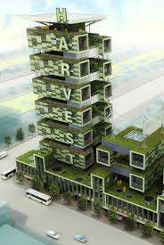
Vertical Farm
Vertical Harvesting
Growing UP

Slide 6

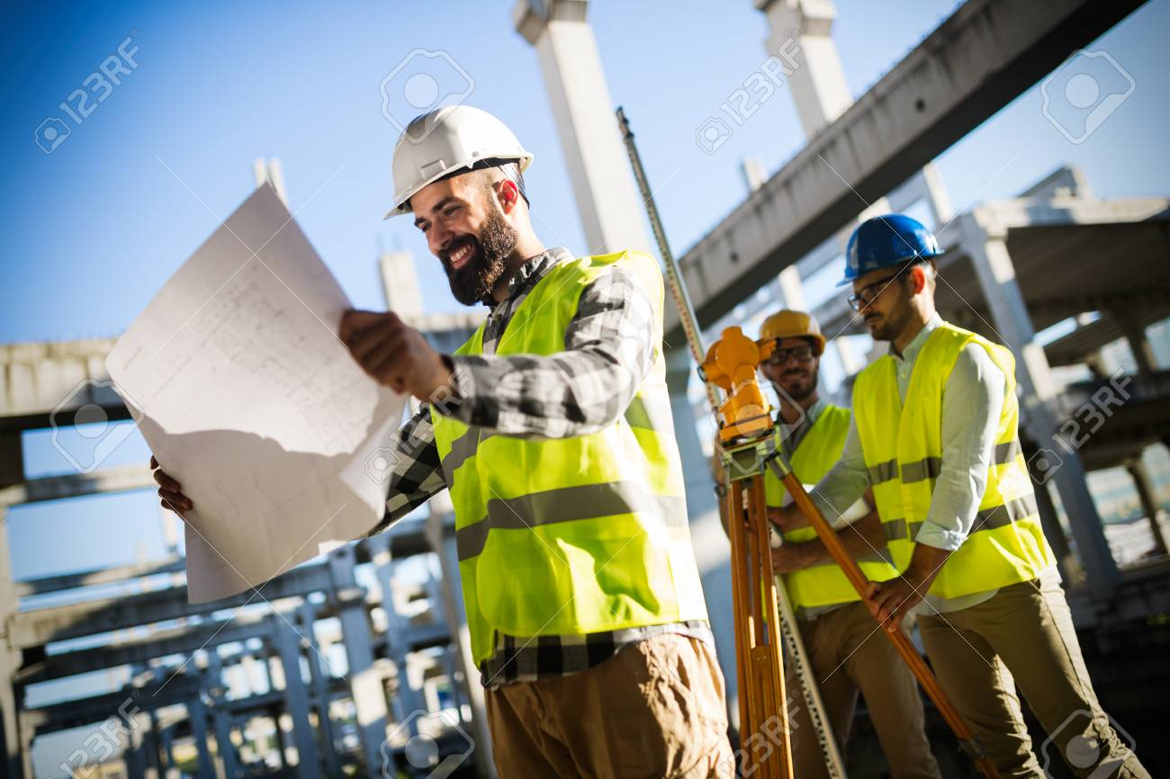

Combination of :
Biotechnology + Engineering + Data Science
+ +

Slide 7

What plants need to grow?
water
oxygen
sunlight
Plant growth
By Carefully Controlling the environment Leads To
Extend the Growing Season .

Slide 8

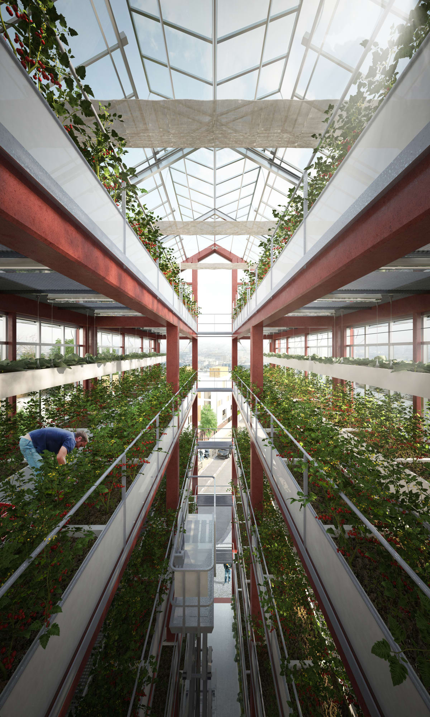
Production capacity rate 1m2 = 0.5 acres

Slide 9
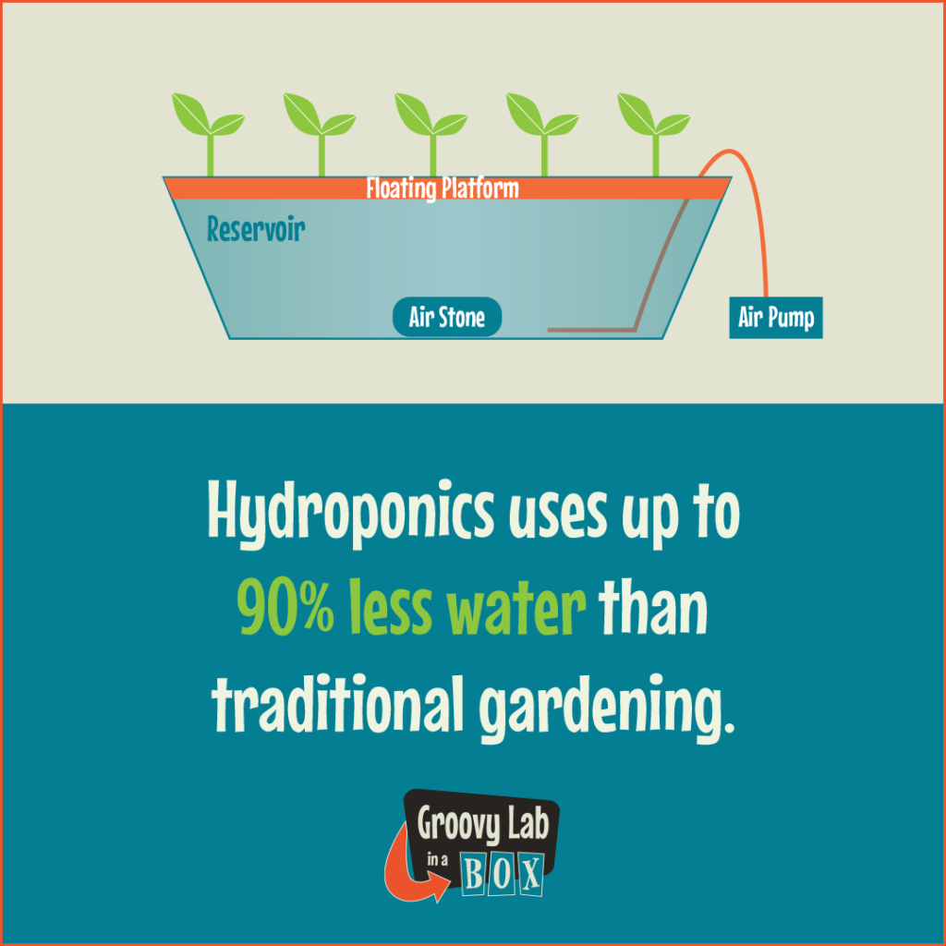

produce 20 tons of vegetables every day

Slide 10
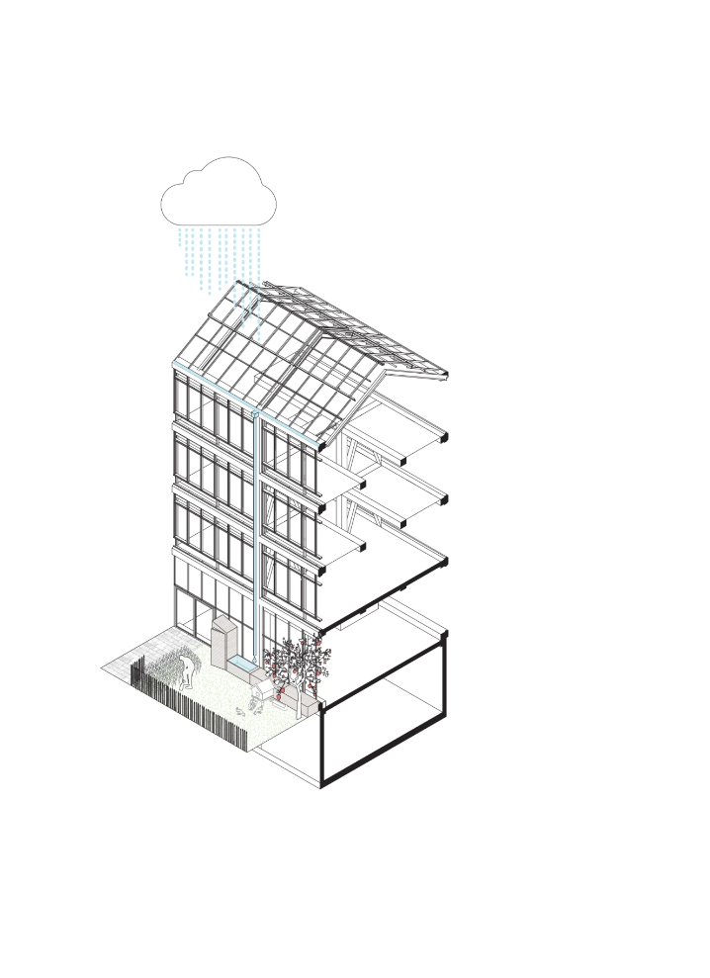
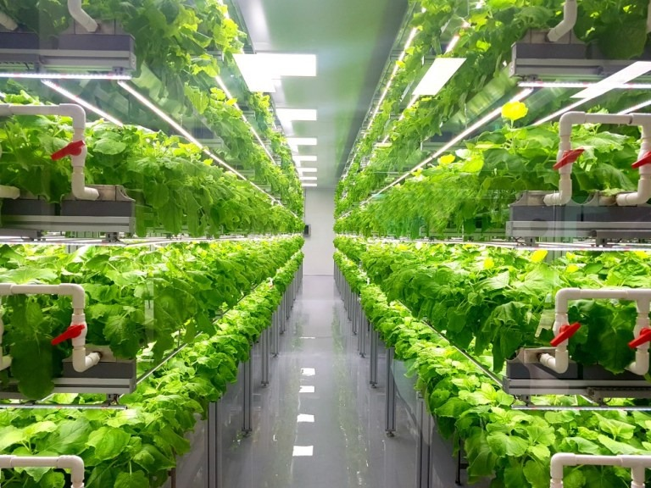
water
Rain water is collected and then reused it.
Theses gardens use up to 2/3 less water.

Slide 11
Introduction:
1.1. Project Description.
Location
It is located at east of Nablus Wadi Al-Tuffah . It’s extended over an area 1000 meter square . It consists of two parts of structure one of them have an area of 600 meter square
Stories and usage
7 floors
Stories |  | Function | Area(m²) | Height(m)
1 | Ground floor | Mainly: offices and storage | 600 | 4
2-7 | Agricultural floors | Agriculture containers (50*80 cm) for crops growing | 600 | 3

Slide 12
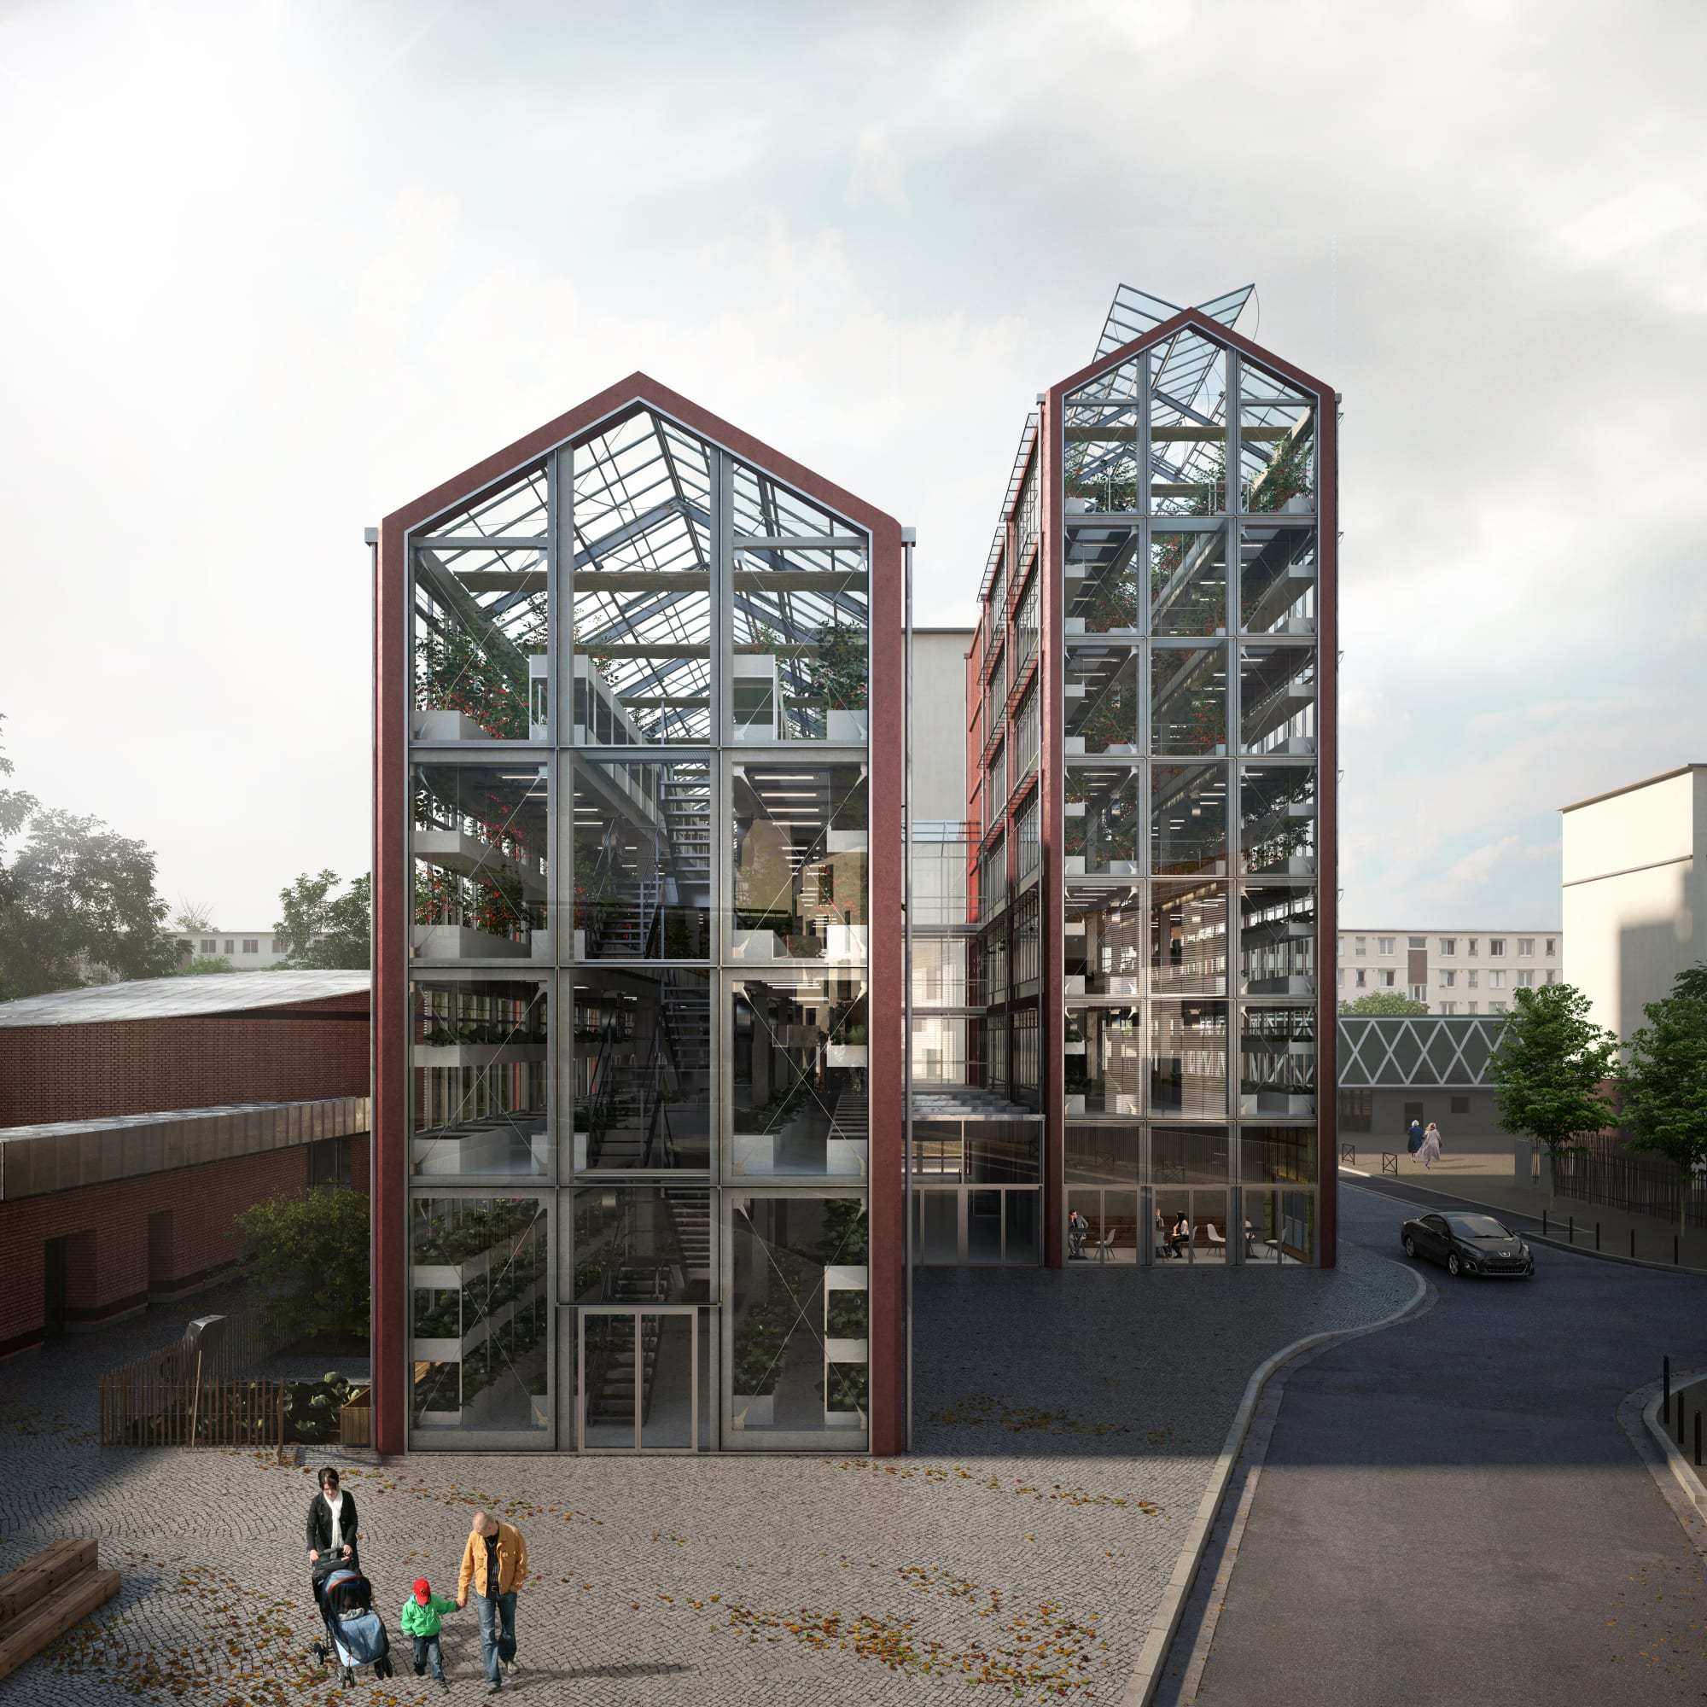
How to solve the problem?
6
5
4
3
2
1
Used the same area of the land 6 times ,so increase the productivity not just 6 times but more

Slide 13
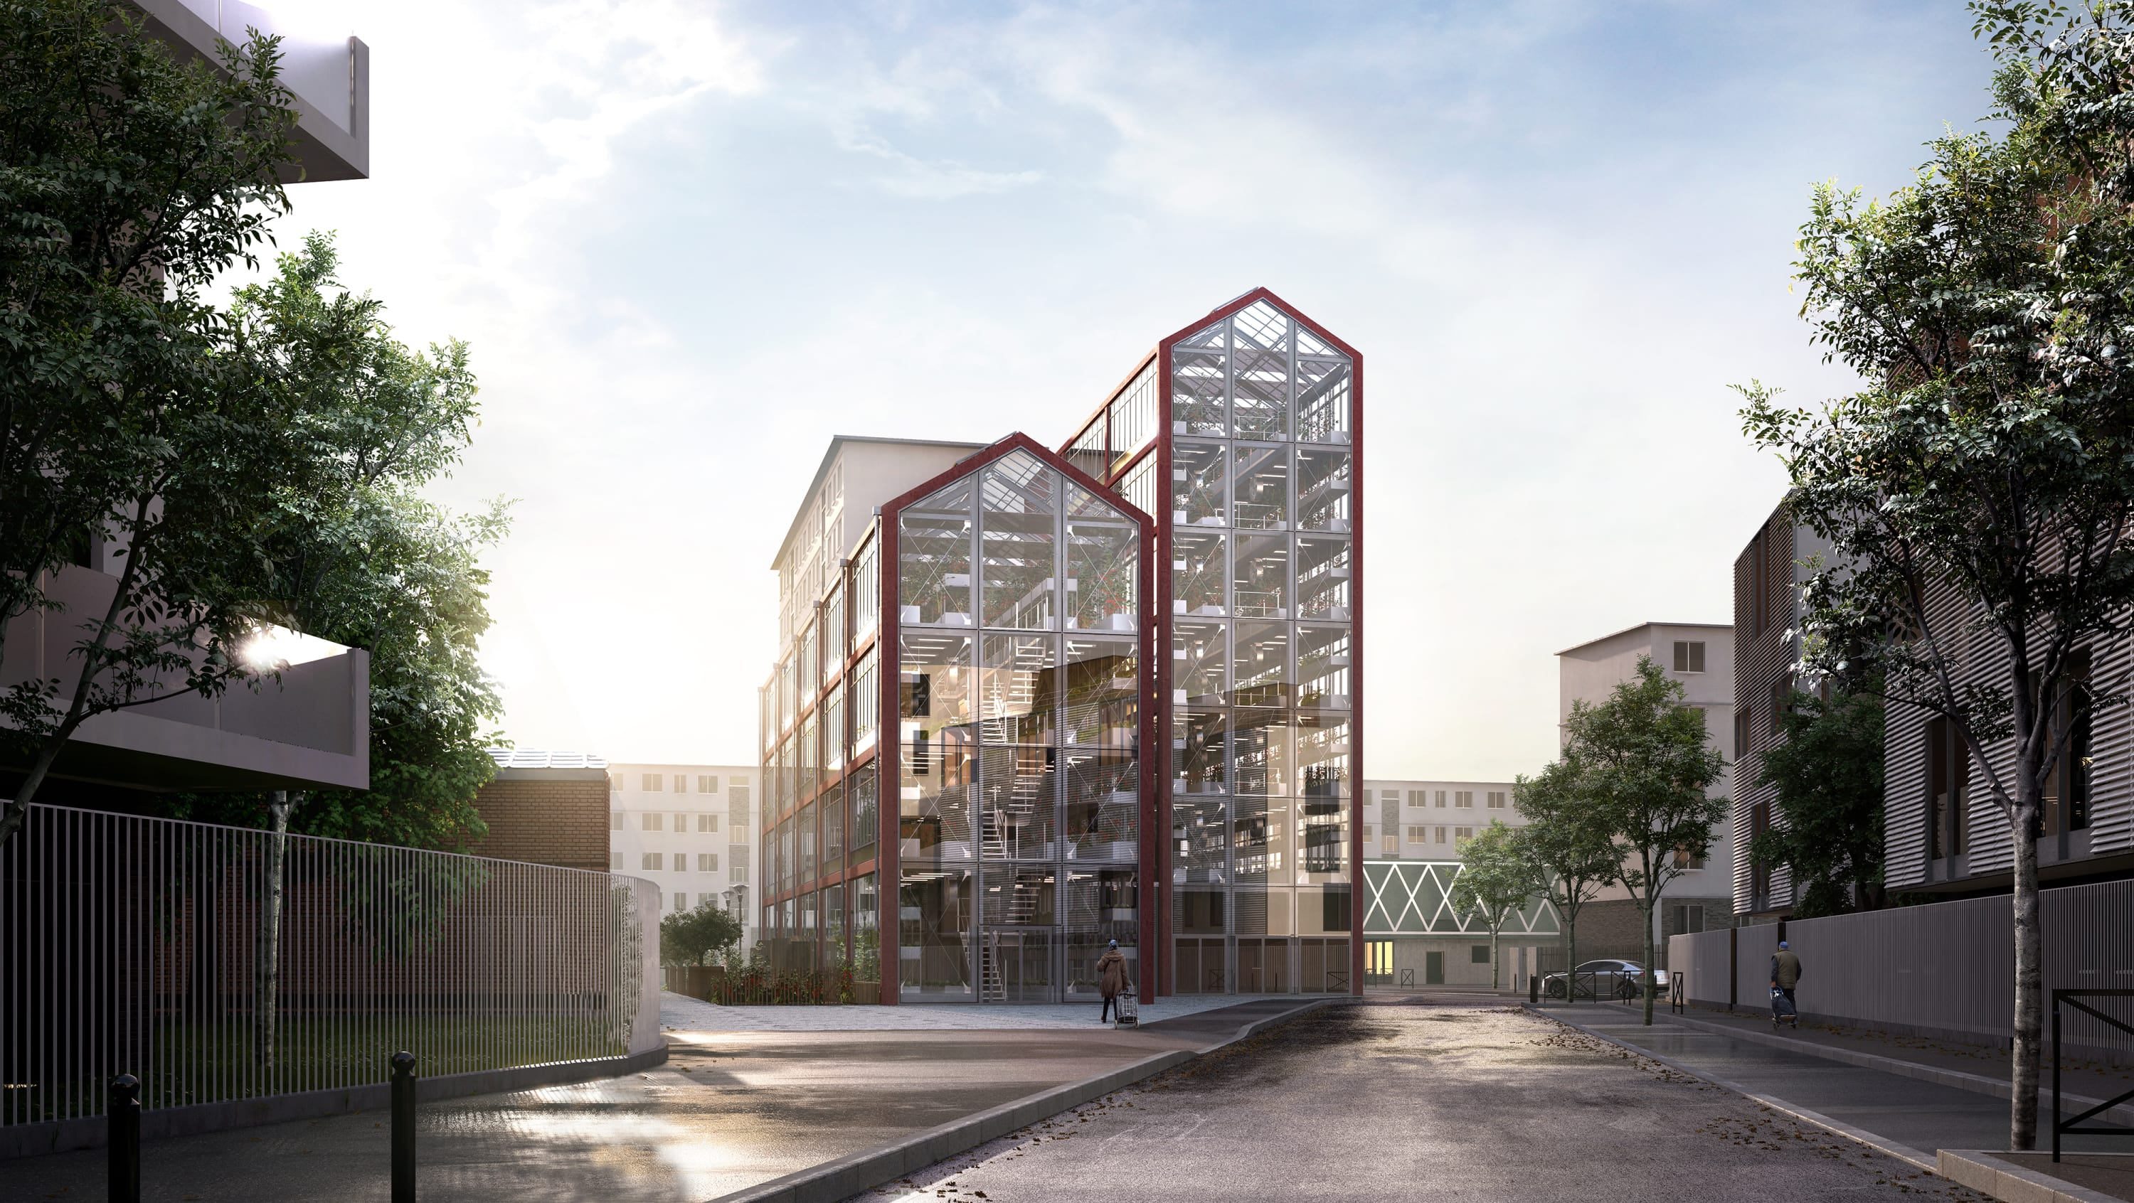
Romainville, Paris

Slide 14
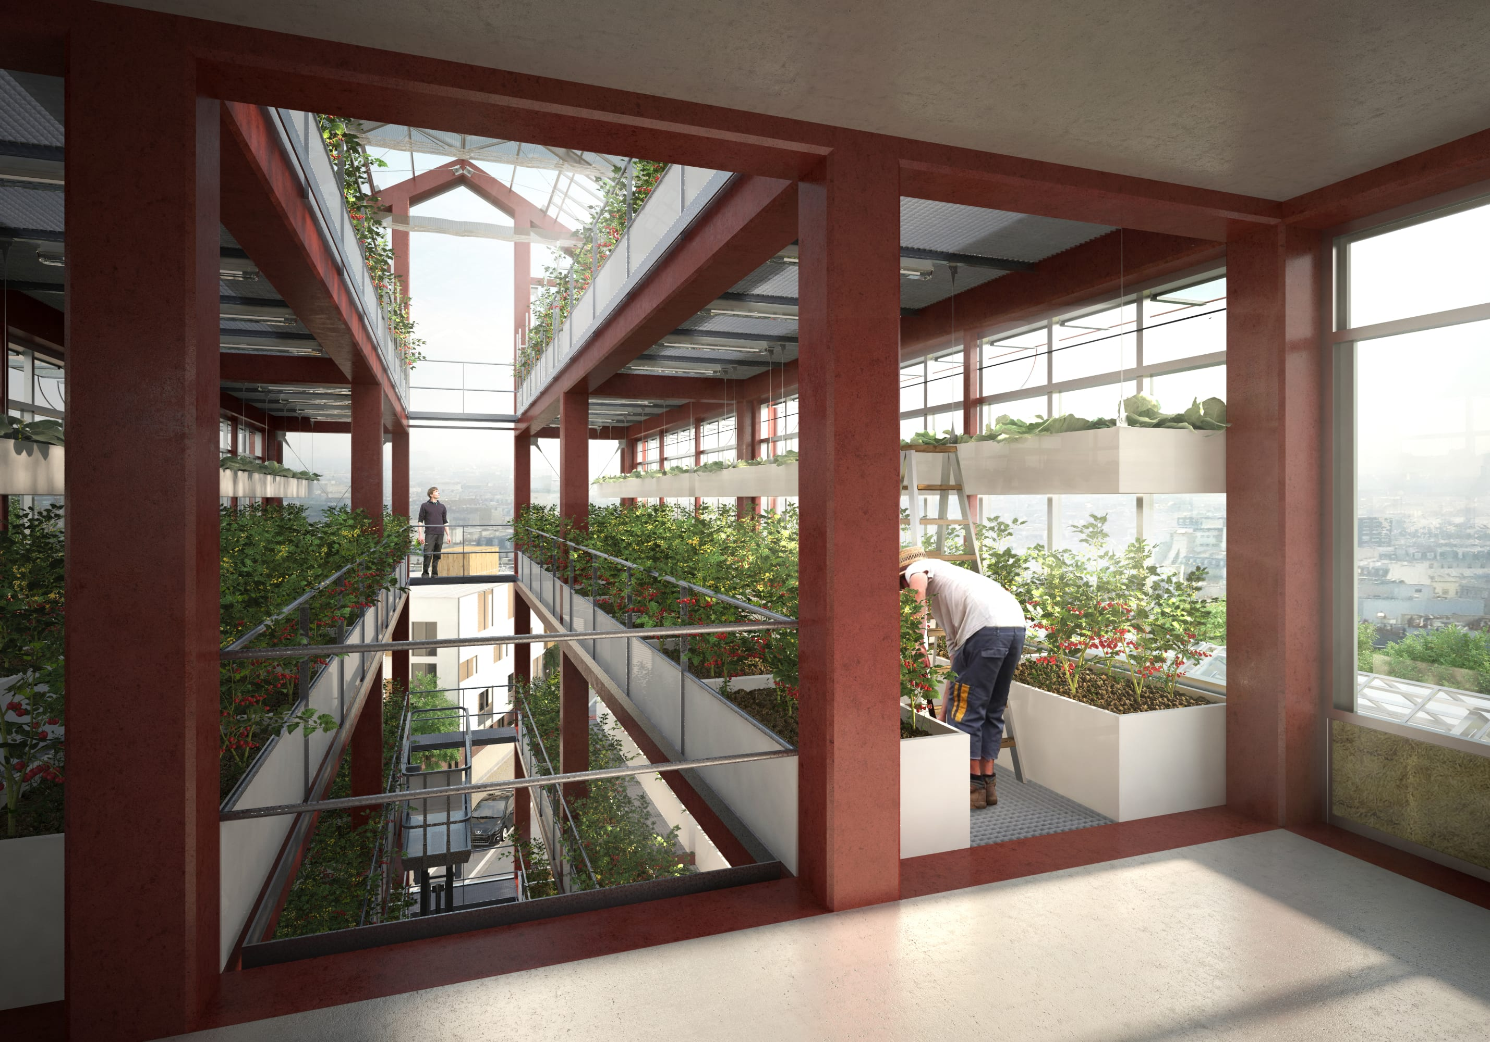

Slide 15
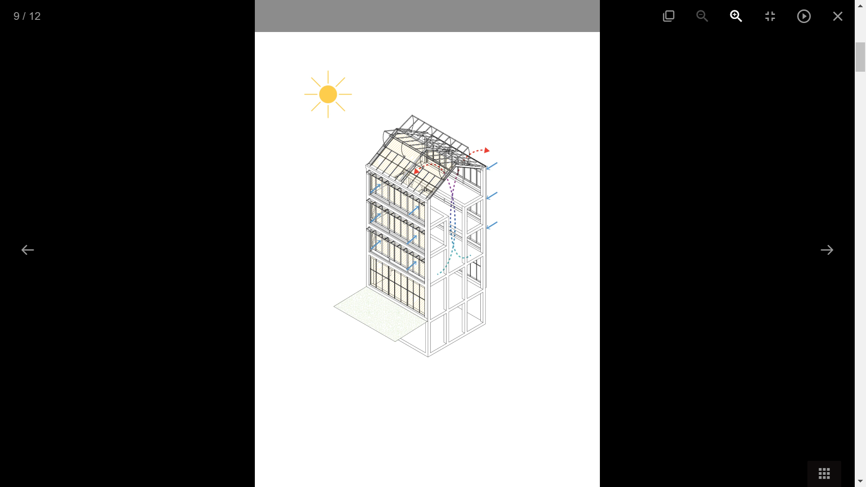

sunlight
The space inside the building helps to enter the sunlight and reach all plants.

Slide 16
Ventilation(oxygen)
The space inside the building in helps in ventilation process.

Slide 17
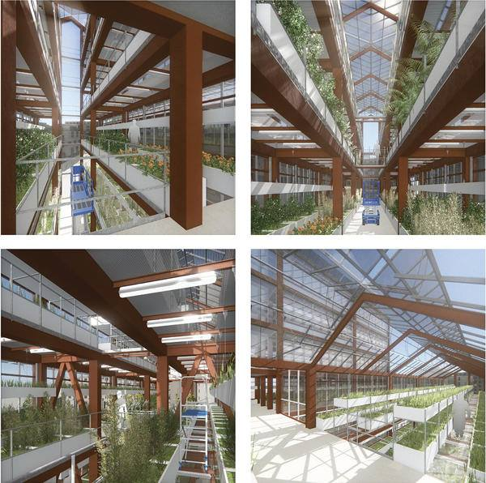
Due to ideal growing conditions, plants mature 25% faster and produce 30% more product

Slide 18
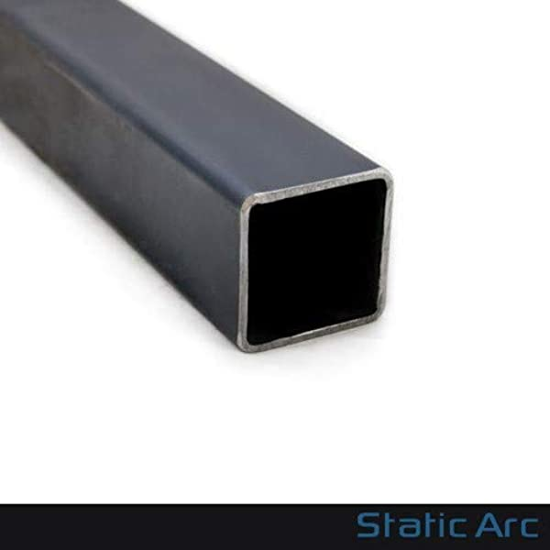
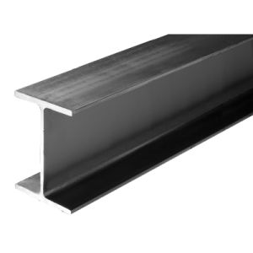
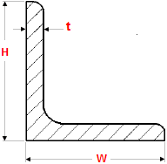
Materials used:
A36 STEEL
Tensile Strength, Yield | 250 MPa

Slide 19
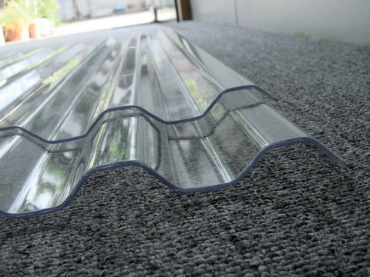
Polycarbonate Sheets
They are transparent panels made of distinguished and strong imported materials, which are light, strong, durable and flexible compared to glass
Its advantages:
-stability of the color degree
-It is characterized by high light transmittance up to 90%.
-Resistant to mechanical stress
- Lightweight material
- Easy constructed

Slide 20
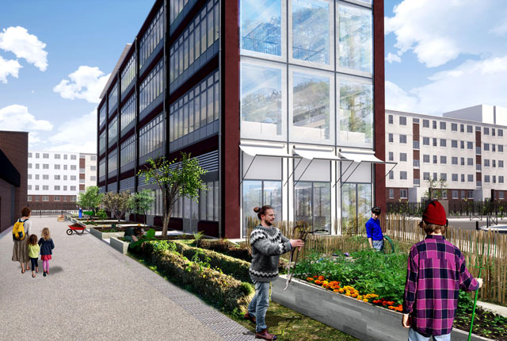
glass
Glass curtain walls are lightweight aluminum-framed facades housing glass or metal panels.
gravity loads and wind resistance
thickness equals 10 mm

Slide 21
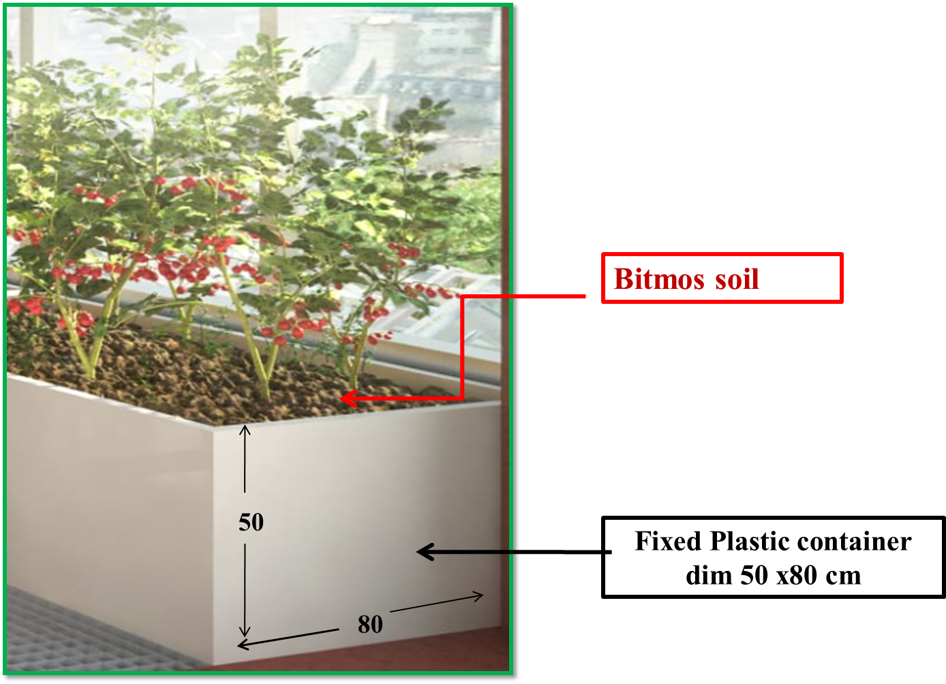
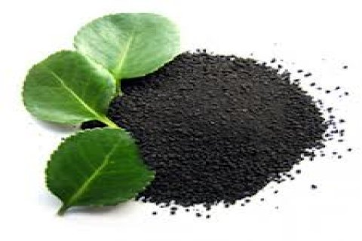
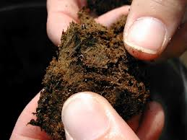
compost soil
light
high quality of the soil
raising production
contain a lot of organic fertilizer
plants to grow well

Slide 22
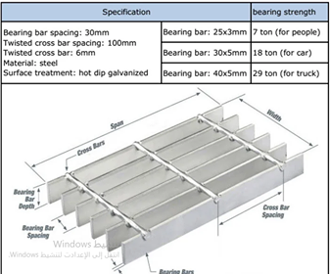
steel mesh
Steel Floor Grating with (6 mm) bar thickness
    high strength
    Light structure

Slide 23
Loads in SAP
(KN/M) | Type of load
1.25 | SD
2.5 1 | LIVE GLSS

Slide 24
Steel Sections shown in shop drawings.:
Members Group: | Section type | Dimensions
Columns | H- beam | HEA220
Main Beam | I-Beam | IPE 270
Secondary Beam | I-Beam | IPE 180
Rafter Beam | I-Beam | IPE 270
Purlins | TUPE | 120Tubo
XZ Bracing | 2L-Double Angle | 2L 80×60×7×8
YZ Bracing | 2L-Double Angle | 2L 60×40×60/20
1st Floor Bracing | 2L-Double Angle | 2L 100×50×10/30

Slide 25

2.3.Structural design
Verification of the model
Compatibility check
1
2
Equilibrium check
Internal force check
3

Slide 26
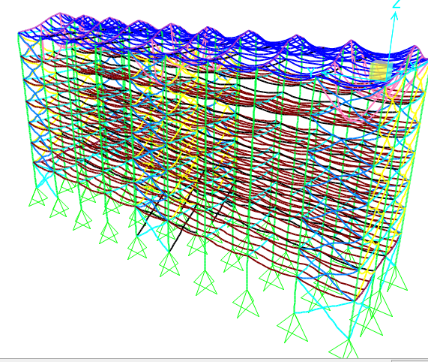
Verification of the model
2.3.1.Compatibility check :
From the figure, it is clear that the component of the structure looks compatible with each other.

Slide 27
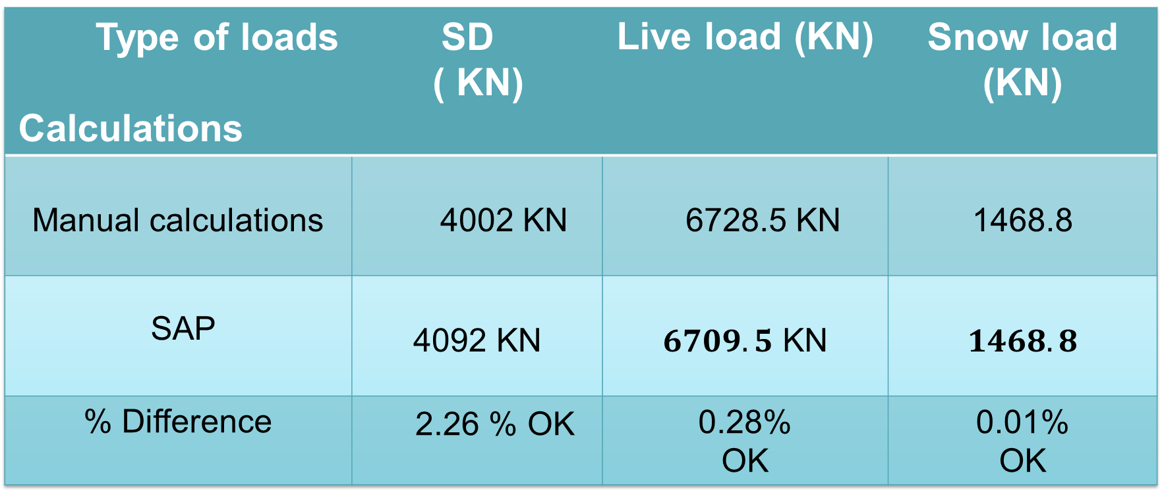
Verification of the model
2.3.2:Equilibrium check:
Summarize the results For gravity loads :-
Type of loads Calculations | SD ( KN) | Live load (KN) | Snow load (KN)
Manual calculations | 4002 KN | 6728.5 KN | 1468.8
SAP | $$\text{4092 }\text{KN}$$ | $6709.5$ KN | $1468.8$
% Difference | 2.26 % OK | 0.28% OK | 0.01% OK

Slide 28
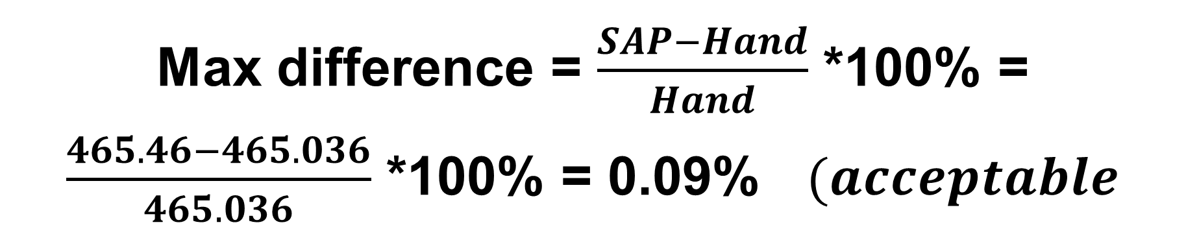
Verification of the model
2.3.2:Equilibrium check:
3
For Lateral loads (Wind Load)
Max difference = $\frac{SAP−Hand}{Hand}$ *100% = $\frac{465.46−465.036}{465.036}$ *100% = 0.09% $(acceptable$

Slide 29



Verification of the model
2.3.3. Verification of Internal Forces
2.3.3.1.Stress – Strain check:
The check will be done on purlins by using live loads only.
Live load = 0.7 $KN/m^{2}$
Purlins Length = 5 m
Distributed loads on purlins = 0.85 X 0.7 = 0.595 KN/m.
$$M_{by hand}=\frac{W L^{2}}{8}=\frac{0.595×5^{2}}{8}=1.86 KN.m$$
$M_{sap}=1.8221 KN.m$
$$Error\%= \frac{1.86−1.9 1}{1.86}=2.7 \% <10\%→OK$$

Slide 30
Verification of the model
2.4:Deflection Check:
:
Steel deflection limit:
Service (D+L+SD) deflection= $\frac{L}{120}$
Service (D+L+SD) deflection= 𝐿/120
Snow load deflection = $\frac{L}{180}$
Snow load deflection = 𝐿/180
Live load deflection = $\frac{L}{180}$
Live load deflection = L/180

Slide 31
Deflection Check
1
the allowable deflection for (snow) = From IBC 2012 code Δ_{allowable}= 𝐿 /180 = 5/180 = 0.027 m = 27.78 mm
= Max Snow deflection from SAP = 17.66 mm < 27.78 mm (OK)
the allowable deflection for (Wind)
. From IBC 2012 code Δ_{allowable}= 𝐿 /180 = 6.8/180 = 0.037 m = 37.78 mm
Max Wind deflection from SAP = 28.8 mm < 37.78 mm (OK)
2

Slide 32
Deflection Check
1
Service (D+L) deflection
From IBC 2012 code Δ_{allowable} = 𝐿/120 = 5/120 = 0.042 m = 41.66 mm
Max deflection from SAP = 6.47mm < 41.66 mm (OK)
2

Slide 33
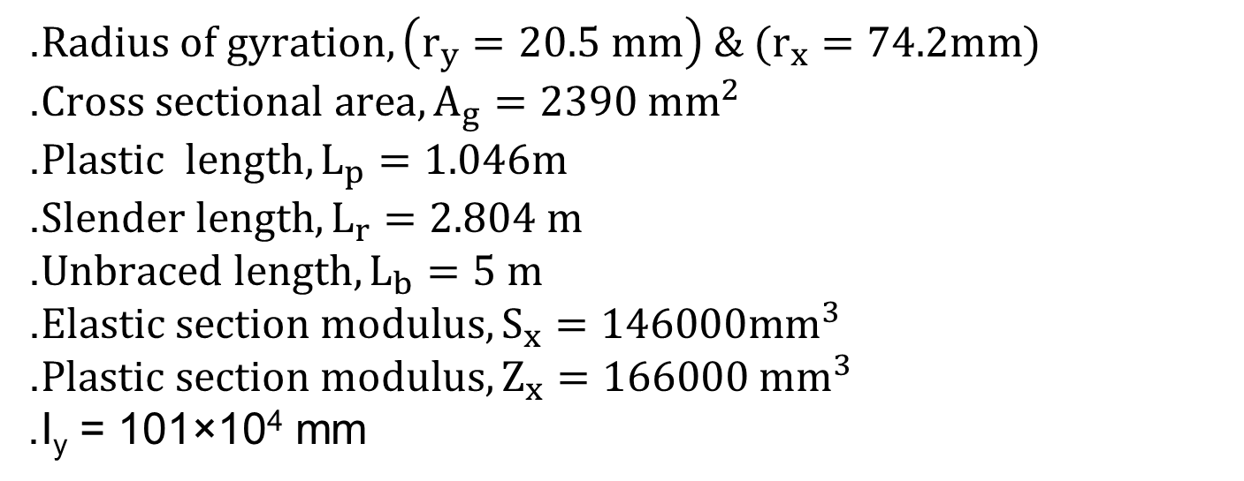
Member Design
Design of Secondary Beam :
.$Radius of gyration, \left(r_{y}=20.5 mm\right) \& (r_{x}=74.2mm)$
.$Cross sectional area, A_{g}=2390 mm^{2}$
.$Plastic length, L_{p}=1.046m$
.$Slender length, L_{r}=2.804 m$
.$Unbraced length, L_{b}=5 m$
.$Elastic section modulus, S_{x}=146000mm^{3}$
.$Plastic section modulus, Z_{x}=166000 mm^{3}$
.I_{y} = 101×10⁴ mm

Slide 34

Member Design
Design of Secondary Beam:
$∴ ∅M_{n}=0.9 \sqrt{\frac{π^{2 }EI_{Y}}{{L_{B}}^{2}}(GJ+\frac{π^{2 }EC_{w}}{{L_{B}}^{2}}) }$
${∴∅M}_{n}= 18.348 kN.m$
$∴\frac{M_{u}}{∅M_{n}}=\frac{17.877}{18.348}=0.97$
$∴\frac{Demand }{Capacity}=0.97$
$$\% difference= \frac{0.97−0.946}{0.97}=2.4\% (acceptable)$$

Slide 35
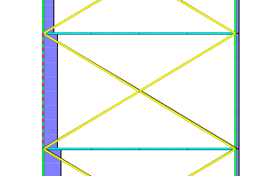
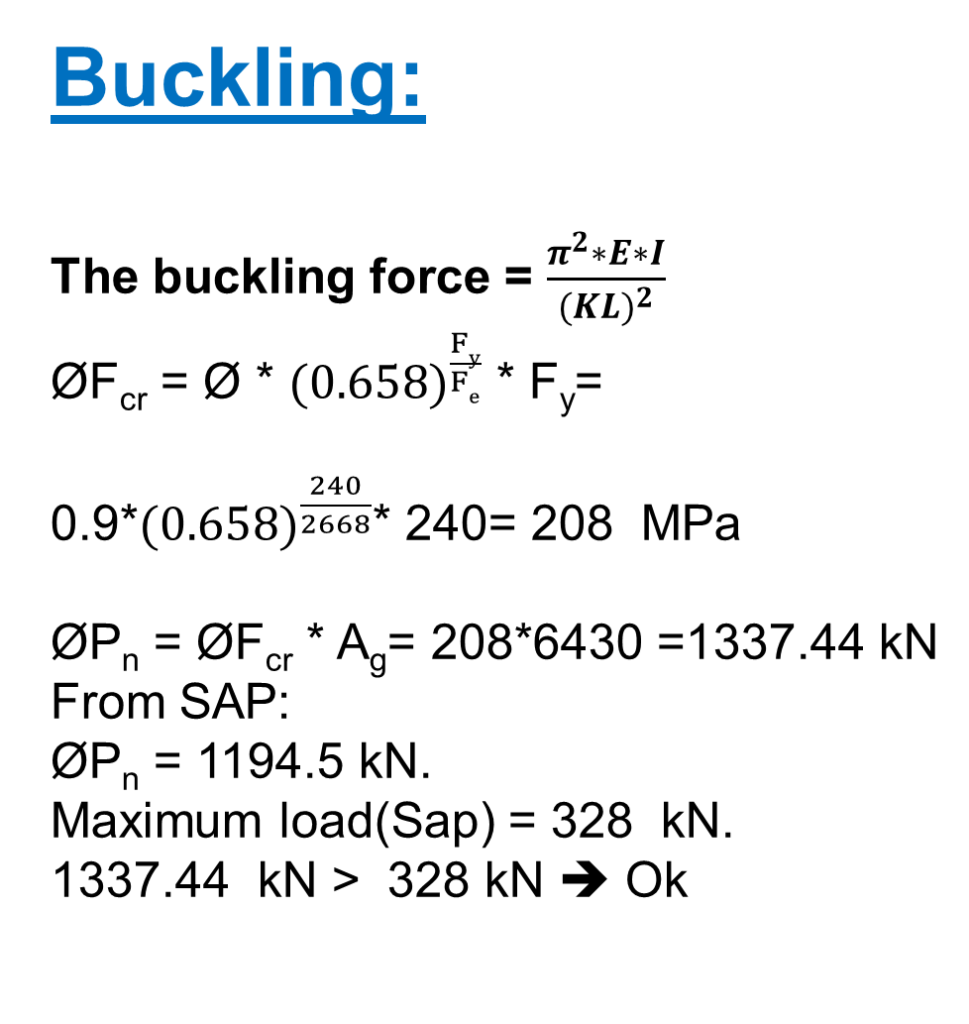
Buckling:
The buckling force = $\frac{π^{2}∗E∗I}{{(KL)}^{2}}$
ØF_{cr} = Ø * ${(0.658)}^{\frac{Fy}{Fe}}$ * F_{y}=
0.9*${(0.658)}^{\frac{240}{2668}}$* 240= 208 MPa
ØP_{n} = ØF_{cr} * A_{g}= 208*6430 =1337.44 kN
From SAP:
ØP_{n} = 1194.5 kN.
Maximum load(Sap) = 328 kN.
1337.44 kN > 328 kN ➔ Ok

Slide 36
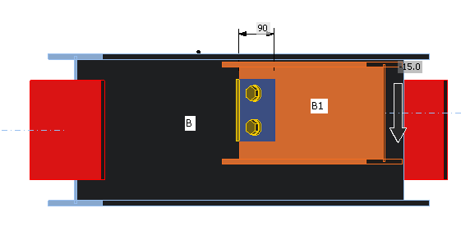
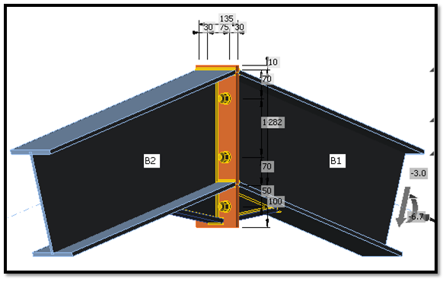
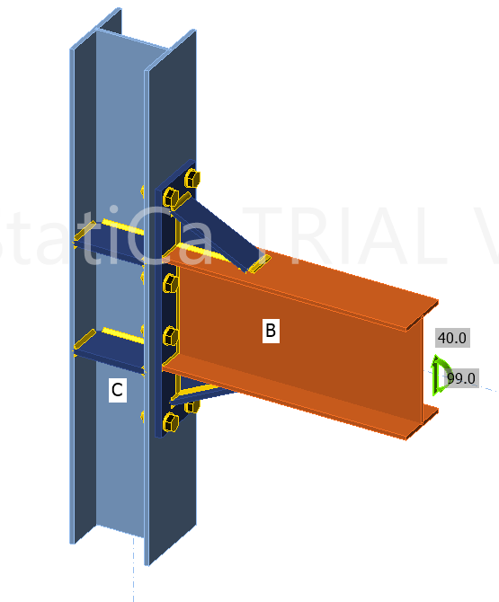
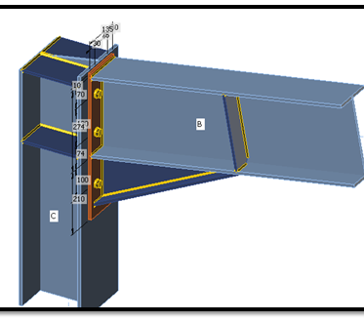
connections

Slide 37
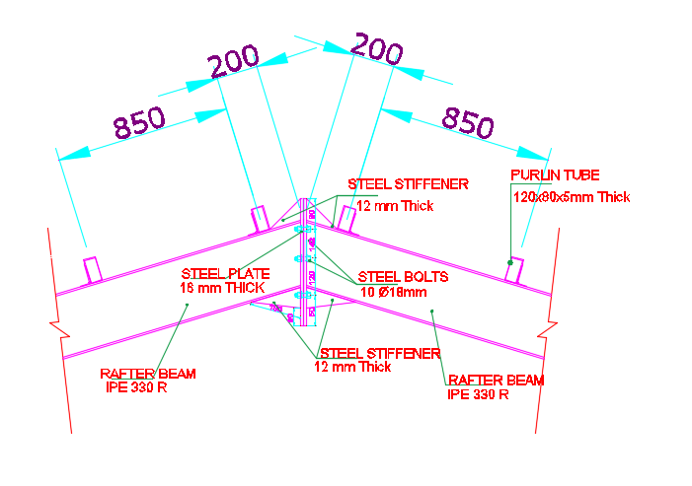
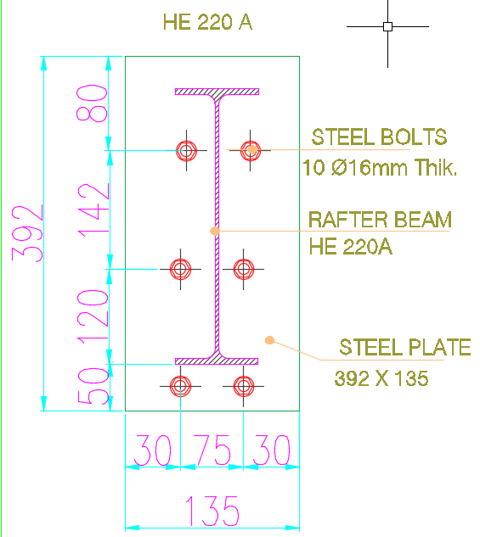
Two Rafters Connection (Apex ):

Slide 38
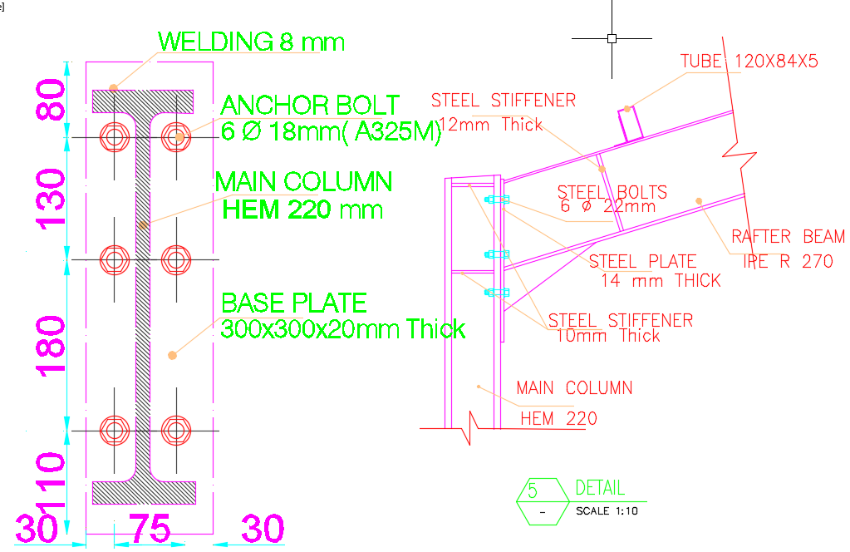
Rafter-Column connection

Slide 39
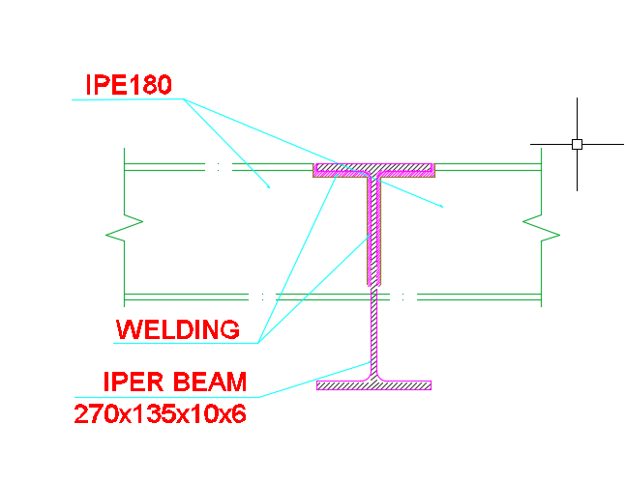
Sec-Main Beam Connection:

Slide 40
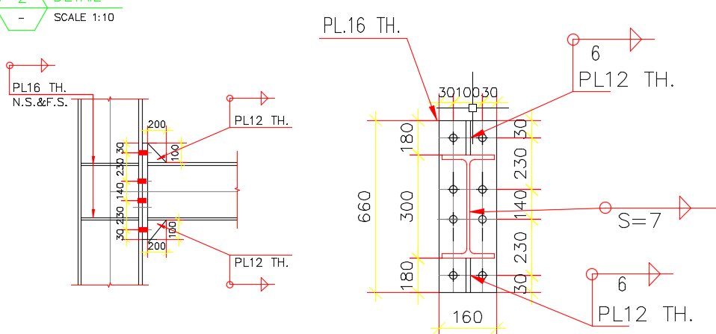
Beam-column Connection:

Slide 41
Beam-Column Connection hand Checks:
loads in beam are:
1-moment
2-shear

Slide 42
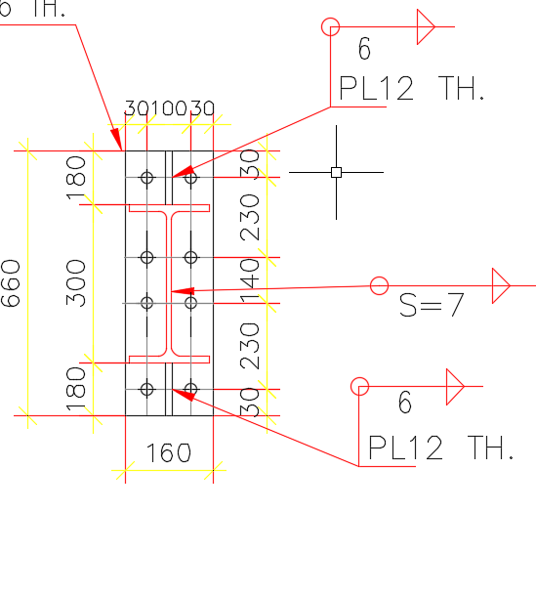
Assumptions:
Use 8Ø22 of A325 bolts.
Use an (E80) weld only on all member sides of (8.00 mm) thickness.
Use an (12.00 mm) steel plate of grade A36.

Slide 43
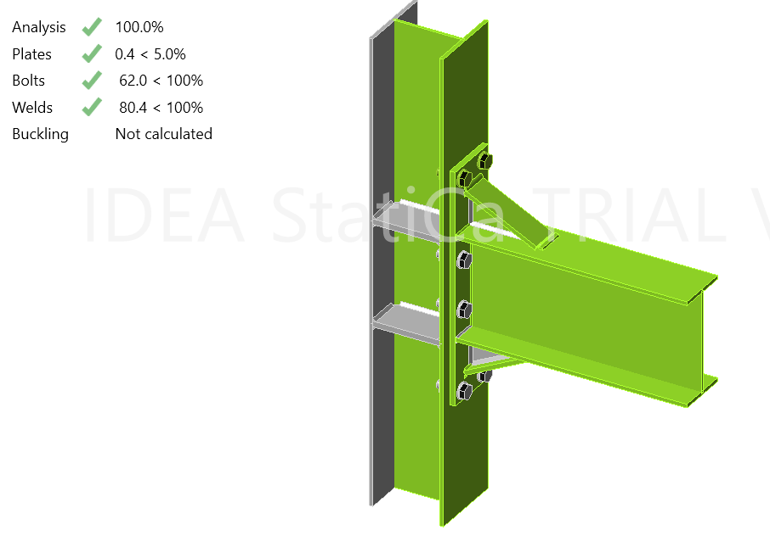
IDEA STATICA Results

Slide 44
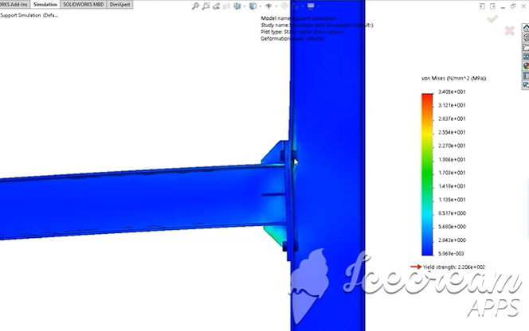

Slide 45


Checks For the bolts:
first due to moment loads:
$f_{t_{}}=\frac{M y}{I}=\frac{99×{10}^{6}×310}{4\left(\frac{π}{4}\right)\left({22}^{2}\right)\left({310}^{2}\right)+4\left(\frac{π}{4}\right)\left({22}^{2}\right)\left({80}^{2}\right)}$
$∴f_{t_{}}=197 MPa$
$∅f_{n_{t}}=0.75×620=465 MPa$
$∴∅f_{n_{t}}>f_{t} \left(acceptable\right)$

Slide 46
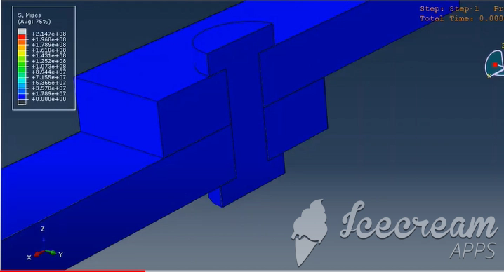
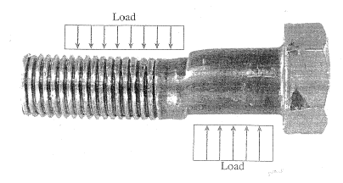

Slide 47
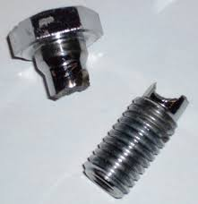

Second due to shear loads:
$f_{v}=\frac{40000}{8\left(\frac{π}{4}\right)\left({22}^{2}\right)}=13.16 MPa$
$∅f_{n_{v}}=0.75×330=247.5 MPa$
$∴∅f_{n_{v}}>f_{v} \left(acceptable\right)$

Slide 48
Base plate connection
the following assumptions are made for this connection on IDEA Statica
Use 4Ø16 bolts.
.Use a (16 mm) steel plate of grade A36
.Use an (E60) weld only on the flange sides of (8.00 mm) thickness.
Use a vertical bolt spacing of (140.00 mm).
Use a horizontal bolt spacing of (90.00 mm).
Use a vertical distance between the plate edge and the bolt of (165.00 mm).
Use a horizontal distance between the plate edge and the bolt of (190.00 mm).
Use a horizontal distance between the section flange and the bolts of (60.00 mm).
Use plate dimensions of (470.00x470.00 mm).

Slide 49
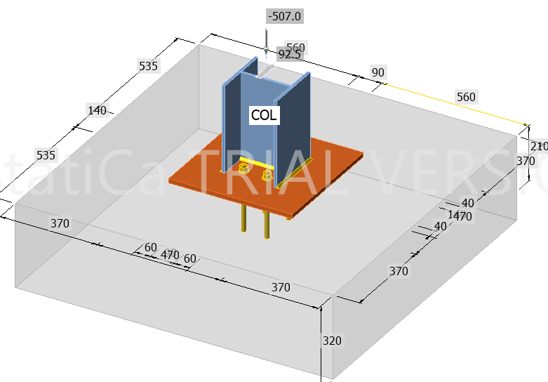

Slide 50

Assume Ø16 diameter For the bolts:
Shear check
115 KN < 247.5 KN
Ok
For the weld:
$18.58 Mpa$ < $189 MPa$
Ok
For the plate :
bearing check:
$23.13\text{<}$ $184.32 kN$
Ok
, tear-out check:
$$23.13 kN\text{<}895.86 kN$$
Ok Area check :
$21.3cm^{2}\text{<}$ $22.1 cm^{2}$
Ok

Slide 51

Base plate Details

Slide 52

Footing Dimensions
Maximum service reaction = 299KN
$A_{f}=\frac{P_{s}}{q_{allow}}$ = $0.95 m$
$$h=320 mm$$
$$d=250 mm$$
checking the one-way shear:
$$V_{u}=q_{u}\left(L_{1}−d\right)$$
$165.36 kN$ $>$ $77.8kN$
$$ØV_{C}>V_{u} →Ok$$
:checking The ultimate two-way shear checking
$$V_{u_{p}}= P_{u}−q_{u}A_{1}$$
$$∴ØV_{C_{p}}>V_{u_{p}} →Ok$$
$615.14 kN>$ $482.53 kN$

Slide 53




Flexural Design of Footing
$M_{u}=\frac{q_{u}{ L}_{1}^{2}}{2}$ = $45.81kN.m$
$∴ρ=\frac{0.85 f_{c}^{′}}{f_{y}}\left(1−\sqrt{1−\frac{2.61×{10}^{6}×M_{u}}{b d^{2}f_{c}^{′}}}\right)$ $ρ=0.00197$
$A_{s}=ρ_{ } b h=630 mm^{2}/m$
$$∴use 1 Ø 12 / 150 mm$$

Slide 54


