Slide 1
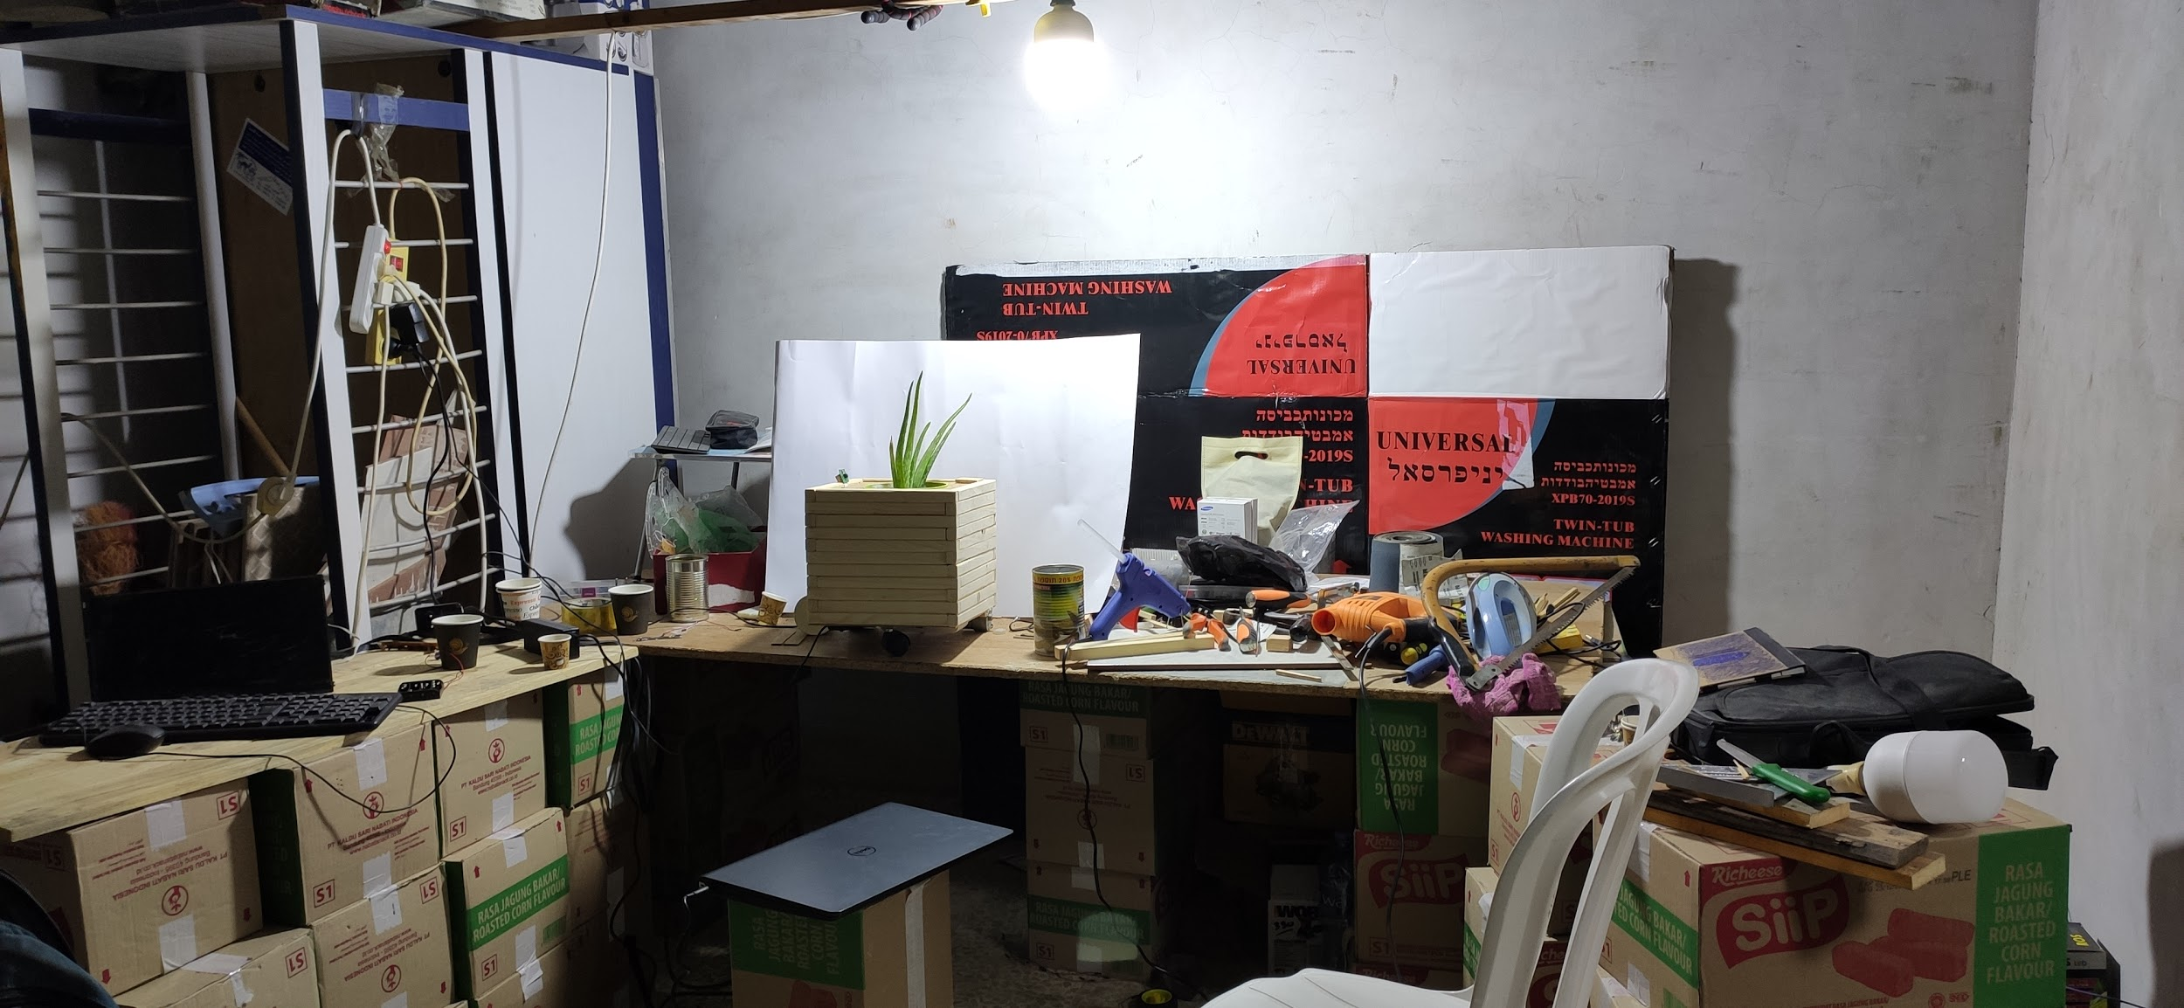
Smart IoT Planter
Dawoud Younis, Radi Barq

Slide 2
Problem
Having plants becomes essential inside houses, especially in urban areas.
These plants needs special care as they grow generally in unnatural conditions inside buildings where the amount of light and space are limited.
For the fast majority, they don’t have the experience or time to look for their plants.

Slide 3
Solution
Smart IoT planter that have senses to monitor the plant.
Smart IoT planter that take automatically care about the plant.
Very modern design and movement without any effort.

Slide 4
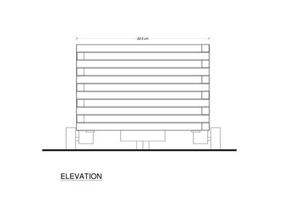
Design
External Design:
External walls are made from Pallets Wood
cheap,
The design is composed of short narrow strips of
wood that wood be joint with white glue
to create whatever design.

Slide 5
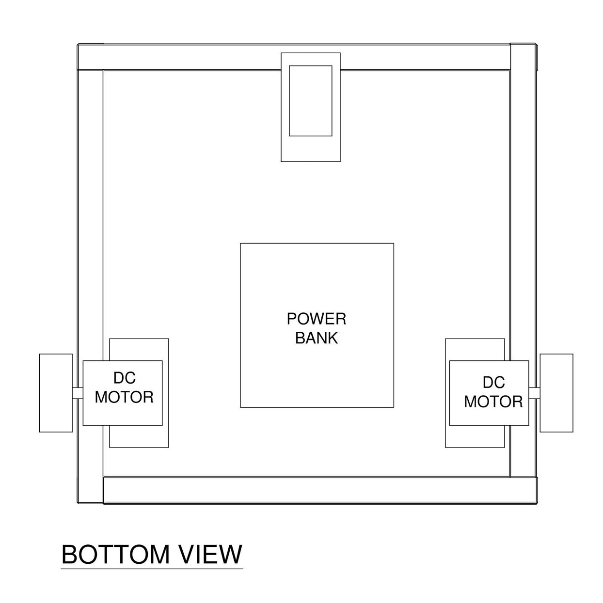
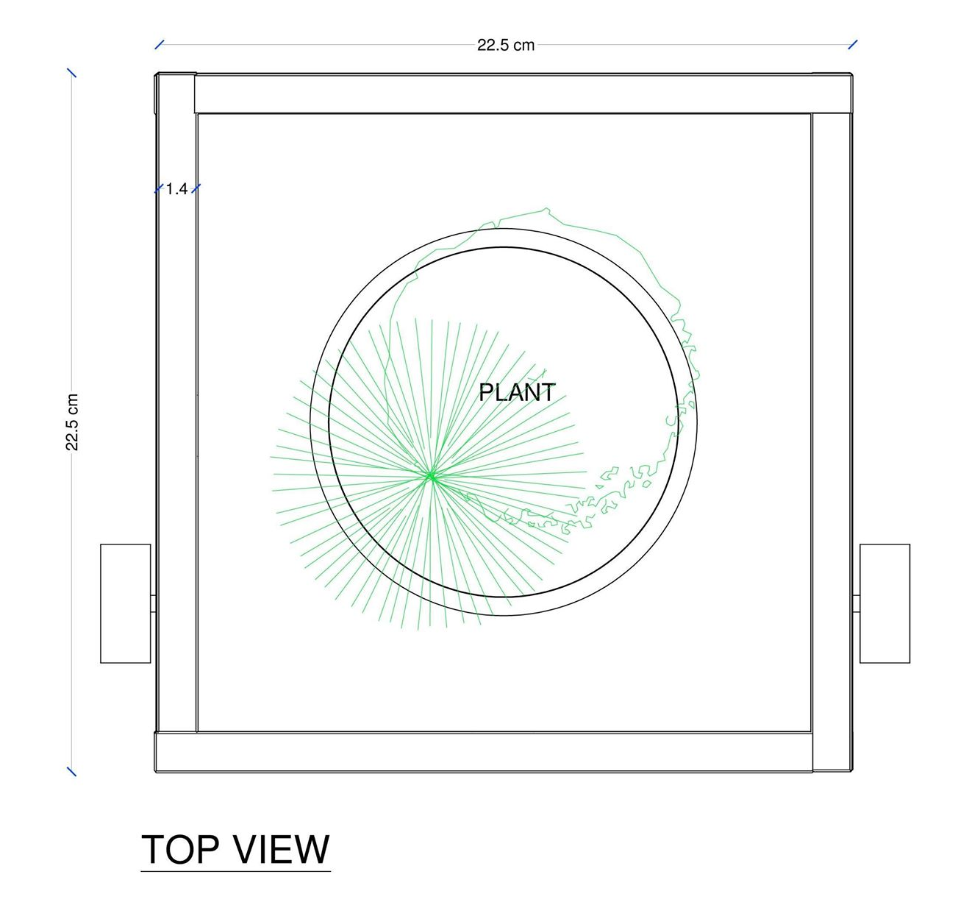
Design
External Design:

Slide 6
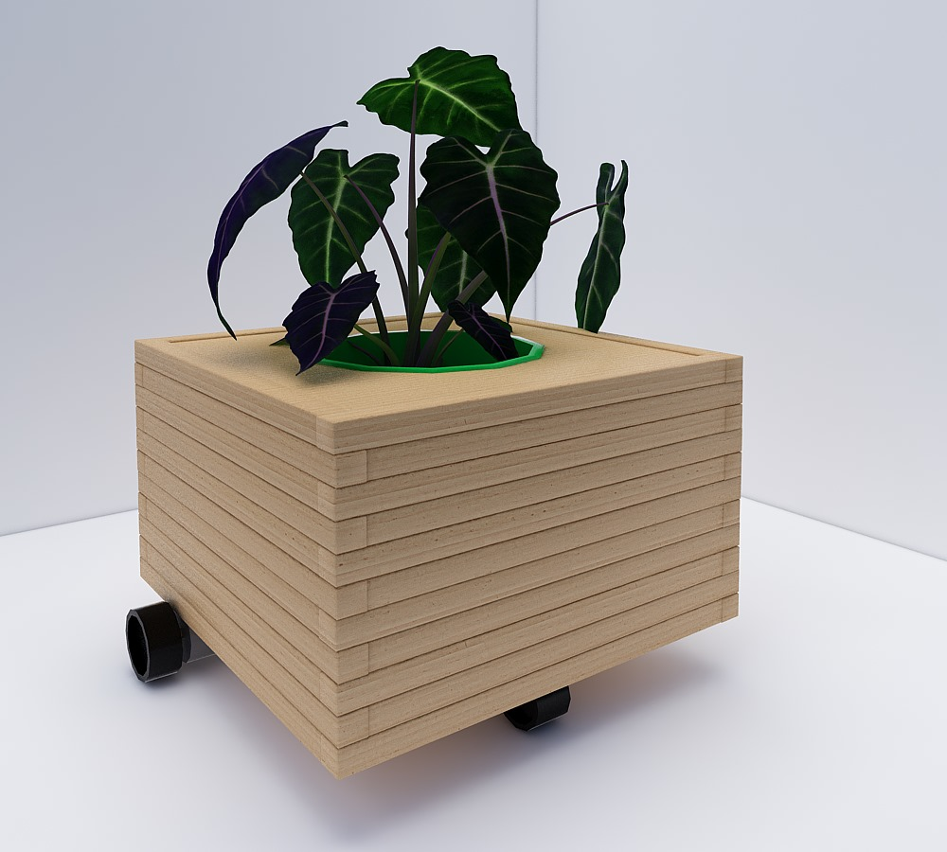
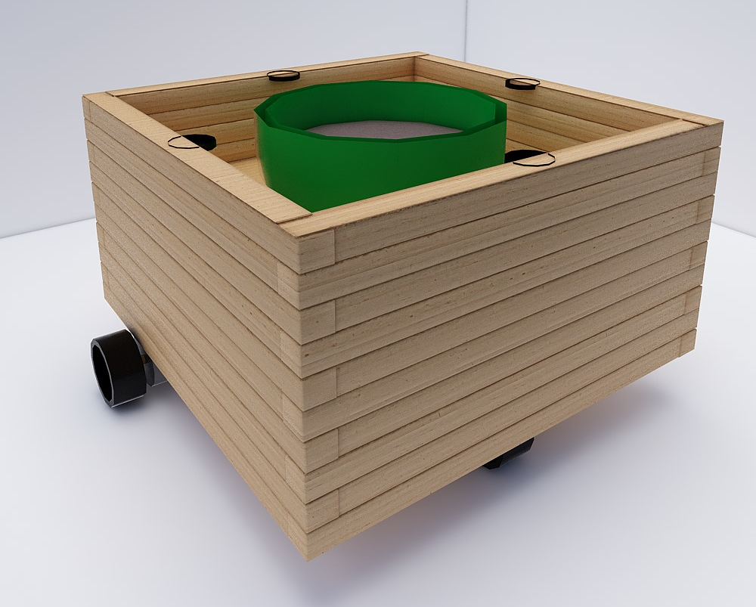
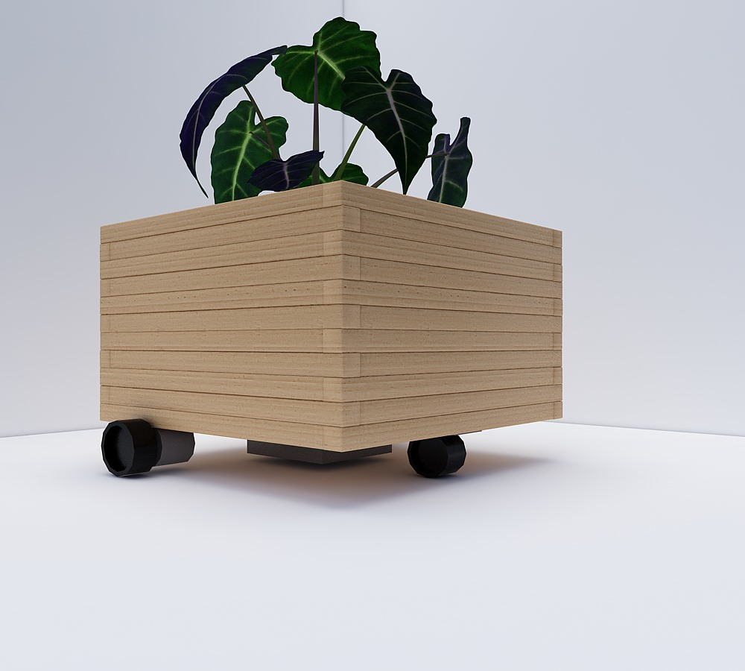
Design
External Design 3D

Slide 7
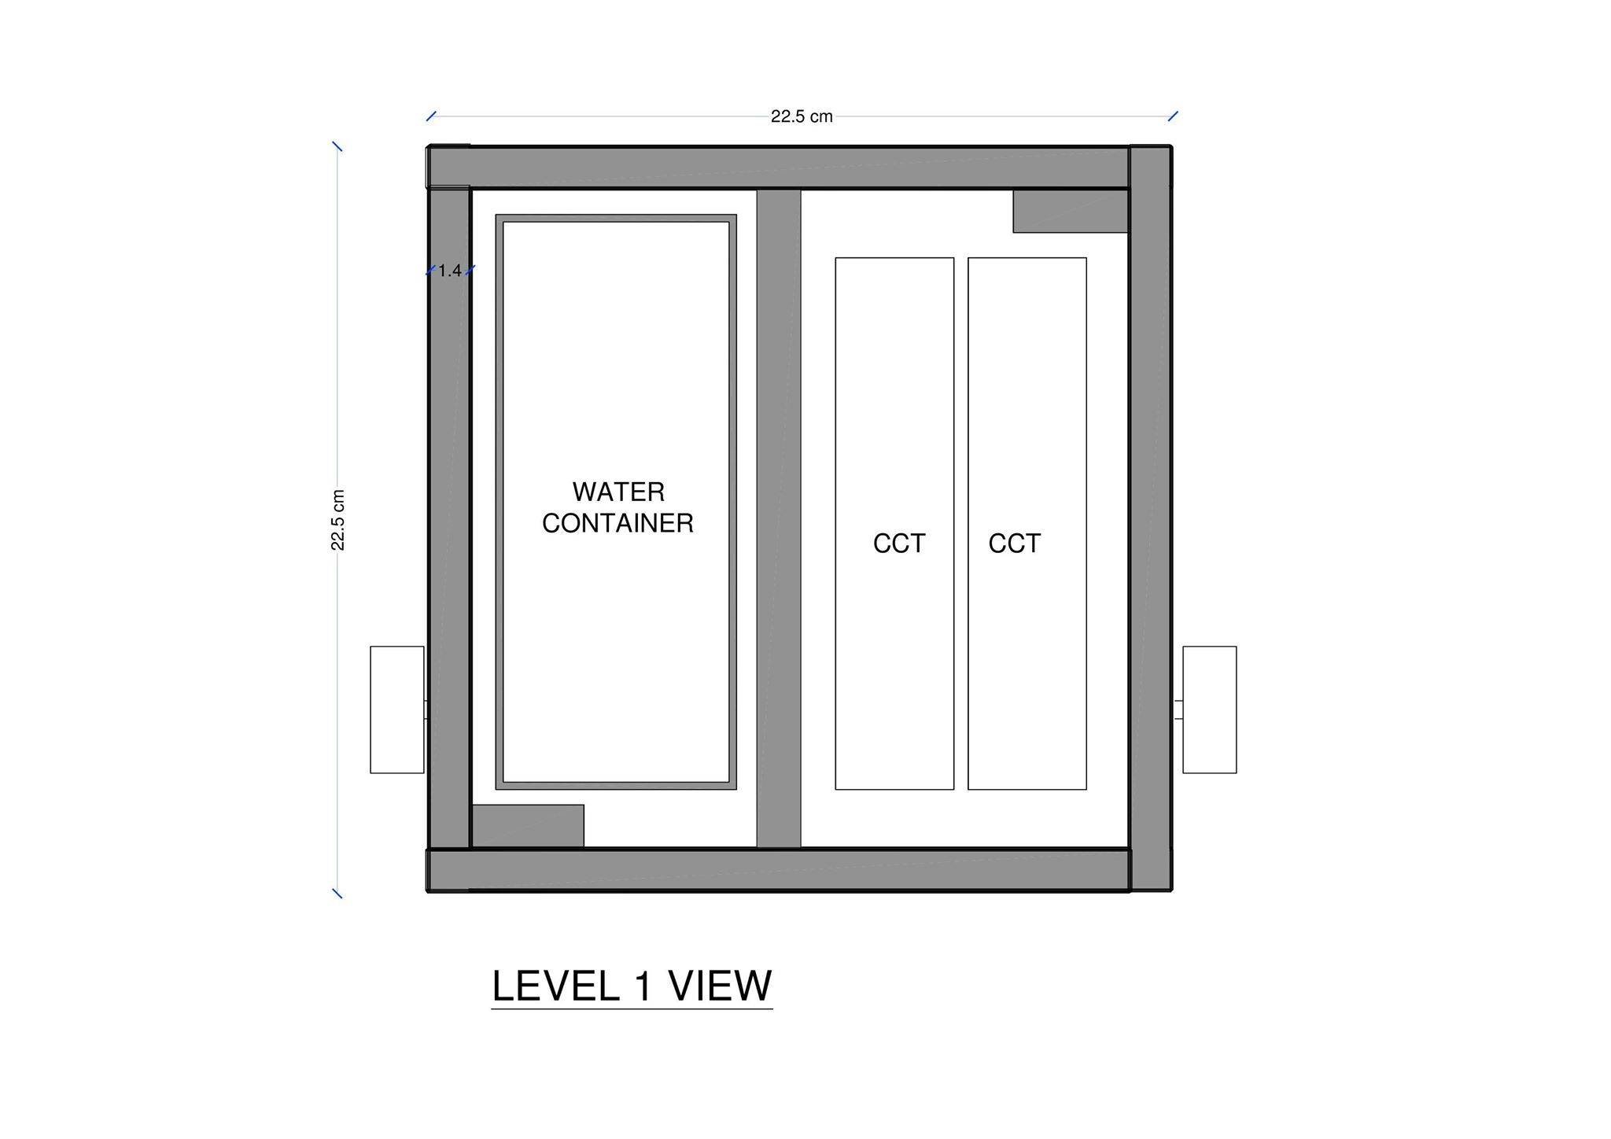
Design
Internal Design
For the internal, we divided the planter from inside vertically into two level:
First Level: this level will have the water reservoir and the circuit in it,
this level also is divided horizontally into two
areas separated with a wood panel to prevent
any water from reaching the circuit in case of a water leakage.
Second level: (upper level) this level will hold the sensors and the plastic planter

Slide 8
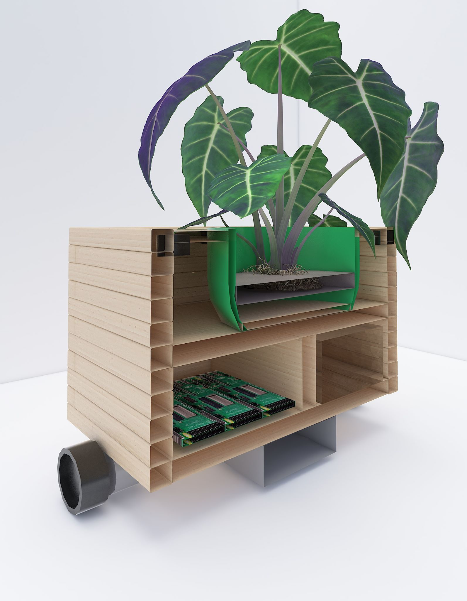
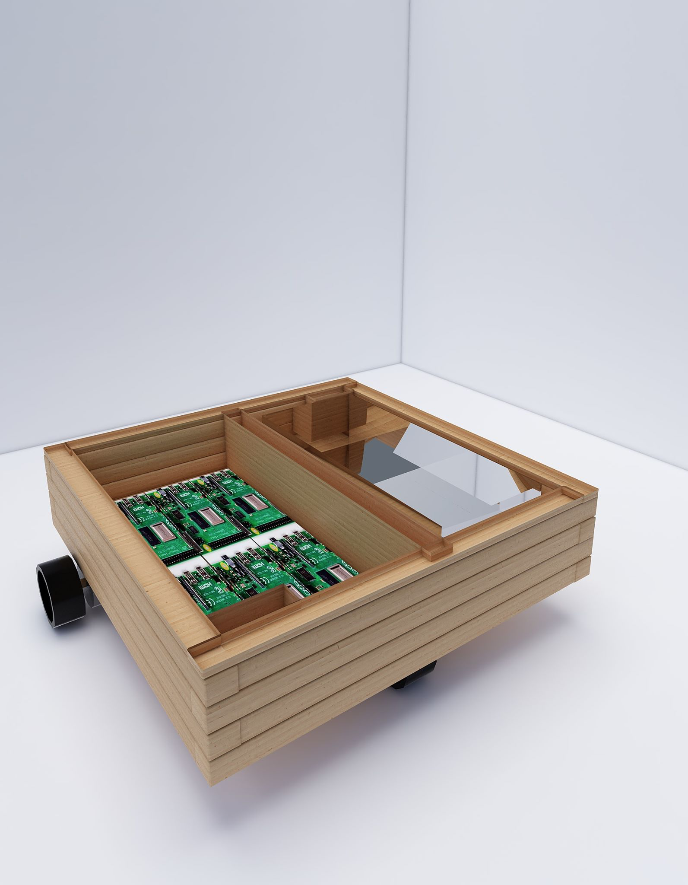
Design
Internal Design 3D

Slide 9
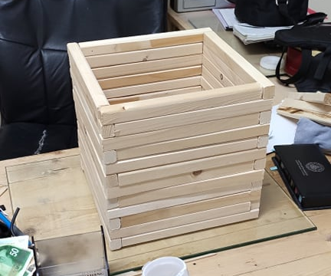
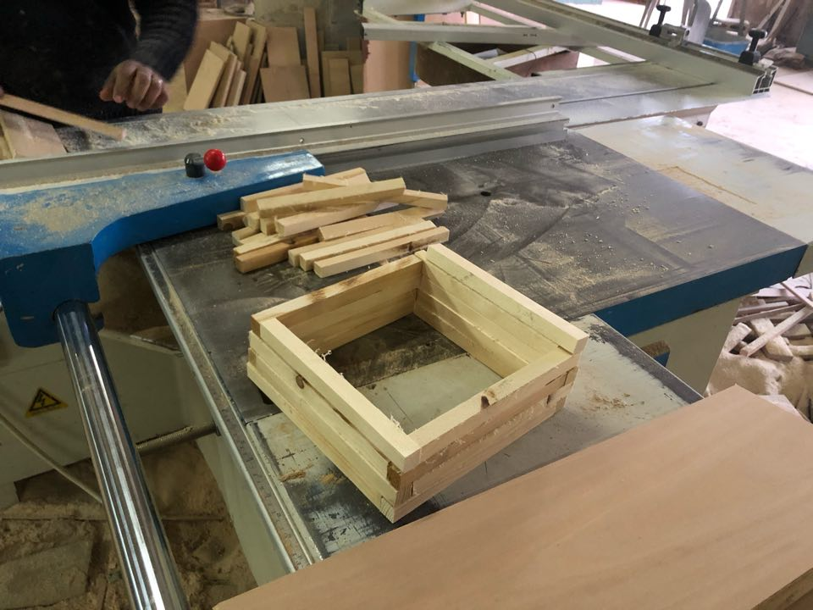
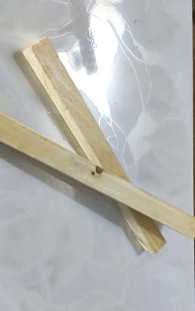
Design

Slide 10
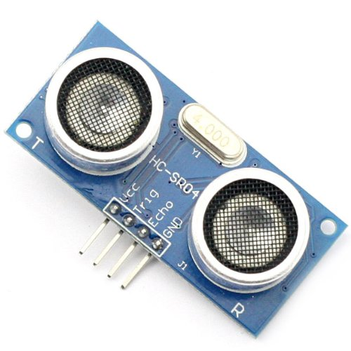
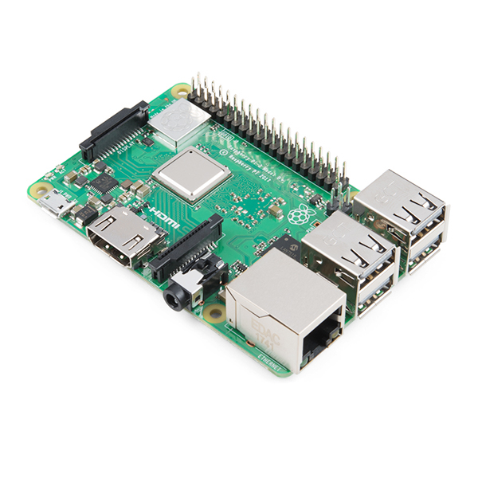
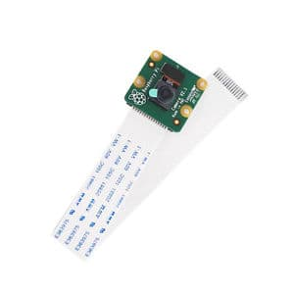
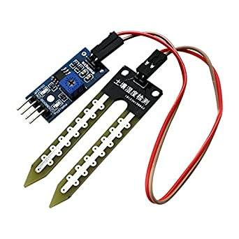
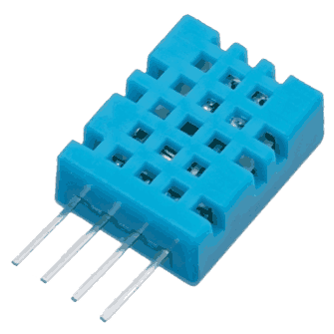
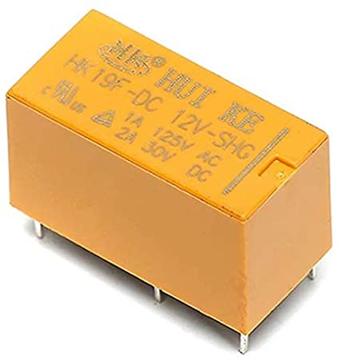
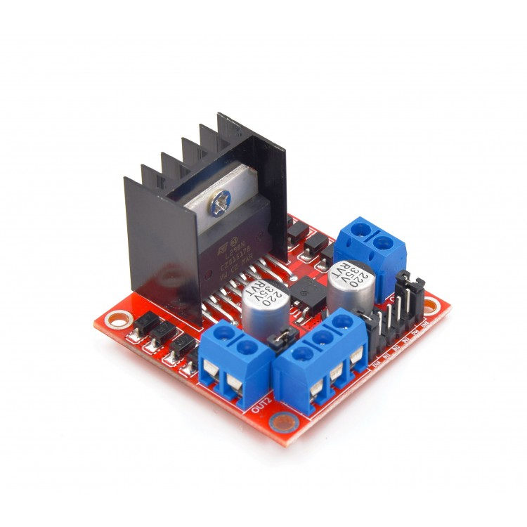
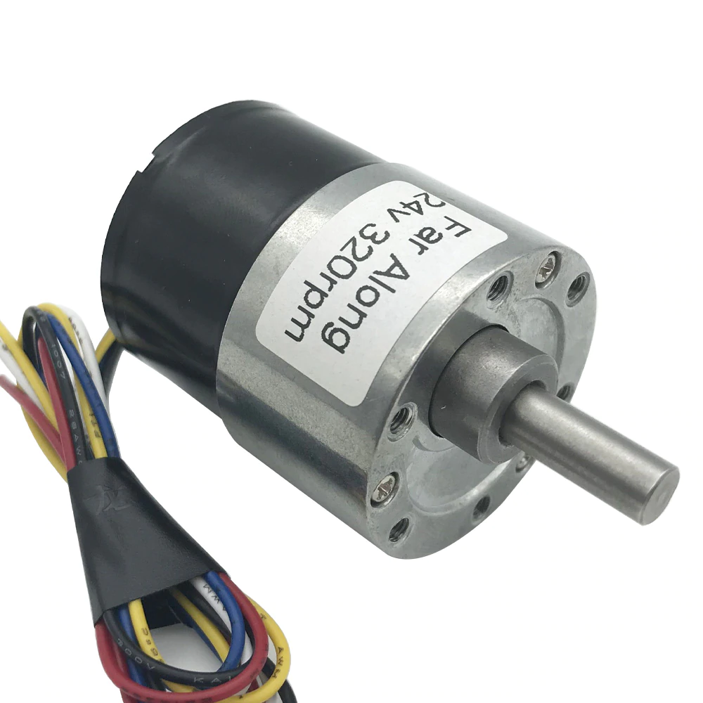
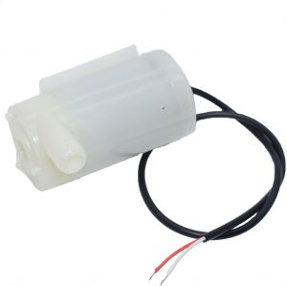
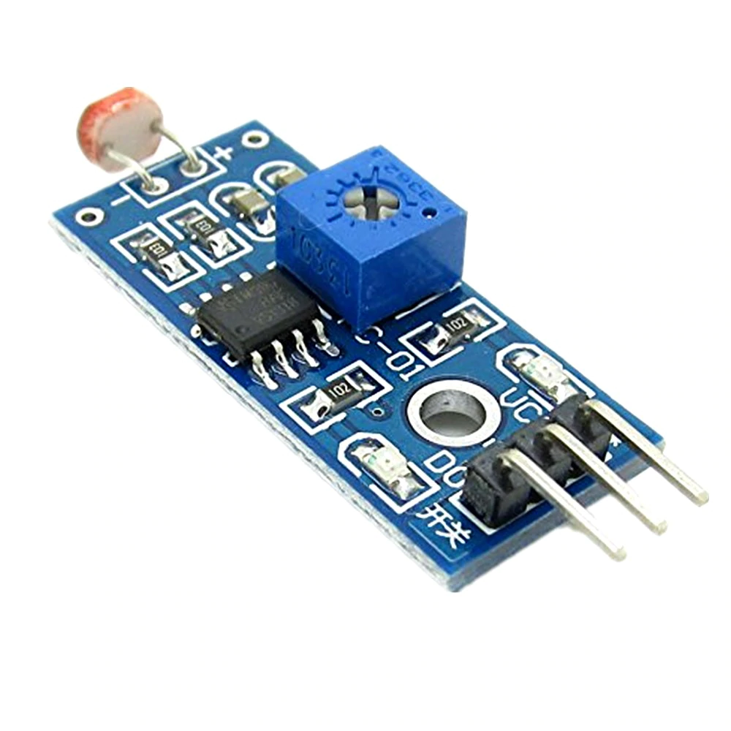
Components Used
Camera
Camera module
Moisture Sensor
Humidity, Temperature
Ultrasonic
Raspberry
Light Sensor
Realy
Motors
H-Bridge
Pump

Slide 11
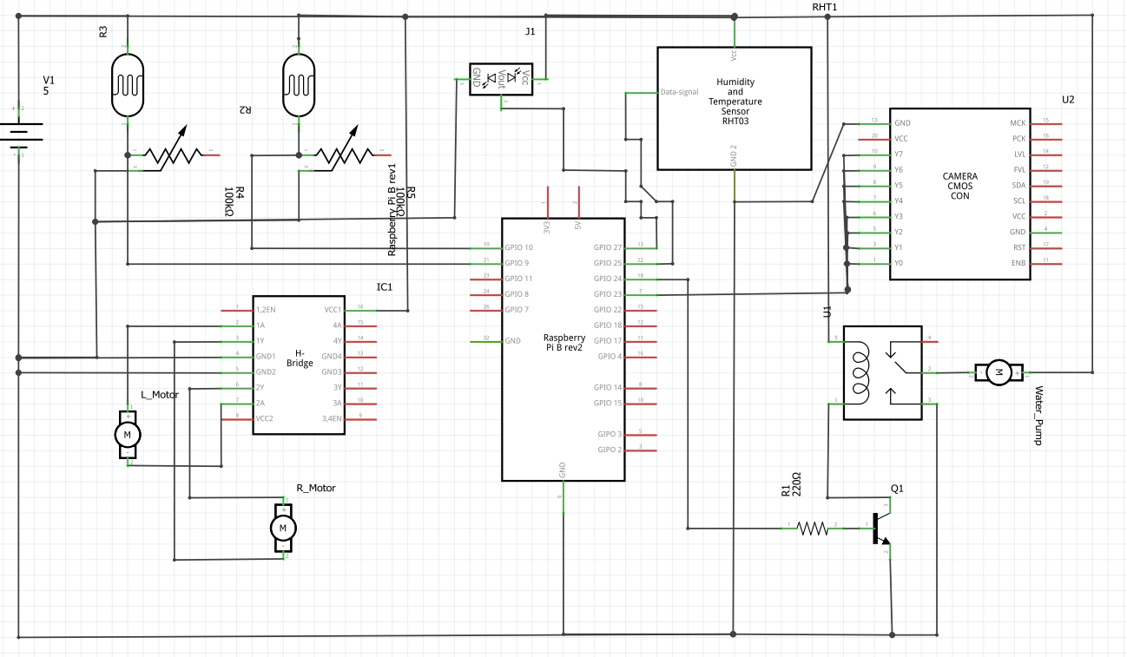
Schematic

Slide 12
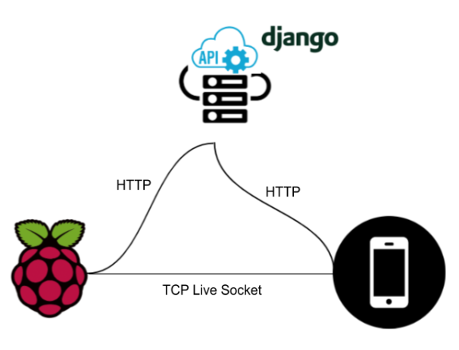
Data Communication Schematic

Slide 13
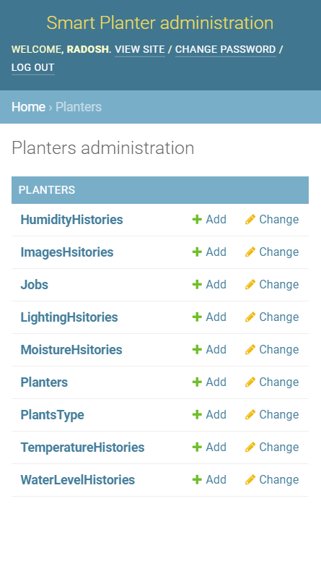
Admin Panel
Add-Remove Jobs
Add-Remove Plants
See Sensors Data

Slide 14
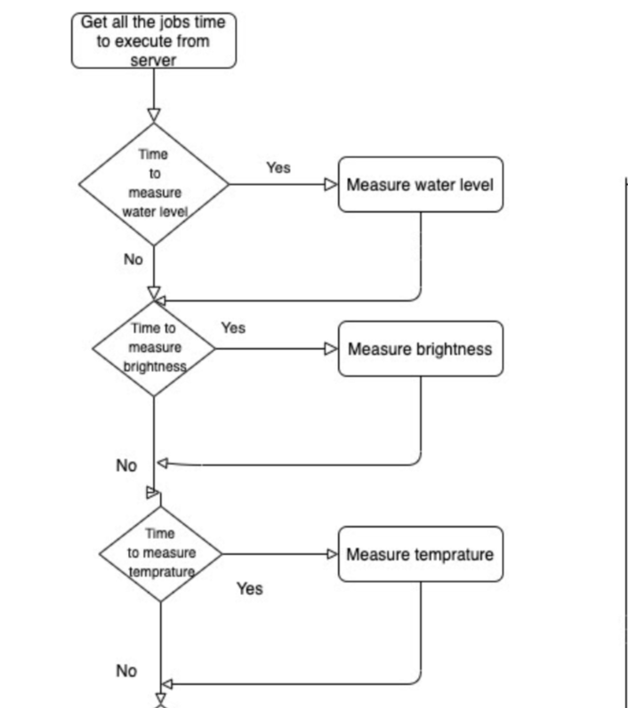
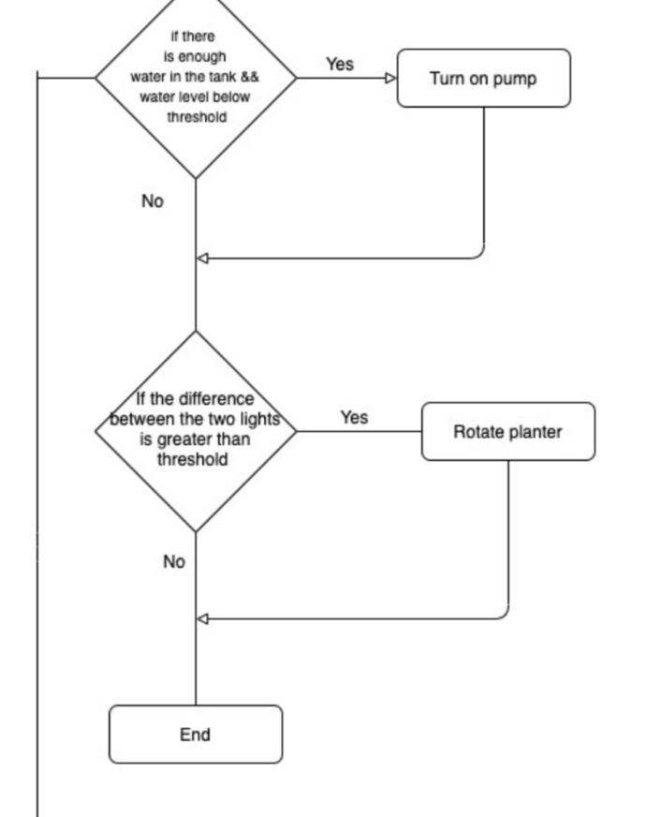
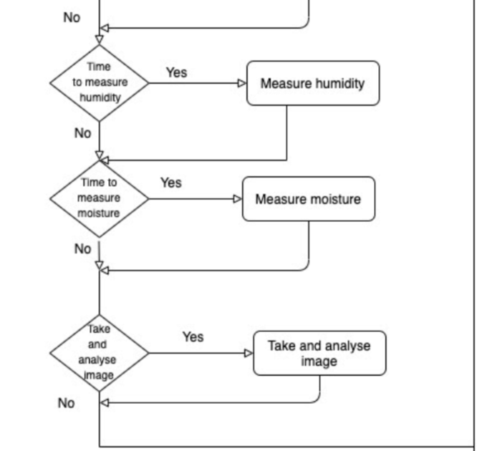
Client Side Logic

Slide 15
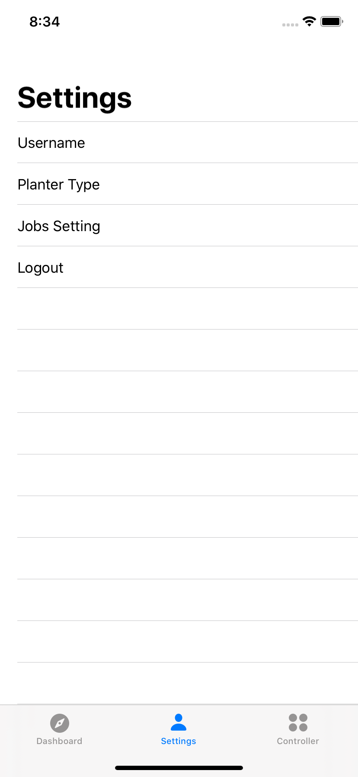
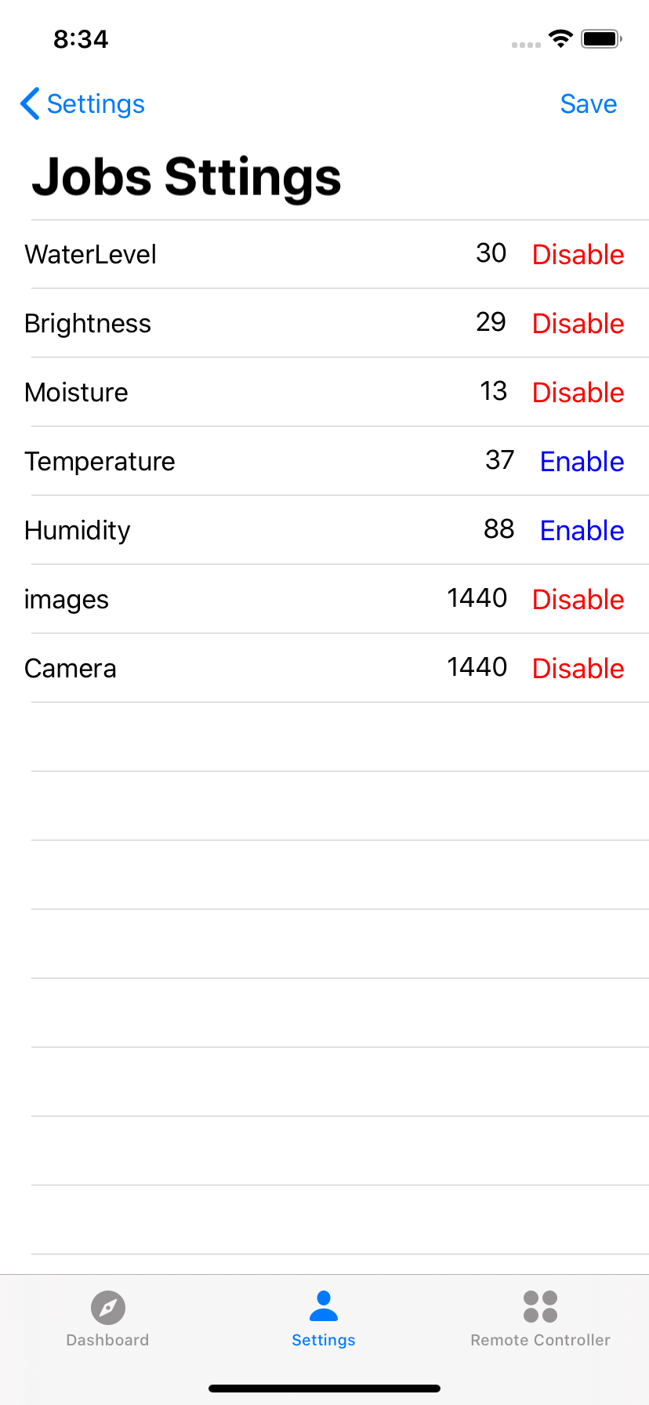
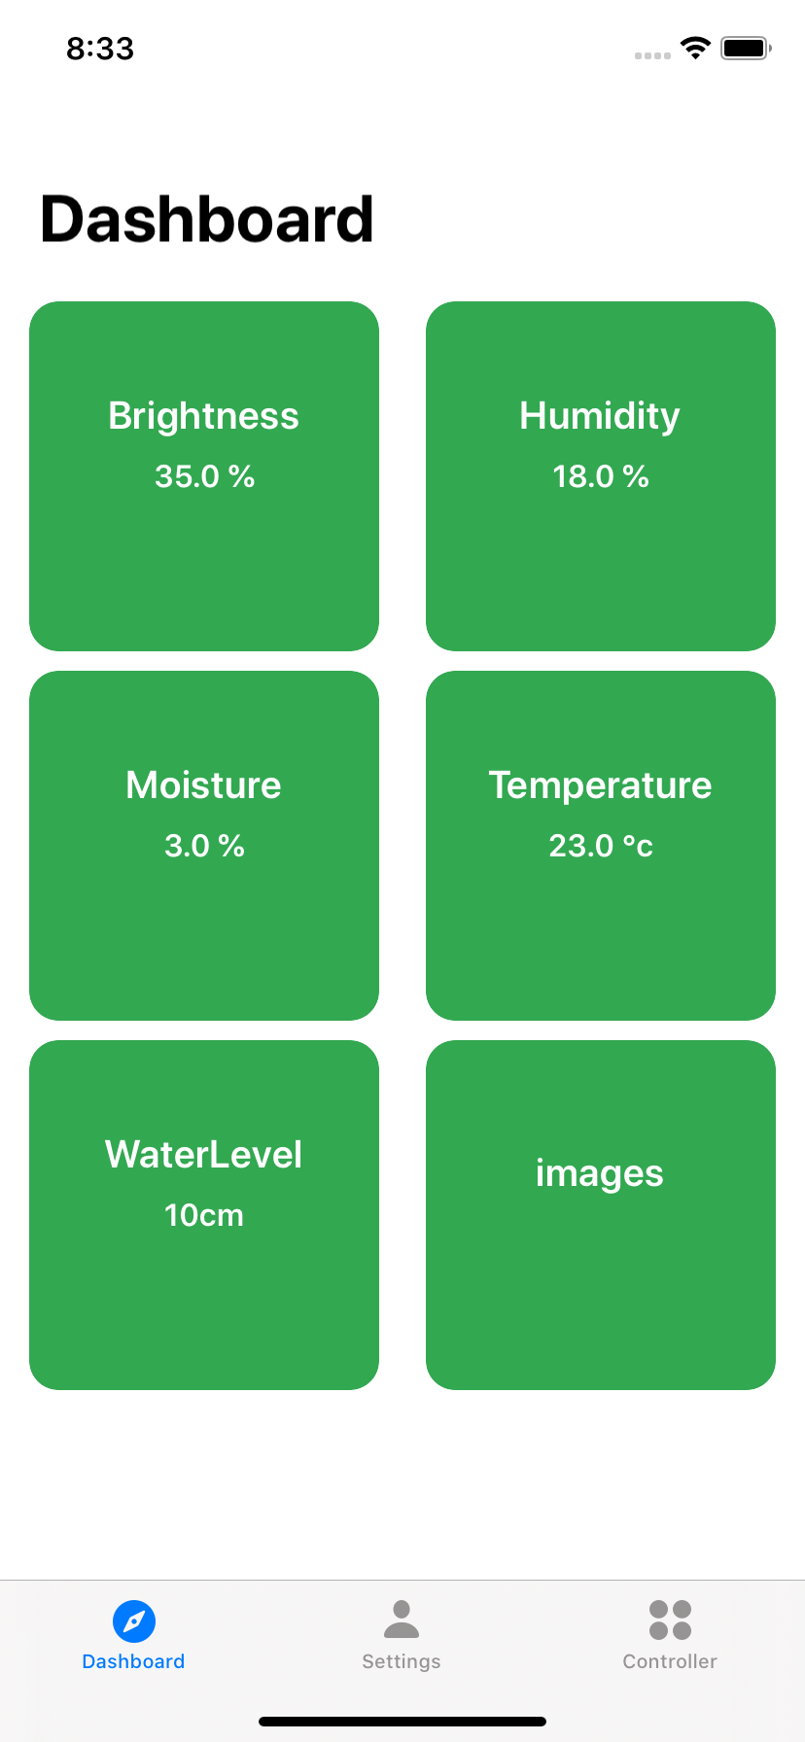
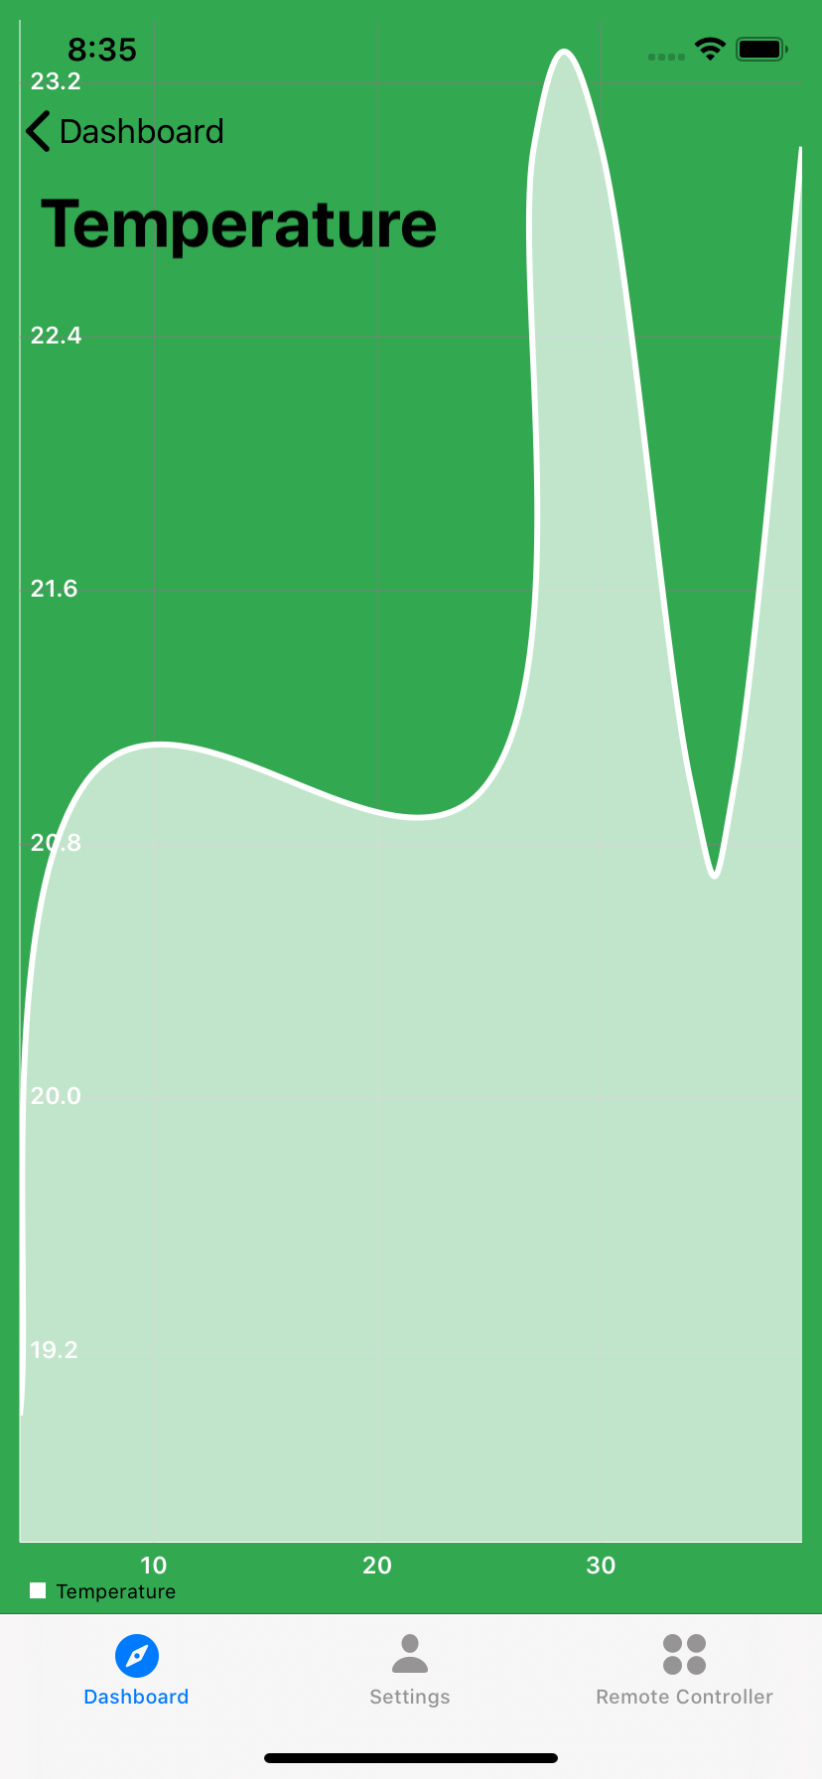
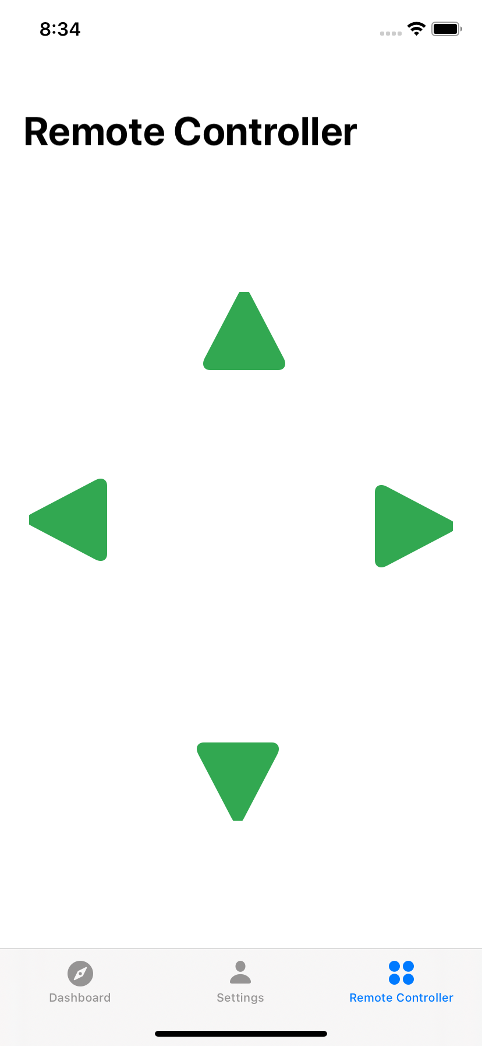
Mobile Application

Slide 16
Demo Videos

Slide 17
The End, Thank You

