Slide 1

An-Najah National University
Faculty of Engineering
Mechanical Engineering Department
Gradation Project 2
“Assessment of the use of wasted palm oil in biofuel production and the feed industry in Palestine”
Midien Rashed
Bahaa Dwaikat
Mahmoud Jomaa
Supervised by: Dr. Ramiz Al-Khalidi

Slide 2
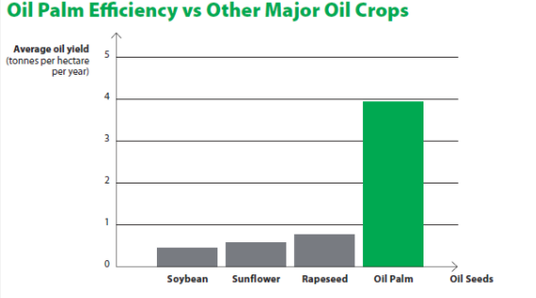
Introduction
Palm oil is one of the most produced types of oils around the world and constitutes 33% of the oils produced around the world.

Slide 3
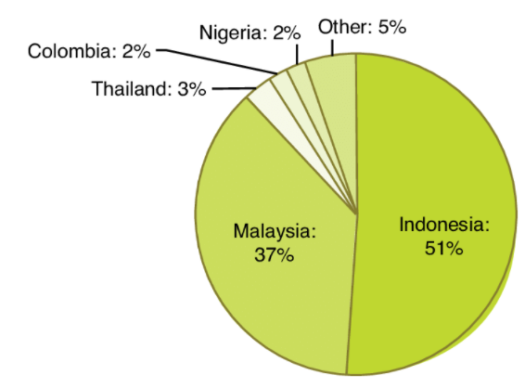
Palm oil is mostly produced in Malaysia , Indonesia ,
Nigeria and other countries.

Slide 4
Palm oil usage
Palm oil is used in many industries , for example :
Palm oil enters into biofuel production.
Soap industry.
Chocolate industry , where cocoa butter is replaced with palm oil.
Animal feed industry, which will be the goals of our project.

Slide 5
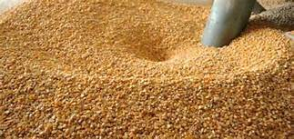
Palm oil in feed industries
There are many benefits of introducing oil in feeds :
Energy source because it contains a good percentage of fats.
Gives a coherent structure for the feed.
Gives a unique yellow color for the feed.

Slide 6
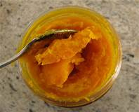
Introducing palm oil in feed industries
Introducing palm oil in feed requires that the oil to be liquid.
At normal conditions palm oil is in solid state, so that it must be converted to a liquid state , and that is the target we want to achieve in our project.

Slide 7
Introducing palm oil in hydroponics and fish farming
Farmers are facing a problem, which is the increase in the cost of fish food from fish oils and other oils.
It takes 60% of the total profit, as we can use palm oil as a substitute for many of the oils that we rely on in raising Fish
.
Palm oil does not affect the genes of fish and their growth, where the effect of palm oil on fish feed in a positive way.
Fish feed produced from palm oil will help the prosperity of aquaculture farms to raise fish in remote and poor countries compared to other oil .

Slide 8
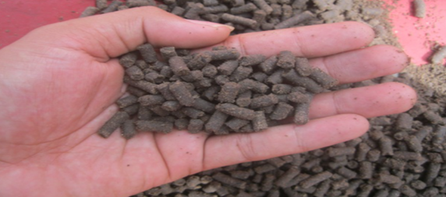

Slide 9
Palm oil effect on cows milk
An experiment was conducted on milk cows, where they were fed a fodder that included palm oil in its manufacture.
it was noted that the percentage of fat inside the milk increased from 3.44% to 3.95%.
the amount of milk production was increased and no negative effects were observed.

Slide 10
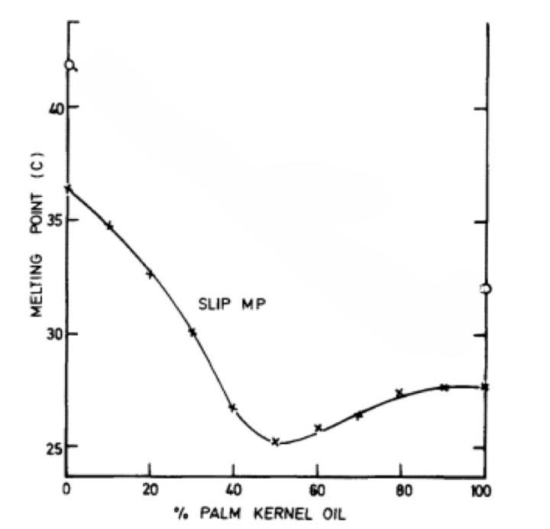
Palm oil phase converting
In order to convert palm oil to the liquid state, It requires decreasing melting temperature, by mixing palm oil with other types of oils, either with palm kernel oil or Olein oil.

Slide 11
Olein oil
Olein oil is a type of palm oil.
It’s a kind of palm oil that doesn't need hydrogenation.
It has melting point of 18 ^{ჿ}C , and its considered low compared to palm oil.
In order to decrease palm oil melting point we mix Olein oil with palm oil.

Slide 12
Lab tests for palm oil
Lab tests were made for three samples of palm oil, one of the samples was pure. We compared the pure sample with the wasted samples and we reached this results :
Test results were acceptable, and we focused on peroxide
value result.

Slide 13
Converting palm oil to liquid state
In order to convert, three experiments were made:
Adding H₂O_{2.}
The distillation experiment.
The distillation experiment with H₂O_{2 .}

Slide 14
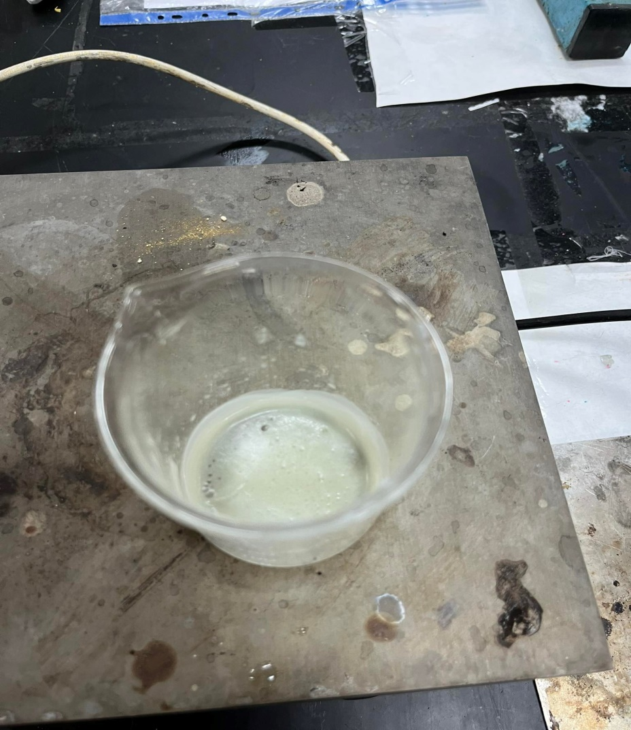
Adding H₂O_{2.}

Slide 15
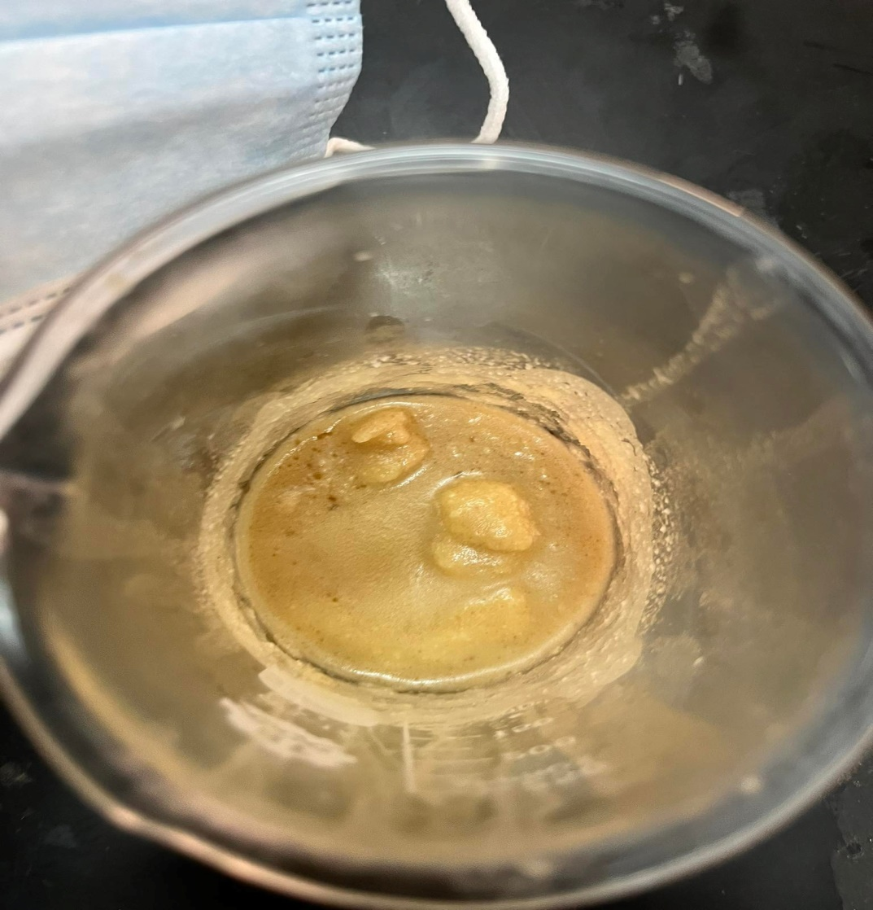
The distillation experiment.

Slide 16
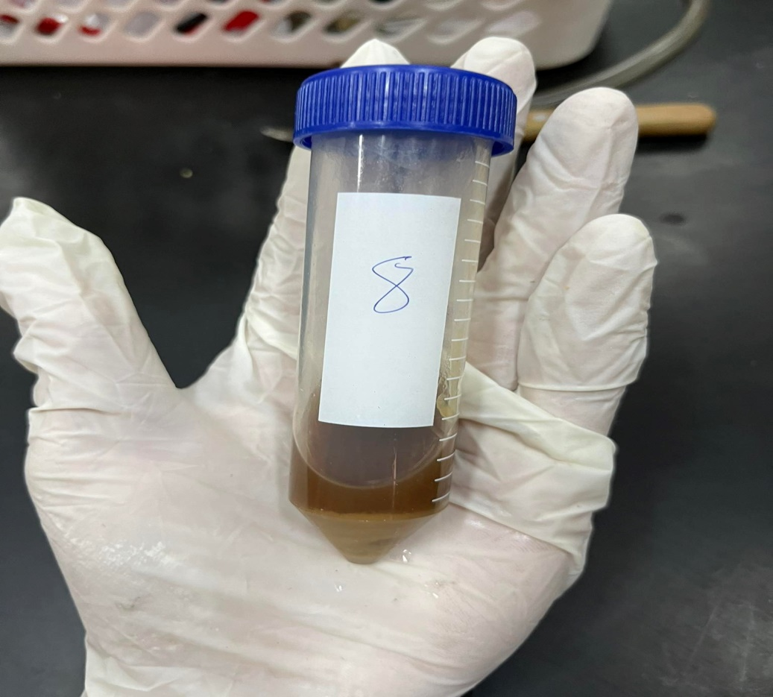
The distillation experiment with H₂O_{2 .}

