Slide 1

An-Najah National University
Faculty of Engineering
Building Engineering Department
2016
Graduation Project – 2
Design of an Integrative Telecommunication Building
(JAWWAL Company)
Prepared By:
Abdel Rahman Khateeb
Iyad Daraghma
Amro Bdair
Project supervisor:
Dr. Ahmad Saleh

Slide 2
Outlines
Introduction
Selected Site
Architectural Design
Structural Design
Environmental Design
Mechanical Design
Electrical Design
Estimated Cost

Slide 3
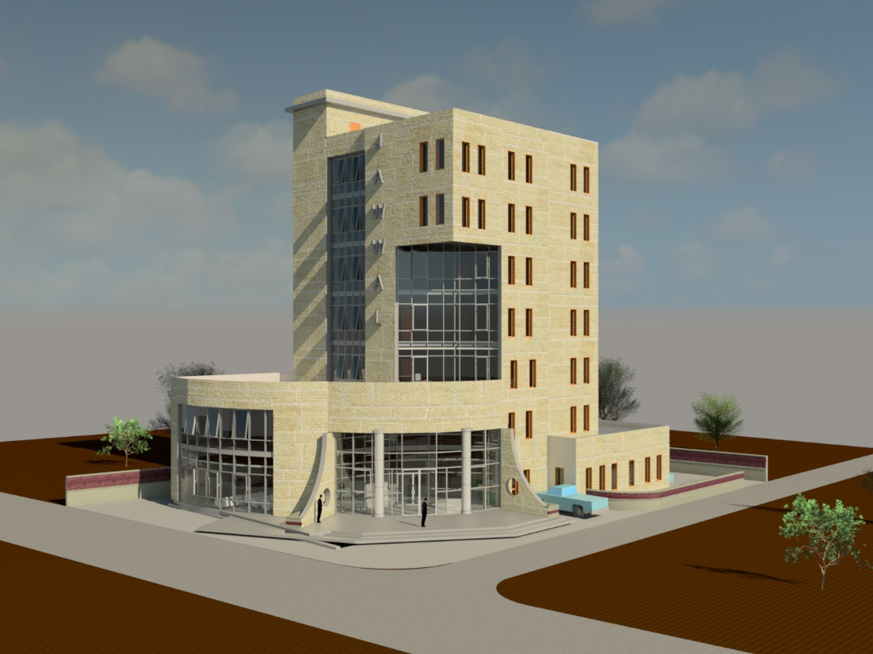
INTRODUCTION
The main concept of our project was to design an integrated telecommunication building for Jawwal company, and our focus has been on all aspects that include : Architectural, Structural, Environmental, Electrical and Mechanical design to make a comfortable building as much as possible.

Slide 4
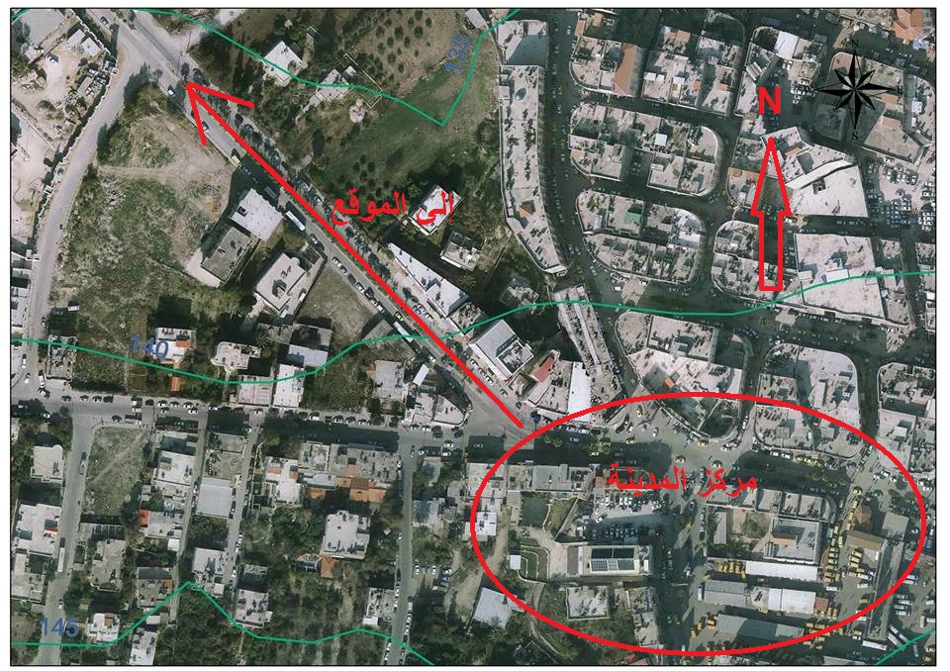
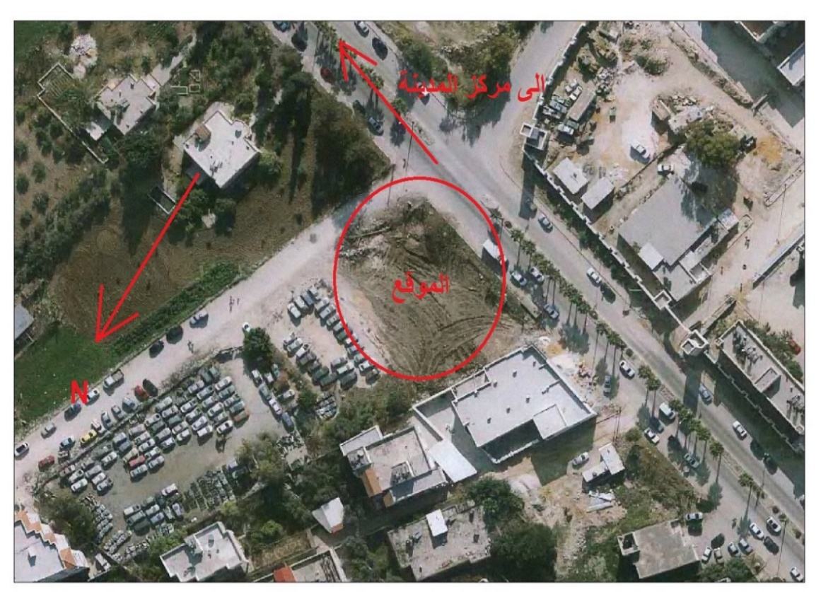
Site Selected
Site Area : 1060 m²
Rebound from streets : 4m

Slide 5
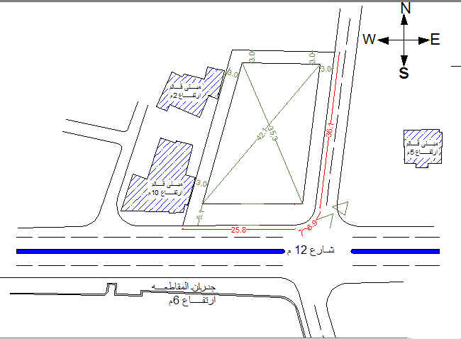
Site Selected

Slide 6
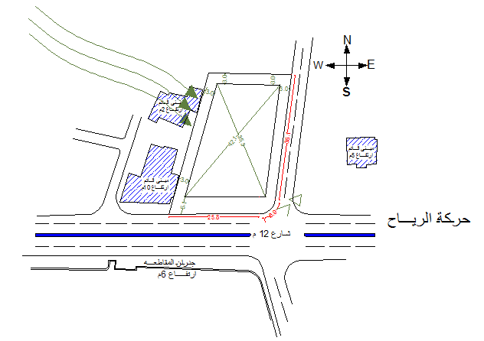
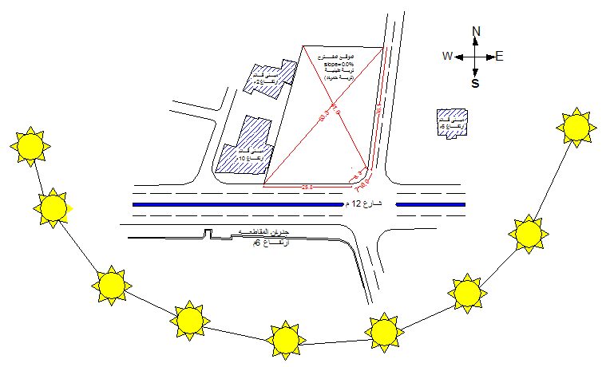
Site Analysis

Slide 7
Architectural Design

Slide 8
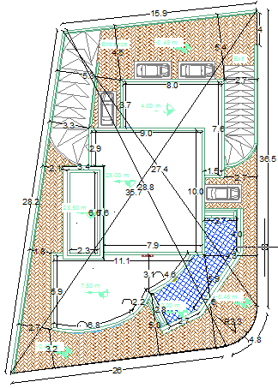
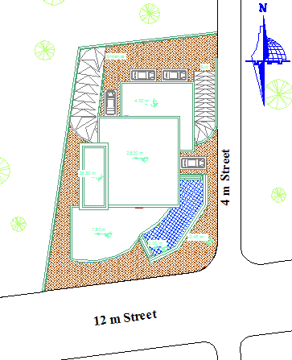
Site Plan

Slide 9
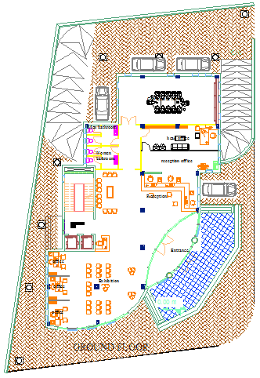
Master Plan

Slide 10
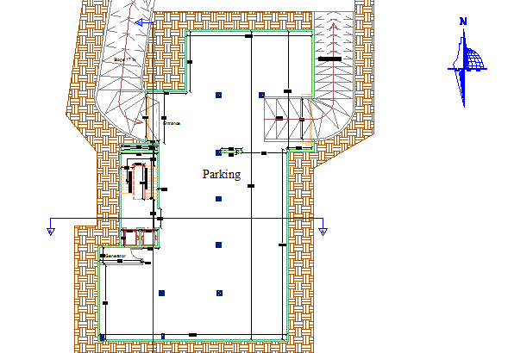
Plans
Basement plan

Slide 11
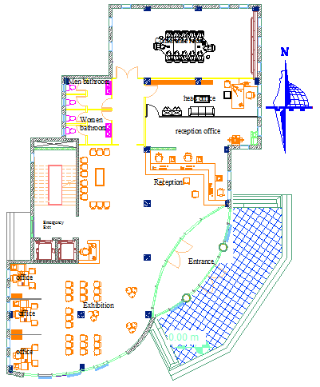
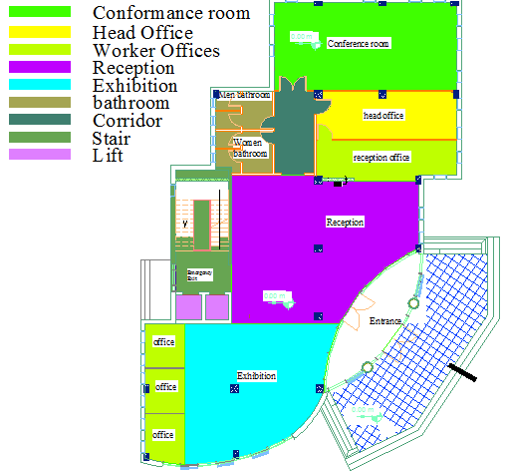
Plans
Ground floor Plan

Slide 12
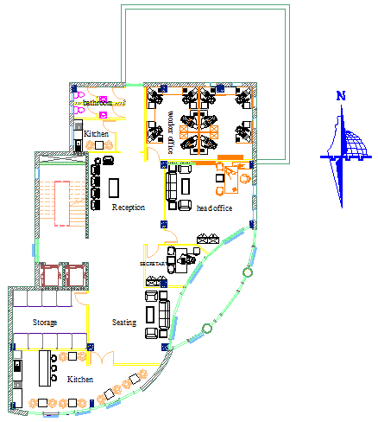
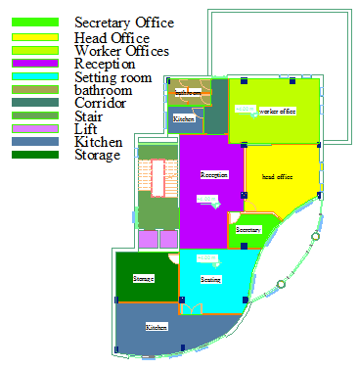
Plans
First floor Plan

Slide 13
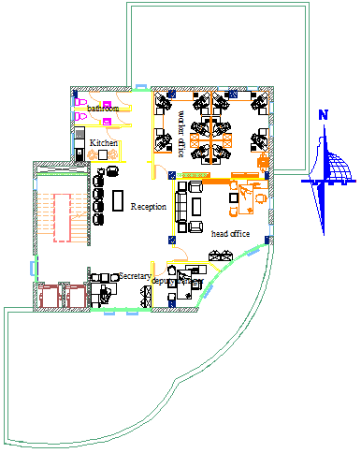
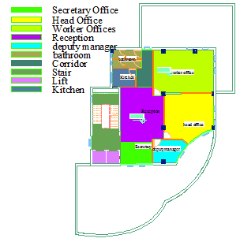
Plans
Second to forth floor Plan

Slide 14
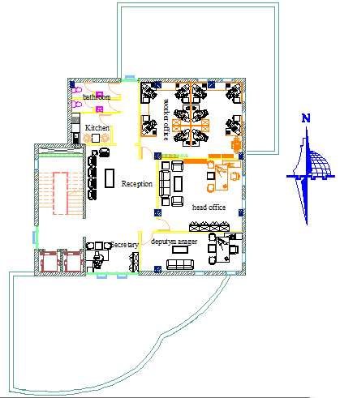
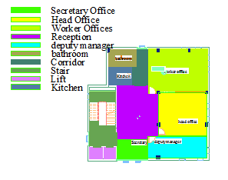
Plans
Fifth floor plan

Slide 15
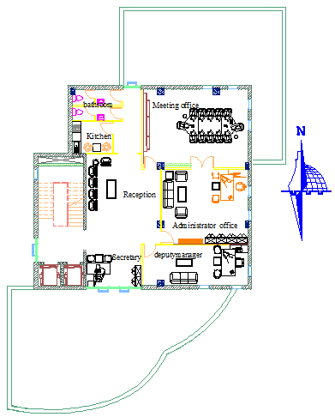
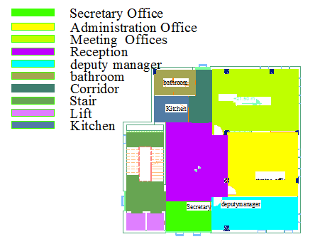
Plans
Sixth floor Plan

Slide 16
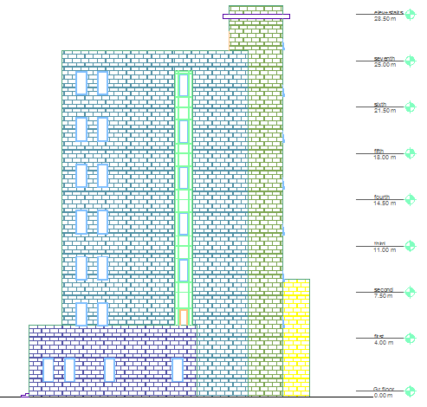
Elevations
North-Elevation

Slide 17
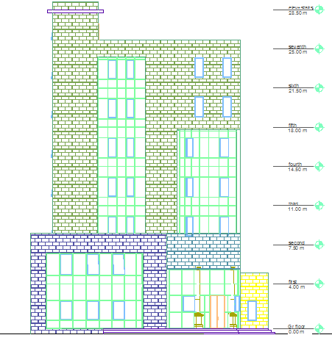
Elevations
South-Elevation

Slide 18
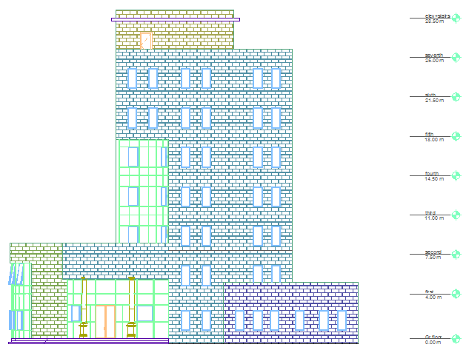
Elevations
East-Elevation

Slide 19
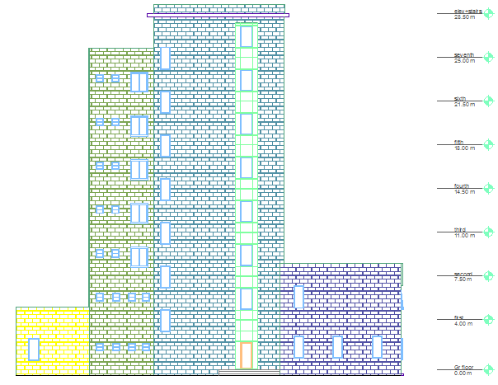
Elevations
West-Elevation

Slide 20
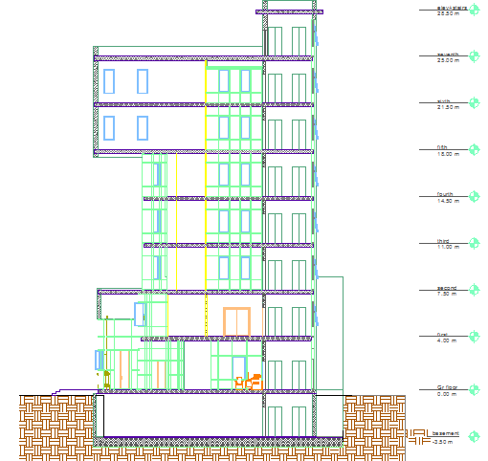
Sections
Section A-A

Slide 21
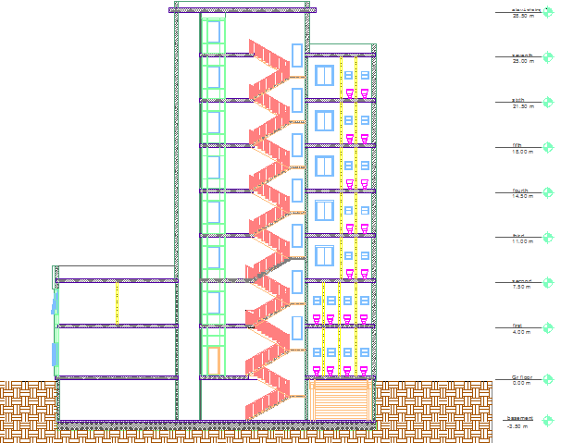
Sections
Section B-B

Slide 22
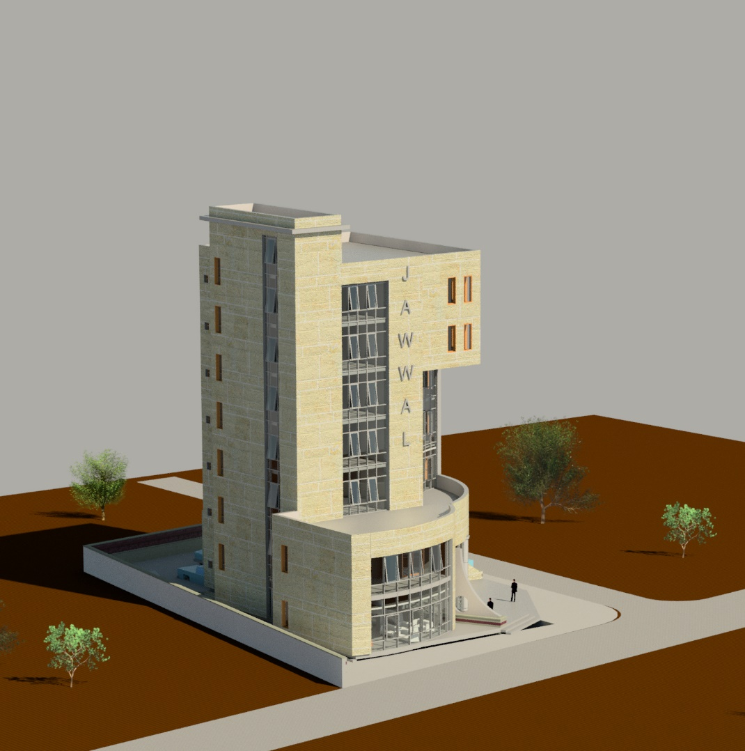
Rendered Views
3D views

Slide 23
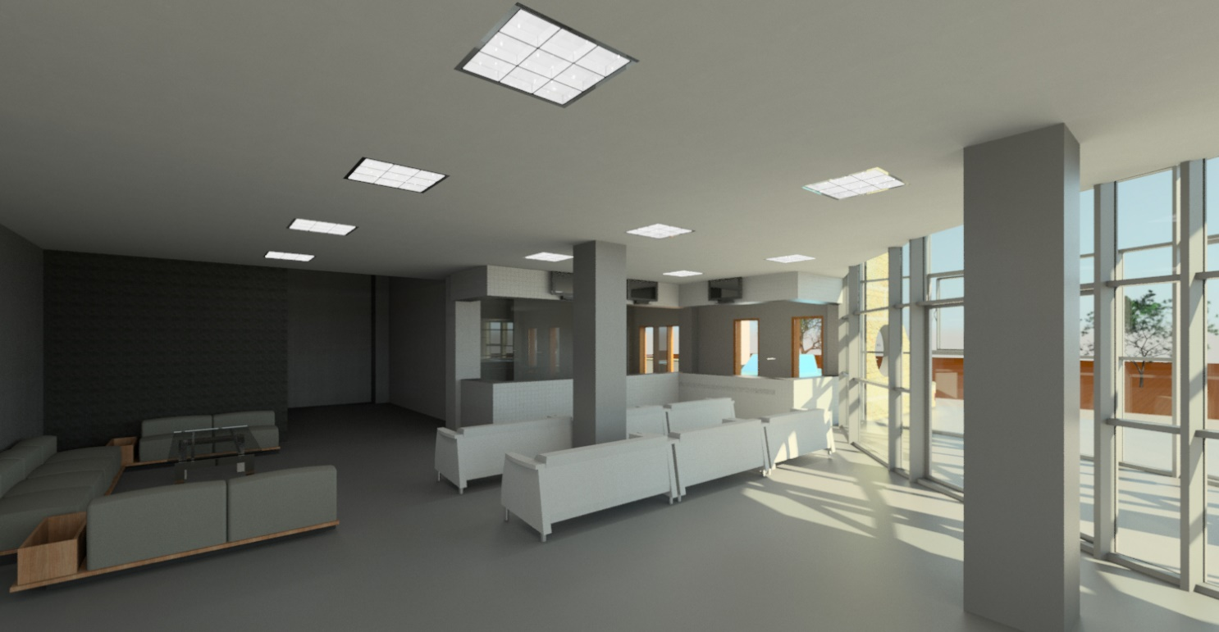
Rendered Views
Internal views

Slide 24
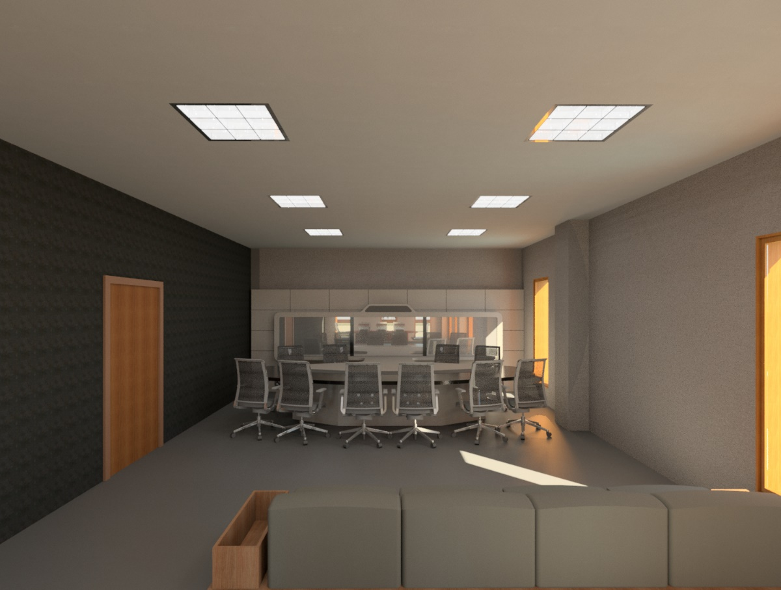
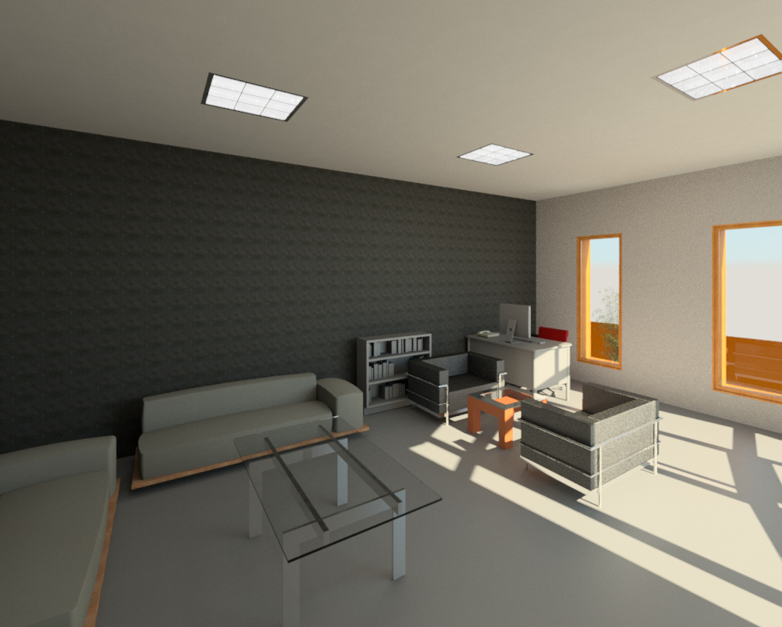
Rendered Views
Internal views

Slide 25
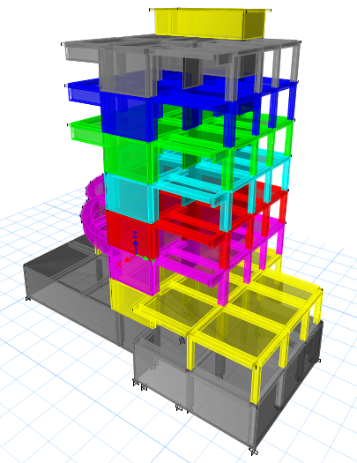
STRUCTURAL DESIGN

Slide 26
Design Codes
ACI -318-08 for reinforced concrete structural design.
ACI -350-3-06 for seismic design of soil pressure with concrete structure .
UBC -97 for earthquake load combinations.
ASCE for load combinations.

Slide 27
Material Property
Compressive strength of Concrete “f′c”.
    For columns and footing f′c = 28 Mpa
    For slabs and beams f′c =24Mpa
    For all other elements in structure such as blinding and bracing f′c = 12 MPa
Yielding strength of steel fy = 420 MPa.
Soil Property
Soil bearing capacity = 124 KN/m2
Soil profile = S_{E}

Slide 28
Loads
Dead loads (D.L): 5 .05KN/m²
Super Imposed dead load (SI):6.1 KN/m²
Live Load (L.L): 5 KN/m² (for all floor except stair roof)
10KN/m² ( for stair roof)
Lateral loads consider earthquake load.

Slide 29
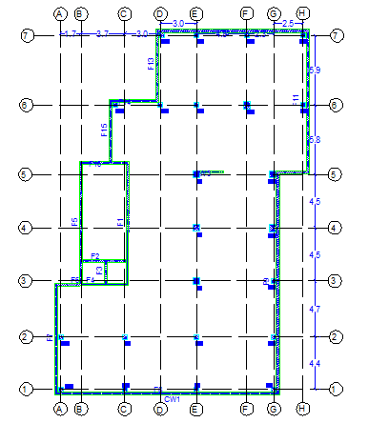
Column Center Lines Grid

Slide 30
Design and Reinforcement of Structural Elements
Slab (one way ribbed slab 350mm).
Beams ( drop &hidden).
Columns(0.4*0.4and 0.6*0.6 m)
Shear wall(200mm)
Basement wall (250mm)
Stair
Footings(1100mm)

Slide 31
3D Model - Etabs

Slide 32
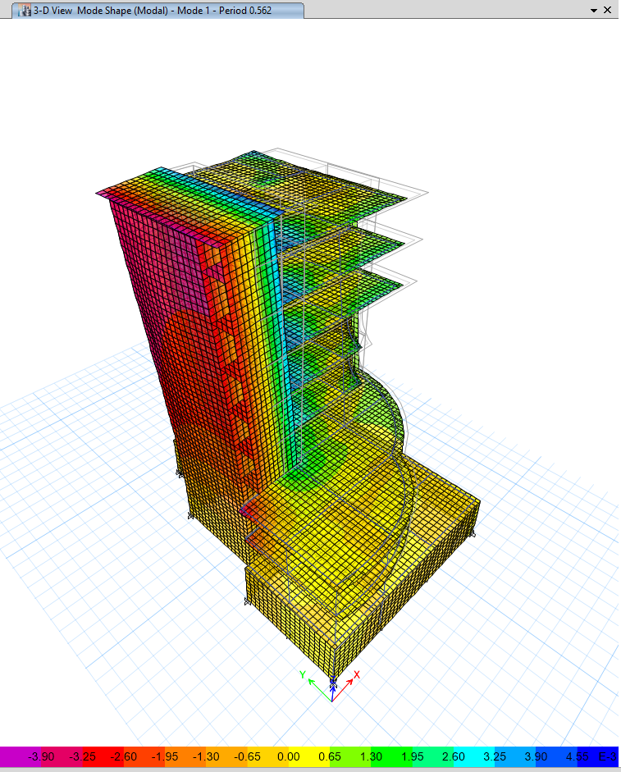
Model Checks
Compatibility

Slide 33
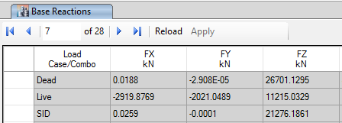
Model Checks
Equilibrium
load | Manual calc | Etabs results | %error
live | 11102.5KN | 11215 | 1.15%
dead | 48633.3 KN | 47977KN | 3.7%

Slide 34
Model Checks
Internal Forces
column | Manual axial (KN) | Etabs reading | error
C20 | 826 | 874 | 5.6%
C21 | 291.23 | 312 | 6%
C17 | 4937.6 | 5167 | 4.45%

Slide 35
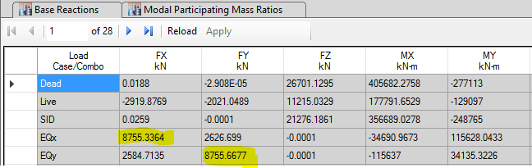
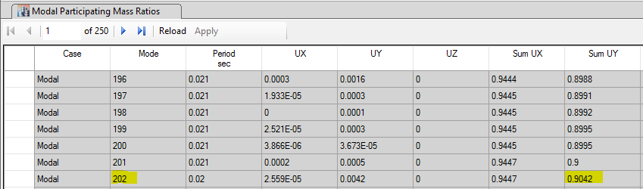
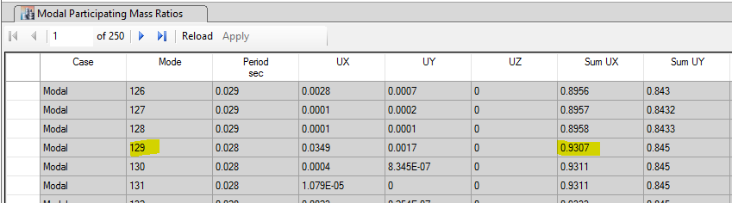
Seismic design
Cv = 0.64
Ca = 0.34
I = 1
R = 5.5
Soil profile S_{E}
Z = 0.2
From Etabs
Base shear ( V ) = 8755.4 KN
Mass participation ratio is larger than 90% in X, Y .

Slide 36
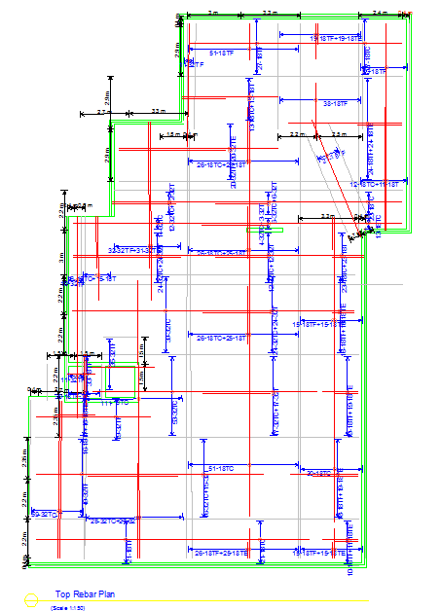
Footing Reinforcement Details
Mat Footing

Slide 37
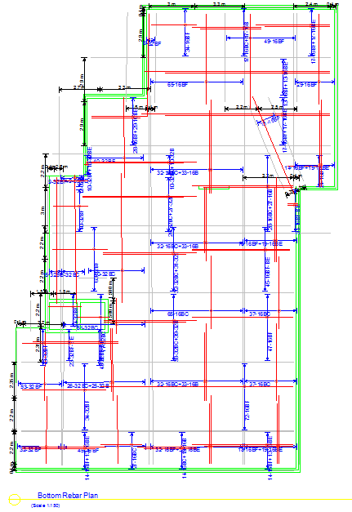
Footing Reinforcement Details
Mat Footing

Slide 38
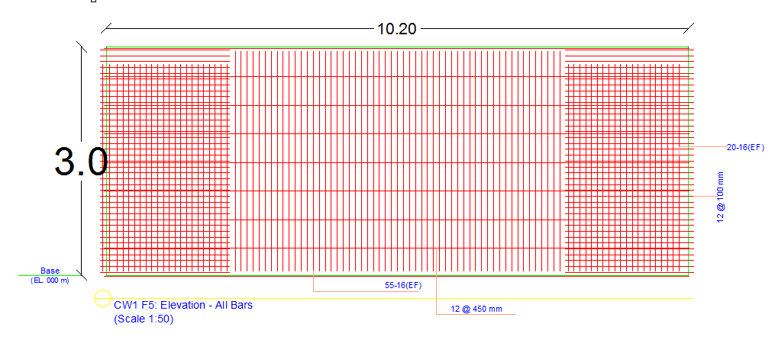
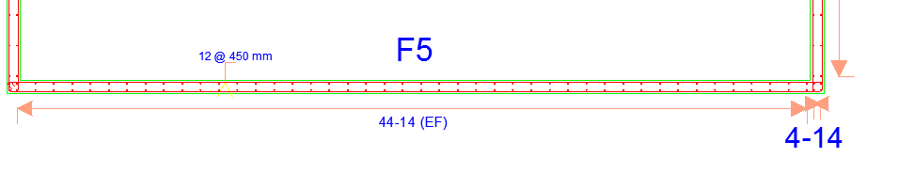
Basement Retaining Wall Details

Slide 39
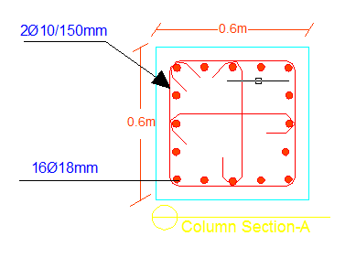
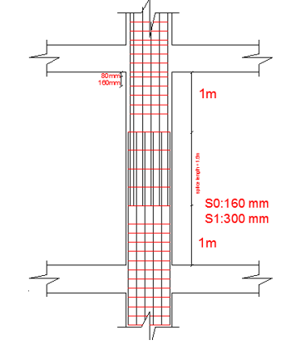
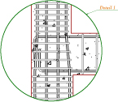
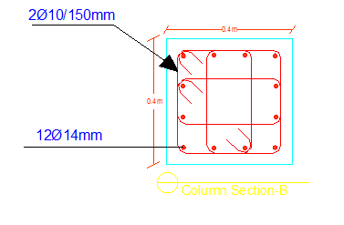
Column Reinforcement Details

Slide 40
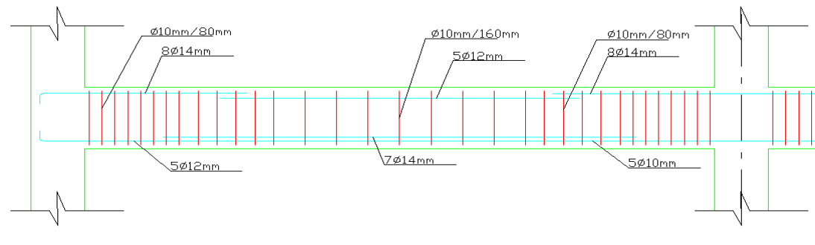
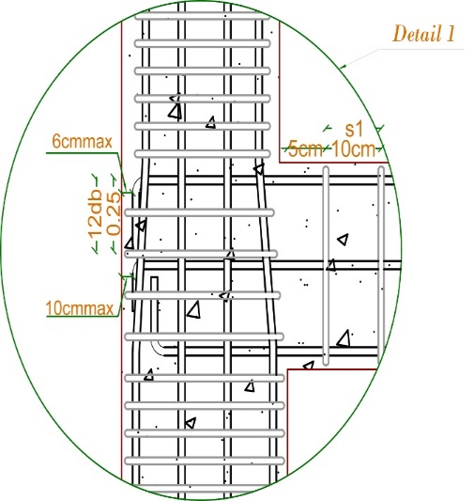
Beam Reinforcement Details

Slide 41
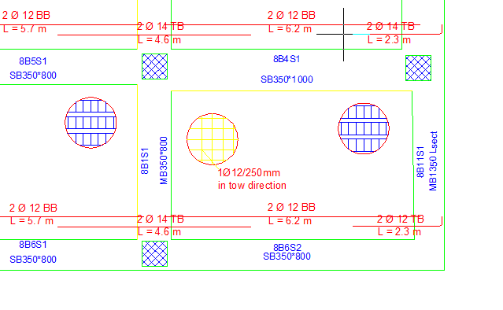
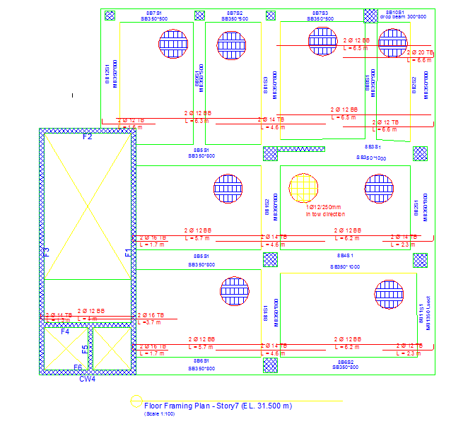
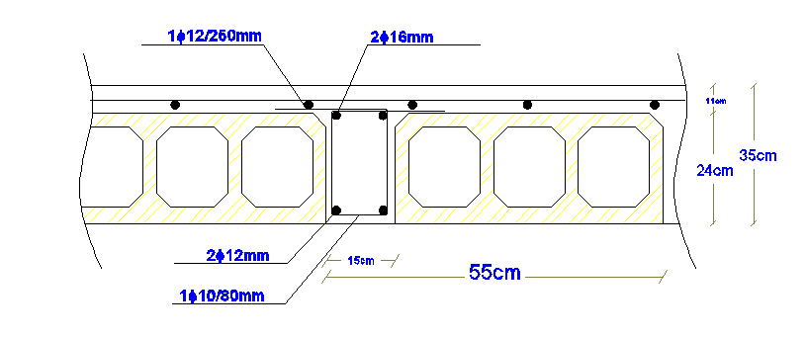

Slab Reinforcement Details
Middle of the rib drawing
Edge of the rib drawing

Slide 42



Shear Wall Details

Slide 43

Stair Reinforcement Details

Slide 44

Environmental DESIGN

Slide 45


Thermal Insulation
Floor Section
Floor Properties

Slide 46
Thermal Insulation
U-Value Of The Other Elements
Elements | U-Value
External wall | 0.51
Ceiling | 0.63
Partition | 1.94
Roof | 0.63
Window | 2.41

Slide 47

Thermal Insulation
Zone Management
Before calculate of loads, we define the area conditions like thermal and comfort conditions and occupancy and operations for zones
zone management part1 (all zones except reception-exception zone):

Slide 48

Thermal Insulation
zone management part 2 (reception-exception zone)

Slide 49

Thermal Insulation
Cooling and heating load for G.F
After adding insulation:

Slide 50

Thermal Insulation
After adding insulation:

Slide 51

Natural Daylight Analysis

Slide 52

Shading design

Slide 53

Shading design
Using low SHGC for windows = 0.25

Slide 54
Acoustical Design
Sound Transmission Class (STC)
STC-Values Between Different Spaces |  | Recommendation
Office - Office | 45 | > 45
Exception-Office | 45 | >=42
Large office - corridor | 44 | >=40

Slide 55

    Acoustical Design
    Reverberation Time (RT60)
    Range RT60 for reception and exception recommended (0.6-1.2)
    RT60 values for reception and exception before improving :

Slide 56

    Acoustical Design
    Reverberation Time (RT60)
    Improving RT60 by adding gypsum board for ceiling and walls and porous plywood for walls :

Slide 57



    Acoustical Design
    Reverberation Time (RT60)
    RT60 values for reception and exception after improving = 0.78 :

Slide 58

    Acoustical Design
    Transmission loss (TL)
    TL = 44.1 > 40

Slide 59

Mechanical DESIGN

Slide 60

    Water Supply Design

Slide 61


    Water Supply System

Slide 62


    Drainage System
    For Ground Floor

Slide 63

    Rain Drainage System

Slide 64


    H-VAC System
    VAV system

Slide 65
Electrical DESIGN

Slide 66


    Sockets Arrangement

Slide 67


    Lighting arrangement

Slide 68




    Artificial Lighting
Reception & Exhibition Lighting:

Slide 69




Conference Room & offices lighting:
    Artificial Lighting

Slide 70




    Artificial Lighting

Slide 71

Estimated Cost

Slide 72
Estimated Cost
The total cost of the Building is about 6.3 million NIS.
The total cost per meter square for the building is about 2625 NIS.

Slide 73
Thank You

