Slide 1

Enterprise Resource Planning for
Rifai Refrigeration and Air Conditioning Company
Supervised by
Dr.Ahmad Shraide
Presented By:
Hiba Rifai
Aysha seddeh

Slide 2
Introduction
Modules
Problem
Comparison of Odoo and Shamel
Reporting
Solution
Contents

Slide 3

Introduction
Al-refai company
Founded in Nablus 1959
Selling refrigerators, machines, and air conditioners, and also manufacturing water coolers

Slide 4
Problem
Integration.
Inventory Management.
Phone ordering process.
Reorder.
Show products.

Slide 5
Comparison of Odoo and Shamel
 | Odoo | shamel
experienced | + | _
Integration | + | +
Flexibility | + | _
Customization | + | _
Budget | _ | +

Slide 6
Solution
Is to ERP solution using odoo

Slide 7
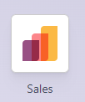
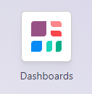

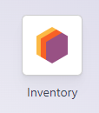
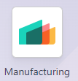
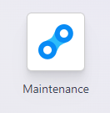
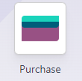
Odoo Modules

Slide 8
Sales
Sales scenario in odoo
Rejection
End
Quotation
Send by email
Accept
Delivery
Create
invoice
register
payment

Slide 9
Purchase
Purchase scenario in odoo
RFQ
Receive
By email
Confirm
Receive
products
Vendor bill
Payment

Slide 10
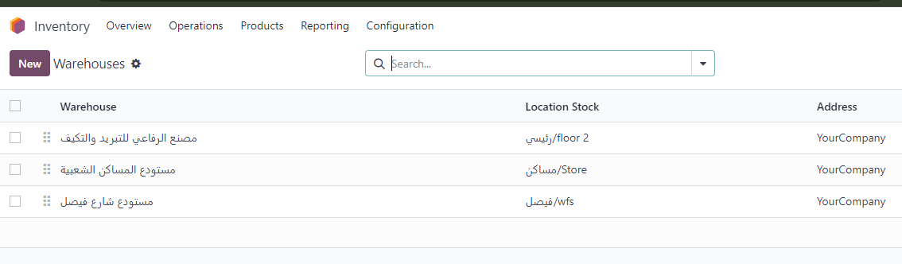
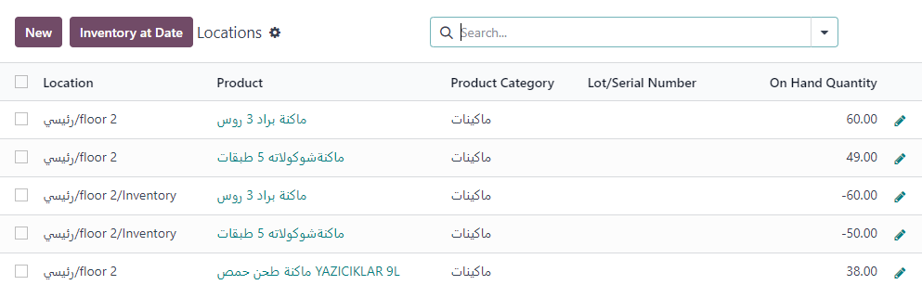
Warehouses and Locations

Slide 11
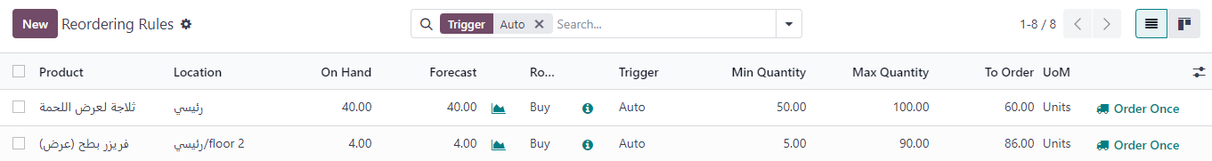
Reordering rules
Reordering rules are used to automate the process of replenishing stock levels for a particular product.
اذا التنبؤ اقل من الحد الادنى يتم اعادة الطلب
If the quantity available in stock is less than the minimum for the product, a purchase order is created automatically from the supplier who provides me with this product.

Slide 12
Manufacturing
One of the most critical operations in our company.
The company imports components from different companies and assembles them to create a single product.
When a customer orders a product that needs to be manufactured, a notification is sent to the manufacturing branch )pull strategy)

Slide 13
Manufacturing
Manufacturing scenario in odoo
orders
Plan orders
Start
manufacture
process ends
Delivery to customer

Slide 14
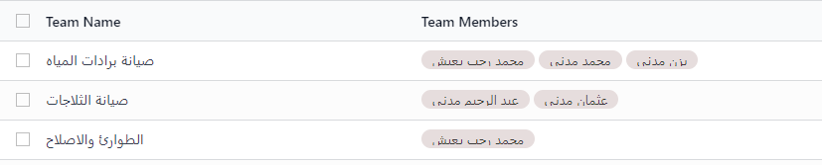
Maintenance
Maintenance Teams

Slide 15
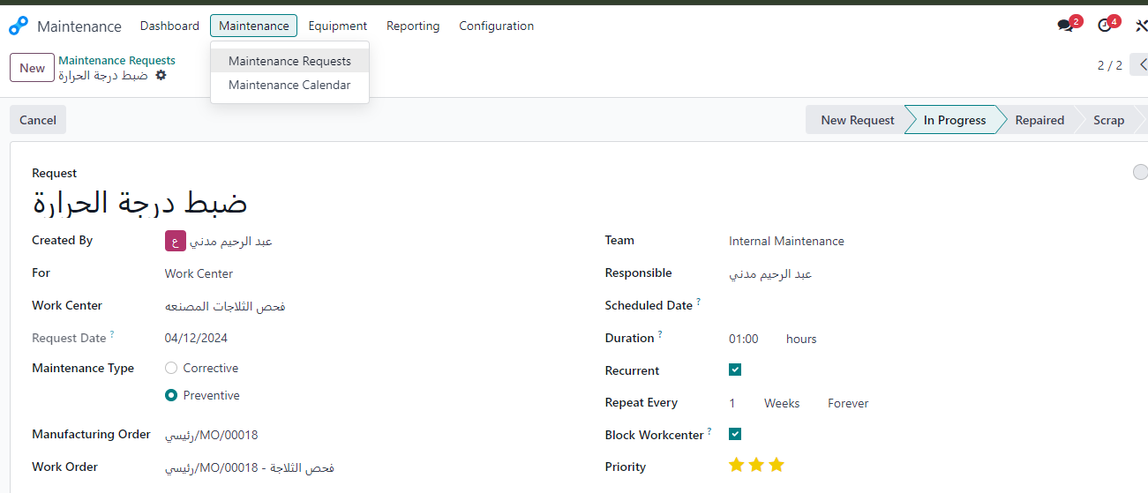
Maintenance Requests

Slide 16
Let’s take tour of our website !

Slide 17
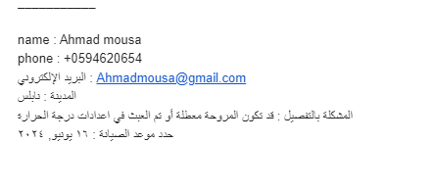
Maintenance appointment

Slide 18
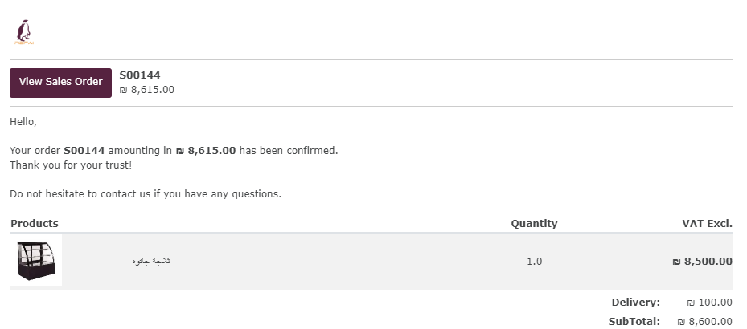
Sales order

Slide 19

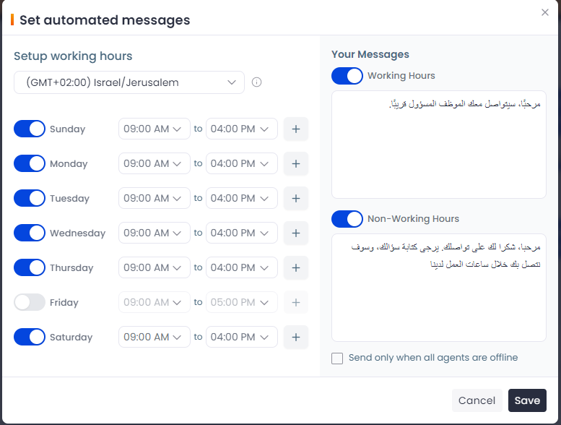
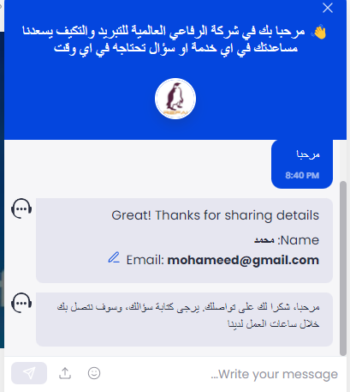
Chat way

Slide 20
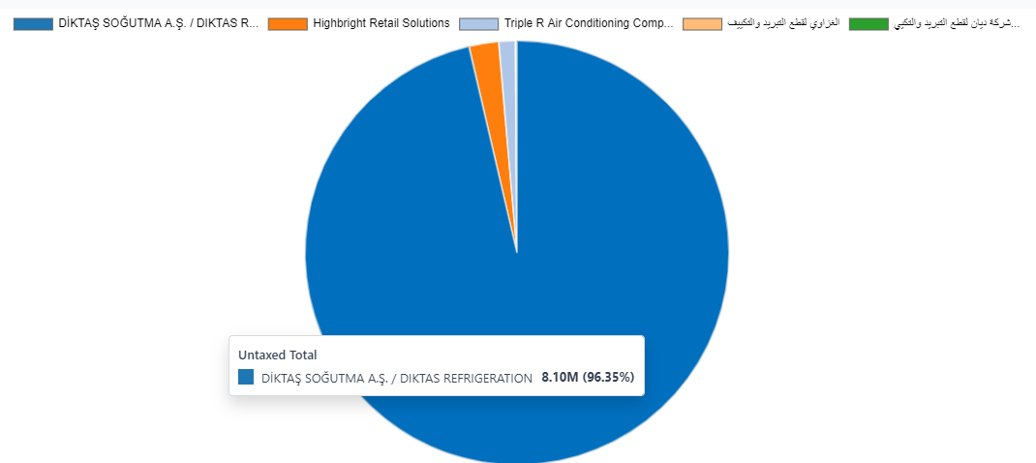
Reports
Reports of Purchase
we use a Pie chart to compare between total purchases from different Vendors.

Slide 21
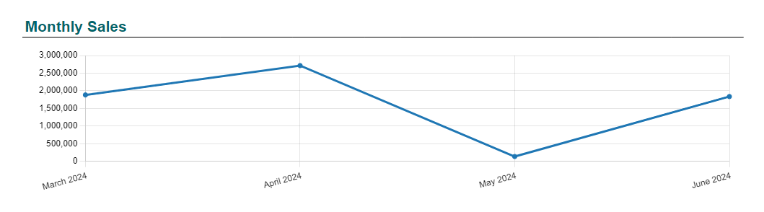
Reports
Reports of Sales
View total sales for a specific time period(month)

Slide 22
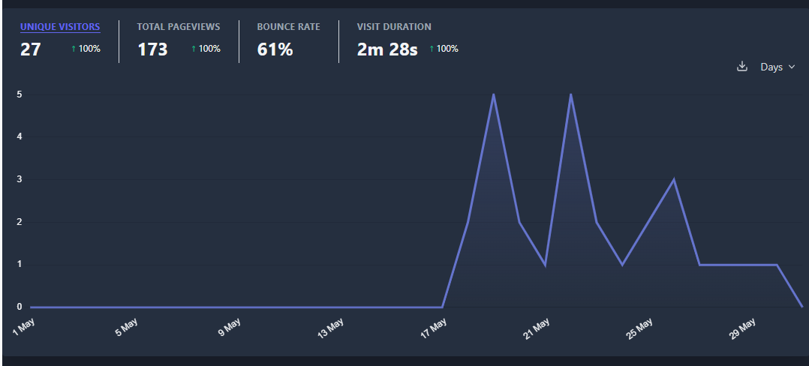
Reports
Reports of website
Analyzing visits to a website in a certain period of time

Slide 23
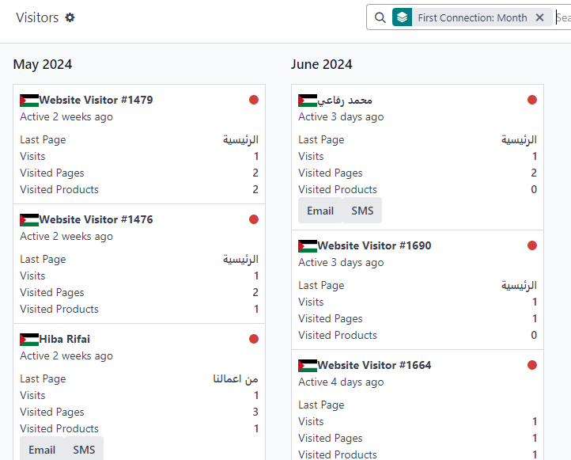
Reports
Reports of website

Slide 24
Future development
Data mining (customer classification, prediction).
Improve marketing.
CRM modules and operations.

Slide 25


Slide 26
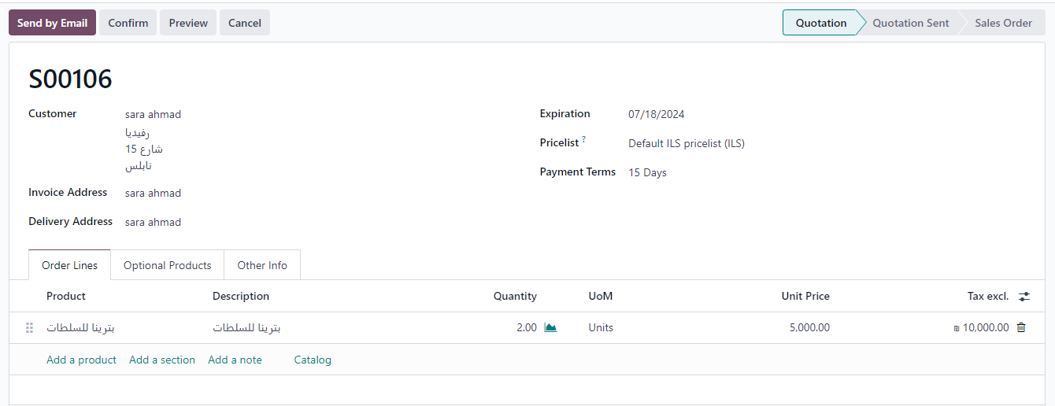
Sale scenario
1-Quotation

Slide 27
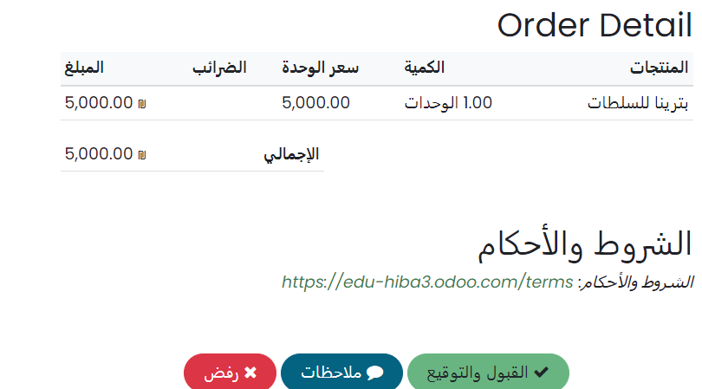
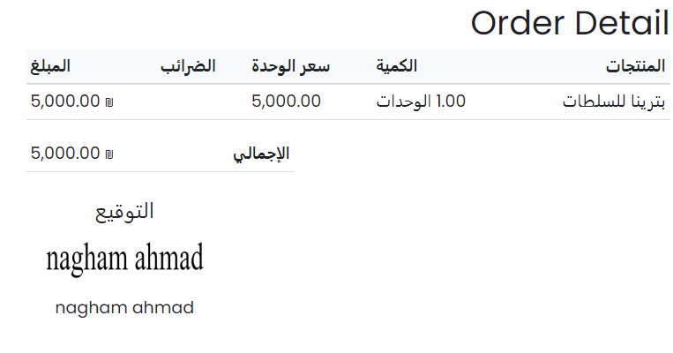
After saving the quotation information, an email is sent to the customer
Accept and signature

Slide 28
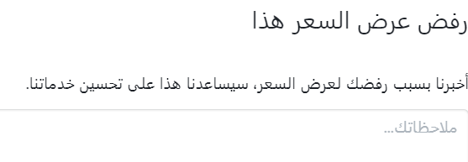
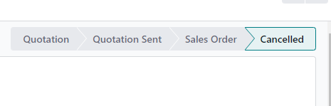
Rejection

Slide 29
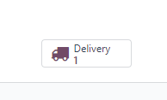
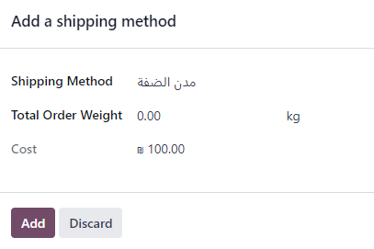

2-Delivery

Slide 30

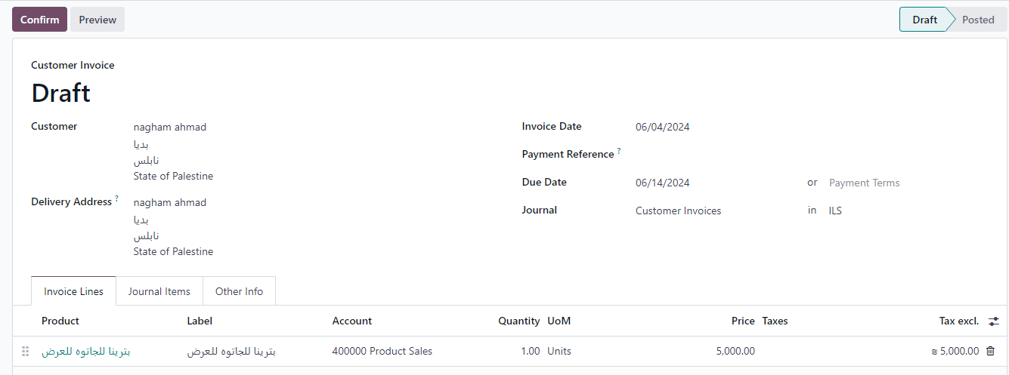
3-Create invoice

Slide 31
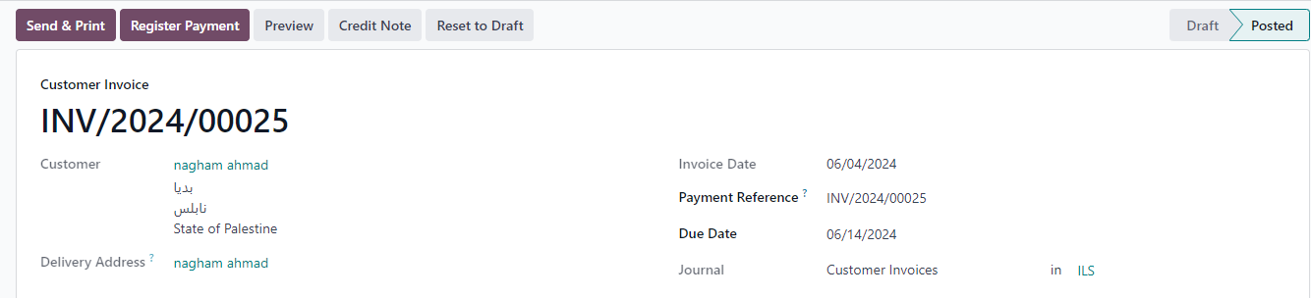
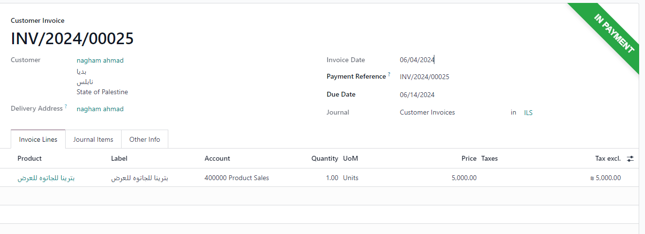
4-Register payment

Slide 32
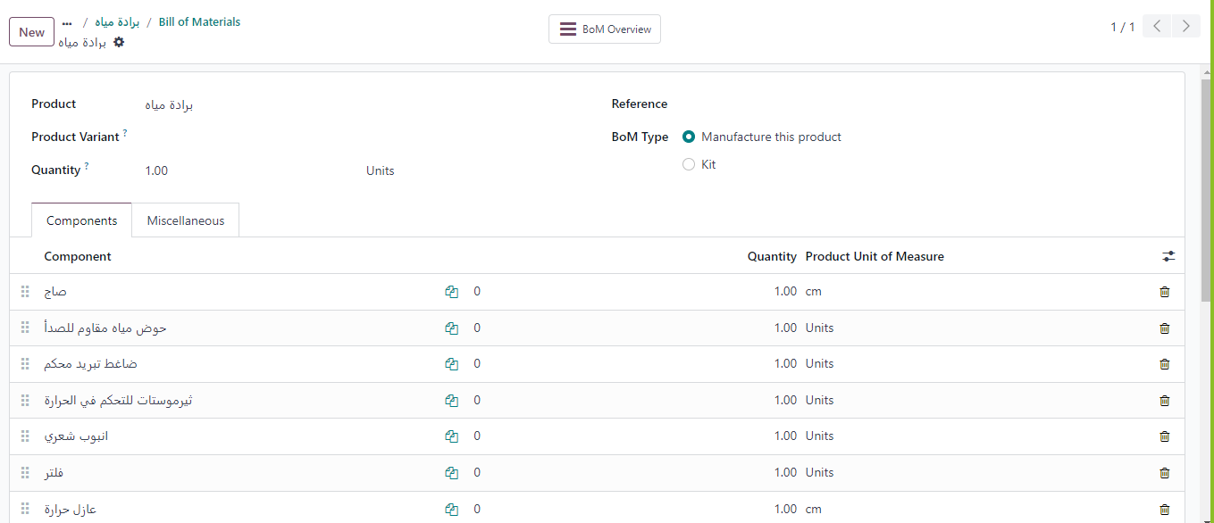
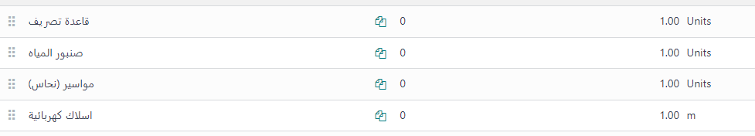
Bill of material
Every product manufactured requires ingredients
List of materials for producing water coolers

Slide 33
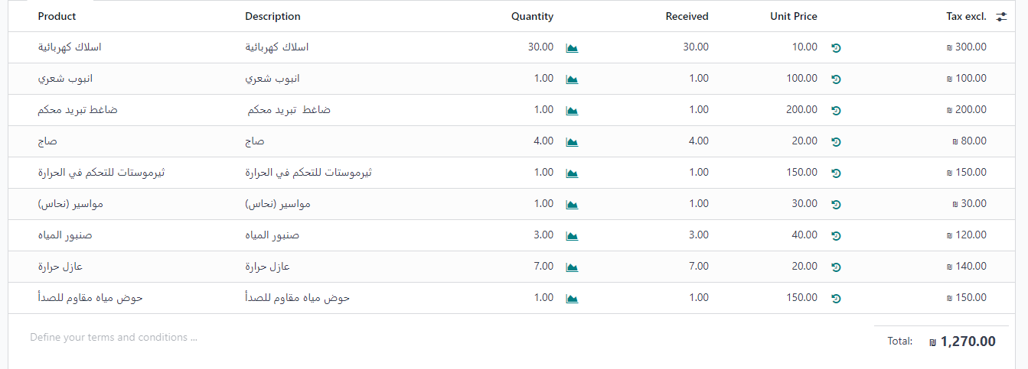
Components cost

Slide 34
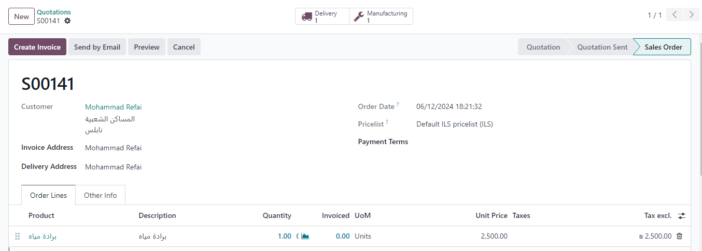
Manufacturing orders
When a customer orders a product that needs to be manufactured, a notification is sent to the manufacturing branch )pull strategy)

Slide 35
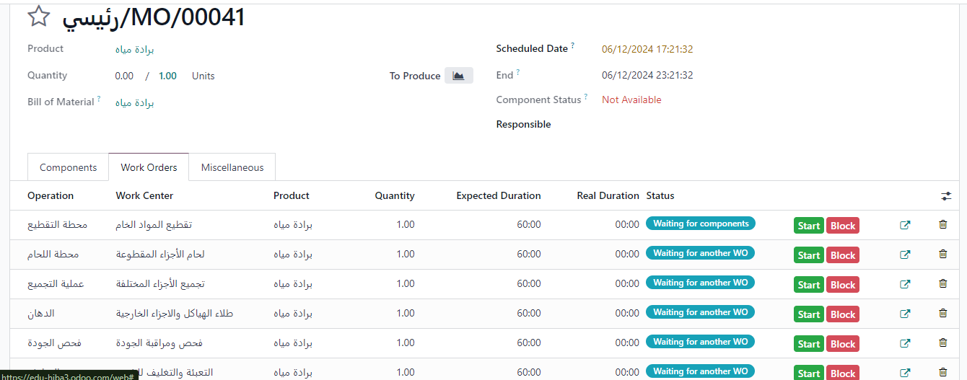
Work Orders
management of various manufacturing operations that need to be performed at respective work centers in order to manufacture the final product.
The manufacturing completion date is calculated based on real duration

Slide 36
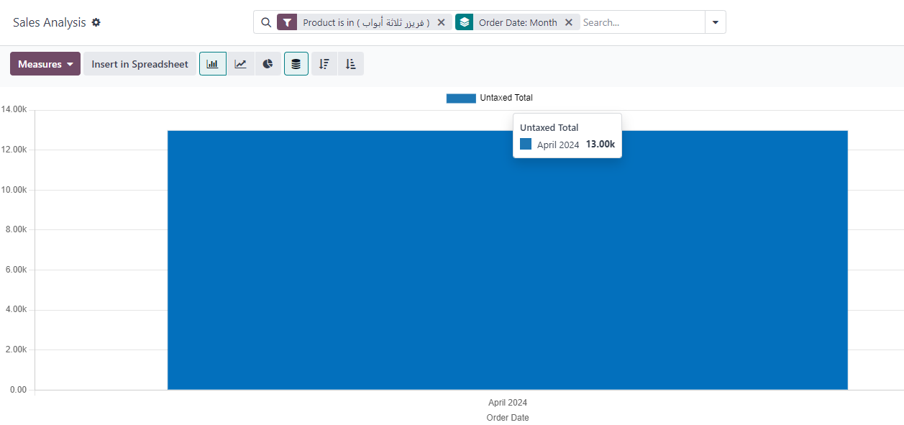
Sales for a specific product in April

Slide 37
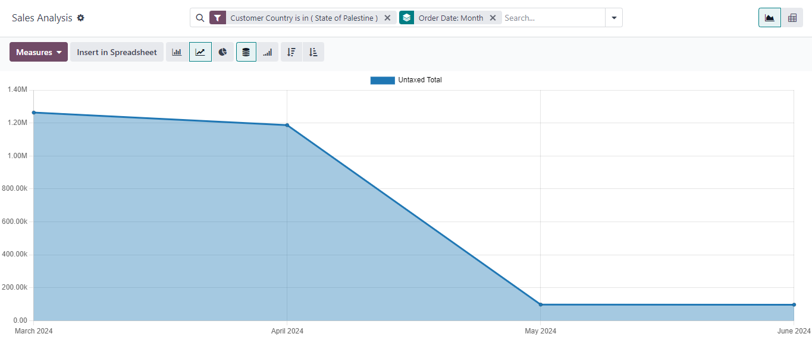
Analysis of sales in Palestine for a specific period of time

Slide 38
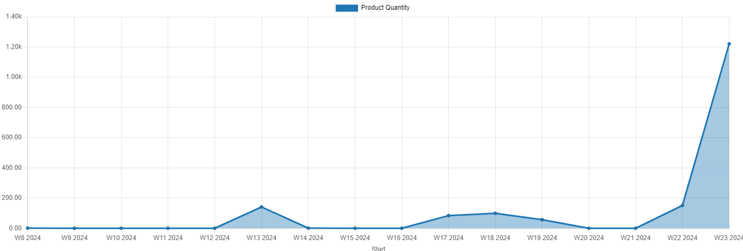
Reports
Reports of manufacturing
we use a line chart to find out the weekly production

Slide 39
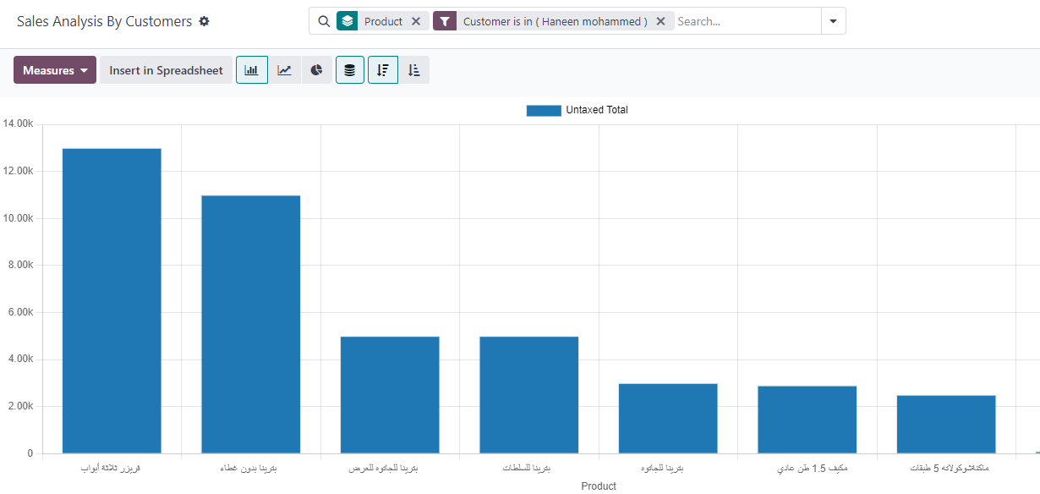
Reports
Sales analysis by customer

