Slide 1
Study the effect of adding sand and gravel in the concrete mixture which contains 4% PCB.
Mahmoud Masoud
Mohammad Shahin
Ibrahim Deiryah
Supervisor
Dr. Osayd Abdul Fattah

Slide 2
01.
Our project.
04.
Methodology.
02.
Introduction
05.
Result
03.
Concrete structure.
06.
Conclusion.

Slide 3
01
Introduction

Slide 4
Through our project, the effect of increasing sand and gravel was studied by fixing the percentage of PCB on the strength of the concrete in order to know the best possible addition percentage.

Slide 5

02
Concrete structure

Slide 6
In the beginning, the work was on the B300 mixture, and that mixture contained the following materials:
Cement 3.706 Kg
W/C=0.054
Sand=3.579 Kg
Agrregate have a 3types :
1-6mm=9.458 Kg
7-17mm =3.834 kg
18-25mm=7.669kg

Slide 7
4% PCB cement ratio=0.148g*
2% super G7 cement ratio=93g
Adding sand and aggregate
1-6mm (0%,2%,3%,4%,5%)

Slide 8

3. Methodology

Slide 9
Our project included a number of mechanical tests for the mixture:
Slump test
Compression stress test
Adsorption test
Friction test

Slide 10
Slump test
When the mixture is complete, we fill the sample into a container designated for testing, and when filling a third of the container, we hit the rod 25 times.

Slide 11
Compression test
After preparing the sample cubes and waiting for them for 7 and 28 days, we use the compression stress device by placing them in the middle of the device.

Slide 12
Adsorption test
Using a convection oven, we dry the sample from the water, then measure its mass, then return the sample to the water for 24 hours, then measure its mass again to check the amount of water absorbed by the sample.

Slide 13

Friction test
Using a grinder, and sandpaper, weigh the sample before starting the examination, then run the machine with the sample inside it for 5 minutes, and measure the sample again.

Slide 14
Result and discussion
04.

Slide 15
The most important results from the following Tests :-
1-Compression Test .
2-Water adsorption Test.
3-Friction Test.
4- Slump Test.
Result and
discussion

Slide 16
Compression Test

Slide 17
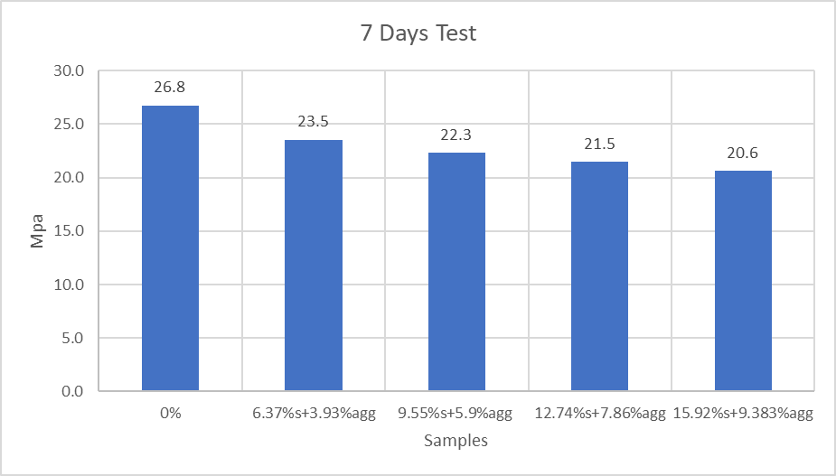
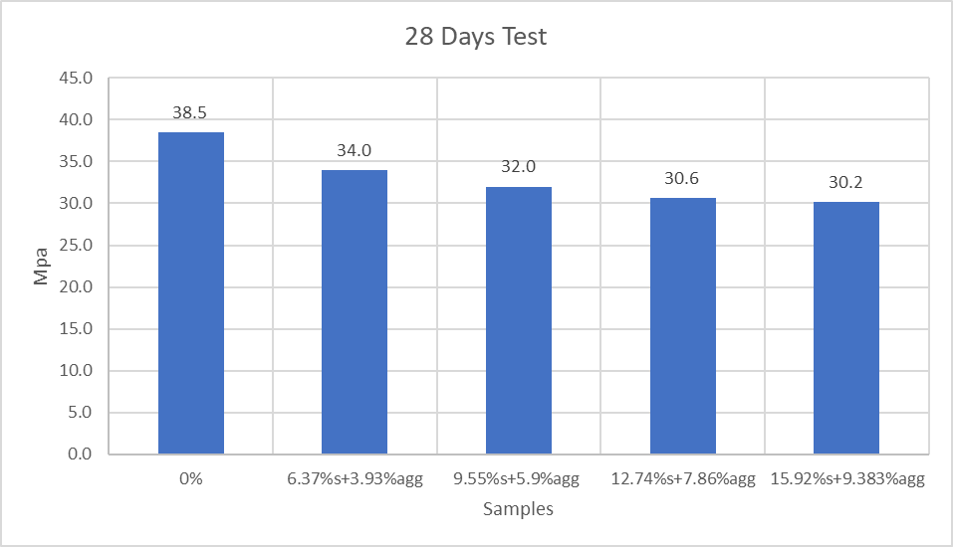
Compression Test

Slide 18
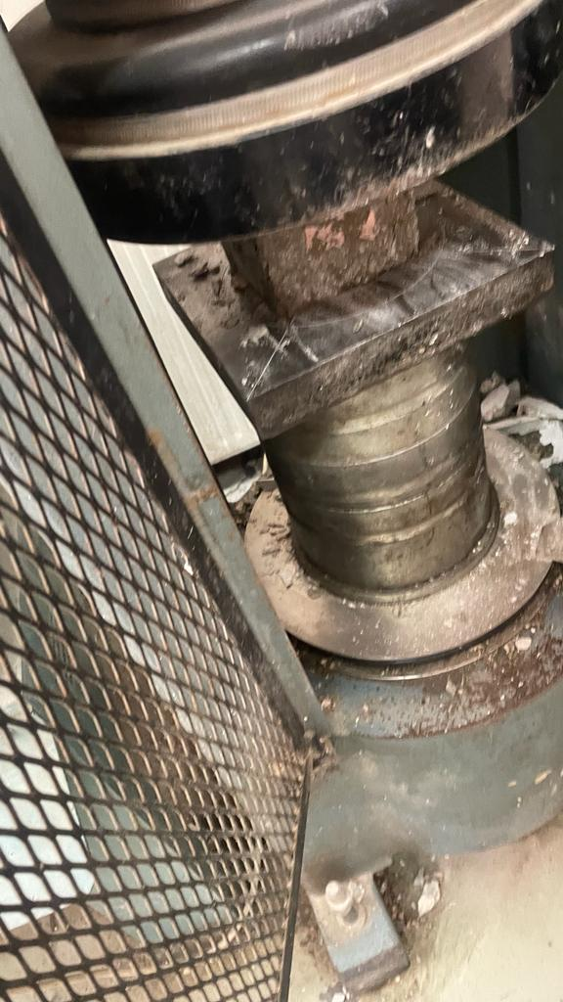
Compression Test

Slide 19
Water adsorption Test

Slide 20
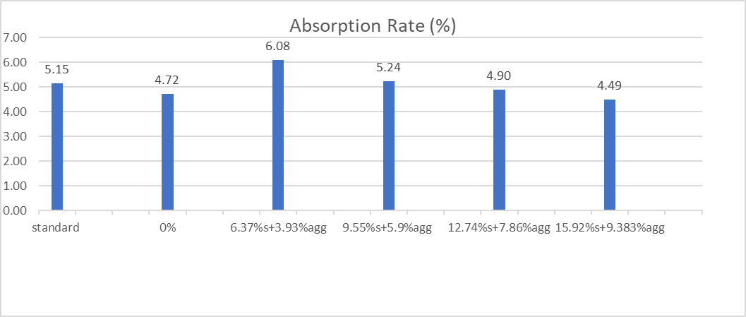
Water adsorption Test

Slide 21
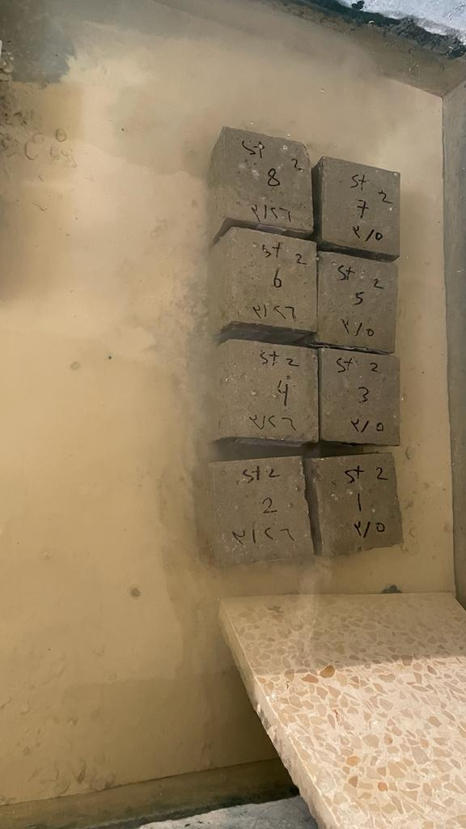
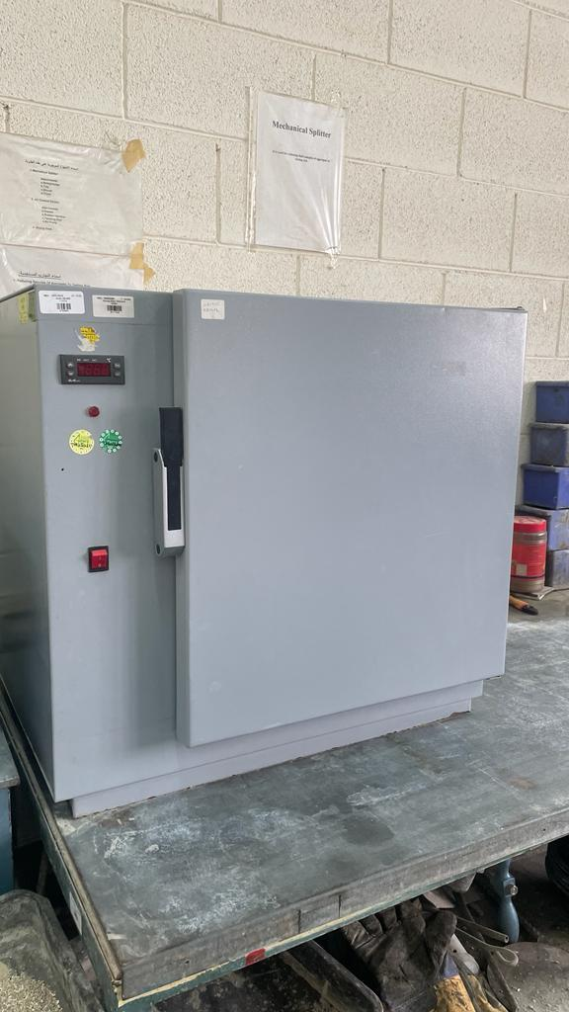
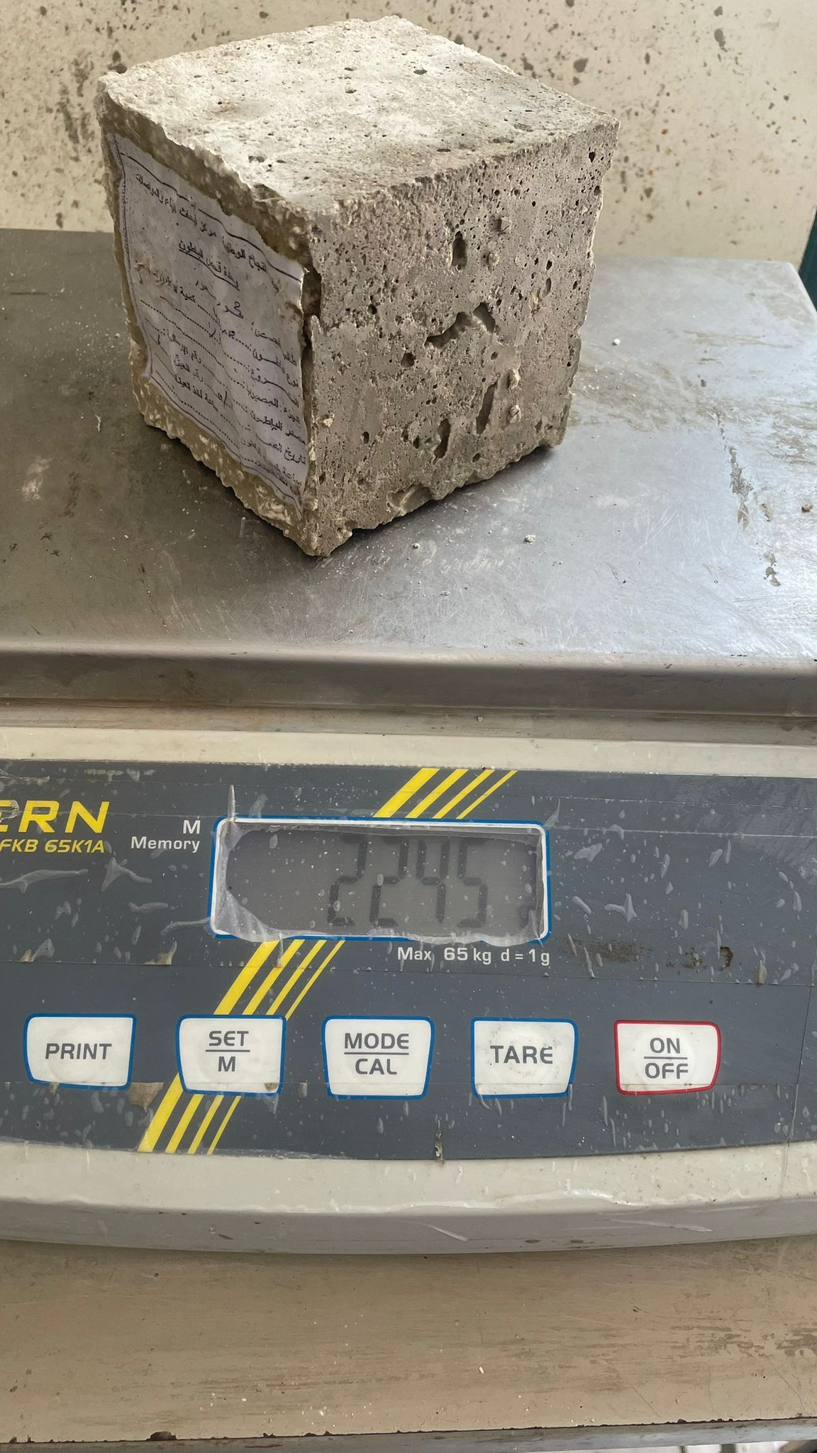
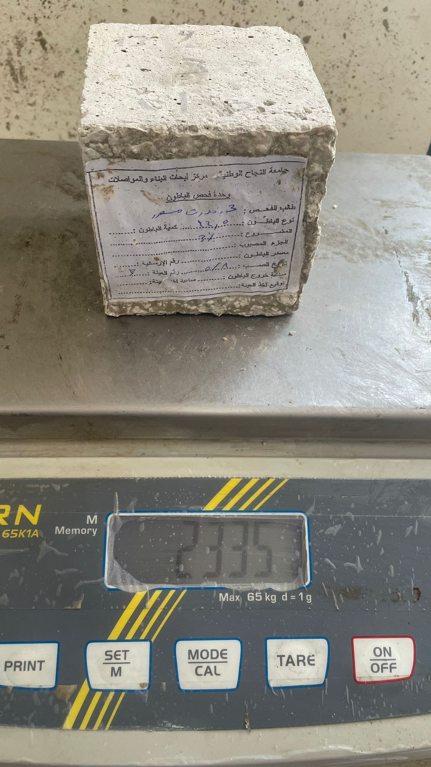
Water adsorption Test

Slide 22
Friction test

Slide 23
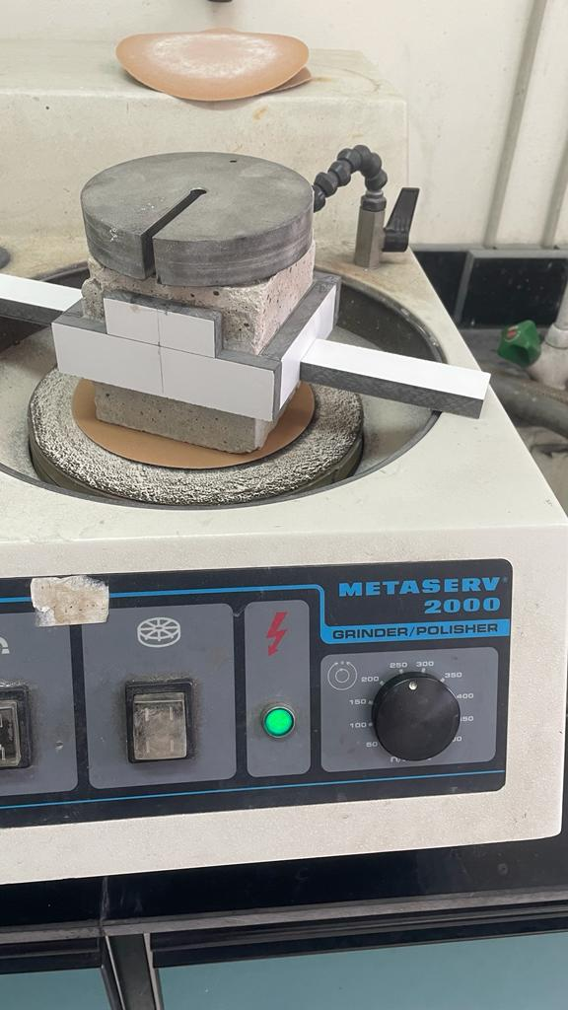
Friction test

Slide 24
Slump Test

Slide 25
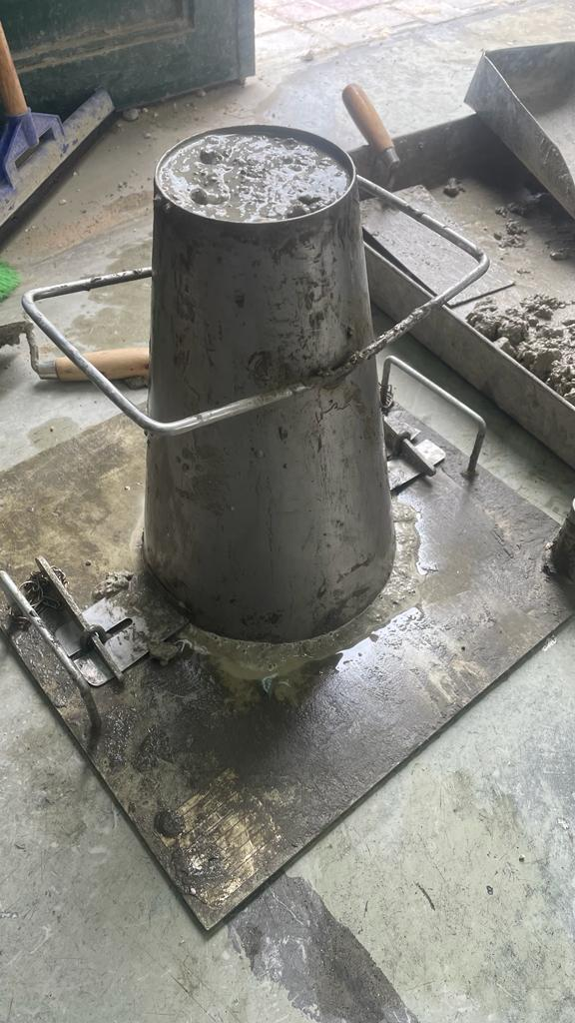
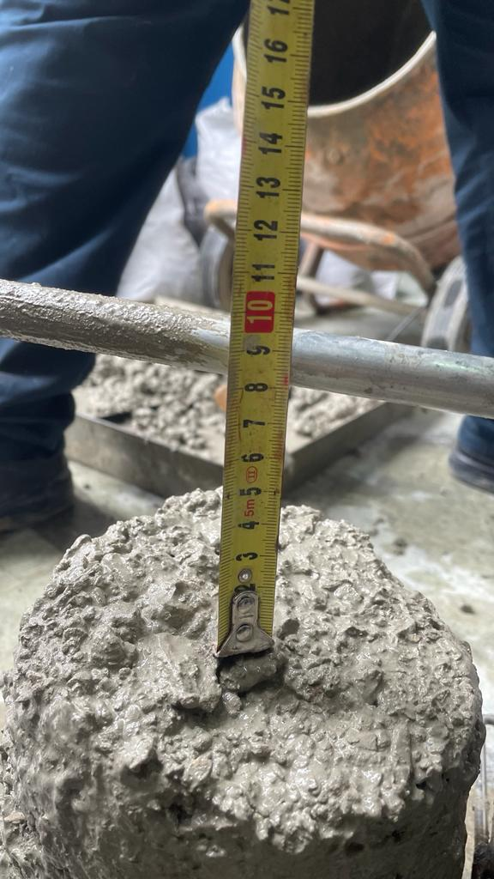
Slump Test

Slide 26
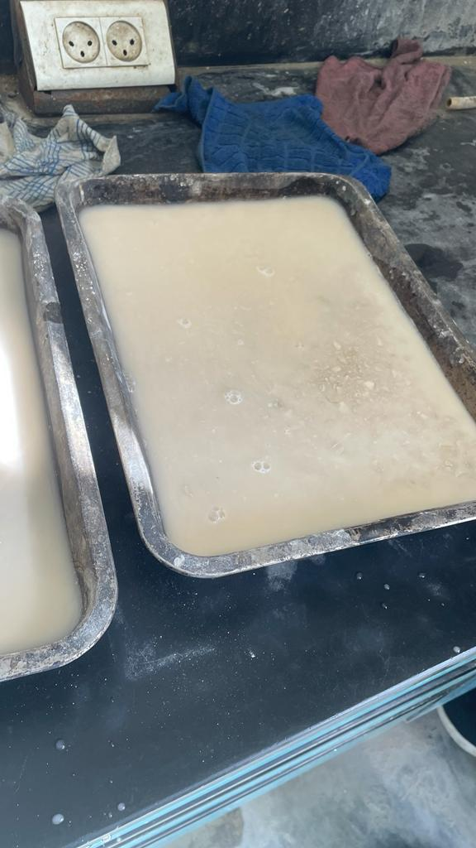
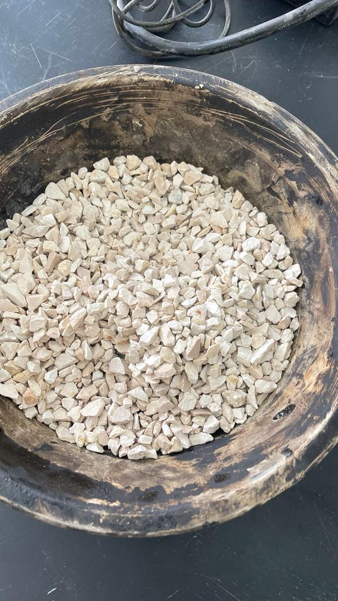
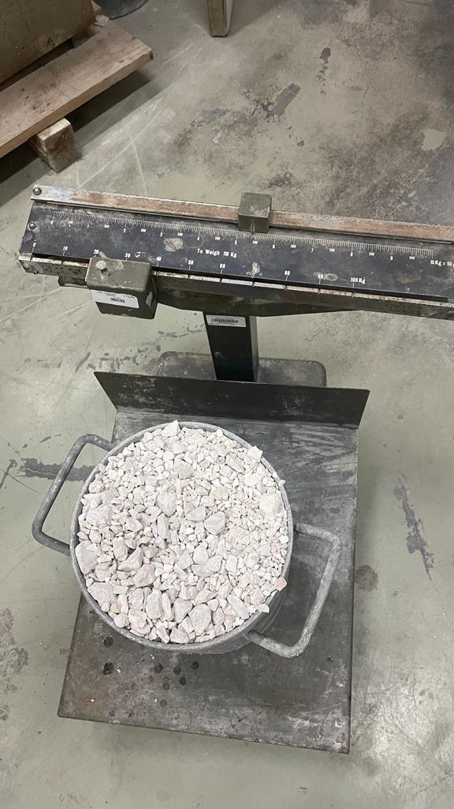
Result and discussion
There are also some results of some other research from the most important of these researches
Material Absorption
material density

Slide 27
Material Absorption
Material | Absorption Rate (%)
Sand | 1.9
Aggregate(18-25) | 1.71
Aggregate(7-17) | 2.11
Aggregate(1-6) | 2.88

Slide 28
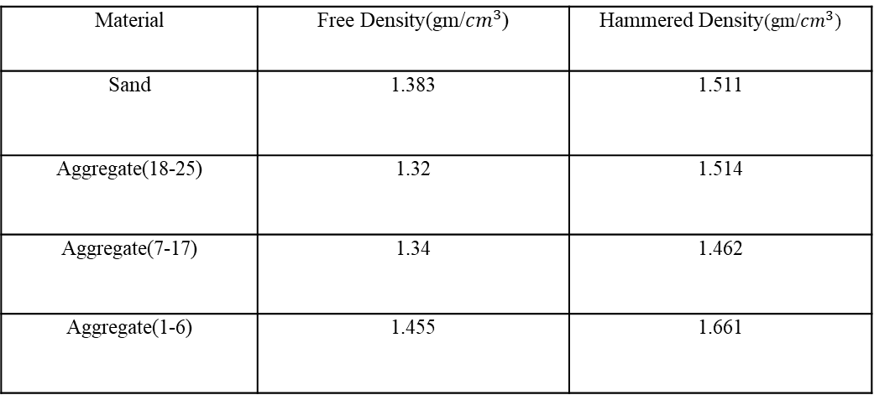
material density
Material | Free Density(gm/${cm}^{3}$) | Hammered Density(gm/${cm}^{3}$)
Sand | 1.383 | 1.511
Aggregate(18-25) | 1.32 | 1.514
Aggregate(7-17) | 1.34 | 1.462
Aggregate(1-6) | 1.455 | 1.661

Slide 29

Challenges
05.

Slide 30
Challenges
Search for high-quality materials.
Search for a mixture that meets the required standards.
There are errors in some of the mixtures that have been excluded.

Slide 31
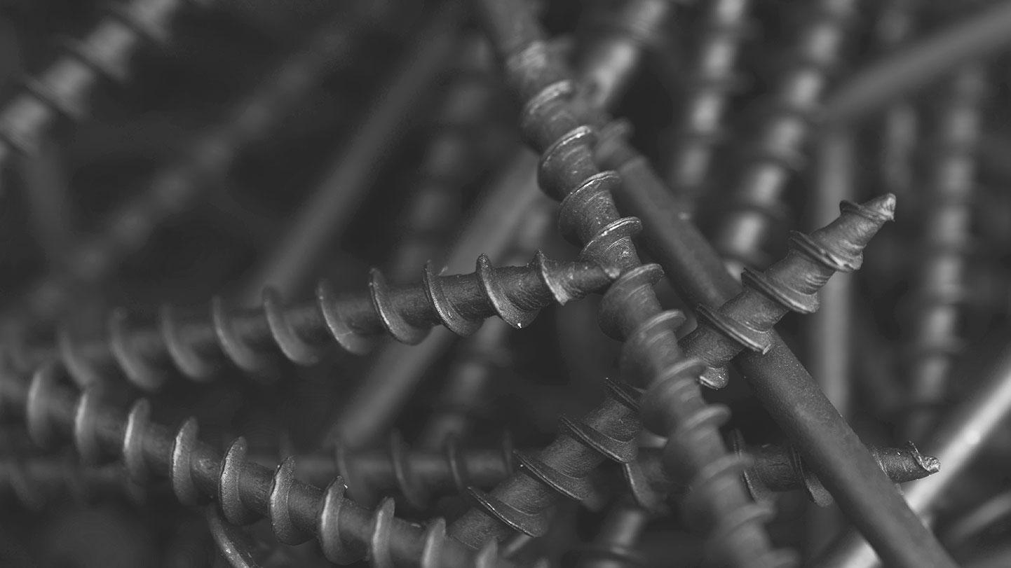
Conclusion
06.

Slide 32
Conclusion
When the addition reaches about 4%, the force numbers are very good, as it has returned to its standard state.

Slide 33
Thanks!

