Slide 1
Assessment of road quality control/quality assurance in Nablus and Jenin Cities.

Slide 2
Project Outline
Questionnaire
Data Collection
Analyze the Data
Results
Recommendations

Slide 3
Introduction
In their daily life, people depend mainly on roads and transportation, as they save both time and effort for man in many aspects of his life, but these in general suffer from problems such as cracks, slumps -that may occur in the street- and poor quality in general, the need to know has increased the causes and events which lead to problems occurring in the asphalt, so we will collect and study the factors that -as we believe- have a role in the problems experienced on the roads.

Slide 4
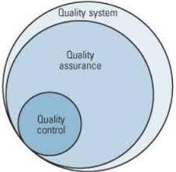
Quality Assurance
Quality assurance is about building processes that eliminate problems before they arise.
Quality assurance can be defined as "part of quality management focused on providing confidence that quality requirements will be fulfilled.

Slide 5
Quality Control
Quality control of pavement is a process by which quality engineers seek to ensure that the quality of the project is maintained or improved. Quality control requires the creation of an environment in which both management and employees strive for perfection. This is achieved by training staff and engineers, establishing quality standards for asphalt, and taking samples to check for statistically significant differences.

Slide 6
Objectives
Analyze the factors that affect the quality of road projects in Palestine in general and in Nablus and Jenin in particular.
The extent to which contractors agree with the factors in the questionnaire.
Expand recommendations to the competent authorities after completing the analysis and reaching the most influential factors.

Slide 7
Project Constrains
    The quick response of contractors in filling the questionnaire and returning back during the specified period.
    The lack of experience of GP team in analyzing the collected data by using SPSS software.
    The limited existing relevant previous studies in Palestine in general at Nablus and Jenin as specific.

Slide 8
Methodology
After reading previous research on the topic of quality control and quality control in road projects, about 30 factors affecting the quality of work in road projects were collected to make a questionnaire targeting a specific group: experienced contractors and engineers. On the other hand, the factors were linked to general information in the questionnaire form such as: Location of the person participating in the questionnaire, classification of the contracting company according to the Palestinian Ministry of Works, number of years. The experience of the contracting company in road projects, the average budget of the projects executed by the company, and the average time spent by the company on road projects. In any case, the questionnaire form was distributed to the contracting offices and companies, either by e-mail or through a hard copy. After collecting the data, it was statistically analyzed through the SPSS statistical program with the help of the analysis experts in the program. And then arriving at the results and identifying the most important influencing factors from the contractors' point of view, which will be submitted to the competent authorities, such as municipalities, and to provide recommendations to engineering consultancy firms.

Slide 9
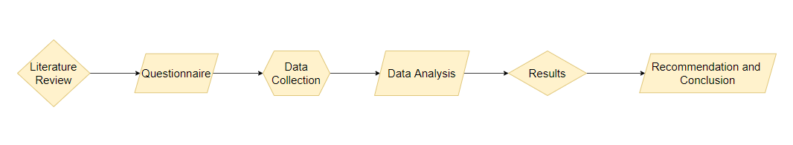
Methodology Flowchart

Slide 10
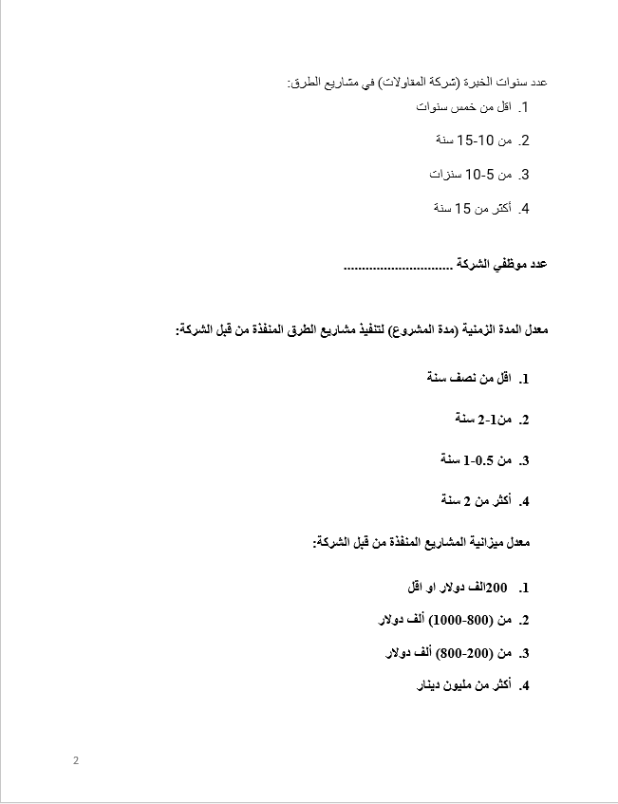
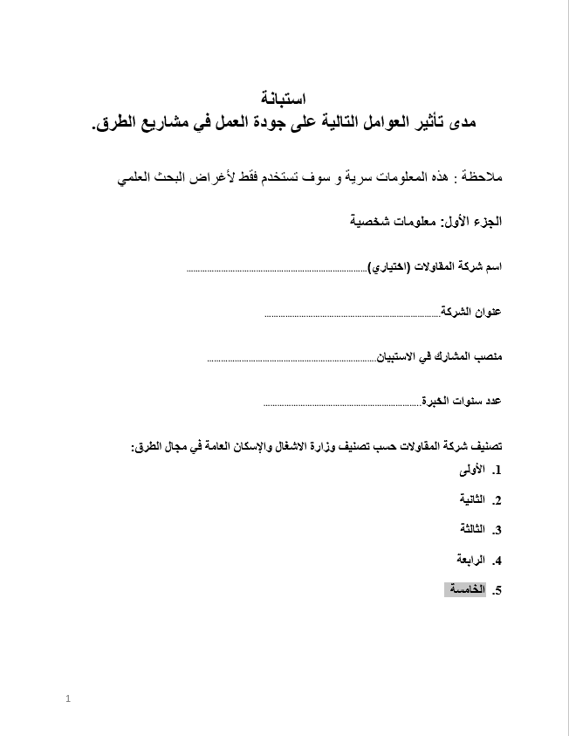
Questionnaire Form
Part One

Slide 11
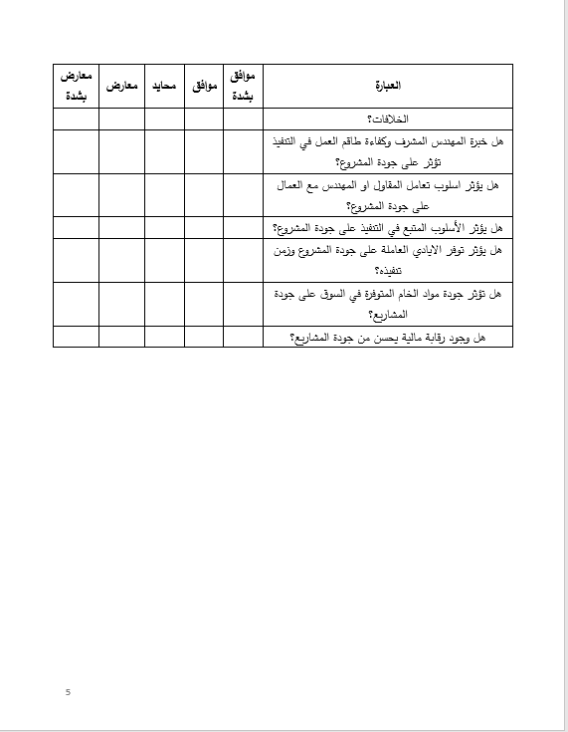
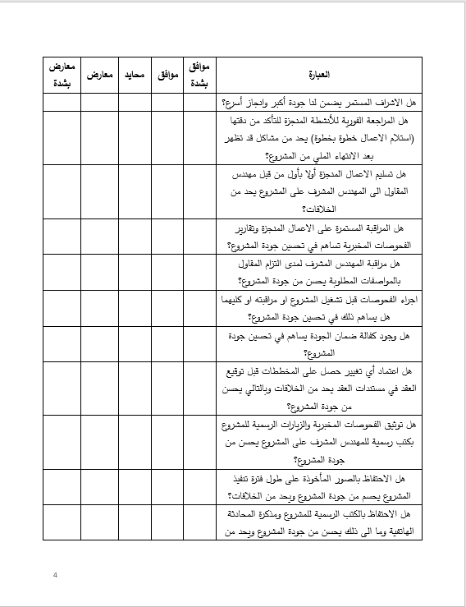
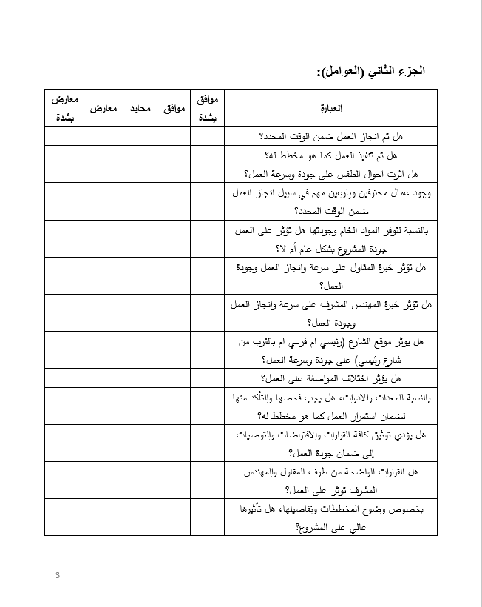
Questionnaire Form
Part Two

Slide 12
Data Collection
A total of fifty (50) contracting companies were contacted; only thirty-three (33) responded, which represents approximately (two-thirds) of the total population. The questionnaire was then statistically analyzed to determine the degree of effect that the factors have on the quality. For the accessible consultants within the northern geographical area governorates, the project team interviewed two of them to fill out a questionnaire.
The Likert scale (1–5) was used such that each answer was given a value from ‘5’ to ‘1’as below; the respondent should select only one of these answers.
Value 5 indicates ‘Strongly agree’
Value 4 indicates ‘Agree’
Value 3 indicates ‘Neutral’
Value 2 indicates ‘Opposed’
Value 1 indicates ‘Strongly opposed’

Slide 13
Data Analysis
Data obtained from the questionnaires were analyzed by using the computer program SPSS as follows:
For part one: a cross-tabulation method was used to obtain a general description of the contractor company.
For part two: a qualitative analysis was used to determine the factors affecting the quality. Descriptive statistics such as frequency analysis; mean, standard deviation, and variance were presented for each factor where the effect of each factor was measured by the Relative Importance Index (RII).

Slide 14
Data Analysis
Estimated scale according to the five-point Likert scale
Response | Weighted average | level
Strongly opposed | 1-1.79 | Low
Opposed | 1.80-2.59
Neutral | 2.60-3.39 | Medium
Agree | 3.40-4.19 | High
Strongly Agree | 4.20-5.00
Reliability Statistics
Cronbach's Alpha | No of Items
0.797 | 30

Slide 15
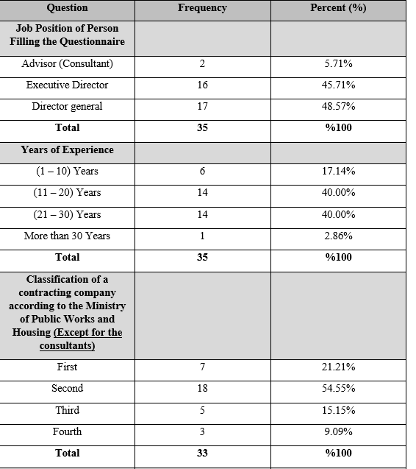
General information about the contractor companies.

Slide 16
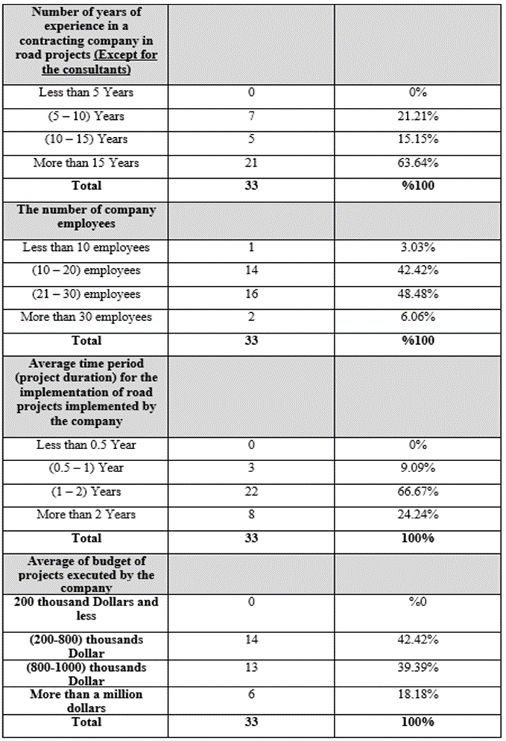

Slide 17
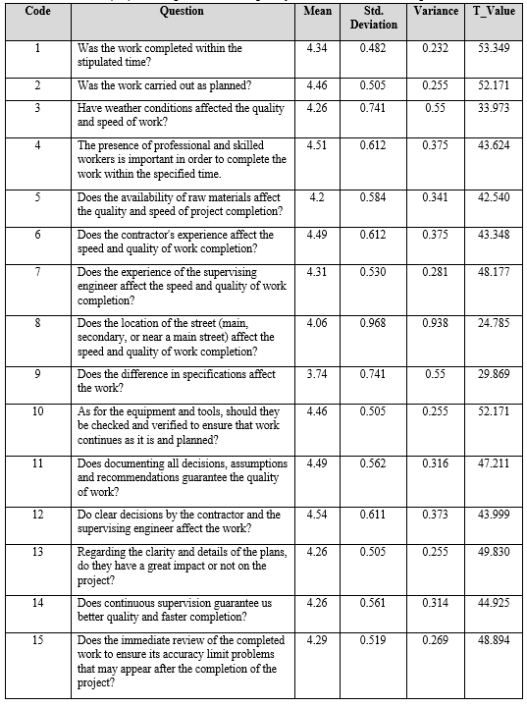
Descriptive statistics quality factors contractor’s response

Slide 18
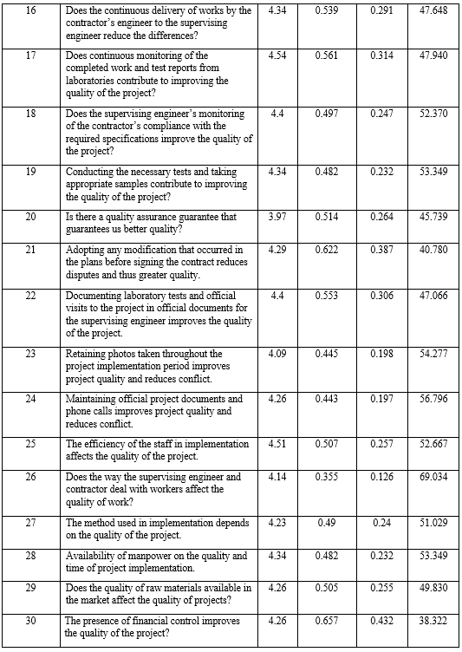

Slide 19
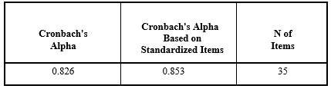
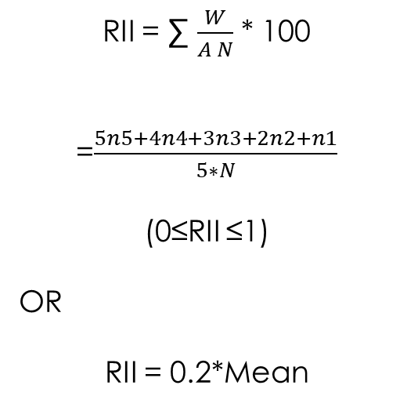
Cronbach's alpha test measuring reliability statistics
RII = ∑ $\frac{W}{A N}$ * 100
=$\frac{5n5+4n4+3n3+2n2+n1}{5∗N}$
(0≤RII ≤1)
OR
RII = 0.2*Mean

Slide 20
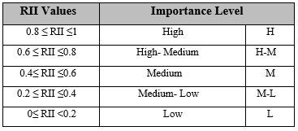
Importance levels

Slide 21
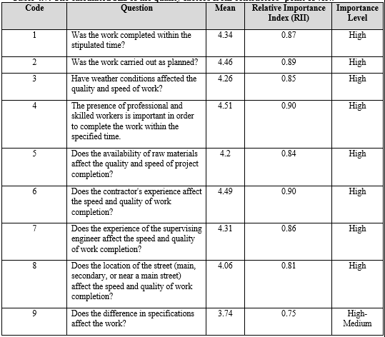
The calculated RII of the quality factors from contractors’ point of view

Slide 22
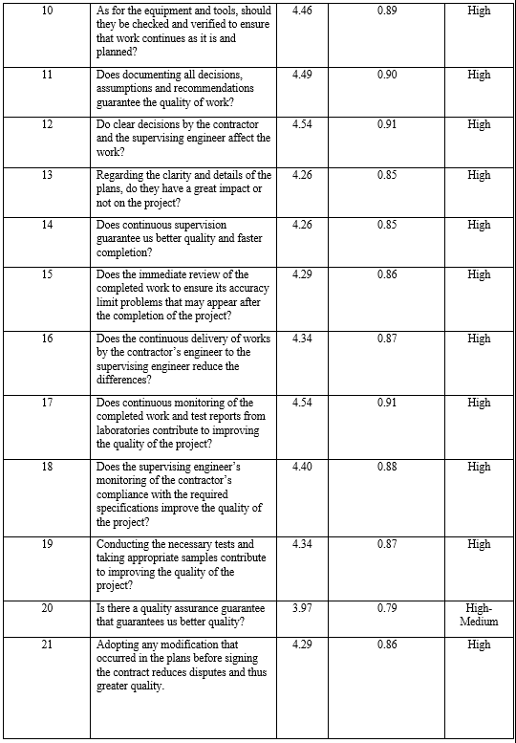

Slide 23
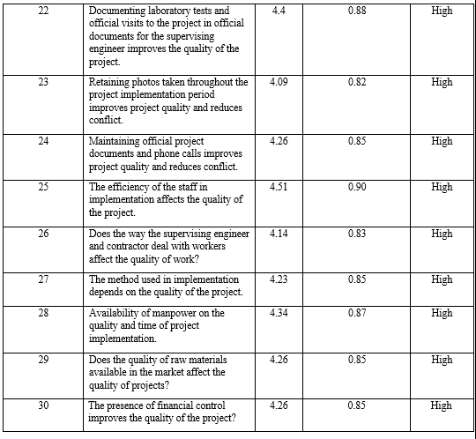

Slide 24
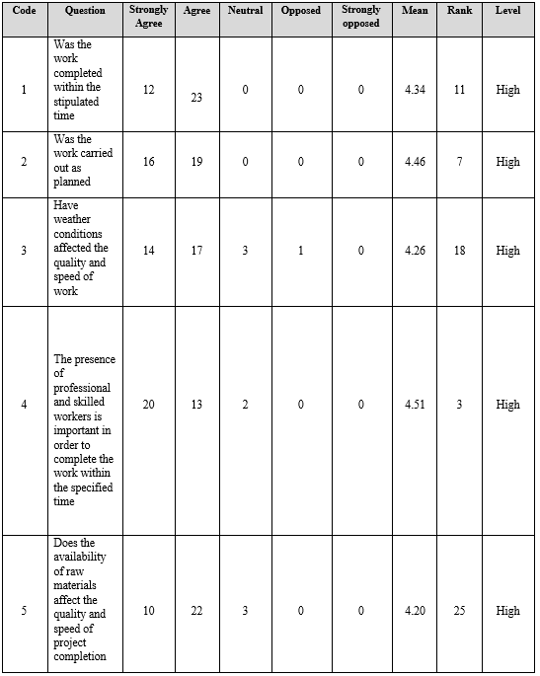
Frequencies the response and the rank according to the level of importance.

Slide 25
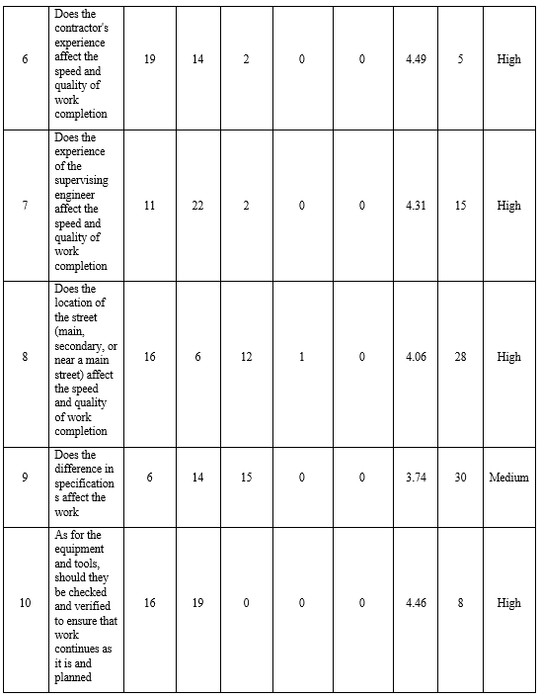

Slide 26
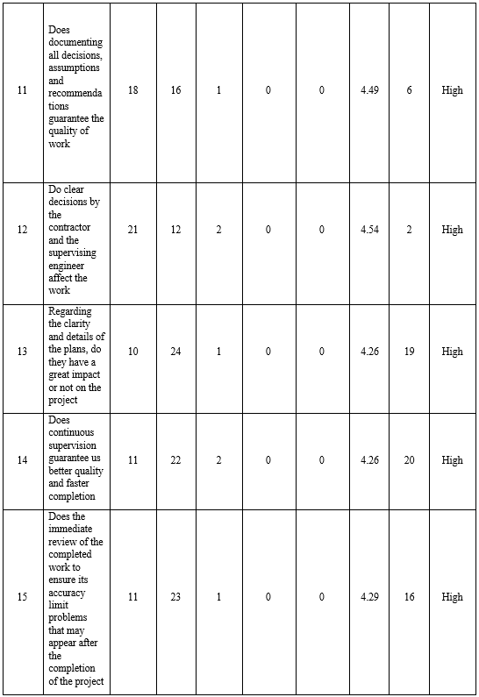

Slide 27
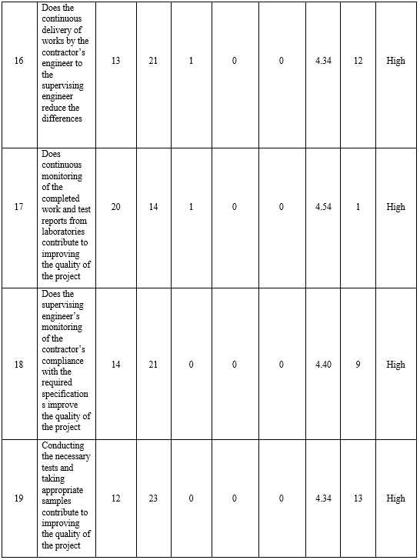

Slide 28
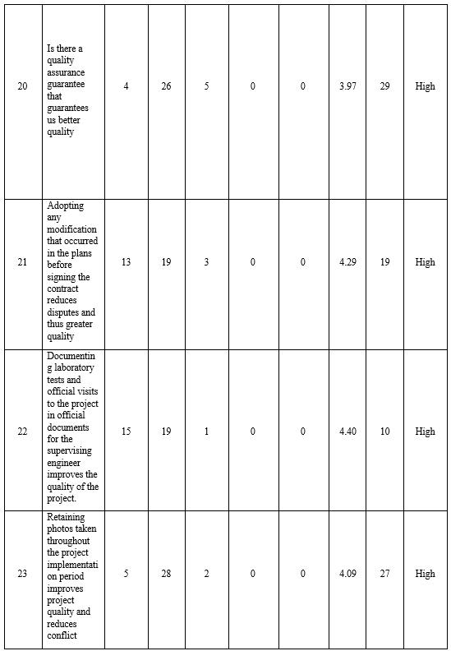

Slide 29
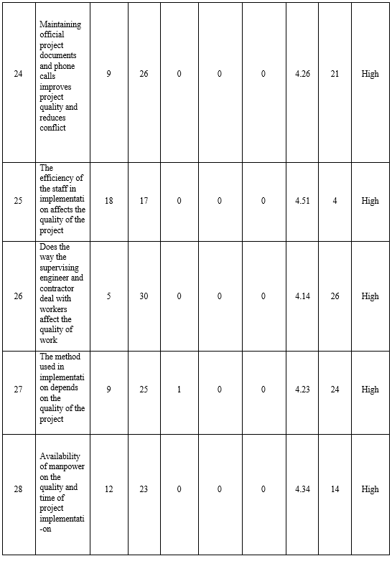

Slide 30
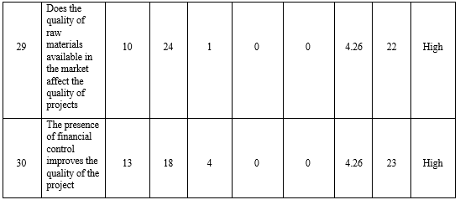

Slide 31
Results Analysis
Based to the results which were presented in the previous tables considering the ranking of each factors the following points can be concluded.
In the first rank came the factor No.17: Does continuous monitoring of the completed work and test reports from laboratories contribute to improving the quality of the project with an average of 4.54 and a standard deviation of 56.1% with a relative importance indix of 91%.
The factor No.12 came in second rank: Do clear decisions by the contractor and the supervising engineer affect the work, with an average of 4.54 and a standard deviation of 61.1% and a level of relative importance of 91%.
In the third rank came the factor No.4: The presence of professional and skilled workers is important in order to complete the work within the specified time with an average of 4.51 and a standard deviation of 53% with a level of relative importance of 90%.

Slide 32
Results Analysis
And in the last three ranks:
In the 28th rank, the factor No.8: Does the location of the street (main, secondary, or near a main street) affect the speed and quality of work completion with an average of 4.06, and a standard deviation of 96.8%, with a level of relative importance of 81%.
The factor No.20 came in 29th rank. Is there a quality assurance guarantee that guarantees us better quality, with an average of 3.97 and a standard deviation of 51.4%, with a level of relative importance of 79%.
while the factor No.9 came in the 30th rank, Does the difference in specifications affect the work with an average of 3.74 and a standard deviation of 74.1% with a level of relative importance of 75%.

Slide 33
Recommendation
Develop overall management system.
Choosing the most efficient contractor, not the lowest price.
The availability of qualified, experienced, and efficient site staff (both supervision and contractor).
Detailed and comprehensive site investigation should be done during the design phase.
It is recommended to do design-review checking to ensure that everything is accurate and consistent.

Slide 34
Recommendation
Implementing an eﬀective quality control and assurance systems during the construction process.
Contract documents should be clear, concise, and contain quantitative descriptions.
It is recommended for large municipalities to have effective coordination between the departments responsible for infrastructure and road projects to ensure infrastructure works.

Slide 35


