Slide 1
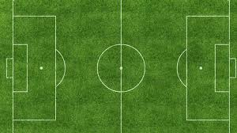
Soccer Robot
Prepared by
Ayman Ghaneem
Ameen Odah
Supervisor
Dr.Aladdin Masri
Dr.Hanal Abu-Zant

Slide 2
Outline
What is soccer robot.
Overview.
Motivation.
Components.
Methodology.
Constraints.
Future Work.
Demo

Slide 3
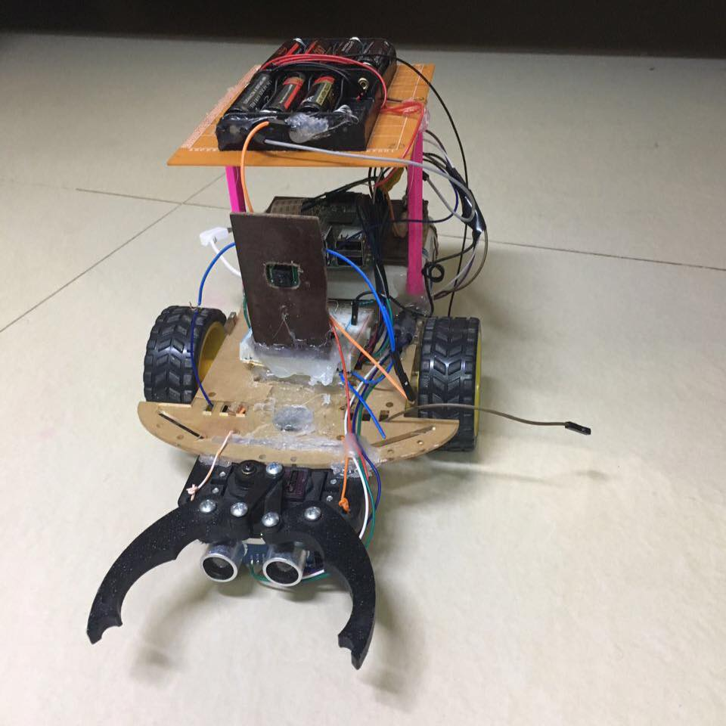
What is Soccer Robot
Soccer robot is a vehicle that analyze its playground then detect ball and catch it , move it to The goal.

Slide 4
Overview
The project consists of two main parts:
Image processing using Raspberry Pi 3 microcontroller and Raspberry Pi camera module.
Controlling robotic car movement and sensors operation using Raspberry Pi 3 microcontroller.

Slide 5
Motivation
Entertainer

Slide 6
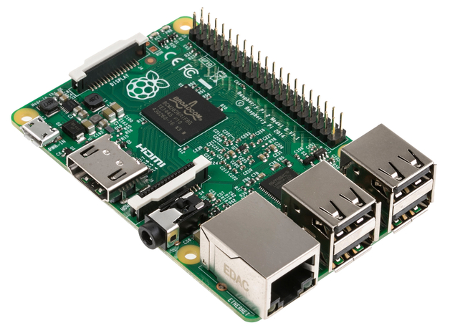
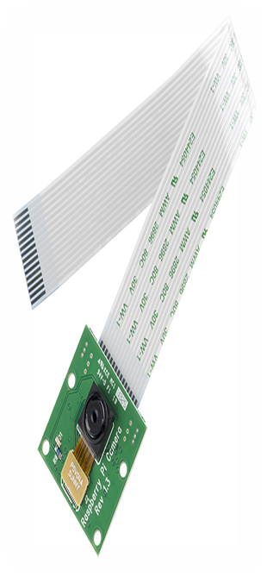
Components

Slide 7
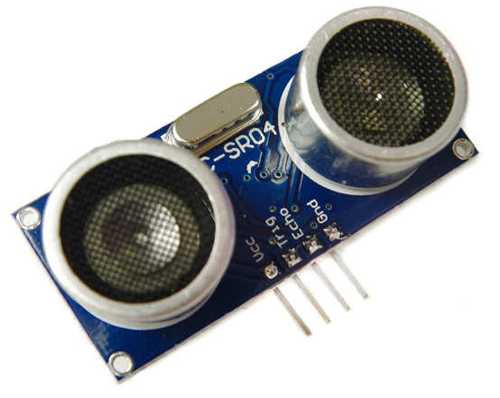
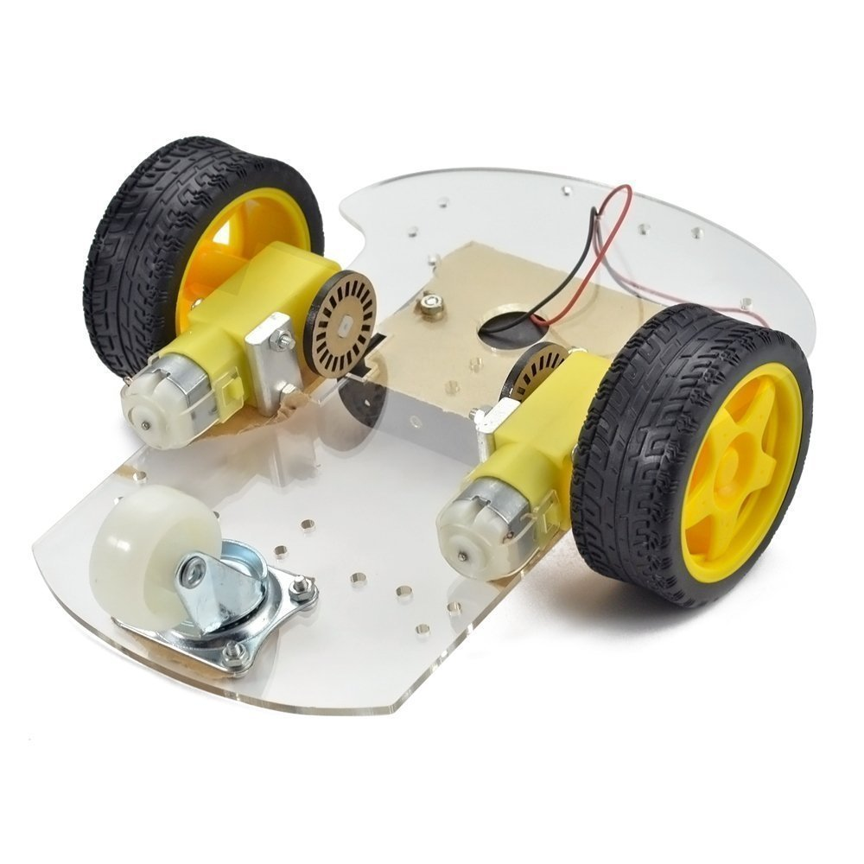
Components

Slide 8
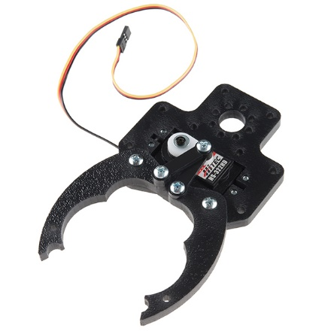
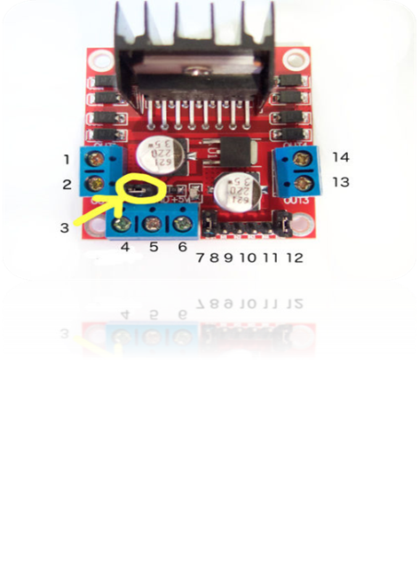
Components

Slide 9
Methodology
Project main parts:
Ball detection using Image Processing.
Destination (goal )detection using Image Processing.
Car movement using Raspberry Pi 3.

Slide 10
Ball Detection
We use Raspberry Pi 3 kit and camera module.
Use Open CV 3 python library for Image Processing .
Ball and Goal Detection based on color and shape.

Slide 11
Flow Chart

Slide 12
Constraints
Unstable Robotic car movement.
Raspberry Pi power supply.
Bad Luck

Slide 13
Future Work
Implement more reliable and accurate Image Processing Algorithm.
Use another robotic car

Slide 14
DEMO

Slide 15
Thank You

