Slide 1

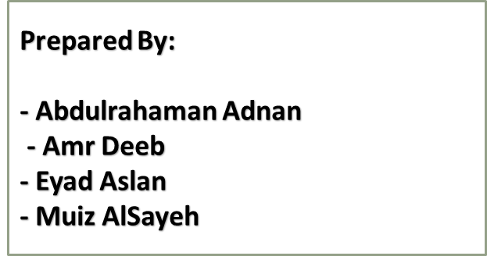
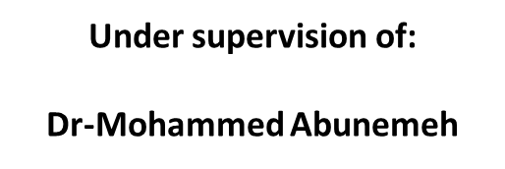
Construction Site Safety

Slide 2
Outline
Introduction.
Statement of problem.
Research question.
Research objective.
Significant of study.
Safety management.
Research methodology.
Data Analysis.
Mobile Safety Application.
Conclusion & Recommendations.

Slide 3

Introduction
WHAT IS SAFETY ?
Safety is the Control of Recognized Hazards to attain an Acceptable Level of Risk.

Slide 4
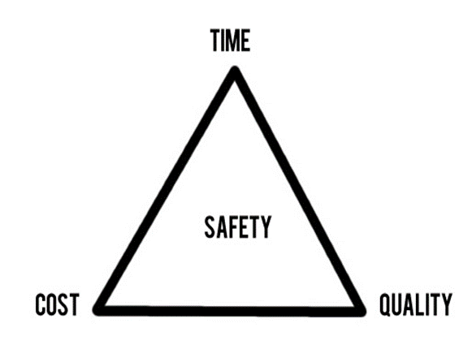
Introduction
The construction industry has accomplished extensive growth worldwide particularly in the past few decades. Construction starts with planning, design, and continues until the project is built and ready for use.
Construction projects are facing significant challenges that are related to safety, cost, time, and quality. The safety issues are to be considered right from the design stage till the completion and handing over of the structure. The construction industry employs, skilled or unskilled, are subject to construction site accidents and health risks.

Slide 5
Statement of Problem
Construction works includes many hazardous tasks and conditions such as working with height, excavation, noise, dust, power tools and equipment.
Failures in hazard identification are often due to limited or improper and no training and supervision of workers.
Most common
accidents
Overexertion
Falling debris, materials or objects
Slips and falls

Slide 6

Research Question
Can we really be safe in construction sites?
What are the most hazards occur in construction sites and lead to fatal accidents?
How the safety engineer implement safety management process in a construction site?
How can technologies help in improving our safety standards?

Slide 7

Objectives
Identify the most significant hazards that frequently occur on the construction site.
Investigate the current procedure adopted by contracting companies related to safety management.
Identify the most common items where the hazard occurs frequently.
Enhancing the safety management process followed in construction projects through developing mobile apps.

Slide 8
Significance of The Study
Since the safety plays an important role in consuming cost, consuming time, improving the quality of the projects in general and develop the productivity of labor, the findings of this study will be redounded to the benefit of the construction projects.
Safety
Time
Cost
Quality

Slide 9
Owner
Reducing the time of the project.
Prevent financial losses
Contractor
Reduce the costs.
Reduce the time.
Labor
Improve the reputation.
Technical evaluation.
Improve the productivity rate.

Slide 10

Safety management.
Safety management is managing business activities and applying principles, framework, processes to help prevent accidents, injuries and to minimize other risk.

Slide 11
Methodology
Objectives
Questionnaire
Data
Analysis
Literature
Review
Identify the most significant hazards.
Previous Studies
Related Work
Safety in construction sites
Safety Management
General Information.
Common accidents in construction sites.
Collecting Required data and information
Analyze data
Determine the most important actions
Investigate the current related to safety management.
Identify the most common items where the hazard occurs frequently.
Enhancing the safety through developing mobile apps.
Current implementation of OSHA standards in West Bank.
The most hazardous items.
The effect of safety on delays and costs.

Slide 12
Questionnaire parts
General information
Common accidents in construction sites
Current implementation of OSHA standards in West Bank
The most hazardous items
The effect of safety on delays and costs

Slide 13

Pilot-tested Questionnaire.
Two experts in construction have been met in order to detect any errors, modify the questionnaire and avoid misunderstanding among respondents. The appropriate adjustments have been made to get the final version of the questionnaire.

Slide 14
Data Analysis
The questionnaire has been analyzed according to collect information from the expert’s engineers and contractor companies.
Fifty questionnaires has been distributed. The questionnaire has been distributed over the period from 20th of March 2018 up to 15th of April 2018 within the northern region of West Bank.
The city. | A number of copies were distributed. | The percent.
Nablus | 27 | 54%
Jenin | 15 | 30%
Tulkarem | 5 | 10%
Qalqilia | 3 | 6%

Slide 15
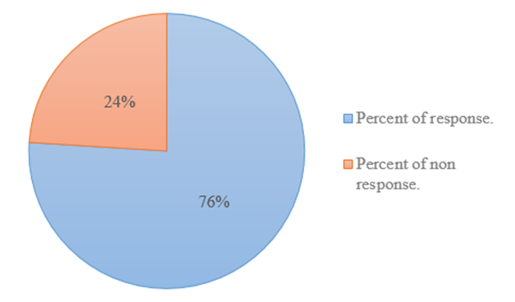
Respondents
38 out of 50 responded to the questionnaire

Slide 16
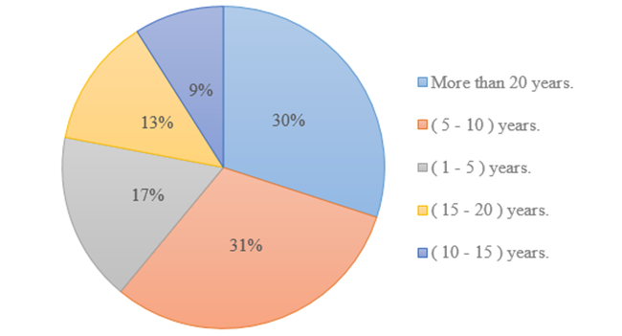
Level of Experience
The respondents were asked to identify their level of experience through selecting the number of the years depending on their experiences in constructions.

Slide 17
Construction site accidents
The most common accidents that occur in construction sites in the West Bank
Falling debris, materials or objects
Overexertion
Slips and falls
Machinery accidents
Getting hit by a vehicle

Slide 18
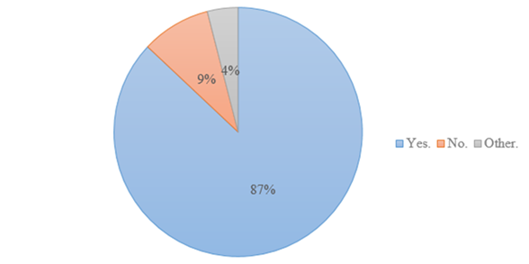
Applicability of safety requirement
The majority of companies apply the minimum safety requirements (87%)

Slide 19
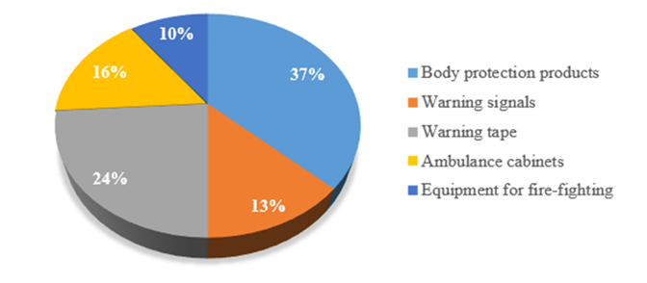
The use of safety tools in construction site

Slide 20
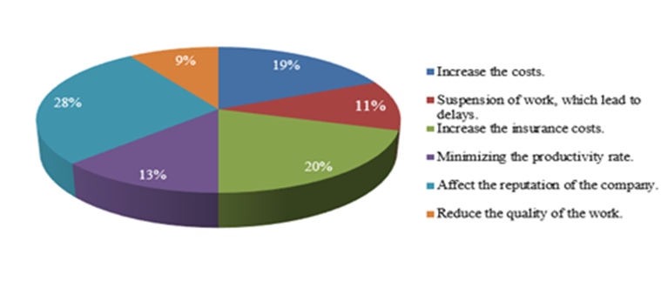
The effect of accidents on the project

Slide 21
The most hazardous activities
Carpentry work
Excavation work
Masonry work
Frame roof
Electrical work

Slide 22
The effect of applying safety rules
Reputation of company
Clarify the responsibilities in the construction site
Minimize the injuries in the construction site
Defining the acceptable and unacceptable behavior in the workplace
Rise labors morale

Slide 23


Mobile Safety Application

Slide 24


Slide 25


Slide 26
Conclusion
Most common accidents
Application
The main reasons

Slide 27
Recommendations
Hold training sessions for contractors and labors.
Hold courses about OSHA and safety procedures for contractors and labors in order to increase their safety culture.
Introduce the application as a tool for safety and its effect on minimizing the accidents which may occur in construction site.
Increase the amount of money paid for safety in construction site.
Defining the acceptable and unacceptable behavior in the workplace.
Clarify the responsibilities in the construction site.

Slide 28


